Slide 1

Ph.D. Thesis Defense
Algebraic Shortest Path Algorithms
By
I-Lin Wang
Apr 29, 2008

Slide 2
Shortest Path Problem/Algorithm
SP
Single Source Shortest Path (SSSP)
  Nonnegative Arc Cost (LS)
  General Arc Cost (LC)
All Pairs Shortest Paths (APSP)
  Combinatorial Type Algorithms (repeated SSSP)
  Algebraic Type Algorithms (FW)
  LP Type Algorithms (Network simplex)
Multiple Pairs Shortest Paths (MPSP)
MPSP problems with fixed topology & OD pairs
0
 | 0
 |  | 0
 |  |  | 0
 |  |  |  | 0
0
 | 0
 |  | 0
 |  |  | 0
 |  |  |  | 0
0
 | 0
 |  | 0
 |  |  | 0
 |  |  |  | 0
0
 | 0
 |  | 0
 |  |  | 0
 |  |  |  | 0
0
 | 0
 |  | 0
 |  |  | 0
 |  |  |  | 0
Notes:
1-ALL:
Nonnegative Arc Cost
Label Setting (Dijkstra: heap/bucket..etc)
Label Correcting (Bellman-Ford, Pape-Levit, Goldberg-Radzik..etc)
General Arc Cost
Acyclic : Topological Ordering
Nonacyclic : Label Correcting
ALL-ALL:
Combinatorial Type Algorithms
Apply n times of Label Setting/Correcting Algorithm
Algebraic Type Algorithms
Floyd-Warshall , Carré , Wang
Other: matrix multiplication, decomposition..etc
SOME-SOME:
Very common in practice
Need ALL-ALL to get SOME-SOME ??
Extreme cases: “matching” pairs

Slide 3
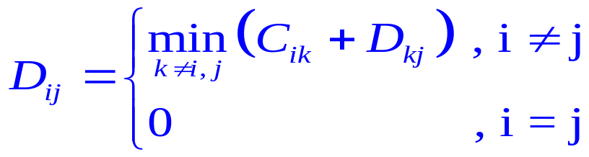
Path Algebra
Problem: Given a measure matrix C
  NO (1)multiple arcs, (2)loops (C_{ii}=0), (3)negative cycles
  C_{ij}=arc length of (i,j) if it exists , or ∞ o.w.
  What is the distance matrix D?
    D_{ij}=distance from i to j , or ∞ if i can’t reach j
Define path algebra
Original definition | a⊕b | a⊗b | e | 0(Null)
Path algebra | min{a,b} | a+b | 0 | ∞
D = C ⊗D ⊕ I_{n}
D_{ij}
i
k
j
Notes:
Note that there is no multiplication/division operation on Path Algebra.

Slide 4
ALL-ALL SP Algorithm
SP
Solving D = C ⊗D ⊕ I_{n} is like solving system of linear equations , or, computing C⁻¹
Jacobi : Bellman-Ford O(n²m)
Gauss-Seidel : Ford-Fulkerson
Gauss-Jordan : Floyd-Warshall Algorithm O(n³)
Gauss : O(n³) : Carré , DLU
  LU factorization (once)
  forward elimination (for each node)
  backward substitution (for each node)
  Same # iterations as Floyd-Warshall, but can decompose to solve some-some shortest path problem
Notes:
In the operation of the Path Algebra, we only do addition and comparison (i.e. NO multiplication/division).
Therefore, there is no “stability” concern caused by “rounding error” as we might see when applying the iterative method to solve linear system of equation.
The same argument applies for solving the shortest distance matrix by the direct methods such as Gauss-Jordan, or Gauss elimination. Therefore, in the process of the direct methods, we only care about the pivoting order that could reduce # of fill-in.

Slide 5
Floyd-Warshall Algorithm
Idea: update C_{ij} by min{C_{ij}, C_{ik}+C_{kj}} where k≠i, j
(triple comparison)
i
k
j
0
0
0
0
0
X
0
0
0
0
0
X
0
0
0
0
0
0
0
0
0
0
0
0
0
0
X
0
Total # triple comparison = n(n-1)(n-2)
It is O(n³) → not good for sparse graph.
Note:
  In the beginning of the last iteration, we already got optimal solution
for [n]-ALL and ALL-[n]
Q={(1,4),(2,3),(5,2)}

Slide 6
Carré’s Algorithm
Input: j
Output: shortest path and shortest d_{i}stance for any (k,j) pair,
where k≠j
Algorithm Carré(j)
begin
Initialize: d(i,j)=C_{ij}; succ(i,j)=j ∀ (i,j)
if (i,j) does not exist then d(i,j)=∞ , but d(i,i)=0 ∀ i
LU();
for each sink node j do
begin
Forward(j);
Backward(j);
end
end
Notes:
Carré’s algorithm was originally designed for solving the ALL-ALL SP problem.
However, I found it can be decomposed by the sink/source node j.
Thus unlike the Floyd-Warshall algorithm which you could not get 1-ALL(or ALL-1) shortest path until the last 2nd iteration, Carré’s algorithm could take advantage of this decomposability to solve SOME-ALL SP problem.
Even better, I found out we can “truncate” the operation of the SOME-ALL process to get a SOME-SOME process. (That’s the Sparse-LU algorithm that I will present later)

Slide 7
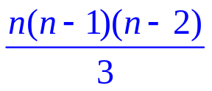
LU() Procedure
Idea: update C_{ij} by min{C_{ij}, C_{ik}+C_{kj}} where k<i, k<j
i.e. using 1~(n-1) as intermediate nodes to update the remaining submatrix
for the k that minimizes above, update succ(i,j)=succ(i,k)
0
 | 0
 |  | 0
 |  |  | 0
 |  |  |  | 0
0
 | 0
 |  | 0
 |  |  | 0
 |  |  |  | 0
0
 | 0
 |  | 0
 |  |  | 0
 |  |  |  | 0
0
 | 0
 |  | 0
 |  |  | 0
 |  |  |  | 0
Total # comparison = (n-1)(n-2) + (n-2)(n-3) +…+ 2*1 =
It is O(n³) → not good, but may use some heuristic to minimize fill-in
About 1/3 of total operations
Notes:
Light green cells are the entries being updated in that iteration.
Dark green cells represent “optimal cells” which means they are already shortest and won’t be updated anymore.

Slide 8
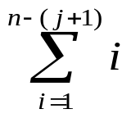
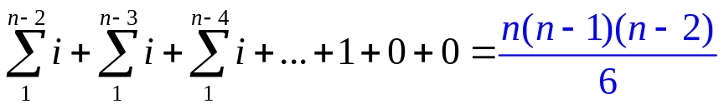
FORWARD (j) Procedure
Idea: update X_{i} by min{C_{ij}, C_{ik}+X_{k}} where j<k<i, j<i
e.g..: ALL-[1]
X_{i} : shortest distance from i to j so far
0
0
∞
∞
∞
∞
0
X₂= C₂₁
0
X₃= Min{C₃₁, C₃₂+X₂}
0
X₄= Min{C₄₁, C₄₂+X₂, C₄₃+X₃}
0
X₅= Min{C₅₁, C₅₂+X₂,C₅₃+X₃, C₅₄+X₄} opt!
#comparison for j =
Total # comparison for j:1~n =
About 1/6 of total operations
Notes:
After LU(), the entry (n-1,n) & (n,n-1) are already shortest. In this 5-node example to find ALL-[1] shortest path, that means, after LU(), we get shortest distance from node 5 to node 4. The FORWARD(1) process is to gradually update the distance label from node k with higher index (k>1) to sink 1 using only the arcs from higher node to lower node.
Therefore, after FORWARD(j) the last entry in the right-hand-side (r.h.s.) is dark green because that entries has been updated using all the other nodes as intermediate node in triple comparison.
The light green cells are the entries going to be used to update the r.h.s.

Slide 9

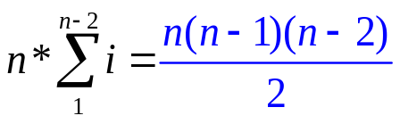
BACKWARD (j) Procedure
Step [1] : update X_{i}=min{X_{i},C_{ik}+X_{k}} for k>j, i>j
Step [2] : update X_{i}=min{X_{i},C_{ik}+X_{k}} for k≠j, i<j
( Note: for Step[2] , X_{i}=∞, X_{j}=0 initially, thus we can skip 1 comparison )
e.g.: ALL-[3]
X_{i} : shortest distance from i to j so far
0 |  |  | [2]
 | 0
 |  | 0
 |  |  | 0 | [1]
 |  |  |  | 0
∞
∞
0
X₄
X₅
X₁= Min{C₁₅+X₅, C₁₄+X₄, C₁₃+0, C₁₂+X₂}
X₂= Min{C₂₅+X₅,C₂₄+X₄,C₂₃+0}
X₄= Min{X₄ , C₄₅+X₅}
X₅ opt in FORWARD(j) already
#comparison for j = Total # comparison for j=1~n =
About 1/2 of total operations
Notes:
After FORWARD(j), the last entry in the r.h.s., is already the shortest (i.e. represents the shortest distance from n to j)
The BACKWARD(j) process is to gradually update the distance label from node k with higher index (k>j) to sink j using only the arcs from lower node to higher node.
Therefore, starting for the last 2nd entry in the r.h.s., we gradually obtain the shortest distance to j. This explains why I can “truncate” the process if I only want to know the shortest distance between any node k to sink j.
Since we assume no “loop” and no negative cycle, we can skip the jth entry of r.h.s.. To detect a negative cycle is also easy—once we find the jth entry is negative, it means we get a negative cycle.
The light green cells are the entries going to be used to update the r.h.s.

Slide 10



Illustration of Carré’s Algorithm
LU()
0
0
0
0
Forward()
0
0
0
0
0
0
0
0
Backward()
0
0
0
0
0
0
0
0
0
0
0
∞
0
∞
0
∞
0
∞
0
∞
0
0
0
∞
0
∞
0
∞
0
∞
0
∞
0
0
0
∞
0
∞
0
∞
0
∞
0
∞
0
0
0
∞
0
∞
0
∞
0
∞
0
∞
0
0
0
0
0
∞
0
∞
0
∞
0
∞
0
X₂
0
0
0
∞
0
∞
0
∞
0
X₃
0
X₃
0
0
0
∞
0
∞
0
X₄
0
X₄
0
X₄
0
0
0
∞
0
X₆
0
X₆
0
X₆
0
X₆
0
0
ALL-[1]
ALL-[2]
ALL-[3]
ALL-[4]
ALL-[5]
Notes:
Observation:
Process Backward() seems to be the bottleneck since it occupies about half of the total triple comparisons.
Therefore the computational loads on the 3 processes are “skewly” distributed. This inspires me to invent the Dense-LU algorithm which more evenly distributing the computational work into 3 processes.

Slide 11
Carré’s Algorithm
SP
LU()
0
0
0
0
Forward()
0
0
0
0
0
0
0
0
Backward()
0
0
0
0
0
0
0
0
0
0
0
∞
0
∞
0
∞
0
∞
0
∞
0
0
0
∞
0
∞
0
∞
0
∞
0
∞
0
0
0
∞
0
∞
0
∞
0
∞
0
∞
0
0
0
∞
0
∞
0
∞
0
∞
0
∞
0
0
0
0
0
∞
0
∞
0
∞
0
∞
0
X₂
0
0
0
∞
0
∞
0
∞
0
X₃
0
X₃
0
0
0
∞
0
∞
0
X₄
0
X₄
0
X₄
0
0
0
∞
0
X₆
0
X₆
0
X₆
0
X₆
0
0
ALL-[1]
ALL-[2]
ALL-[3]
ALL-[4]
ALL-[5]
(5,2)
(2,3)
(1,4)
Notes:
Observation:
Process Backward() seems to be the bottleneck since it occupies about half of the total triple comparisons.
Therefore the computational loads on the 3 processes are “skewly” distributed. This inspires me to invent the Dense-LU algorithm which more evenly distributing the computational work into 3 processes.

Slide 12
Floyd-Warshall vs. Carré
Example: a 4-node complete graph
Floyd-Warshall
213 214 312 314 412 413 | 123 124 321 324 421 423 | 132 134 231 234 431 432 | 142 143 241 243 341 342
Carré
LU factorization (1/3) | 213 324 214 423 312 314 412 413
Forward elimination (1/6) | 321 421 431 | 432
Backward substitution (1/2) | 341 231 241 | 342 132 142 | 243 123 143 | 234 124 134
Total # comparison = n(n-1)(n-2)
same complexity as
Floyd-Warshall , but fewer storage
Notes:
With the same number of triple comparison but different orderings, both Floyd-Warshall and Carré’s Algorithm converge to optimality in getting ALL-ALL shortest paths.
Comments about Carré’s Algorithm
Good:
Total #operation is the same as Floyd-Warshall’s algorithm in the worst case for ALL-ALL cases
Fewer storage requirement (only need to store LU nontrivial entries)
For SOME-SOME cases, can skip some unwanted operation
Bad:
Bad theoretical complexity : O(n³)
Using Code Generation may make the codes too long to be compiled. Even if storing the triples only, it may still need some storage.
Efficient sparse implementation is desired. (i.e. Alg. Sparse-LU)

Slide 13
Sparse Implementation
Algebraic algorithms are good for dense graphs
Maintain Sparsity: Good Ordering
  Minimize fill-in by Markowitz’s rule (static, dynamic)
    Pre-sorted by (in_degree * out_degree)
    Good tie-breaking strategy is required
  Try to make fill-in closer to the diagonal
  Call state-of-the-art sparse matrix reordering routines
    METIS (a package based on the multilevel graph partitioning scheme by a research group in C.S dept of U. Minnesota)
Sparse Implementation Methods: (for fixed network topology)
  Code Generation
  Acyclic operations on Augmented Graph (Alg. Sparse-LU)
Notes:
Sparsity ordering:
There are many sparsity ordering algorithms developed by many researchers in these 4decades.
e.g. Markowitz, Duff, Erisman, Reid, George, Ng, Gilbert …etc.
Markowitz’s rule:
Developed in 1957, a very effective local ordering technique
Minimum degree ordering (MMD):
Similar to Markowitz’s rule, but only for symmetric matrix. I found out many people instead of using Markowitz’s rule to do the ordering on the unsymmetric case (say, to solve Ax=b, where A is unsymmetric) , they tend to use MMD on A’Ax=A’b. (it was shown by George 7 Ng that the L&U nonzero structure is contained in the Lc+Lc’ nonzero structure, where Lc is the lower triangle of Cholesky factorization on A’A.
Approximate minimum degree ordering (AMD, by Davis, Gilbert, Larimore, and Ng; 2000)
Dissection:
One-way dissection (George; 1980)
Nested dissection (George; 1973), a global ordering technique in the sense that decisoins made at the very first stage take the entire matrix into account
Multilevel nested dissection (used in METIS package, developed by a research group in CS dept, U. Minnesota)

Slide 14
Code Generation
Write a code to generate codes which only contains necessary operations of Carré’s Algorithm
Good:
  Only contains necessary operations, thus efficient
Bad:
    e.g. a 1025 nodes 6464 arcs graph using dynamic Markowitz rule
    #LU: 410,415 #FOR: 331,510 #BACK: 24,883,979
    If do code generation on all LU/FOR/BACK: 500MB!
    If only generate triple index on all LU/FOR/BACK: 200MB!
Algorithm Sparse-LU:
    If store LU triples, but do acyclic operations on FOR/BACK: 5MB!
    If do sparse LU operation and acyclic operations on FOR/BACK: 0!
Notes:
The japanese researchers in 1978 used code generation to solve ALL-ALL SP problem. The biggest case they have tried only contain 100 nodes, 180 arcs.
From the example, we see that most of the computational work spent on FORWARD/BACKWARD operations. It’s not necessarily that BACKWARD process will always be longer. (for example, an acyclic graph using dynamic Markowitz rule will end up with all the nonzeros in the L part.)
Observing the FORWARD/BACKWARD operations basically are 2 acyclic processes in 2 subgraphs (L,U), we can use the graphical algorithm to solve it thus saving much of the space needed for code generation in these 2 processes.
The sparse LU operation will be difficult. If we really want to implement it by linked list, we will spend much time searching for arcs. To save some time, right now I sacrifice some storage by storing a n² Arc_Status matrix which only takes O(1) to check whether arc(i,j) exists or not. This idea may be ok for cases with reasonable size.

Slide 15
Algorithm Sparse-LU (I)
Input: i,j
Output: shortest path and shortest distance for any (k,j) pair,
where k≥i, k≠j
An efficient sparse implementation of Carré’s Algorithm
Algorithm Sparse-LU(i,j)
begin
Initialize: d(i,j)=C_{ij}; succ(i,j)=j ∀ (i,j)
if (i,j) does not exist then d(i,j)=∞ , but d(i,i)=0 ∀ i
Sparse_LU(); Construct Augmented Graph
Forward(j);
Backward(i,j);
end
Notes:
Sparse_LU
Use forward/backward star data struct, need to store a O(n²) Arc_Status matrix
Complexity: O(∑_{j}fo(j)*bi(j))
Only a little slower than Code Generation, but save much space

Slide 16
Algorithm Sparse-LU (II)
0
Augmented Graph:
  Graph obtained by LU() operations
e.g. ALL-[3]
fi[i]
fo[i]
0
bi[i]
0
bo[i]
i
0
0
3
Artificial arc
C_{ij} [succ(i,j)]
3
1
4 [1]
9 [2]
7 [3]
6
3
8
1
1
3
7
5
1
1
2
2
1
1
7
2
6 [2]
X_{i}
X_{j}
1
2
3
4
5
C_{ij}
Original arc
4
i
j
2
8
3
2
6
Augmented Graph
4 [1]
7 [3]
3
8
0
6 [2]
2
Node i | 3 | 4 | 5
X_{i} | 0 | 6 | 6
succ(i) | - | 2 | 3
Node i | 1 | 2 | 4 | 5
X_{i} | 3 | 4 | 6 | 6
succ(i) | 3 | 1 | 2 | 3
3
4
5
0
6
6
1
2
3
4
5
6
Forward(3)
Backward(1,3)
Notes:
3 versions of Algorithm Sparse-LU: same LU operations, but different philosophy to do the FORWARD/BACKWARD operations
Sparse-LU1:
use bucket idea: n buckets, 1 for each node
Each node is either labeled or not. In FORWARD(j), starting from node j, scan all the arcs stored in arc list bi[i], update their head distance labels, put them into buckets corresponding to their index.
Repeat above step until the last node. (thus end the FORWARD(j) )
Starting from the last node, only scan nonempty buckets. For each such bucket i, scan all the arcs in arc list fi[i], update their head distance labels, then remove the node out of its bucket by marking it as unlabeled.
Repeat above step until the last labeled node is scanned. Done!!
Sparse-LU2:
Similar to Sparse-LU1, only differs in the way maintaining labeled nodes. Sparse-LU2 will use a min-heap in FORWARD(j). After FORWARD(j), we switch the min-heap to be a max-heap in BACKWARD(j). We have to identify the last labeled node first. Once we find it, we initiate the max-heap by the last labeled node.
The reason to use heap is to save some unnecessary work spent in scanning empty buckets in Sparse-LU1.
Sparse-LU3:
Almost the same as Sparse-LU2, except it maintains 2 heaps, one min-heap and one max-heap, at the same time in FORWARD(j). That is, in FORWARD(j), whenever we label a node, we put that node into both min-heap and max-heap. So, after FORWARD(j) is done, min-heap becomes empty and max-heap is already ready to start. Therefore, we save some time in identifying the last labeled node as in Sparse-LU2.
Computational Results:
Time(Sparse-LU1) < Time(Sparse-LU3) < Time(Sparse-LU2)

Slide 17
Comments on Algorithm Sparse-LU
Sparse implementation of Carré’s Algorithm
Input: node pair(i,j)
Output: shortest path/distance of node pairs(k,j), k ≥ i
In SOME-SOME case
  Truncated sparse version of Carré’s Algorithm
  Less work/storage than Floyd-Warshall’s algorithm
  May be better than applying |SOME| times of the combinatorial type algorithm (label-setting/correcting)
  OK for general arc cost case
Notes:
Data structure:
For FORWARD(j):
only need bi[i], an incoming arc list to node i from nodes with higher index. (bi means backward incoming)
For BACKWARD(j):
only need fi[i], an incoming arc list to node i from nodes with lower index. (fi means forward incoming)
For LU():
need fo[i], bi[i]. bi[i] is as explained above. fo[i] is an outgoing arc list from node i to nodes with higher index. (fo means forward outgoing)
To sacrifice some storage to save time in identifying an arc number in doing triple comparison, we may need a n² matrix Arc_Status[i,j], where its entry is 1 if (I,j) is either original or artificial, and 0 otherwise.

Slide 18
Key ideas of DLU
SP
Suppose h is the highest intermediate node in the shortest path from s to t
h<min{s,t} (Case 1) [LU]
min{s,t}<h<max{s,t} (Case 2) [Acyclic_L/U]
max{s,t}<h (Case 3) [Reverse_LU]

Slide 19
Algorithm DLU₁(Q)
SP
Get x*_{st} for OD pairs (s,t): s≥k₀ t≥j₀ or s≥i₀ t≥i₀
where i₀=min_{i} s_{i} , j₀=min_{i} t_{i} , k₀=min_{i} {max{s_{i},t_{i}}}
Algorithm DLU₁(Q={(s_{i},t_{i}),i=1,…,q})
begin
LU;
Acyclic_L( j₀ );
Acyclic_U( i₀ );
Reverse_LU( k₀ );
end
LU: construct Augmented Graph G’ (Case 1)
Acyclic_L(j₀): compute shortest path in G’_{L} (Case 2)
Acyclic_U(i₀): compute shortest path in G’_{U} (Case 2)
Reverse_LU(k₀): (Case 3)
Notes:
4 main steps:
LU(): same as before, ((n(n-1)(n-2))/3) triples
Acyclic_Forward(): same as Forward(j) for all j.
That is, use the subgraph in L, do (n-1) times topological ordering,
update L.((n(n-1)(n-2))/6) triples
Acyclic_Backward(): similar to the previous operation,
except that we do it in the subgraph of U. also ((n(n-1)(n-2))/6) triples
Reverse_LU(): similar as LU(), but using node n, n-1,..,2 as
intermediate node to update the remaining submatrix.
Just looks like doing LU in the reverse way. It has ((n(n-1)(n-2))/3) triples.

Slide 20
Operations of Algorithm DLU₁
SP
ALL-ALL
i₀=1, j₀=1 , k₀=2
0
0
0
0
LU
0
0
0
0
0
0
0
0
0
0
0
0
0
0
0
0
Acyclic_L
Acyclic_U
0
0
0
0
0
0
0
0
0
0
0
0
0
0
0
0
0
0
0
0
0
0
0
0
Reverse_LU
0
0
0
0
0
0
0
0
0
0
0
0
0
0
0
0
Notes:
Compare with Carré's and Floyd-Warshall’s algorithm :
In Carré's algorithm, the process Backward(j) does about half the work for dense case. Thus the workload is “skewed”.
Dense-LU algorithm more evenly splits the workload to the 4 processes.
This algorithm should behave worse than Carré's for Some-Some problems, but should still better than Floyd-Warshall's algorithm.
More Insights:
The process Acyclic_Forward() (or Acyclic_Backward()) can be viewed as a process of updating node distance label starting from the last node, along the subgraph L (or U), where all the arcs are pointing from node with higher (or lower) index to lower (or higher) index.
Since the 2 processes above are acyclic operations, the sparse implementation will be more efficient. Thus inspired me to invent the Sparse-LU algorithm.

Slide 21
Example of Algorithm DLU₁
SP
SOME-SOME
Q={(1,4),(2,3),(5,2)}
i₀=1, j₀=2
k₀=min {4,3,5}=3
0
X
0
X
0
X
0
X
0
X
0
X
0
0
0
0
0
0
Requested OD pair
X
0
X
0
X
0
X
(a) Procedure G_LU
Updated entries by G_LU
Updated entries by Acyclic_L
0
X
0
X
0
X
Updated entries by Acyclic_U
0
X
0
X
0
X
Updated entries by Reverse_LU
0
0
0
Optimal entries
0
0
0
X
0
X
0
X
0
(b) Procedure Acyclic_L(2) and Acyclic_U(1)
gen. cost, Neg. cycle
good for south-eastern ODs
sparcity min fill-ins tech. (Markowitz)
undirected / acyclic graph
Has computational dependency
Difficult tracing shortest path tracing
0
X
0
X
0
X
0
X
0
X
0
X
0
0
0
0
0
0
X
0
X
0
X
0
(c) Procedure Reverse_LU(3)
Notes:
Compare with Carré's and Floyd-Warshall’s algorithm :
In Carré's algorithm, the process Backward(j) does about half the work for dense case. Thus the workload is “skewed”.
Dense-LU algorithm more evenly splits the workload to the 4 processes.
This algorithm should behave worse than Carré's for Some-Some problems, but should still better than Floyd-Warshall's algorithm.
More Insights:
The process Acyclic_Forward() (or Acyclic_Backward()) can be viewed as a process of updating node distance label starting from the last node, along the subgraph L (or U), where all the arcs are pointing from node with higher (or lower) index to lower (or higher) index.
Since the 2 processes above are acyclic operations, the sparse implementation will be more efficient. Thus inspired me to invent the Sparse-LU algorithm.

Slide 22
Properties of Algorithm DLU₁
Good:
Efficient if only x*_{st} are requested
(if need to trace paths, set i₀=1)
Work for general arc costs, can detect any negative cycle
A good node ordering decreases fill-in arcs
  Preprocessing (Markowitz’s rule, MMD, MND..etc)
Save ½ storage/computation for undirected graphs.
Acyclic graphs: same as topological ordering
1
2
3
4
2
3
4
3
4
4
Bad:
Redundant work on unrequested OD pairs
Difficulty to trace shortest path

Slide 23
Algorithm DLU₂
SP
Algorithm DLU₂(Q={(s_{i},t_{i}),i=1,…,q})
begin
LU;
for i=1~q
Get_D(s_{i},t_{i});
if x*_{si,ti}≠∞ & need to trace path
Get_P(s_{i},t_{i});
end
Procedure Get_D(s_{i},t_{i})
begin
Get_D_L(t_{i});
Get_D_U(s_{i});
Min_add(s_{i},t_{i});
end
Procedure Get_P(s_{i},t_{i})
begin
let k:=succ_{si,ti}
while k≠t_{i} do
Get_D(k,t_{i});
let k:=succsi,ti
end
attacks requested OD pairs individually
fewer operations than DLU₁
easier to trace path

Slide 24
Example of Algorithm DLU₂
SP
SOME-SOME
Q={(1,4),(2,3),(5,2)}
0
X
0
X
0
X
0
X
0
X
0
X
Requested OD pair
0
0
0
X
0
0
0
Updated entries by G_LU
X
0
X
0
X
0
Updated entries by Get_D_L
(a) Procedure G_LU
Updated entries by Get_D_U
0
X
0
0
Updated entries by Min_add
0
0
X
0
0
0
0
0
0
0
0
0
X
0
Get_D(1,4)
Get_D(2,3)
Get_D(5,2)
(b) Procedure Get_D(s,t)
gen. cost, Neg. cycle
good for south-eastern ODs
sparcity min fill-ins tech. (Markowitz)
undirected / acyclic graph
NO computational dependency
EASY shortest path tracing
0
X
0
X
0
0
0
X
0
0
X
0
0
0
0
X
0
X
0
0
X
0
Get_P(1,4)
1→3→5→4
Get_P(2,3)
2→1→3
Get_P(5,2)
5→4→2
(c) Procedure Get_P(s,t)
Notes:
Compare with Carré's and Floyd-Warshall’s algorithm :
In Carré's algorithm, the process Backward(j) does about half the work for dense case. Thus the workload is “skewed”.
Dense-LU algorithm more evenly splits the workload to the 4 processes.
This algorithm should behave worse than Carré's for Some-Some problems, but should still better than Floyd-Warshall's algorithm.
More Insights:
The process Acyclic_Forward() (or Acyclic_Backward()) can be viewed as a process of updating node distance label starting from the last node, along the subgraph L (or U), where all the arcs are pointing from node with higher (or lower) index to lower (or higher) index.
Since the 2 processes above are acyclic operations, the sparse implementation will be more efficient. Thus inspired me to invent the Sparse-LU algorithm.

Slide 25
MPSP Computational Tests
SP
Preprocess: 8 pivot rules (MKZ(S,D),MMD,MND,…)
SLU_{1*}: sparse implementation of Carré’s Algorithm
  Code generation (e.g.: n=1000,m=6000,500MB->200MB->5MB->0MB!)
  bucket (SLU1) , 1 heap (SLU2) , 2 heaps (SLU3)
DLU_{2*}: sparse implementation of Algorithm DLU₂
  bucket (DLU21) , 1 heap (DLU22)
Compare with: (Cherkassky et al. 1996 Math.Program.)
gor1 , bfp , thresh , pape , two-q , dikh , dikbd , dikr , dikba
Test cases:
4 network generators: spgrid , sprand , netgen , spacyc
1 real Asia-Pacific flight network (AP-NET n=112, m=1038)
4 different % OD pairs (25%, 50%, 75%, 100%)

Slide 26
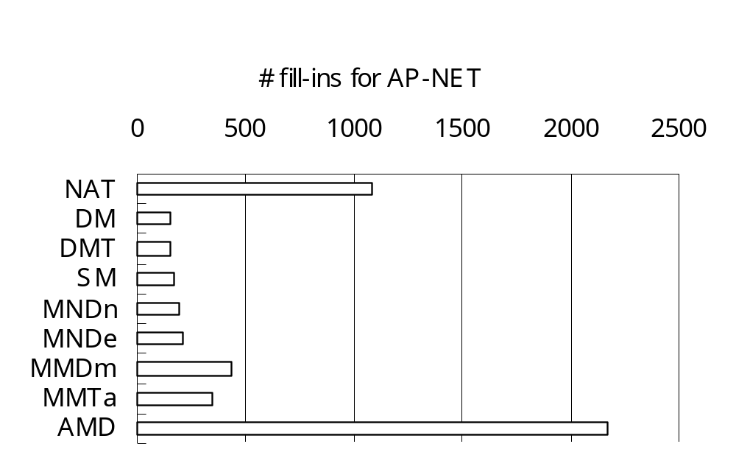
Preprocessing: Best Node Ordering Rule
SP
NAT: natural ordering
SM: Static Markowitz
DM: Dynamic Markowitz,
DMT: DM with tie breaking
NP-Complete
Usually DM, DMT or SM create fewer # of fill-ins

Slide 27
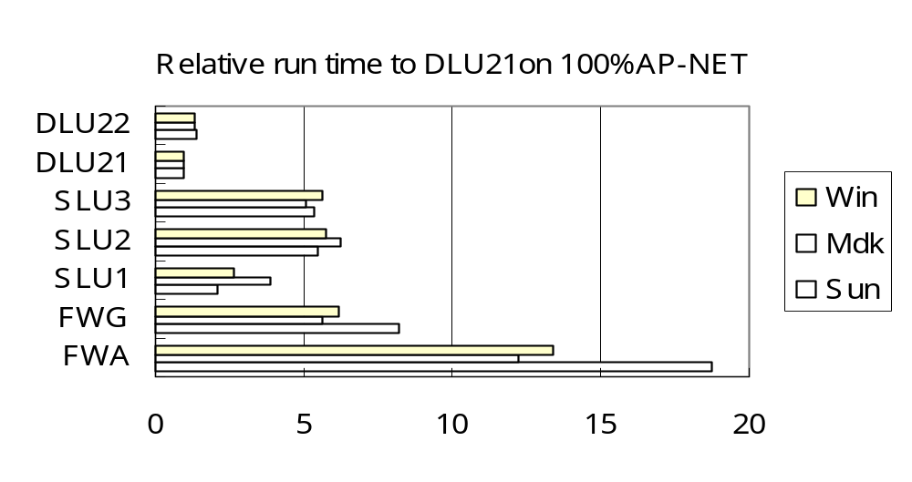
FW vs. SLU & DLU
SP
FWA: Algebraic Floyd-Warshall
FWG: Graphic Floyd-Warshall
DLU21 and SLU1 are the best implementations
DLU & SLU are always faster than FW

Slide 28
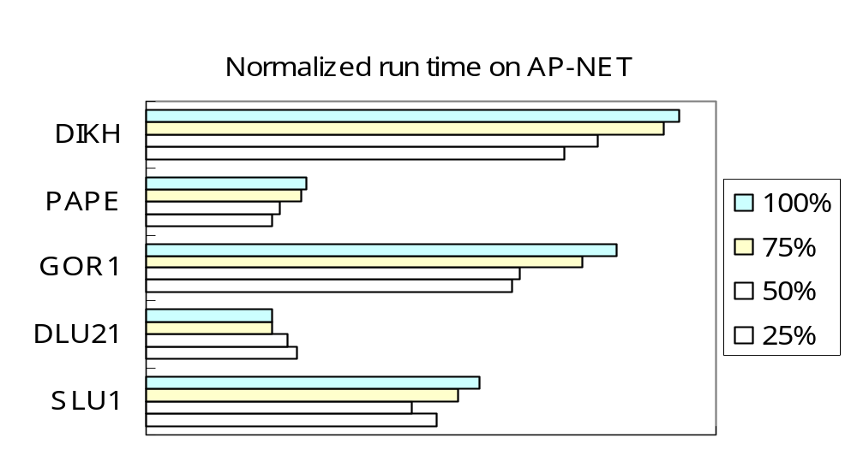
SLU & DLU vs. LC & LS (1)
SP
Label-Correcting (LC) algorithms: GOR1, PAPE
Label-Setting (LS) algorithms: DIKH
DLU21 performs relatively better for larger %

Slide 29
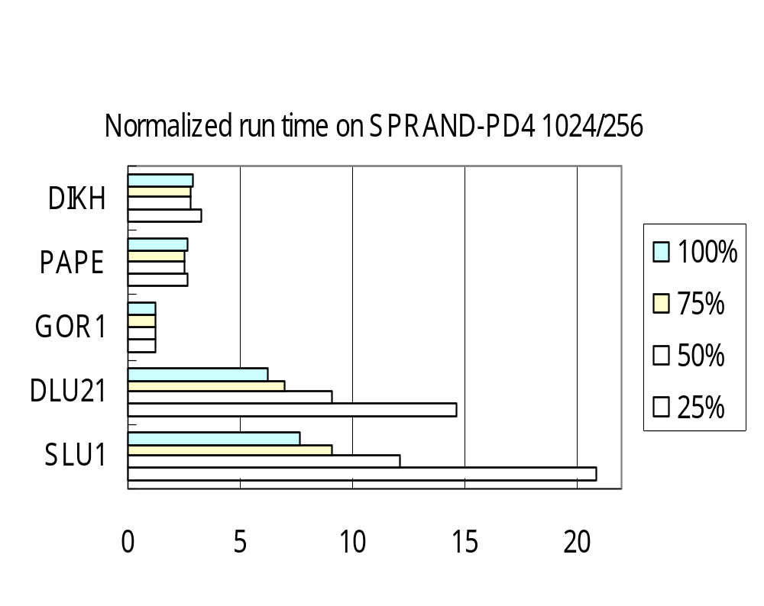
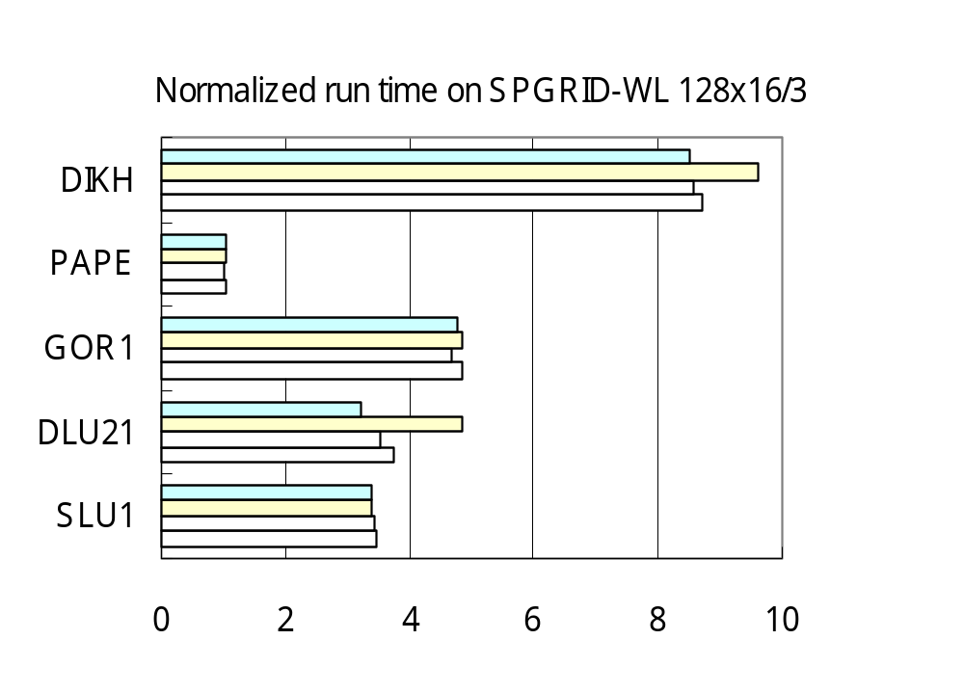
SLU & DLU vs. LC & LS (2)
SP
Label-Correcting (LC) algorithms: GOR1, PAPE
Label-Setting (LS) algorithms: DIKH
DLU & SLU performs relatively better for larger %

Slide 30
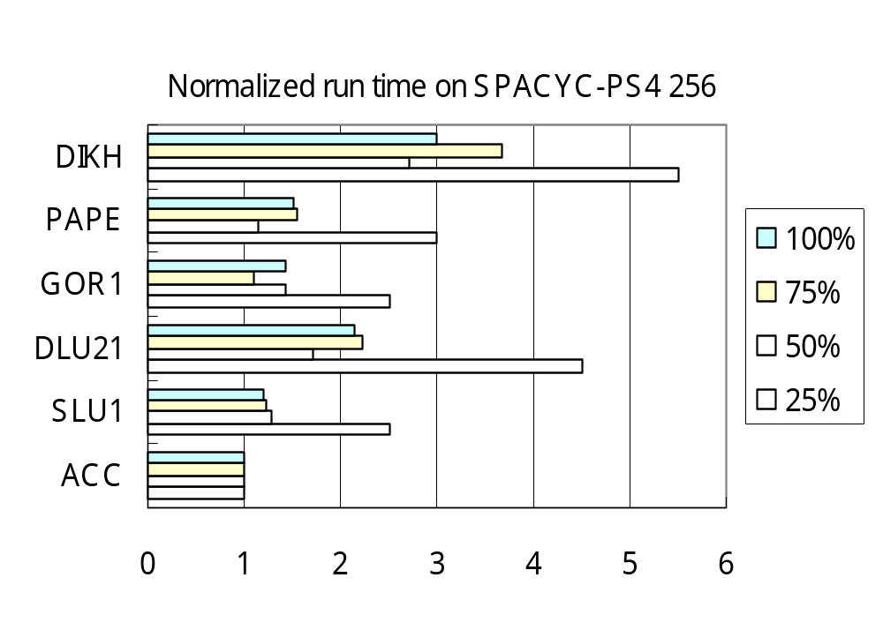
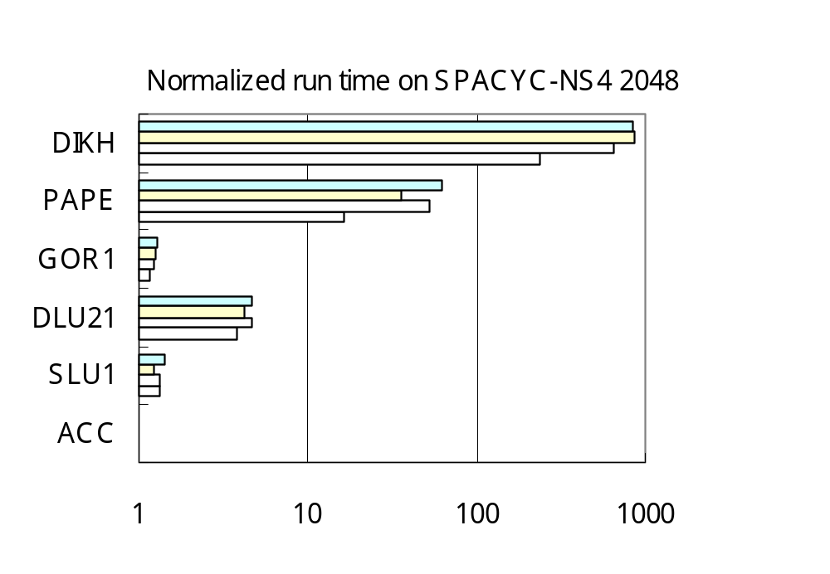
SLU & DLU vs. LC & LS (3)
SP
Topological ordering algorithm: ACC
Label-Correcting (LC) algorithms: GOR1, PAPE
Label-Setting (LS) algorithms: DIKH
DLU & SLU performs better for acyclic graphs

Slide 31
MPSP Results & Conclusion
SP
Computational Results:
  Depend on size, topology , node ordering , OD pairs
  In general not the best (diff Platform, OS, Compiler?)
  Markowitz’s rule usually gives better ordering
  Definitely much better than Floyd-Warshall Algorithm
Conclusion:
  Simple, efficient for SOM-SOME shortest paths
  ‘Ad hoc’ code, exploit graph properties (fixed topology & OD pairs)
  Theoretically suitable for dense graphs, better complexity than APSP algorithms
  Practically suitable for acyclic or undirected or logistics (AP-NET) networks with moderate size
  Need more storages (O(n²))
  Iterative methods (stability) vs. direct methods (sparsity)
Notes:
Data structure:
For FORWARD(j):
only need bi[i], an incoming arc list to node i from nodes with higher index. (bi means backward incoming)
For BACKWARD(j):
only need fi[i], an incoming arc list to node i from nodes with lower index. (fi means forward incoming)
For LU():
need fo[i], bi[i]. bi[i] is as explained above. fo[i] is an outgoing arc list from node i to nodes with higher index. (fo means forward outgoing)
To sacrifice some storage to save time in identifying an arc number in doing triple comparison, we may need a n² matrix Arc_Status[i,j], where its entry is 1 if (I,j) is either original or artificial, and 0 otherwise.

Slide 32
Thank you
Questions ?
Contact
  I-Lin Wang (王逸琳)
  ilin@isye.gatech.edu
  http://www.isye.gatech.edu/~ilin
  Industrial & System Engineering (ISyE)
  Georgia Institute of Technology (GA Tech)

