Slide 1
Solving the Maximum Flow Problem by Augmenting Flows on Subnetworks
指導教授：王逸琳 博士 。
李宇欣 博士 。
洪政煌 博士 。
黃耀廷 博士 。
學 生：李俊賢 。
日 期：2009/06/01 。
Notes:
Introduce max-flow problem

Slide 2
Outline
Introduction
Literature review
New maximum flow algorithms
  Proportional arc augmenting algorithm
  Flow splitting augmenting algorithm
  Modified LSDP algorithm
Computational experiments and analysis
Conclusions

Slide 3
Introduction

Slide 4
Motivation
Ideas of previous max-flow algorithms
  Send flow via single path
  Push flow from an active node to its neighbors
Our idea: augment flow along
admissible subnetworks
(subgraphs composed by all shortest paths)
S
T
Notes:
大部分求解max-flow問題的以算法可歸納為兩種：一種為在網路中找出一條path並根據這條path運送流量，另一種為不斷的從起點推送流量到終點。而張在2006提出一個新的最大流量演算法，其每次擴張流量時可根據一個子網路運送流量。由於每次找出一個子網路運送流量比單找出一條path直覺上可減少其運算次數，因此構成我的研究動機

Slide 5
Objective
Propose three poly-time max-flow algorithms
  Ship more flows via more spacious arcs
  ➔ PAA , O(n²m) time
  Distribute flows fairly to each outgoing arc
  ➔ FSA , O(nm²) time
  Nondegenrate pivoting, by Kirchhoff’s circuit laws
  ➔ MLSDP , O(nm⁴) time
Computational experiments

Slide 6
Maximum flow algorithms
      Network simplex methods
      Augmenting path methods
      Preflow push methods
      Scaling methods
      Maximum adjacency ordering methods
      Least-squares dual-primal method
Literature Review

Slide 7
Literature Review(1/6)
Network simplex methods
Fulkerson and Dantzig (1955)
  Network simplex method : O(n²mU)
Goldfarb and Hao (1990)
  Choose the arc closest to the source node : O(n²m)
Armstrong et al. (1998)
  Dual network simplex method : O(n³)
Notes:
由於max-flow可視為LP問題且為網路問題, 因此可用網路的simplex求解之.

Slide 8
Literature Review(2/6)
Augmenting path methods
Ford and Fulkerson (1956)
  Augmenting path : O(nmU)
Dinic (1970)
  Layered network : O(n²m)
  To be used in our proposed algorithms
Edmonds and Karp (1972)
  Shortest path：O(nm²)
Ahuja and Orlin (1991)
  Distance labels : O(n²m)
Notes:
Augmenting path概念：找一條path送，直到沒有為止
由於以此方法找尋時無法得到polynomial time bound
若找時根據最短路徑，則可以得到strongly polynomial time
Dinic：BFS

Slide 9
Literature Review(3/6)
Preflow push methods
Karzanov (1974)
  Preflow push on layered network : O(n³)
Goldberg and Tarjan (1986)
  Preflow push with distance labels : O(nmlog(n²/m))
Cerulli et al. (2008)
  Combine with augmenting path : O(n²m^{1/2})

Slide 10
Literature Review(4/6)
Scaling methods
Ahuja and Orlin (1989)
  Incorporated with preflow push : O(nm+n²logU)
Ahuja and Orlin (1991)
  Incorporated with distance labels : O(nmlogU)
Sedeño-Noda and González-Martín (2000)
  Two phase scaling method : O(nmlog(U/n))

Slide 11
Literature Review(5/6)
Maximum adjacency ordering methods
Fujishige (2003)
  MA ordering augmenting path : O(n(m+nlogn)lognU)
Fujishige and Isotani (2003)
  MA ordering with scaling phase : O(nmlogU)
Matsuoka and Fujishige (2005)
  MA ordering with preflows : O(n(m+nlogn)lognU)

Slide 12
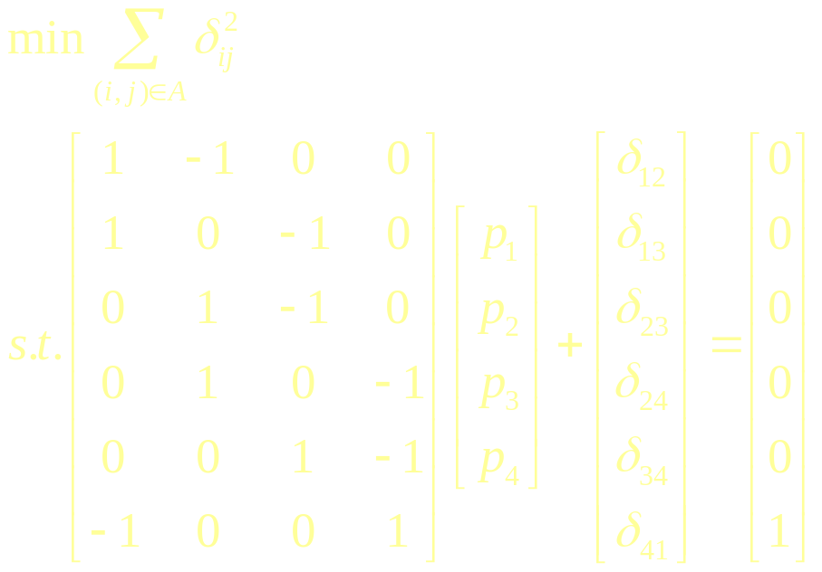
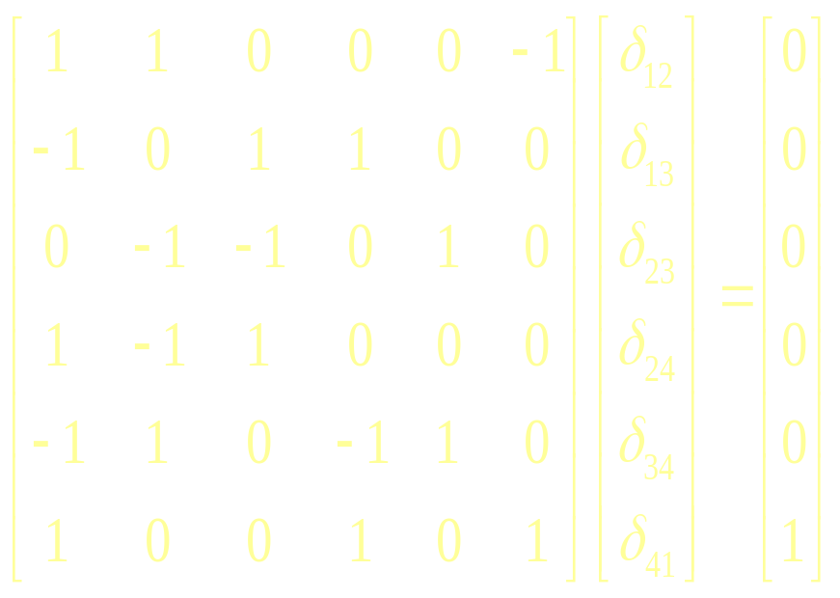
Literature Review(6/6)
Least-squares dual-primal method
Least-squares primal-dual
  Leichner et al. (1993)
    NNLS phase I
  Barnes et al. (2002)
    NNLS PD
  Gopalakrishnan et al. (2004)
    LSNF
  Wang (2004)
    LSNF for shortest path
Chang (2006)
  LSDP to solve maximum flow problem
    NNLS subproblem is solved by Kirchhoff’s laws (i.e. KCL, KVL)
NNLS subproblem
2
1
4
3

Slide 13
Definitions

Slide 14
Definitions
Distance label d(i)
  Minimum number of arcs from source to node i
Admissible arc (i,j)
  d(j) = d(i) + 1 and r_{ij} > 0
Residual network G(x)
  Residual capacity r_{ij}
    Unused capacity u_{ij} – x_{ij} on arc (i, j)
    Current flow x_{ij} on arc (j, i)
d(1)=1
1
u₁-x₁
u₂-x₂
u₁
u₃
d(s)=0
x₁
x₃
d(t)=2
x₁
x₂
S
T
x₃
x₄
u₂
x₂
u₄
u₃-x₃
x₄
u₄-x₄
2
d(2)=1
Notes:
當有一流量x流過後,由i->j還可繼續流過的空間為u-x,反向由j->i最多可流過x以抵銷該流量

Slide 15
Proportional Arc Augmenting (PAA) Algorithm
New Max-flow
Algorithms
A layered network
Proportional augmenting
j
At most n-1 layered networks
10×2/10
2
2
S
10
10×5/10
T
5
i
5
k
3
10×3/10
3
l

Slide 16
Proportional Arc Augmenting (PAA) Algorithm
Use BFS and distance labels to construct a layered network
Starting from node i = s based on a BFS order, calculateδ_{ij} for each admissible arc (i, j)
Calculate maximum step length θ
Augment flows by Δx =δ×θ
Saturate at least one node (and all of its outgoing arcs) after each augmenting iteration
Theoretical Complexity：O(n²m)
Notes:
簡單介紹PAA演算法,首先以BFS建立子網路,接著從起點計算各arc之改善方向,進一步找出可提升之最大比值theda來擴張流量,由於每次擴張流量後至少可滿足一點能流出之最大流量,進一步可證明PAA演算法之理論複雜度為O(n2m)

Slide 17
PAA Example(1/9)
(u, x)
i
j
S(2) = 8
d(2) = 1
S(4) = 9
d(2) = ∞
d(4) = 2
d(4) = ∞
(7,0)
2
4
(9,0)
(9,0)
S(1) = 15
d(1) = 0
d(1) = 0
S(6) = 0
d(6) = 3
(1,0)
d(6) = ∞
1
(2,0)
(5,0)
6
(2,0)
(6,0)
(17,0)
3
5
(6,0)
S(3) = 8
d(3) = 1
S(5) = 17
d(3) = ∞
d(5) = 2
d(5) = ∞

Slide 18
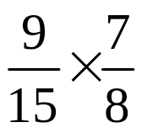


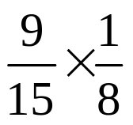
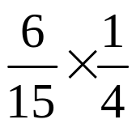


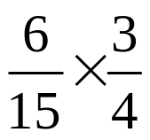
PAA Example(2/9)
Layered network 1
b(4) = 0
b(2) = 0
5/8
9/15
21/40
7
2
2
4
4
9
9
b(1) = 1
b(6) = 0
5/8
1
1
1
1
1
6
6
2
6
17
3
3
5
5
6
b(3) = 0
6/15
b(5) = 0
3/40
3/8

Slide 19


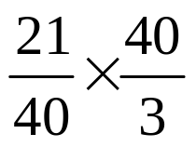

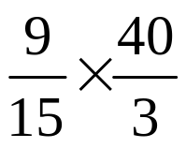
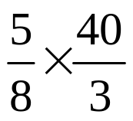
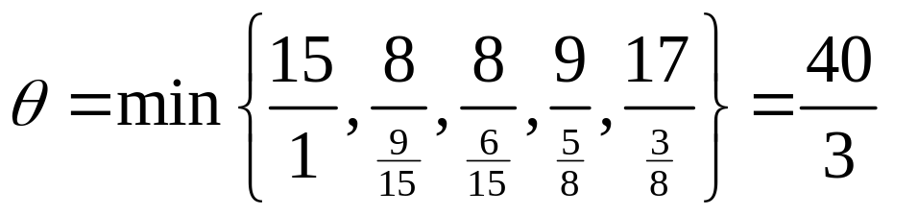
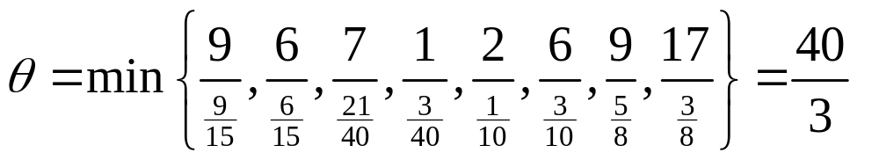
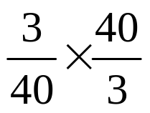

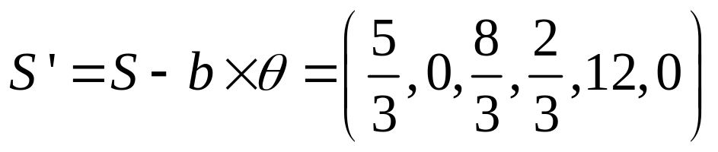
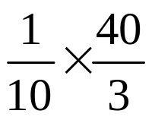

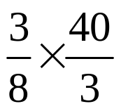
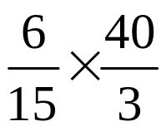
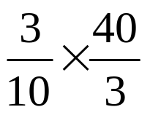

PAA Example(3/9)
: Flow augmented
: Flow augmenting vector
(u, x)
i
j
b(2) = 9/15
b(4) = 5/8
S(2) = 0
S(4) = 2/3
(7,7)
2
2
4
(9,8)
(9,25/3)
b(1) = 1
(1,1)
S(1) = 5/3
2/3
S(6) = 0
b(6) = 1
40/3
1
6
(2,4/3)
(6,16/3)
(17,5)
3
5
(6,4)
S(3) = 8/3
b(3) = 6/15
S(5) = 12
b(5) = 3/8

Slide 20



PAA Example(4/9)
r_{ij}
i
j
b(4) = 1/4
4
4
2/3
b(1) = 1
b(6) = 1
1
1
1
6
6
2/3
2/3
12
3
5
3
5
2
b(3) = 1
b(5) = 3/4

Slide 21
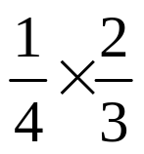

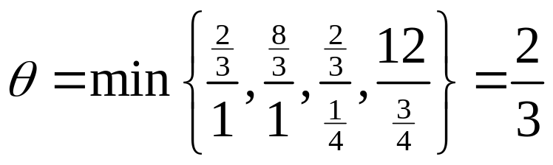

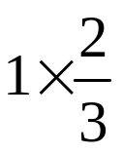
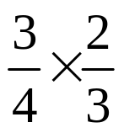


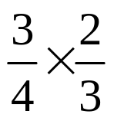

PAA Example(5/9)
: Flow augmented
: Flow augmenting vector
4
2/3
1
1
6
3
5

Slide 22
PAA Example(6/9)
(u, x)
i
j
S(4) = 1/2
4
NO more s-t path
in current layered network
(9,17/2)
S(1) = 0
S(6) = 0
1
6
(2,3/2)
(6,6)
(17,11/2)
3
5
(6,9/2)
S(3) = 2
S(5) = 23/2

Slide 23


PAA Example(7/9)
: Flow augmented
: Flow augmenting vector
Layered network 2
d(2) = 1
S(2) = 2
d(4) = 3
b(2) = 1
S(4) = 1/2
b(4) = 1/4
2
4
b(1) = 1
S(1) = 1
d(1) = 0
d(6) = 4
S(6) = 0
b(6) = 1
1
1
6
3
5
b(3) = 1
d(3) = 2
S(3) = 2
d(5) = 3
S(5) = 23/2
b(5) = 3/4

Slide 24
PAA Example(8/9)
(u, x)
i
j
2
4
NO more s-t path
in current layered network
(9,9)
(9,35/4)
1
(1,1)
6
(2,7/4)
17,25/4
3
5
(6,21/4)

Slide 25
PAA Example(9/9)
(u, x)
i
j
d(2) = ∞
d(4) = ∞
(7,7)
2
4
(9,9)
(9,35/4)
The max-flow is 15
NO more layered network
d(1) = 0
(1,1)
d(6) = ∞
1
(2,1)
(5,0)
6
(2,7/4)
(6,6)
(17,25/4)
3
5
(6,21/4)
d(3) = ∞
d(5) = ∞

Slide 26
Complexity Analysis
PAA algorithm constructs at most n-1 layered networks in the residual network
Calculate the max-flow in a given layered network : O(nm)
  Calculate flow augmenting vector δ: O(m)
  Augment flow : O(m)
  Update sum of residual capacity : O(n)
  Remove at least one node after augmenting flow
Theoretical complexity of PAA : O(n²m)
  Same as Dinic’s algorithm

Slide 27
Convert Fractional Flow to Integral Flow
Use the flow decomposition method to find integral paths from s to t to decompose fractional flow
Remove at least one arc after identifying a decomposed path
Theoretical complexity : O(m²)

Slide 28
Speed-up Techniques(1/4)
Skipping Exhausted Nodes
A doubly linked list to store admissible nodes in BFS order
  For each admissible node, record its previous and next node, according to the BFS order
  Skip scanning those nodes not in layered networks
Update the doubly linked list when exhausted nodes are removed
Scan admissible nodes by the order of the doubly linked list

Slide 29
Speed-up Techniques(2/4)
Forward and Backward Augmentation
Backward augmentation
Total flow augmented = 19.04 > 4
Larger than forward augmentation
Forward augmentation considers outgoing arcs,
Backward augmentation considers incoming arcs
Different augmenting orientations give different δ and θ
Alternatively swapping augmenting orientations may help
  In K^{th} layered network, perform forward augmentation
  In K+1th layered network, perform backward augmentation
  May select a larger θ to augment flow (same complexity)
Forward augmentation
Total forward flow augmented = 4
r_{ij}
x_{ij}
x_{ij}
j
j
i
j
i
i
2
4
2
2
24/23
2
2
47/23
10
24/23
3
1
8
60
3
57
1
2
1
1
1
18
1
17
20
17
2
19
140
1
138
1
17
2
18
S
T
4
4
10
80
6
76
4
4
0
Notes:
由於PAA演算法是從起點找出一組改善方向,其可能不甚理想,若我們能同時考慮從終點根據incoming arc找出另一組改善方向,並選擇較好的作為擴張流量,如此每次便可能運送較多的流量到終點,以試圖下降運送次數

Slide 30
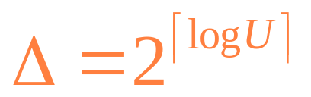
Speed-up Techniques(3/4)
Scaling Phase
Step0:
Step1: Construct a layered network that only contains those arcs with residual capacities at least △
Step2: If no layered network can be constructed by current △, recursively set △’= △/2 until a layered network can be constructed
Step3: Augment flow by PAA until current layered network is optimal. Then set △’= △/2

Slide 31
Speed-up Techniques(4/4)
Scaling Phase
Step4: If △=1, then set △=0 and find layered networks to augment flow by PAA until the max-flow is attained
Theoretical complexity of scaling version of PAA : O(nmlogU+n²m)

Slide 32
Flow Splitting Augmenting (FSA) Algorithm

Slide 33
Flow Splitting Augmenting
(FSA) Algorithm
Fairly distribute the incoming flow of each node to its outgoing arcs in a given layered network
Remove at least one arc after one time of augmentation
Total running time in a given layered network :O(m²)
Theoretical complexity of FSA : O(nm²)
  Same as Edmonds and Karp’s algorithm
j
3
9
3
i
k
3
l

Slide 34
Computational Results

Slide 35
Computational Results(1/11)
Tested network families
GENRMF generator
  GENRMF-LONG (G-LONG)
  GENRMF-WIDE (G-WIDE)
Ak generator (AK)
Washington generator with function 10
(WAS-10)
Acyclic dense with equal-capacity arcs (ACU)

Slide 36
Computational Results(2/11)
Tested proposed algorithms
PAA and its speed-up techniques
  Skipping exhausted nodes (PAA2)
  Forward and backward augmentation (PAAFB)
  Scaling phase (PSA)
Flow splitting augmenting algorithm (FSA)

Slide 37
Computational Results(3/11)
PAA and its speed-up techniques
Network |  | Running time (second)
Family | (n, m) | PAA | PAA2 | PAAFB | PSA
G-LONG | (65536, 311040) | 535,89 | 324.74 | 294.05 | 170.113
 | (130682, 625537) | 2152.531 | 1421.287 | 1205.865 | 706.066
G-WIDE | (65025, 314840) | 306.7 | 130.566 | 128.644 | 303.728
 | (123210, 599289) | 1283.38 | 549.044 | 557.084 | 1099.781
AK | (65542, 98311) | 480.37 | 329.577 | 311.962 | 83.172
 | (131078, 196615) | 2117.58 | 1386.224 | 1331.585 | 405.33
WAS-10 | (49155, 65537) | 0.016 | 0.015 | 0.031 | 0.028
 | (98307, 131073) | 0.031 | 0.031 | 0.062 | 0.084
ACU | (1024, 523776) | 0.125 | 0.063 | 0.078 | 0.047
 | (2048, 2096128) | 0.532 | 0.313 | 0.328 | 0.234
PAA2 is better than PSA in G-WIDE and WAS-10
PAAFB is better than PAA2 in G-LONG and AK
PAA2 is better than PAA

Slide 38
Computational Results(4/11)
PAA and its speed-up techniques
Network |  | # of augmentation
Family | (n, m) | PAA2 | PAAFB | PSA
G-LONG | (65536, 311040) | 51243.6 | 51239.8 | 23928
 | (130682, 625537) | 105204.6 | 105200.2 | 46416.8
G-WIDE | (65025, 314840) | 57566.4 | 57592.8 | 44323.8
 | (123210, 599289) | 110899.2 | 110953.6 | 90539.6
AK | (65542, 98311) | 32770 | 32770 | 10928
 | (131078, 196615) | 65538 | 65538 | 21850
WAS-10 | (49155, 65537) | 1 | 1 | 1
 | (98307, 131073) | 1 | 1 | 1
ACU | (1024, 523776) | 2 | 2 | 2
 | (2048, 2096128) | 2 | 2 | 2
PAAFB has fewer iterations than PAA2 in G-LONG
PSA has fewer iterations
than PAA2

Slide 39
Computational Results(5/11)
PAA and FSA
Network |  | Running time (second) |  | # of augmentation
Family | (n, m) | PAA2 | FSA | PAA2 | FSA
G-LONG | (65536, 311040) | 324.74 | 780.406 | 51243.6 | 107550.4
 | (130682, 625537) | 1421.287 | 3245.1 | 105204.6 | 215173
G-WIDE | (65025, 314840) | 130.566 | 32.516 | 57566.4 | 128798.6
 | (123210, 599289) | 549.044 | 1423.503 | 110899.2 | 248974.4
AK | (65542, 98311) | 329.577 | 285.919 | 32770 | 24578
 | (131078, 196615) | 1386.224 | 1196.606 | 65538 | 49154
WAS-10 | (49155, 65537) | 0.015 | 0.031 | 1 | 1
 | (98307, 131073) | 0.031 | 0.078 | 1 | 1
ACU | (1024, 523776) | 0.063 | 0.078 | 2 | 2
 | (2048, 2096128) | 0.313 | 0.297 | 2 | 2
FSA is better than PAA2 in AK

Slide 40
Performance Summary
fast
slow
GENRMF-LONG
  PSA << PAAFB < PAA2 << PAA < FSA
GENRMF-WIDE
  PAA2 < PAAFB << PSA < PAA < FSA
AK
  PSA << FSA < PAAFB < PAA2 << PAA
WAS-10
  PAA2 ≒ PAA < PAAFB < FSA < PSA
ACU
  PSA < PAA2 ≒ FSA < PAAFB < PAA
Recommend PAA2 and PSA

Slide 41
Computational Results(6/11)
Tested algorithms
PAA2 and PSA
Dinic’s algorithm
  Implemented by Setubal (DINIC)
    Maximum nodes：20000
  Implemented by Cherkassky and Goldberg (DF)
Highest-label preflow push algorithm (HI_PR)
MA ordering
  scaling phase (FS1)
  Preflow (FMAP)

Slide 42
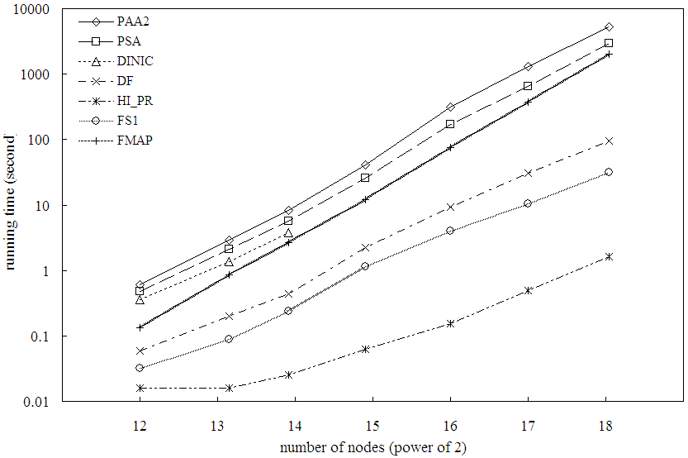
Computational Results(7/11)
G-LONG
PAA2 & PSA perform the worst
G-LONG | Running time (second)
(n, m) | PAA2 | PSA | DINIC | DF | HI_PR | FS1 | FMAP
(65536, 311040) | 327.74 | 170.11 | * | 9.24 | 0.153 | 4.02 | 74.99
(130682, 625537) | 1421.29 | 706.06 | * | 30.45 | 0.494 | 10.51 | 369.14
(270848, 1306607) | 6066.44 | 3136.5 | * | 95.65 | 1.625 | 31.4 | 2011.4

Slide 43
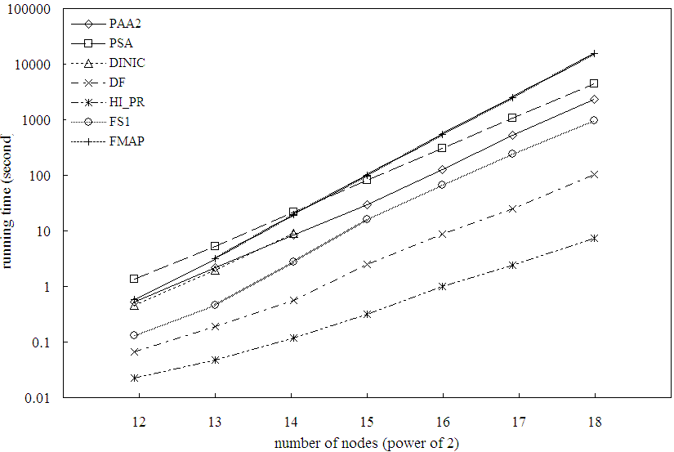
Computational Results(8/11)
G-WIDE
PAA2 and PSA performs
better than FMAP
G-WIDE | Running time (second)
(n, m) | PAA2 | PSA | DINIC | DF | HI_PR | FS1 | FMAP
(65025, 314840) | 130.57 | 303.73 | * | 8.706 | 0.997 | 65.64 | 540.66
(123210, 599289) | 549.04 | 1099.8 | * | 25.18 | 2.397 | 240.6 | 2506.8
(259308, 1267875) | 2464.14 | 4612.1 | * | 103.3 | 7.409 | 970.7 | 15309

Slide 44
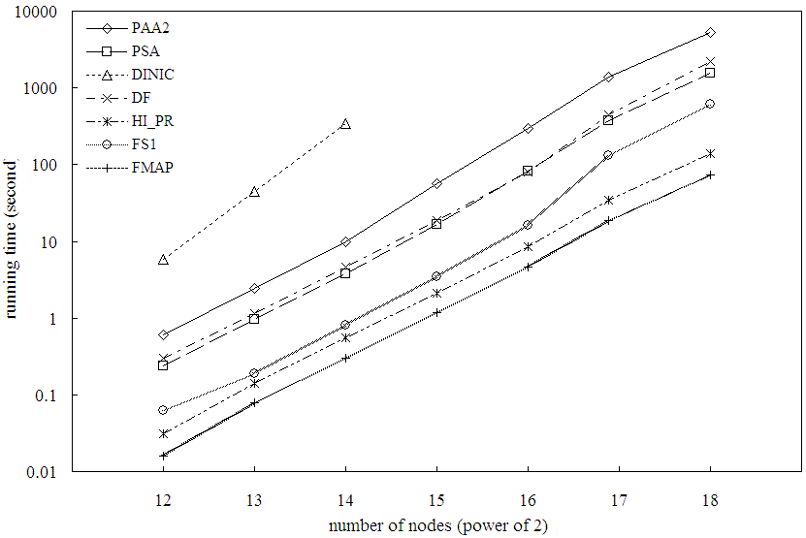
Computational Results(9/11)
AK
PAA2 and PSA outperform DINIC
PSA performs better than DF
AK | Running time (second)
(n, m) | PAA2 | PSA | DINIC | DF | HI_PR | FS1 | FMAP
(65542, 98311) | 296.87 | 83.172 | * | 80.44 | 8.61 | 16.19 | 4.672
(131078, 196615) | 1376.43 | 405.33 | * | 451.1 | 34.313 | 130.4 | 18.61
(262150, 393223) | 5338.71 | 1582.5 | * | 2224 | 138.45 | 616.8 | 74.39

Slide 45
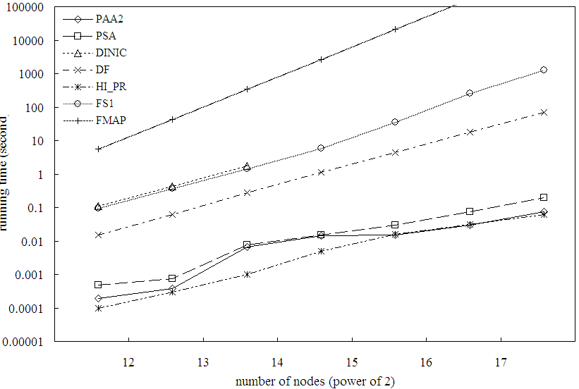
Computational Results(10/11)
WAS-10
PAA2 performs the best
WAS-10 | Running time (second)
(n, m) | PAA2 | PSA | DINIC | DF | HI_PR | FS1 | FMAP
(49155, 65537) | 0.015 | 0.03 | * | 4.42 | 0.016 | 35.22 | 21443
(98307, 131073) | 0.029 | 0.074 | * | 17.73 | 0.031 | 263.3 | 170707
(196611, 262145) | 0.074 | 0.193 | * | 71.05 | 0.063 | 1282 | 1314449

Slide 46
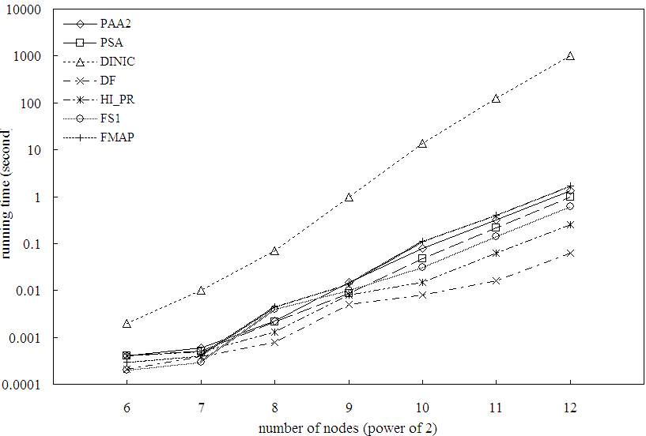
Computational Results(11/11)
ACU
PAA2 and PSA outperform DINIC and perform better than FMAP
ACU | Running time (second)
(n, m) | PAA2 | PSA | DINIC | DF | HI_PR | FS1 | FMAP
(1024, 523776) | 0.078 | 0.047 | 13.5 | 0.008 | 0.015 | 0.031 | 0.11
(2048, 2096128) | 0.313 | 0.234 | 124 | 0.016 | 0.063 | 0.141 | 0.406
(4096, 8386560) | 1.36 | 1.182 | 1027.1 | 0.063 | 0.25 | 0.61 | 1.69

Slide 47
Performance Summary(1/2)
fast
slow
G-LONG
  HI_PR << FS1 < DF << FMAP < DINIC < PSA << PAA2
G-WIDE
  HI_PR << DF << FS1 < PAA2 < DINIC < PSA << FMAP
AK
  FMAP < HI_PR << FS1 < PSA < DF < PAA2 << DINIC
WAS-10
  PAA2 ≒ HI_PR < PSA << DF << FS1 < DINIC << FMAP
ACU
  DF < HI_PR < FS1 < PSA < PAA2 < FMAP << DINIC

Slide 48
Performance Summary(2/2)
HI_PR performs the best in most cases
PAA2 performs the best in WAS-10
  Only one time of augmentation
In ACU family
  PAA2 and PSA only need two times of augmentation

Slide 49
Modified LSDP (MLSDP) Algorithm

Slide 50
MLSDP Algorithm(1/2)
LSPD method to solve the min-cost problem
  Nondegenerate pivot by solving NNLS subproblem
Max-flow problem → min-cost problem by adding an artificial arc (t, s) with infinite capacity
LSDP for the max-flow problem
  NNLS subproblem can be solved by Kirchhoff’s laws to obtain improving direction δ
LSDP for max-flow in layered networks
  Polynomial-time algorithm

Slide 51
MLSDP Algorithm(2/2)
Use BFS and distance labels to construct a layered network
Treating each admissible arc as 1Ω, calculate the electronic flow δ_{ij} by KCL/KVL
Calculate maximum step length θ
Augment flows by Δx =δ×θ
Saturate at least one arc after each augmenting iteration
Theoretical Complexity：O(nm⁴)
Notes:
由於在送流量時必須滿足flow balance，而找augmenting path是一種容易找到feasible delta的方法，亦即另delta=1 if arc belongs to path and theda = min{r}
若考慮送整個admissible subgraph時，找尋滿足flow balance的feasible delta便是困難之處
在此便提出以比例的方法，亦即考慮空間大小，按照比例運送

Slide 52
MLSDP Example(1/7)
(u, x)
d(2) = 1
d(2) = ∞
d(4) = 2
d(4) = ∞
i
j
(7,0)
2
4
(9,0)
(9,0)
d(1) = 0
d(1) = 0
d(6) = ∞
(1,0)
d(6) = 3
1
(2,0)
(5,0)
6
(2,0)
(6,0)
(17,0)
3
5
(6,0)
d(3) = 1
d(3) = ∞
d(5) = 2
d(5) = ∞
(∞,0)

Slide 53
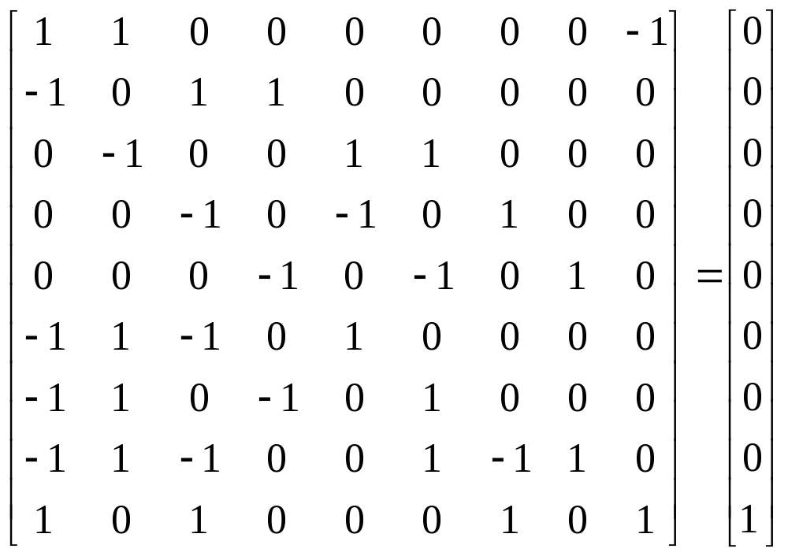
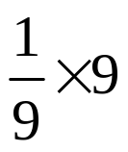

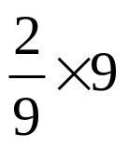





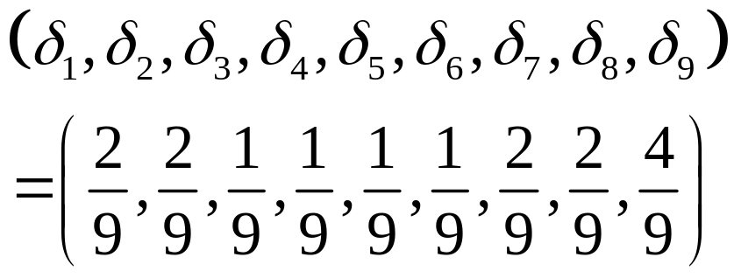
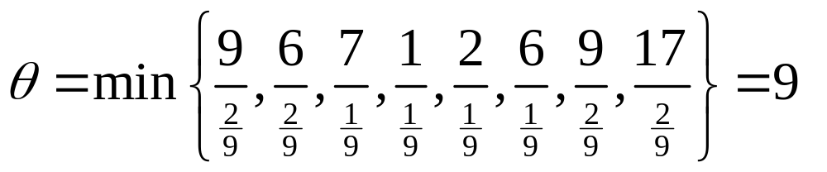


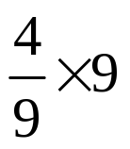

MLSDP Example(2/7)
Kirchhoff’s laws
: Flow augmented
Current residual capacity
: Flow augmenting vector
(u, x)
Layered network 1
i
r_{ij}
j
δ₃
i
j
(7,1)
7
2
4
9
(9,2)
δ₁
9
δ₇
(9,2)
(1,1)
KCL
1
δ₄
1
6
2
δ₅
(2,1)
δ₂
(6,2)
(17,2)
6
17
δ₈
3
5
(6,1)
KVL
6
δ₆
(∞,4)
δ₉

Slide 54
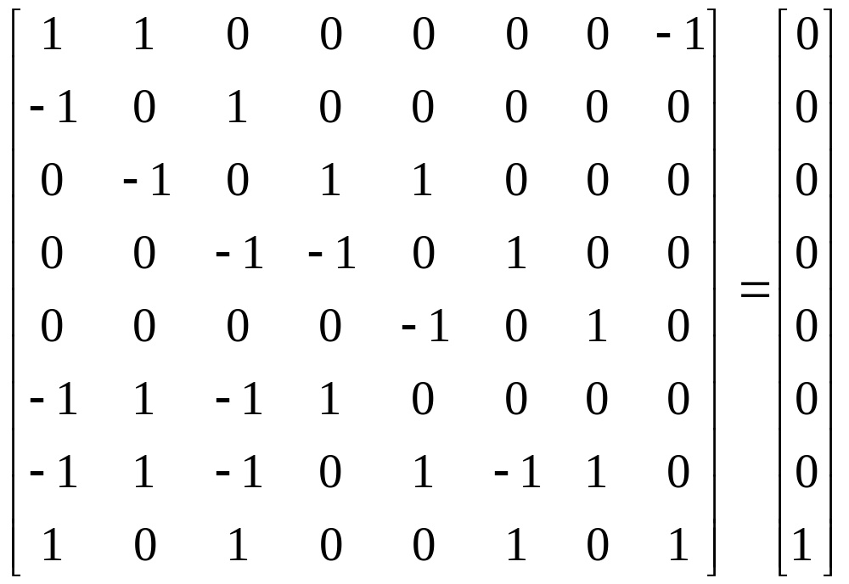
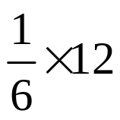

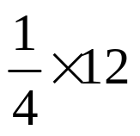
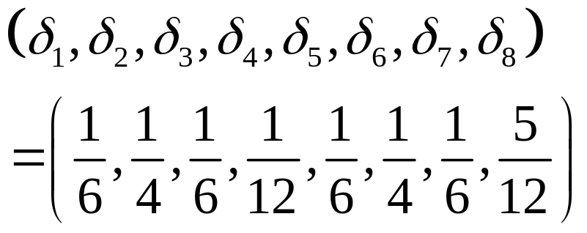
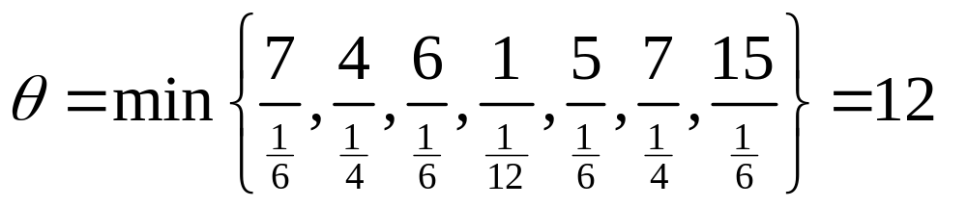
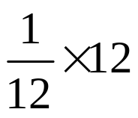


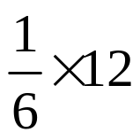
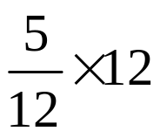

MLSDP Example(3/7)
Kirchhoff’s laws
: Flow augmented
Current residual capacity
: Flow augmenting vector
(u, x)
i
r_{ij}
j
δ₃
i
j
6
(7,3)
2
4
(9,4)
δ₁
7
δ₆
(9,5)
7
KCL
1
6
1
δ₄
(2,2)
δ₂
(6,5)
(17,4)
4
15
δ₇
3
5
(6,3)
KVL
5
δ₅
(∞,9)
δ₈

Slide 55
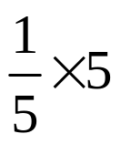

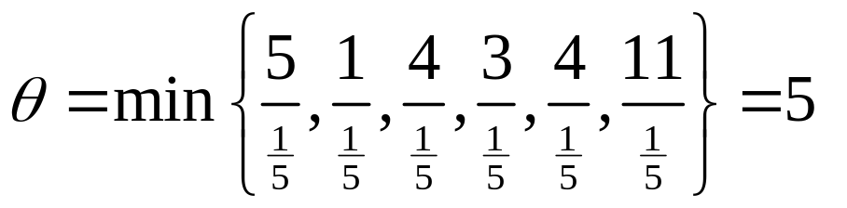
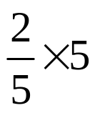

MLSDP Example(4/7)
: Flow augmented
: Flow augmenting vector
(u, x)
i
j
(7,4)
2
4
(9,5)
(9,6)
1
6
(6,6)
(17,5)
3
5
(6,4)
(∞,11)

Slide 56

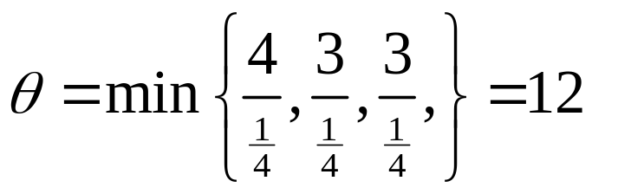
MLSDP Example(5/7)
: Flow augmented
: Flow augmenting vector
(u, x)
i
j
(7,7)
2
4
(9,8)
(9,9)
NO more s-t path
in current layered network
1
6
(∞,14)

Slide 57


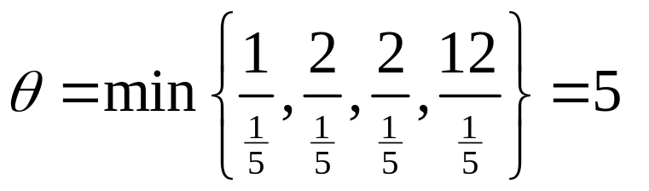
MLSDP Example(6/7)
: Flow augmented
: Flow augmenting vector
(u, x)
Layered network 2
d(2) = 1
d(4) = 4
i
j
2
4
(9,9)
NO more s-t path
in current layered network
d(1) = 0
d(6) = 4
1
(2,1)
6
(17,6)
3
5
(6,5)
d(3) = 2
d(5) = 3
(∞,15)

Slide 58
MLSDP Example(7/7)
(u, x)
i
j
d(2) = ∞
d(4) = ∞
(7,7)
2
4
(9,9)
(9,9)
The max-flow is 15
NO more layered network
d(1) = 0
(1,1)
d(6) = ∞
1
(2,1)
(5,0)
6
(2,2)
(6,6)
(17,6)
3
5
(6,5)
d(3) = ∞
d(5) = ∞

Slide 59
Complexity Analysis
The MLSDP algorithm constructs at most n-1 layered networks in the residual network
Calculate the max-flow in a given layered network : O(m⁴)
  Calculate electron flow δ by Kirchhoff’s laws : O(m³)
  Augment flow : O(m)
  Remove at least one arc after augmenting flow
Theoretical complexity of MLSDP : O(nm⁴)

Slide 60
Speed-up Techniques
KCL/KVL form a sparse linear system
  Using UMFPACK sparse linear solver instead of Gauss-Jordan elimination
Improving the O(m³) complexity for KCL/KVL?
  Flow decomposition? Only path flow, NO cycle flow?
  q path flows, O(q³) ? ➔ future research!
    q = m – n + 1 (KVL)
Notes:
由於建立科西和夫定律之linear system是以arc數目建立,若能改成找尋m-n+1條path,並計算各path之電流值,進一步得到各arc之電流值的話,如此便可以降低linear system之dimension,以加快求解效率,然而,是否能建立q條path來取代仍未之

Slide 61
Computational Results

Slide 62
Computational Results(1/2)
Test algorithms
  PAA2
  MLSDP using Gauss-Jordan elimination
  MLSDP using UMFPACK (MLSDP2)
Tested network families
  G-LONG & G-WIDE
  AK
  WAS-10
  ACU

Slide 63
Computational Results(2/2)
PAA and MLSDP
Network |  | Running time (second) |  |  | # of augmentation
Family | (n, m) | PAA2 | MLSDP | MLSDP2 | PAA2 | MLSDP
G-LONG | (756, 3240) | 0.026 | 1503.65 | 30.041 | 486 | 758
 | (1225, 5376) | 0.067 | 10418.3 | 106.161 | 862.4 | 1289.8
G-WIDE | (676, 3003) | 0.02 | 547.1 | 10.716 | 462.8 | 660.2
 | (1024, 4608) | 0.062 | 4018.27 | 61.473 | 737.2 | 1612.4
AK | (2054, 3079) | 0.281 | 263.703 | 20.968 | 1026 | 770
 | (4102, 6151) | 1.094 | 3947.48 | 165.327 | 2050 | 1538
WAS-10 | (1539, 2049) | 0.008 | 0.282 | 0.093 | 1 | 1
 | (3075, 4097) | 0.016 | 1.171 | 0.407 | 1 | 1
ACU | (512, 130816) | 0.016 | 2.579 | 0.047 | 2 | 2
 | (1024, 523776) | 0.079 | 20.344 | 0.234 | 2 | 2
MLSDP has fewer iterations than PAA2 in AK
MLSDP2 outperforms MLSDP

Slide 64
Conclusions

Slide 65
Contributions(1/2)
PAA proportionally distribute flows to arcs in an admissible subnetwork
Theoretical complexity of PAA : O(n²m)
Implementations of PAA
  Advanced data structure
  Forward and backward augmentation
  Scaling phase
FSA fairly distribute flows to arcs in an admissible subnetwork
Theoretical complexity of FSA : O(nm²)

Slide 66
Contributions(2/2)
The MLSDP algorithm can be bounded in O(nm⁴) time
Use UMFPACK sparse linear solver
Converting fractional flows to integral flows in O(m²) time
FSA and MLSDP have fewer iterations than PAA in AK family
PAA may be suitable for WAS-10 、ACU or symmetric networks

Slide 67
Future Research
Augment flows along at most k outgoing arcs in PAA algorithm
PAA for fair networks
Path flow augmentations in MLSDP

Slide 68
Thank you for listening
Q & A

Slide 69
Convert fractional flow
to integral flow

Slide 70
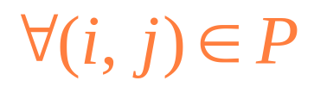
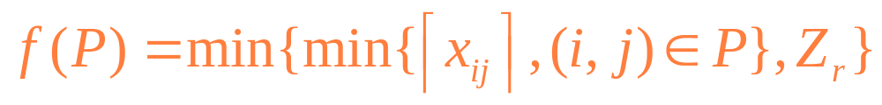
Convert Fractional Flow to Integral Flow
Current max-flow Z
  Step0: set Z_{r}=Z
  Step1: find a path P such that x_{ij}>0
  Step2: let
  If Z_{r}’>0 Go to Step1

Slide 71
Example(1/7)
(u, x)
Max-flow：Z = 15
i
j
(7,7)
2
4
(9,9)
(9,35/4)
(1,1)
1
(2,1)
(5,0)
6
(2,7/4)
(6,6)
(17,25/4)
3
5
(6,21/4)

Slide 72
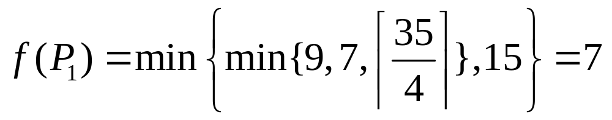
Example(2/7)
Remaining flow
Current flow of f(P₁)
Z_{r} = 15 - 7 = 8
Z_{r} = Z = 15
0
x₂₄=7
2
4
2
x₁₂=9
7/4
x₄₆=35/4
1
1
1
6
7/4
6
25/4
3
5
21/4

Slide 73

Example(3/7)
Remaining flow
Current flow of f(P₂)
Z_{r} = 8
Z_{r} = 8 – 1 = 7
2
4
x₁₂=2
1
7/4
x₂₅=1
0
1
1
6
7/4
6
x₅₆=25/4
21/4
3
5
21/4

Slide 74

Example(4/7)
Remaining flow
Current flow of f(P₃)
Z_{r} = 7
Z_{r} = 7 – 1 = 6
2
4
x₁₂=1
x₄₆=7/4
0
3/4
1
0
x₂₃=1
6
x₃₄=7/4
3/4
6
21/4
3
5
21/4

Slide 75

Example(5/7)
Remaining flow
Current flow of f(P₄)
Z_{r} = 6
Z_{r} = 6 – 6 = 0
Z_{r} = 0
We don’t need to find cycle flow because the integral flow has been found
2
4
3/4
1
6
3/4
x₁₃=6
0
x₅₆=21/4
-3/4
3
5
-3/4
x₃₅=21/4

Slide 76
Example(6/7)
Summarize above steps
f(P₂) = 1
f(P₁) = 7
f(P₃) = 1
f(P₄) = 6
7
7
2
4
7
7+1
8+1
7
7
8
9
7+1
8
1
1
1
1
1
6
1
1
1
6
6
1
7
6+1
1
3
5
6
6

Slide 77
Example(7/7)
(u, x)
Max-flow：Z = 15
i
j
(7,7)
2
4
(9,9)
(9,8)
(1,1)
1
(2,1)
(5,0)
6
(2,1)
(6,6)
(17,7)
3
5
(6,6)

Slide 78
Complexity Analysis
Find a path to in step1 : O(m)
Can delete at least one arc in setp2
Until Z_{r}=0, total running time is O(m²)

Slide 79

Genrmf family

Slide 80


AK family

Slide 81

Washington-10 family

Slide 82

Acyclic-dense family

Slide 83


q paths

