Slide 1
Application 4.2 – Allocating Inspection Effort on a Production Line

Slide 2
Introduction
出處:
White, L.S. (1969). Shortest Route Models for the Allocation of Inspection Effort on a Production Line. Management Science, 15(5), 249-259.

Slide 3
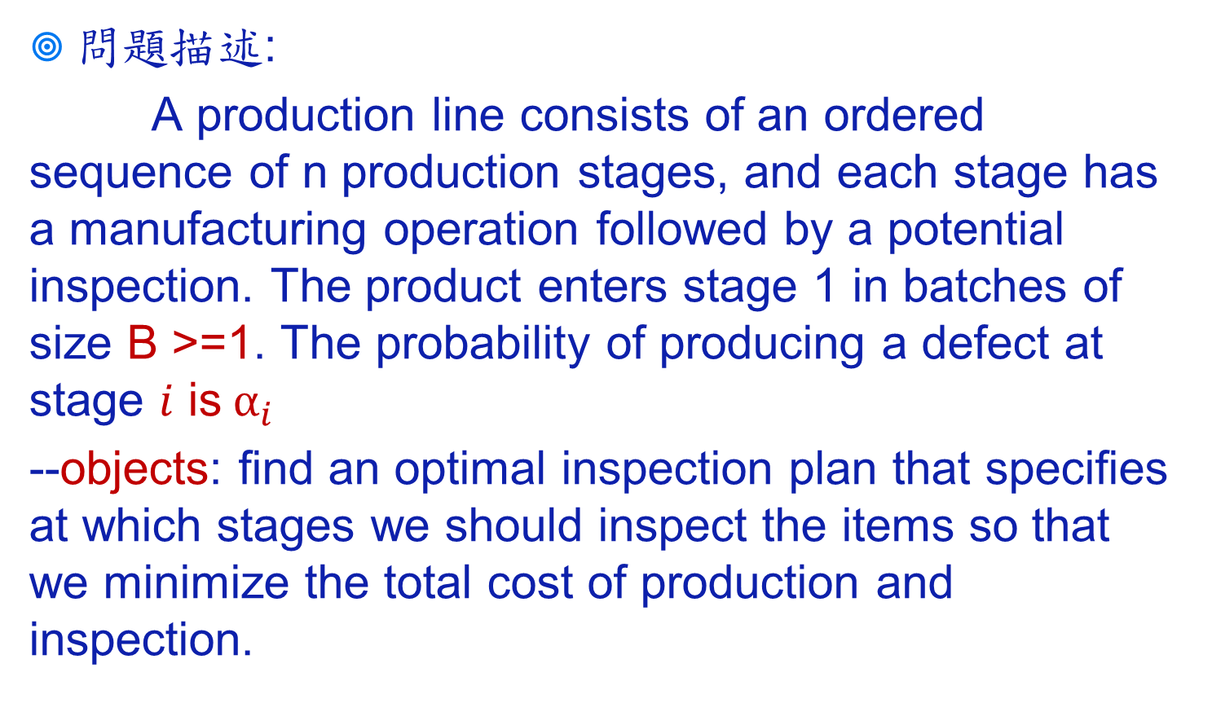
Introduction

Slide 4
Introduction
問題假設:
損壞為不可維修
每個階段結束後只有檢查或是不檢察所有產品(無抽樣)
生產線結束前需要通過檢查站，以避免蝦疵品流出

Slide 5
Introduction
Manufacture Operations
B
1
2
3
4
5
Potential Inspection Stations

Slide 6
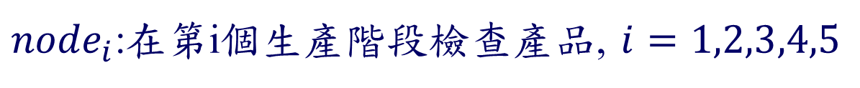
Transfer to network problem
0
1
2
3
4
5

Slide 7
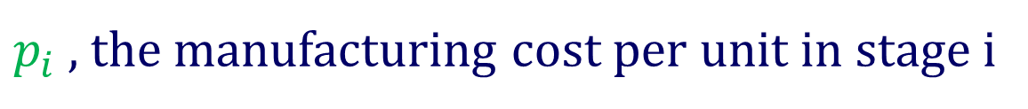
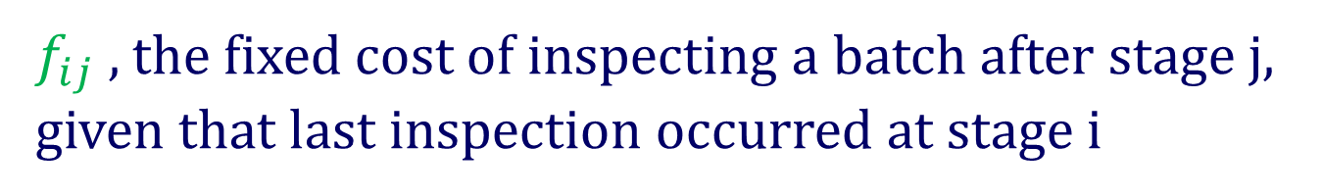
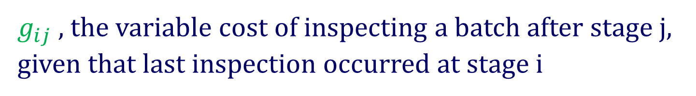

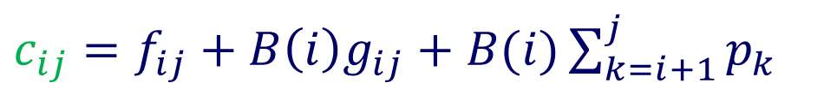
Transfer to network problem

Slide 8
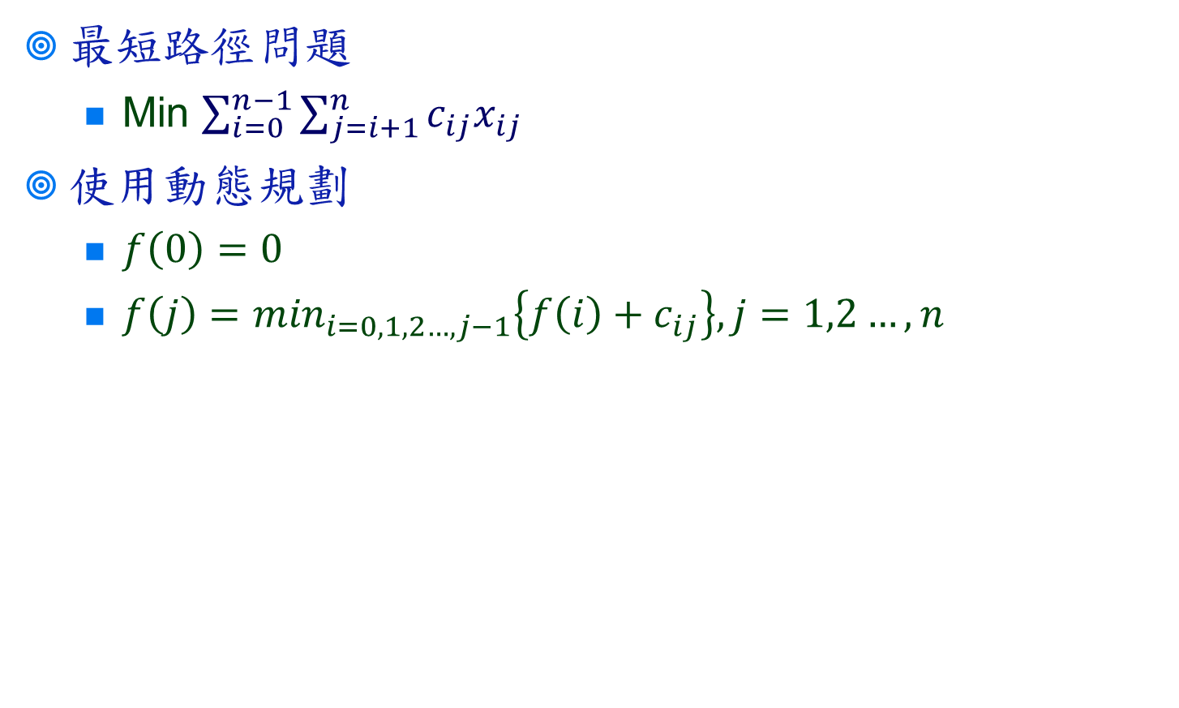
Solution

