Slide 1
離 散 數 學
Graphs
Contents:
Graphs and Their Representations
Path and Circuits
Shortest Paths and Distance
Coloring a Graph
Directed Graphs and Multigraphs

Slide 2
Graphs and their representations
A graph is a nonempty finite set V along with a set E of 2-element subsets of V
  V: vertices (vertex) (or vertex)
  E: edges (undirected) (or Arcs: directed)
A graph can be described either by the use of sets, or diagrams
Edge e={u,v} means
  e joins vertices u and v
  u and v are adjacent
  e is incident with u (and vice versa)
Degree of v: # edges incident with v
D
B
C
A
4.1: Graphs and Their Presentations

Slide 3

Subgraph & Complete graph
Thm 4.1
In a graph, the sum of the degrees of the vertices equals
twice the # of edges
Labeled graph: G=(V,E) with n vertices labeled v₁,v₂,…v_{n}
Subgraph G₁=(V₁,E₁) of G=(V,E), if
where each edge in E₁ joins vertices in V₁.
Complete graph K_{n}: a graph of n vertices, each vertex is joined to every other vertex, i.e. each vertex in K_{n} has degree n-1
D
D
B
B
B
E
A
C
A
C
A
C
K₃
K₄
K₅
4.1: Graphs and Their Presentations

Slide 4
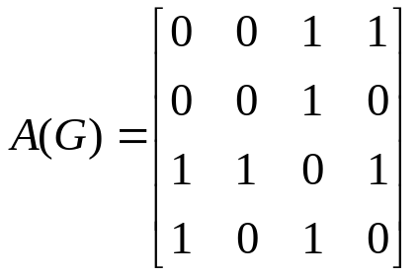
Adjacency Matrix & Adjacency List
Adjacency matrix of G: A(G), an n x n matrix where
(i,j) entry is 1, if there is an edge from v_{i} to v_{j}
(i,j) entry is 0, if there is NO edge from v_{i} to v_{j}
easy to represent G, but need n² storage, inefficient for sparse graph
Thm 4.2
The sum of the entries in row i of A(G) is the degree of the vertex v_{i}
Adjacency List of G:
List each vertex followed by the vertices adjacent to it
Corresponds to the nonzero entries in A(G)
e.g.
D
Adjacency List:
A: C,D
B: C
C: A,B,D
D: A,C
B
C
A
4.1: Graphs and Their Presentations

Slide 5

Isomorphism
G₁ is isomorphic to G₂: there is a one-to-one correspondence f between the vertices of G₁ and G₂ such that vertices u and w are adjacent in G₁ iff the vertices f(u) and f(w) are adjacent in G₂
Another way to say, G₁ and G₂ are isomorphic, denoted
Such a function is called an isomorphism of G₁ with G₂
Thm 4.3
Let f be an isomorphism of G₁ with G₂ . For any vertex v in G₁, the degrees of v and f(v) are equal
3
D
4
2
B
G₁
G₂
C
A
1
4.1: Graphs and Their Presentations

Slide 6
Exercises 4.1
Q.18, Q.28, Q36, Q42 (a)(b), Q43 (a)(b)
Isomorphism is an equivalence relation
  Symmetric, reflexive, transitive
Isomorphism is one-to-one & onto
4.1: Graphs and Their Presentations

Slide 7
Multigraph & Path
A multigraph (pseudograph) consists of a nonempty finite set of vertices and a set of edges, where we allow an edge to join a vertex to itself, and where we allow several edges joining the same pair of vertices.
Loop: an edge from a vertex to itself
  A loop on a vertex v is counted twice in deg(v)
Parallel edge: more than 1 edge between 2 vertices
A simple graph is a graph that contains NO loops & parallel edges
u-v path (path from u to v) with length n:
sequence of n+1 vertices v₁ v₂ … v_{n+1}, where v₁=u, v_{n+1}=v
sequence of n edges e₁ e₂ … e_{nn}
  These n+1 vertices & n edges may not be distinct
  (i.e. a path may pass the same vertex or edge twice)
  [such definition may be different in other books]
u-v simple path: a path from u to v where no vertex/edge is repeated
4.2: Paths and Circuits

Slide 8
Simple Path, Cycle
Thm 4.4 Every u-v path contains a u-v simple path
A multigraph is connected if there is a path between every 2 vertices
  In a connected multigraph, each vertex is reachable from every other vertex
  An unconnected graph may contain isolated vertices which has zero degree
A circuit is a path from a vertex to itself with no repeated intermediate edges.
A cycle is a circuit without repeated intermediate vertices.
C
The bridges of Königsberg
Is there a way to start from a mass land, cross each bridge
exactly once, and then return to the same mass land ?
A
B
D
C
In communication network: checking each link
In garbage picking up route: pass each street
Chinese postman problem
how to make the crossing/passing more efficient ?
A
B
D
4.2: Paths and Circuits
Notes:
Proof of Thm 4.4: if U=V, just select that vertex; if all vertices are different, done; o.w. at least 2 vertices on the path are the same, deleting those edges in between will still keep a path connecting U,V. keep doing these deletion until there is no repeated vertices; since the # of vertices are finite, this process will give a simple U-V path
Chinese postman problem:
Find a minimum length closed walk that traverses each edge AT LEAST ONCE
Fining an optimal solution is NP-complete

Slide 9
Euler Circuit & Euler Path
Euler path: a path in a multigraph G that includes exactly once all the edges of G and has different origin and destination
Euler circuit: a path in a multigraph G that includes exactly once all the edges of G and has the same origin and destination
Thm 4.5 For a connected multigraph G (with |V|≧2)
each vertex in G has even degree iff G contains an Euler circuit
each vertex in G has even degree except for 2 distinct vertices iff G contains an Euler path
Euler path starts at one and ends at the other of the 2 vertices of odd degree
This theorem gives a O(n) algorithm to determine whether a given graph contains Euler circuits, or Euler paths.
D
D
D
D
D
E
F
B
B
B
B
C
B
G
A
A
C
A
C
A
A
C
EC: ABDA
EP: ABDC
EP: ABDACB
EP: ? EC: ?
EC: ABA DEC FGCA
4.2: Paths and Circuits
Notes:
Pf:
(a)<= : when the circuit passes a vertex, there is an entering edge, and a leaving edge (different from the entering edge), since each edge is passed exactly once, thus there are 2|V| edges which is an even #
=> choose a starting vertex u, if there is a loop on u, pass it, then leave u along an edge (u,u1) (it must exist since there are more than 2 vertices and the graph is connected), in u1, if there is a loop on u1, pass it, then leave u1 along an edge other than any edge that has been passed like (u1,u) (it must exist since each vertex has even degree) to vertex u2. Repeat these steps until finally we return u. (this has to happen since # edge is finite and the graph is connected) Then we get a circuit C1 from u to u.
If C1 covers all the edge, then we get an Euler circuit, done.
Otherwise, we delete all the edges on C1 from G, then delete all the isolated vertices from G, and obtain the remaining subgraph G1.
On G1, we choose a vertex v (it exists due to connected graph), and do the same steps as above to form a circuit C2 back to v.
Now, combine C1 & C2, we get a larger circuit C’ starts from u along C1 to v, then along C2 back to v, and along C1 back to u. if C’ covers all the edges, we are done. Otherwise, we repeat the same procedures until finally all the edges are covered. The algorithm will stop since the graph is finite, at which time, we obtain an Euler circuit by combining all the smaller circuits.
(b,c)<= trivial
=> Add an artificial edge between the 2 vertices with odd degrees, we can form an Euler circuit, then we remove the artificial edge and obtain the Euler path

Slide 10
Proof of Thm 4.5
(a)<= : when the circuit passes a vertex, there is an entering edge, and a leaving edge (different from the entering edge), so they can be paired. Since each edge is passed exactly once, every edge through a vertex can be paired, thus each vertex has even deg
=> choose a starting vertex u, if there is a loop on u, pass it, then leave u along an edge (u,u1) (it must exist since there are more than 2 vertices and the graph is connected), in u1, if there is a loop on u1, pass it, then leave u1 along an edge other than any edge that has been passed like (u1,u) (it must exist since each vertex has even degree) to vertex u2. Repeat these steps until finally we return u. (this has to happen since # edge is finite and the graph is connected) Then we get a circuit C1 from u to u.
If C1 covers all the edges, then we get an Euler circuit, done.
Otherwise, we delete all the edges on C1 from G, then delete all the isolated vertices from G, and obtain the remaining subgraph G1.
On G1, we choose a vertex v (it exists due to connected graph), and do the same steps as above to form a circuit C2 back to v.
Now, combine C1 & C2, we get a larger circuit C’ starts from u along C1 to v, then along C2 back to v, and along C1 back to u. if C’ covers all the edges, we are done. Otherwise, we repeat the same procedures until finally all the edges are covered. The algorithm will stop since the graph is finite, at which time, we obtain an Euler circuit by combining all the smaller circuits.
(b,c)<= trivial, ;=> Add an artificial edge between the 2 vertices with odd degrees, we can form an Euler circuit, then we remove the artificial edge and obtain the Euler path
4.2: Paths and Circuits

Slide 11

Euler Circuit Algorithm
Given: connected multigraph G in which every vertex has even degree
begin
initialization: Set E={all edges of G}
select a vertex u, let C be the path consisting of just u
while E is not empty do
choose a vertex v in C that is incident with some edge in E
set P to be the path consisting of just v
set w=v
while there is an edge e in E that is incident with w
remove e from E
replace w with the other vertex on e
append edge e and vertex w to path P
end while
replace any one occurrence of v in C with path P
end while
output C: Euler circuit
end
Pass loop first
Elementary operation
Complexity: O(|E|)
Constructing
a circuit P
Merging P with C
4.2: Paths and Circuits

Slide 12
Exercise on Euler circuits
Ex1: when does the complete graph K_{n} contains an Euler circuit?
Ex2: give an algorithm to determine whether a given connected graph G contains Euler paths or not. What is the complexity of your algorithm?
Exercise 4.2- Q19, 21, 23
Q31,32,33,34,35,36,37,38
4.2: Paths and Circuits

Slide 13
Hamiltonian Cycles & Paths
Hamiltonian path: a path in a multigraph G that includes exactly once all the vertices of G and has different origin and destination
Hamiltonian cycle: a cycle in a multigraph G that includes exactly once all the vertices of G
It is a major unsolved problem to determine necessary & sufficient conditions for a graph to have either Hamiltonian cycle or path.
  A special case of the Traveling Salesman Problem (TSP)
  A complete graph must be Hamiltonian (i.e. contains Hamiltonian cycle)
Thm 4.6 (Ore’s Thm) suppose G is a simple graph with n≧3 vertices
if for each pair of nonadjacent vertices u and v we have
deg(u)+deg(v)≧n,
then G has a Hamiltonian cycle
4.2: Paths and Circuits
Notes:
Sir William Rowan Hamilton, developed a puzzle (a dodecahedron[12facets], 20 vertices[cities]) whose answer required the construction of Hamiltonian cycle
Show Ore’s Thm: by contradiction, Suppose such G has NO Ham.cyc.
G is a subgraph of Kn (but not Kn).
We can recursively add edges between 2 nonadj vert of G until it becomes a H where adding one more edge joining 2 nonadj vert in H will create a Ham.cyc.
Let x,y be 2 nonadj vert in H ➔ x,y are nonadj in G
Known: deg(x)+deg(y)≧n in G ➔ deg(x)+deg(y)≧n in H
If we add a new edge (x,y) on H ➔ create a Ham.cyc. (by assumption)
i.e. there exists a Ham.path from x to y, say, x=v1-v2-v3-…-vi-1-vi-vi+1-…-vn-1-vn=y
Suppose deg(x)=r
Claim: if there exists an edge (x,vi), then there exists NO edge (vi-1,y)
Pf: o.w. H has a Ham.cyc. -><-
The claim is tru for I=2,3,…,n-1
Since deg(x)=r, there exists r vertices in {v1,v2,…,vn-1} NOT adj to y
Thus deg(y)<=(n-2)-r which means deg(x)+deg(y)<=n-2<n -><-

Slide 14
Show Ore’s Theorem
Try to show by contradiction, Suppose such G has NO H.C.
G is a subgraph of K_{n} (but G is not K_{n} [why?]).
We can recursively add edges between 2 nonadj. vertices of G until it becomes another graph H, where adding one more edge joining 2 nonadj. vertices in H will create a H.C.
Let x,y be 2 nonadj. vertices in H ➔ x,y are nonadj in G [why?]
If we add a new edge (x,y) on H ➔ we will create a H.C. (by assumption)
i.e. there exists a H.P. from x to y in H, say, x=v₁-v₂-v₃-…-v_{i-1}-v_{i}-v_{i+1}-…-v_{n-1}-v_{n}=y
Suppose deg(x)=r
Claim: if there exists an edge (x,v_{i}), then there exists NO edge (v_{i-1},y)
Pf: if there exists edge (v_{i-1},y), then H has a H.C. Contradiction.
The claim is true for i=2,3,…,n-1
Since deg(x)=r, thus there exists r vertices in {v₁,v₂,…,v_{n-2}} NOT adjacent to y.
Thus deg(y)≦(n-2)-r which means deg(x)+deg(y)≦n-2<n in H (and in G, too)
Thus, if deg(x)+deg(y)≧n in G ➔ such G has H.C.
4.2: Paths and Circuits
Notes:
Known: deg(x)+deg(y)≧n in G ➔ deg(x)+deg(y)≧n in H [why?]

Slide 15
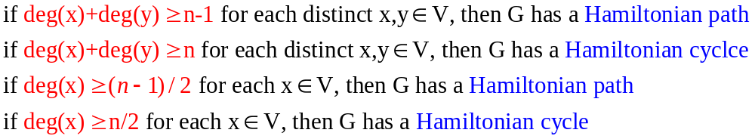
Exercise on Hamiltonian Cycles
Dirac’s Thm
suppose G is a simple graph with n≧3 vertices, and every vertex has degree at least n/2 then G contains a Hamiltonian cycle
Some criteria to check whether G has a H.C. or H.P.
(!Note! If the following 4 criteria all fail, it’s still possible to have H.C. or H.P.)
Ex1: give examples of simple graphs that (a) have E.C. & H.C. (b) have E.C. but NO H.C. (c) has H.C. but no E.C.
Ex2: For a K_{n}, how many distinct (a) H.P. (b) H.C. ?
(a) n!/2 (treating path a-b-c the same as path c-b-a) (b) (n-1)!/2
4.2: Paths and Circuits
Notes:
Show Dirac’s Thm: deg(v)>=n/2, so deg(u)+deg(v)>=n for any vertices u,v
of course it’s also true for any nonadj vertices u,v, thus by Ore’s thm, done
Ex1: (a) 1-2-3-4-1 (b) 1-2-3-4-5-3-1 (c) 1-2-3-4-1; (1,3)

Slide 16
Shortest Paths and Distance
Shortest path: a path of minimal length between vertices s and t
Distance from s to t: smallest possible # of edges in a path from s to t
!Note! This definition only applies for unweighted graph
Weighted graph: a graph where each edge has a “weight” as its length.
Weight of a path: sum of weights of the edges in the path
To trace a path, we can use predecessor (pred) or successor (succ)
If a path passes vertex i then consecutively to vertex j, we say
pred(j)=i , succ(i)=j
If we record the pred(i) (or succ(i)) for each vertex i in any path-related algorithm, we then will be able to trace the entire path
For the first vertex in the path, say, s, we define pred(s)=NULL (or “-”)
For the last vertex in the path, say, t, we define succ(t)=NULL (or “-”)
e.g. pred(1)=3, pred(2)=4, pred(3)=2, pred(4)=NULL
e.g. succ(4)=2, succ(2)=3, succ(3)=1, succ(1)=NULL
4
2
3
1
4.3: Shortest Paths and Distance

Slide 17
Breadth-First Search
To find out all the vertices that are reachable from a specific vertex (source), say, s
M is a very large number
begin
initialization: Set d[v]=M for each v in V; LIST= ∅
d[s]=0; pred[s]=NULL;
add s in LIST;
while LIST is not empty do
remove a vertex i from LIST;
while there exists an edge (i,j) with d[j]=M do
d[j]=d[i]+1; pred[j]=i;
add j into LIST; mark (i,j) as scanned;
end while
end while
for each vertex i do
tracepath(s,i);
end for
end
LIST is a queue
(FIFO)
Vertex Selection
Scan vertex i
Distance Updating
4.3: Shortest Paths and Distance

Slide 18
Complexity of Breadth-First Search
Scan vertex i:
scan all the edges (i,j) connecting vertex i
Scan edge (i,j): check whether d[j]=M or not
if yes then update distance label of vertex j
d[j]=d[i]+1; pred[j]=i;
add j into LIST;
Two major operations:
Vertex Selection: each vertex is selected to be scanned exactly once
i.e. total # of vertex selection operations=|V|
Distance Updating: each edge is scanned exactly twice
i.e. total # of edge scanning operations=2|E|
during these 2|E| scanning, at most |E| of them perform distance updating
Complexity: O(|V|+|E|)=O(|E|)
usually O(|E|)=O(|V|²) but O(|E|) is a better approximation
4.3: Shortest Paths and Distance

Slide 19
More about Breadth-First Search
How to select a vertex from LIST?
Queue: FIFO
How to trace a path from vertex s to i?
Why the dist[j] represents the shortest distance from s to j?
math. induction
begin
output i;
while pred[i] ≠ s do
i=pred[i];
output i
end while
output s
end
This prints out the path from s to i in reverse order
Complexity : O(|V|)
4.3: Shortest Paths and Distance

Slide 20
Shortest Path on Weighted Graphs
Distance from s to t on a weighted graph = Weight of a path
Negative cycle:
a cycle that has a total weight which is negative
If there is a path from s to t that contains a negative cycle
then there exists NO shortest path from s to t
If there exists a shortest path from s to t
then we can assume such a path is simple path
(Thm 4.4 every u-v path contains a u-v simple path)
Shortest path problems:
1-1, 1-ALL, ALL-1, ALL-ALL, SOME-SOME
Nonnegative edge length vs. negative edge length
4.3: Shortest Paths and Distance

Slide 21
Shortest Path Problems
Single Source Shortest Path (SSSP)
  Nonnegative Arc Cost (LS)
  General Arc Cost (LC)
All Pairs Shortest Paths (APSP)
  Combinatorial Type Algorithms (repeated SSSP)
  Algebraic Type Algorithms (FW)
  LP Type Algorithms (Network simplex)
Multiple Pairs Shortest Paths (MPSP)
0
 | 0
 |  | 0
 |  |  | 0
 |  |  |  | 0
0
 | 0
 |  | 0
 |  |  | 0
 |  |  |  | 0
0
 | 0
 |  | 0
 |  |  | 0
 |  |  |  | 0
0
 | 0
 |  | 0
 |  |  | 0
 |  |  |  | 0
0
 | 0
 |  | 0
 |  |  | 0
 |  |  |  | 0
4.3: Shortest Paths and Distance

Slide 22
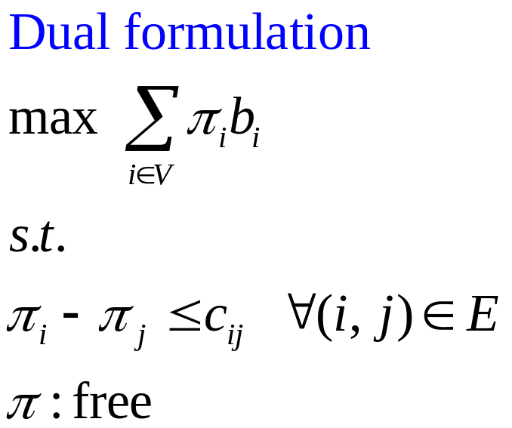
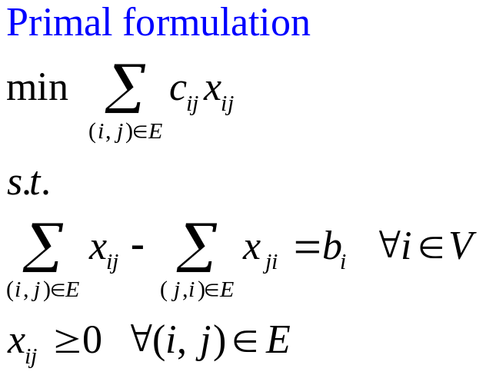
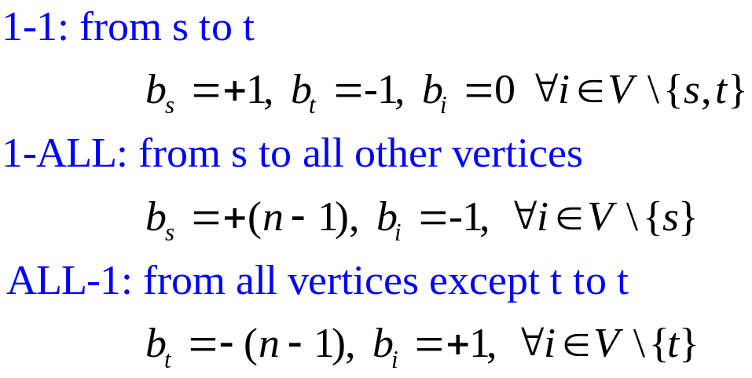
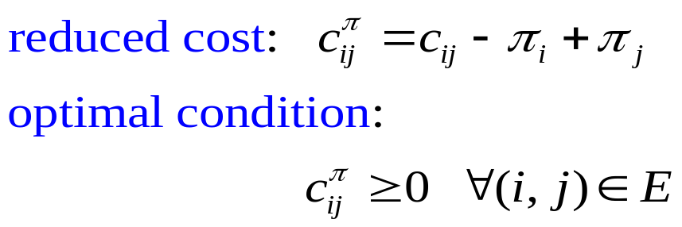
LP form for SSSP Problems
4.3: Shortest Paths and Distance

Slide 23
Dijkstra’s Algorithm
Only valid for graphs with nonnegative edge length
1-ALL: from s to all other vertices
begin
initialization: S= ∅; S^{c}=V;
d[i]=∞, pred[i]=NULL for each i in V
d[s]=0, pred[s]=NULL;
while |S|<n do
choose i from S^{c} such that d[i]=min{d[j]: j in S^{c}};
S=S∪{i}; S^{c}= S^{c}\{i};
for each (i,j) in E[i] do
if d[j]>d[i]+c_{ij} then
d[j]=d[i]+c_{ij}; pred[j]=i;
end for
end while
end
Vertex Selection
select a vertex i to scan
then vertex i becomes
permanently labeled
Outgoing edge list
Scan edge (i,j)
Distance Updating
(triple comparison)
4.3: Shortest Paths and Distance

Slide 24
Example of Dijkstra’s Algorithm
3 [s]
∞ [-]
2 [B]
4 [B]
Choose B
S={s,B}
S^{c}={A,C,D,E}
Scan (B,A),(B,C),(B,D)
2
A
2
C
A
C
3
Choose s
S={s}
S^{c}={A,B,C,D,E}
Scan (s,A), (s,B)
3
0 [-]
3
∞ [-]
0 [-]
3
∞ [-]
s
1
3
1
E
s
1
3
1
E
1
1
1
1
5
B
5
B
D
D
1 [s]
∞ [-]
1 [s]
6 [B]
2 [B]
4 [B]
2 [B]
4 [B]
Choose C
S={s,B,A,C}
S^{c}={D,E}
Scan (C,D),(C,E)
2
C
Choose A
S={s,B,A}
S^{c}={C,D,E}
Scan (A,C)
A
2
C
A
3
3
0 [-]
3
∞ [-]
0 [-]
3
7 [C]
s
1
3
1
E
s
1
3
1
E
1
1
1
1
5
B
5
B
D
D
1 [s]
6 [B]
1 [s]
5 [C]
2 [B]
4 [B]
2 [B]
4 [B]
Choose D
S={s,B,A,C,D,E}
S^{c}=∅
DONE!!
2
C
Choose D
S={s,B,A,C,D}
S^{c}={E}
Scan (D,E)
A
2
C
A
3
3
0 [-]
3
6 [D]
0 [-]
3
6 [D]
s
1
3
1
E
s
1
3
1
E
1
1
1
1
5
5
B
D
B
D
1 [s]
5 [C]
1 [s]
5 [C]
4.3: Shortest Paths and Distance

Slide 25
Binary Min-Heap
Priority queue: any data structure that supports the operations of search min, insert, and delete min (or max)
Heap: a min heap is a complete binary tree with the property that the value at each vertex is ≦ the values at its children
Suppose there are n elements in the heap:
Search min: O(1) (i.e. the toppest vertex)
Insert an element: O(log n)
put the new element to the last vertex, then compare with its ancestors, swap parents/children when necessary
Delete min: O(log n)
delete the toppest vertex, put the last vertex to be the toppest, then compare with its descendants, swap parents/children when necessary
4.3: Shortest Paths and Distance

Slide 26
More about Binary Heap
Why is the depth of a binary tree “log n” for a tree of n vertices?
Since we keep “balanced” binary tree, suppose there are n vertices in the binary tree,
Graphical illustration of inserting & deleting an element in min-heap
5
5
5
5
5
2
11
120
11
120
11
20
11
20
11
2
11
5
40
100
40
100
20
40
100
120
40
100
120
2
40
100
120
20
40
100
120
20
Original min-heap
Insert a new element 20
Insert a new element 2
20
5
5
5
3
11
5
11
5
11
20
11
20
3
20
5
20
40
100
120
20
40
100
120
40
100
120
40
3
120
40
11
120
40
11
120
Delete an element 2
Change element 100 to be 3
4.3: Shortest Paths and Distance

Slide 27
Complexity of Dijkstra’s Algorithm
Scan vertex i:
scan all the outgoing edges (i,j) connecting vertex i (i.e. edges in E[i])
after i is scanned, we say i is permanently labeled
Once a vertex is permanently labeled, its distance label is set and won’t be changed.
Scan edge (i,j): check whether d[j]>d[i]+c_{ij} or not
if yes then update distance label of vertex j
d[j]= d[i]+c_{ij}; pred[j]=i;
Two major operations:
Vertex Selection: each vertex is selected to be scanned exactly once
however, effort to choose the vertex with minimal distance label:
by linear search: |V|+|V-1|+|V-2|+…+1= O(|V|²)
by binary heap: O(|V|log|V|)
Distance Updating: each outgoing edge is scanned exactly once
i.e. total # of edge scanning operations= |E|
using binary heap: after each updating, need to resort the data structure,
each sorting takes O(log|V|), so totally takes O(|E|log|V|)
Complexity: O(|V|²+|E|) , or O((|V|+|E|)log|V|)
There are many other variants of Dijkstra’s algorithm. Most of them use different techniques to do the vertex selection.
4.3: Shortest Paths and Distance

Slide 28
Other Implementations of Dijkstra’s algorithm
Variants of Dijkstra’s algorithm:
Dial’s bucket implementation (for integral edge length)
nC+1 unit-length buckets to store temporarily labeled vertices (C=max{c_{ij}})
bucket k stores vertices with distance label k (using doubly linked list)
idea: 1. choose the 1st nonempty bucket;
2. scan all vertices in the bucket one by one;
3. redistribute vertices into new buckets if their distance labels are
decreased;
e.g. In iteration 5, d[E]=9 (i.e. put vertex E in the bucket 9), if d[E]
becomes 7
in iteration 7, we have to move vertex E from bucket 9 to bucket 7
4. remove any scanned vertices;
5. then choose the next nonempty bucket, repeat steps 1~4 until
all buckets are checked
Complexity: O(m+nC)
Radix Heap implementation
more complicated data structure (not covered in this course)
Bucket
Distance label
….
0
1
2
3
4
5
6
7
….
4.3: Shortest Paths and Distance

Slide 29
Binary Heap & Dial’s implementation-1
3 [s]
∞ [-]
Binary min-heap: parent.key ≦ child.key
key: distance label
A
2
C
Choose s
S={s}
S^{c}={A,B,C,D,E}
Scan (s,A), (s,B)
3
3
∞ [-]
0 [-]
0
3
3
1
s
1
3
1
E
1
1
--
--
--
--
1
--
3
--
B
5
D
Bucket
Distance label
s | B |  | A
1 [s]
∞ [-]
4 [B]
0 | 1 | 2 | 3 | 4 | 5 | 6 | 7
2 [B]
2
Choose B
S={s,B}
S^{c}={A,C,D,E}
Scan (B,A),(B,C),(B,D)
A
C
3
3
2
2
0 [-]
3
∞ [-]
s
1
3
1
E
--
--
--
--
4
6
1
1
B
5
Bucket
Distance label
 |  | A |  | C |  | D
D
1 [s]
6 [B]
0 | 1 | 2 | 3 | 4 | 5 | 6 | 7
2 [B]
4 [B]
Choose A
S={s,B,A}
S^{c}={C,D,E}
Scan (A,C)
A
2
C
6
4
3
3
∞ [-]
0 [-]
4
--
6
--
s
1
3
1
E
1
1
Bucket
Distance label
 |  |  |  | C |  | D
5
B
D
0 | 1 | 2 | 3 | 4 | 5 | 6 | 7
1 [s]
6 [B]
4.3: Shortest Paths and Distance

Slide 30
Binary Heap & Dial’s implementation-2
2 [B]
4 [B]
Binary min-heap: parent.key ≦ child.key
2
C
Choose C
S={s,B,A,C}
S^{c}={D,E}
Scan (C,D),(C,E)
A
3
0 [-]
3
7 [C]
6
5
3
E
5
s
1
1
1
1
--
--
--
--
7
--
B
5
D
Bucket
Distance label
 |  |  |  |  | D |  | E
1 [s]
5 [C]
2 [B]
4 [B]
0 | 1 | 2 | 3 | 4 | 5 | 6 | 7
2
C
Choose D
S={s,B,A,C,D}
S^{c}={E}
Scan (D,E)
A
3
7
6
0 [-]
3
6 [D]
s
1
3
1
E
--
--
--
--
1
1
Bucket
Distance label
 |  |  |  |  |  | E
5
B
D
1 [s]
5 [C]
0 | 1 | 2 | 3 | 4 | 5 | 6 | 7
2 [B]
4 [B]
Choose D
S={s,B,A,C,D,E}
S^{c}=∅
DONE!!
A
2
C
--
Trace Paths
s-B-A
s-B
s-B-C
s-B-C-D
s-B-C-D-E
3
3
6 [D]
0 [-]
--
--
s
1
3
1
E
1
Bucket
Distance label
5
1
B
D
0 | 1 | 2 | 3 | 4 | 5 | 6 | 7
1 [s]
5 [C]
4.3: Shortest Paths and Distance

Slide 31
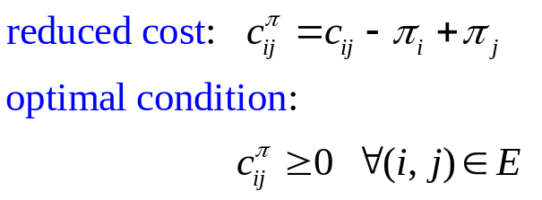
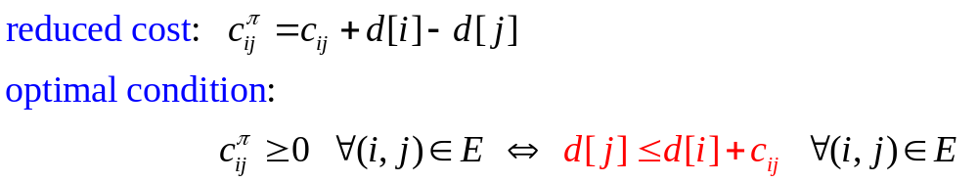
Triple Comparisons
Distance Updating:
when we scan vertex i, we check each outgoing edges (i,j) as follows:
if d[j]>d[i]+c_{ij} then
d[j]=d[i]+c_{ij}; pred[j]=i;
such an operation is called a “triple comparison”
Remember in the dual form of SSSP
By defining d[i]=-π_{i}, the above become
Thus, triple comparison is an operation to achieve the LP optimal condition.
All Shortest Path algorithms perform sequences of triple comparisons.
d[i]
i
c_{ij}
d[j]
s
j
4.3: Shortest Paths and Distance

Slide 32
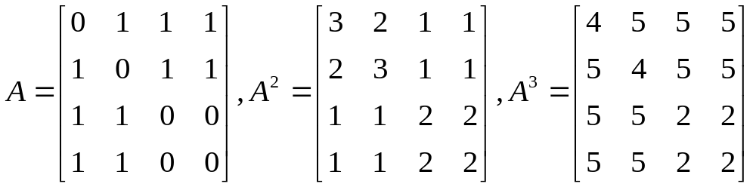
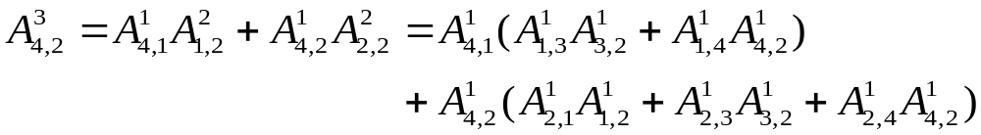
Number of Paths
How many paths of p edges between 2 specific vertices?
Thm 4.7 Given a graph G with vertices V, edges E
the # paths of p edges from vertex i to vertex j is the (i,j)^{th} entry of A^{p},
where A is the adjacency matrix
Ex:
Paths of 3 edges from 3 to 4: 3-1-2-4, 3-2-1-4
Paths of 3 edges from 4 to 2: 4-1-3-2, 4-1-4-2, 4-2-1-2, 4-2-3-2, 4-2-4-2
1
2
3
4
4.3: Shortest Paths and Distance

Slide 33
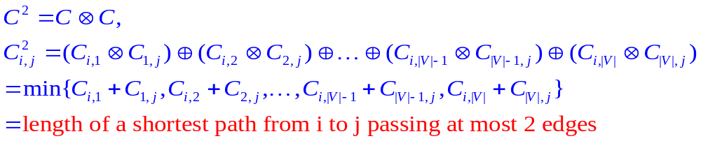
Path Algebra
Path algebra: an ordered semiring
with 2 binary operations defined as
Measure matrix: C, where C_{ij} represents the length of edge (i,j)
C_{ii} =0 for all i; C_{ij}=∞ , if there exists no edge (i,j)
 | Generalized addition | Generalized multiplication | Unit element | Null element
Original sense | a ⊕ b | a ⊗ b | e | 0
Path algebra | min{a,b} | a+b | 0 | ∞
|V| addition
|V|-1 comparison
4.3: Shortest Paths and Distance

Slide 34
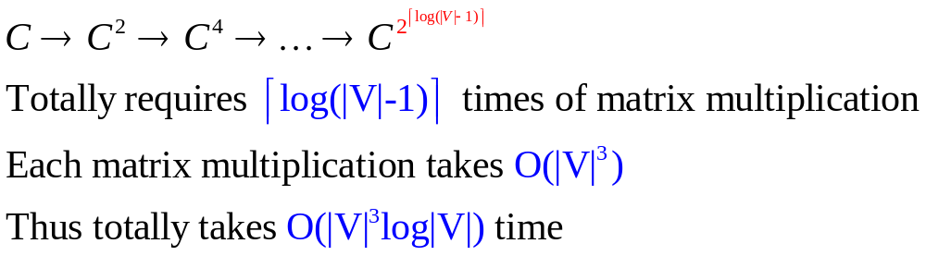
Compute APSP by C^{|V|-1}
Every simple path between 2 vertices at most contains |V|-1 edges
Thus
By computing matrix C^{|V|-1}, we can obtain ALL-ALL shortest paths
How to efficiently compute C^{|V|-1}?
There are many fast-matrix-multiplication techniques that can be used to improve this complexity, but such algorithms are complicated.
O(|V|²*|V|) since there are
|V|² entries, each takes O(|V|)
4.3: Shortest Paths and Distance

Slide 35
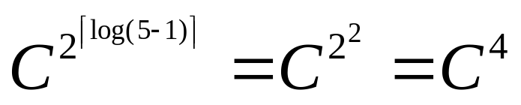
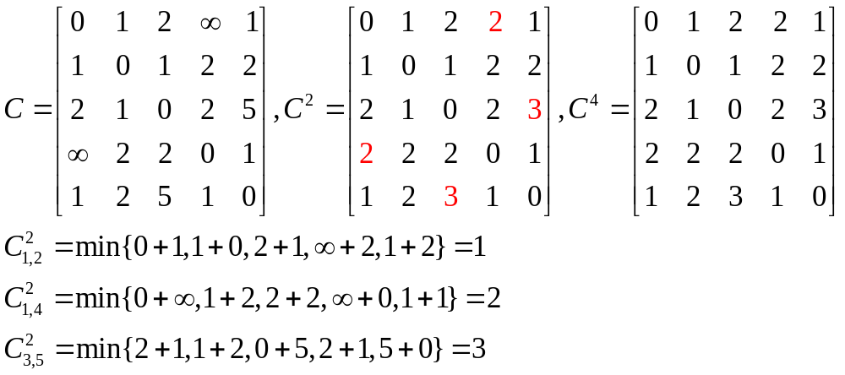
Example of Matrix Multiplication
2
3
2
1
1
5
4
2
1
1
1
2
2
5
4.3: Shortest Paths and Distance

Slide 36
Floyd-Warshall Algorithm
Let D be a n×n distance matrix, whose entry D_{ij} is initially set to be C
final D_{ij} denotes the length of the shortest path from i to j
PRED be a n×n predecessor matrix, whose entry PRED_{ij} is initially set to be i
final PRED_{ij} denotes the predecessor of j on the path from i to j
Triple comparison : d_{ij}=min{d_{ij}, d_{ik}+d_{kj}}
Claim:
if we perform triple comparisons for successive k=1,2,…,|V|
then the final d_{ij} equals the length of the shortest path from i to j
Floyd-Warshall Algorithm is based on the above claim
begin
initialization: D:=C; PRED_{ij}:=i for each (i,j);
for k=1 to |V| do
for i=1 to |V| do
for j=1 to |V| do
if d_{ij}>d_{ik}+d_{kj} then
d_{ij}=dik +d_{kj}; PRED_{ij}=PREDkj ;
end
4.3: Shortest Paths and Distance

Slide 37
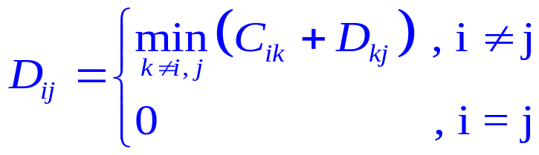
Properties of Floyd-Warshall Algorithm
Let D_{ij}^{k} denote the entry D_{ij} after the k^{th} iteration of Floyd-Warshall algorithm
D_{ij}^{k} is the length of shortest path from i to j with intermediate vertices in {1,2,…,k-1,k}
Totally O(|V|³) operations, most efficient for complete graph
Detect negative cycle: if D_{ii}^{k}<0, there exists a negative cycle from i to i with k edges
Dynamic Programming:
Bellman’s Equation:
D = C ⊗D ⊕ I_{n}
Floyd-Warshall algorithm ⬄ Gauss Jordan method
D_{kj}
i
k
j
4.3: Shortest Paths and Distance

Slide 38
Example of APSP problems
2
3
2
D_{k}: distance matrix after the k^{th} iteration
PRED_{k}: predecessor matrix after the k^{th} iteration
After the |V|-1th iteration, the last column & row are already optimal
1
1
5
4
2
1
1
1
2
2
5
D¹
D²
D³
D⁴
D⁵
0
1
2
∞
1
0
1
2
3
1
0
1
2
3
1
0
1
2
3
1
0
1
2
2
1
1
0
1
2
2
1
0
1
2
2
1
0
1
2
2
1
0
1
2
2
1
0
1
2
2
2
1
0
2
3
2
1
0
2
3
2
1
0
2
3
2
1
0
2
3
2
1
0
2
3
∞
2
2
0
1
3
2
2
0
1
3
2
2
0
1
3
2
2
0
1
2
2
2
0
1
1
2
3
1
0
1
2
3
1
0
1
2
3
1
0
1
2
3
1
0
1
2
3
1
0
PRED¹
PRED²
PRED³
PRED⁴
PRED⁵
1
1
1
1
1
1
1
1
2
1
1
1
1
2
1
1
1
1
2
1
1
1
1
5
1
2
2
2
2
2
2
2
2
2
2
2
2
2
2
2
2
2
2
2
2
2
2
2
2
2
3
3
3
3
1
3
3
3
3
1
3
3
3
3
1
3
3
3
3
1
3
3
3
3
1
4
4
4
4
4
2
4
4
4
4
2
4
4
4
4
2
4
4
4
4
5
4
4
4
4
5
5
1
5
5
5
5
1
5
5
5
5
1
5
5
5
5
1
5
5
5
5
1
5
5
4.3: Shortest Paths and Distance

Slide 39
Trace Shortest Paths by PRED matrix
2
3
2
PRED⁵
1
1
5
4
1
1
1
5
1
2
1
1
2
2
2
2
2
1
3
3
3
3
1
2
2
5
5
4
4
4
4
5
5
1
5
5
Trace_path(PRED,i,j)
begin
k=j;
output k;
while PRED_{ik} ≠ i do
k=PRED_{ik};
output k
end while
output i
end
trace path 1→4: i=1,j=4
k=j=4
output 4
Since PRED₁₄=5 ≠ 1
k= PRED₁₄=5
output 5
Since PRED₁₅=1 = 1
output 1
Thus we obtain 4←5←1 as the shortest path
4.3: Shortest Paths and Distance

Slide 40



Coloring a Graph
How many colors do we need to color each vertex such that its adjacent vertices have different color?
If we can color a graph with k colors, we say the graph is k-colorable
The smallest k for which the graph is k-colorable is called
the chromatic number of the graph, denoted by
E.g.
2
3
2
|V| vertices ➔ we can use |V| or more colors
Can we use fewer colors?
How to determine whether k colors are enough or not?
Can we do it efficiently?
1
1
5
4
2
1
1
1
2
2
5
4.4: Coloring a Graph

Slide 41
Colors on Even cycle, Odd cycle
Ex: Jim has 6 children: {A,B,C,D,E,F}. Among these 6 kids,
C fights with B,F,E; E fights (besides C) with A,D; A fights with B
How many rooms do Jim at least need to put all 6 kids so that there will be no fights inside each room?
Observation:
If G is k-colorable, then G is (k+1)-colorable
Isolated vertices are 1-colorable
Bipartite graphs are 2-colorable
A complete graph K_{n} has chromatic number n
A cycle of even # of vertices (even cycle) can be colored with 2 colors
An odd cycle can be colored with 3 colors
➔ if a graph contains odd cycles, then it can not be 2-colorable
A
B
C
At least 2 colors
➔ 2 rooms: {A,C,D}, {B,E,F}
E
D
F
4.4: Coloring a Graph

Slide 42
2-colorable Graphs
Thm 4.8
A graph G is 2-colorable iff it contains no odd cycle
Pf:➔: if a graph contains odd cycles, then it can not be 2-colorable (known already)
⬅: without loss of generality (w.l.o.g.), we assume G is connected (i.e. the discussion can be applied to any component of G).
Suppose G has no odd cycle. Choose any vertex s, apply BFS algorithm starting from s. Each vertex j will have a distance label d[j]. Let’s color all vertices with even distance label by red color, and blue color, otherwise. Now we want to show any adjacent vertices have different color by contradiction.
By the BFS algorithm, we know that for any adjacent vertices i and j,
|d[i]-d[j]| = 0 or 1. Suppose there exists an edge between 2 vertices, say, i & j, of the same color, which means i & j are adjacent and d[i]=d[j]. Using the predecessor info by the BFS algorithm, we can trace both the path backwards from i to s, and from j to s to identify the first common “ancestor” vertex W. Thus we identify a cycle from i to W to j with edges= (d[j]-d[W])+(d[i]-d[W])+1=2(d[j]-d[W])+1, which is odd.
This means, if color[i]=color[j], we will have an odd cycle →←
Therefore, using BFS algorithm to do the 2-coloring on a graph G that has no odd cycle, any adjacent vertices will have different color.
4.4: Coloring a Graph
Notes:
⬅
1.Apply BFS, give 2 colors
2.Show adj vertices have different colors
Pf: suppose not, thus there exists adjacent i, j with same color
claim: i&j adj➔|d[i]-d[j]|=0 or 1 (Pf: o.w. violating d[] is the shortest distance)
Since same color, d[i]&d[j] are either both odd or even, using above, we know d[i]=d[j]
Since d[i]=d[j], trace route will identify an odd cycle -><-
➔this also gives an O(m) to check whether a given graph contains odd cycle or not

Slide 43

Algorithms to find Chromatic number
There exists NO efficient algorithm to find the chromatic number for general graphs, except for the 2-colorable graphs.
The proof of Thm 4.8 gives a polynomial-time algorithm (i.e. BFS) to
Find a 2-coloring, if it exists
Find an odd cycle, if the 2-coloring does not exist
For general graphs, there are theorems to give upper bounds on
Thm 4.9 (by Brooks)
if every vertex of G has degree at most d, then G is (d+1)-colorable
Pf: Trivial if G has fewer than or equal to (d+1) vertices.
Suppose the thm holds for a graph G of k (>d+1) vertices. In a graph G with k+1 vertices, we can pick any vertex v, and construct a new graph G’ by deleting v and all its adjacent edges (at most d such edges) from G. By induction hypothesis, G’ is (d+1)-colorable. Thus we can use d+1 colors to color all of v’s neighbors. Since v has at most d neighbors, we can use d colors to color all of v’s neighbors, and color v by the remaining color. Therefore, G is still (d+1)-colorable. This completes the induction.
4.4: Coloring a Graph

Slide 44

More about Coloring
Observation:
if G contains a K_{p} subgraph, then G is not (p-1)-colorable
Q: if G does not contain a K_{p} subgraph, then G is (p-1)-colorable?
Chromatic number is graph isomorphism invariant
Coloring maps: there are countries on a planar map, adjacent countries must be colored by different colors. How many colors are enough?
country ⬄ vertex,
country i is adjacent to country j ⬄ draw an edge (i,j)
Four-Color Thm:
if G is a planar graph, then (i.e. at most 4)
Conjectured by Francis Guthrie in 1852, but verified by Kenneth Appel & Wolfgang Haken in 1976
False!
The graph in the left does not contain a K₄, but it is NOT 3-colorable
A graph without crossover edges
4.4: Coloring a Graph

Slide 45
Exercise on Graph Coloring
Ex1: suppose G is a graph with 3 vertices. How many ways are there to assign 3 colors to the vertices?
Ex2: show that if a graph with n vertices has chromatic number n, then the graph has n(n-1)/2 edges
3³
If not a K_{n}, remove any 2 nonadjacent vertices, the remaining graph is n-2 colorable
(since a graph of k nodes should be k-colorable);
then add these 2 vertices back with a new color, which make the chromatic number=n-1, -><-
4.4: Coloring a Graph
Notes:
ex

Slide 46
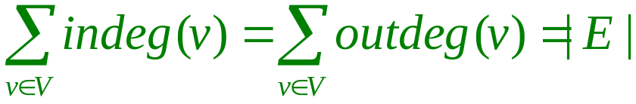
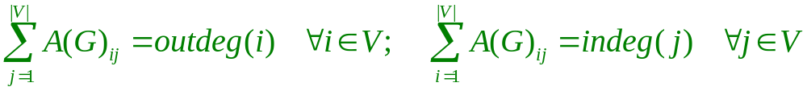
Directed Graphs
Directed graph (digraph): contains a finite nonempty set V and
a set E of ordered pairs of distinct elements of V.
Directed edge (i,j): an edge from vertex i to vertex j (not the other way)
Outdegree of vertex v: outdeg(v), # directed edges outgoing from v
Indegree of vertex v: indeg(v), # directed edges incoming to v
Thm 4.10 in a directed graph G=(V,E)
Adjacency matrix A(G) & Adjacency lists are defined as before
Thm 4.11 Let A(G)_{ij} denotes the (i,j)^{th} entry of A(G)
4.5: Directed Graphs and Multigraphs

Slide 47
Directed Multigraphs
Directed Multigraph: a Multigraph whose edges are directed
Thm 4.12
Every u-v directed path contains a u-v simple directed path
A directed multigraph is strongly connected if there exists a directed path from any vertex to any other vertex
Thm 4.13 For a connected directed multigraph G (with |V|≧2)
each vertex v in G has outdeg(v)=indeg(v) iff
G contains a directed Euler circuit
each vertex in G has outdeg(v)=indeg(v) except for 2 distinct vertices s & t where outdeg(s)=indeg(s)+1, indeg(t)=outdeg(t)+1 iff
G contains an directed Euler path from s to t
Connected, but NOT strongly connected
4.5: Directed Graphs and Multigraphs

Slide 48
Tournament
Tournament: a digraph T where for every 2 distinct vertices u and v of T, exactly one of (u,v), (v,u) is an edge
Score of v in a tournament: s(v)=outdeg(v)
Score sequence of T: list of outdegrees in nonincreasing order
Thm Every tourrnament has a directed Hamiltonian path
A tournament is transitive iff whenever (u,v) & (v,w) exists, then (u,w) also exists
Thm the following are equivalent
(1) T has a unique directed Hamiltonian path
(2) T is transitive
(3) Every player in T has a different score
Score: s(A)=3,s(B)=2,s(C)=2,s(D)=0,s(E)=3
Score sequence: 3,3,2,2,0
Round-robin competition in sport
A beats BCD, B beats DE, C beats BD, E beats ACD
find a ranking ➔ find a Hamiltonian path
EACBD is a directed Hamiltonian path
A
E
B
D
C
4.5: Directed Graphs and Multigraphs
Notes:
1.Single (double) round-robin tournament: every player plays with each other exactly once (twice)
2.If there is a directed cycle, the directed H.P. is not unique
Proof of Thm: why a tournament must have a directed H.P.
By induction. Suppose it’s true when |T|=n, where we can find a directed H.P., say, v_1-…-v_n
in the case of |T|=n+1, we select a vertex v_0
Case1: if v_o beats all v_k for k=1~n, then v_0-v_1-…-v_n is a directed H.P. done!
Case2: o.w. w.l.o.g., let v_1~v_i be the set of vertices with directed edge (v_k,v_0) for k=1,…,i,
Then v_1-…-v_i-v_0-v_i+1-…-v_n will be a directed H.P.

Slide 49
Exercises
p.211 example 4.40
p.213 ex.29,30,31,32
p.214 ex.32,34
p.215 ex.55
p.218 ex.76
Now, do the following new problem set:
5
4
1
5
Given the graph as left, use Dijkstra’s algorithm to compute
all the shortest paths starting from vertex s, also trace all
these shortest paths by the predecessors.
4
8
2
5
s
1
3
4
6
7
4
6
6
2
5
4.5: Directed Graphs and Multigraphs

