Slide 1
Trees
離 散 數 學
Contents:
Properties of Trees
Spanning Trees
Depth-First Search
Rooted Trees
Binary Trees and Traversals
Optimal Binary Trees and Binary Search Trees

Slide 2
Properties of Trees
Given a telecommunication network, how to use the minimum # of edges so that each vertex communicates with each other?
tree: a connected graph which contains no cycles
Thm 5.1
There is exactly one simple path from vertex U to vertex V in T
Pf: by contradiction (suppose not, then it contains a cycle)
Thm 5.2
In a tree T with more than one vertex, there are at least 2 vertices of degree 1 (these 2 vertices are called leaves)
Pf: Suppose not, then T contains 0 or 1 vertex of degree 1. That is, at least (n-1) nodes have degree ≥2, which means Sum(deg(i)) ≥ 2n or 2(n-1)+1}=2n-1.
Since a tree has n-1 edges, so Sum(deg(i)) = 2(n-1) < 2n-1 or 2n ≤ Sum(deg(i)) , →←
Thm 5.3 (modified) Suppose T is a connected graph with n vertices,
T is a tree iff T has exactly n-1 edges
Pf: → true for n=1, suppose true for n=k, check n=k+1, remove a leaf with its edge (such a leaf always exists by Thm5.2), ok by induction; add back leaf, done!
← suppose T contains a cycle which contains an edge (v₁,v₂), deleting such edge will still make T connected. Thus we keep deleting edges (say, totally deleting k edges, k>=1) on cycles until finally we obtain a connected graph without cycle, which is a tree, but with n-1-k<n-1 edges, contradiction
5.1: Properties of Trees
Notes:
Thm5.2: suppose not, the # vertices of degree=1 is either 0 or 1.
If it is 0, then we can start from a vertex, moving along edges such that no cycle happens. Finally we will encounter a visited vertex (since total # vertices is finite) which corresponds to a cycle.-><-
Use similar arguments for case where T has a vertex of deg=1.(start from that vertex of deg=1, then the remaining graph has been shown to contain a cycle -><-)
Thm5.3:
➔n=1, trivial; suppose true for n=k, then for n=k+1, remove the leaf with its edge (it must exist by Thm 5.2), ok (i.e. k-1 edges) by induction assumption, add back the leaf and its edge, so totally k edges, done!
⬅suppose not a tree, thus containing a cycle. Delete an edge in that cycle so the remaining graph contains n-1-1 edges, repeat the steps until no cycle but still connected, at that time it’s a tree but with less than n-1 edges, -><-

Slide 3

Properties of Trees
Thm 5.4
(a) removing any edge (but not vertex) from a tree T makes the resulting graph not connected and hence is not a tree
(b) adding a new edge (but not vertex) to a tree T makes the resulting graph contains a cycle and hence is not a tree
Pf: by Thm 5.3
Thm 5.5 the following statements are equivalent for a graph T
(a) T is a tree
(b) T is connected, |V(T)|=|E(T)|+1
(c) T has no cycles, |V(T)|=|E(T)|+1
(d) there is exactly one simple path between each pair of vertices in T
(e) T is connected, and the removal of any edge of T results in a
graph that is not connected
(f) T has no cycle, and the addition of any edge between 2
nonadjacent vertices results in a graph with a cycle
Pf: exercise
Ex1: can a tree with 13 vertices have 4 vertices of degree 3, 3 vertices of degree 4, and 6 vertices of degree 1?
Ex2: for a tree T of n vertices, how many distinct paths does T have?
No!
5.1: Properties of Trees
Notes:
n=13, m=13-1=12
4*3+3*4+6*1=2m, m=15!=12 -><-

Slide 4
Spanning Trees
Spanning tree of G: a subgraph of G which is a tree containing all the vertices of G
If G is a tree, then its spanning tree is itself
A graph may have more than one spanning tree
There are many ways to generate a spanning tree, e.g. BFS algorithm (why?)
Thm 5.6
A graph G is connected iff it has a spanning tree T
Pf: ← the spanning tree T is a subgraph of G. By definition of spanning tree, T is connected, so, G is connected
→ by BFS algorithm
Weighted graph: a graph where each edge (i,j) has a weight w_{ij}
Weight of a tree: sum of all the weights of the edge in the tree
Minimum spanning tree: a spanning tree of least weight
Maximum spanning tree: a spanning tree of largest weight
Algorithms to compute minimum spanning tree:
Prim’s algorithm: selecting best edges to grow a tree (stay connected)
Kruskal’s algorithm: selecting best edges as long as no cycle (merge components)
5.2: Spanning Trees

Slide 5
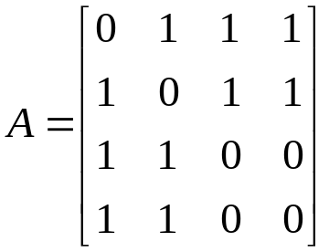
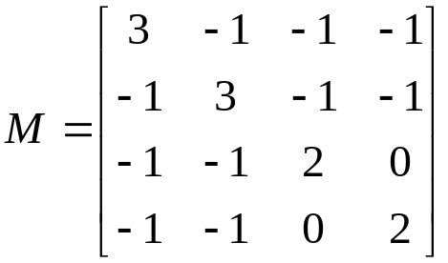
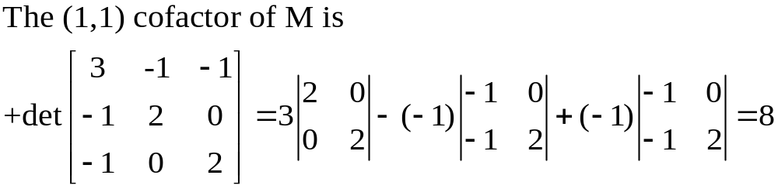
Number of Spanning Trees
How many spanning trees does a connected graph have?
Thm By Gustav Kirchhoff in 1847
Let M be the matrix obtained from the adjacency matrix of a connected graph G by changing all 1’s to -1’s, and each diagonal 0 to the degree of the corresponding vertex. Then the # of spanning trees of G is equal to the value of any cofactor of M
Ex.: suppose an adjacency matrix
Thm for a complete graph of n vertices
The number of labeled spanning trees with n vertices is n^{n-2}
5.2: Spanning Trees

Slide 6

Minimum Spanning Trees
Minimum spanning tree problems (MST) are usually for undirected graphs
How to obtain a spanning tree whose weights is the minimum of all spanning trees?
➔ enumeration takes O(n^{n}) which is too inefficient!
Forest: a graph having NO circuit (i.e. a collection of node-disjoint trees)
Cut: An edge set denoted as
Optimality condition: the followings are equivalent, suppose T* is a spanning tree of G
T* is a MST
For every nontree edge (k,l), c_{kl}≧c_{ij} for every tree edge (i,j) on the unique path from k to l in T* (Prim)
For every tree edge (i,j) in T*, suppose deleting (i,j) in T* forms a cut [S,S^{c}],
we have c_{ij}≦c_{kl} for every nontree edge (k,l) in the cut [S,S^{c}] of G (Kruskal)
S
S^{c}
Tree edge: red solid line
Nontree edge: black dashed line
S
S^{c}
B
A
C
D
H
i
j
E
G
k
l
F
5.2: Spanning Trees
Notes:
Optimality conditioin
(b) Stay connected → prim
(c) Choose best edge in a cut → kruskal
o.w. (k.l) in T will make a smaller weighting

Slide 7
Prim’s Algorithm
It grows an MST by adding new edges to a connected tree (subgraph)
begin
initialization: T= ∅ ; LIST= ∅
arbitrarily select a vertex u, add u in LIST;
while there exists edge (i,j) where i in LIST, j in V\LIST do
among all such edges, choose the one (k,k’) with least weight
T=T∪(k,k’);
LIST=LIST∪{k’};
end while
if |LIST|<|V| then
the graph is not connected, thus it has no minimum spanning tree
else
T is the minimum spanning tree
end
Each iteration
identifies an
MST edge
Edge selection:
Such a selection guarantees no cycle
it is a greedy algorithm
Total # iterations: O(|V|) Each iteration: edge selection takes O(|E|) comparison
Complexity: O(|V||E|) or O(|V|³) it can be improved by heaps
5.2: Spanning Trees
Notes:
Using heaps:
Maintain V\LIST as a min-heap with key equal to infinity or c_ij for each vertex j in V\LIST adjacent to each vertex i in LIST
Time= Time(V times of extract-min) + Time(E times of update key)
=VlogV+ElogV=ElogV

Slide 8
Example of Prim’s Algorithm
A
A
A
2
2
2
5
B
5
5
B
5
5
B
5
3
6
3
6
3
6
4
4
4
C
C
2
C
2
2
2
2
2
D
1
E
D
1
E
D
1
E
Cut: [LIST,LIST^{c}] where
LIST={D},LIST^{c}={A,B,C,E}
Choose edge (D,E), T={(D,E)}, LIST={D,E}
Choose edge (D,C), T={(D,E),(D,C)},
LIST={D,E,C}
A
A
A
2
2
2
5
B
5
5
B
5
5
B
5
3
6
3
6
3
6
4
4
4
C
C
C
2
2
2
2
2
2
D
1
E
D
1
E
D
1
E
Choose edge (D,B),
T={(D,E),(D,C),(D,B)},
LIST={D,E,C,B}
Choose edge (B,A),
T={(D,E),(D,C),(D,B),(B,A)},
LIST={D,E,C,B,A}, Done!
Another minimum spanning tree
5.2: Spanning Trees

Slide 9
Correctness of Prim’s Algorithm
Show Prim’s algorithm will correctly give a minimum spanning tree for graph G
Pf: try to show that each step of Prim’s algorithm gives a tree T which is a subgraph of some minimum spanning tree T_{m}
when |T|=0, it’s true.(why?) Suppose the statement is also true for |T|=r. That is, T is a subgraph of T_{m}. Now, in the next step, the algorithm identifies an edge (k,k’) where k is in LIST, but k’ is not, and c_{kk’}≦c_{st} for any edge (s,t) where s is in LIST, but t is not.
Let T’=T∪{(k,k’)}. If T’ is a subgraph of T_{m}, then we are done. If T’ is not a subgraph of T_{m}, then there must exist a path in T_{m} from k to k’ which contains an edge (f,g) where f is in LIST, but g is not. (why?).
By Prim’s algorithm, we know c_{kk’}≦c_{fg} , thus, for the new spanning tree T_{m”} =T_{m}∪{(k,k’)}\{(f,g)}, the weight of T_{m”} ≦the weight of T_{m}. Since T_{m} is already a minimum spanning tree, T_{m”} must also be a minimum spanning tree with the same weights. Thus T’ is a subgraph of another minimum spanning tree T_{m”} .
By math induction, we are done.
5.2: Spanning Trees
Notes:
|T|=o means T is an empty set which is of course a subset of any tree T including Tm.

Slide 10
Kruskal’s Algorithm (simplified)
It grows an MST by adding best edges as long as the subgraph contains no cycle
begin
initialization: T= ∅ ; S=E;
while |T|<|V|-1 and S≠ ∅ do
select an edge (k,k’) = arg min{c_{ij}: (i,j) in S,
i & j in different components};
T=T∪(k,k’);
S=S\{(k,k’)};
end while
if |T|<|V|-1 then
the graph is not connected, thus it has no minimum spanning tree
else
T is the minimum spanning tree
end
Requires a sorting preprocessing
Each iteration
identifies a
MST edge
Edge selection:
Such a selection guarantees no cycle
it is a greedy algorithm
Merge 2 components
Preprocess: sort edge length in nondecreasing order: O(|E|²) or O(|E|log|E|)
Total # iterations: O(|V|) if G is connected, or O(|E|) if G is not connected
Q: How to detect whether 2 vertices belong to the same components?Merge components?
5.2: Spanning Trees

Slide 11
Kruskal’s Algorithm (detailed)
IC[i]: Index of the component containing vertex i
NC[i]: Size of the component containing vertex i
begin (assume G is connected, and vertex is numbered from 1 to |V|)
initialization: T= ∅ ; S=E; IC[i]=i, NC[i]=1 for each vertex i in V;
sort edges in S by nondecreasing order of length
while |T|<|V|-1 do
while the 1st edge (k,k’) from S has IC[k]=IC[k’] do
S=S\{(k,k’)};
end while
T=T∪(k,k’); S=S\{(k,k’)};
if NC[k]≦NC[k’] then
for each vertex i with IC[i]=IC[k] or IC[i]=IC[k’] do
IC[i]=IC[k’]; NC[i]=NC[k]+NC[k’];
else
for each vertex i with IC[i]=IC[k] or IC[i]=IC[k’] do
IC[i]=IC[k]; NC[i]=NC[k]+NC[k’];
end while
end
Edge selection:
When this while loop is stopped, we have
identified (k,k’) with IC[k]≠IC[k’]
Each iteration
identifies a
MST edge
Merge 2 components
5.2: Spanning Trees

Slide 12
Example of Kruskal’s Algorithm
1
1
1
2
2
2
5
2
5
5
2
5
5
2
5
3
6
3
6
3
6
4
4
4
3
3
2
3
2
2
2
2
2
4
1
5
4
1
5
4
1
5
Sort edge length in nondecreasing order:
(4,5),(4,3),(3,5),(1,2),(2,4),(2,5),(1,4),(1,5)
Choose edge (4,5), T={(4,5)},
IC[4]=IC[5]=5, NC[5]=2
Choose edge (4,3), T={(4,5),(4,3)},
IC[3]=IC[4]=5, NC[5]=3
1
1
1
2
2
2
5
2
5
5
2
5
5
2
5
3
6
3
6
3
6
4
4
4
3
3
3
2
2
2
2
2
2
4
1
5
4
1
5
4
1
5
Skip (3,5) since IC[3]=IC[5]=5
Choose edge (1,2), T={(4,5),(4,3),(1,2)},
IC[1]=IC[2]=2, NC[2]=2
Choose edge (2,4),
T={(4,5),(4,3),(1,2),(2,4)}, |T|=4
IC[1]=IC[2]=IC[4]=5, NC[5]=5, Done!
Another minimum spanning tree
5.2: Spanning Trees

Slide 13
Complexity of Kruskal’s Algorithm
Let COMP[v] denote the set of vertices of the component containing vertex y
|COMP[v]| denote the size of the component (i.e. # vertices in COMP[v])
Preprocess: sorting edge length takes O(|E|²) or O(|E|log|E|)
Time spent on verifying whether adding an edge will create a cycle or not:
In any iteration, once the 1st edge in S, say, (i,j), is selected to verify whether both
i & j are in the same component or not, (i,j) will not be selected any more
➔ overall, each edge is verified at most once,
thus totally O(|E|) for verifying whether adding an edge will create a cycle
Time spent on merging components and relabeling:
When (i,j) is selected to merge 2 components, say, COMP[i] & COMP[j], w.l.o.g., assume NC[i]≦NC[j]. Then the new merged component, COMP’, will have size |COMP’|≧2*NC[i]
➔ each merger makes the new component at least twice as large as the smaller one.
So suppose a vertex is relabled t times, then 2^{t}≦|V|
thus for each vertex, there are at most log|V| times of relabeling
There are totally |V| vertices, so the total # of relabeling is O(|V|log|V|)
➔ Thus the algorithm spent O(|V| log|V|) in merging components and relabeling
Therefore, this implementation of Kruskal’s algorithm takes O(|E|log|E|+|E|+|V|log|V|) time, which is about O(|E|log|E|).
5.2: Spanning Trees

Slide 14

Depth-First Search
To find out all the vertices that are reachable from a specific vertex (source), say, s
order[v] : depth-first search numbering, the order of being visited for vertex v by the DFS algorithm
begin
initialization: Set order[v]=0 for each v in V; k=0; LIST= ∅
k=1; order[s]=k; pred[s]=NULL;
add s in LIST;
while LIST is not empty do
select a vertex i from LIST;
if there exists edge (i,j) with order[j]=0 then
k=k+1;
order[j]=k; pred[j]=i;
add j into LIST;
else (i is exhausted, i.e. for i, every (i,j) in E has been checked)
remove i from LIST;
end while
end
LIST is a stack
(LIFO or FILO)
Vertex Selection (not removal)
Scan each edge (i,j)
from vertex i
Backtrack, go up 1 level
scan edges from pred[i]
5.3: Depth-First Search

Slide 15
Complexity of Depth-First Search
Exhausted vertex:
when we have scanned all edges (i,j) for vertex i, we say vertex i is exhausted
Scan edge (i,j): when order[i]=k, check whether order[j]=0 or not
if order[j]=0 then update the order label of vertex j by
order[j]=k+1; pred[j]=i; add j into LIST;
else order[j]>0 (i.e. j has been visited)
go to scan next edge (i,j)
Two major operations:
Vertex Selection: each vertex enters LIST at most once. once vertex i is “exhausted”, we no longer need to scan any edge (i,j) from i
i.e. total # of vertex selection=|V|
Edge Scanning: each edge is scanned at most once
i.e. total # of edge scanning operations=|E|
Complexity: O(|V|+|E|)=O(|E|)
Connectivity: after DFS, if there is any vertex i with order[i]=0 ➔ not connected
A DFS search tree, which connects every vertex of the same component, can be constructed by pred[] . A non-tree edge is called a back edge
5.3: Depth-First Search

Slide 16
Example of DFS Algorithm
2 [s]
4 [B]
1
A
C
6 [D]
2
9
10
13
s
E
1 [-]
3
5
8
11
12
14
B
D
3 [A]
5 [C]
4
6
7
15
Example 5.16
Example 5.17
Thm 5.7 apply DFS algorithm on a graph G
(a) The edges scanned by DFS form a tree (DFS tree)
(b) If G is connected, the tree is a spanning tree
5.3: Depth-First Search

Slide 17
Bridge & Strong Connectivity-1
Strongly connected (di)graph:
there exists a (directed) path from any vertex to any other vertex
A graph has a strongly connected orientation if it is possible to assign a direction to each edge such that the resulting digraph is strongly connected.
e.g. one-way street
Bridge (or cut edge) of a connected graph G:
an edge e such that G\{e} is not connected
How to detect a bridge for a given G?
by DFS (or BFS, or MST), the bridge must be on the spanning tree
then check each tree edge by deleting it and check connectivity of resulting graph
How to know a given G has a strongly connected orientation?
Thm
(a) G has a strongly connected orientation iff G is connected and has no bridge
(b) if G has a strongly connected orientation,
then each edge of G must be part of a circuit
5.3: Depth-First Search
Notes:
Time to detect a bridge: O(m)+O(m^2) where O(m) for first DFS, and then for each edge we remove it and run a DFS (thus O(m^2))

Slide 18
Bridge & Strong Connectivity-2
How to assign “strongly connected orientations” to edges of a given G that is known to be connected and contain no bridge?
Method 1: constructing directed circuits C₁,C₂,…C_{k} until all edges are covered
After constructing C_{i} , if there exists vertex u not in some circuit yet, but is adjacent to some vertex v of C_{i} , then we construct circuit C_{i+1} which contains edge (u,v).
If C_{i+1} overlaps with circuit C_{i}, we keep the orientation of those overlapped edges in C_{i}
Method 2: Apply DFS.
For edges in DFS-tree, assign direction from lower indexed vertex to higher one
For non-tree edges, assign direction from higher indexed vertex to lower one
Thm 5.8 G is connected and has no bridge
assign direction to edges of G by Method 2, the resulting digraph is strongly connected
Pf: (to show there exists directed path from any vertex k’ to 1, by math induction)
key: 1. there is NO bridge!
2. when DFS backtracks at vertex k, it means all vertices reachable from k
have already been visited (thus labeled)
1
6
1
6
5
5
2
By Method 1
By Method 2
3
4
2
3
4
5.3: Depth-First Search
Notes:
Show Thm5.8:
Suppose there is a directed path between 1 and k
Trivial when k=1, suppose it’s true for all l such that 1<=l<k
Suppose DFS label l immediately before k (so l<k), it’s trivial that there exists a path from 1 to k (i.e. 1->l plus (l,k))
To show: there exists a path from k to 1
Case 1: DFS starts backtracking immediately after labeling k
Observation(1): all vertices adjacent to k have already been labeled (i.e. their labels<k) why?
Observation(2):

Slide 19
Proof of Thm 5.8
k’+s’
It suffices to show that there is a directed path from 1 to k and vice versa for all k
Trivial when k=1, suppose it’s true for k=1,2,..,k’-1
Suppose DFS label t’ immediately before k’ (so t’=k’-1),
it’s trivial that there exists a path from 1 to k’ (i.e. 1→t’ plus (t’,k’))
To show: there exists a directed path from k’ to some t with 1≦t<k’
Case 1: DFS starts backtracking immediately after labeling k’
Observation (a): all vertices adjacent to k’, if exist, have already been labeled (with labels<k’)
why? Suppose not, then DFS will go to label that adjacent unlabeled vertex with label=k’+1,
and then there will be NO backtracking at k’ at all! →←
Observation (b): there must exist some vertex t₁ adjacent to k’ with 1≦t₁<k’
why? O.W. (t’,k’) is a bridge →←
Thus there must exist a nontree edge (k’,t₁) where t₁<k’, and (k’,t₁) plus t₁→1 is a path from k’ to 1
Case 2: DFS continues after labeling k’, k’+1,…until all vertices reachable from k’ are labeled, let the last labeled vertex be k’+s
Observation (c): there must exist a vertex t₂<k’ adjacent to some vertex in the set {k’,k’+1,…,k’+s}
why? Suppose not, then the path in G from k’+s to t’ must pass (k’,t’), i.e. (k’,t’) is a bridge →←
Thus there must exist a nontree edge (k’+s’,t₂) where t₂<k’, s’≦s, and k’→k’+s’ plus (k’+s’,t₂) and t₂→1 is a path from k’ to 1
By Observation (a)(b)(c), we conclude there exists a directed path from k’ to 1, DONE!
k’+s
t’
k’
t₂
t₁
2
1
5.3: Depth-First Search
Notes:
Goal: find a path from k’ to 1 (case1: find an arc from k’ to t_1; case2: find an arc from k’+s’ to t_2; these 2 cases both guarantee a path from k’ to 1.)

Slide 20
Rooted Trees
Rooted Tree: a digraph T satisfying
(1) when ignoring the directions of edges in T, the resulting graph is a tree
(2) T has a unique vertex r whose indeg=0, and all other vertices have indeg=1
r is called the root of T
Thm 5.9 in a rooted tree T=(V,E)
(a) |V|=|E|+1
(b) T contains NO directed cycles
(c) there is a unique simple directed path from the root to every other vertex
If there exists a directed edge (u,v), then u is a parent of v, and v is a child of u
All vertices on the unique simple directed path from root r to u in T are ancestors of u
All vertices reachable from u in T are descendents of u
All the descendents of u forms a subtree rooted at u
All the vertices with a common parent are siblings
A terminal vertex (leaf) in T is a vertex with no children
A vertex that is not a leaf in T is an internal (branch) vertex
Thm 5.10
DFS tree forms a rooted tree, if the direction on each tree edge is assigned from the lower indexed vertex to the higher one (so does BFS tree)
1
2
9
10
13
3
5
8
11
12
14
4
6
7
15
5.4: Rooted Trees

Slide 21
Binary Trees & Traversals
Binary Tree: a rooted tree T where each vertex has at most 2 children (left & right child)
Left (right) subtree of u: a subtree rooted at the left (right) child of u in a binary tree T
Expression tree: a binary tree with operations as internal vertices, operands as leaves
Example 5.25, 5.26, 5.27
Traversal: search procedure that visits each vertex of a graph exactly once
e.g. BFS, DFS, each vertex is labeled exactly once
Traversal of a binary tree:
Preorder Traversal: parent → left child → right child
  Prefix form (Polish notation): a preorder listing on an expression tree
  Root will be firstly labeled
Postorder Traversal: left child → right child → parent
  Postfix form (reverse Polish notation): a postorder listing on an expression tree
  Root will be lastly labeled
Inorder Traversal: left child → parent → right child
  All vertices labeled before root will be in the left subtree of root
  All vertices labeled after root will be in the right subtree of root
5.5: Binary Trees and Traversals

Slide 22
Binary Trees Exercise
In-class exercise: exercise 5.5
Q6,8
Q51,53,55
Q57,59,60,61
Thm Let n₀: # leaf , n₁: # degree-1 vertices, n₂: # degree-2 vertices
n₀= n₂+1
Pf:
|V|=|E|+1; |E|= n₁+2n₂
5.5: Binary Trees and Traversals

Slide 23
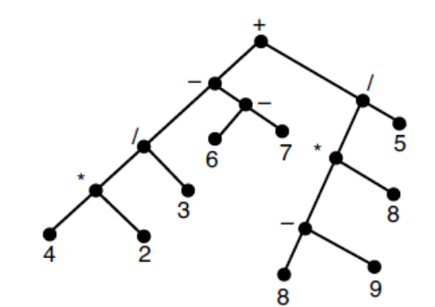
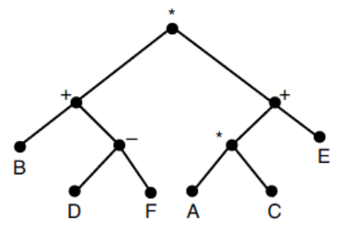
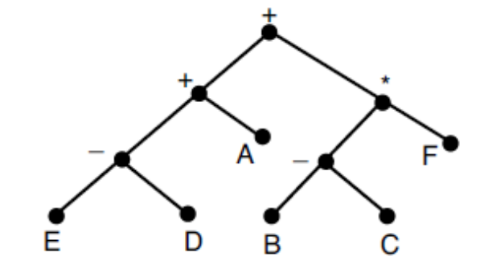
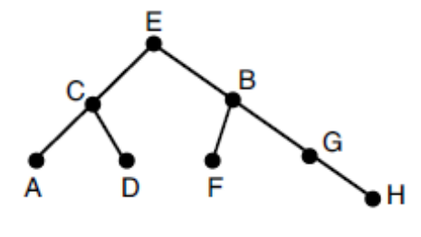
Q6: (((4*2)/3)-(6-7))+(((8-9)*8)/5)
Q52: polish notation for *+B-DF+*ACE
Q54: reverse-polish notation for ED-A+BC-F*+
Q56: preorder: ECADBFGH,
inorder: ACDEFBGH

Slide 24
Optimal Binary Trees
Data Compression:
computer represents symbols by codewords (i.e. 0s and 1s)
Given a text, let L={w_{i},i=1,…,n} be the set of all words in the text
suppose word w_{i} appears f_{i} times, and w_{i} has length d_{i} bits,
the length of the text=Σf_{i}d_{i}
how to store the text that minimized the compressed text length?
e.g. L={a,b,c} with frequencies 3,2, and 1, we can greedily represent
a by the bit string 0, b by 1, and c by 00.
Q: how do we decode 00? Is it “aa” or “c”?
Prefix property: no codeword is the first part (prefix) of any other codeword
Given a set of codewords, we can construct a binary tree as follows:
From a parent, assign 0 to the edge to its left child, and 1 to right child
For each codeword, construct a path from the root in the order of the bits of codeword
Each leaf represents a codeword. Since no leaf is a parent of other leaves, the prefix property holds.
There is a unique path from root to any leaf whose length represents the length of the specific codeword
Q: how to encode the word so that the resulting text has minimized compressed text length?
0
1
0
1
a
b
c
5.6: Optimal Binary Trees and Binary Search Trees

Slide 25
Huffman’s Optimal Binary Tree Algorithm
Given a text, how to construct the optimal binary tree:
For each leaf, the bit on each edge along the path from the root represents its codeword
Complexity: O(nlog n) by heap (O(n) merges, each takes O(log n) to identify 2 trees)
  Create a heap takes O(n) , inserting/deleting an element from a heap takes O(log n)
begin
sort the words in L in nondecreasing order of frequency
for each word w in L, create a rooted tree consisting of an isolated vertex
labeled with its frequency
denote the resulting set of trees by S
while S contains more than one tree do
select 2 trees T₁ & T₂ which have the 2 smallest frequencies from S
suppose T₁ has frequency f₁, T₂ has frequency f₂
merge T₁ & T₂ by assigning a new root with label= f₁+f₂
remove T₁ & T₂ from S
end while
end
5.6: Optimal Binary Trees and Binary Search Trees

Slide 26
Optimal Binary Trees Exercise
Ex1: for the set of weights {8,9,12,14,16,19}, construct an optimal binary prefix code. How many bits are needed for this prefix code?
Ex2: construct Huffman Binary codes for the following 6 messages whose probabilities of appearance are A:0.29, B:0.25, C:0.14, D:0.13, E:0.11, F:0.1. suppose E is encoded as 010, D is 101, What are A and F encoded?
78
8: 010 9: 011 16:00
12: 100 14: 101 19:11
Height of the binary tree is 3➔3bits are needed
33
45
16
17
26
19
8
9
12
14
1.02
0.46
0.56
0.25
0.21
0.27
0.29
B
A
0.11
0.1
0.14
0.13
E
F
C
D
5.6: Optimal Binary Trees and Binary Search Trees

Slide 27
Binary Search Trees
Binary search tree: a binary tree which may be empty. If it’s not empty then
Every element (vertex) has a unique key
The keys in a nonempty left subtree < the key in the root of the subtree
The keys in a nonempty right subtree > the key in the root of the subtree
The left & right subtrees are also binary search trees
Given n vertices with key a₁,a₂,…,a_{n}, the following algorithm constructs the B.S.T.
begin
construct the root of the binary tree, label it as a₁; k=1;
while k<n do
V= a₁; k=k+1;
while (a_{k}<V and V has a l.c) or (a_{k}>V and V has a r.c.) do
if (a_{k}<V and V has a l.c. W) then V=W;
if (a_{k}>V and V has a r.c. W) then V=W;
end while
if (a_{k}<V) then construct a l.c. for V and label it as a_{k}
else construct a r.c. for V and label it as a_{k}
end while
end
l.c.=left child
r.c.=right child
Complexity: O(n²)
5.6: Optimal Binary Trees and Binary Search Trees

Slide 28
Exercise in Constructing Binary Search Trees
Ex1: construct a binary search tree for the list 5,9,8,1,2,4,10,6
Ex2: insert a new node 3 to
the B.S.T. of ex1
5
5
5
5
5
9
9
9
9
1
1
8
8
8
5
2
5
5
9
9
9
1
1
1
8
8
10
8
10
2
2
2
4
6
4
4
5
1
9
2
8
10
Applying inorder traversal:
➔1,2,3,4,5,6,8,9,10
4
6
3
5.6: Optimal Binary Trees and Binary Search Trees

Slide 29
Binary Search Tree Search Algorithm
Given a binary search tree, and an element a, check whether a is in the B.S.T.
Applying the inorder traversal to the B.S.T. yields the “increasing” order
Insert a new element: apply the search algorithm
Delete a leaf: easy
Delete an internal node V:
1.Identify W: the largest element in V’s left subtree, or smallest element in V’s right subtree
2.If W has a child X, put X to be a child of W’s parent (Why W has at most 1 child?)
3.Replace W with V
begin
let V be the root of the B.S.T.;
while (a<V and V has a l.c) or (a>V and V has a r.c.) do
if (a<V and V has a l.c. W) then V=W;
if (a>V and V has a r.c. W) then V=W;
end while
if (a=V) then found a
else a is not in the tree
end while
end
l.c.=left child
r.c.=right child
h: height of B.S.T.
Complexity: O(h)
h is as large as O(n)
, but O(log n) in average
5.6: Optimal Binary Trees and Binary Search Trees

