Slide 1
Shortest Path Problem/Algorithm
Single Source Shortest Path (SSSP)
  Nonnegative Arc Cost (LS)
  General Arc Cost (LC)
All Pairs Shortest Paths (APSP)
  Combinatorial Type Algorithms (repeated SSSP)
  Algebraic Type Algorithms (FW)
  LP Type Algorithms (Network simplex)
Multiple Pairs Shortest Paths (MPSP)
0
 | 0
 |  | 0
 |  |  | 0
 |  |  |  | 0
0
 | 0
 |  | 0
 |  |  | 0
 |  |  |  | 0
0
 | 0
 |  | 0
 |  |  | 0
 |  |  |  | 0
0
 | 0
 |  | 0
 |  |  | 0
 |  |  |  | 0
0
 | 0
 |  | 0
 |  |  | 0
 |  |  |  | 0
Notes:
1-ALL:
Nonnegative Arc Cost
Label Setting (Dijkstra: heap/bucket..etc)
Label Correcting (Bellman-Ford, Pape-Levit, Goldberg-Radzik..etc)
General Arc Cost
Acyclic : Topological Ordering
Nonacyclic : Label Correcting
ALL-ALL:
Combinatorial Type Algorithms
Apply n times of Label Setting/Correcting Algorithm
Algebraic Type Algorithms
Floyd-Warshall , Carré , Wang
Other: matrix multiplication, decomposition..etc
SOME-SOME:
Very common in practice
Need ALL-ALL to get SOME-SOME ??
Extreme cases: “matching” pairs

Slide 2
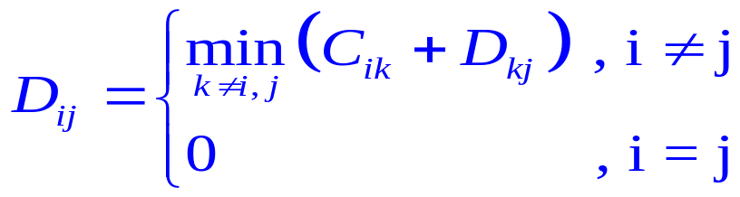
Path Algebra
Problem: Given a measure matrix C
  NO (1)multiple arcs, (2)loops (C_{ii}=0), (3)negative cycles
  C_{ij}=arc length of (i,j) if it exists , or ∞ o.w.
  What is the distance matrix D?
    D_{ij}=distance from i to j , or ∞ if i can’t reach j
Define path algebra
Original definition | a⊕b | a⊗b | e | 0(Null)
Path algebra | min{a,b} | a+b | 0 | ∞
D = C ⊗D ⊕ I_{n}
D_{ij}
i
k
j
Notes:
Note that there is no multiplication/division operation on Path Algebra.

Slide 3
ALL-ALL SP Algorithm
Solving D = C ⊗D ⊕ I_{n} is like solving system of linear equations , or, computing C⁻¹
Jacobi : Bellman-Ford O(n²m)
Gauss-Seidel : Ford-Fulkerson
Gauss-Jordan : Floyd-Warshall Algorithm O(n³)
Gauss : O(n³) : Carré , DLU
  LU factorization (once)
  forward elimination (for each node)
  backward substitution (for each node)
  Same # iterations as Floyd-Warshall, but can decompose to solve some-some shortest path problem
Notes:
In the operation of the Path Algebra, we only do addition and comparison (i.e. NO multiplication/division).
Therefore, there is no “stability” concern caused by “rounding error” as we might see when applying the iterative method to solve linear system of equation.
The same argument applies for solving the shortest distance matrix by the direct methods such as Gauss-Jordan, or Gauss elimination. Therefore, in the process of the direct methods, we only care about the pivoting order that could reduce # of fill-in.

Slide 4
Floyd-Warshall Algorithm
Idea: update C_{ij} by min{C_{ij}, C_{ik}+C_{kj}} where k≠i, j
(triple comparison)
i
k
j
0
0
0
0
0
X
0
0
0
0
0
X
0
0
0
0
0
0
0
0
0
0
0
0
0
0
X
0
Total # triple comparison = n(n-1)(n-2)
It is O(n³) → not good for sparse graph.
Note:
  In the beginning of the last iteration, we already got optimal solution
for [n]-ALL and ALL-[n]
Q={(1,4),(2,3),(5,2)}

Slide 5



Carré’s Algorithm
LU()
0
0
0
0
Forward()
0
0
0
0
0
0
0
0
Backward()
0
0
0
0
0
0
0
0
0
0
0
∞
0
∞
0
∞
0
∞
0
∞
0
0
0
∞
0
∞
0
∞
0
∞
0
∞
0
0
0
∞
0
∞
0
∞
0
∞
0
∞
0
0
0
∞
0
∞
0
∞
0
∞
0
∞
0
0
0
0
0
∞
0
∞
0
∞
0
∞
0
X₂
0
0
0
∞
0
∞
0
∞
0
X₃
0
X₃
0
0
0
∞
0
∞
0
X₄
0
X₄
0
X₄
0
0
0
∞
0
X₆
0
X₆
0
X₆
0
X₆
0
0
ALL-[1]
ALL-[2]
ALL-[3]
ALL-[4]
ALL-[5]
(5,2)
(2,3)
(1,4)
Notes:
Observation:
Process Backward() seems to be the bottleneck since it occupies about half of the total triple comparisons.
Therefore the computational loads on the 3 processes are “skewly” distributed. This inspires me to invent the Dense-LU algorithm which more evenly distributing the computational work into 3 processes.

Slide 6
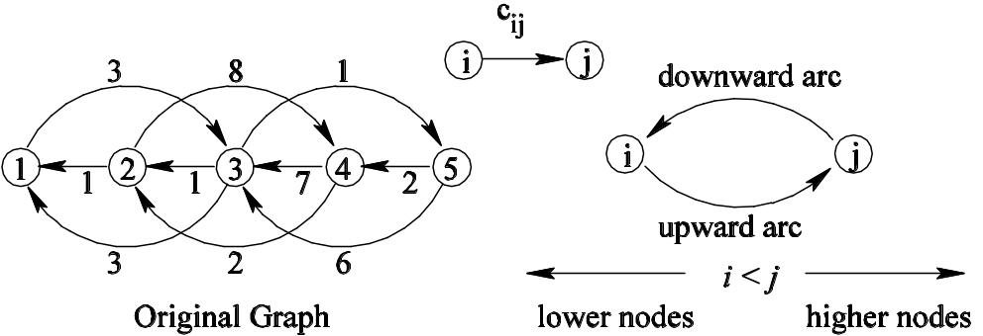
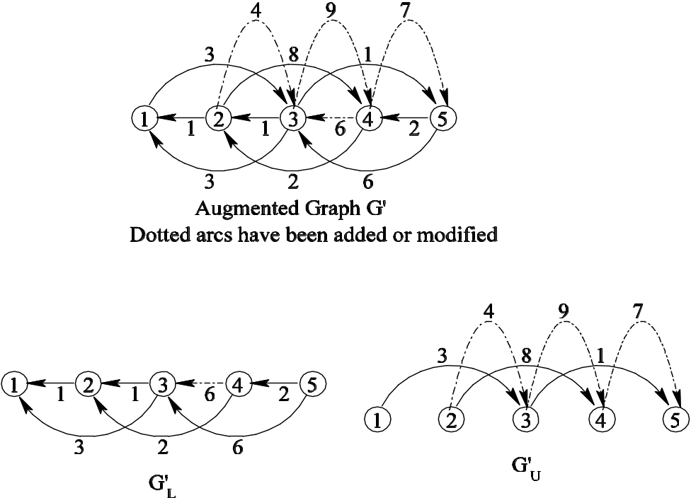
Augmented Graph G’ by LU
3
3
1
1
3
6
5
1
7
1
2
2
2
8
4
0
U
0
0
L
0
0

Slide 7
Key ideas of our algorithm DLU
Suppose h is the highest intermediate node in the shortest path from s to t
h<min{s,t} (Case 1) [LU]
min{s,t}<h<max{s,t} (Case 2) [Acyclic_L/U]
max{s,t}<h (Case 3) [Reverse_LU]

Slide 8
Algorithm DLU₁(Q)
Get x*_{st} for OD pairs (s,t): s≥k₀ t≥j₀ or s≥i₀ t≥i₀
where i₀=min_{i} s_{i} , j₀=min_{i} t_{i} , k₀=min_{i} {max{s_{i},t_{i}}}
Algorithm DLU₁(Q={(s_{i},t_{i}),i=1,…,q})
begin
LU;
Acyclic_L( j₀ );
Acyclic_U( i₀ );
Reverse_LU( k₀ );
end
LU: construct Augmented Graph G’ (Case 1)
Acyclic_L(j₀): compute shortest path in G’_{L} (Case 2)
Acyclic_U(i₀): compute shortest path in G’_{U} (Case 2)
Reverse_LU(k₀): (Case 3)
Notes:
4 main steps:
LU(): same as before, ((n(n-1)(n-2))/3) triples
Acyclic_Forward(): same as Forward(j) for all j.
That is, use the subgraph in L, do (n-1) times topological ordering,
update L.((n(n-1)(n-2))/6) triples
Acyclic_Backward(): similar to the previous operation,
except that we do it in the subgraph of U. also ((n(n-1)(n-2))/6) triples
Reverse_LU(): similar as LU(), but using node n, n-1,..,2 as
intermediate node to update the remaining submatrix.
Just looks like doing LU in the reverse way. It has ((n(n-1)(n-2))/3) triples.

Slide 9
Operations of Algorithm DLU₁
ALL-ALL
i₀=1, j₀=1 , k₀=2
0
0
0
0
LU
0
0
0
0
0
0
0
0
0
0
0
0
0
0
0
0
Acyclic_L
Acyclic_U
0
0
0
0
0
0
0
0
0
0
0
0
0
0
0
0
0
0
0
0
0
0
0
0
Reverse_LU
0
0
0
0
0
0
0
0
0
0
0
0
0
0
0
0
Notes:
Compare with Carré's and Floyd-Warshall’s algorithm :
In Carré's algorithm, the process Backward(j) does about half the work for dense case. Thus the workload is “skewed”.
Dense-LU algorithm more evenly splits the workload to the 4 processes.
This algorithm should behave worse than Carré's for Some-Some problems, but should still better than Floyd-Warshall's algorithm.
More Insights:
The process Acyclic_Forward() (or Acyclic_Backward()) can be viewed as a process of updating node distance label starting from the last node, along the subgraph L (or U), where all the arcs are pointing from node with higher (or lower) index to lower (or higher) index.
Since the 2 processes above are acyclic operations, the sparse implementation will be more efficient. Thus inspired me to invent the Sparse-LU algorithm.

Slide 10
Example of Algorithm DLU₁
Q={(1,4),(2,3),(5,2)}
i₀=1, j₀=2
k₀=min {4,3,5}=3
0
X
0
X
0
X
0
X
0
X
0
X
0
0
0
0
0
0
Requested OD pair
X
0
X
0
X
0
X
(a) Procedure G_LU
Updated entries by G_LU
Updated entries by Acyclic_L
0
X
0
X
0
X
Updated entries by Acyclic_U
0
X
0
X
0
X
Updated entries by Reverse_LU
0
0
0
Optimal entries
0
0
0
X
0
X
0
X
0
(b) Procedure Acyclic_L(2) and Acyclic_U(1)
gen. cost, Neg. cycle
good for south-eastern ODs
sparcity min fill-ins tech. (Markowitz)
undirected / acyclic graph
computational dependency
tracing shortest path
0
X
0
X
0
X
0
X
0
X
0
X
0
0
0
0
0
0
X
0
X
0
X
0
(c) Procedure Reverse_LU(3)
Notes:
Compare with Carré's and Floyd-Warshall’s algorithm :
In Carré's algorithm, the process Backward(j) does about half the work for dense case. Thus the workload is “skewed”.
Dense-LU algorithm more evenly splits the workload to the 4 processes.
This algorithm should behave worse than Carré's for Some-Some problems, but should still better than Floyd-Warshall's algorithm.
More Insights:
The process Acyclic_Forward() (or Acyclic_Backward()) can be viewed as a process of updating node distance label starting from the last node, along the subgraph L (or U), where all the arcs are pointing from node with higher (or lower) index to lower (or higher) index.
Since the 2 processes above are acyclic operations, the sparse implementation will be more efficient. Thus inspired me to invent the Sparse-LU algorithm.

Slide 11
Algorithm DLU₂
Algorithm DLU₂(Q={(s_{i},t_{i}),i=1,…,q})
begin
LU;
for i=1~q
Get_D(s_{i},t_{i});
if x*_{si,ti}≠∞ & need to trace path
Get_P(s_{i},t_{i});
end
Procedure Get_D(s_{i},t_{i})
begin
Get_D_L(t_{i});
Get_D_U(s_{i});
Min_add(s_{i},t_{i});
end
Procedure Get_P(s_{i},t_{i})
begin
let k:=succ_{si,ti}
while k≠t_{i} do
Get_D(k,t_{i});
let k:=succsi,ti
end
attacks requested OD pairs individually
fewer operations than DLU₁
easier to trace path

Slide 12
Example of Algorithm DLU₂
Q={(1,4),(2,3),(5,2)}
0
X
0
X
0
X
0
X
0
X
0
X
X
Requested OD pair
0
0
0
Updated entries by G_LU
0
0
0
Updated entries by Get_D_L
X
0
X
0
X
0
Updated entries by Get_D_U
(a) Procedure G_LU
Updated entries by Min_add
0
X
0
0
0
0
X
0
0
0
0
0
0
0
0
0
X
0
Get_D(1,4)
Get_D(2,3)
Get_D(5,2)
(b) Procedure Get_D(s,t)
0
X
0
X
0
0
0
X
0
0
X
0
0
0
0
X
0
X
0
0
X
0
Get_P(1,4)
1→3→5→4
Get_P(2,3)
2→1→3
Get_P(5,2)
5→4→2
(c) Procedure Get_P(s,t)
Notes:
Compare with Carré's and Floyd-Warshall’s algorithm :
In Carré's algorithm, the process Backward(j) does about half the work for dense case. Thus the workload is “skewed”.
Dense-LU algorithm more evenly splits the workload to the 4 processes.
This algorithm should behave worse than Carré's for Some-Some problems, but should still better than Floyd-Warshall's algorithm.
More Insights:
The process Acyclic_Forward() (or Acyclic_Backward()) can be viewed as a process of updating node distance label starting from the last node, along the subgraph L (or U), where all the arcs are pointing from node with higher (or lower) index to lower (or higher) index.
Since the 2 processes above are acyclic operations, the sparse implementation will be more efficient. Thus inspired me to invent the Sparse-LU algorithm.

Slide 13
Implementation
Preprocess: 8 pivot rules (MKZ(S,D),MMD,MND,…)
SLU₁: sparse implementation of Carré’s Algorithm
  Code generation (e.g.: n=1000,m=6000,500MB->200MB->5MB->0MB!)
  bucket(slu11) , 1 heap(slu12) , 2 heaps(slu13)
SLU₂: sparse implementation of Algorithm DLU₂
  bucket(slu21) , 1 heap(slu22)
Compare with: (Cherkassky et al. 1996 Math.Program.)
gor1 , bfp , thresh , pape , two-q , dikh , dikbd , dikr , dikba
Test cases:
4 network generators: spgrid , sprand , netgen , spacyc
1 real Asia-Pacific flight network (n=112, m=1038)

Slide 14
MPSP Computational Tests
Preprocess: 8 pivot rules (MKZ(S,D),MMD,MND,…)
SLU₁: sparse implementation of Carré’s Algorithm
  Code generation (e.g.: n=1000,m=6000,500MB->200MB->5MB->0MB!)
  bucket(slu11) , 1 heap(slu12) , 2 heaps(slu13)
SLU₂: sparse implementation of Algorithm DLU₂
  bucket(slu21) , 1 heap(slu22)
Compare with: (Cherkassky et al. 1996 Math.Program.)
gor1 , bfp , thresh , pape , two-q , dikh , dikbd , dikr , dikba
Test cases:
4 network generators: spgrid , sprand , netgen , spacyc
1 real Asia-Pacific flight network (n=112, m=1038)
4 different % OD pairs (25%, 50%, 75% and 100%)

Slide 15
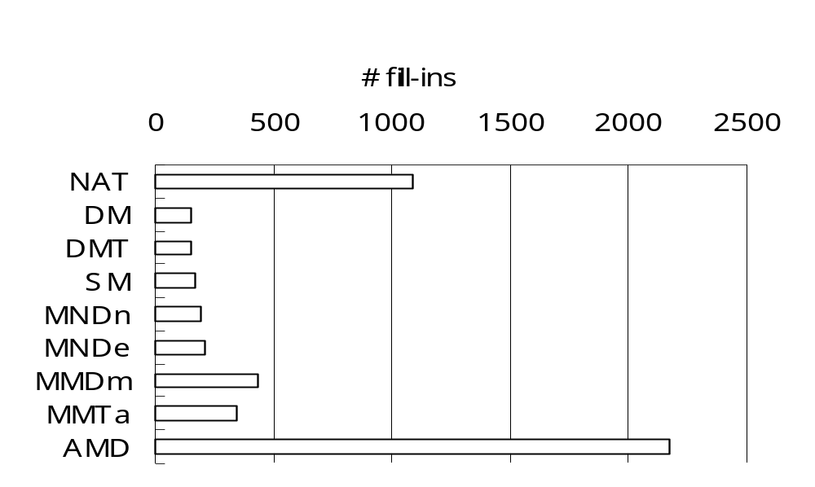
Preprocessing: Best Node Ordering Rule
NAT: natual ordering
SM: Static Markowitz
DM: Dynamic Markowitz,
DMT: DM with tie breaking
NP-Complete
Usually DM, DMT or SM create fewer # of fill-ins

Slide 16
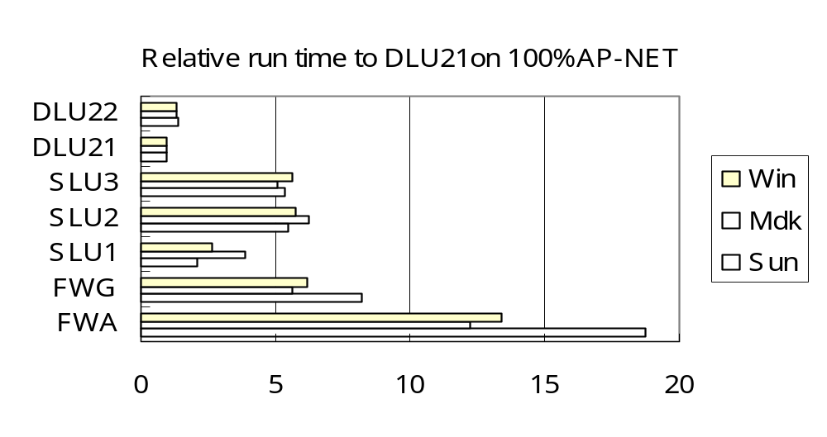
FW vs. SLU & DLU
FWA: Algebraic Floyd-Warshall
FWG: Graphic Floyd-Warshall
DLU21 and SLU1 are the best implementations
DLU & SLU are always faster than FW

Slide 17
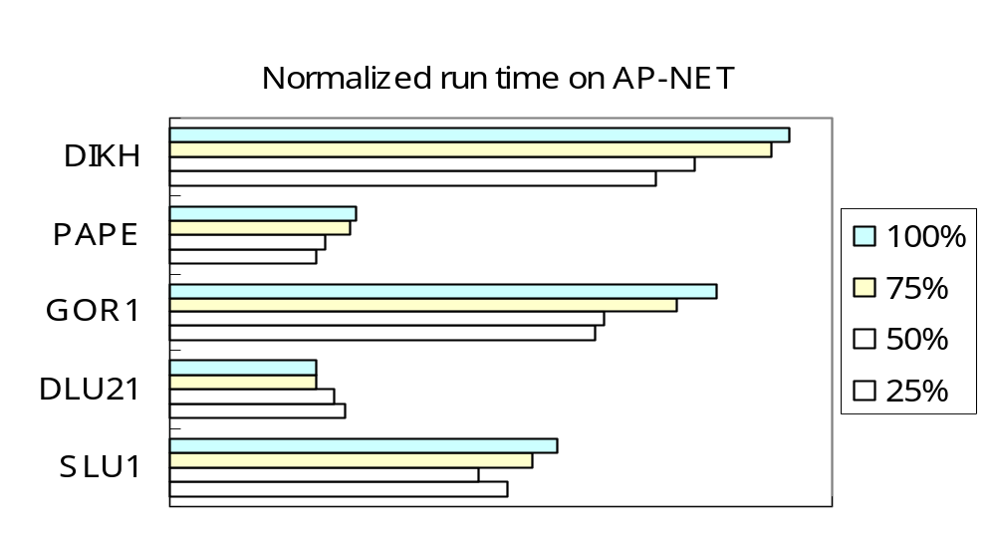
SLU & DLU vs. LC & LS (1)
Label-Correcting (LC) algorithms: GOR1, PAPE
Lable-Setting (LS) algorithms: DIKH
DLU21 performs relatively better for larger %

Slide 18
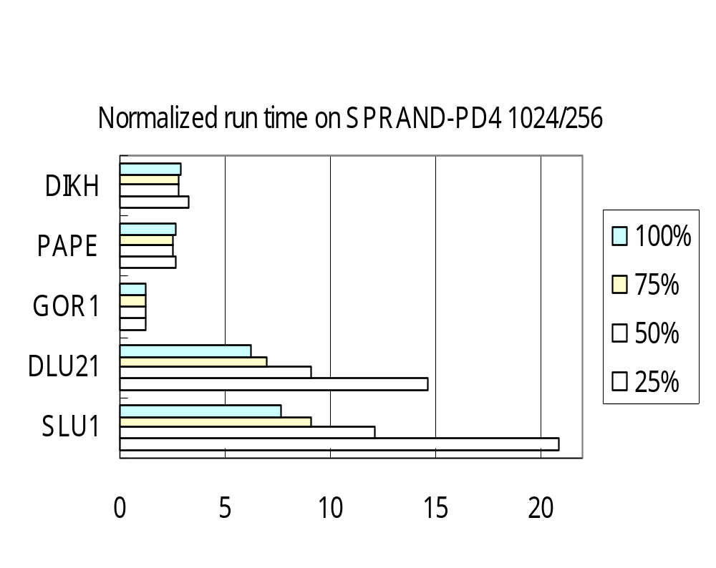
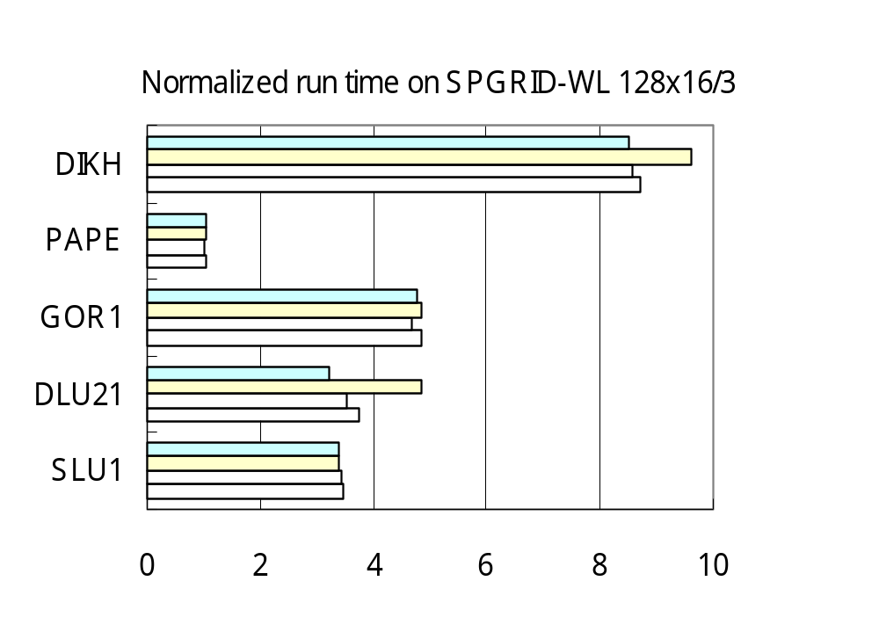
SLU & DLU vs. LC & LS (2)
Label-Correcting (LC) algorithms: GOR1, PAPE
Lable-Setting (LS) algorithms: DIKH
DLU & SLU performs relatively better for larger %

Slide 19
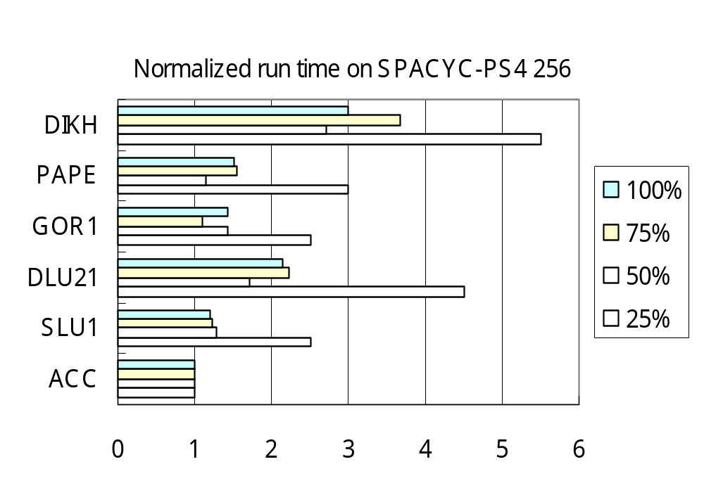
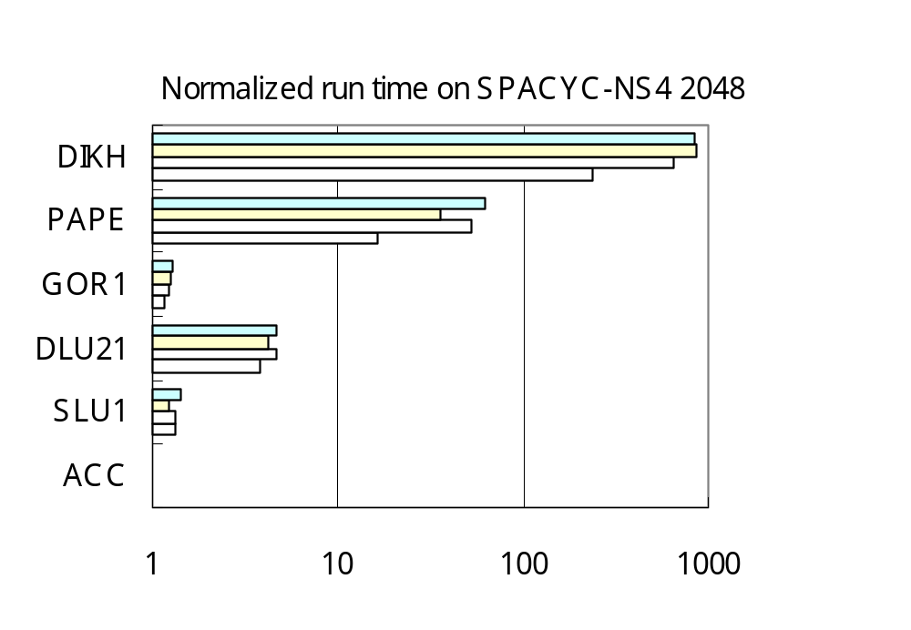
SLU & DLU vs. LC & LS (3)
Topological ordering algorithm: ACC
Label-Correcting (LC) algorithms: GOR1, PAPE
Lable-Setting (LS) algorithms: DIKH
DLU & SLU performs better for acyclic graphs

Slide 20
Results & Conclusion
Computational Results:
  Depend on size, topology , node ordering , OD pairs
  In general not the best (diff Platform, OS, Compiler?)
  Markowitz’s rule usually gives better ordering
  Definitely much better than Floyd-Warshall Algorithm
Conclusion:
  Simple , efficient for SOM-SOME shortest paths
  ‘Ad hoc’ code , exploits properties of graphs
  Theoretically suitable for dense graphs
  Need more storages (O(n²))
  Complexity O(∑_{k=1~n}uo(k)di(k)+min{q*nnz(LU),n³})
  Iterative methods(stability) vs. direct methods(sparsity)
Notes:
Data structure:
For FORWARD(j):
only need bi[i], an incoming arc list to node i from nodes with higher index. (bi means backward incoming)
For BACKWARD(j):
only need fi[i], an incoming arc list to node i from nodes with lower index. (fi means forward incoming)
For LU():
need fo[i], bi[i]. bi[i] is as explained above. fo[i] is an outgoing arc list from node i to nodes with higher index. (fo means forward outgoing)
To sacrifice some storage to save time in identifying an arc number in doing triple comparison, we may need a n² matrix Arc_Status[i,j], where its entry is 1 if (I,j) is either original or artificial, and 0 otherwise.

Slide 21
Example of Algorithm SLU₁
0
Augmented Graph:
  Graph obtained by LU operations
e.g. ALL-[3]
ri[i]
ro[i]
0
li[i]
0
lo[i]
i
0
0
3
Artificial arc
C_{ij} [succ(i,j)]
3
1
4 [1]
9 [2]
7 [3]
6
3
8
1
1
3
7
5
1
1
2
2
1
1
7
2
6 [2]
X_{i}
X_{j}
1
2
3
4
5
C_{ij}
Original arc
4
i
j
2
8
3
2
6
Augmented Graph
4 [1]
7 [3]
3
8
0
6 [2]
2
Node i | 3 | 4 | 5
X_{i} | 0 | 6 | 6
succ(i) | - | 2 | 3
Node i | 1 | 2 | 4 | 5
X_{i} | 3 | 4 | 6 | 6
succ(i) | 3 | 1 | 2 | 3
3
4
5
0
6
6
1
2
3
4
5
6
Forward(3)
Backward(1)
Notes:
3 versions of Algorithm Sparse-LU: same LU operations, but different philosophy to do the FORWARD/BACKWARD operations
Sparse-LU1:
use bucket idea: n buckets, 1 for each node
Each node is either labeled or not. In FORWARD(j), starting from node j, scan all the arcs stored in arc list bi[i], update their head distance labels, put them into buckets corresponding to their index.
Repeat above step until the last node. (thus end the FORWARD(j) )
Starting from the last node, only scan nonempty buckets. For each such bucket i, scan all the arcs in arc list fi[i], update their head distance labels, then remove the node out of its bucket by marking it as unlabeled.
Repeat above step until the last labeled node is scanned. Done!!
Sparse-LU2:
Similar to Sparse-LU1, only differs in the way maintaining labeled nodes. Sparse-LU2 will use a min-heap in FORWARD(j). After FORWARD(j), we switch the min-heap to be a max-heap in BACKWARD(j). We have to identify the last labeled node first. Once we find it, we initiate the max-heap by the last labeled node.
The reason to use heap is to save some unnecessary work spent in scanning empty buckets in Sparse-LU1.
Sparse-LU3:
Almost the same as Sparse-LU2, except it maintains 2 heaps, one min-heap and one max-heap, at the same time in FORWARD(j). That is, in FORWARD(j), whenever we label a node, we put that node into both min-heap and max-heap. So, after FORWARD(j) is done, min-heap becomes empty and max-heap is already ready to start. Therefore, we save some time in identifying the last labeled node as in Sparse-LU2.
Computational Results:
Time(Sparse-LU1) < Time(Sparse-LU3) < Time(Sparse-LU2)

Slide 22
Properties of Algorithm DLU₁
Good:
Efficient if only x*_{st} are requested
(if need to trace paths, set i₀=1)
Work for general arc costs, can detect any negative cycle
A good node ordering decreases fill-in arcs
  Preprocessing (Markowitz’s rule, MMD, MND..etc)
Save ½ storage/computation for undirected graphs.
Acyclic graphs: same as topological ordering
1
2
3
4
2
3
4
3
4
4
Bad:
Redundant work on unrequested OD pairs
Difficulty to trace shortest path

