Slide 1
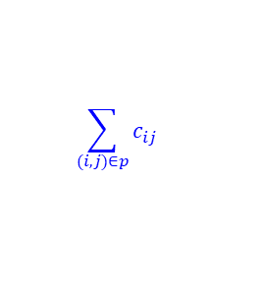
Shortest Paths (SP) and Distance
Shortest path: a path of minimal length between vertices s and t
Distance from s to t: smallest possible # of edges in a path from s to t !Note! This definition only applies for unweighted (unit) graph
Weighted graph: a graph where each edge (i,j) has a “weight” c_{ij} as its length
Weight of a path: sum of weights of the edges in the path p
To trace a path, we can use predecessor (pred) or successor (succ)
If a path passes vertex i then consecutively to vertex j, i.e., i → j we say pred(j) = i , succ(i) = j
If we record the pred(i) (or succ(i)) for each vertex i in any path-related algorithm, we then will be able to trace the entire path
For the first vertex in the path, say, s, we define pred(s)=NULL (or “-”)
For the last vertex in the path, say, t, we define succ(t) =NULL (or “-”)
e.g., pred(1)=3, pred(2)=4, pred(3)=2, pred(4)=NULL
e.g., succ(4)=2, succ(2)=3, succ(3)=1, succ(1)=NULL
$$\sum_{(i,j)∈p}{c_{ij}}$$
4
2
3
1
4.3: Shortest Paths and Distance

Slide 2
SP on Unweighted / Unit Graphs
Unit graph: a graph where all edges have the same length
1-1 SP on a unit graph: a s-t path with the minimum number of edges e.g., to measure the closeness of 2 persons in a social network
Search algorithm:
INPUT: A network G, and starting vertex s
OUTPUT: the set of reachable vertices from s: {j : there is a path from s to j in G}
Settings:
For vertex i:
distance label: d[i] is the distance (# edges) between s & i
Predecessor: pred[i] is the predecessor of i on the path from s to I
A vertex is either marked (visited) or unmarked (unvisited) Initially only s is marked. If a vertex is marked ➔ it is reachable from s
An edge (i,j) in A is admissible if vertex i is marked but j is unmarked
visited
unvisited
4.3: Shortest Paths and Distance

Slide 3

Breadth-First Search
To find out all the vertices that are reachable from a specific vertex (source), say, s
M represents infinity (∞)
begin
initialization: Set d[v]=M for each v in V; LIST= ∅
d[s]=0; pred[s]=NULL; add s into LIST;
while LIST is not empty do
remove a vertex i from LIST; while there exists an admissible edge (i,j)
d[j]=d[i]+1; pred[j]=i; add j into LIST; mark (i,j) as scanned;
end while
end while
for each vertex i do
tracepath(s,i);
end for
end
LIST is a queue (FIFO)
Select i
Vertex Selection [VS]
Admissible edge/arc
visited unvisited
$$\}$$
Scan i Distance Updating [DU]
i
j
d[j]=M
BFS Animation
4.3: Shortest Paths and Distance

Slide 4
Initialize
Initialize
4
2
4
2
8
8
1
1
1
1
5
5
7
7
pred(1) = 0
next := 1 order(1) = next
LIST:= {1}
Unmark all vertices in N;
Mark vertex s
9
3
9
3
6
6
LIST
1
next
1
4.3: Shortest Paths and Distance

Slide 5
Select a vertex i in LIST
[VS]
Breadth first search animation
2
4
8
1
1
1
1
5
7
In BFS, i is the first vertex in LIST
3
6
9
LIST
1
next
1
4.3: Shortest Paths and Distance

Slide 6
If vertex i is incident to an admissible edge …
[DU]
2
Breadth first search animation
2
4
2
8
1
1
1
1
5
7
Select an admissible edge (i,j)
Mark vertex j
pred(j) := i
next := next + 1
order(j) := next
add j to LIST
3
6
9
LIST
1
2
1
next
2
4.3: Shortest Paths and Distance

Slide 7
If vertex i is incident to an admissible edge…
[DU]
2
Breadth first search animation
2
4
2
8
1
1
1
1
5
5
7
3
next := next + 1
order(j) := next
add j to LIST
Mark vertex j
pred[j] := i
Select an admissible edge (i,j)
3
6
9
LIST
1
2
5
2
next
3
4.3: Shortest Paths and Distance

Slide 8
If vertex i is incident to an admissible edge …
[DU]
2
Breadth first search animation
2
4
2
8
1
1
1
1
5
5
7
3
Select an admissible edge (i,j)
Mark vertex j
pred(j) := i
next := next + 1
order(j) := next
add j to LIST
3
9
3
6
4
LIST
1
2
5
3
2
3
next
4
4.3: Shortest Paths and Distance

Slide 9
If vertex i is not incident to an admissible edge …
[DU]
2
Breadth first search animation
2
4
2
8
1
1
1
1
1
5
5
7
3
Delete vertex i from LIST
3
9
3
6
4
LIST
1
2
5
3
2
3
next
4
4.3: Shortest Paths and Distance

Slide 10
Select Vertex i
[VS]
2
Breadth first search animation
2
4
2
2
8
1
1
1
1
1
5
5
7
3
The first vertex on LIST becomes vertex i
9
3
3
6
4
LIST
1
2
5
3
2
3
next
4
4.3: Shortest Paths and Distance

Slide 11
If vertex i is incident to an admissible edge …
[DU]
5
Breadth first search animation
2
4
2
4
2
2
8
1
1
1
5
5
7
3
Select an admissible edge (i,j)
next := next + 1
order(j) := next
add j to LIST
Mark vertex j
pred(j) := i
3
9
3
6
4
LIST
1
2
5
3
4
2
3
4
next
5
4.3: Shortest Paths and Distance

Slide 12
If vertex i is not incident to an admissible edge …
[DU]
5
Breadth first search animation
2
4
2
4
2
2
2
8
1
1
1
5
5
7
3
Delete vertex i from LIST
3
9
3
6
4
LIST
1
2
5
3
4
2
3
4
next
5
4.3: Shortest Paths and Distance

Slide 13
Select a vertex
[VS]
5
Breadth first search animation
2
4
2
4
2
2
8
1
1
1
5
5
5
7
3
3
9
The first vertex on LIST becomes node i
3
6
4
LIST
1
2
5
3
4
2
3
4
next
5
4.3: Shortest Paths and Distance

Slide 14
If vertex i is incident to an admissible edge …
[DU]
5
Breadth first search animation
2
4
2
4
2
2
8
1
1
1
5
5
5
7
3
Select an admissible edge (i,j)
Mark vertex j
pred(j) := i
next := next + 1
order(j) := next
add j to LIST
3
9
3
6
6
4
6
LIST
1
2
5
3
4
6
2
3
4
5
next
6
4.3: Shortest Paths and Distance

Slide 15
If vertex i is not incident to an admissible edge …
[DU]
5
Breadth first search animation
2
4
2
4
2
2
8
1
1
1
5
5
5
5
7
3
Delete vertex i from LIST
3
9
3
6
6
4
6
LIST
1
2
5
3
4
6
2
3
4
5
next
6
4.3: Shortest Paths and Distance

Slide 16
Select vertex 3
[VS]
5
Breadth first search animation
2
4
2
4
2
2
8
1
1
1
5
5
5
5
7
3
delete vertex 3 from LIST
vertex 3 is not incident to any admissible edges
3
9
3
3
3
6
6
4
6
LIST
1
2
5
3
4
6
2
3
4
5
next
6
4.3: Shortest Paths and Distance

Slide 17
Select a vertex
[VS]
5
Breadth first search animation
2
4
4
2
4
2
8
1
1
1
5
5
7
3
i : = 4
3
9
3
6
6
4
6
LIST
1
2
5
3
4
6
2
3
4
5
next
6
4.3: Shortest Paths and Distance

Slide 18
If vertex i is incident to an admissible edge …
[DU]
5
Breadth first search animation
2
4
4
2
4
7
2
8
8
1
1
1
5
5
7
3
next := next + 1
order(j) := next
add j to LIST
Select an admissible edge (i,j)
Mark vertex j
pred(j) := i
3
9
3
6
6
4
6
LIST
1
2
5
3
4
6
8
2
3
4
5
6
next
7
4.3: Shortest Paths and Distance

Slide 19
If vertex i is not incident to an admissible edge …
[DU]
5
Breadth first search animation
2
4
4
4
2
4
7
2
8
8
1
1
1
5
5
7
3
Delete vertex i from LIST
3
9
3
6
6
4
6
LIST
1
2
5
3
4
6
8
2
3
4
5
6
next
7
4.3: Shortest Paths and Distance

Slide 20
Select vertex i
[VS]
5
Breadth first search animation
2
4
2
4
7
2
8
8
1
1
1
5
5
7
3
i := 6
3
9
3
6
6
6
4
6
LIST
1
2
5
3
4
6
8
2
3
4
5
6
next
7
4.3: Shortest Paths and Distance

Slide 21
If vertex i is incident to an admissible edge …
[DU]
5
Breadth first search animation
2
4
2
4
7
2
8
8
1
1
8
1
5
5
7
7
3
Select an admissible edge (i,j)
Mark vertex j
pred(j) := i
next := next + 1
order(j) := next
add j to LIST
3
9
3
6
6
6
4
6
LIST
1
2
5
3
4
6
8
7
2
3
4
5
6
7
next
8
4.3: Shortest Paths and Distance

Slide 22
If vertex i is incident to an admissible edge …
[DU]
5
Breadth first search animation
2
4
2
4
7
2
8
8
1
1
8
1
5
5
7
7
3
next := next + 1
order(j) := next
add j to LIST
Mark vertex j
pred(j) := i
Select an admissible arc (i,j)
9
3
9
3
6
6
6
4
6
9
LIST
1
2
5
3
4
6
8
7
9
2
3
4
5
6
7
8
next
9
4.3: Shortest Paths and Distance

Slide 23
If vertex i is not incident to an admissible edge …
[DU]
5
Breadth first search animation
2
4
2
4
7
2
8
8
1
1
8
1
5
5
7
7
3
Delete vertex i from LIST
9
3
9
3
6
6
6
6
4
6
9
LIST
1
2
5
3
4
6
8
7
9
2
3
4
5
6
7
8
next
9
4.3: Shortest Paths and Distance

Slide 24
Select vertex 8
[VS]
5
Breadth first search animation
2
4
2
4
7
2
8
8
8
8
1
1
8
1
5
5
7
7
3
vertex 8 is not incident to an admissible edge; delete it from LIST
9
3
9
3
6
6
6
6
4
6
9
LIST
1
2
5
3
4
6
8
7
9
2
3
4
5
6
7
8
next
9
4.3: Shortest Paths and Distance

Slide 25
Select vertex 7
[VS]
5
Breadth first search animation
2
4
2
4
7
2
8
8
1
1
8
1
5
5
7
7
7
7
3
vertex 7 is not incident to an admissible edge; delete it from LIST
9
3
9
3
6
6
6
6
4
6
9
LIST
1
2
5
3
4
6
8
7
9
2
3
4
5
6
7
8
next
9
4.3: Shortest Paths and Distance

Slide 26
Select vertex 9
[VS]
5
Breadth first search animation
2
4
2
4
7
2
8
8
1
1
8
1
5
5
7
7
3
vertex 9 is not incident to an admissible edge; delete it from LIST
9
9
9
3
9
3
6
6
6
6
4
6
9
LIST
1
2
5
3
4
6
8
7
9
2
3
4
5
6
7
8
next
9
4.3: Shortest Paths and Distance

Slide 27
More on Breadth-First Search
Theorem. The breadth first search tree is the “shortest path tree”, that is, the path from s to j in the tree has the fewest possible number of edges.
1
2
3
4
2
4
2
8
8
0
BFS-tree
1
1
5
5
7
7
3
1
9
9
9
3
9
3
6
6
6
6
1
2
3
4.3: Shortest Paths and Distance

Slide 28
Exercise of BFS
4.3: Shortest Paths and Distance

Slide 29
Exercise of BFS (ANS)
4.3: Shortest Paths and Distance

Slide 30
Complexity of Breadth-First Search
Scan vertex i: scan all the edges (i,j) connecting vertex i
Scan edge (i,j): check whether d[j]=M ,i.e., (i,j) is admissible, or not if yes, update distance label & predecessor of vertex j, and then add j into LIST d[j]=d[i]+1; pred[j]=i; add j into LIST (Queue);
Two major operations:
Vertex Selection [VS]: each vertex is selected to be scanned exactly once
i.e. total # of vertex selection operations = |V|
Distance Update [DS]: each edge is scanned exactly twice (undirected) i.e., total # of edge scanning operations = 2|E| (undirected) during these 2|E| scanning, at most |E| of them perform distance updating
Complexity: O(|V|+|E|) = O(|E|) if using Adj.L. (or O(|V|²) if using Adj.M.)
usually O(|E|) = O(|V|²) but O(|E|) is a better approximation
4.3: Shortest Paths and Distance

Slide 31
More about Breadth-First Search
How to select a vertex from LIST?
Queue: FIFO
How to trace a path from vertex s to i?
from i, continue to print, backtrack to its predecessor, until s
Why the d[j] represents the shortest distance from s to j? math. induction
begin
output i;
while pred[i] ≠ s do
i=pred[i]; output i
end while
output s
end
This prints out the path from s to i in a reverse order Complexity : O(|V|)
4.3: Shortest Paths and Distance

Slide 32
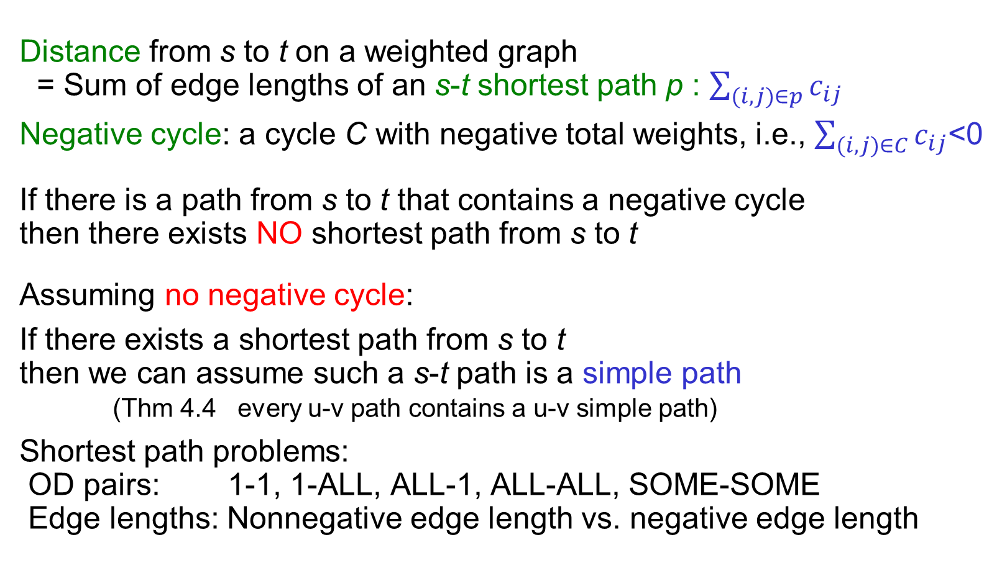


Shortest Path on Weighted Graphs
Distance from s to t on a weighted graph
= Sum of edge lengths of an s-t shortest path p : $\sum_{(i,j)∈p}{c_{ij}}$
Negative cycle: a cycle C with negative total weights, i.e., $\sum_{(i,j)∈C}{c_{ij}}$<0
If there is a path from s to t that contains a negative cycle then there exists NO shortest path from s to t
Assuming no negative cycle:
If there exists a shortest path from s to t then we can assume such a s-t path is a simple path
(Thm 4.4 every u-v path contains a u-v simple path)
Shortest path problems: OD pairs: 1-1, 1-ALL, ALL-1, ALL-ALL, SOME-SOME
Edge lengths: Nonnegative edge length vs. negative edge length
$$c_{ij}≥0, ∀(i,j)∈E$$
$$\text{some} c_{ij}<0$$
4.3: Shortest Paths and Distance

Slide 33
Shortest Path Problems
ALL-1
1-ALL
Single Source Shortest Path (SSSP)
Nonnegative Edge Cost (LS)
General Edge Cost (LC)
All Pairs Shortest Paths (APSP)
Combinatorial Type Algorithms (repeated SSSP)
Algebraic Type Algorithms (FW)
LP Type Algorithms (Network simplex)
Multiple Pairs Shortest Paths (MPSP)
May be done by APSP (overkill)
0
 | 0
 |  | 0
 |  |  | 0
 |  |  |  | 0
0
 | 0
 |  | 0
 |  |  | 0
 |  |  |  | 0
ALL-ALL
0
 | 0
 |  | 0
 |  |  | 0
 |  |  |  | 0
ALL-1 + 1-ALL
1-1 * 5
0
 | 0
 |  | 0
 |  |  | 0
 |  |  |  | 0
0
 | 0
 |  | 0
 |  |  | 0
 |  |  |  | 0
SOME-SOME
4.3: Shortest Paths and Distance

Slide 34

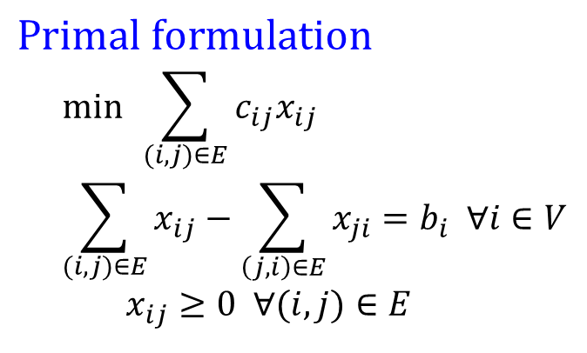

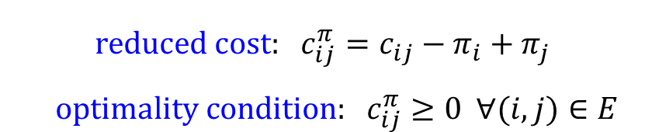
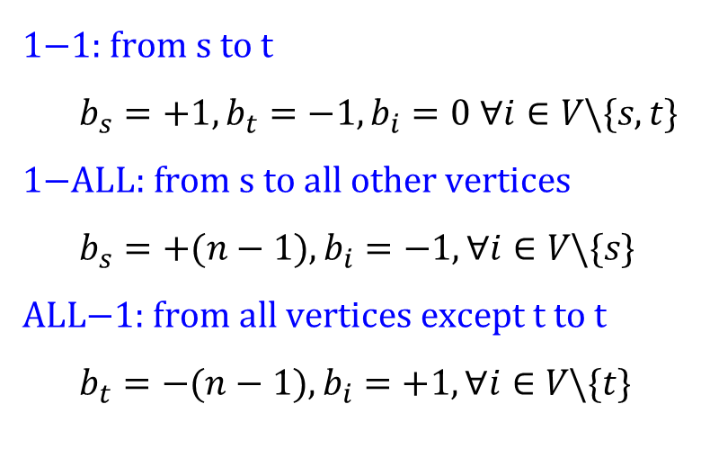

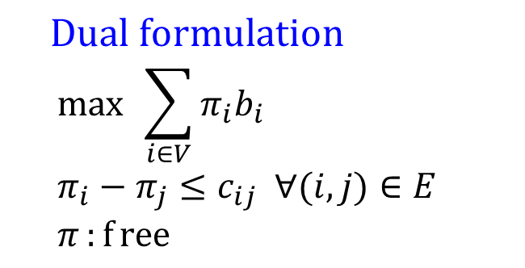
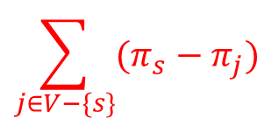
LP form for SSSP Problems
$$\text{Primal} \text{formulation} \\ \min{ }\sum_{(i,j)∈E}{c_{ij}x_{ij}} \\ \sum_{(i,j)∈E}{x_{ij}}−\sum_{\left(j,i\right)∈E}{x_{ji}}=b_{i} ∀i∈V$$
$$x_{ij}≥0 ∀(i,j)∈E$$
$$\text{Dual} \text{formulation} \\ \max{ }\sum_{i∈V}{π_{i}b_{i}} \\ π_{i}−π_{j}≤c_{ij} ∀(i,j)∈E \\ π:{f}\text{ree}$$
s.t.
s.t.
$$\text{reduced} \text{cost}\text{: }c_{ij}^{π}=c_{ij}−π_{i}+π_{j}$$
$$\text{optimality} \text{condition}\text{: }c_{ij}^{π}≥0 ∀(i,j)∈E$$
$$\text{1−1: }\text{from} \text{s} \text{to} \text{t} \\ b_{s}=+1, b_{t}=−1, b_{i}=0 ∀i∈V\backslash \{s,t\} \\ \text{1−}\text{ALL}\text{: }\text{from} \text{s} \text{to} \text{all} \text{other} \text{vertices} \\ b_{s}=+(n−1), b_{i}=−1, ∀i∈V\backslash \{s\} \\ \text{ALL}\text{−1: }\text{from} \text{all} \text{vertices} \text{except} \text{t} \text{to} \text{t} \\ b_{t}=−(n−1), b_{i}=+1, ∀i∈V\backslash \{t\}$$
For 1-1, 1-ALL SP: let
1-1 (s-j) SP obj: max
1-ALL (s-V) SP obj: max
$$d[j]:{=}−π_{j}\text{, } π_{s}:{=}0$$
$$π_{s}−π_{j}=d[j]$$
$$\sum_{j∈V−\{s\}}{(π_{s}−π_{j})}$$
$$d[j]$$
4.3: Shortest Paths and Distance

Slide 35
SSSP LP form Exercise
4.3: Shortest Paths and Distance

Slide 36
More on the Dual of SSSP LP form
1-1 SP from vertex 1 to 5
2
5
4
1
4
8
2
5
1
3
7
1
6
2
1-ALL SP from vertex 1 to 2~5
2
1
5
4
4
8
2
5
1
3
7
6
2
4.3: Shortest Paths and Distance

Slide 37

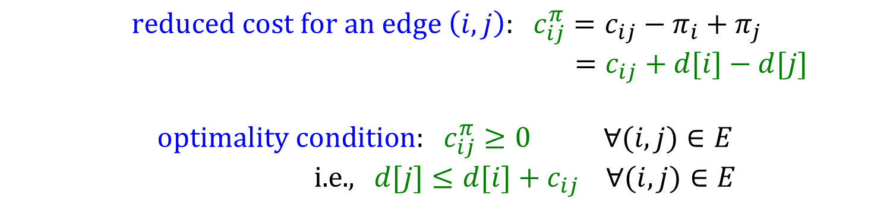
Optimality Condition for SP
Let d[j] represents the shortest path length from s to j
Given d[j] for each j in V, how to verify its correctness?
Idea:
(1) by some SP algorithm again (bad idea! NOT efficient)
(2) by the optimality condition of the SSSP LP form
a for loop for each edge (i,j) to check if
this takes O(m) time.
If ALL edges pass this check, this implies d[j] is optimal !
$$\text{reduced} \text{cost} \text{for} \text{an} \text{edge} \left(i,j\right)\text{: }c_{ij}^{π}=c_{ij}−π_{i}+π_{j}$$
$=c_{ij}+d[i]−d[j]$
$$\text{optimality} \text{condition}\text{: }c_{ij}^{π}≥0 ∀(i,j)∈E \\ \text{i}\text{.}\text{e}\text{., }d[j]≤d[i]+c_{ij} ∀(i,j)∈E$$
d[i]
i
c_{ij}
d[j]
s
j
d[s]=0
$$d[j]≤d[i]+c_{ij}$$

Slide 38

Triple Comparison = Distance Update
Distance Updating (DU): when we scan vertex i, we check each outgoing edge (i,j) as follows:
if d[j] > d[i]+c_{ij} then
d[j] = d[i]+c_{ij}; pred[j]=i;
this operation is called a “triple comparison”, or a “distance update”
Remember the optimality condition:
Thus, a triple comparison improves the “dual infeasibility”
All SP algorithms perform sequences of triple comparisons
Fewer # triple comparisons Faster SP calculation
Dijkstra’s algorithm does fewer triple comparisons by Node Selection
d[i]
i
c_{ij}
Distance reduction = d[j] – (d[i]+c_{ij})
d[j]
s
j
d[s]=0
$$d[j]≤d[i]+c_{ij} ∀(i,j)∈E$$
4.3: Shortest Paths and Distance

Slide 39

Dijkstra’s Algorithm
Only valid for graphs with nonnegative edge length c_{ij} ≥ 0
1-ALL: from s to all other vertices
begin
initialization: S= ∅; S^{c}=V;
d[i]=∞, pred[i]=NULL for each i in V
d[s]=0, pred[s]=NULL;
while |S|<n do
choose i from S^{c} such that d[i]=min{d[j]: j in S^{c}};
S=S∪{i}; S^{c}= S^{c}\{i};
for each (i,j) in E[i] do
if d[j]>d[i]+c_{ij} then
d[j]=d[i]+c_{ij}; pred[j]=i;
end for
end while
end
Vertex Selection (VS) select a vertex i to scan then vertex i becomes permanently labeled
Outgoing edge list
$$\}$$
Scan edge (i,j) Distance Update (DU) (triple comparison)
Dijkstra’s Animation
4.3: Shortest Paths and Distance

Slide 40
Example of Dijkstra’s Algorithm
3 [s]
∞ [-]
2 [B]
4 [B]
Choose B
S={s,B}
S^{c}={A,C,D,E}
Scan (B,A),(B,C),(B,D)
2
A
2
C
A
C
3
Choose s
S={s}
S^{c}={A,B,C,D,E}
Scan (s,A), (s,B)
3
0 [-]
3
∞ [-]
0 [-]
3
∞ [-]
s
1
3
1
E
s
1
3
1
E
1
1
1
1
5
B
5
B
D
D
1 [s]
∞ [-]
1 [s]
6 [B]
2 [B]
4 [B]
2 [B]
4 [B]
Choose C
S={s,B,A,C}
S^{c}={D,E}
Scan (C,D),(C,E)
2
C
Choose A
S={s,B,A}
S^{c}={C,D,E}
Scan (A,C)
A
2
C
A
3
3
0 [-]
3
∞ [-]
0 [-]
3
7 [C]
s
1
3
1
E
s
1
3
1
E
1
1
1
1
5
B
5
B
D
D
1 [s]
6 [B]
1 [s]
5 [C]
2 [B]
4 [B]
2 [B]
4 [B]
Choose D
S={s,B,A,C,D,E}
S^{c}=∅
DONE!!
2
C
Choose D
S={s,B,A,C,D}
S^{c}={E}
Scan (D,E)
A
2
C
A
3
3
0 [-]
3
6 [D]
0 [-]
3
6 [D]
s
1
3
1
E
s
1
3
1
E
1
1
1
1
5
5
B
D
B
D
1 [s]
5 [C]
1 [s]
5 [C]
4.3: Shortest Paths and Distance

Slide 41
Binary Min-Heap
Priority queue (Heap): any data structure that supports the operations of search min, insert, and delete min (or max)
Min-Heap: a complete binary tree with the property that the value at each vertex is ≦ the values at its children
Suppose there are n elements in the heap:
Search min: O(1) (i.e. the toppest vertex)
Insert an element: O(log n) put the new element to the last vertex, then compare with its ancestors, swap parents/children when necessary
Delete min: O(log n) delete the toppest vertex, put the last vertex to be the toppest, then compare and swap with its descendants, whenever necessary
4.3: Shortest Paths and Distance

Slide 42
More about Binary Min-Heap
Why is the depth of a binary tree “log n” for a tree of n vertices? Since we keep “balanced” binary tree, suppose there are n vertices in the binary tree,
Graphical illustration of inserting & deleting an element in min-heap
$$n=1+2+4+8+…+2^{\left\lfloor \log{n}\right\rfloor −1}+(n+1−2^{\left\lfloor \log{n}\right\rfloor −1})\text{, }\text{where} {\text{2}}^{\left\lfloor \log{n}\right\rfloor }\text{ < }(n+1−2^{\left\lfloor \log{n}\right\rfloor }) ≤ {\text{2}}^{\left\lfloor \log{n}\right\rfloor } \\ \text{e}\text{.}\text{g}\text{. }\text{n}\text{=12, }\log{n}=3.⋯, \text{i}\text{.}\text{e}\text{. }\text{n}\text{=12=1+2+}{\text{2}}^{2}+5\text{, }\text{where} {\text{2}}^{2}\text{< 5=12+1−}{\text{2}}^{3} ≤ {\text{2}}^{3}$$
5
5
5
5
5
2
11
120
11
120
11
20
11
20
11
2
11
5
40
100
40
100
20
40
100
120
40
100
120
2
40
100
120
20
40
100
120
20
Original min-heap
Insert a new element 20
Insert a new element 2
20
5
5
5
3
11
5
11
5
11
20
11
20
3
20
5
20
40
100
120
20
40
100
120
40
100
120
40
3
120
40
11
120
40
11
120
Delete an element 2
Change element 100 to be 3
4.3: Shortest Paths and Distance

Slide 43
Complexity of Dijkstra’s Algorithm
Scan vertex i: scan all the outgoing edges (i,j) connecting vertex i (i.e. edges in E[i]) after i is scanned, we say i is permanently labeled Once a vertex is permanently labeled, its distance label is set and won’t be changed.
Scan edge (i,j): check whether d[j] > d[i]+c_{ij} or not if yes then update distance label & predecessor of vertex j by d[j]= d[i]+c_{ij}; pred[j]=i;
Two major operations:
Vertex Selection (VS): each vertex is selected to be scanned exactly once
however, effort to choose the vertex with minimal distance label: by linear search: |V|+|V-1|+|V-2|+…+1= O(|V|²) by binary heap: O(|V|log|V|)
Distance Updating (DU): each outgoing edge is scanned exactly once i.e. total # of edge scanning operations= |E| by Adj.L. (o.w., |V|² by Adj.M.)
using binary heap: after each updating, need to resort the data structure, each sorting takes O(log|V|) time, so totally takes O(|E|log|V|)
Complexity: O(|V|²+|E|) , or O((|V|+|E|)log|V|) = O(m log n)
There are many Dijkstra’s algorithm variants of, with different techniques of vertex selection.
4.3: Shortest Paths and Distance

Slide 44
Dial’s Implementations of Dijkstra’s algorithm
Variants of Dijkstra’s algorithm:
Dial’s bucket implementation (for integral edge length)
(n-1)C+1 unit-length buckets to store temporarily labeled vertices (C=max{c_{ij}})
bucket k stores vertices with distance label k (using doubly linked list)
Idea: 1. choose the 1st nonempty bucket;
2. scan all vertices in the bucket one by one; 3. if some distance labels are decreased, move those vertices to right buckets e.g., In iteration 5, d[E]=9 (i.e. put vertex E in the bucket 9), if d[E] becomes 7 in iteration 7, we have to move vertex E from bucket 9 to bucket 7 4. remove any scanned (exhausted) vertices;
5. choose the next nonempty bucket, repeat 1~4 until all buckets are empty
Complexity: O(m+nC)
Radix Heap implementation more complicated data structure (not covered in this course)
Dial’s Implementation
Bucket
Distance label
….
0
1
2
3
4
5
6
7
….
Radix Heap Implementation
4.3: Shortest Paths and Distance

Slide 45
Binary Heap & Dial’s implementation-1
3 [s]
∞ [-]
Binary min-heap: parent.key ≦ child.key key: distance label
A
2
C
Choose s
S={s}
S^{c}={A,B,C,D,E}
Scan (s,A), (s,B)
3
3
∞ [-]
0 [-]
0
3
3
1
s
1
3
1
E
1
1
--
--
--
--
1
--
3
--
B
5
D
Bucket
Distance label
s | B |  | A
1 [s]
∞ [-]
4 [B]
0 | 1 | 2 | 3 | 4 | 5 | 6 | 7
2 [B]
2
Choose B
S={s,B}
S^{c}={A,C,D,E}
Scan (B,A),(B,C),(B,D)
A
C
3
3
2
2
0 [-]
3
∞ [-]
s
1
3
1
E
--
--
--
--
4
6
1
1
B
5
Bucket
Distance label
 |  | A |  | C |  | D
D
1 [s]
6 [B]
0 | 1 | 2 | 3 | 4 | 5 | 6 | 7
2 [B]
4 [B]
Choose A
S={s,B,A}
S^{c}={C,D,E}
Scan (A,C)
A
2
C
6
4
3
3
∞ [-]
0 [-]
4
--
6
--
s
1
3
1
E
1
1
Bucket
Distance label
 |  |  |  | C |  | D
5
B
D
0 | 1 | 2 | 3 | 4 | 5 | 6 | 7
1 [s]
6 [B]
4.3: Shortest Paths and Distance

Slide 46
Binary Heap & Dial’s implementation-2
2 [B]
4 [B]
Binary min-heap: parent.key ≦ child.key
2
C
Choose C
S={s,B,A,C}
S^{c}={D,E}
Scan (C,D),(C,E)
A
3
0 [-]
3
7 [C]
6
5
3
E
5
s
1
1
1
1
--
--
--
--
7
--
B
5
D
Bucket
Distance label
 |  |  |  |  | D |  | E
1 [s]
5 [C]
2 [B]
4 [B]
0 | 1 | 2 | 3 | 4 | 5 | 6 | 7
2
C
Choose D
S={s,B,A,C,D}
S^{c}={E}
Scan (D,E)
A
3
7
6
0 [-]
3
6 [D]
s
1
3
1
E
--
--
--
--
1
1
Bucket
Distance label
 |  |  |  |  |  | E
5
B
D
1 [s]
5 [C]
0 | 1 | 2 | 3 | 4 | 5 | 6 | 7
2 [B]
4 [B]
Choose D
S={s,B,A,C,D,E}
S^{c}=∅
DONE!!
A
2
C
--
Trace Paths
s-B-A s-B s-B-C
s-B-C-D
s-B-C-D-E
3
3
6 [D]
0 [-]
--
--
s
1
3
1
E
1
Bucket
Distance label
5
1
B
D
0 | 1 | 2 | 3 | 4 | 5 | 6 | 7
1 [s]
5 [C]
4.3: Shortest Paths and Distance

Slide 47
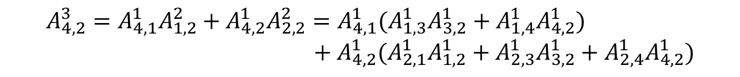
Number of Paths
How many paths of p edges between 2 specific vertices?
Thm 4.7 Given a graph G with vertices V, edges E the # paths of p edges from vertex i to vertex j is the (i,j)^{th} entry of A^{p}, where A is the adjacency matrix
e.g.,:
Paths of 3 edges from 3 to 4: 3-1-2-4, 3-2-1-4
Paths of 3 edges from 4 to 2: 4-1-3-2, 4-1-4-2, 4-2-1-2, 4-2-3-2, 4-2-4-2
1
2
3
4
$$A_{3,4}^{3}=A_{3,1}^{1}A_{1,4}^{2}+A_{3,2}^{1}A_{2,4}^{2}=A_{3,1}^{1}(A_{1,2}^{1}A_{2,4}^{1})+A_{3,2}^{1}(A_{2,1}^{1}A_{1,4}^{1})$$
$$A_{4,2}^{3}=A_{4,1}^{1}A_{1,2}^{2}+A_{4,2}^{1}A_{2,2}^{2}=A_{4,1}^{1}(A_{1,3}^{1}A_{3,2}^{1}+A_{1,4}^{1}A_{4,2}^{1}) \\ +A_{4,2}^{1}(A_{2,1}^{1}A_{1,2}^{1}+A_{2,3}^{1}A_{3,2}^{1}+A_{2,4}^{1}A_{4,2}^{1})$$
4.3: Shortest Paths and Distance

Slide 48

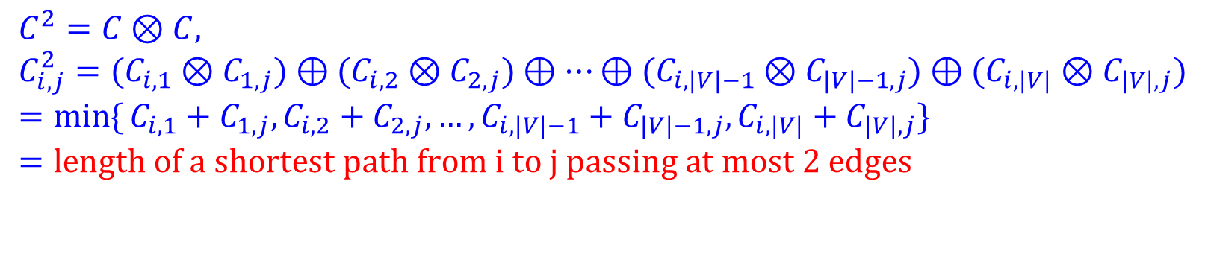
Path Algebra
Path algebra: an ordered semiring with 2 binary operations defined as
Measure matrix: C, where C_{ij} represents the length of edge (i,j) C_{ii} =0 for all i; C_{ij}=∞ , if there exists no edge (i,j)
$$(S,⊕,⊗,e,∅,≤) \text{with} S=ℝ∪\{∞\}$$
 | Generalized addition | Generalized multiplication | Unit element | Null element
Original sense | a ⊕ b | a ⊗ b | e | 0
Path algebra | min{a,b} | a+b | 0 | ∞
$$C^{2}=C⊗C, \\ C_{i,j}^{2}=(C_{i,1}⊗C_{1,j})⊕(C_{i,2}⊗C_{2,j})⊕…⊕(C_{i,|V|−1}⊗C_{|V|−1,j})⊕(C_{i,|V|}⊗C_{|V|,j}) \\ =\min{\{}C_{i,1}+C_{1,j},C_{i,2}+C_{2,j},…,C_{i,|V|−1}+C_{|V|−1,j},C_{i,|V|}+C_{|V|,j}\} \\ =\text{length} \text{of} \text{a} \text{shortest} \text{path} \text{from} \text{i} \text{to} \text{j} \text{passing} \text{at} \text{most}\text{ 2 }\text{edges}$$
|V| addition |V|-1 comparison
4.3: Shortest Paths and Distance

Slide 49
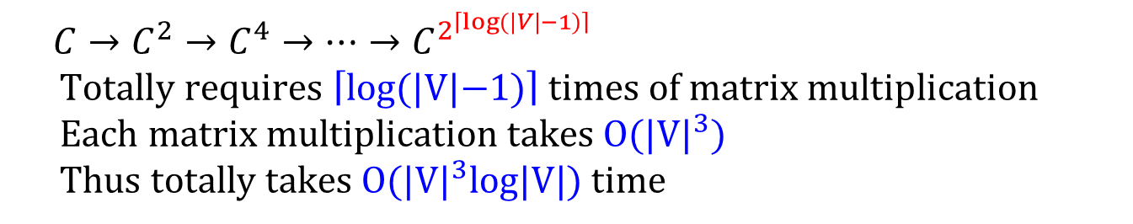
Compute APSP by C^{|V|-1}
$$C_{i,j}^{k}=\text{length} \text{of} \text{a} \text{shortest} \text{path} \text{from} \text{i} \text{to} \text{j} \text{passing} \text{at} \text{most} \text{k} \text{edges}$$
Every simple path between 2 vertices at most contains |V|-1 edges
Thus
By computing matrix C^{|V|-1}, we can obtain ALL-ALL shortest paths
How to efficiently compute C^{|V|-1}?
There are many fast-matrix-multiplication techniques that can be used to improve this complexity, but such algorithms are complicated.
$$C_{i,j}^{|V|−1}=\text{length} \text{of} \text{a} \text{shortest} \text{path} \text{from} \text{i} \text{to} \text{j}$$
$$C→C^{2}→C^{4}→…→C^{2^{\left\lceil \log{(}|V|−1)\right\rceil }} \\ \text{Totally} \text{requires} \left\lceil \text{log}(|V|\text{−1})\right\rceil \text{times} \text{of} \text{matrix} \text{multiplication} \\ \text{Each} \text{matrix} \text{multiplication} \text{takes} O(|V|^{3}) \\ \text{Thus} \text{totally} \text{takes} O(|V|^{3}\text{log}|V|) \text{time}$$
O(|V|²*|V|) since there are |V|² entries, each takes O(|V|)
4.3: Shortest Paths and Distance

Slide 50
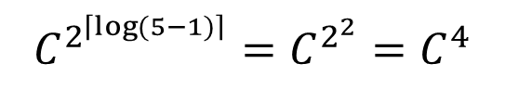
Example of Matrix Multiplication
2
3
2
1
1
5
4
$$C^{2^{\left\lceil \log{(}5−1)\right\rceil }}=C^{2^{2}}=C^{4}$$
2
1
1
1
2
2
5
4.3: Shortest Paths and Distance

Slide 51
Floyd-Warshall Algorithm
Let D be an n × n distance matrix, whose entry D_{ij} is initially set to be C final D_{ij} denotes the length of the shortest path from i to j PRED be a n × n predecessor matrix, whose entry PRED_{ij} is initially set to be i final PRED_{ij} denotes the predecessor of j on the path from i to j
Triple comparison : d_{ij}=min{d_{ij}, d_{ik}+d_{kj}}
Claim:
if we perform triple comparisons for successive k=1,2,…,|V| then the final d_{ij} equals the length of the shortest path from i to j
Floyd-Warshall Algorithm is based on the above claim
begin
initialization: D:=C; PRED_{ij}:=i for each (i,j);
for k=1 to |V| do
for i=1 to |V| do
for j=1 to |V| do
if d_{ij}>d_{ik}+d_{kj} then
d_{ij}=dik + d_{kj}; PRED_{ij}=PREDkj ;
end
4.3: Shortest Paths and Distance

Slide 52
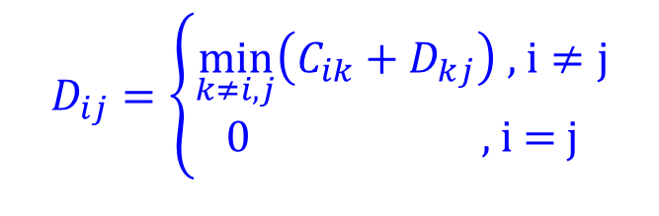
Properties of Floyd-Warshall Algorithm
Let D_{ij}^{k} denote the entry D_{ij} after the k^{th} iteration of Floyd-Warshall algorithm
D_{ij}^{k} is the length of shortest path from i to j with intermediate vertices in {1,2,…,k-1,k}
Totally O(|V|³) operations, most efficient for complete graph
Detect negative cycle: if D_{ii}^{k}<0, there is a neg. cycle with intermediate nodes in {1,…,k}
Dynamic Programming:
$$D_{ij}=\left\{\begin{matrix}\min_{k≠i,j}\left(C_{ik}+D_{kj}\right)\text{ , }\text{i}≠j \\ 0\text{ , }\text{i}\text{ = }\text{j}\end{matrix}\right.$$
Bellman’s Equation:
D = C ⊗D ⊕ I_{n}
Floyd-Warshall algorithm ⬄ Gauss Jordan method
D_{kj}
i
k
j
4.3: Shortest Paths and Distance

Slide 53
Example of APSP problems
2
3
2
D^{k}: distance matrix after the k^{th} iteration
PRED^{k}: predecessor matrix after the k^{th} iteration
After the |V|-1th iteration, the last column & row are already optimal
1
1
5
4
2
1
1
1
2
2
5
D¹
D²
D³
D⁴
D⁵
0
1
2
∞
1
0
1
2
3
1
0
1
2
3
1
0
1
2
3
1
0
1
2
2
1
1
0
1
2
2
1
0
1
2
2
1
0
1
2
2
1
0
1
2
2
1
0
1
2
2
2
1
0
2
3
2
1
0
2
3
2
1
0
2
3
2
1
0
2
3
2
1
0
2
3
∞
2
2
0
1
3
2
2
0
1
3
2
2
0
1
3
2
2
0
1
2
2
2
0
1
1
2
3
1
0
1
2
3
1
0
1
2
3
1
0
1
2
3
1
0
1
2
3
1
0
PRED¹
PRED²
PRED³
PRED⁴
PRED⁵
1
1
1
1
1
1
1
1
2
1
1
1
1
2
1
1
1
1
2
1
1
1
1
5
1
2
2
2
2
2
2
2
2
2
2
2
2
2
2
2
2
2
2
2
2
2
2
2
2
2
3
3
3
3
1
3
3
3
3
1
3
3
3
3
1
3
3
3
3
1
3
3
3
3
1
4
4
4
4
4
2
4
4
4
4
2
4
4
4
4
2
4
4
4
4
5
4
4
4
4
5
5
1
5
5
5
5
1
5
5
5
5
1
5
5
5
5
1
5
5
5
5
1
5
5
4.3: Shortest Paths and Distance

Slide 54
Trace Shortest Paths by PRED matrix
2
3
2
PRED⁵
1
1
5
4
1
1
1
5
1
2
1
1
2
2
2
2
2
1
3
3
3
3
1
2
2
5
5
4
4
4
4
5
5
1
5
5
Trace_path(PRED,i,j)
begin
k=j;
output k;
while PRED_{ik} ≠ i do
k=PRED_{ik}; output k
end while
output i
end
trace path 1→4: i=1,j=4
k=j=4
output 4
Since PRED₁₄=5 ≠ 1
k= PRED₁₄=5
output 5
Since PRED₁₅=1 = 1
output 1
Thus we obtain 4←5←1 as the shortest path
4.3: Shortest Paths and Distance

