Slide 1
A Network Flow Model for Clustering Segments and Minimizing Total Maintenance and Rehabilitation Cost
by
I-Lin Wang
Yi-Chang Tsai
Feng Li
On
Computers & Industrial Engineering
Vol.60 (2011), pp.593--601

Slide 2
Segment Clustering Problem (SCP)
Objective
  To group m segments into ? (say, n*) clusters in a way such that the total cluster cost is minimized
Given
  m segments {1,2,…,m}, segment i has original treatment cost c_{i}
  each cluster induces an initial set-up cost (or mobilization cost) f
Constraints:
  segments have to be clustered consecutively
  a cluster may have bounds on the number of its segments
    e.g. Contains at least m_{l}=2 segments, or at most m_{u}=10 segments
  once segment i is grouped into cluster j, its final treatment cost has to be greater than or equal to c_{i}
  all segments in the same cluster must have the same final treatment cost
  cost for a cluster equals to the sum of f and the total final treatment costs for all the segments it contains, which should be at least L

Slide 3
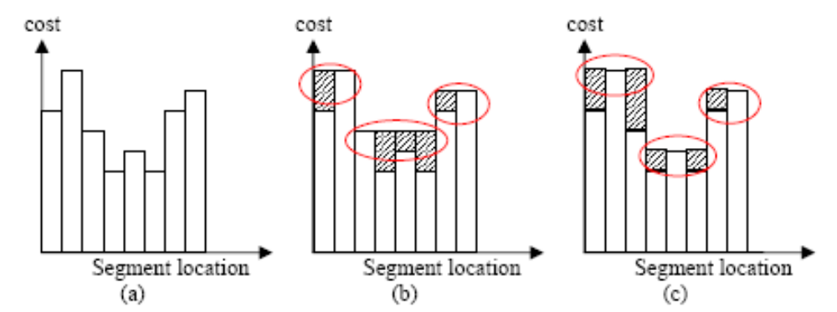

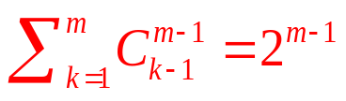
A small segment clustering example
m=8
To minimize the shaded area
= To minimize the total area
k-clustering
  Group m segments into k clusters
  Placing k-1 separators over the m-1 internal boundaries
  Totally possible combinations
Totally possible clustering combinations
Size of the solution space is exponential w.r.t. m
n=3
n=3
How many clusters?
In what combinations?
consecutive segments
in the same cluster

Slide 4
An MIP formulation - variables
Clustering problem can be formulated as an MIP, usually in facility location type, or set covering type
Binary variables (0-1):
  x_{ij} : 1, if segment i is assigned to cluster j
  y_{j} : 1, if cluster j contains some segment
Linear variables:
  z_{ij} : final treatment cost for each segment i in cluster j
    If x_{ij} = 0, then z_{ij} = 0
    If x_{ij} = 1, then z_{ij} = Z_{j} ≥ c_{i}
  Z_{j} : final treatment cost for each segment contained in cluster j
    If cluster j is empty, then Z_{j} = 0
each segment has to be covered
by some cluster with
minimum totoal cost
segment ←→ customer
  treatment cost ←→ transportation cost
cluster ←→ warehouse (or, plant)
  “invisible” , or “logical” warehouse
  fixed cost ←→ building facility cost
Notes:
Explain facility location & set covering
Logical facility (not a physical one)

Slide 5

Segment Clustering Problem (SCP)
treatment cost + fixed cost
(transportation) (building facility)
each segment can only be included in one cluster
if cluster j is empty, then it contains no segment
Q: a very large number
a nonempty cluster should contain at least m_{l} segments
Continuity constraints:
different assignments can not cross over each other
empty clusters always have larger indices
    If x_{ij} = 0, then z_{ij} = 0
    If x_{ij} = 1, then z_{ij} = Z_{j} ≥ c_{i}
a nonempty cluster should cost at least L
O(mn) decision variables; O(m²n²) constraints ;
Bottle neck: Constraints (4) !

Slide 6
Uncapacitated Facility Location Problem (UFLP)
Assign a segment (customer) to a cluster (warehouse; facility) such that total cost is minimized
Each facility has no capacity limit (uncapacitated)
SCP is a specialized UFLP
  With ordering constraints
UFLP is NP-hard in general
Q: is SCP NP-hard as well?
A: It is polynomial-time solvable!!
by a proposed O(m³) algorithm TOSC
(Topological Ordering based Segment Clustering)

Slide 7
Topological Ordering Segment Clustering Algorithm (TOSC) - Intuitions
Idea:
  Construct a Segment Graph (SG=(V,A))
    Construct a qualified cluster node for each qualified cluster
      Calculate the cost associated with a qualified cluster
      Takes O(m³) time, |V|=O(m²) storage
    Construct dummy source v₀₀ and sink v_{m’m’} , where m’=m+1
    Construct arcs
      |A|=O(m³) storage, but NO need to store them
  SG is acyclic
  Each v₀₀-v_{m’m’} path corresponds to a feasible clustering
  A shortest v₀₀-v_{m’m’} path gives an optimal clustering
Complexity : O(m³) time
  by a topological ordering based Shortest Path algorithm

Slide 8
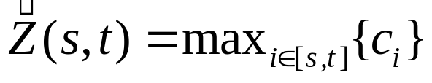
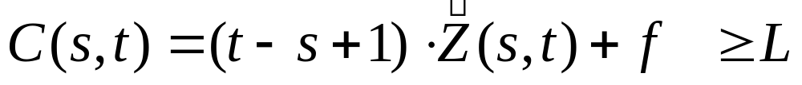
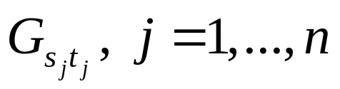



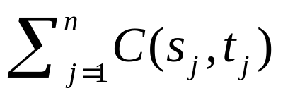
Notations
A possible cluster G_{st}, where 1 ≤ s ≤ s+m_{l}-1 ≤ t ≤ m
  groups consecutive segments s,s+1,…,t-1,t, with m_{l} ≤ t-s+1
  Individual final treatment cost for each segment in G_{st}
  Individual cluster cost for G_{st}
Suppose totally n clusters,
  where
  Total clustering costs

Slide 9

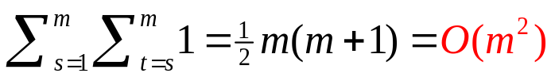
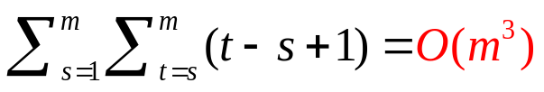

Segment Graph SG=(V,A) (1/2)
A cluster node v_{st} represents a qualified cluster G_{st}
  v_{st} will be constructed only if it satisfies
    the constraint that bounds on the number of segments,
    (e.g. m_{l}=2 ≤ t-s+1 ≤ 10=m_{u})
    cost constraint
    checking whether v_{st} should be constructed takes O(t-s+1) time,
      Calculating takes O(t-s+1) time
      All other operations takes O(1) time
  |V| is at most
  Total time to construct V is at most
For each s, t where 1 ≤ s ≤ s+m_{l}-1 ≤ t ≤ m-1, connecting v_{st} to v_{s’t’} by a successive arc with length C(s,t) for each s’, t’ where t+1 ≤ s’ ≤ s’+m_{l}-1 ≤ t’ ≤ m
  at most such arcs
  Total time to construct these successive arcs is at most

Slide 10





Segment Graph SG=(V,A) (2/2)
Dummy nodes and artificial arcs
  Dummy source node v₀₀
    Connecting v₀₀ to v_{1t}, for each possible t in [1,m]
    Assign zero length to these artificial arcs
  Dummy sink node v_{m’m’} where m’=m+1
    Connecting v_{sm} to v_{m’m’} for each possible s in [1,m]
    Each such artificial arc has length C(s,m) for each possible s in [1,m]
  Number of dummy nodes: 2
  Number of artificial arcs: at most
Total time to construct SG is at most
Storage for SG
  |V|= , |A|=
  However, it suffices to store |V| only (thus only ),
  since all outgoing arcs from a node have the same lengths
  and SG is acyclic

Slide 11
Mathematical properties for SG
Lemma 1:
  A segment graph SG =(V,A) contians at most |V|=O(m²) nodes and |A|=O(m³) arcs.
  Constructing SG =(V,A) takes O(m³) time, although it suffices to consume O(m²) storage space without storing A.
Lemma 2:
  The internal nodes on a v₀₀-v_{m’m’} path in SG correspond to a feasible clustering to the SCP.
  The length for a v₀₀-v_{m’m’} path equals to the total cost of that clustering.
Lemma 3:
  The segment graph SG is acyclic.
  A shortest v₀₀-v_{m’m’} path can be identified in O(m³) time
    By topological ordering O(|A|)= O(m³) , or
    by Dijkstra’s Fibonacci heap implementation O(|A|+|V|log|V|)= O(m³)
arcs always point from nodes of smaller indices to nodes of larger indices
[FT87] M.L. Fredman and R.E. Tarjan, “Fibonacci heaps and their uses in improved network optimization algorithms”,
Journal of the ACM 34, 596-615 (1987).
Notes:
[FT87] M.L. Fredman and R.E. Tarjan, “Fibonacci heaps and their uses in improved network optimization algorithms”, Journal of the ACM 34, 596-615 (1987).

Slide 12
An illustrative example for m=5 segments
m=5, c_{i}=[6,8,4,3,4], f=3, L=0, m_{l}=1
Dummy nodes &
Artificial arcs
6,6
1,5
2,5
3,5
4,5
5,5
1,4
2,4
3,4
4,4
A v₀₀-v₆₆ path [0,0]-[1,1]-[2,3]-[4,5]-[6,6]
3 clusters {1},{2,3}, {4,5}
where
C(1,1)=6+3=9
C(2,3)=2*max{8,4}+3=19
C(4,5)=2*max{3,4}+3=11
total clustering cost: 9+19+11=39
1,3
2,3
3,3
1,2
2,2
Cluster nodes &
Succesive arcs
1,1
Shortest Path: [0,0]-[1,2]-[3,5]-[6,6]
2 clusters {1,2}, {3,4,5}
total clustering cost: 19+15=34
0,0

Slide 13
An illustrative example for m=8 segments
m=8, c_{i}=[6,8,4,3,4,3,6,7], f=3, L=20, m_{l}=2
1,5
6,8
Shortest Path: [0,0]-[1,3]-[4,8]-[9,9]
2 clusters {1,2,3}, {4,5,6,7,8}
total clustering cost: 27+38=65
43
0
24
0,0
1,4
5,8
9,9
0
35
31
Q: why there is no cluster node v_{1,1}, v_{1,2}?
A: v_{1,1} violates m_{l}=2; v_{1,2} does not lie on any
v₀₀-v₉₉ path, thus no need to draw it.
0
1,3
4,8
38
27
Successive arcs
Artificial arcs
s,t
s’,t’
length
0,0
s,t
C(6,8)=3*max{3,6,7}+3=24
C(5,8)=4*max{4,3,6,7}+3=31
C(4,8)=5*max{3,4,3,6,7}+3=38
length
C(1,5)=5*max{6,8,4,3,4}+3=43
C(1,4)=4*max{6,8,4,3}+3=35
C(1,3)=3*max{6,8,4}+3=27
s,t
m’,m’
length
Notes:
Answer to Q:
(1) v1,1 does not show since each cluster contains at least 2 segments.
(2) v1,2 does not show since such a cluster incurs 2*8+3=19<20, not qualified.
Note that we do not draw those nodes/arcs not lying on any v0-v8 path, although they are still constructed in the first place.

Slide 14
Algorithm TOSC
Algorithm TOSC([c₁,…,c_{m}],f,L,m_{l})
Step 1. Calculating C(s,t), the cost for each possible cluster combination [s,t]
Step 2. Constructing V, the set of qualified cluster nodes and dummy nodes v₀₀, v_{m’m’}
Set C(0,0)=0, C(m’,m’)=0
Step 3. Initialization for the distance labels and predecessors:
Let D(s,t) =∞ and P(s,t) =NULL denote the initial distance label and
predecessor for each qualified node v_{st}, respectively. s,t in [1,m’]
D(0,0) =0 and P(0,0) =NULL; D(1,t) =0 and P(1,t) = v₀₀ for each qualified v_{1t} , t in [1,m];
Step 4. Topological ordering operations to calculate a shortest path:
For s = 1 to s = m do
For t = s+m_{l} -1 to t = m-1 and qualified nodes v_{st} do
s’ = t +1;
For t’ = s’+m_{l} -1 to t’ = m and qualified node v_{s’t’} do
If D(s’,t’) > D(s,t) + C(s,t) then
D(s’,t’) = D(s,t) + C(s,t) ; P(s’,t’) = v_{st} ;
If D(m’,m’) > D(s,m) + C(s,m) and qualified nodes v_{sm} then
D(m’,m’) = D(s,m) + C(s,m) ; P(m’,m’) = v_{sm} ;
Step 5. Trace a best clustering:
If D(m’,m’) =∞ then
there exists no feasible clustering, STOP.
Else
output a best clustering by tracing from v_{m’m’} back to v₀₀ based on
predecessors. The best clustering has total cost equal to D(m’,m’).
takes O(m³) time
takes O(m²) time
takes O(m²) time
takes O(m³) time
Bottlenecks: Step 1 & 4: takes O(m³) time ! ➔ A Polynomial-time Algorithm !!
takes O(m) time

Slide 15
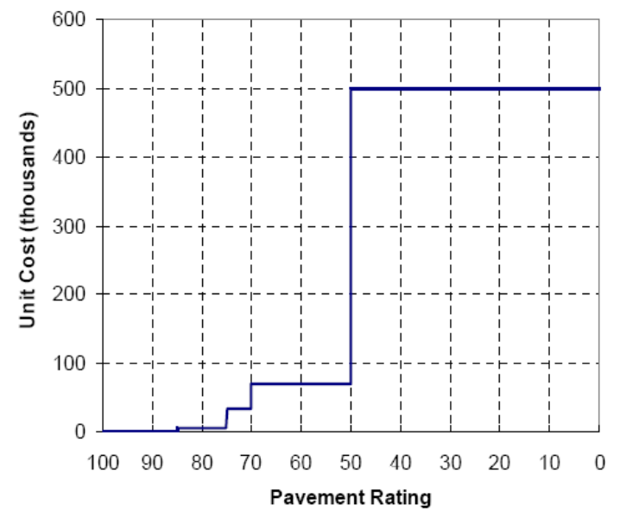
Computational experiments
Settings:
  Solve SCP formulations (an MIP) by CPLEX 11.0
  Solve the shortest path on SG by algorithm TOSC, implemented by Visual C++ 2005
  OS: Windows XP
  CPU: Intel Core Duo 2 1.86GHz
  1GB RAM
Problem sets: m_{l}=2, L=0, f=150,000 USD
  2 real datasets: m=34, m=96, imported from a subset of continuous roadway pavement segments in Georgia State, USA.
  8 categories of simulated datatsets, each with 10 random cases
    Rating uniformly distributed in [40, 100],
    rating can be converted into cost by the figure above
    Small scale : m=30, 50
    Medium scale : m=100, 250, 500
    Large scale : m=1000, 2500, 5000

Slide 16
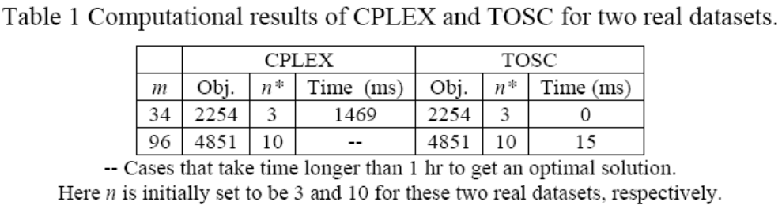
Results for 2 real datasets
Data source:
  m=34, m=96, imported from a subset of continuous roadway pavement segments in Georgia State, USA.
  The m=34 case has been tested by Tsai et al. (2006) and Yang et al. (2009) using Fuzzy c-means algorithm
  The m=96 case was too hard to be solved by previous researchers
Performance:
  Different n will affect the running time of CPLEX
    Even setting n=n*, CPLEX is still too slow, compared with TOSC
Notes:
[TYW06] Y. Tsai, C. Yang, and Z. Wang, “Spatial clustering for determining economical highway pavement let projects”, Proceedings of GeoCongress 1-6 (2006).
[YTW09] C. Yang, Y. Tsai, and Z. Wang, “Algorithm for spatial clustering of pavement segments”, Computer-Aided Civil and Infrastructure Engineering 24, 1-16 (2009).

Slide 17
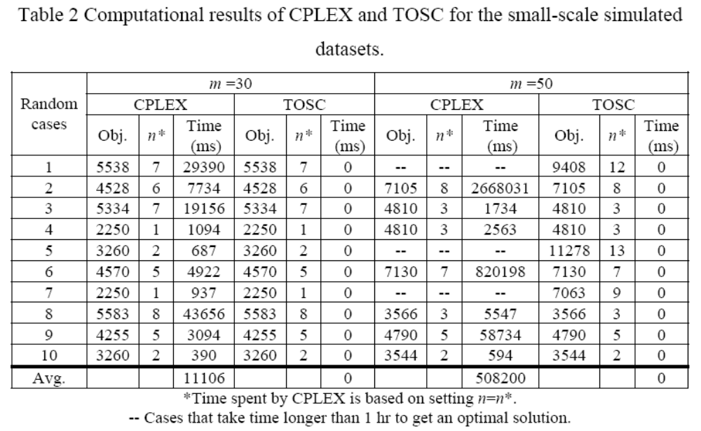
Results of small-scale simulated datasets
2 categories: m=30, 50
Even with the most tightest initial guess on n (i.e. n=n*), CPLEX still cannot compete with TOSC.

Slide 18
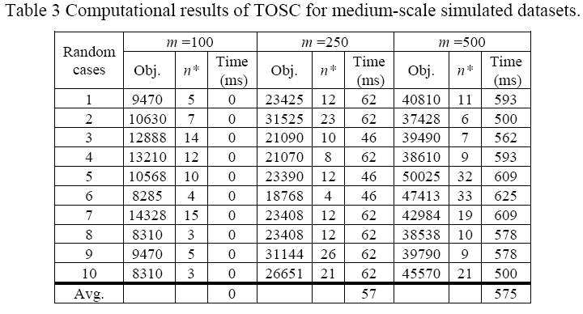
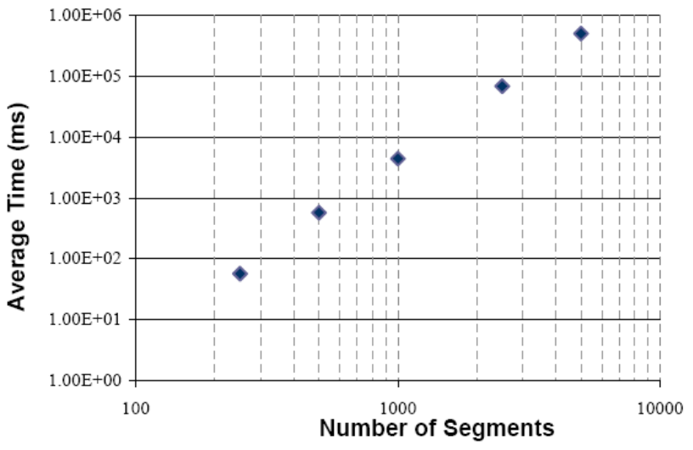
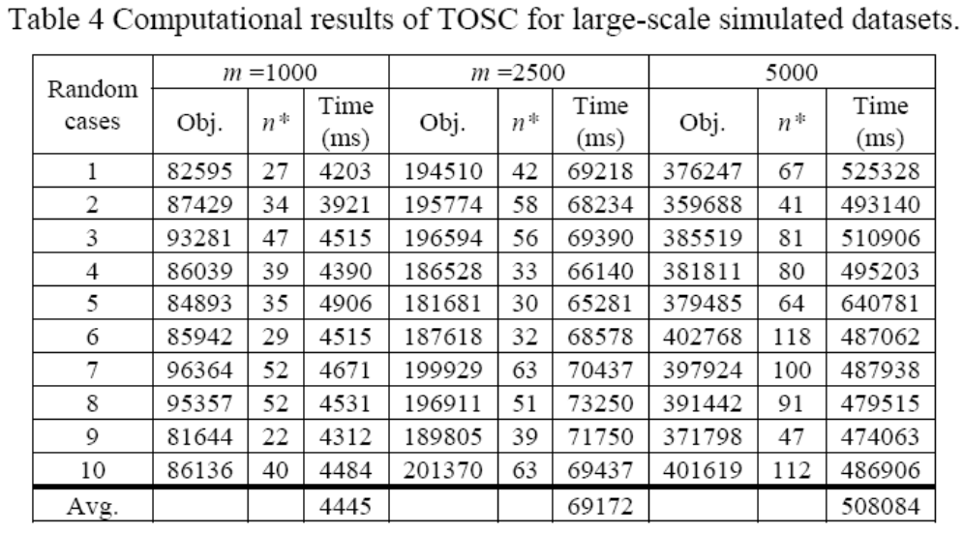
Results of medium/large-scale simulated datasets
Medium: 3 categoreis: m=100, 250, 500
Large: 3 categoreis: m=1000, 2500, 5000
T=O(m³) ⬅➔ Log(T)=O(log(m))
TOSC performs very efficiently
and robustly, unlike CPLEX whose
efficiency highly depends on n.

Slide 19
Conclusions
We first give a special UFLP model, then propose a network model to map each possible clustering into a path in an acyclic network SG=(V,A) with O(m²) nodes and O(m³) arcs.
Our proposed algorithm TOSC are based on topological ordering algorithm, and solves SCP in O(m³) time.
Computational experiments indicate the TOSC is highly robust and efficient for solving large-scale SCPs with m up to 5000 segments within minutes, whereas CPLEX even takes hours to solve small-scale (say, m=50) SCPs.
This modeling technique may be further applicable to solve the spatial clustering problem proposed by Yang et al. (2009)

Slide 20
Future research topics
Constrained shortest path
  Try to add more constraints such as
    Bounds on # clusters a clustering should have
    Budget, time, rating bounds?
    What else?
Sensor network on a road to detect/monitor pavement condition or traffic
  One dimension, similar to SCP?
What else?

