Slide 1

Ph.D. Thesis Defense
Shortest Paths and Multicommodity Network Flows
By
I-Lin Wang
Jan 21, 2003
Committee Chair:
member:
Dr. Ellis L. Johnson
Dr. George L. Nemhauser
Dr. Joel S. Sokol
Dr. Pamela Vance
Dr. Huei-Chuen Huang

Slide 2
ODMCNF : Introduction
Commodity: an O-D pair
Example:
|N| = 7
|A| = 16
|K| = 5
3
2
5
Problem | Cargo/Packet Routing
Commodity | O-D shipments
Flow Balance | Conservation of shipments
Bundle Constraints | Arc Capacity, Node Capacity
4
1
6
7
Commodity:
k1 1-5 : 1-2-4-5
k2 2-6 : 2-3-5-7-4-6
k3 3-1 : 3-4-5-7-1
k4 6-2 : 6-7-1-2
k5 7-3 : 7-4-5-2-3
Shared arcs:
(1,2) : k1, k4
(2,3) : k2, k5
(4,5) : k1, k3, k5
(5,7) : k2, k3
(7,1) : k3, k4
Notes:
Commodity k1 and k4 share arc (1,2)

Slide 3
Asia-Pacific Aircargo Network
OD Multicommodity flow
Model I:
  nodes: countries , arcs: traffic between countries
  11 center nodes: SG,TW,JP,KR,PH,ID,MY,CN,HK,VN,TH
  20 rim nodes:
  AU,BH,CA,DK,FI,FR,DE,GR,IN,IT,NL,NZ,PK,RU,LK,CH,TR,AE,GB,US
  center⬄center , rim⬄center
Model II:
  nodes: cities , arcs: traffic between cities
  48 center nodes, 64 rim nodes
  1038 arcs: center⬄center (480), rim ⇨center (277), center ⇨ rim (281)
Notes:
12 center countries, 48 center airports:
SG [1]: Singapore
TW [2]: Taiwan (Kaohsiung, Taipei)
JP [12]: Japan (Fukuoka, Hiroshima, Niigata, Komatsu, Kagoshima, Nagoya, Okinawa, Okayama, Osaka, Sendai, Sapporo, Tokyo)
KR [3]: Republic of Korea (Cheju, Pusan, Seoul)
PH [3]: Philippine (Cebu, Manila, Subic Bay)
ID [3]: Indonesia (Denpasar Bali, Jakarta, Surabaya)
MY [4]: Malaysia (Kota Kinabalu, Kuching, Kuala Lumpur, Penang, Langkawi)
BN [1]: Brunei Darussalam
CN [12]: China (Beijing, Guangzhou, Dalian, Kunming, Shanghai, Shenyang, Xi An, Shenzhen, Qingdao, Tianjin, Urumqi, Xiamen)
HK [1]: Hong Kong
VN [2]: Viet Nam (Hanoi, Ho Chi Minh City)
TH [4]: Bangkok, Chiang Mai, Hat Yai, Phuket
22 rim countries, 60 rim airports
AE [3]: United Arab Emirates (Abu Dhabi, Dubai, Sharjah)
AU [8]: Australia (Adelaide, Avalon, Brisbane, Cairns, Darwin, Melbourne, Perth, Sydney)
BH [1]: Bahrain
CA [2]: Canada (Toronto, Vancouver)
CH [1]: Switzerland (Zurich)
DE [2]: Germany (Frankfurt, Munich)
DK [1]: Denmark (Copenhagen)
FI [1]: Finland (Helsinki)
FR [1]: France (Paris)
GB [2]: United Kingdom (London, Manchester)
GR [1]: Greece (Athens)
IN [6]: India (Ban galore, Mumbai, Calcutta, Delhi, Hyderabad, Chennai)
IT [2]: Italy (Milan, Rome)
LK [1]: Sri Lanka (Colombo)
NL [1]: Netherlands (Amsterdam)
NZ [2]: New Zealand (Auckland, Christchurch)
PK [3]: Pakistan (Islamabad, Karachi, Lahore)
RU [4]: Russian Federation (St Petersburg, Moscow, Novosibirsk, Ulyanovsk, Khabarovsk)
TR [1]: Turkey (Istanbul)
US [17]: United States (Anchorage, Atlanta, Chicago, Dallas/Fort Worth, Detroit, Fairbanks, Honolulu, Houston, Las Vegas, Los Angeles, Minneapolis/St Paul, New York, Portland, Seattle, San Francisco, San Jose, Washington, Boston, Kona, Memphis, Oakland)

Slide 4
Aircargo Network
Airport node i splits into 4 nodes
  i₁ , i₂ , i₃ , i₄
Original network: n nodes, m arcs
New network: 4n nodes, (m+3n) arcs
Local export
Local export
export
import
export
import
Local import
Local import
Transshipment
Notes:
Suppose we have k OD commodities
Each airport node i can be split up into 4 nodes
i₁ : for outside import , supply/demand b^{k}_{i1} = 0
i₂ : for local import , supply/demand b^{k}_{i2} = local export supply
i₃ : for local export , supply/demand b^{k}_{i3} = local import demand
i₄ : for outside export , supply/demand b^{k}_{i1} = 0
Arc Cost:
C^{k}_{i1,i2} : 0
C^{k}_{i2,i3} : Transshipment cost
C^{k}_{i3,i4} : 0
C^{k}_{i4,j1} : Transportation cost
Arc Capacity:
U^{k}_{i1,i2} : ∞
U^{k}_{i2,i3} : Transshipment capacity
U^{k}_{i3,i4} : ∞
U^{k}_{i4,j1} : flight capacity

Slide 5
Overview
  2 formulations
  Node-Arc vs. Arc-Path
ODMCNF
Improvement
  Try to solve RMP faster
    Good Paths
    Primal-Dual method
    Key path decomposition method
  Try to solve Shortest Path faster
    good SOME-SOME SP algorithms
Notes:
Reference
MCNF:
J.B. Rosen (1964), Primal partition programming for block diagonal matrices, Numerische Methematik 6, 250-260
C. Barnhart, C.A. Hane, E.L. Johnson, and G. Sigimondi (1995), A column generation and partitioning approach for multicommodity flow problems, Telecommunication Systems 3, 239-258
C. Barnhart, C.A. Hane, and P. Vance (2000), Using Branch-and-Price-and-Cut to Solve Origin-Destination Integer Multicommodity Flow Problems, Operations Research, Vol. 48, No. 2, 318-326
K.L. Jones, I.J. Lustig, J.M. Farvolden, and W.B. Powell (1993), Multicommodity network flows: The impact of formulation on decomposition, Mathematical Programming 62, 95-117
P-D subproblem:
J. Hu, and E. Johnson (1999),Computational Results with a Primal-Dual subproblem simplex method, OR Letters 25, 149-157
P-D NNLS:
E. Barnes, V. Chen, B. Gopalakrishnan , and E. Johnson (2001), A Least Squares Primal-Dual Algorithm for Solving Linear Programming Problems, OR Letters (to appear)
Shortest Path:
B. A. Carré (1969), A Matrix Factorization Method for Finding Optimal Paths through Networks, I.E.E. Conference Publication (Computer-Aided Design) No. 51, 388-397
B. A. Carré (1971), An Algebra for Network Routing Problems, Journal of Institute of Mathematics and Its Applications 7, 273-294
S. Goto, T. Ohtsuki, and T. Yoshimura (1976), Sparse Matrix Techniques for the Shortest Path Problem, IEEE Transactions on Circuits and Systems CAS-23, 752-758
B. Cherkassky, A. Goldberg, and T. Radzik (1996), Shortest paths algorithms: Theory and experimental evaluation, Mathematical Programming 73, 129-174

Slide 6
Contributions
Comprehensive Surveys:
  Shortest path algorithms & MCNF applications/algorithms
Show the LSPD method = Dijkstra’s algorithm
(for 1-1,1-ALL SP problems with nonnegative arc length)
New MPSP Shortest Path Algorithms
  3 new algorithms DLU1, DLU2, SLU
Computational Experiments on MPSP problems
New MCNF Algorithms
  Combine Primal-Dual method with key path decomposition
Computational Experiments on MCNF problems
Notes:
Key path idea is based on Rosen’s Algorithm. It has been applied on solving ODMCNF by Barnhart et al. It is especially good for cases with many OD commodities since it significantly decrease the size of the RMP.
P-D subproblem approach has been applied on solving Crew Pairing & Cutting Stock problem with success. Its advantages are due to the better columns generated by better feasible dual variables. Thus this method is especially good for column generation.
P-D Nonnegative Least Squares method is a new method designed to avoid degenerate pivots in solving LP. It is especially good for highly degenerate problems.
To generate good columns as fast as possible, efficient shortest path algorithms are desired. More specifically, good SOME-SOME SP algorithms are desired.
In 1970’s, there were algebraic algorithms designed for solving ALL-ALL SP problem. Carré applied Gaussian Elimination technique to solve the Bellman-Ford Equation.
Goto, Ohtsuki, and Yoshimura in 1976 used code generation to do a sparse implementation of Carré’s algorithm
Algorithm Sparse-LU is another sparse version of Carré’s algorithm without using code generation.
Algorithm Dense-LU is a new SP algorithm which takes different triple comparing orders other than Floyd-Warshall and Carré’s algorithm to get ALL-ALL shortest path.

Slide 7
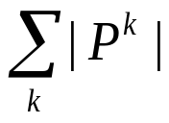
Node-Arc vs. Arc-Path
Node-Arc Form Arc-Path Form
# var: |A||K|
# var:
# row: |N||K| # row: |A|
# row: |K| # row: |A|
Bundle constraints
Bundle constraints
use Lagrangian Relaxation
subproblem : min-cost network flow
use D-W + Column Generation
subproblem : shortest path
Notes:
Comments on Node-Arc Formulation(1):
When |K| is huge (at most n(n-1)) , the # of constraint rows become huge.
Lagrangian Relaxation
Relax Bundle constraints
Only need to solve k subproblem.
Harder subproblem
Use subgradiant method to get λ (dual variable to the bundle constraints)
Worse dual variable λ
More iterations to converge

Slide 8
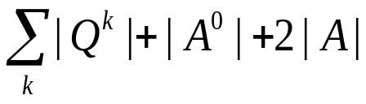
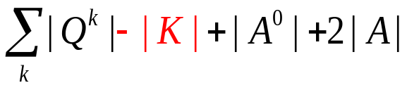
Primal-Dual key path method
PD method PD key path method
# var:
# var:
# row: |K| # row: |A|
Bundle constraints
Bundle constraints
# row: |A|
RPP
Relaxed RPP
generate ALL shortest paths Q^{k}
subproblem : shortest path
Shortest paths are needed to:
Construct RPP columns
Compute max step length
choose key path key(k) ∀k
allow flow on key(k) to be negative
substitute key variables
after relaxed problem is solved,
recompute flow on key(k)
Notes:
Comments on Node-Arc Formulation(1):
When |K| is huge (at most n(n-1)) , the # of constraint rows become huge.
Lagrangian Relaxation
Relax Bundle constraints
Only need to solve k subproblem.
Harder subproblem
Use subgradiant method to get λ (dual variable to the bundle constraints)
Worse dual variable λ
More iterations to converge

Slide 9
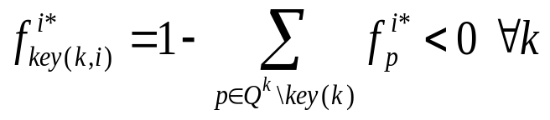
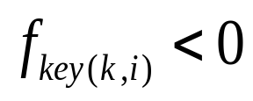
Solving Relaxed RPP
Given a RPP, i=1
Select key path key(k) for each k
Construct R_RPP(i)
Solve R_RPP(i), compute
Yes
No
i=i+1
Is there any
OPT!!
Notes:
Comments on Path-Oriented Formulation(2):
There are too many variables (columns).
Column generation technique can be applied.
Dantzig-Wolf Decomposition + Column Generation
Solve smaller Restricted Master Problem (RMP)
Easier subproblem
Solve RMP (a LP) to get λ (dual variable to the bundle constraints)
Better dual variable λ
Fewer iterations to converge

Slide 10
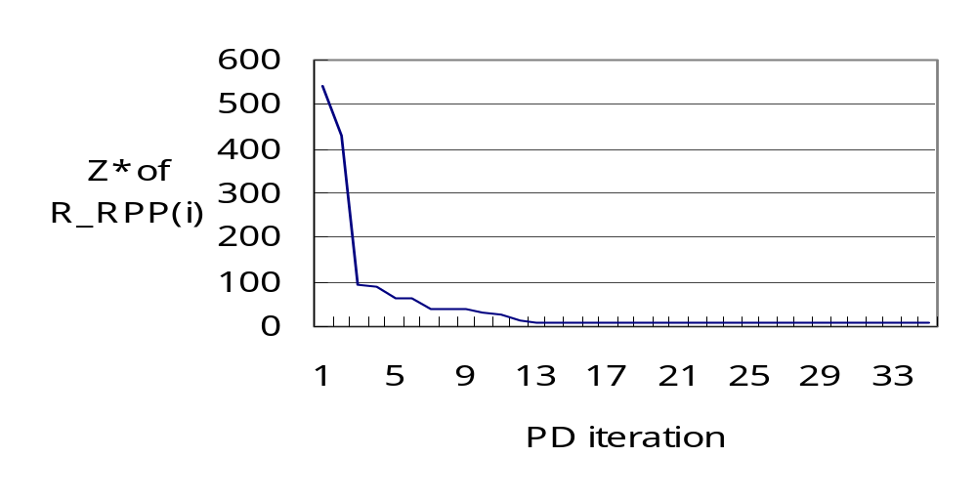
Primal Degeneracy in PD method
Stalling Problem:
Optimal infeasibility remains the same for many iterations
Randomly perturb the objective coefficient of
artificial variables
Notes:
Comments on Path-Oriented Formulation(2):
There are too many variables (columns).
Column generation technique can be applied.
Dantzig-Wolf Decomposition + Column Generation
Solve smaller Restricted Master Problem (RMP)
Easier subproblem
Solve RMP (a LP) to get λ (dual variable to the bundle constraints)
Better dual variable λ
Fewer iterations to converge

Slide 11
Dual Degeneracy in key path method
Cycling problem:
swapping between alternative key paths forever
there exist multiple optimal primal solutions
1
2
3
4
1
2
3
4
key(1,1): 1-2-3-4
key(1,3): 1-2-3-4
……
key(1,2): 1-3-4
key(1,4): 1-3-4
……
Slightly perturb each objective coefficient of cycle flows
to some randomε
Need to adjust optimal dual solution for dual feasibility
subproblem : shortest path
Notes:
Comments on Path-Oriented Formulation(2):
There are too many variables (columns).
Column generation technique can be applied.
Dantzig-Wolf Decomposition + Column Generation
Solve smaller Restricted Master Problem (RMP)
Easier subproblem
Solve RMP (a LP) to get λ (dual variable to the bundle constraints)
Better dual variable λ
Fewer iterations to converge

Slide 12
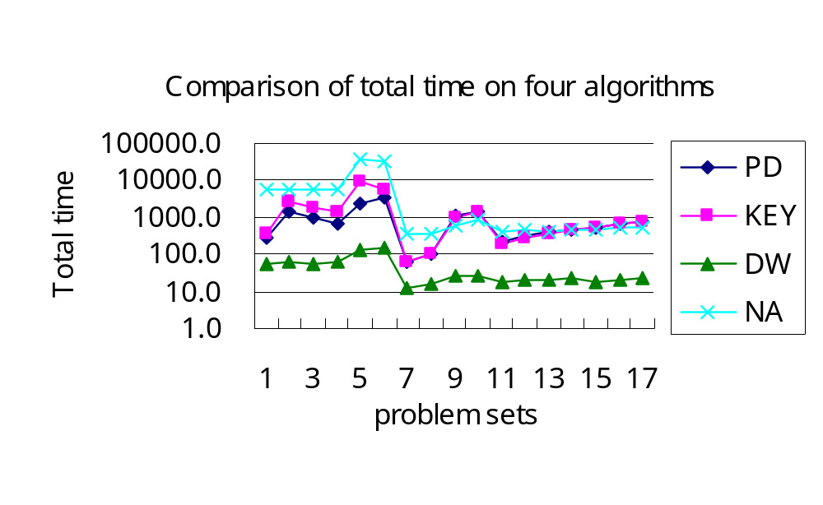
ODMCNF Computational Experiments
Total running time: DW < PD ≈ KEY < NA
Too many key path swapping iterations
PD-based methods have more iterations than DW
Notes:
Comments on Path-Oriented Formulation(2):
There are too many variables (columns).
Column generation technique can be applied.
Dantzig-Wolf Decomposition + Column Generation
Solve smaller Restricted Master Problem (RMP)
Easier subproblem
Solve RMP (a LP) to get λ (dual variable to the bundle constraints)
Better dual variable λ
Fewer iterations to converge

Slide 13
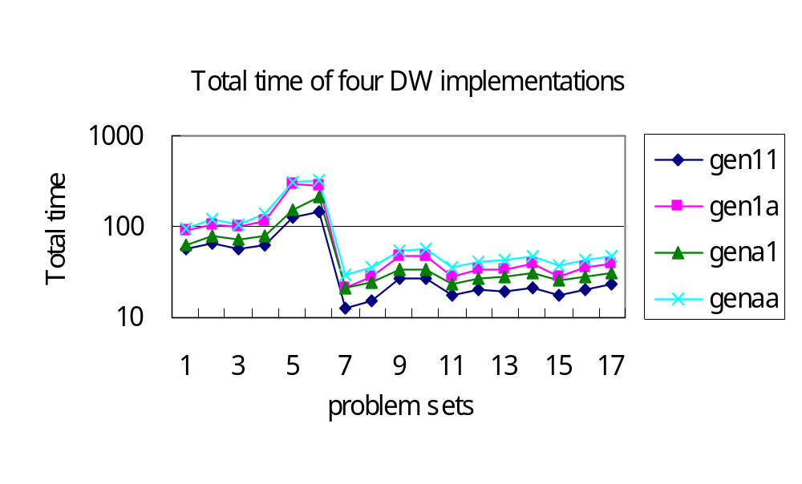
Best DW Implementation
Which is better ?
Generate ALL shortest paths ? or single shortest path ?
Generate single shortest path is better

Slide 14
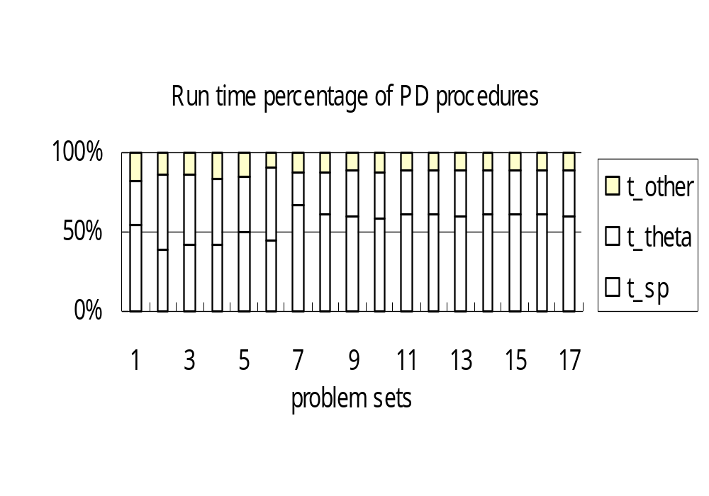
Run time % of PD procedures
How does PD spend its time ?
%t_theta + %t_sp = 82%~90% total run time

Slide 15
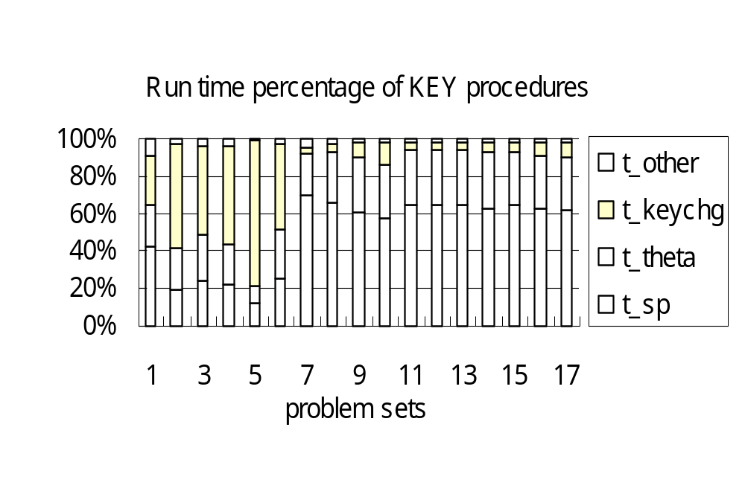
Run time % of KEY procedures
How does KEY spend its time ?
%t_theta + %t_sp = 21%~94% total run time
PD and KEY spend about the same time in (t_theta + t_sp)

Slide 16
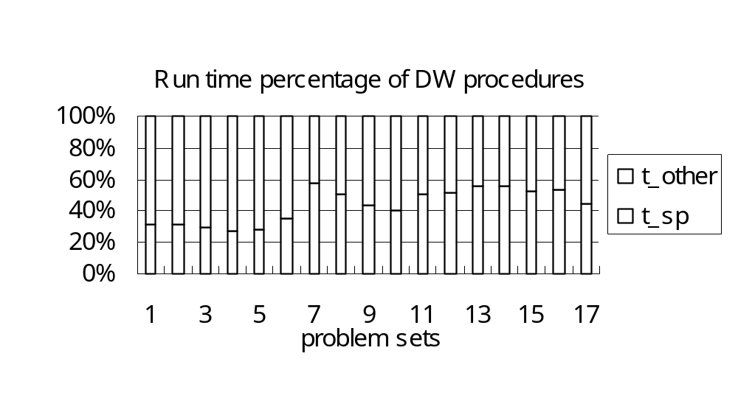
Run time % of DW procedures
How does DW spend its time ?
%t_sp = 27%~57% total run time

Slide 17
Summary of MCNF algorithms
DW is the fastest implementation
KEY performs better for problems with many OD pairs
To improve PD & KEY
  Try to choose better optimal solutions of RPP, if more than one
  Try to give better algorithm to compute max. step length θ
  Try to have more efficient SP algorithms
Importance of shortest path algorithms
Construct columns of RPP; compute θ
Fixed topology, changeable arc lengths and OD pairs
  Multiple Pairs Shortest Path Algorithms !!

Slide 18
Shortest Path Problem/Algorithm
Single Source Shortest Path (SSSP)
  Nonnegative Arc Cost (LS)
  General Arc Cost (LC)
All Pairs Shortest Paths (APSP)
  Combinatorial Type Algorithms (repeated SSSP)
  Algebraic Type Algorithms (FW)
  LP Type Algorithms (Network simplex)
Multiple Pairs Shortest Paths (MPSP)
0
 | 0
 |  | 0
 |  |  | 0
 |  |  |  | 0
0
 | 0
 |  | 0
 |  |  | 0
 |  |  |  | 0
0
 | 0
 |  | 0
 |  |  | 0
 |  |  |  | 0
0
 | 0
 |  | 0
 |  |  | 0
 |  |  |  | 0
0
 | 0
 |  | 0
 |  |  | 0
 |  |  |  | 0
Notes:
1-ALL:
Nonnegative Arc Cost
Label Setting (Dijkstra: heap/bucket..etc)
Label Correcting (Bellman-Ford, Pape-Levit, Goldberg-Radzik..etc)
General Arc Cost
Acyclic : Topological Ordering
Nonacyclic : Label Correcting
ALL-ALL:
Combinatorial Type Algorithms
Apply n times of Label Setting/Correcting Algorithm
Algebraic Type Algorithms
Floyd-Warshall , Carré , Wang
Other: matrix multiplication, decomposition..etc
SOME-SOME:
Very common in practice
Need ALL-ALL to get SOME-SOME ??
Extreme cases: “matching” pairs

Slide 19
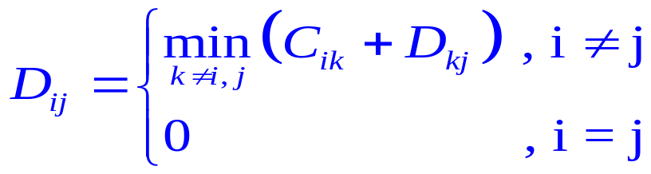
Path Algebra
Problem: Given a measure matrix C
  NO (1)multiple arcs, (2)loops (C_{ii}=0), (3)negative cycles
  C_{ij}=arc length of (i,j) if it exists , or ∞ o.w.
  What is the distance matrix D?
    D_{ij}=distance from i to j , or ∞ if i can’t reach j
Define path algebra
Original definition | a⊕b | a⊗b | e | 0(Null)
Path algebra | min{a,b} | a+b | 0 | ∞
D = C ⊗D ⊕ I_{n}
D_{ij}
i
k
j
Notes:
Note that there is no multiplication/division operation on Path Algebra.

Slide 20
ALL-ALL SP Algorithm
Solving D = C ⊗D ⊕ I_{n} is like solving system of linear equations , or, computing C⁻¹
Jacobi : Bellman-Ford O(n²m)
Gauss-Seidel : Ford-Fulkerson
Gauss-Jordan : Floyd-Warshall Algorithm O(n³)
Gauss : O(n³) : Carré , DLU
  LU factorization (once)
  forward elimination (for each node)
  backward substitution (for each node)
  Same # iterations as Floyd-Warshall, but can decompose to solve some-some shortest path problem
Notes:
In the operation of the Path Algebra, we only do addition and comparison (i.e. NO multiplication/division).
Therefore, there is no “stability” concern caused by “rounding error” as we might see when applying the iterative method to solve linear system of equation.
The same argument applies for solving the shortest distance matrix by the direct methods such as Gauss-Jordan, or Gauss elimination. Therefore, in the process of the direct methods, we only care about the pivoting order that could reduce # of fill-in.

Slide 21
Floyd-Warshall Algorithm
Idea: update C_{ij} by min{C_{ij}, C_{ik}+C_{kj}} where k≠i, j
(triple comparison)
i
k
j
0
0
0
0
0
X
0
0
0
0
0
X
0
0
0
0
0
0
0
0
0
0
0
0
0
0
X
0
Total # triple comparison = n(n-1)(n-2)
It is O(n³) → not good for sparse graph.
Note:
  In the beginning of the last iteration, we already got optimal solution
for [n]-ALL and ALL-[n]
Q={(1,4),(2,3),(5,2)}

Slide 22



Carré’s Algorithm
LU()
0
0
0
0
Forward()
0
0
0
0
0
0
0
0
Backward()
0
0
0
0
0
0
0
0
0
0
0
∞
0
∞
0
∞
0
∞
0
∞
0
0
0
∞
0
∞
0
∞
0
∞
0
∞
0
0
0
∞
0
∞
0
∞
0
∞
0
∞
0
0
0
∞
0
∞
0
∞
0
∞
0
∞
0
0
0
0
0
∞
0
∞
0
∞
0
∞
0
X₂
0
0
0
∞
0
∞
0
∞
0
X₃
0
X₃
0
0
0
∞
0
∞
0
X₄
0
X₄
0
X₄
0
0
0
∞
0
X₆
0
X₆
0
X₆
0
X₆
0
0
ALL-[1]
ALL-[2]
ALL-[3]
ALL-[4]
ALL-[5]
(5,2)
(2,3)
(1,4)
Notes:
Observation:
Process Backward() seems to be the bottleneck since it occupies about half of the total triple comparisons.
Therefore the computational loads on the 3 processes are “skewly” distributed. This inspires me to invent the Dense-LU algorithm which more evenly distributing the computational work into 3 processes.

Slide 23
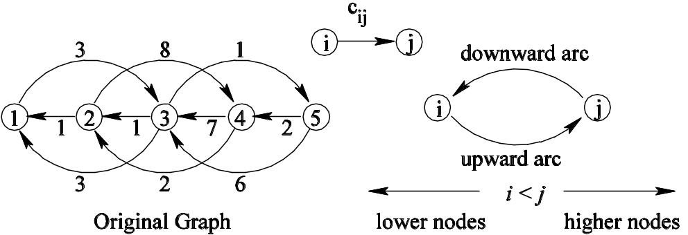
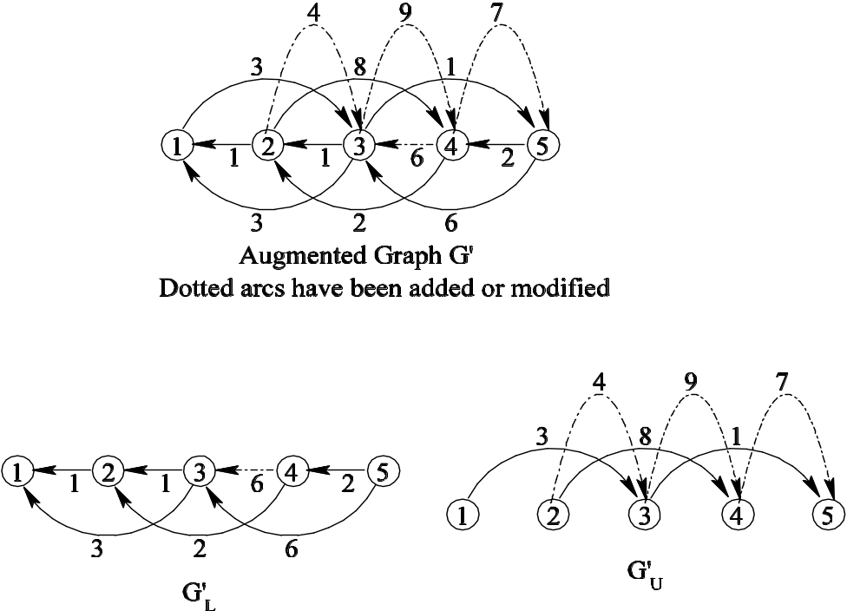
Augmented Graph G’ by LU
3
3
1
1
3
6
5
1
7
1
2
2
2
8
4
0
U
0
0
L
0
0

Slide 24
Key ideas of our algorithm DLU
Suppose h is the highest intermediate node in the shortest path from s to t
h<min{s,t} (Case 1) [LU]
min{s,t}<h<max{s,t} (Case 2) [Acyclic_L/U]
max{s,t}<h (Case 3) [Reverse_LU]

Slide 25
Algorithm DLU₁(Q)
Get x*_{st} for OD pairs (s,t): s≥k₀ t≥j₀ or s≥i₀ t≥i₀
where i₀=min_{i} s_{i} , j₀=min_{i} t_{i} , k₀=min_{i} {max{s_{i},t_{i}}}
Algorithm DLU₁(Q={(s_{i},t_{i}),i=1,…,q})
begin
LU;
Acyclic_L( j₀ );
Acyclic_U( i₀ );
Reverse_LU( k₀ );
end
LU: construct Augmented Graph G’ (Case 1)
Acyclic_L(j₀): compute shortest path in G’_{L} (Case 2)
Acyclic_U(i₀): compute shortest path in G’_{U} (Case 2)
Reverse_LU(k₀): (Case 3)
Notes:
4 main steps:
LU(): same as before, ((n(n-1)(n-2))/3) triples
Acyclic_Forward(): same as Forward(j) for all j.
That is, use the subgraph in L, do (n-1) times topological ordering,
update L.((n(n-1)(n-2))/6) triples
Acyclic_Backward(): similar to the previous operation,
except that we do it in the subgraph of U. also ((n(n-1)(n-2))/6) triples
Reverse_LU(): similar as LU(), but using node n, n-1,..,2 as
intermediate node to update the remaining submatrix.
Just looks like doing LU in the reverse way. It has ((n(n-1)(n-2))/3) triples.

Slide 26
Operations of Algorithm DLU₁
ALL-ALL
i₀=1, j₀=1 , k₀=2
0
0
0
0
LU
0
0
0
0
0
0
0
0
0
0
0
0
0
0
0
0
Acyclic_L
Acyclic_U
0
0
0
0
0
0
0
0
0
0
0
0
0
0
0
0
0
0
0
0
0
0
0
0
Reverse_LU
0
0
0
0
0
0
0
0
0
0
0
0
0
0
0
0
Notes:
Compare with Carré's and Floyd-Warshall’s algorithm :
In Carré's algorithm, the process Backward(j) does about half the work for dense case. Thus the workload is “skewed”.
Dense-LU algorithm more evenly splits the workload to the 4 processes.
This algorithm should behave worse than Carré's for Some-Some problems, but should still better than Floyd-Warshall's algorithm.
More Insights:
The process Acyclic_Forward() (or Acyclic_Backward()) can be viewed as a process of updating node distance label starting from the last node, along the subgraph L (or U), where all the arcs are pointing from node with higher (or lower) index to lower (or higher) index.
Since the 2 processes above are acyclic operations, the sparse implementation will be more efficient. Thus inspired me to invent the Sparse-LU algorithm.

Slide 27
Example of Algorithm DLU₁
Q={(1,4),(2,3),(5,2)}
i₀=1, j₀=2
k₀=min {4,3,5}=3
0
X
0
X
0
X
0
X
0
X
0
X
0
0
0
0
0
0
Requested OD pair
X
0
X
0
X
0
X
(a) Procedure G_LU
Updated entries by G_LU
Updated entries by Acyclic_L
0
X
0
X
0
X
Updated entries by Acyclic_U
0
X
0
X
0
X
Updated entries by Reverse_LU
0
0
0
Optimal entries
0
0
0
X
0
X
0
X
0
(b) Procedure Acyclic_L(2) and Acyclic_U(1)
gen. cost, Neg. cycle
good for south-eastern ODs
sparcity min fill-ins tech. (Markowitz)
undirected / acyclic graph
computational dependency
tracing shortest path
0
X
0
X
0
X
0
X
0
X
0
X
0
0
0
0
0
0
X
0
X
0
X
0
(c) Procedure Reverse_LU(3)
Notes:
Compare with Carré's and Floyd-Warshall’s algorithm :
In Carré's algorithm, the process Backward(j) does about half the work for dense case. Thus the workload is “skewed”.
Dense-LU algorithm more evenly splits the workload to the 4 processes.
This algorithm should behave worse than Carré's for Some-Some problems, but should still better than Floyd-Warshall's algorithm.
More Insights:
The process Acyclic_Forward() (or Acyclic_Backward()) can be viewed as a process of updating node distance label starting from the last node, along the subgraph L (or U), where all the arcs are pointing from node with higher (or lower) index to lower (or higher) index.
Since the 2 processes above are acyclic operations, the sparse implementation will be more efficient. Thus inspired me to invent the Sparse-LU algorithm.

Slide 28
Algorithm DLU₂
Algorithm DLU₂(Q={(s_{i},t_{i}),i=1,…,q})
begin
LU;
for i=1~q
Get_D(s_{i},t_{i});
if x*_{si,ti}≠∞ & need to trace path
Get_P(s_{i},t_{i});
end
Procedure Get_D(s_{i},t_{i})
begin
Get_D_L(t_{i});
Get_D_U(s_{i});
Min_add(s_{i},t_{i});
end
Procedure Get_P(s_{i},t_{i})
begin
let k:=succ_{si,ti}
while k≠t_{i} do
Get_D(k,t_{i});
let k:=succsi,ti
end
attacks requested OD pairs individually
fewer operations than DLU₁
easier to trace path

Slide 29
Example of Algorithm DLU₂
Q={(1,4),(2,3),(5,2)}
0
X
0
X
0
X
0
X
0
X
0
X
X
Requested OD pair
0
0
0
Updated entries by G_LU
0
0
0
Updated entries by Get_D_L
X
0
X
0
X
0
Updated entries by Get_D_U
(a) Procedure G_LU
Updated entries by Min_add
0
X
0
0
0
0
X
0
0
0
0
0
0
0
0
0
X
0
Get_D(1,4)
Get_D(2,3)
Get_D(5,2)
(b) Procedure Get_D(s,t)
0
X
0
X
0
0
0
X
0
0
X
0
0
0
0
X
0
X
0
0
X
0
Get_P(1,4)
1→3→5→4
Get_P(2,3)
2→1→3
Get_P(5,2)
5→4→2
(c) Procedure Get_P(s,t)
Notes:
Compare with Carré's and Floyd-Warshall’s algorithm :
In Carré's algorithm, the process Backward(j) does about half the work for dense case. Thus the workload is “skewed”.
Dense-LU algorithm more evenly splits the workload to the 4 processes.
This algorithm should behave worse than Carré's for Some-Some problems, but should still better than Floyd-Warshall's algorithm.
More Insights:
The process Acyclic_Forward() (or Acyclic_Backward()) can be viewed as a process of updating node distance label starting from the last node, along the subgraph L (or U), where all the arcs are pointing from node with higher (or lower) index to lower (or higher) index.
Since the 2 processes above are acyclic operations, the sparse implementation will be more efficient. Thus inspired me to invent the Sparse-LU algorithm.

Slide 30
Implementation
Preprocess: 8 pivot rules (MKZ(S,D),MMD,MND,…)
SLU₁: sparse implementation of Carré’s Algorithm
  Code generation (e.g.: n=1000,m=6000,500MB->200MB->5MB->0MB!)
  bucket(slu11) , 1 heap(slu12) , 2 heaps(slu13)
SLU₂: sparse implementation of Algorithm DLU₂
  bucket(slu21) , 1 heap(slu22)
Compare with: (Cherkassky et al. 1996 Math.Program.)
gor1 , bfp , thresh , pape , two-q , dikh , dikbd , dikr , dikba
Test cases:
4 network generators: spgrid , sprand , netgen , spacyc
1 real Asia-Pacific flight network (n=112, m=1038)

Slide 31
MPSP Computational Tests
Preprocess: 8 pivot rules (MKZ(S,D),MMD,MND,…)
SLU₁: sparse implementation of Carré’s Algorithm
  Code generation (e.g.: n=1000,m=6000,500MB->200MB->5MB->0MB!)
  bucket(slu11) , 1 heap(slu12) , 2 heaps(slu13)
SLU₂: sparse implementation of Algorithm DLU₂
  bucket(slu21) , 1 heap(slu22)
Compare with: (Cherkassky et al. 1996 Math.Program.)
gor1 , bfp , thresh , pape , two-q , dikh , dikbd , dikr , dikba
Test cases:
4 network generators: spgrid , sprand , netgen , spacyc
1 real Asia-Pacific flight network (n=112, m=1038)
4 different % OD pairs (25%, 50%, 75% and 100%)

Slide 32
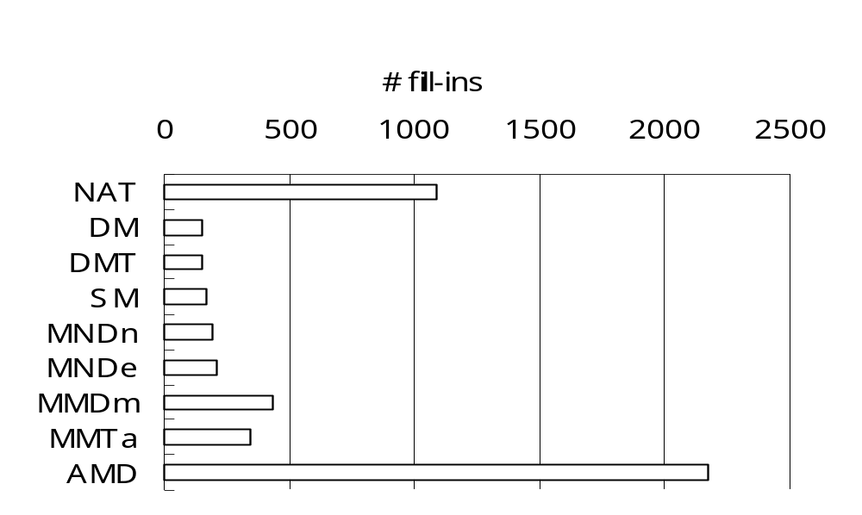
Preprocessing: Best Node Ordering Rule
NAT: natual ordering
SM: Static Markowitz
DM: Dynamic Markowitz,
DMT: DM with tie breaking
NP-Complete
Usually DM, DMT or SM create fewer # of fill-ins

Slide 33
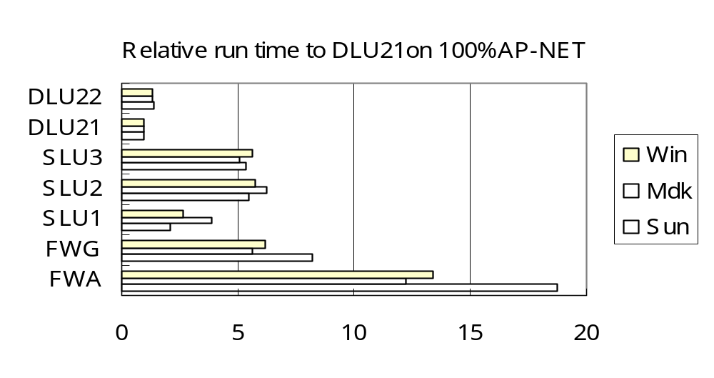
FW vs. SLU & DLU
FWA: Algebraic Floyd-Warshall
FWG: Graphic Floyd-Warshall
DLU21 and SLU1 are the best implementations
DLU & SLU are always faster than FW

Slide 34
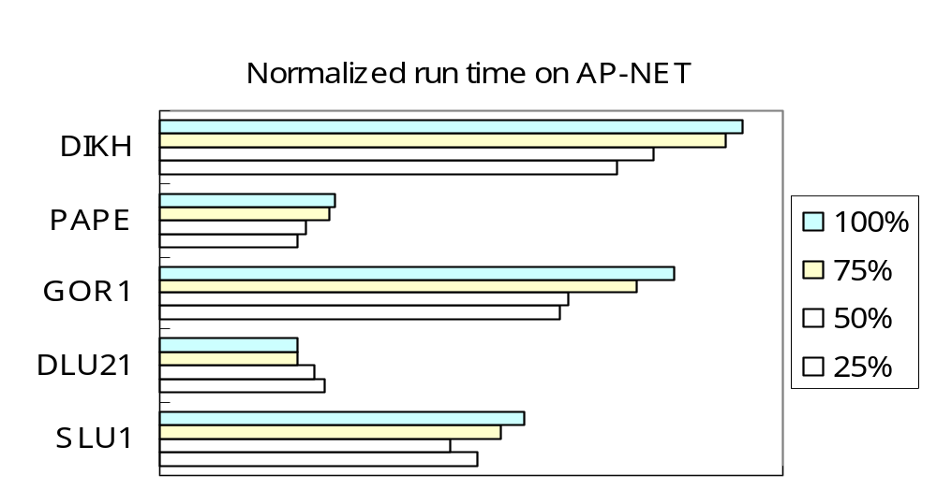
SLU & DLU vs. LC & LS (1)
Label-Correcting (LC) algorithms: GOR1, PAPE
Lable-Setting (LS) algorithms: DIKH
DLU21 performs relatively better for larger %

Slide 35
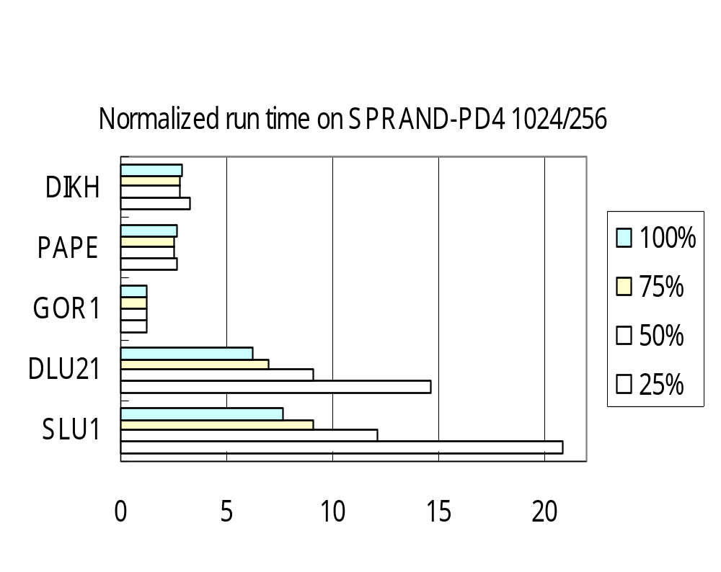
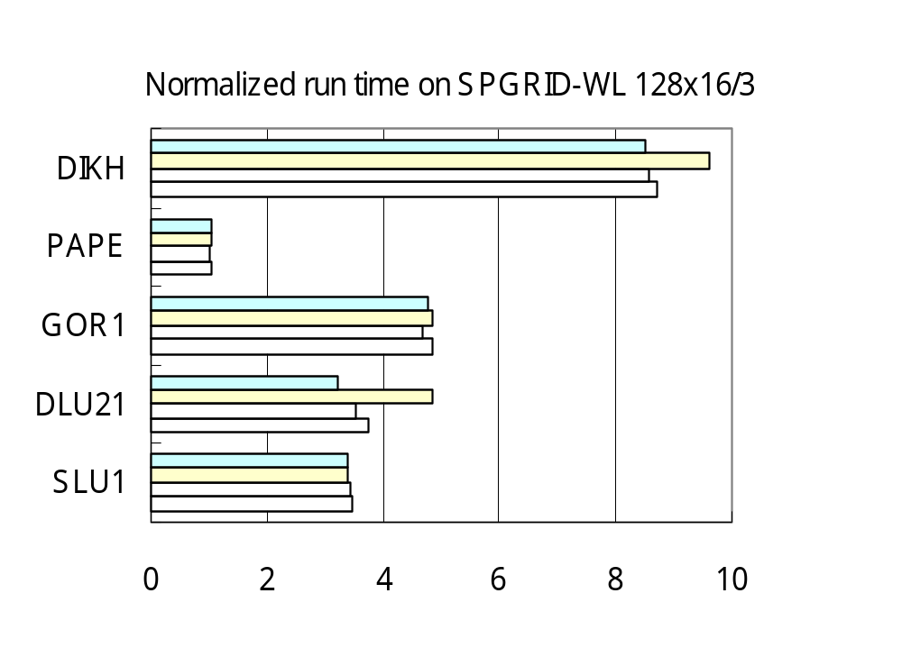
SLU & DLU vs. LC & LS (2)
Label-Correcting (LC) algorithms: GOR1, PAPE
Lable-Setting (LS) algorithms: DIKH
DLU & SLU performs relatively better for larger %

Slide 36
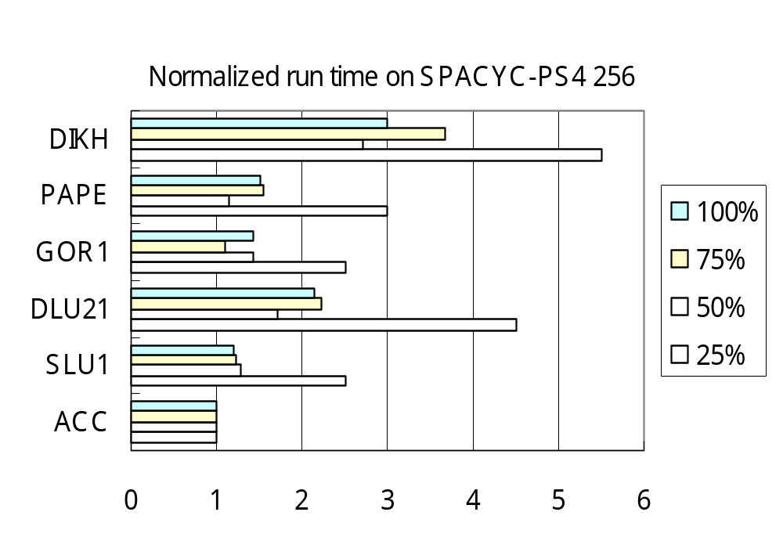
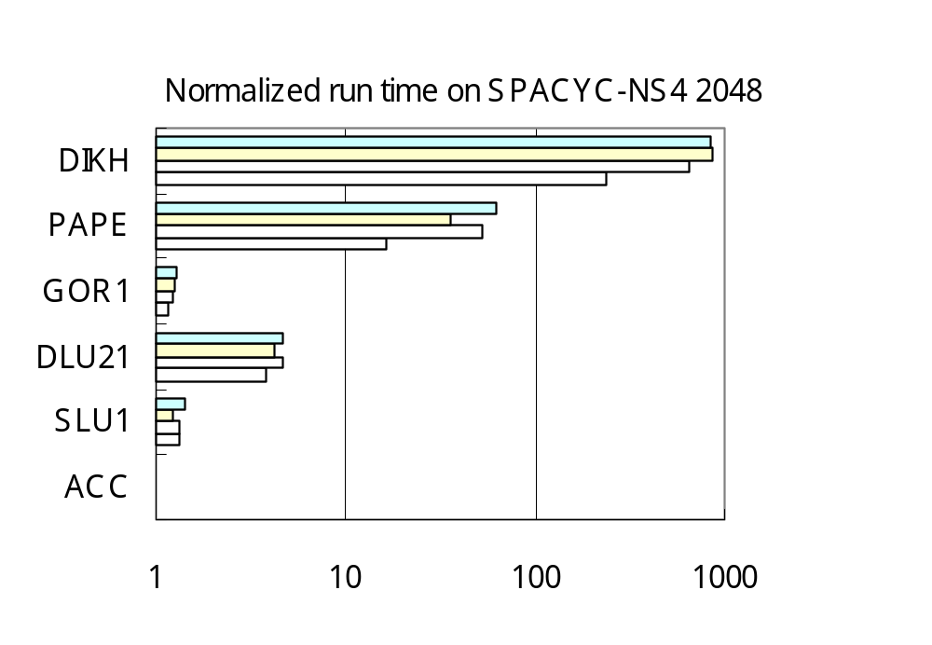
SLU & DLU vs. LC & LS (3)
Topological ordering algorithm: ACC
Label-Correcting (LC) algorithms: GOR1, PAPE
Lable-Setting (LS) algorithms: DIKH
DLU & SLU performs better for acyclic graphs

Slide 37
Results & Conclusion
Computational Results:
  Depend on size, topology , node ordering , OD pairs
  In general not the best (diff Platform, OS, Compiler?)
  Markowitz’s rule usually gives better ordering
  Definitely much better than Floyd-Warshall Algorithm
Conclusion:
  Simple , efficient for SOM-SOME shortest paths
  ‘Ad hoc’ code , exploits properties of graphs
  Theoretically suitable for dense graphs
  Need more storages (O(n²))
  Complexity O(∑_{k=1~n}uo(k)di(k)+min{q*nnz(LU),n³})
  Iterative methods(stability) vs. direct methods(sparsity)
Notes:
Data structure:
For FORWARD(j):
only need bi[i], an incoming arc list to node i from nodes with higher index. (bi means backward incoming)
For BACKWARD(j):
only need fi[i], an incoming arc list to node i from nodes with lower index. (fi means forward incoming)
For LU():
need fo[i], bi[i]. bi[i] is as explained above. fo[i] is an outgoing arc list from node i to nodes with higher index. (fo means forward outgoing)
To sacrifice some storage to save time in identifying an arc number in doing triple comparison, we may need a n² matrix Arc_Status[i,j], where its entry is 1 if (I,j) is either original or artificial, and 0 otherwise.

Slide 38
Thank you
Questions ?
Contact
  I-Lin Wang (王逸琳)
  ilin@isye.gatech.edu
  http://www.isye.gatech.edu/~ilin
  Industrial & System Engineering (ISyE)
  Georgia Institute of Technology (GA Tech)

Slide 39
Example of Algorithm SLU₁
0
Augmented Graph:
  Graph obtained by LU operations
e.g. ALL-[3]
ri[i]
ro[i]
0
li[i]
0
lo[i]
i
0
0
3
Artificial arc
C_{ij} [succ(i,j)]
3
1
4 [1]
9 [2]
7 [3]
6
3
8
1
1
3
7
5
1
1
2
2
1
1
7
2
6 [2]
X_{i}
X_{j}
1
2
3
4
5
C_{ij}
Original arc
4
i
j
2
8
3
2
6
Augmented Graph
4 [1]
7 [3]
3
8
0
6 [2]
2
Node i | 3 | 4 | 5
X_{i} | 0 | 6 | 6
succ(i) | - | 2 | 3
Node i | 1 | 2 | 4 | 5
X_{i} | 3 | 4 | 6 | 6
succ(i) | 3 | 1 | 2 | 3
3
4
5
0
6
6
1
2
3
4
5
6
Forward(3)
Backward(1)
Notes:
3 versions of Algorithm Sparse-LU: same LU operations, but different philosophy to do the FORWARD/BACKWARD operations
Sparse-LU1:
use bucket idea: n buckets, 1 for each node
Each node is either labeled or not. In FORWARD(j), starting from node j, scan all the arcs stored in arc list bi[i], update their head distance labels, put them into buckets corresponding to their index.
Repeat above step until the last node. (thus end the FORWARD(j) )
Starting from the last node, only scan nonempty buckets. For each such bucket i, scan all the arcs in arc list fi[i], update their head distance labels, then remove the node out of its bucket by marking it as unlabeled.
Repeat above step until the last labeled node is scanned. Done!!
Sparse-LU2:
Similar to Sparse-LU1, only differs in the way maintaining labeled nodes. Sparse-LU2 will use a min-heap in FORWARD(j). After FORWARD(j), we switch the min-heap to be a max-heap in BACKWARD(j). We have to identify the last labeled node first. Once we find it, we initiate the max-heap by the last labeled node.
The reason to use heap is to save some unnecessary work spent in scanning empty buckets in Sparse-LU1.
Sparse-LU3:
Almost the same as Sparse-LU2, except it maintains 2 heaps, one min-heap and one max-heap, at the same time in FORWARD(j). That is, in FORWARD(j), whenever we label a node, we put that node into both min-heap and max-heap. So, after FORWARD(j) is done, min-heap becomes empty and max-heap is already ready to start. Therefore, we save some time in identifying the last labeled node as in Sparse-LU2.
Computational Results:
Time(Sparse-LU1) < Time(Sparse-LU3) < Time(Sparse-LU2)

Slide 40
Properties of Algorithm DLU₁
Good:
Efficient if only x*_{st} are requested
(if need to trace paths, set i₀=1)
Work for general arc costs, can detect any negative cycle
A good node ordering decreases fill-in arcs
  Preprocessing (Markowitz’s rule, MMD, MND..etc)
Save ½ storage/computation for undirected graphs.
Acyclic graphs: same as topological ordering
1
2
3
4
2
3
4
3
4
4
Bad:
Redundant work on unrequested OD pairs
Difficulty to trace shortest path

