Slide 1
台灣作業研究學會2005年研討會
A PRIMAL-DUAL KEY-PATH METHOD FOR THE MULTICOMMODITY NETWORK FLOWS
By
I-Lin Wang
王 逸 琳
成功大學工業與資訊管理學系 助理教授
Nov 5, 2005

Slide 2
ODMCNF : Introduction
Commodity: an O-D pair
Example:
|N| = 7
|A| = 16
|K| = 5
3
2
5
Problem | Cargo/Packet Routing
Commodity | O-D shipments
Flow Balance | Conservation of shipments
Bundle Constraints | Arc Capacity, Node Capacity
4
1
6
7
Commodity:
k1 1-5 : 1-2-4-5
k2 2-6 : 2-3-5-7-4-6
k3 3-1 : 3-4-5-7-1
k4 6-2 : 6-7-1-2
k5 7-3 : 7-4-5-2-3
Shared arcs:
(1,2) : k1, k4
(2,3) : k2, k5
(4,5) : k1, k3, k5
(5,7) : k2, k3
(7,1) : k3, k4
Notes:
Commodity k1 and k4 share arc (1,2)

Slide 3
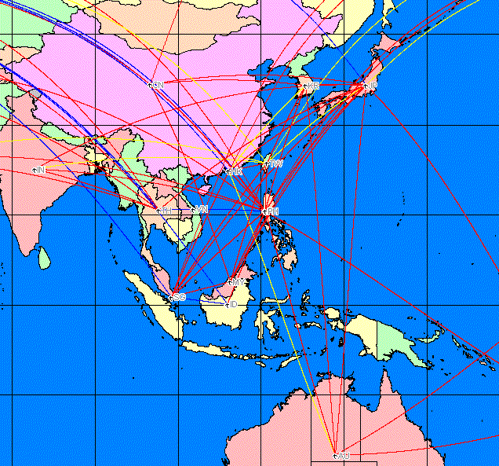
AP-NET
center-center
rim-center

Slide 4
Asia-Pacific Aircargo Network
OD Multicommodity flow
Model I:
  nodes: countries , arcs: traffic between countries
  11 center nodes: SG,TW,JP,KR,PH,ID,MY,CN,HK,VN,TH
  20 rim nodes:
  AU,BH,CA,DK,FI,FR,DE,GR,IN,IT,NL,NZ,PK,RU,LK,CH,TR,AE,GB,US
  center⬄center , rim⬄center
Model II:
  nodes: cities , arcs: traffic between cities
  48 center nodes, 64 rim nodes
  1038 arcs: center⬄center (480), rim ⇨center (277), center ⇨ rim (281)
Notes:
12 center countries, 48 center airports:
SG [1]: Singapore
TW [2]: Taiwan (Kaohsiung, Taipei)
JP [12]: Japan (Fukuoka, Hiroshima, Niigata, Komatsu, Kagoshima, Nagoya, Okinawa, Okayama, Osaka, Sendai, Sapporo, Tokyo)
KR [3]: Republic of Korea (Cheju, Pusan, Seoul)
PH [3]: Philippine (Cebu, Manila, Subic Bay)
ID [3]: Indonesia (Denpasar Bali, Jakarta, Surabaya)
MY [4]: Malaysia (Kota Kinabalu, Kuching, Kuala Lumpur, Penang, Langkawi)
BN [1]: Brunei Darussalam
CN [12]: China (Beijing, Guangzhou, Dalian, Kunming, Shanghai, Shenyang, Xi An, Shenzhen, Qingdao, Tianjin, Urumqi, Xiamen)
HK [1]: Hong Kong
VN [2]: Viet Nam (Hanoi, Ho Chi Minh City)
TH [4]: Bangkok, Chiang Mai, Hat Yai, Phuket
22 rim countries, 60 rim airports
AE [3]: United Arab Emirates (Abu Dhabi, Dubai, Sharjah)
AU [8]: Australia (Adelaide, Avalon, Brisbane, Cairns, Darwin, Melbourne, Perth, Sydney)
BH [1]: Bahrain
CA [2]: Canada (Toronto, Vancouver)
CH [1]: Switzerland (Zurich)
DE [2]: Germany (Frankfurt, Munich)
DK [1]: Denmark (Copenhagen)
FI [1]: Finland (Helsinki)
FR [1]: France (Paris)
GB [2]: United Kingdom (London, Manchester)
GR [1]: Greece (Athens)
IN [6]: India (Ban galore, Mumbai, Calcutta, Delhi, Hyderabad, Chennai)
IT [2]: Italy (Milan, Rome)
LK [1]: Sri Lanka (Colombo)
NL [1]: Netherlands (Amsterdam)
NZ [2]: New Zealand (Auckland, Christchurch)
PK [3]: Pakistan (Islamabad, Karachi, Lahore)
RU [4]: Russian Federation (St Petersburg, Moscow, Novosibirsk, Ulyanovsk, Khabarovsk)
TR [1]: Turkey (Istanbul)
US [17]: United States (Anchorage, Atlanta, Chicago, Dallas/Fort Worth, Detroit, Fairbanks, Honolulu, Houston, Las Vegas, Los Angeles, Minneapolis/St Paul, New York, Portland, Seattle, San Francisco, San Jose, Washington, Boston, Kona, Memphis, Oakland)

Slide 5
Aircargo Network
Airport node i splits into 4 nodes
  i₁ , i₂ , i₃ , i₄
Original network: n nodes, m arcs
New network: 4n nodes, (m+3n) arcs
Local export
Local export
export
import
export
import
Local import
Local import
Transshipment
Notes:
Suppose we have k OD commodities
Each airport node i can be split up into 4 nodes
i₁ : for outside import , supply/demand b^{k}_{i1} = 0
i₂ : for local import , supply/demand b^{k}_{i2} = local export supply
i₃ : for local export , supply/demand b^{k}_{i3} = local import demand
i₄ : for outside export , supply/demand b^{k}_{i1} = 0
Arc Cost:
C^{k}_{i1,i2} : 0
C^{k}_{i2,i3} : Transshipment cost
C^{k}_{i3,i4} : 0
C^{k}_{i4,j1} : Transportation cost
Arc Capacity:
U^{k}_{i1,i2} : ∞
U^{k}_{i2,i3} : Transshipment capacity
U^{k}_{i3,i4} : ∞
U^{k}_{i4,j1} : flight capacity

Slide 6
Contributions : MCNF
New MCNF Algorithms
  Combine Primal-Dual method with key path decomposition
New techniques to resolve both primal and dual degeneracy
  Perturbing objective coefficients of artificial variables
  Perturbing zero objective coefficients of flow variables
Computational Experiments on MCNF problems
  Comparing KEY, NA
  Show the importance of multiple shortest path algorithms
Notes:
Key path idea is based on Rosen’s Algorithm. It has been applied on solving ODMCNF by Barnhart et al. It is especially good for cases with many OD commodities since it significantly decrease the size of the RMP.
P-D subproblem approach has been applied on solving Crew Pairing & Cutting Stock problem with success. Its advantages are due to the better columns generated by better feasible dual variables. Thus this method is especially good for column generation.
P-D Nonnegative Least Squares method is a new method designed to avoid degenerate pivots in solving LP. It is especially good for highly degenerate problems.
To generate good columns as fast as possible, efficient shortest path algorithms are desired. More specifically, good SOME-SOME SP algorithms are desired.
In 1970’s, there were algebraic algorithms designed for solving ALL-ALL SP problem. Carré applied Gaussian Elimination technique to solve the Bellman-Ford Equation.
Goto, Ohtsuki, and Yoshimura in 1976 used code generation to do a sparse implementation of Carré’s algorithm
Algorithm Sparse-LU is another sparse version of Carré’s algorithm without using code generation.
Algorithm Dense-LU is a new SP algorithm which takes different triple comparing orders other than Floyd-Warshall and Carré’s algorithm to get ALL-ALL shortest path.

Slide 7
Overview
  4 formulations
  Node-Arc (NA) vs. Arc-Path
  PD vs. PD key path
  Primal & Dual Degeneracy
  MCNF Computational Results
ODMCNF
Improvement
  Try to solve Shortest Path faster
    good SOME-SOME SP algorithms
Notes:
Reference
MCNF:
J.B. Rosen (1964), Primal partition programming for block diagonal matrices, Numerische Methematik 6, 250-260
C. Barnhart, C.A. Hane, E.L. Johnson, and G. Sigimondi (1995), A column generation and partitioning approach for multicommodity flow problems, Telecommunication Systems 3, 239-258
C. Barnhart, C.A. Hane, and P. Vance (2000), Using Branch-and-Price-and-Cut to Solve Origin-Destination Integer Multicommodity Flow Problems, Operations Research, Vol. 48, No. 2, 318-326
K.L. Jones, I.J. Lustig, J.M. Farvolden, and W.B. Powell (1993), Multicommodity network flows: The impact of formulation on decomposition, Mathematical Programming 62, 95-117
P-D subproblem:
J. Hu, and E. Johnson (1999),Computational Results with a Primal-Dual subproblem simplex method, OR Letters 25, 149-157
P-D NNLS:
E. Barnes, V. Chen, B. Gopalakrishnan , and E. Johnson (2001), A Least Squares Primal-Dual Algorithm for Solving Linear Programming Problems, OR Letters (to appear)
Shortest Path:
B. A. Carré (1969), A Matrix Factorization Method for Finding Optimal Paths through Networks, I.E.E. Conference Publication (Computer-Aided Design) No. 51, 388-397
B. A. Carré (1971), An Algebra for Network Routing Problems, Journal of Institute of Mathematics and Its Applications 7, 273-294
S. Goto, T. Ohtsuki, and T. Yoshimura (1976), Sparse Matrix Techniques for the Shortest Path Problem, IEEE Transactions on Circuits and Systems CAS-23, 752-758
B. Cherkassky, A. Goldberg, and T. Radzik (1996), Shortest paths algorithms: Theory and experimental evaluation, Mathematical Programming 73, 129-174

Slide 8
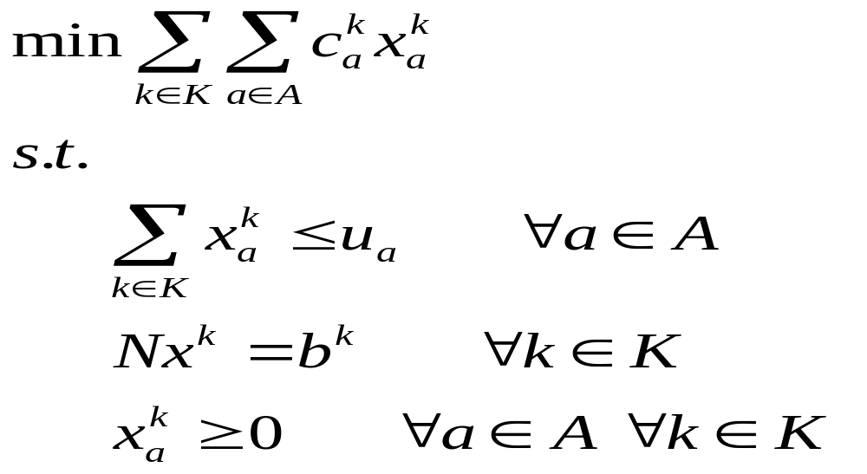
ODMCNF : Formulation (1)
Linear Formulation(1): Node-Arc Oriented
Dimension # var: |A||K| # row: |A| # row: |N||K|
Bundle constraints
Usually solved by Lagrangian Relaxation
subproblem : min-cost network flow
Notes:
Comments on Node-Arc Formulation(1):
When |K| is huge (at most n(n-1)) , the # of constraint rows become huge.
Lagrangian Relaxation
Relax Bundle constraints
Only need to solve k subproblem.
Harder subproblem
Use subgradiant method to get λ (dual variable to the bundle constraints)
Worse dual variable λ
More iterations to converge

Slide 9
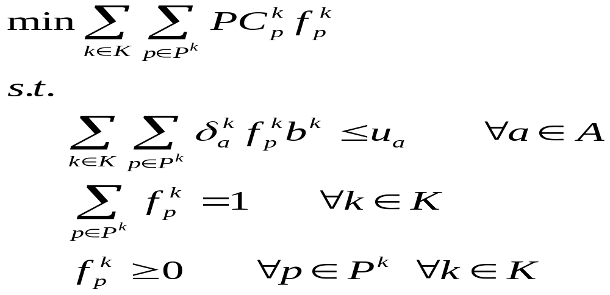
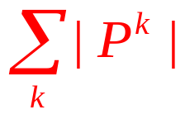
ODMCNF : Formulation (2)
Linear Formulation(2): Path Oriented (MP -> RMP)
Dimension
# var:
# row: |A|
# row: |K|
Bundle constraints
Usually solved by D-W + Column Generation
subproblem : shortest path
Notes:
Comments on Path-Oriented Formulation(2):
There are too many variables (columns).
Column generation technique can be applied.
Dantzig-Wolf Decomposition + Column Generation
Solve smaller Restricted Master Problem (RMP)
Easier subproblem
Solve RMP (a LP) to get λ (dual variable to the bundle constraints)
Better dual variable λ
Fewer iterations to converge

Slide 10
ODMCNF : General Concept
Try to decompose a hard problem into a set of easy problems
 | Node-Arc Oriented | Path Oriented
Property | Many Constraints Harder subproblem | Fewer Constraints Much more Columns Easier subproblem
Subproblem | Min-cost Network Flow | Shortest Path
Notes:
(1)Resource Directive
(2)Price-Directive
(3)Basis Partitioning
Price-Directive
Lagrangian Relaxation
Dantzig-Wolfe Decomposition
We use D-W + Column Generation + Rosen’s Partiton Algorithm
Only solve LP; for IP, can use “Branch & Price”

Slide 11

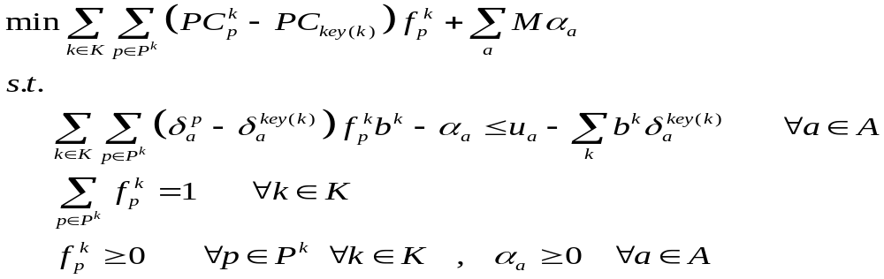
Key Path/Cycle Formulation
Choose a key path key(k) ∀ commodity k
Add a surplus variable with big cost M ∀ arc a
Convexity constraints
D
key(k)
Bundle constraints
O
p
Not good enough, How to improve further ?
Notes:
Comments on Key-Path/Cycle Formulation:
For each commodity, choose a “key-path”.
Do column operations to eliminate the key-path column, thus we obtain the key-cycle formulation.
This formulation is basically the same as the previous Path-Oriented formulation. The only difference is that we apply some column operations to eliminate the key-path column for each commodity.

Slide 12
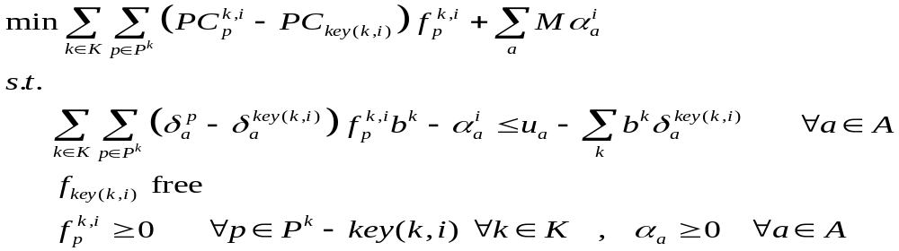
RELAX (i) Formulation
Similar to Cycle Formulation, except…
relax the flow nonnegativity constraint for key(k,i)
Where are the Convexity constraints ?
Bundle constraints
Notes:
Comments on Relax(i) Formulation:
Based on key-cycle formulation
Relax the flow nonnegativity constraint for the flow passing key-path key(k,i) , where k is commodity index, i is major iteration index.
When we relax the nonnegativity constraint for key(k,i), we can easily maintain the convexity constraint for commodity k. It is because the free flow variable on key(k,i) can compensate whatever infeasibility that might occur.
So the constraints size is further cut down. Only the bundle constraints and nonnegativity constraints of other flow variables are needed to be satisfied.
In other words, we still implicitly maintain the convexity constraint by freeing the flow variable along each key-path.

Slide 13
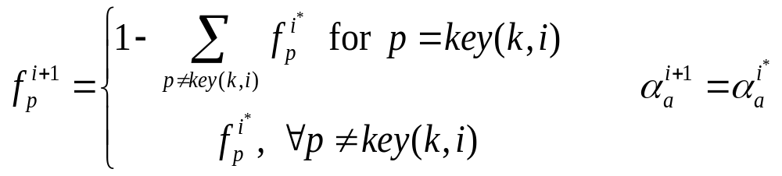
Rosen’s Algorithm (1)
Idea:
How to redefine flow for key(k,i+1)
  relax key variable’s nonnegativity constraint
  smartly redefining flow for key(k,i+1)
  implicitly maintain ALL the |K| convexity constraints.
  in RMP, only the Bundle constraints are left to be solved.
Notes:
We can easily compute the flow variable along the key-path key(k,i) by above formula.
If all the key-paths have nonnegative flow, we are done!

Slide 14
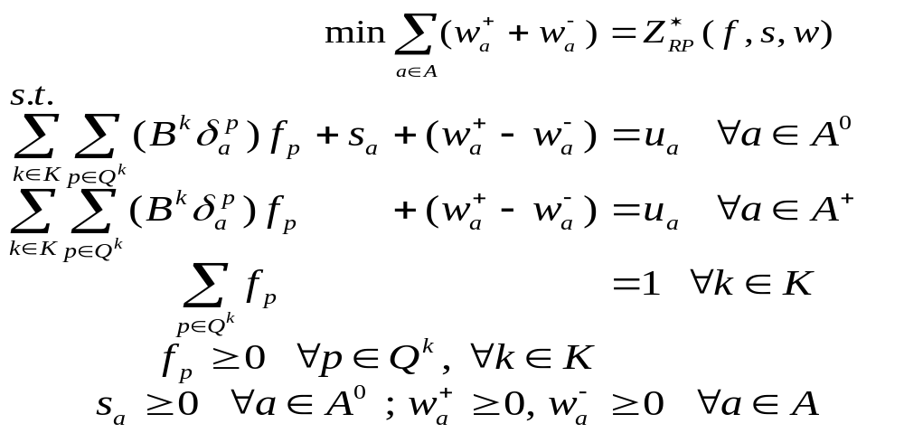
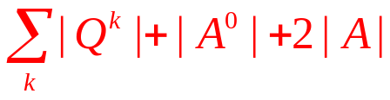
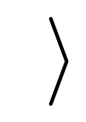
ODMCNF : Formulation (3)
Linear Formulation(3): Primal-Dual Path Oriented
Dimension
# var:
# row: |A|
# row: |K|
Bundle constraints
subproblem : shortest path
Notes:
Comments on Path-Oriented Formulation(2):
There are too many variables (columns).
Column generation technique can be applied.
Dantzig-Wolf Decomposition + Column Generation
Solve smaller Restricted Master Problem (RMP)
Easier subproblem
Solve RMP (a LP) to get λ (dual variable to the bundle constraints)
Better dual variable λ
Fewer iterations to converge

Slide 15
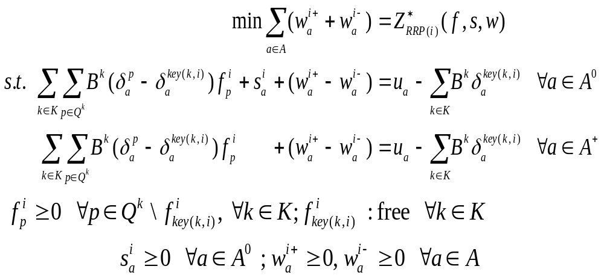
ODMCNF : Formulation (4)
Linear Formulation(4): Primal-Dual Key Path Oriented
# var:
# row: |A|
Bundle constraints
subproblem : shortest path
Notes:
Comments on Path-Oriented Formulation(2):
There are too many variables (columns).
Column generation technique can be applied.
Dantzig-Wolf Decomposition + Column Generation
Solve smaller Restricted Master Problem (RMP)
Easier subproblem
Solve RMP (a LP) to get λ (dual variable to the bundle constraints)
Better dual variable λ
Fewer iterations to converge

Slide 16
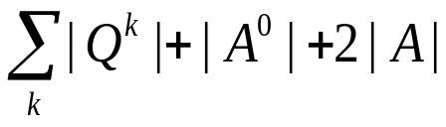
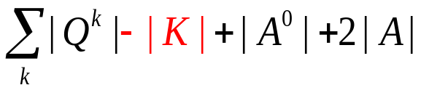
Primal-Dual key path method
PD method PD key path method
# var:
# var:
# row: |K| # row: |A|
Bundle constraints
Bundle constraints
# row: |A|
RPP
Relaxed RPP
generate ALL shortest paths Q^{k}
subproblem : shortest path
Shortest paths are needed to:
Construct RPP columns
Compute max step length
following PD iterations
choose key path key(k) ∀k
allow flow on key(k) to be negative
substitute key variables
after relaxed problem is solved,
recompute flow on key(k)
Notes:
Comments on Node-Arc Formulation(1):
When |K| is huge (at most n(n-1)) , the # of constraint rows become huge.
Lagrangian Relaxation
Relax Bundle constraints
Only need to solve k subproblem.
Harder subproblem
Use subgradiant method to get λ (dual variable to the bundle constraints)
Worse dual variable λ
More iterations to converge

Slide 17
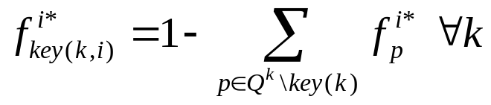
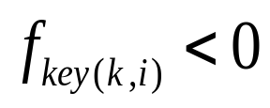
Solving Relaxed RPP
Given a RPP, i=1
Select key path key(k) for each k
Construct R_RPP(i)
Solve R_RPP(i), compute
Yes
No
i=i+1
Is there any
OPT!!
Notes:
Comments on Path-Oriented Formulation(2):
There are too many variables (columns).
Column generation technique can be applied.
Dantzig-Wolf Decomposition + Column Generation
Solve smaller Restricted Master Problem (RMP)
Easier subproblem
Solve RMP (a LP) to get λ (dual variable to the bundle constraints)
Better dual variable λ
Fewer iterations to converge

Slide 18
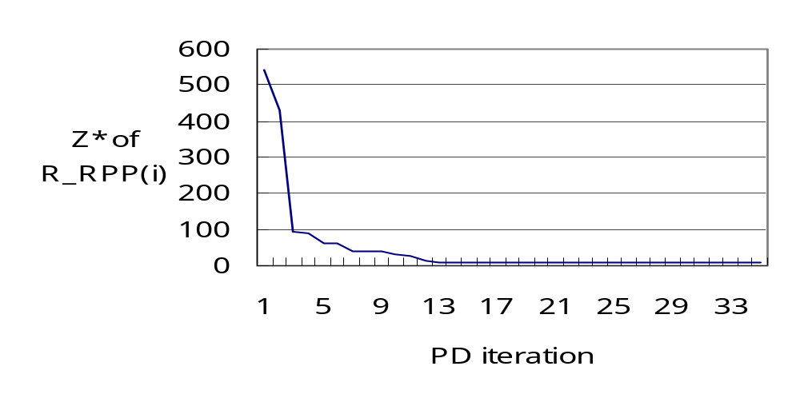
Primal Degeneracy in PD method
Stalling Problem:
Optimal infeasibility remains the same for many iterations
Randomly perturb the objective coefficient of
artificial variables
Notes:
Comments on Path-Oriented Formulation(2):
There are too many variables (columns).
Column generation technique can be applied.
Dantzig-Wolf Decomposition + Column Generation
Solve smaller Restricted Master Problem (RMP)
Easier subproblem
Solve RMP (a LP) to get λ (dual variable to the bundle constraints)
Better dual variable λ
Fewer iterations to converge

Slide 19
Dual Degeneracy in key path method
Cycling problem:
swapping between alternative key paths forever
there exist multiple optimal primal solutions
1
2
3
4
1
2
3
4
key(1,1): 1-2-3-4
key(1,3): 1-2-3-4
……
key(1,2): 1-3-4
key(1,4): 1-3-4
……
Slightly perturb each objective coefficient of cycle flows
to some randomε
Need to adjust optimal dual solution for dual feasibility
Notes:
Comments on Path-Oriented Formulation(2):
There are too many variables (columns).
Column generation technique can be applied.
Dantzig-Wolf Decomposition + Column Generation
Solve smaller Restricted Master Problem (RMP)
Easier subproblem
Solve RMP (a LP) to get λ (dual variable to the bundle constraints)
Better dual variable λ
Fewer iterations to converge

Slide 20
Computational Experiments Settings
Six telecommunication problem sets
Problem | |N| | |A| | |K| | |N||K|+|A| constraints | |M||K| variables
P₁ | 200 | 517 | 323 | 65,117 | 166,991
P₂ | 200 | 501 | 323 | 65,101 | 161,823
P₃ | 200 | 508 | 323 | 65,108 | 164,084
P₄ | 200 | 520 | 317 | 63,920 | 164,840
P₅ | 300 | 760 | 561 | 169,060 | 426,360
P₆ | 300 | 811 | 530 | 159,811 | 429,830
CPLEX 7.0 callable library on a Sun Sparc machine with 512MB
Notes:
Comments on Path-Oriented Formulation(2):
There are too many variables (columns).
Column generation technique can be applied.
Dantzig-Wolf Decomposition + Column Generation
Solve smaller Restricted Master Problem (RMP)
Easier subproblem
Solve RMP (a LP) to get λ (dual variable to the bundle constraints)
Better dual variable λ
Fewer iterations to converge

Slide 21
Computational Experiments Settings
Total running time: KEY < NA
 | KEY |  |  |  |  | NA
 | t_sp% | t_theta% | t_key% | t_other% | t_all (ms) | (ms)
P₁ | 43% | 22% | 26% | 9% | 366 | 5,532
P₂ | 19% | 22% | 56% | 3% | 2,584 | 5,934
P₃ | 24% | 25% | 48% | 4% | 1,713 | 5,611
P₄ | 22% | 22% | 53% | 4% | 1,334 | 5,479
P₅ | 12% | 9% | 78% | 1% | 9,769 | 34,753
P₆ | 25% | 26% | 46% | 3% | 5,630 | 30,460
%t_theta + %t_sp = 21%~79% total run time (MPSP)
%t_key = 26%~78% total run time, including LP solving
too much time in key path swapping
Notes:
Comments on Path-Oriented Formulation(2):
There are too many variables (columns).
Column generation technique can be applied.
Dantzig-Wolf Decomposition + Column Generation
Solve smaller Restricted Master Problem (RMP)
Easier subproblem
Solve RMP (a LP) to get λ (dual variable to the bundle constraints)
Better dual variable λ
Fewer iterations to converge

Slide 22
Summary of MCNF algorithms
KEY performs better for problems with many OD pairs
To improve KEY
  Try to choose better optimal solutions of RPP, if more than one
  Try to give better algorithm to compute max. step length θ
  Try to have more efficient SP algorithms
Importance of shortest path algorithms
Construct columns of RPP; compute θ
Fixed topology & OD pairs, changeable arc lengths
  Multiple Pairs Shortest Path Algorithms !!

Slide 23
Shortest Path Problem/Algorithm
Single Source Shortest Path (SSSP)
  Nonnegative Arc Cost (LS)
  General Arc Cost (LC)
All Pairs Shortest Paths (APSP)
  Combinatorial Type Algorithms (repeated SSSP)
  Algebraic Type Algorithms (FW)
  LP Type Algorithms (Network simplex)
Multiple Pairs Shortest Paths (MPSP)
MPSP problems with fixed topology & OD pairs
A multiple pairs shortest path algorithm
(Transportation Science, accepted on May 30, 2005)
0
 | 0
 |  | 0
 |  |  | 0
 |  |  |  | 0
0
 | 0
 |  | 0
 |  |  | 0
 |  |  |  | 0
0
 | 0
 |  | 0
 |  |  | 0
 |  |  |  | 0
0
 | 0
 |  | 0
 |  |  | 0
 |  |  |  | 0
0
 | 0
 |  | 0
 |  |  | 0
 |  |  |  | 0
Notes:
1-ALL:
Nonnegative Arc Cost
Label Setting (Dijkstra: heap/bucket..etc)
Label Correcting (Bellman-Ford, Pape-Levit, Goldberg-Radzik..etc)
General Arc Cost
Acyclic : Topological Ordering
Nonacyclic : Label Correcting
ALL-ALL:
Combinatorial Type Algorithms
Apply n times of Label Setting/Correcting Algorithm
Algebraic Type Algorithms
Floyd-Warshall , Carré , Wang
Other: matrix multiplication, decomposition..etc
SOME-SOME:
Very common in practice
Need ALL-ALL to get SOME-SOME ??
Extreme cases: “matching” pairs

Slide 24
Thank you
Questions ?
Contact
  I-Lin Wang 王逸琳 助理教授
  ilinwang@mail.ncku.edu.tw
  http://ilin.iim.ncku.edu.tw
  成功大學工業與資訊管理學系 (IIM, NCKU)

