Slide 1
11/26 成大群創 期末報告
陳彥瑋 在製品對應需求最佳化配置

Slide 2
在製品對應需求最佳化配置問題說明
目標
依在製品與需求之關聯，進行在製品對應需求最佳化
Case
需求料號 | 需求量
甲 | 0
乙 | 17,100
丙 | 26,500
丁 | 34,000
戊 | 49,300
 | 126,900
在製品料號 | 供給數
a | 20,000
b | 30,000
c | 30,000
d | 16,900
e | 30,000
 | 126,900
需求料號 | 在製品料號 |  | 需求料號 | 在製品料號 |  | 需求料號 | 在製品料號
甲 | c |  | 丙 | b |  | 戊 | a
甲 | d |  | 丙 | c |  | 戊 | c
甲 | e |  | 丙 | e |  | 戊 | e
需求料號 | 在製品料號 |  | 需求料號 | 在製品料號
乙 | a |  | 丁 | a
乙 | c |  | 丁 | c
乙 | e |  | 丁 | e

Slide 3
在製品與需求之最佳分配路徑圖
e
30,000 X A
圖例說明
Q’ty X Grade
x
A:non-A=95%:5%
A:non-A=97%:3%
d
16,900 X A
c
30,000 X A
A:non-A=93%:7%
A:non-A=94%:6%
a
20,000 X A
b
30,000 X A
甲
A:B=93%:7%
0 X A/C
丙
26,500 X A/B
A:B:C=100%:0%:0%
A:B:C=100%:0%:0%
A:C=95%:5%
乙
戊
丁
17,100 X A
49,300 X A
34,000 X A/C
Notes:
機台特性
機型 layer
月產能 示意Daily Plan TFT & CF 對應的料號展到日Shedule

Slide 4
1
2
3
4
5
6
7
11
9
10
8
17
15
12
13
16
14
18
19
22
20
24
27
23
25
26
21

Slide 5
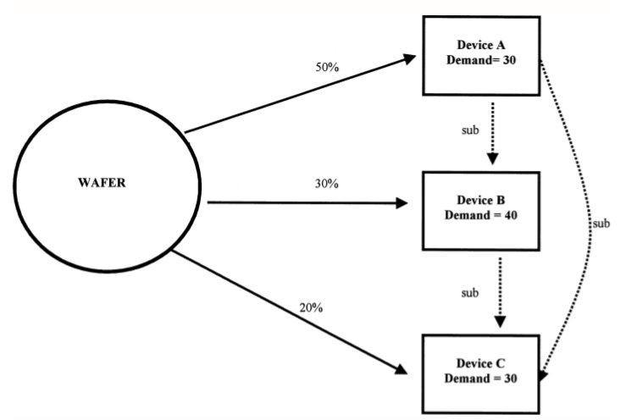
Binning

Slide 6
流程
Step 1.匯入資料
Step 2.前處理:建立網路圖、移除不必要的路徑、處理等級之分
Step 3.建立數學模型
Step 4.使用GUROBI求解
Step 5.將最終解轉換為產線所知的語言並輸出

Slide 7
Step1. 匯入資料

Slide 8
匯入DB
SUPPAG_ADM.NO_DEMAND_WIP_BANK 庫存資料
SUPPAG_ADM.suppag_config 資料庫限制
SUPPAG_ADM.NO_DEMAND_DEMAND 需求資料
SUPPAG_ADM.NO_DEMAND_PROD_BOM BOM表清單
SUPPAG_ADM.NO_DEMAND_TESTYIELD TEST良率資料
SUPPAG_ADM.NO_DEMAND_LINEYIELD LINE良率資料
SUPPAG_ADM.NO_DEMAND_GRADEYIELD GRADE良率資料
SUPPAG_ADM.NO_DEMAND_EOL_INDEP_LIST EOL_LIST
SUPPAG_ADM.NO_DEMAND_PM_RED_ALARM 紅標資料

Slide 9
Step 2.1 建立網路圖

Slide 10
Input data
From | To
01 | 02
01 | 03
02 | 04
03 | 04
03 | 05
03 | 06
04 | 07
1. Bom
Notes:
First to input is the bom
The bom means the product can be transform to another product
So it have the information let us to get nodes and arcs
Use this bom to be an example

Slide 11
Input data
From | To
01 | 02
01 | 03
02 | 04
03 | 04
03 | 05
03 | 06
04 | 07
1. Bom
03
05
01
06
02
04
07
Notes:
Then the network is finished

Slide 12
Input data
Part number | Grade | Percentage
04 | A | 70%
04 | B | 20%
04 | C | 10%
2. Consider binning
03
05
01
06
02
04
07
Notes:
And if we consider binning
the network will be more complex
Use the above network with a simple example
Now We know the part 4 will have different grade and their ratio

Slide 13
Input data
Part number | Grade | Percentage
04 | A | 70%
04 | B | 20%
04 | C | 10%
05
03
06
04A
07A
01
70%
04B
07B
08
20%
02
10%
04C
07C
Notes:
the node 4 will be different with the grade
and the product which be produce with node 4 ,will have different grade too
Just like node 7 in this picture

Slide 14
Input data
3. Input Supply
Part number | Grade | Amount
01 | NULL | 100
02 | NULL | 30
04 | B | 20
04 | C | 10
Notes:
Now we are going to know which node is supply
And Which node is demand
In the network we construct
It’s will base on it’s net-value
So we will input the node’s value
By Using this simple example

Slide 15
Input data
05
03
b01=100
06
04A
07A
01
70%
b04B=20
04B
07B
08
20%
b02=30
02
10%
b04C=10
04C
07C
Notes:
Then put it information on the network

Slide 16
Input data
3. Input Demand
Part number | Grade | Amount
05 | NULL | 50
06 | NULL | 30
07 | A | 30
04 | B | 10
Notes:
The demand is do the same thing
But the net-value is negative

Slide 17
Input data
b05=-50
05
03
b06=-30
b07A=-30
b01=100
06
04A
07A
01
b04B=-10
70%
b04B=20
04B
07B
08
20%
b02=30
02
10%
b04C=10
04C
07C

Slide 18
Step 2.2 移除不必要的路徑

Slide 19
Input data
From | To
01 | 02
01 | 03
02 | 04
03 | 04
03 | 05
03 | 06
04 | 07
1. Bom
03
05
01
06
02
04
07
Notes:
Then the network is finished

Slide 20
讀入供給、需求
03
05
b05=-10
b01=100
01
06
b06=-20
02
04
07
b07=0

Slide 21
移除不必要的路徑
03
05
b05=-10
b01=100
01
06
b06=-20

Slide 22
Step 2.3處理等級之分

Slide 23
Complex binning
Part number | Grade | Percentage
02 | A | 50%
02 | B | 30%
02 | C | 20%
03 | A | 70%
03 | B | 20%
03 | C | 10%
03
01
02
04
Notes:
Now we are going to say a special case in this problem
Its complex binning
If we have the binning in two level which is connect or relative
Then the network will become complex
Use the part 2 and part 3 to be an example

Slide 24
01
05
02A
04A
02B
04B
02C
04C
Notes:
Now we Expand the path (1, 2 ,4 ) first
Because this path only have one d-node , so it’s simple

Slide 25
03
AA
06
03
AB
03
AC
03
BA
07
03
BB
03
BC
08
03
CA
03
CB
03
CC
01
05
02A
04A
02B
04B
02C
04C
Notes:
But in the another path (1 2 3)
Because both 2 and 3 need to binning
So if we do twice binning
We will have complex combination
Because the node 2A to binning might different with node 2B binning
So it’s cause the node 3AC AB AA from node 2A , 3BC BB BA from node 2B
So if we have only 2 level binning and 3 grade we will cause 9 node
Because the combination of the 2 level grade
And how about 10 level and 10 grade
The network will be complex and hard to solve

Slide 26
03
AA
06
03
AB
03
AC
03
BA
07
03
BB
03
BC
08
03
CA
03
CB
03
CC
01
05
02A
04A
02B
04B
02C
04C
Notes:
So we need to simplify the problem

Slide 27
Complex binning
Part number | Grade | Percentage
02 | A | 50%
02 | B | 30%
02 | C | 20%
03 | A | 70%
03 | B | 20%
03 | C | 10%
D-node
(1→2→3)
Notes:
If we have two level binning

Slide 28
Complex binning
Part number | Grade | Percentage
02 | A | 50%
02 | B | 30%
02 | C | 20%
03 | A | 70%
03 | B | 20%
03 | C | 10%
D-node
(1→2→3)
D-node
(1→2→3)
Notes:
We only need to see the last node we need to binningg

Slide 29
03A
02
03B
06
03C
01
02A
04A
02B
04B
05
02C
04C
Notes:
So we now have the node 2 with grade in the below path and without grade in the above path
And the network become more simple the last page
But use this method
We need to decomposition every path
And know Which is the last binning node in the path
So we will do a algo like dfs (depth first search )

Slide 30
03A
02
03B
06
03C
01
02A
04A
02B
04B
05
02C
04C
Notes:
So we now have the node 2 with grade in the below path and without grade in the above path
And the network become more simple the last page
But use this method
We need to decomposition every path
And know Which is the last binning node in the path
So we will do a algo like dfs (depth first search )

Slide 31
Complex binning
03
01
02
04
Notes:
Now we are going to say a special case in this problem
Its complex binning
If we have the binning in two level which is connect or relative
Then the network will become complex
Use the part 2 and part 3 to be an example

Slide 32
03
05
01
06
02
04
07
Supply set = {01}
Demand set= {05,06,07}
Notes:
In the network
We will use every supply node and demand node to trace the longest path if it can be combinate
If we don’t use supply and demand node to be the start and end in the path
It’s will waste many time
Just like (畫圖)
{1->3->4->7}
And
(3->4->7)
It actually the same path just different with the node 1
And we only need the longest path to know which is the last d-node

Slide 33
03
05
01
06
02
04
07
(01 → 03 → 05)
Notes:
The algo is easy
We start from the demand node like 5
To walk to the supply node
If the ingoing list have another way to go
Try it

Slide 34
03
05
01
06
02
04
07
(01 → 03 → 05)
(01 → 03 → 06)

Slide 35
03
05
01
06
02
04
07
(01 → 03 → 05)
(01 → 03 → 06)
(01 → 03 → 04 → 07)

Slide 36
03
05
01
06
02
04
07
(01 → 03 → 05)
(01 → 03 → 06)
(01 → 03 → 04 → 07)
(01 → 02 → 04 → 07)

Slide 37
Step3. 建立數學模型

Slide 38
數學模型簡略介紹
目標式:
需求最大化
限制:
流量限制 (庫存量、需求量限制)
流量平衡 (符合上下BOM表關係)
良率固定損失 (EX: NG、production已偏貼所流失、 LINE/TEST YIELD)
固定等級比例(EX:70%A等級、20%B等級、10%C等級)
已偏貼之庫存20%須直接流入良率損失

Slide 39
Symbol

Slide 40
Parameter & variable

Slide 41
Formulation

Slide 42
Dummy yield
TEMP022689 A/Y/C/D/E
94 TN W1852
TEMP060755 D TN Downgrade
In-house 33 0D~30D PROD CLBK
TEMP022689 A/Y/C/D
1193 TN W1850
Dummy source
Dummy sink
TEMP060755D
TEMP022689D
TEMP022689 A/Y/C/D/E 200 TN W1901
Dummy balance

Slide 43
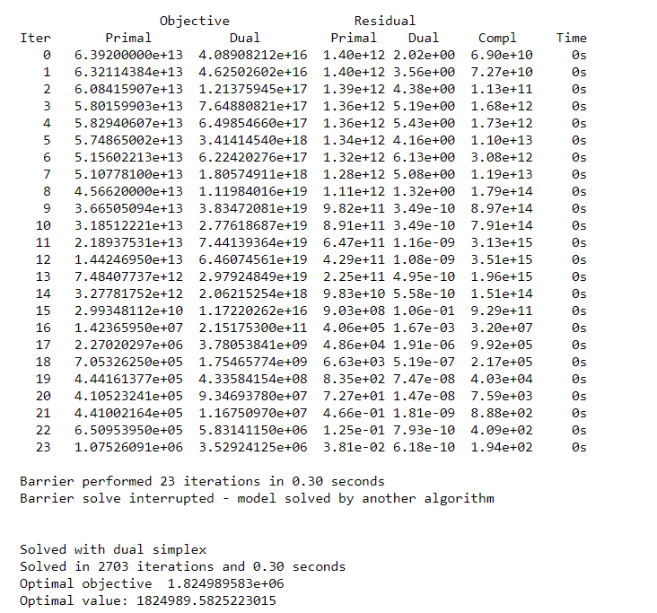
Step4.使用Gurobi求解

Slide 44
Step5. 匯出結果
SUPPAG_ADM.RPT_MASTER_KEY ->版本紀錄
SUPPAG_ADM.RPT_All_Component ->分群結果
SUPPAG_ADM.RPT_woCF_Raw_Result ->woCF分配結果
SUPPAG_ADM.RPT_CF_Raw_Result ->CF分配結果
SUPPAG_ADM.RPT_AERS_Raw_Result ->AERS分配結果
SUPPAG_ADM.RPT_Supply_to_Demand_Relative ->供給需求關係圖
SUPPAG_ADM.RPT_Demand_to_Supply_Relative ->需求供給關係圖
SUPPAG_ADM.RPT_ITEM_ID_RESULT ->各料號分配狀況
SUPPAG_ADM.RPT_SIMP_SPLY_TO_DMD_RELATIVE ->簡略供給需求關係圖
SUPPAG_ADM.RPT_SIMP_DMD_TO_SPLY_RELATIVE ->簡略需求供給關係圖
SUPPAG_ADM.RPT_SN_MAPPING ->SN與料號MAPPING表
SUPPAG_ADM.RPT_Supply_Demand_Component ->分群供給需求

Slide 45
分群概念說明

Slide 46
1
2
3
4
5
6
7
11
8
9
10
17
12
15
16
13
14
18
19
22
24
20
25
27
23
26
21

Slide 47
1
2
3
4
5
6
7
11
8
9
10
17
12
15
16
13
14
18
19
22
20
23
24
26
27
25
21

Slide 48
1
2
3
4
5
6
7
11
8
9
10
17
12
15
16
13
14
18
19
22
20
23
24
26
27
25
21

Slide 49
AERS說明

Slide 50
28
1
2
3
27
29
4
5
6
7
11
8
9
10
17
12
15
16
13
14
18
19
100
22
20
20
500
24
26
27
23
800
25
300
21
2000
10000
5000

Slide 51
28
1
2
3
27
29
4
5
6
7
11
8
9
10
17
12
15
16
13
14
18
19
100
22
20
20
500
24
26
27
23
800
25
300
21
2000
10000
5000

Slide 52
細項說明
1.需求與庫存最佳化模型配置功能
2.設定部份機種具有高優先權
3.設定在製品所在廠區與需求廠區優先順序
4.設定部份在製品料號綁定特定需求機種

Slide 53
Dummy yield
TEMP022689 A/Y/C/D/E
94 TN W1852
TEMP060755 D TN Downgrade
In-house 33 0D~30D PROD CLBK
TEMP022689 A/Y/C/D
1193 TN W1850
Dummy source
Dummy sink
TEMP060755D
TEMP022689D
TEMP022689 A/Y/C/D/E 200 TN W1901
Dummy balance

Slide 54
設定部份機種具有高優先權

Slide 55
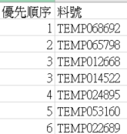
優先機種

Slide 56
TEMP022689 A/Y/C/D/E
94 TN W1852
0.1
0.1
TEMP022689 A/Y/C/D
1193 TN W1850
Dummy source
0.1
0.1
0.12
Dummy sink
TEMP060755D
TEMP022689D
0.1
0.1
TEMP060755 D TN Downgrade
In-house 33 0D~30D PROD CLBK
0.1
0.1
TEMP022689 A/Y/C/D/E 200 TN W1901

Slide 57
設定在製品所在廠區與需求廠區優先順序

Slide 58
TN
NGB
FS
TEMP000510
TEMP000510
TEMP000510
120
40
30
TEMP000510
TEMP021642
TEMP021642
TEMP021642
60
70
10
TN
NGB
FS

Slide 59
TN
NGB
FS
TEMP000510
TEMP000510
TEMP000510
120
40
30
TEMP000510
TEMP021642
TEMP021642
TEMP021642
60
70
10
TN
NGB
FS

Slide 60
TN
NGB
FS
TEMP000510
TEMP000510
TEMP000510
120
0
30
TEMP000510
TEMP021642
TEMP021642
TEMP021642
60
30
10
TN
NGB
FS

Slide 61
TN
NGB
FS
TEMP000510
TEMP000510
TEMP000510
120
0
30
TEMP000510
TEMP021642
TEMP021642
TEMP021642
60
30
10
TN
NGB
FS

Slide 62
TN
NGB
FS
TEMP000510
TEMP000510
TEMP000510
120
0
20
TEMP000510
TEMP021642
TEMP021642
TEMP021642
60
30
0
TN
NGB
FS

Slide 63
TN
NGB
FS
TEMP000510
TEMP000510
TEMP000510
120
0
20
TEMP000510
TEMP021642
TEMP021642
TEMP021642
60
30
0
TN
NGB
FS

Slide 64
TN
NGB
FS
TEMP000510
TEMP000510
TEMP000510
50
0
0
TEMP000510
TEMP021642
TEMP021642
TEMP021642
0
0
0
TN
NGB
FS

Slide 65
設定部份在製品料號綁定特定需求機種

Slide 66
0.12
0.1
0.12
0.1
0.1
0.1
Dummy source
0.1
Dummy sink
0.1
0.1
0.1
0.1
0.1
0.1
0.1

Slide 67
使用者介面

Slide 68
報表分類
設定
報表
流量組成報表
分配流量細項
分配流量彙總表
剩餘待加量報表

Slide 69
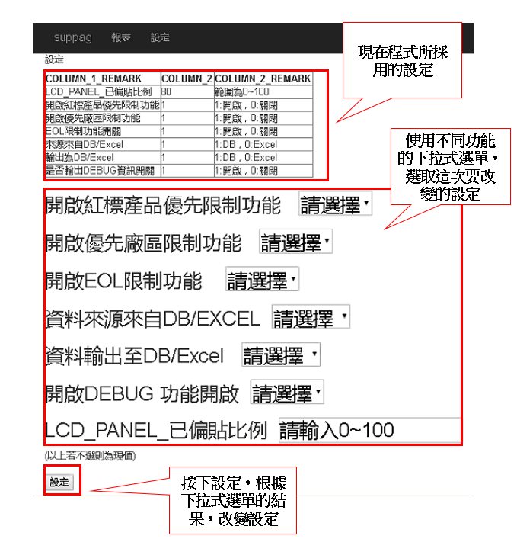
設定

Slide 70
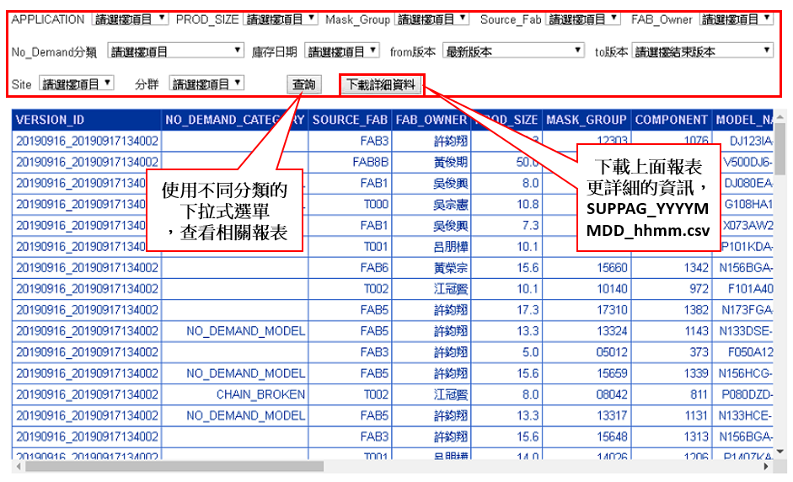
報表

Slide 71
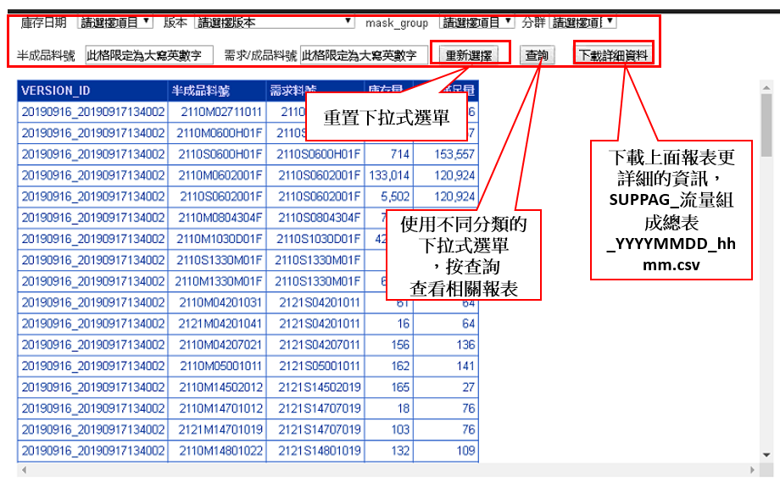
流量組成報表

Slide 72
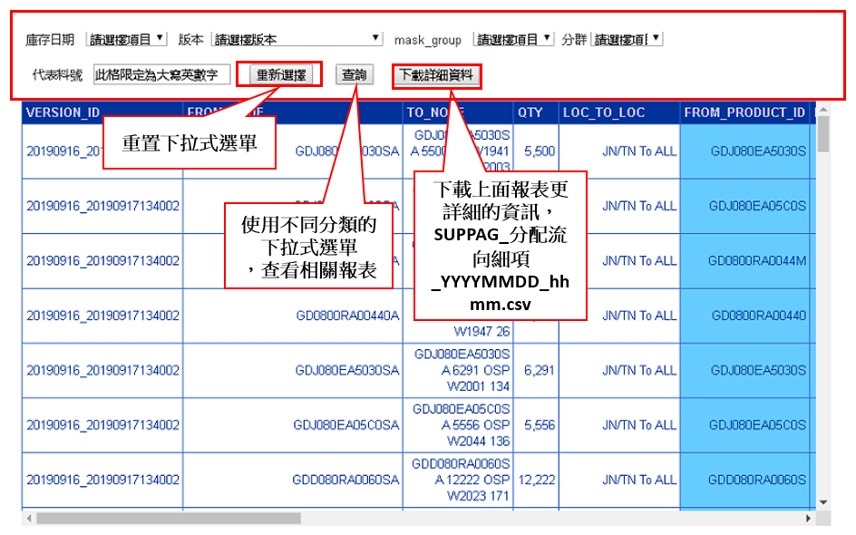
分配流量細項

Slide 73
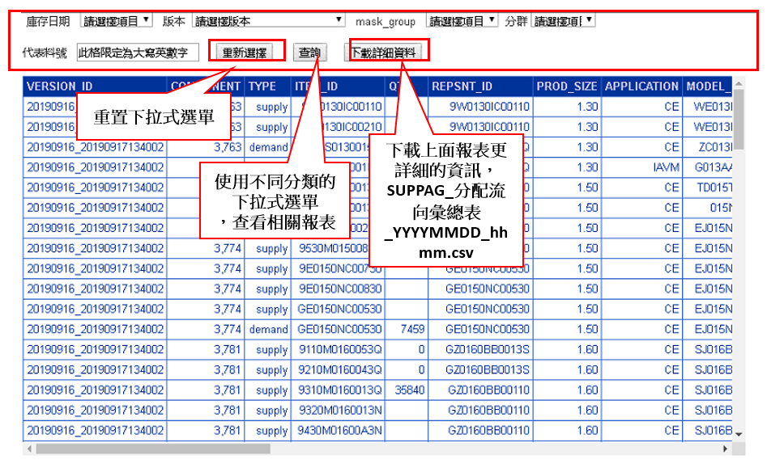
分配流量彙總表

Slide 74
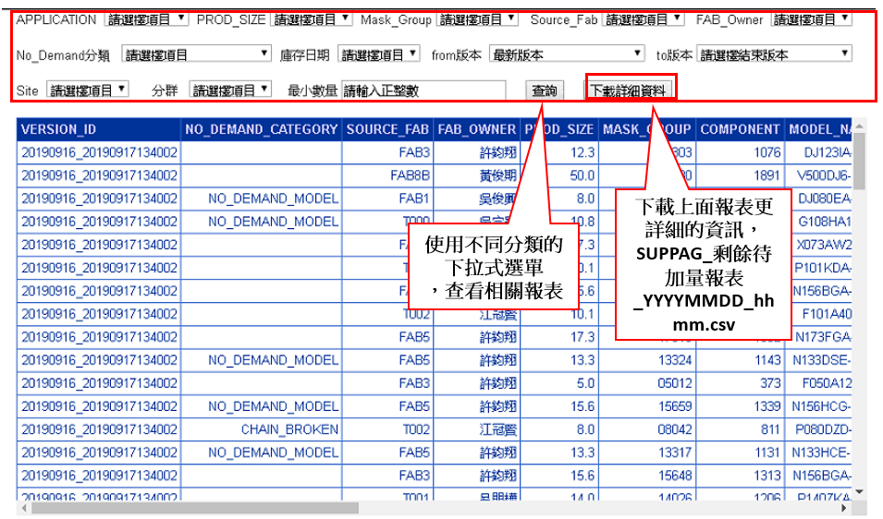
剩餘待加量報表

Slide 75
Thank you for listening

