Slide 1
2020/11/09 助教課9

Slide 2
The maximum-subarray problem

Slide 3
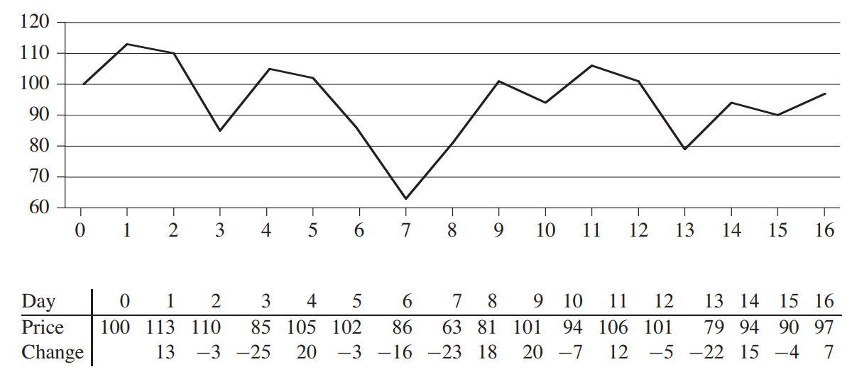
Midterm Q4.(a)

Slide 4
Midterm Q4.(b)
It will return the least negative position.
As each of the cross sums are computed, the most positive one must have the shortest possible lengths.
The algorithm doesn’t consider length zero sub arrays, so it must have length 1

Slide 5
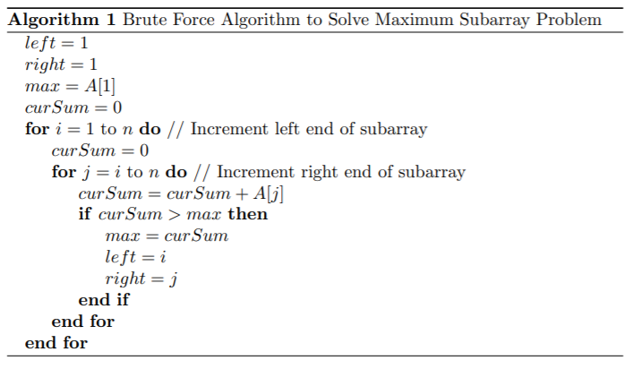
Midterm Q4.(c)

Slide 6
The complexity of BUILD-MAX-HEAP

Slide 7

Building a Max-Heap
BUILD-MAX-HEAP(A, n)
  for downto 1
  do MAX-HEAPIFY(A, i, n)
MAX-HEAPIFY(A, i, n)
  l ← LEFT(i )=2i
  r ← RIGHT(i )=2i+1
  if l ≤ n and A[l] > A[i ]
  then largest ← l
  else largest ←i
  if r ≤ n and A[r] > A[largest]
  then largest ←r
  if largest ≠ i
  then exchange A[i ] ↔ A[largest]
  MAX-HEAPIFY(A, largest, n)

Slide 8
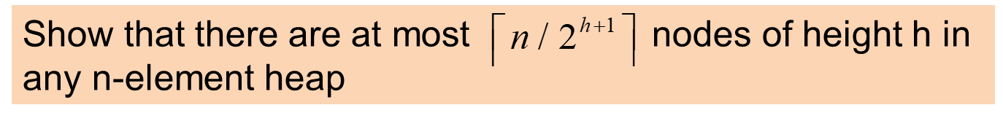
Height of node: the longest distance from a leaf
Depth of node: the distance from the root
d = 0
h = 2
d = 1
h = 1
d = 2
h = 0

Slide 9
Height of node: the longest distance from a leaf
Depth of node: the distance from the root
d = 0
h = 2
d = 1
h = 1
d = 2
h = 0

Slide 10
d = 0
d = 1
d = 2
n-x nodes(must be odd)
d = 3
Because n-x is odd
➔n is odd, x is even
➔n is even, x is odd
x leaves in depth H

Slide 11
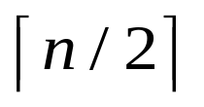
# of leaves =
Case I
n is odd (n=9)
x is even (x=2)
All internal nodes have 2 children
# of internal nodes = # of leaves -1
# of nodes = # of leaves + # of internal nodes
= 2 * # of leaves -1
# of leaves = (n+1) / 2=

Slide 12


# of leaves =
Case II
n is even (n=8)
x is odd (x=1)
There is one leaf doesn’t have sibling
Add a new node, make n’=n+1 (is even)
From case I, we can know # of leaves +1 =
# of leaves +1 =

Slide 13
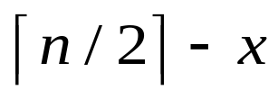
# of leaves =
d = 0
d = 1
d = 2
leaves in depth H-1
d = 3
x leaves in depth H

Slide 14

By mathematical induction
h=0
d = 0
Case I
n is odd (n=9)
x is even (x=2)
d = 1
d = 2
= H-1
nodes in depth d = H-1
d = 3
= H

Slide 15

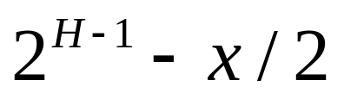
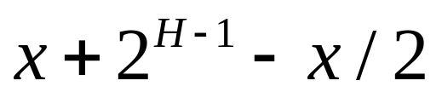
By mathematical induction
h=0
Case I
n is odd (n=9)
x is even (x=2)
nodes are parents
d = 2
= H-1
leaves in depth H-1
d = 3
= H
# of height-0 nodes =

Slide 16
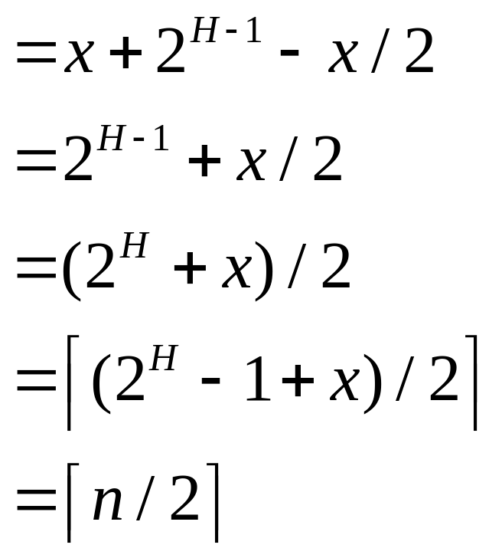
By mathematical induction
h=0
# of height-0 nodes

Slide 17
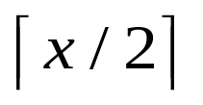
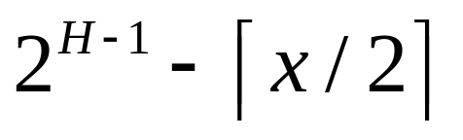
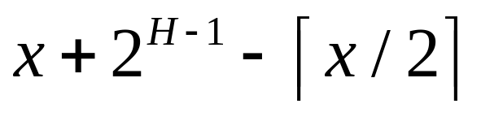
By mathematical induction
h=0
Case II
n is even (n=8)
x is odd (x=1)
nodes are parents
d = 2
= H-1
leaves in depth H-1
d = 3
= H
# of height-0 nodes =

Slide 18
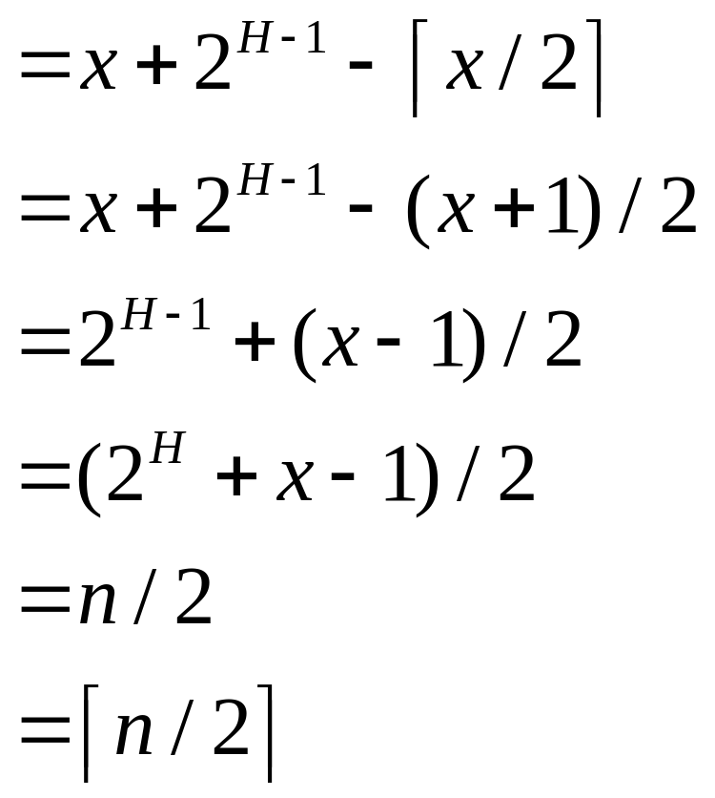
By mathematical induction
h=0
# of height-0 nodes

Slide 19


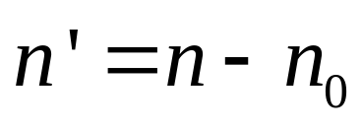
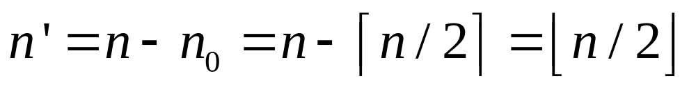
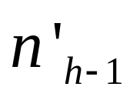
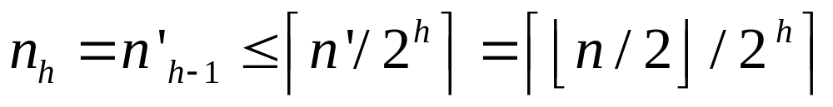
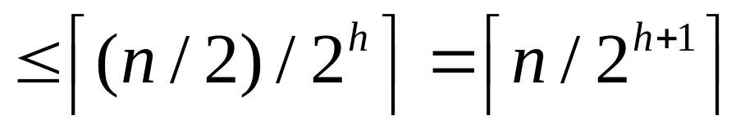
By mathematical induction
Suppose it’s true for height h-1, it’s true for h
is # of nodes at height h in n-node tree T
formed by removing the leaves of T
has height h-1 with
nodes
is # of nodes at height h-1 in n’-node tree T’

Slide 20
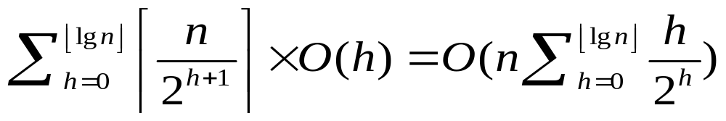
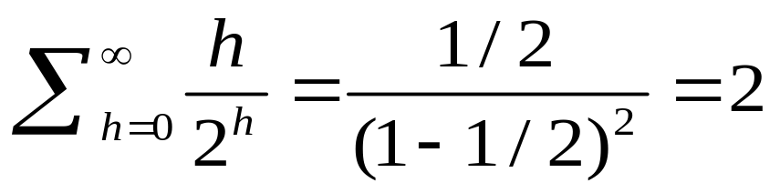
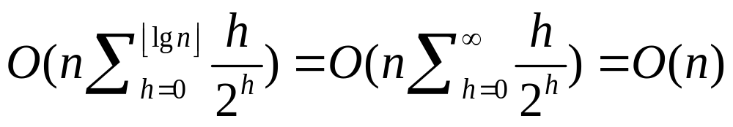
Complexity

Slide 21
Practice

Slide 22
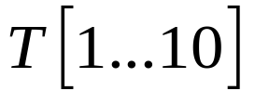
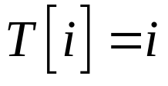

Let be an array such that for each .
1.Please write down the pseudo codes
2.Please build a Max-Heap
3.Please execute heap sort

Slide 23
Building a Max-Heap
BUILD-MAX-HEAP(A, n)
  for downto 1
  do MAX-HEAPIFY(A, i, n)
MAX-HEAPIFY(A, i, n)
  l ← LEFT(i )=2i
  r ← RIGHT(i )=2i+1
  if l ≤ n and A[l] > A[i ]
  then largest ← l
  else largest ←i
  if r ≤ n and A[r] > A[largest]
  then largest ←r
  if largest ≠ i
  then exchange A[i ] ↔ A[largest]
  MAX-HEAPIFY(A, largest, n)

Slide 24
Building a Max-Heap
1
2
3
4
5
6
7
index | 1 | 2 | 3 | 4 | 5 | 6 | 7 | 8 | 9 | 10
num | 1 | 2 | 3 | 4 | 5 | 6 | 7 | 8 | 9 | 10
8
9
10
11

Slide 25
Building a Max-Heap
1
2
3
4
5
6
7
i
l=2i
1 | 2 | 3 | 4 | 5 | 6 | 7 | 8 | 9 | 10
1 | 2 | 3 | 4 | 5 | 6 | 7 | 8 | 9 | 10
8
9
10

Slide 26
Building a Max-Heap
1
2
3
4
10
6
7
i
l=2i
1 | 2 | 3 | 4 | 5 | 6 | 7 | 8 | 9 | 10
1 | 2 | 3 | 4 | 10 | 6 | 7 | 8 | 9 | 5
8
9
5

Slide 27
Building a Max-Heap
1
2
3
4
10
6
7
1 | 2 | 3 | 4 | 5 | 6 | 7 | 8 | 9 | 10
1 | 2 | 3 | 4 | 10 | 6 | 7 | 8 | 9 | 5
8
9
5

Slide 28
Building a Max-Heap
1
2
3
4
10
6
7
1 | 2 | 3 | 4 | 5 | 6 | 7 | 8 | 9 | 10
1 | 2 | 3 | 4 | 10 | 6 | 7 | 8 | 9 | 5
8
9
5

Slide 29
Building a Max-Heap
1
2
3
9
10
6
7
1 | 2 | 3 | 4 | 5 | 6 | 7 | 8 | 9 | 10
1 | 2 | 3 | 9 | 10 | 6 | 7 | 8 | 4 | 5
8
4
5

Slide 30
Building a Max-Heap
1
2
3
9
10
6
7
1 | 2 | 3 | 4 | 5 | 6 | 7 | 8 | 9 | 10
1 | 2 | 3 | 9 | 10 | 6 | 7 | 8 | 4 | 5
8
4
5

Slide 31
Building a Max-Heap
1
2
7
9
10
6
3
1 | 2 | 3 | 4 | 5 | 6 | 7 | 8 | 9 | 10
1 | 2 | 7 | 9 | 10 | 6 | 3 | 8 | 4 | 5
8
4
5

Slide 32
Building a Max-Heap
1
2
7
9
10
6
3
1 | 2 | 3 | 4 | 5 | 6 | 7 | 8 | 9 | 10
1 | 2 | 7 | 9 | 10 | 6 | 3 | 8 | 4 | 5
8
4
5

Slide 33
Building a Max-Heap
1
10
7
9
2
6
3
1 | 2 | 3 | 4 | 5 | 6 | 7 | 8 | 9 | 10
1 | 10 | 7 | 9 | 2 | 6 | 3 | 8 | 4 | 5
8
4
5

Slide 34
Building a Max-Heap
1
10
7
9
2
6
3
1 | 2 | 3 | 4 | 5 | 6 | 7 | 8 | 9 | 10
1 | 10 | 7 | 9 | 2 | 6 | 3 | 8 | 4 | 5
8
4
5

Slide 35
Building a Max-Heap
1
10
7
9
5
6
3
1 | 2 | 3 | 4 | 5 | 6 | 7 | 8 | 9 | 10
1 | 10 | 7 | 9 | 5 | 6 | 3 | 8 | 4 | 2
8
4
2

Slide 36
Building a Max-Heap
1
10
7
9
5
6
3
1 | 2 | 3 | 4 | 5 | 6 | 7 | 8 | 9 | 10
1 | 10 | 7 | 9 | 5 | 6 | 3 | 8 | 4 | 2
8
4
2

Slide 37
Building a Max-Heap
10
1
7
9
5
6
3
1 | 2 | 3 | 4 | 5 | 6 | 7 | 8 | 9 | 10
10 | 1 | 7 | 9 | 5 | 6 | 3 | 8 | 4 | 2
8
4
2

Slide 38
Building a Max-Heap
10
1
7
9
5
6
3
1 | 2 | 3 | 4 | 5 | 6 | 7 | 8 | 9 | 10
10 | 1 | 7 | 9 | 5 | 6 | 3 | 8 | 4 | 2
8
4
2

Slide 39
Building a Max-Heap
10
9
7
1
5
6
3
1 | 2 | 3 | 4 | 5 | 6 | 7 | 8 | 9 | 10
10 | 9 | 7 | 1 | 5 | 6 | 3 | 8 | 4 | 2
8
4
2

Slide 40
Building a Max-Heap
10
9
7
1
5
6
3
1 | 2 | 3 | 4 | 5 | 6 | 7 | 8 | 9 | 10
10 | 9 | 7 | 1 | 5 | 6 | 3 | 8 | 4 | 2
8
4
2

Slide 41
Building a Max-Heap
10
9
7
8
5
6
3
1 | 2 | 3 | 4 | 5 | 6 | 7 | 8 | 9 | 10
10 | 9 | 7 | 8 | 5 | 6 | 3 | 1 | 4 | 2
1
4
2

Slide 42
Max-Heap
10
9
7
8
5
6
3
1 | 2 | 3 | 4 | 5 | 6 | 7 | 8 | 9 | 10
10 | 9 | 7 | 8 | 5 | 6 | 3 | 1 | 4 | 2
1
4
2

Slide 43
Heap sort
10
9
7
8
5
6
3
1 | 2 | 3 | 4 | 5 | 6 | 7 | 8 | 9 | 10
10 | 9 | 7 | 8 | 5 | 6 | 3 | 1 | 4 | 2
1
4
2

Slide 44
Heap sort
Heap 10
Swap the element between
the first index and last index
2
9
7
8
5
6
3
Sorted
1 | 2 | 3 | 4 | 5 | 6 | 7 | 8 | 9 | 10
2 | 9 | 7 | 8 | 5 | 6 | 3 | 1 | 4 | 10
1
4
10

Slide 45
Heap sort
after
MAX-HEAPIFY
9
8
7
4
5
6
3
Sorted
1 | 2 | 3 | 4 | 5 | 6 | 7 | 8 | 9 | 10
9 | 8 | 7 | 4 | 5 | 6 | 3 | 1 | 2 | 10
1
2
10

Slide 46
Heap sort
Heap 9
2
8
7
4
5
6
3
Sorted
1 | 2 | 3 | 4 | 5 | 6 | 7 | 8 | 9 | 10
2 | 8 | 7 | 4 | 5 | 6 | 3 | 1 | 9 | 10
1
9
10

Slide 47
Heap sort
after
MAX-HEAPIFY
8
5
7
4
2
6
3
Sorted
1 | 2 | 3 | 4 | 5 | 6 | 7 | 8 | 9 | 10
8 | 5 | 7 | 4 | 2 | 6 | 3 | 1 | 9 | 10
1
9
10

Slide 48
Heap sort
Heap 8
1
5
7
4
2
6
3
Sorted
1 | 2 | 3 | 4 | 5 | 6 | 7 | 8 | 9 | 10
1 | 5 | 7 | 4 | 2 | 6 | 3 | 8 | 9 | 10
8
9
10

Slide 49
Heap sort
after
MAX-HEAPIFY
7
5
6
4
2
1
3
Sorted
1 | 2 | 3 | 4 | 5 | 6 | 7 | 8 | 9 | 10
7 | 5 | 6 | 4 | 2 | 1 | 3 | 8 | 9 | 10
8
9
10

Slide 50
Heap sort
Heap 7
3
5
6
4
2
1
7
Sorted
1 | 2 | 3 | 4 | 5 | 6 | 7 | 8 | 9 | 10
3 | 5 | 6 | 4 | 2 | 1 | 7 | 8 | 9 | 10
8
9
10

Slide 51
Heap sort
after
MAX-HEAPIFY
6
5
3
4
2
1
7
Sorted
1 | 2 | 3 | 4 | 5 | 6 | 7 | 8 | 9 | 10
6 | 5 | 3 | 4 | 2 | 1 | 7 | 8 | 9 | 10
8
9
10

Slide 52
Heap sort
Heap 6
1
5
3
4
2
6
7
Sorted
1 | 2 | 3 | 4 | 5 | 6 | 7 | 8 | 9 | 10
1 | 5 | 3 | 4 | 2 | 6 | 7 | 8 | 9 | 10
8
9
10

Slide 53
Heap sort
after
MAX-HEAPIFY
5
4
3
1
2
6
7
Sorted
1 | 2 | 3 | 4 | 5 | 6 | 7 | 8 | 9 | 10
5 | 4 | 3 | 1 | 2 | 6 | 7 | 8 | 9 | 10
8
9
10

Slide 54
Heap sort
Heap 5
2
4
3
1
5
6
7
Sorted
1 | 2 | 3 | 4 | 5 | 6 | 7 | 8 | 9 | 10
2 | 4 | 3 | 1 | 5 | 6 | 7 | 8 | 9 | 10
8
9
10

Slide 55
Heap sort
after
MAX-HEAPIFY
4
2
3
1
5
6
7
Sorted
1 | 2 | 3 | 4 | 5 | 6 | 7 | 8 | 9 | 10
4 | 2 | 3 | 1 | 5 | 6 | 7 | 8 | 9 | 10
8
9
10

Slide 56
Heap sort
Heap 4
1
2
3
4
5
6
7
Sorted
1 | 2 | 3 | 4 | 5 | 6 | 7 | 8 | 9 | 10
1 | 2 | 3 | 4 | 5 | 6 | 7 | 8 | 9 | 10
8
9
10

Slide 57
Heap sort
after
MAX-HEAPIFY
3
2
1
4
5
6
7
Sorted
1 | 2 | 3 | 4 | 5 | 6 | 7 | 8 | 9 | 10
3 | 2 | 1 | 4 | 5 | 6 | 7 | 8 | 9 | 10
8
9
10

Slide 58
Heap sort
Heap 3
1
2
3
4
5
6
7
Sorted
1 | 2 | 3 | 4 | 5 | 6 | 7 | 8 | 9 | 10
1 | 2 | 3 | 4 | 5 | 6 | 7 | 8 | 9 | 10
8
9
10

Slide 59
Heap sort
after
MAX-HEAPIFY
2
1
3
4
5
6
7
Sorted
1 | 2 | 3 | 4 | 5 | 6 | 7 | 8 | 9 | 10
2 | 1 | 3 | 4 | 5 | 6 | 7 | 8 | 9 | 10
8
9
10

Slide 60
Heap sort
Heap 2
1
2
3
4
5
6
7
Sorted
1 | 2 | 3 | 4 | 5 | 6 | 7 | 8 | 9 | 10
1 | 2 | 3 | 4 | 5 | 6 | 7 | 8 | 9 | 10
8
9
10

Slide 61
Heap sort
Heap 1
1
2
3
4
5
6
7
Sorted
1 | 2 | 3 | 4 | 5 | 6 | 7 | 8 | 9 | 10
1 | 2 | 3 | 4 | 5 | 6 | 7 | 8 | 9 | 10
8
9
10

