Slide 1
Data Structures & Algorithms
by
王 逸 琳
ilinwang@mail.ncku.edu.tw
http://ilin.iim.ncku.edu.tw
成功大學工業與資訊管理學系教授
授課：二3~4、四2 [61101]；實習：一9[online 9 groups]; Office hr: 三 3~4
課本：Introduction to Algorithms, 4th Edition,
by Cormen, Leiserson, Rivest, and Stein
(開發圖書)

Slide 2
The Role of the Algorithms in Computer
Contents:
Algorithms
Algorithms as a technology

Slide 3
1.1 Algorithms
An algorithm is any well-defined computational procedure that takes some values as input and produces some values as output
What “well-defined” means?
Simplicity: Every instruction (step, statement, …) must be sufficiently
basic so that anyone can follow
Definiteness: Each instruction must be clear and unambiguous
Finiteness: The algorithm must terminate after a finite number of steps
……
An algorithm should be independent of computers, but easy to translate into a computer language
Problem
Description
(input)
Solution
(output)

Slide 4
Problems vs. Instances
Problem: well-defined statement specifies in general terms the desired input/output relationship
e.g., sorting problem:
Input: A sequence of n numbers <a₁, a₂,…, a_{n} >
Output: A permutation <a’₁, a’₂,…, a’_{n} > of the input sequence such that a’₁ ≤ … ≤ a’_{n}
Instance (of a problem): input values needed to compute a solution to the problem
e.g., an instance of a sorting problem:
A sequence of numbers <32,57,92,16,32,58> (n=6)
Output requested: <16,32,32,57,58,92>
An algorithm should solve a problem, i.e., all the instances of a problem
An algorithm is said to be correct if for every input instance, it produces the correct output

Slide 5
What kind of problem can be solved by algorithms?
The Human Genome Project
The Internet Applications
Electronic Commerce with Public-key cryptography and digital signatures
Manufacturing and other commercial settings

Slide 6
Hard Problems
NP-complete problems:
It is unknown whether or not efficient algorithms exist for NP-complete problems
If an efficient algorithm exists for any NP-complete problem, then efficient algorithms exist for ALL of the NP-complete problems
Several NP-complete problems look similar to (but DIFFERENT from) problems for which we do know of efficient algorithms

Slide 7
Traveling Salesman Problem (TSP)
Given
a finite number of "cities"
the cost of travel between each pair of them
Find
the cheapest way of visiting all the cities and returning to your starting point.
Largest cases solved to date (by 2001)
15,112 cities in Germany
110 processors (Compaq EV6 Alpha at 500 MHz )
total computer time 22.6 years
TSP is NP hard
Heuristics (Local Search, GA, SA, Tabu search, Ant Colony, …, etc.)
TSP Wiki
TSP website

Slide 8
1.2 Why study algorithms?
Correctness
Efficiency
Resource
Time

Slide 9

Efficient algorithms? (1)
“I can’t find an efficient algorithm, I guess I’m just too dumb.”
Serious damage to your
position within the company !!!

Slide 10

Efficient algorithms? (2)
“I can’t find an efficient algorithm, because no such algorithm is possible!”
Unfortunately, proving intractability can be just
as hard as finding efficient algorithms !!!
∴ No hope !!!
P ≠ NP

Slide 11
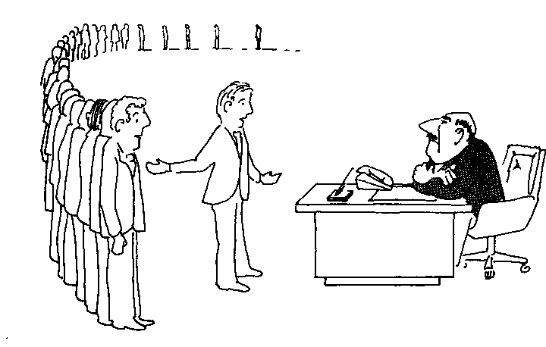
Efficient algorithms? (3)
“I can’t find an efficient algorithm, but neither can all these famous people”

Slide 12

Efficient algorithms? (4)
“Anyway, we have to solve this problem.
Can we satisfy with a good solution ? “

Slide 13

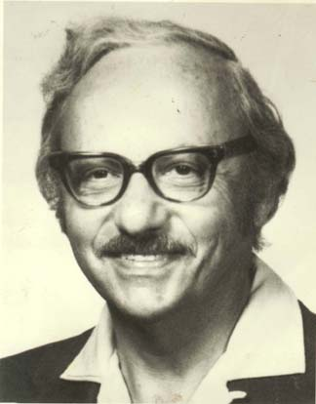
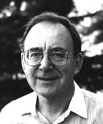
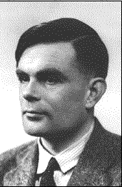

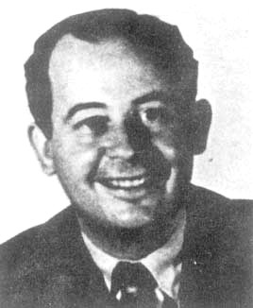
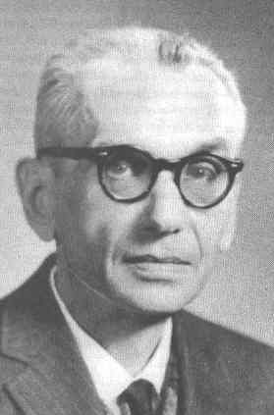
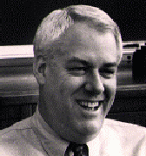

David Johnson
George Dantzig
Richard Karp
Alan Turing
Michael Garey
Ralph Gomory
John Von Neumann
Kurt Gödel
Steven Cook

