Slide 1
Elementary Data Structures
Contents:
Stacks & Queues
Linked Lists
Implementing Pointers and Objects
Representing Rooted Trees

Slide 2
Data Structure
A data structure is a way to store and organize data in order to facilitate access and modifications.
No single data structure works well for all purposes
A dynamic set is manipulated by algorithms and can grow, shrink, or change over time.
A dictionary is a dynamic set that supports operations to insert elements into, delete elements from, and test membership in the set.
A pointer is a reference to an object in memory (usually implemented as a machine address).
Some kinds of dynamic sets assume that one of the object’s fields is an identifying key field. If the keys are all different, we can think of the dynamic set as being a set of key values.
The object may contain satellite data, which are carried around in other object fields but are otherwise unused by the set implementation. It may also have fields that are manipulated by the set operations; these fields may contain data or pointers to other objects in the set.

Slide 3
Operations on Dynamic Sets
2 categories of operations:
Queries: returns info (e.g. pointer) for the element SEARCH(S,k), MINIMUM(S), MAXIMUM(S), SUCCESSOR(S,x), PREDECESSOR(S,x)
Modifying operations: INSERT(S,x), DELETE(S,x)
Stacks and queues: dynamic sets where the element removed from the set by the DELETE operation is prespecified.
Stacks: LIFO (PUSH: INSERT operation ; POP: DELETE operation)
Queues: FIFO (ENQUEUE: INSERT operation ;DEQUEUE: DELETE operation)

Slide 4
Stacks
We can implement a stack of at most n elements with an array S[1..n].
S[1] : the element at the bottom of the stack S[top[S]] : the element at the top (most recently inserted)
When top[S] = 0, the stack contains no elements and is empty.
The stack can be tested for emptiness by the query operation STACK-EMPTY.
If an empty stack is popped, we say the stack underflows, normally an error.
If top[S] exceeds n, the stack overflows, normally an error, too.

Slide 5
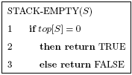

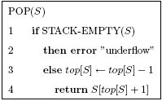
Stack Operations
each of the three stack operations takes computational time of O(1).
S
15,6,2,9
top[S]=4
15,6,2,9,17,3
After PUSH(S,17),PUSH(S,3)
15,6,2,9,17
After POP(S) 3 is still in the array, but not in the stack, now top[S]=5

Slide 6
A Stack Example using MS(P)
To sort P=[5,2,4,7,1,3,2,6]
MS(P,1,8)
q=FL((1+8)/2)=4
MS(P,1,4)
MS(P,5,8)
MG(P,1,4,8)
G
q=FL((1+4)/2)=2
MS(P,1,2)
MS(P,3,4)
MG(P,1,2,4)
C
q=FL((1+2)/2)=1
MS(P,1,1)
MS(P,2,2)
MG(P,1,1,2)
A
3
1
7
Stack
q=FL((3+4)/2)=3
MS(P,3,3)
MS(P,4,4)
MG(P,3,3,4)
B
G
q=FL((5+8)/2)=6
MS(P,5,6)
MS(P,7,8)
MG(P,5,6,8)
F
C
F
2
B
D
E
6
A
q=FL((5+6)/2)=5
MS(P,5,5)
MS(P,6,6)
MG(P,5,5,6)
D
MG(P,1,1,2)
MG(P,3,3,4)
MG(P,1,2,4)
MG(P,5,5,6)
MG(P,7,7,8)
MG(P,5,6,8)
MG(P,1,4,8)
5, 2 ➔ 2, 5
4, 7 ➔(no change)
2, 5, 4, 7 ➔ 2, 4, 5, 7
1, 3 ➔ (no change)
2, 6 ➔ (no change)
1, 3, 2, 6 ➔ 1, 2, 3, 6
2, 4, 5, 7, 1, 2, 3, 6 ➔ 1, 2, 2, 3, 4, 5, 6, 7
4
q=FL((7+8)/2)=7
MS(P,7,7)
MS(P,8,8)
MG(P,7,7,8)
E
5

Slide 7
A Stack Example of Fibonacci series
F(n)=F(n-2)+F(n-1) F(0)=0, F(1)=1
F(5);o
F(3);e
F(4);n
Stack
F(1);a
F(2);d
F(2);h
F(3);m
o
n
e
F(2);l
F(0);b
F(1);c
F(0);f
F(0);g
F(1);i
h
d
m
a
f
g
i
l
c
b
k
F(0);j
F(1);k
j

Slide 8
Queues
A queue of at most n−1 elements can be implemented by an array Q[1..n].
head[Q] indexes, or points to, its head. (delete from the head)
tail[Q] indexes the next location at which a newly arriving element will be inserted into the queue. (insert at the tail)
elements in the queue are in locations, head[Q], head[Q] + 1, · · · , tail[Q] − 1, where we ”wrap around” in the sense that location 1 immediately follows location n in a circular order.
When head[Q] = tail[Q], the queue is empty.
Initially, we have head[Q] = tail[Q] = 1.
To dequeue on an empty queue causes the queue to underflow.
When head[Q] = tail[Q]+1, the queue is full,
To enqueue on a full queue causes the queue to overflow.

Slide 9
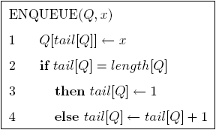
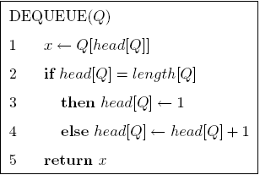
Queue Operations
each of the two queue operations takes computational time of O(1).
Q
5
8
1
head[Q]=4, tail[Q]=7
Q
ENQUEUE(Q,2), ENQUEUE(Q,3)
3
5
8
1
2
head[Q]=4, tail[Q]=2
DEQUEUE(Q) twice
Q
3
5
8
1
2
head[Q]=6, tail[Q]=2

Slide 10
Linked Lists
A linked list is a data structure in which the objects are arranged in a linear order
each element in a doubly linked list L is an object with a key field and two other pointer fields: next and prev
Given an element x in the list
next[x] points to its successor in the linked list
prev[x] points to its predecessor
prev[x] = NIL: x has no predecessor, and is the first element, or head
next[x] = NIL: x has no successor and is the last element, or tail
head[L] points to the first element of the list
head[L] = NIL: the list is empty

Slide 11
Some Linked Lists
Singly linked list : omit the prev pointer in each element of the doubly linked list
Sorted linked list : the linear order of the list corresponds to the linear order of keys stored in elements of the list (thus head is the minimum element, and tail is the maximum element)
Unsorted linked list : a linked list that is not sorted
Circular linked list : a doubly linked list with prev[head]=tail , next[tail]=head
In the following discussion, we assume unsorted and doubly linked lists.

Slide 12
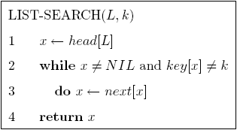
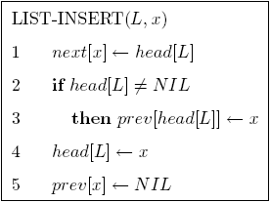
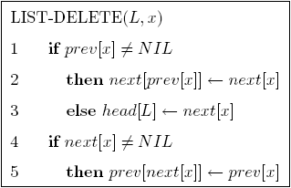
Linked List Operations
Search an object x with key=k on a list of n objects : O(n)
Insert an object x : O(1)
Delete an object x : O(1)

Slide 13
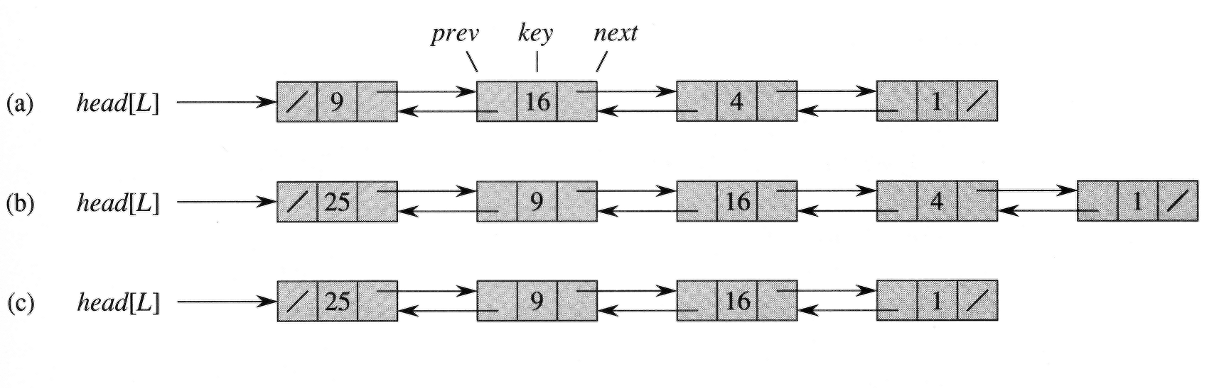
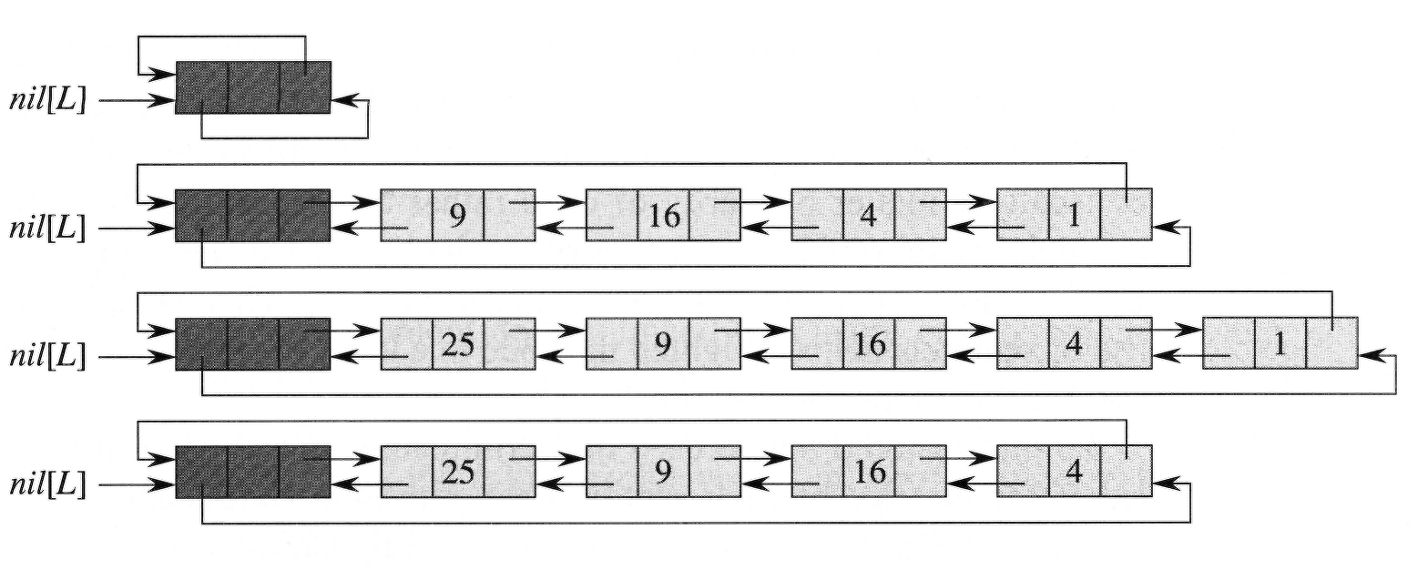
Doubly Linked Lists

Slide 14
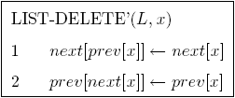
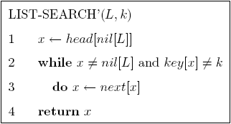
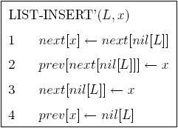
Sentinels
Sentinel : a dummy object that simplifies boundary conditions.
e.g., nil[L] that represents NIL, it makes a doubly linked list to be a circular doubly linked list with a sentinel
next[nil[L]]=head[L] ; prev[nil[L]]=tail[L]
Thus we can replace head[L] by references to next[nil[L]].
next[tail[L]]=nil[L] ; prev[head[L]]=nil[L]
thus an empty list consists of just the sentinel nil[L]
With sentinel, the operations become simpler: it does not save much time, but makes codes clearer.
next[nil[L]]

Slide 15
Implementing pointers and objects
To implement pointers and objects in FORTRAN : Use arrays and array indices
A Multiple-Array Representation of Objects
e.g., a doubly linked list with three arrays, thus a pointer x is simply a common index into the key, next, and prev
A Single-Array Representation of Objects
An object occupies a contiguous subarray A[j..k].
Each field of the object corresponds to an offset in the range from 0 to k −j, and a pointer to the object is the index j.
e.g., if the offsets corresponding to key, next, and prev are 0, 1, and 2, respectively then, to read the value of prev[i], we read A[i + 2].
flexible because it permits objects of different lengths to be stored in the same array.
managing heterogeneous objects is more difficult than managing homogeneous ones, where all objects have the same fields.
Usually multiple-array representation is sufficient

Slide 16
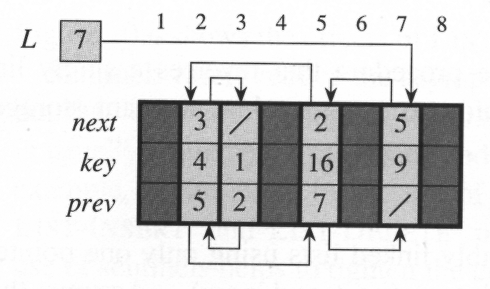
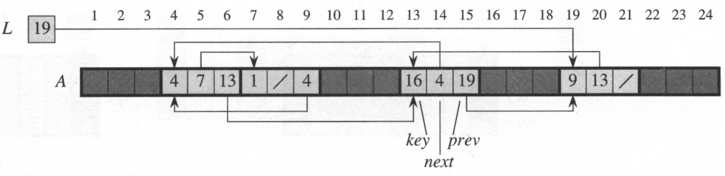
Represent Linked Lists by Arrays

Slide 17
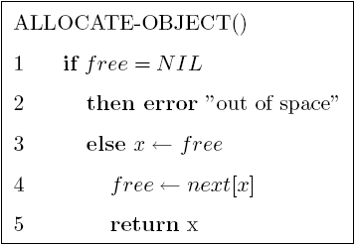
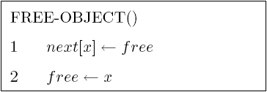
Allocating and Freeing Objects
suppose the arrays have length m , and the dynamic set contains n≤m elements. Then the remaining m−n objects are free.
keep the free objects in a singly linked list called the free list which uses the next array to store the next pointers within the list.
global variable free stores the head of the free list
Maintain the free list as a stack: the next object allocated is the last one freed
(x)
Both operations take O(1)
We may use a single free list to service several linked lists

Slide 18
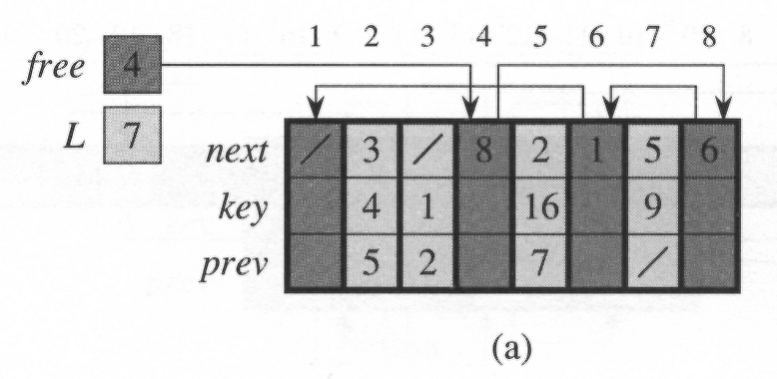
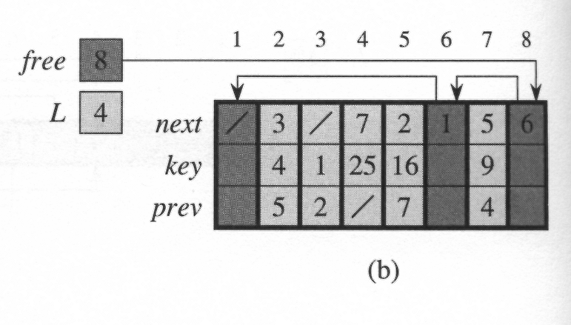
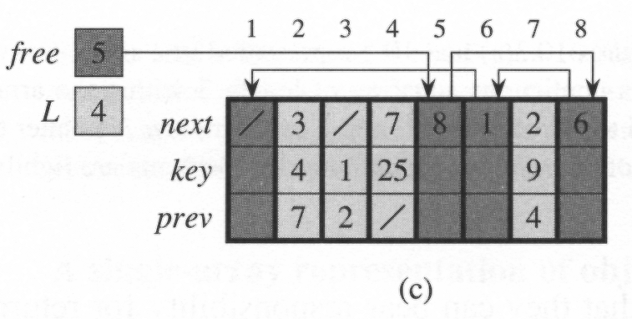
Examples on Allocating & Freeing Objects
ALLOCATE-OBJECT( ), return index 4
LIST-INSERT(L,4), key(4)=25
LIST-DELETE(L,5)
FREE-OBJECT(5)

Slide 19
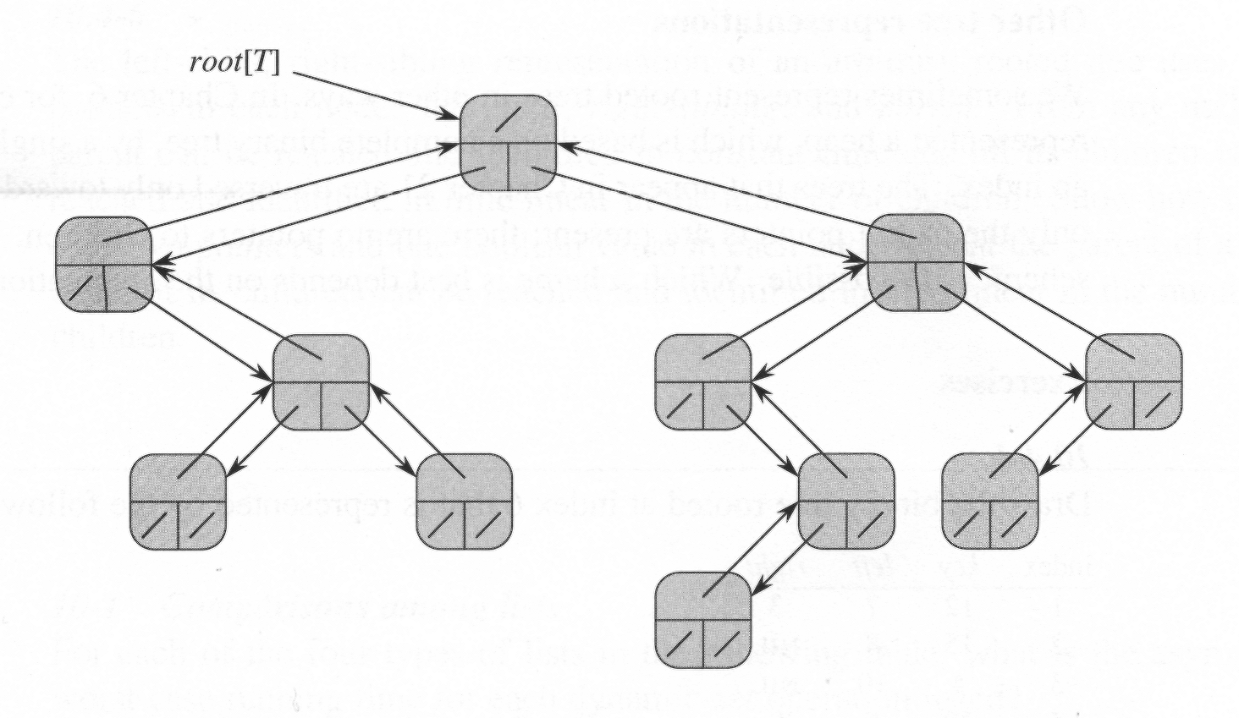
Representing Rooted Trees
Binary trees: use fields p, left, right
p[x]=NIL ⬄ x is the root, root[T]

Slide 20
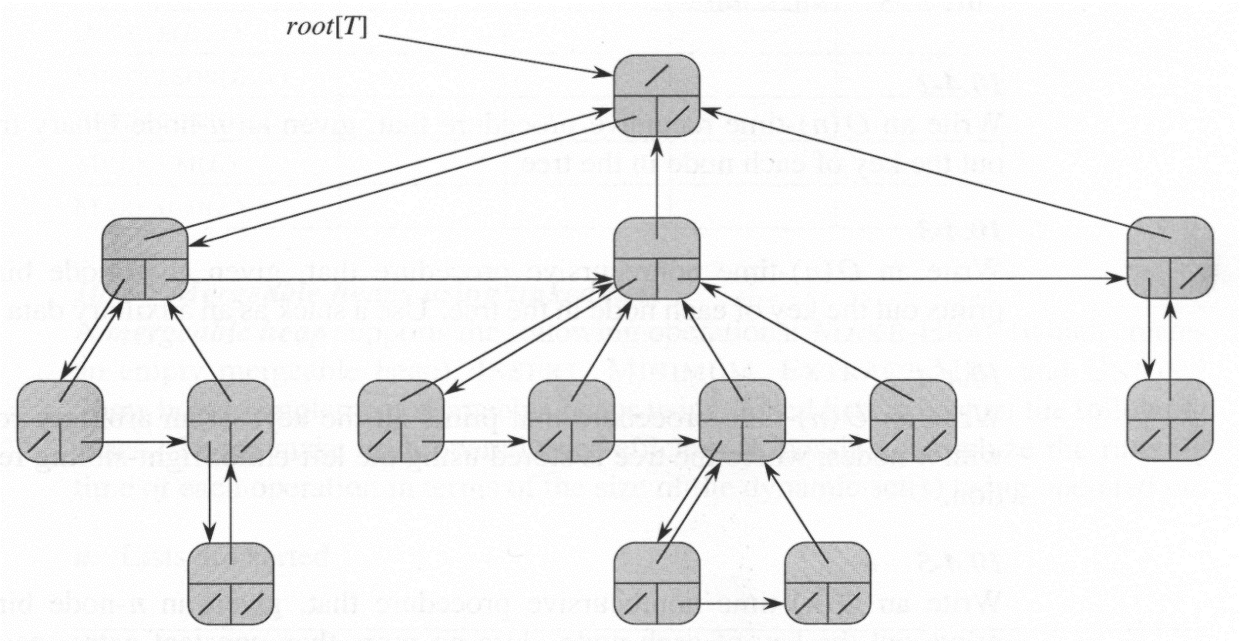
Rooted Trees with unbounded Branching
Binary tree representation can be extended to represent trees with arbitrary # children
Using only O(n) space for any n-node rooted tree
left-child, right-sibling representation : using
Notes:
If each node allocate fixed memory (e.g. max_deg) for its adjacent nodes, it will waste memory.
Using the left-child, right-sibling representation can save much space since it only use O(n) space.

