Slide 1
Divide and Conquer
Contents:
examples of D&C
merge sort, binary search, a^{n},
matrix multiplication, polynomial multiplication

Slide 2
Divide-and-Conquer Approach
Divide the problem into a number of subproblems
Conquer the subproblems by solving them recursively (if the subproblem sizes are small enough, solve them straightforwardly)
Combine the solutions to the subproblems into the solution for the original problem
For example: MERGE-SORT algorithm for sorting

Slide 3
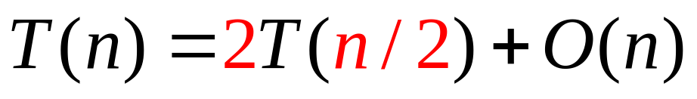
Example: Merge Sort
Divide: trivial
Conquer: recursively sort 2 subarrays
Combine: linear-time merge
# subproblems
Subproblem size
Work dividing & combing

Slide 4
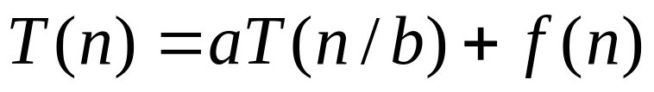
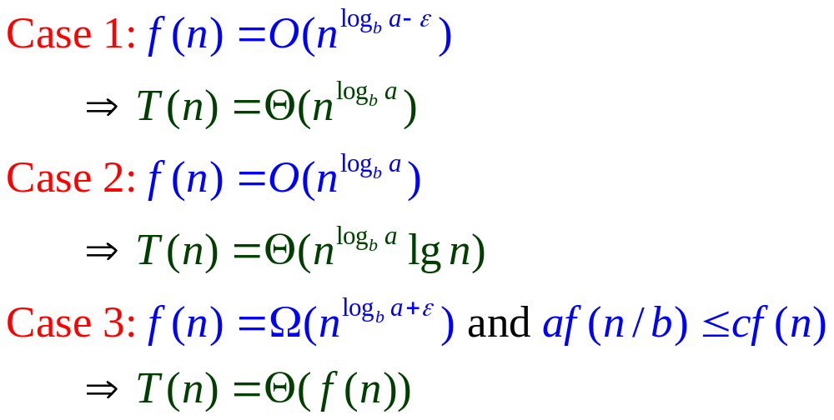
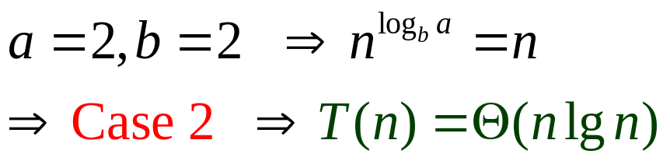
Master theorem (reprise)
Merge sort:

Slide 5
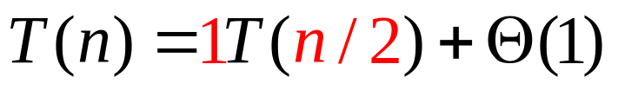





Example: Binary Search
To find an element in a sorted array
Divide: check middle element
Conquer: recursively search 1 subarray
Combine: Trivial
Example: Find 9

Slide 6

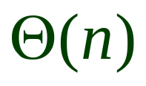
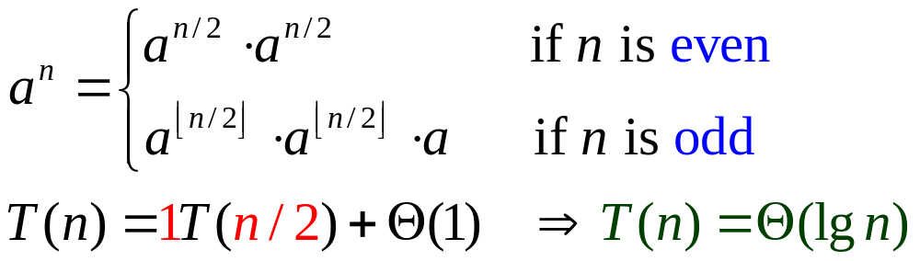
Example: Powering a Number
To compute
Naive algorithm:
Divide-and-Conquer algorithm:

Slide 7
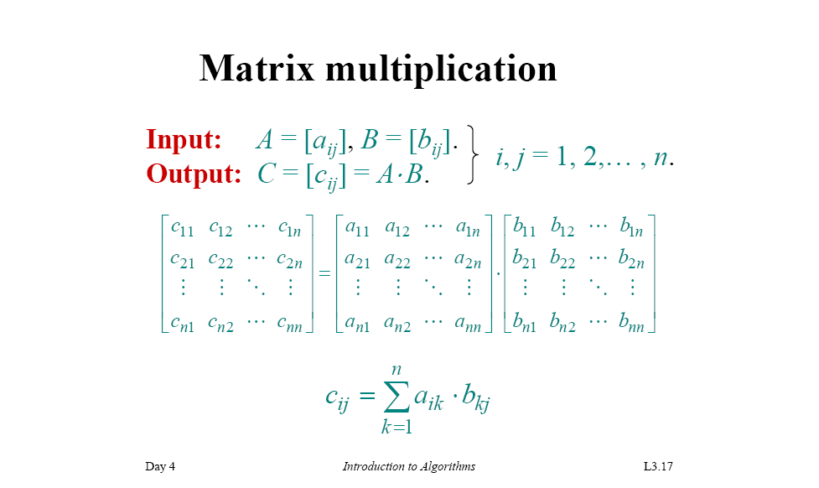

Slide 8
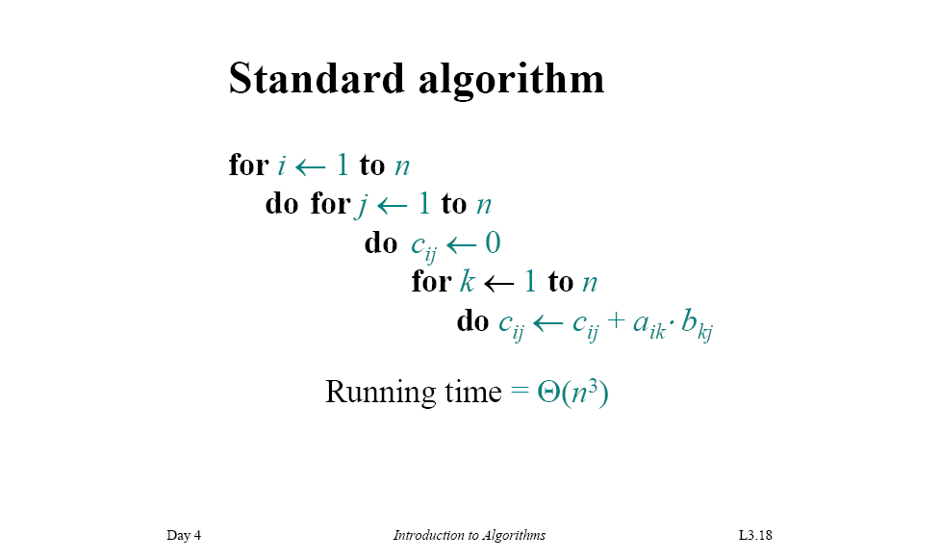

Slide 9
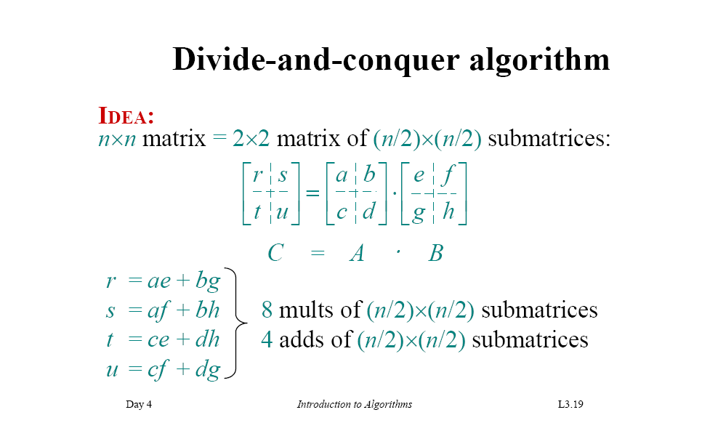
dg
dh

Slide 10
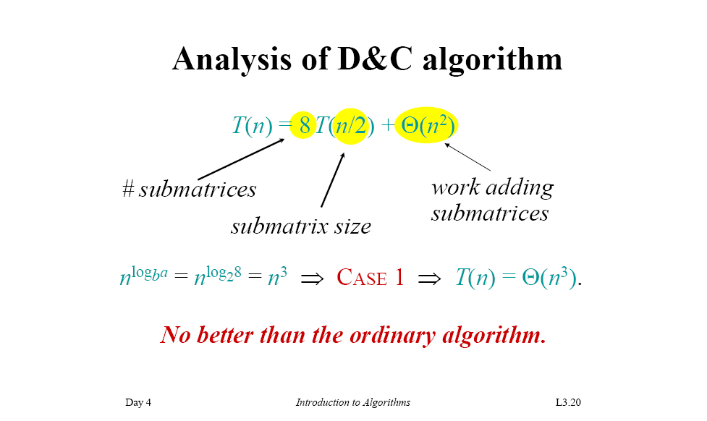

Slide 11
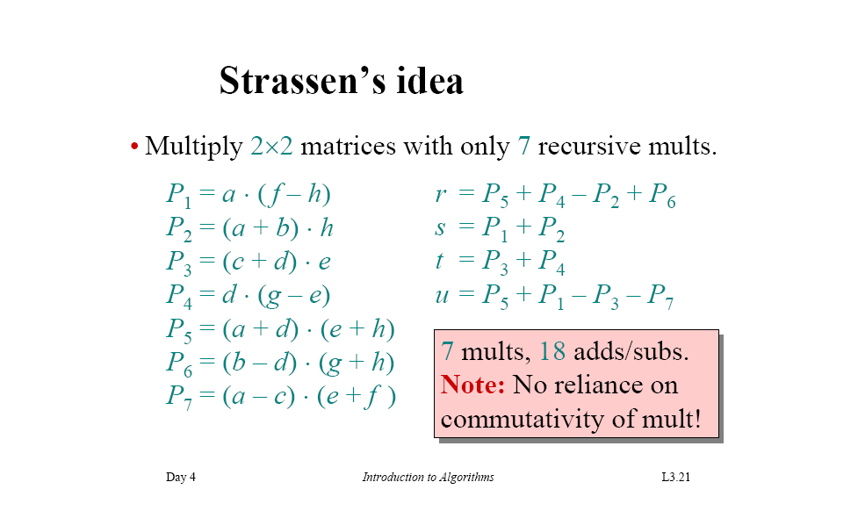

Slide 12
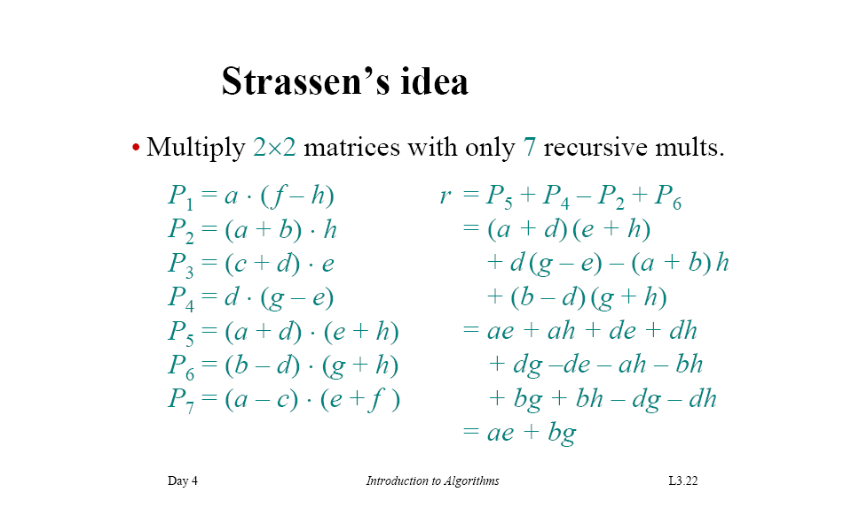

Slide 13
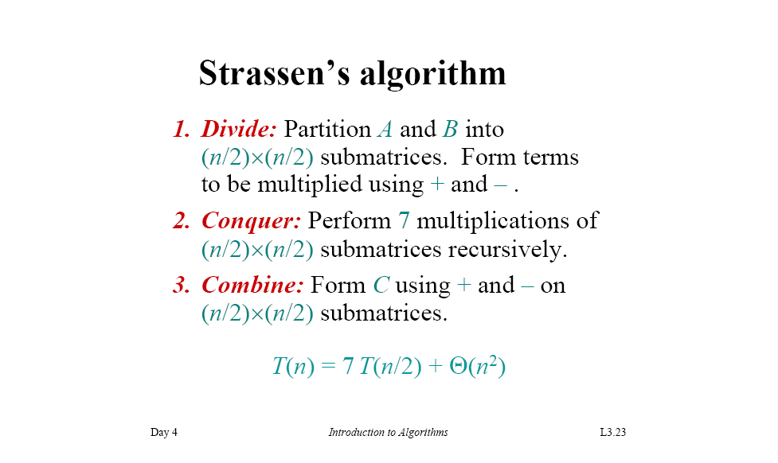

Slide 14
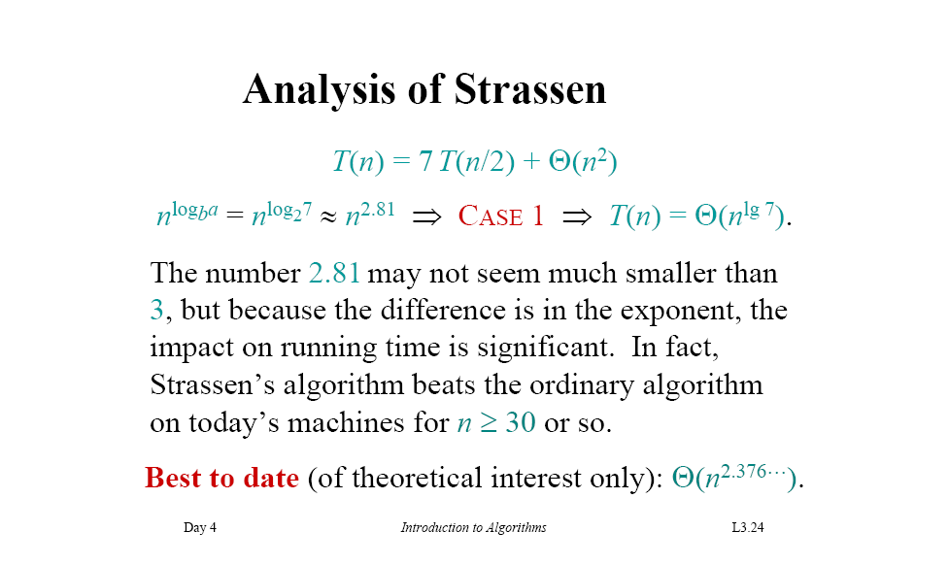

Slide 15
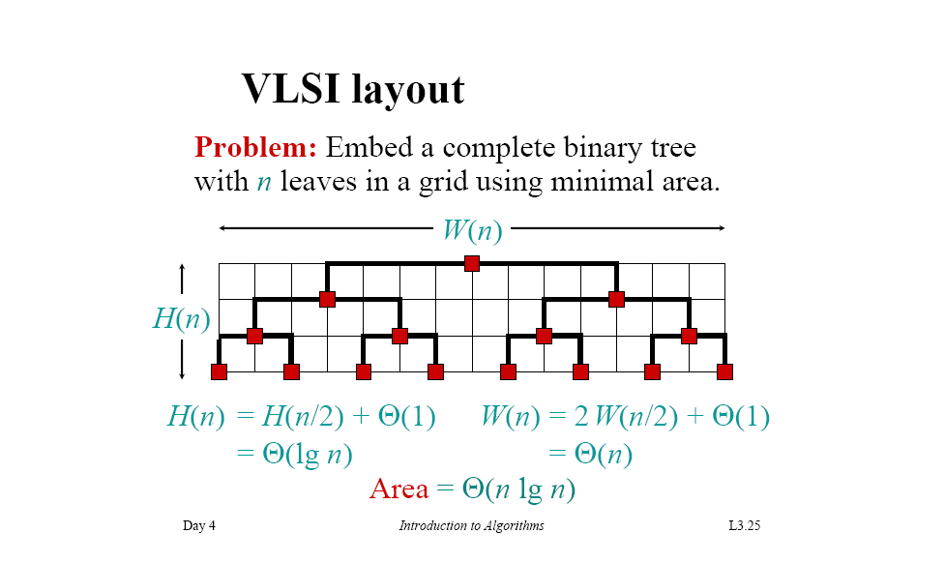

Slide 16
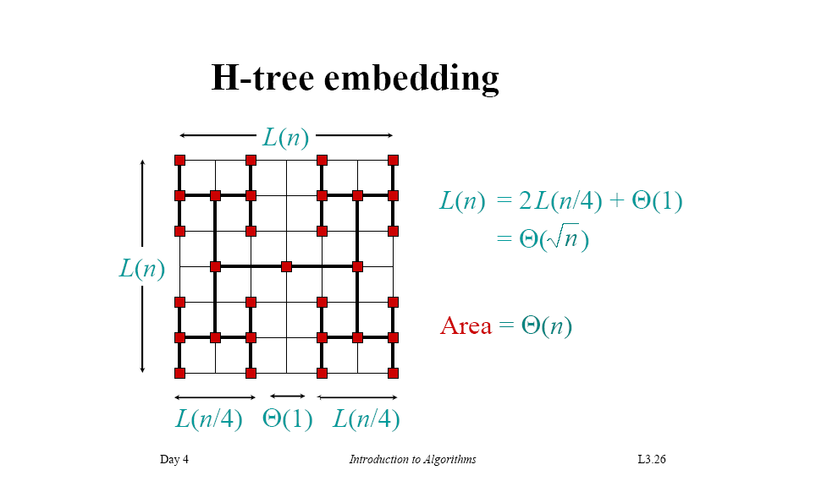

Slide 17
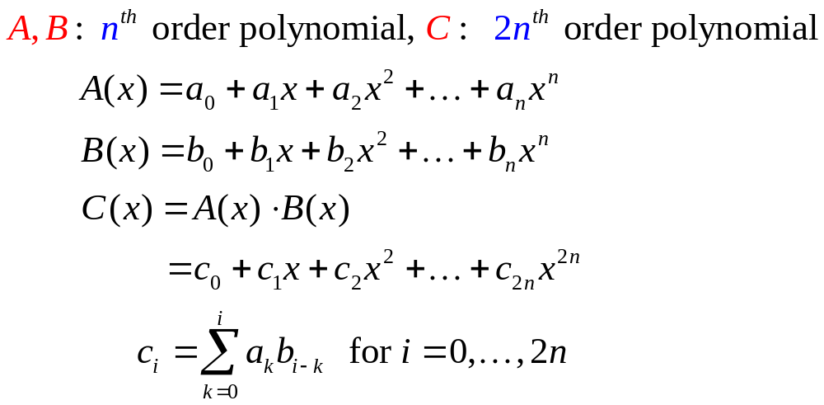
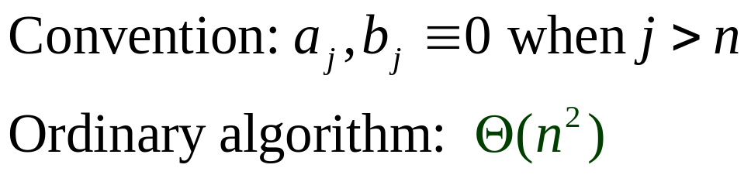
Polynomial Multiplication

Slide 18
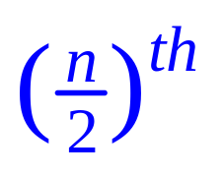
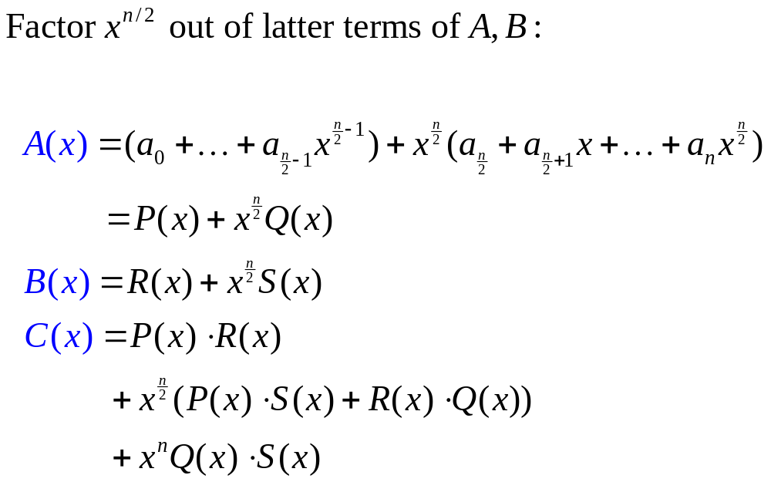
Write C(x) in order polynomial

Slide 19

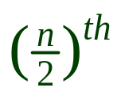
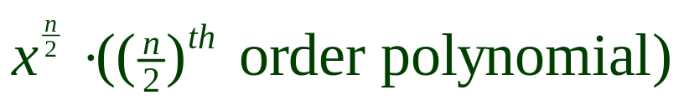

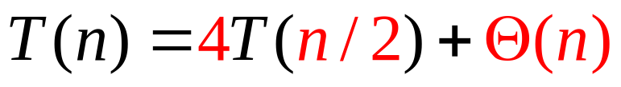
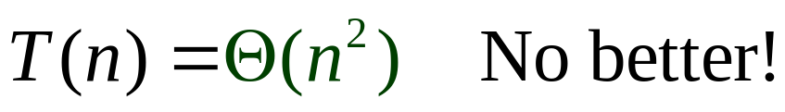
Divide-and-Conquer algorithm
Divide: partition into sum of
  a order polynomial
Conquer: perform 4 multiplications
recursively
Combine: form C using + and -

Slide 20
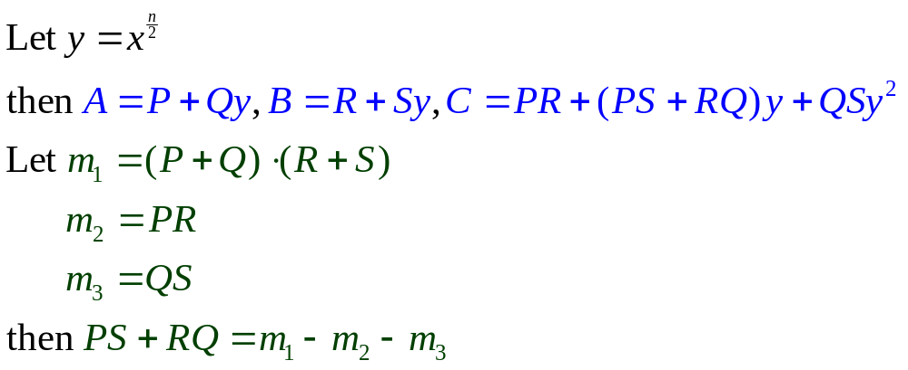
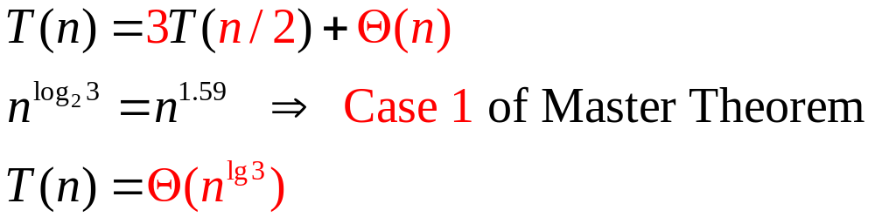
Clever Divide-and-Conquer algorithm
Thus only 3 multiplications are required

Slide 21
Conclusions
Divide and conquer is just one of several powerful techniques for algorithm design.
Divide-and-conquer algorithms can be analyzed using recurrences and the master method (so practice this math).
Can lead to more efficient algorithms

