Slide 1
Trees
離 散 數 學
Contents:
Properties of Trees
Spanning Trees
Depth-First Search
Rooted Trees
Binary Trees and Traversals
Optimal Binary Trees and Binary Search Trees

Slide 2
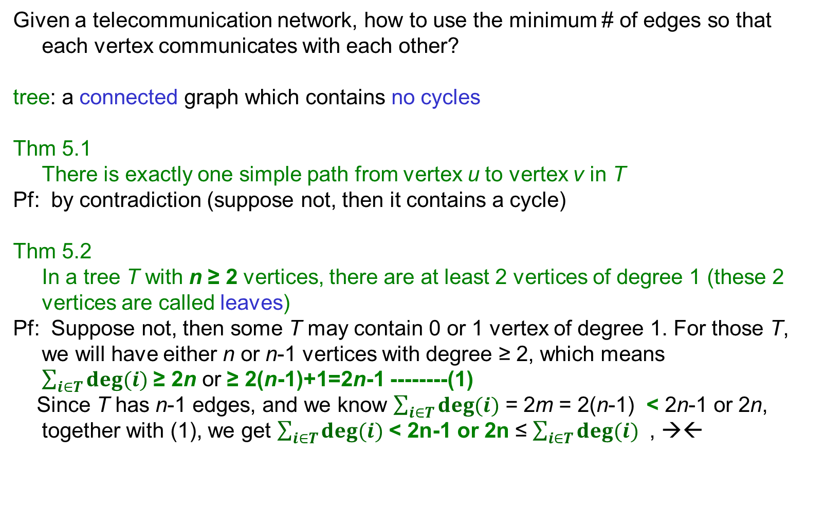
Properties of Trees (1/3)
Given a telecommunication network, how to use the minimum # of edges so that each vertex communicates with each other?
tree: a connected graph which contains no cycles
Thm 5.1 There is exactly one simple path from vertex u to vertex v in T
Pf: by contradiction (suppose not, then it contains a cycle)
Thm 5.2 In a tree T with n ≥ 2 vertices, there are at least 2 vertices of degree 1 (these 2 vertices are called leaves)
Pf: Suppose not, then some T may contain 0 or 1 vertex of degree 1. For those T, we will have either n or n-1 vertices with degree ≥ 2, which means $\sum_{i∈T}{deg⁡(i)}$ ≥ 2n or ≥ 2(n-1)+1=2n-1 --------(1)
Since T has n-1 edges, and we know $\sum_{i∈T}{deg⁡(i)}$ = 2m = 2(n-1) < 2n-1 or 2n, together with (1), we get $\sum_{i∈T}{deg⁡(i)}$ < 2n-1 or 2n ≤ $\sum_{i∈T}{deg⁡(i)}$ , →←
5.1: Properties of Trees
Notes:
Thm5.2: suppose not, the # vertices of degree=1 is either 0 or 1.
If it is 0, then we can start from a vertex, moving along edges such that no cycle happens. Finally we will encounter a visited vertex (since total # vertices is finite) which corresponds to a cycle.-><-
Use similar arguments for case where T has a vertex of deg=1.(start from that vertex of deg=1, then the remaining graph has been shown to contain a cycle -><-)
Thm5.3:
➔n=1, trivial; suppose true for n=k, then for n=k+1, remove the leaf with its edge (it must exist by Thm 5.2), ok (i.e. k-1 edges) by induction assumption, add back the leaf and its edge, so totally k edges, done!
⬅suppose not a tree, thus containing a cycle. Delete an edge in that cycle so the remaining graph contains n-1-1 edges, repeat the steps until no cycle but still connected, at that time it’s a tree but with less than n-1 edges, -><-

Slide 3
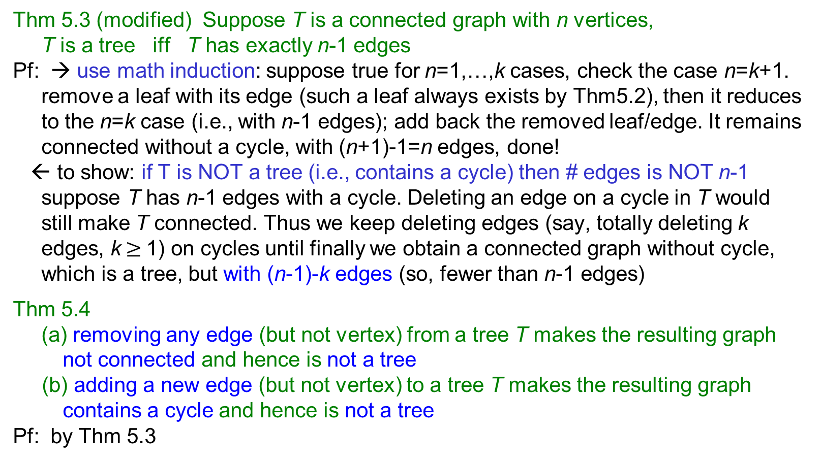
Properties of Trees (2/3)
Thm 5.3 (modified) Suppose T is a connected graph with n vertices, T is a tree iff T has exactly n-1 edges
Pf: → use math induction: suppose true for n=1,…,k cases, check the case n=k+1. remove a leaf with its edge (such a leaf always exists by Thm5.2), then it reduces to the n=k case (i.e., with n-1 edges); add back the removed leaf/edge. It remains connected without a cycle, with (n+1)-1=n edges, done!
← to show: if T is NOT a tree (i.e., contains a cycle) then # edges is NOT n-1 suppose T has n-1 edges with a cycle. Deleting an edge on a cycle in T would still make T connected. Thus we keep deleting edges (say, totally deleting k edges, k$≥$1) on cycles until finally we obtain a connected graph without cycle, which is a tree, but with (n-1)-k edges (so, fewer than n-1 edges)
Thm 5.4 (a) removing any edge (but not vertex) from a tree T makes the resulting graph not connected and hence is not a tree
(b) adding a new edge (but not vertex) to a tree T makes the resulting graph contains a cycle and hence is not a tree
Pf: by Thm 5.3
5.1: Properties of Trees
Notes:
Thm5.2: suppose not, the # vertices of degree=1 is either 0 or 1.
If it is 0, then we can start from a vertex, moving along edges such that no cycle happens. Finally we will encounter a visited vertex (since total # vertices is finite) which corresponds to a cycle.-><-
Use similar arguments for case where T has a vertex of deg=1.(start from that vertex of deg=1, then the remaining graph has been shown to contain a cycle -><-)
Thm5.3:
➔n=1, trivial; suppose true for n=k, then for n=k+1, remove the leaf with its edge (it must exist by Thm 5.2), ok (i.e. k-1 edges) by induction assumption, add back the leaf and its edge, so totally k edges, done!
⬅suppose not a tree, thus containing a cycle. Delete an edge in that cycle so the remaining graph contains n-1-1 edges, repeat the steps until no cycle but still connected, at that time it’s a tree but with less than n-1 edges, -><-

Slide 4
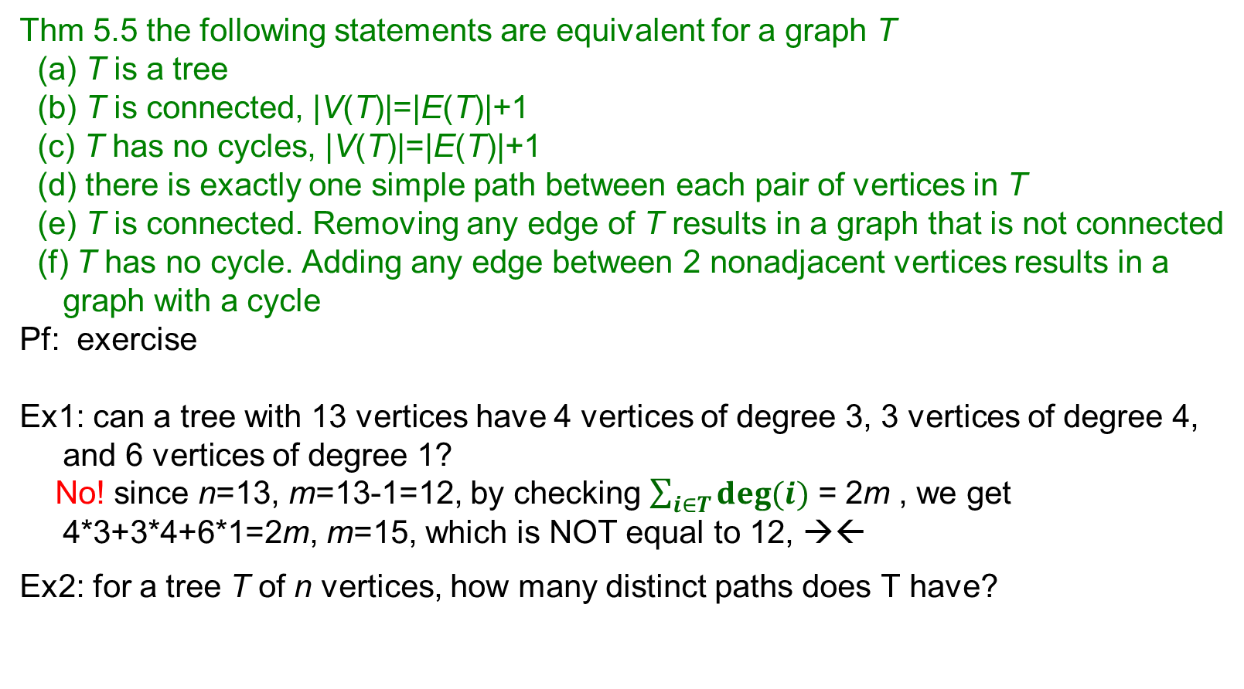

Properties of Trees (3/3)
Thm 5.5 the following statements are equivalent for a graph T
(a) T is a tree
(b) T is connected, |V(T)|=|E(T)|+1
(c) T has no cycles, |V(T)|=|E(T)|+1
(d) there is exactly one simple path between each pair of vertices in T
(e) T is connected. Removing any edge of T results in a graph that is not connected
(f) T has no cycle. Adding any edge between 2 nonadjacent vertices results in a graph with a cycle
Pf: exercise
Ex1: can a tree with 13 vertices have 4 vertices of degree 3, 3 vertices of degree 4, and 6 vertices of degree 1?
No! since n=13, m=13-1=12, by checking $\sum_{i∈T}{deg⁡(i)}$ = 2m , we get 4*3+3*4+6*1=2m, m=15, which is NOT equal to 12, →←
Ex2: for a tree T of n vertices, how many distinct paths does T have?
$$C_{2}^{n}$$
5.1: Properties of Trees
Notes:
n=13, m=13-1=12
4*3+3*4+6*1=2m, m=15!=12 -><-

Slide 5
Spanning Trees
Spanning tree of G: a subgraph of G which is a tree containing all the vertices of G
If G is a tree, then its spanning tree is itself
A graph may have more than one spanning tree
There are many ways to generate a spanning tree, e.g. BFS algorithm (why?)
Thm 5.6 A graph G is connected iff it has a spanning tree T
Pf: ← the spanning tree T is a subgraph of G. By definition of spanning tree, T is connected, so, G is connected
→ by BFS, or 1-ALL shortest path algorithms
Weighted graph: a graph where each edge (i,j) has a weight w_{ij}
Weight of a tree: sum of all the edge weights in the tree
Minimum spanning tree: a spanning tree of least weight
Maximum spanning tree: a spanning tree of largest weight
Algorithms to compute minimum spanning tree: Prim’s algorithm: selecting best edges to grow a tree (stay connected) Kruskal’s algorithm: selecting best edges as long as no cycle (merge components)
5.2: Spanning Trees

Slide 6
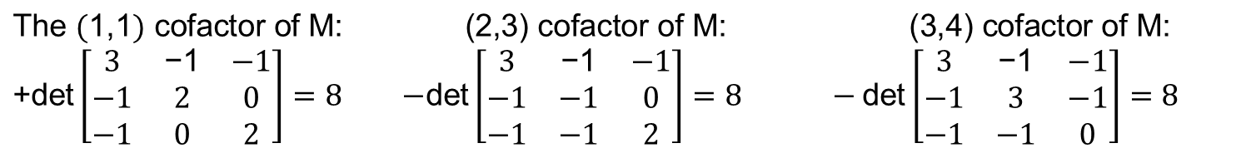
Number of Spanning Trees
How many spanning trees does a connected graph have?
Thm By Gustav Kirchhoff in 1847 Let M be the matrix obtained from the adjacency matrix of a connected graph G by changing all 1’s to -1’s, and each diagonal 0 to the degree of the corresponding vertex. Then the # of spanning trees of G is equal to the value of any cofactor of M
Ex.: an adjacency matrix
Thm for a complete graph of n vertices, K_{n} The number of labeled spanning trees for K_{n} is n^{n-2}
$$\text{The} (\text{1,1}) \text{cofactor} \text{of} \text{M}\text{: } \text{(2,3) }\text{cofactor} \text{of} \text{M}\text{: (3,4) }\text{cofactor} \text{of} \text{M}\text{: }$$ $\text{+}\text{det}\left[\begin{matrix}3 & \text{−1} & −1 \\ −1 & 2 & 0 \\ −1 & 0 & 2\end{matrix}\right]=8$ $−\text{det}\left[\begin{matrix}3 & \text{−1} & −1 \\ −1 & −1 & 0 \\ −1 & −1 & 2\end{matrix}\right]=8 −\text{det}\left[\begin{matrix}3 & \text{−1} & −1 \\ −1 & 3 & −1 \\ −1 & −1 & 0\end{matrix}\right]=8$
5.2: Spanning Trees

Slide 7
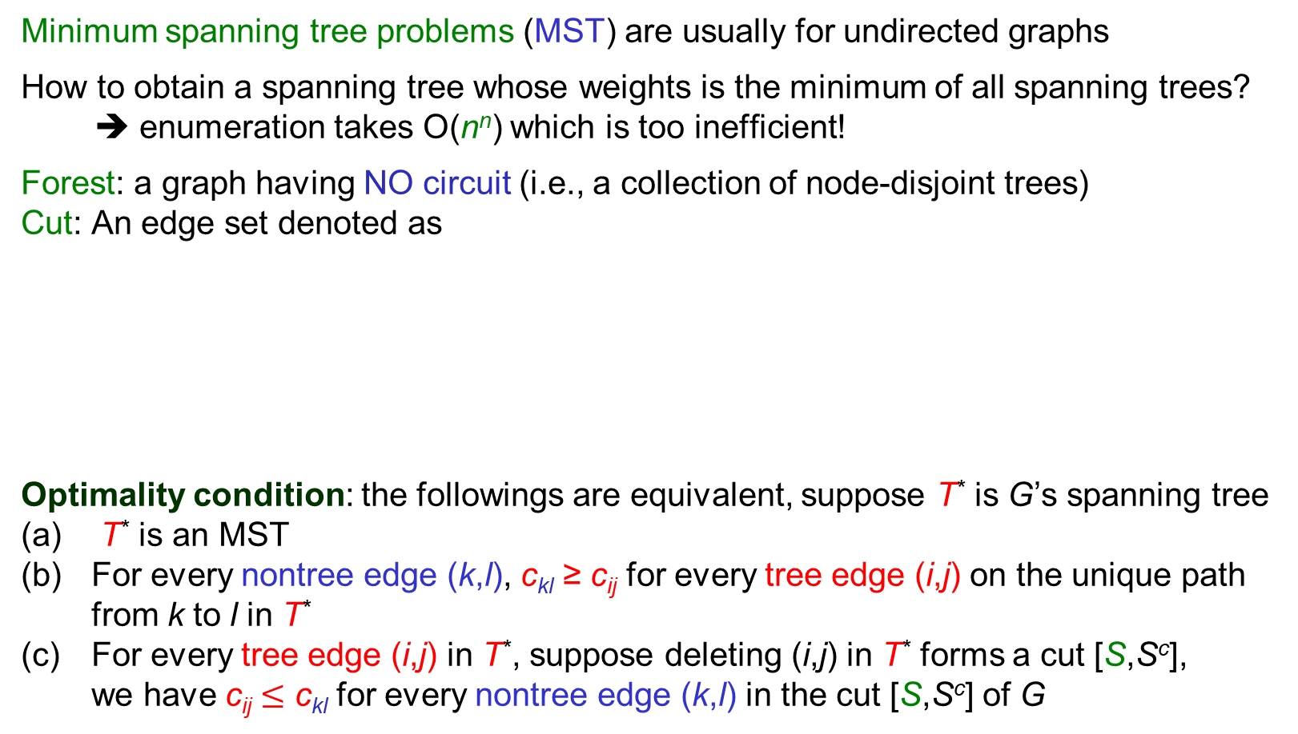

Minimum Spanning Trees
Minimum spanning tree problems (MST) are usually for undirected graphs
How to obtain a spanning tree whose weights is the minimum of all spanning trees?
➔ enumeration takes O(n^{n}) which is too inefficient!
Forest: a graph having NO circuit (i.e., a collection of node-disjoint trees)
Cut: An edge set denoted as
Optimality condition: the followings are equivalent, suppose T* is G’s spanning tree
T* is an MST
For every nontree edge (k,l), c_{kl} ≥ c_{ij} for every tree edge (i,j) on the unique path from k to l in T*
For every tree edge (i,j) in T*, suppose deleting (i,j) in T* forms a cut [S,S^{c}], we have c_{ij} $≤$ c_{kl} for every nontree edge (k,l) in the cut [S,S^{c}] of G
$$δ(S)$$
$$δ(S)=[S,S^{c}]=\{e∈E:{e} \text{has} \text{an} \text{end} \text{in} S\text{, }\text{and} \text{the} \text{other} \text{end} \text{in} S^{c}=V\backslash S\}$$
Tree edge: red solid line
Nontree edge: blue dashed line
S
S^{c}
S
B
D
S^{c}
A
C
H
i
j
E
$$\text{A} \text{cut} \text{of} \text{G} \text{: }δ(S)=\{(A,C),(i,j),(k,l),(A,l),(k,E)\}$$
G
k
l
F
5.2: Spanning Trees
Notes:
Optimality conditioin
(b) Stay connected → prim
(c) Choose best edge in a cut → kruskal
o.w. (k.l) in T will make a smaller weighting

Slide 8
Prim’s Algorithm
It grows an MST by adding new edges (k,k’) to a connected tree (subgraph)
begin
initialization: T= ∅ ; LIST= ∅
arbitrarily select a vertex u, add u in LIST;
while there exists edge (i,j) where i in LIST, j in V\LIST do
among all such edges, choose the one (k,k’) with least weight
T=T∪(k,k’); LIST=LIST∪{k’};
end while
if |LIST| < |V| then
the graph is NOT connected, thus it has NO MST
else
T is an MST
end
Each iteration adds an MST edge (k,k’)
Edge selection: Such a selection guarantees NO cycle it is a greedy algorithm
Total # iterations: O(|V|) Each iteration: edge selection takes O(|E|) comparison
Complexity: O(|V||E|) or O(|V|³) it can be improved by min-heap
5.2: Spanning Trees
Notes:
Using heaps:
Maintain V\LIST as a min-heap with key equal to infinity or c_ij for each vertex j in V\LIST adjacent to each vertex i in LIST
Time= Time(V times of extract-min) + Time(E times of update key)
=VlogV+ElogV=ElogV

Slide 9
Example of Prim’s Algorithm
A
A
A
2
2
2
5
B
5
5
B
5
5
B
5
3
6
3
6
3
6
4
4
4
C
C
2
C
2
2
2
2
2
D
1
E
D
1
E
D
1
E
Cut: [LIST,LIST^{c}] where LIST={D},LIST^{c}={A,B,C,E}
Choose edge (D,E), T={(D,E)}, LIST={D,E}
Choose edge (D,C), T={(D,E),(D,C)},
LIST={D,E,C}
A
A
A
2
2
2
5
B
5
5
B
5
5
B
5
3
6
3
6
3
6
4
4
4
C
C
C
2
2
2
2
2
2
D
1
E
D
1
E
D
1
E
Choose edge (D,B), T={(D,E),(D,C),(D,B)},
LIST={D,E,C,B}
Choose edge (B,A), T={(D,E),(D,C),(D,B),(B,A)},
LIST={D,E,C,B,A}, Done!
Another minimum spanning tree
➔ There may exist multiple MSTs
5.2: Spanning Trees

Slide 10
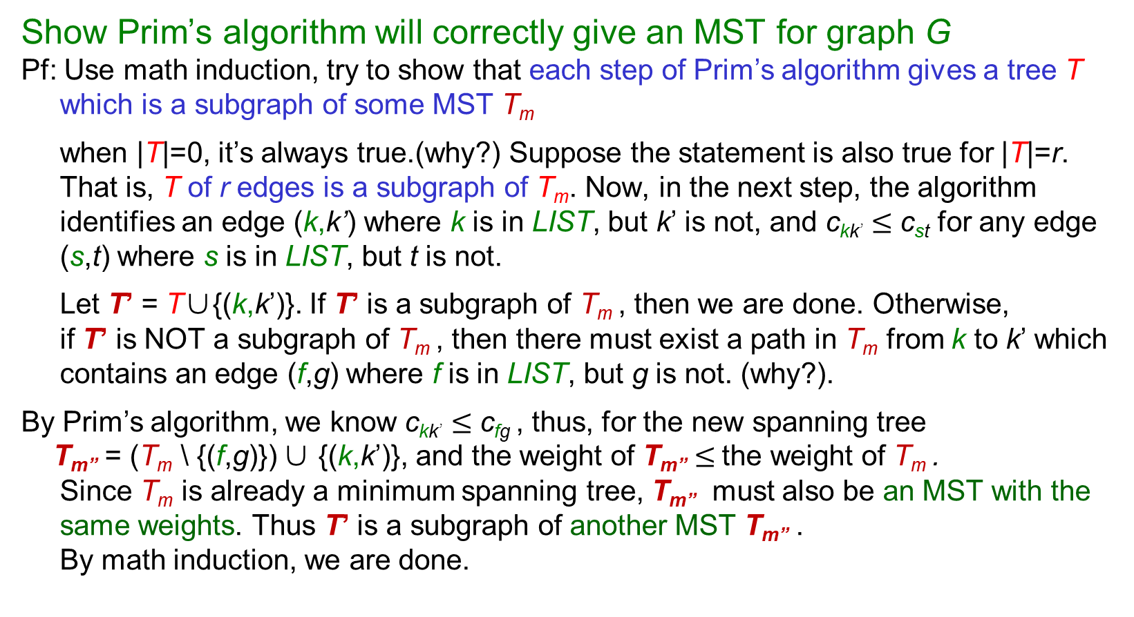
Correctness of Prim’s Algorithm
Show Prim’s algorithm will correctly give an MST for graph G
Pf: Use math induction, try to show that each step of Prim’s algorithm gives a tree T which is a subgraph of some MST T_{m}
when |T|=0, it’s always true.(why?) Suppose the statement is also true for |T|=r. That is, T of r edges is a subgraph of T_{m}. Now, in the next step, the algorithm identifies an edge (k,k’) where k is in LIST, but k’ is not, and c_{kk’} $≤$ c_{st} for any edge (s,t) where s is in LIST, but t is not.
Let T’ = T∪{(k,k’)}. If T’ is a subgraph of T_{m} , then we are done. Otherwise, if T’ is NOT a subgraph of T_{m} , then there must exist a path in T_{m} from k to k’ which contains an edge (f,g) where f is in LIST, but g is not. (why?).
By Prim’s algorithm, we know c_{kk’} $≤$ c_{fg} , thus, for the new spanning tree
T_{m”} = (T_{m} \ {(f,g)}) ∪ {(k,k’)}, and the weight of T_{m”} $≤$the weight of T_{m} . Since T_{m} is already a minimum spanning tree, T_{m”} must also be an MST with the same weights. Thus T’ is a subgraph of another MST T_{m”} . By math induction, we are done.
5.2: Spanning Trees
Notes:
|T|=o means T is an empty set which is of course a subset of any tree T including Tm.

Slide 11
Kruskal’s Algorithm (simplified)
It grows an MST by adding best edges as long as the subgraph contains NO cycle
begin
initialization: T=∅ ; S=E;
while |T| < |V|-1 and S≠∅ do
select an edge (k,k’) = arg min{c_{ij}: (i,j) in S, i & j in different components};
T=T∪(k,k’); S=S\{(k,k’)};
end while
if |T| < |V|-1 then
the graph is NOT connected, thus it has NO MST
else
T is an MST
end
Requires a sorting preprocessing
Each iteration adds an MST edge (k,k’)
Edge selection: Such a selection guarantees NO cycle it is a greedy algorithm
Merge 2 components
Preprocess: sort edge length in nondecreasing order: O(|E|²) or O(|E|log|E|)
Total # iterations: O(|V|) if G is connected, or O(|E|) if G is not connected
Q: How to detect whether 2 vertices belong to the same component? Merge components?
5.2: Spanning Trees

Slide 12
Kruskal’s Algorithm (detailed)
IC[i]: Index of the component containing vertex i
NC[i]: Size of the component containing vertex i
begin (assume G is connected, and vertex is numbered from 1 to |V|)
initialization: T= ∅ ; S=E; IC[i]=i, NC[i]=1 for each vertex i in V; sort edges in S by nondecreasing order of length
while |T| < |V|-1 do
while the 1st edge (k,k’) from S has IC[k]=IC[k’] do
S=S\{(k,k’)};
end while
T=T∪ (k,k’) S=S\{(k,k’)};
if NC[k] ≦ NC[k’] then
for each vertex i with IC[i]=IC[k] or IC[i]=IC[k’] do
IC[i]=IC[k’]; NC[i]=NC[k]+NC[k’];
else
for each vertex i with IC[i]=IC[k] or IC[i]=IC[k’] do
IC[i]=IC[k]; NC[i]=NC[k]+NC[k’];
end while
end
Edge selection:
When this while loop is stopped, we have identified (k,k’) with IC[k] ≠ IC[k’’]
Each iteration adds an MST edge (k,k’)
Merge 2 components
5.2: Spanning Trees

Slide 13
Example of Kruskal’s Algorithm
1
1
1
2
2
2
5
2
5
5
2
5
5
2
5
3
6
3
6
3
6
4
4
4
3
3
2
3
2
2
2
2
2
4
1
5
4
1
5
4
1
5
Sort edge length in nondecreasing order: (4,5),(4,3),(3,5),(1,2),(2,4),(2,5),(1,4),(1,5)
Choose edge (4,5), T={(4,5)}, IC[4]=IC[5]=5, NC[5]=2
Choose edge (4,3), T={(4,5),(4,3)}, IC[3]=IC[4]=5, NC[5]=3
1
1
1
2
2
2
5
2
5
5
2
5
5
2
5
3
6
3
6
3
6
4
4
4
3
3
3
2
2
2
2
2
2
4
1
5
4
1
5
4
1
5
Skip (3,5) since IC[3]=IC[5]=5
Choose edge (1,2), T={(4,5),(4,3),(1,2)},
IC[1]=IC[2]=2, NC[2]=2
Choose edge (2,4), T={(4,5),(4,3),(1,2),(2,4)}, |T|=4
IC[1]=IC[2]=IC[4]=5, NC[5]=5, Done!
Another minimum spanning tree
5.2: Spanning Trees

Slide 14
Complexity of Kruskal’s Algorithm
Let COMP[v] denote the set of vertices of the component containing vertex v
|COMP[v]| denote the size of the component (i.e. # vertices in COMP[v])
Preprocess: sorting edge length takes O(|E|²) or O(|E|log|E|)
Time spent on verifying whether adding an edge will create a cycle or not:
In any iteration, once the 1st edge in S, say, (i,j), is selected to verify whether both i & j are in the same component or not, (i,j) will NOT be selected any more
➔ overall, each edge is verified at most once, and each checking takes O(1) time, thus totally O(|E|) for verifying whether adding an edge will create a cycle
Time spent on merging components and relabeling:
When (i,j) is selected to merge 2 components, say, COMP[i] & COMP[j], w.l.o.g., assume NC[i] ≦ NC[j]. Then the new merged component, COMP’, will have size |COMP’| ≧ 2*NC[i]
➔ each merger makes the new component at least twice as large as the smaller one. So suppose a vertex is relabled t times, then 2^{t} ≦ |V| thus for each vertex, there are at most log|V| times of merging & relabeling
There are totally |V| vertices, so the total # of relabeling is O(|V|log|V|)
➔ Thus the algorithm spent O(|V| log|V|) in merging components and relabeling
Therefore, this implementation of Kruskal’s algorithm takes O(|E|log|E|+|E|+|V|log|V|) time,
i.e., O(|E|log|E|) by comparison sorting, or O(|E|+|V|log|V|) by linear sorting, in preprocessing
5.2: Spanning Trees

Slide 15
Depth-First Search
To find out all the vertices that are reachable from a specific vertex (source), say, s
order[v] : depth-first search numbering, the order of being visited for vertex v by DFS
begin
initialization: Set order[v]=0 for each v in V; k=0; LIST= ∅
k=1; order[s]=k; pred[s]=NULL; add s in LIST;
while LIST is not empty do
select a vertex i from LIST;
if there exists edge (i,j) with order[j]=0 then k=k+1;
order[j]=k; pred[j]=i;
add j into LIST;
else (i is exhausted, i.e., for i, every (i,j) in E has been checked)
remove i from LIST;
end while
end
LIST is a stack (LIFO or FILO)
Vertex Selection (not removal)
Scan each edge (i,j) from vertex i
Backtrack, go up 1 level scan edges from pred[i]
DFS Animation
5.3: Depth-First Search

Slide 16
Complexity of Depth-First Search
Exhausted vertex:
when we have scanned all outgoing edges (i,j) from vertex i, we say vertex i is exhausted
Scan edge (i,j): if order[i]=k, check whether order[j]=0 (unvisited yet) or not (visited)
if order[j]=0 (i.e., j has NOT been visited yet) then update the order label of vertex j by order[j]=k+1; pred[j]=i; add j into LIST;
else order[j] > 0 (i.e., j has been visited) skip (i,j), go to scan the next edge (i,j’)
Two major operations:
Vertex Selection: each vertex enters LIST at most once. once vertex i is “exhausted”, we no longer need to scan any outgoing edge (i,j) from i i.e., total # of vertex selection=|V|
Edge Scanning: each edge is scanned at most once i.e., total # of edge scanning operations=|E|
Complexity: O(|V|+|E|)=O(|E|)
Connectivity: after DFS, if there is any vertex i with order[i]=0 ➔ i can NOT be connected
A DFS search tree, which connects every vertex of the same component, can be constructed by pred[⬝] . A non-tree edge is called a back edge
5.3: Depth-First Search

Slide 17
Bridge & Strong Connectivity (1/2)
Strongly connected (di)graph: there exists a (directed) path from any vertex to any other vertex
A graph has a strongly connected orientation, if it is possible to assign a direction to each edge such that the resulting digraph is strongly connected.
e.g., one-way street
Bridge (or cut edge) e of a connected graph G: an edge e such that G\{e} becomes disconnected
How to detect a bridge for a given G?
by DFS (or BFS, MST, Dijkstra), the bridge MUST BE on a spanning tree (why?) then for each tree edge (i,j), delete it, and then check whether i connects to j
i CANNOT connect to j ⬄ (i,j) is a bridge
How to know whether a given G has a strongly connected orientation or not ?
Thm (a) G has a strongly connected orientation iff G is connected and has NO bridge
(b) if G has a strongly connected orientation, then each edge must be part of a circuit
5.3: Depth-First Search
Notes:
Time to detect a bridge: O(m)+O(m^2) where O(m) for first DFS, and then for each edge we remove it and run a DFS (thus O(m^2))

Slide 18
Bridge & Strong Connectivity (2/2)
How to assign “strongly connected orientations” to edges of a given G that is known to be connected and contain NO bridge?
Method 1: constructing directed circuits C₁,C₂,…C_{k} until all edges are covered
After constructing C_{i} , if there exists vertex u NOT in some circuit yet, but is adjacent to some vertex v of C_{i} , then we construct circuit C_{i+1} which contains edge (u,v).
If C_{i+1} overlaps with circuit C_{i}, we keep the orientation of those overlapped edges in C_{i}
Method 2: Apply DFS.
For edges in DFS-tree, assign direction from lower indexed vertex to higher one
For non-tree edges, assign direction from higher indexed vertex to lower one
Thm 5.8 G is connected and has NO bridge assign direction to edges of G by Method 2, the resulting digraph is strongly connected
Pf: (to show there exists directed path from any vertex k’ to 1, by math induction)
key: 1. there is NO bridge!
2. when DFS backtracks at vertex k, it means all vertices reachable from k have already been visited (thus labeled)
1
6
1
6
5
5
2
By Method 1
By Method 2
3
4
2
3
4
5.3: Depth-First Search
Notes:
Show Thm5.8:
Suppose there is a directed path between 1 and k
Trivial when k=1, suppose it’s true for all l such that 1<=l<k
Suppose DFS label l immediately before k (so l<k), it’s trivial that there exists a path from 1 to k (i.e. 1->l plus (l,k))
To show: there exists a path from k to 1
Case 1: DFS starts backtracking immediately after labeling k
Observation(1): all vertices adjacent to k have already been labeled (i.e. their labels<k) why?
Observation(2):

Slide 19
Exercise of DFS
5.3: Depth-First Search

Slide 20
Example of DFS Algorithm
2 [s]
4 [B]
1
A
C
6 [D]
2
9
10
13
s
E
1 [-]
3
5
8
11
12
14
B
D
3 [A]
5 [C]
4
6
7
15
Example 5.16 (4 queens problem, link1 ) Example 5.17 (maze problem, link1, link2)
Thm 5.7 apply DFS algorithm on a graph G (a) The edges scanned by DFS form a tree (DFS tree) (b) If G is connected, a DFS tree is a spanning tree
5.3: Depth-First Search

Slide 21
Proof of Thm 5.8 (1/2)
It suffices to show that there is a directed path from 1 to k and vice versa for all k
Use mathematical induction:
Trivial when k=1, suppose it’s true for k=1,2,..,k’-1
Suppose DFS label t’ immediately before k’ (so t’=k’-1),
it’s trivial that there exists a path from 1 to k’ (i.e. 1→t’ plus (t’,k’))
To show: there exists a directed path from k’ to some t with 1≦t<k’
2 cases, depending on whether k’ is a leaf (Case 1) or a branch node (Case 2)
Case 1: DFS starts backtracking immediately after labeling k’ (a leaf)
Observation (a): all vertices adjacent to k’, if exist, have already been labeled (with labels<k’)
why? Suppose not, then DFS will go to label that adjacent unlabeled vertex with label=k’+1, and then there will be NO backtracking at k’ at all! →←
Observation (b): there must exist some vertex t₁ adjacent to k’ with 1≦t₁<k’
why? O.W. (t’,k’) is a bridge →←
Thus there must exist a nontree edge (k’,t₁) where t₁<k’, and (k’,t₁) U t₁→1 path is a k’→1 path
t₁
t’
2
k’
1
Case 1: k’ is a leaf
5.3: Depth-First Search
Notes:
Goal: find a path from k’ to 1 (case1: find an arc from k’ to t_1; case2: find an arc from k’+s’ to t_2; these 2 cases both guarantee a path from k’ to 1.)

Slide 22
Proof of Thm 5.8 (2/2)
k’+s’
It suffices to show that there is a directed path from 1 to k and vice versa for all k
To show: there exists a directed path from k’ to some t with 1≦t<k’
Case 2: DFS continues after labeling k’, k’+1,…until all vertices reachable from k’ (a branch node) are labeled, let the last labeled vertex be k’+s (a leaf)
Observation (c): there must exist a vertex t₂<k’ adjacent to some vertex in the set {k’,…,k’+s}
why? Suppose not, then the path in G from k’+s to t’ must pass (k’,t’), i.e. (k’,t’) is a bridge →←
Thus there must exist a nontree edge (k’+s’,t₂) where t₂<k’, s’≦s, and k’→k’+s’ path U (k’+s’,t₂) U t₂→1 path forms a k’→1 path
By Observation (a)(b) for case 1, and (c) for case 2, we conclude there exists a directed path from k’ to 1, DONE!
k’
k’+s
t’
t₂
2
1
Case 2: k’ is a branch node
5.3: Depth-First Search
Notes:
Goal: find a path from k’ to 1 (case1: find an arc from k’ to t_1; case2: find an arc from k’+s’ to t_2; these 2 cases both guarantee a path from k’ to 1.)

Slide 23
Rooted Trees
Rooted Tree: a digraph T satisfying (1) when ignoring the directions of edges in T, the resulting graph is a tree (2) T has a unique vertex r whose indeg=0, and all other vertices have indeg=1 r is called the root of T
Thm 5.9 in a rooted tree T=(V,E) (a) |V|=|E|+1 (b) T contains NO directed cycles (c) there is a unique simple directed path from the root to every other vertex
If there exists a directed edge (u,v), then u is a parent of v, and v is a child of u
All vertices on the unique simple directed path from root r to u in T are ancestors of u
All vertices reachable from u in T are descendents of u
All the descendents of u forms a subtree rooted at u
All the vertices with a common parent are siblings
A terminal vertex (leaf) in T is a vertex with no children
A vertex that is not a leaf in T is an internal (branch) vertex
Thm 5.10 DFS tree forms a rooted tree, if the direction on each tree edge is assigned from the lower indexed vertex to the higher one (so does BFS tree)
1
2
9
10
13
3
5
8
11
12
14
4
6
7
15
5.4: Rooted Trees

Slide 24
Binary Trees & Traversals
Binary Tree: a rooted tree T where each vertex has at most 2 children (left & right child)
Left (right) subtree of u: a subtree rooted at the left (right) child of u in a binary tree T
Expression tree: a binary tree with operators as internal vertices, operands as leaves
Example 5.25, 5.26, 5.27
Traversal: search procedure that visits each vertex of a graph exactly once
e.g. BFS, DFS, each vertex is labeled exactly once
Traversal of a binary tree:
Preorder Traversal: parent → left child → right child
Prefix form (Polish notation): a preorder listing on an expression tree
Root will be firstly labeled
Postorder Traversal: left child → right child → parent
Postfix form (reverse Polish notation): a postorder listing on an expression tree
Root will be lastly labeled
Inorder Traversal: left child → parent → right child
All vertices labeled before root will be in the left subtree of root
All vertices labeled after root will be in the right subtree of root
5.5: Binary Trees and Traversals

Slide 25
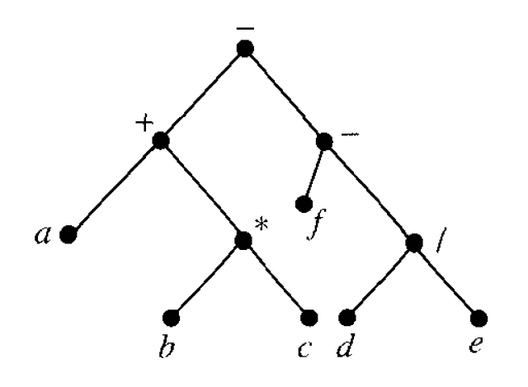
Traversal on Expression Tree
Expression ➔ Not necessarily a unique binary tree
e.g., Fig.5.52: (a+b*c)-(f-d/e)
Preorder: - + a * b c - f / d e
Postorder: a b c * + f d e / - -
Inorder: a + b * c – f – d / e
((a + (b * c)) – (f – (d / e)))
O | # | #
# | # | O
# | O | #

Slide 26
Binary Trees Exercise
In-class exercise: exercise 5.5
Q6,8
Q51,53,55 Q57,59,60,61
Thm Let n₀: # leaf (0-outdeg), n₁: # 1-outdeg vertices, n₂: # 2-outdeg vertices
to show n₀= n₂+1
Pf: |V|=|E|+1; |E|= n₁+2n₂
5.5: Binary Trees and Traversals

Slide 27
Q6: (((4*2)/3)-(6-7))+(((8-9)*8)/5)
Q52: polish notation for *+B-DF+*ACE
Q54: reverse-polish notation for ED-A+BC-F*+
Q56: preorder: ECADBFGH, inorder: ACDEFBGH

Slide 28
Optimal Binary Trees
Data Compression: computer represents symbols by codewords (i.e. 0s and 1s)
Given a text, let L={w_{i},i=1,…,n} be the set of all words in the text suppose word w_{i} appears f_{i} times, and w_{i} has length d_{i} bits, the length of the text=Σf_{i}d_{i} how to store the text that minimized the compressed text length?
e.g. L={a,b,c} with frequencies 3,2, and 1, we can greedily represent a by the bit string 0, b by 1, and c by 00. Q: how do we decode 00? Is it “aa” or “c”?
Prefix property: no codeword is the first part (prefix) of any other codeword
Given a set of codewords, we can construct a binary tree as follows:
From a parent, assign 0 to the edge to its left child, and 1 to right child
For each codeword, construct a path from the root in the order of the bits of codeword
Each leaf represents a codeword. Since no leaf is a parent of other leaves, the prefix property holds.
There is a unique path from root to any leaf whose length represents the length of the specific codeword
Q: how to encode the word so that the resulting text has minimized compressed text length?
0
1
0
1
a
b
c
5.6: Optimal Binary Trees and Binary Search Trees

Slide 29
Huffman’s Optimal Binary Tree Algorithm
Given a text, how to construct the optimal binary tree:
For each leaf, the bit on each edge along the path from the root represents its codeword
Complexity: O(nlog n) by heap (O(n) merges, each takes O(log n) to identify 2 trees)
Create a heap takes O(n) , inserting/deleting an element from a heap takes O(log n)
begin
sort the words in L in nondecreasing order of frequency
for each word w in L, create a rooted tree consisting of an isolated vertex labeled with its frequency denote the resulting set of trees by S
while S contains more than one tree do
select 2 trees T₁ & T₂ which have the 2 smallest frequencies from S suppose T₁ has frequency f₁, T₂ has frequency f₂
merge T₁ & T₂ by assigning a new root with label= f₁+f₂ remove T₁ & T₂ from S
end while end
5.6: Optimal Binary Trees and Binary Search Trees

Slide 30
Optimal Binary Trees Exercise
Ex1: for the set of weights {8,9,12,14,16,19}, construct an optimal binary prefix code. How many bits are needed for this prefix code?
Ex2: construct Huffman Binary codes for the following 6 messages whose probabilities of appearance are A:0.29, B:0.25, C:0.14, D:0.13, E:0.11, F:0.1. suppose E is encoded as 010, D is 101, What are A and F encoded?
78
8: 010 9: 011 16:00 12: 100 14: 101 19:11
Height of the binary tree is 3➔3bits are needed
33
45
16
17
26
19
8
9
12
14
1.02
0.46
0.56
0.25
0.21
0.27
0.29
B
A
0.11
0.1
0.14
0.13
E
F
C
D
5.6: Optimal Binary Trees and Binary Search Trees

Slide 31
Binary Search Trees
Binary search tree: a binary tree which may be empty. If it’s not empty then
Every element (vertex) has a unique key
The keys in a nonempty left subtree < the key in the root of the subtree
The keys in a nonempty right subtree > the key in the root of the subtree
The left & right subtrees are also binary search trees
Given n vertices with key a₁,a₂,…,a_{n}, the following algorithm constructs the B.S.T.
begin
construct the root of the binary tree, label it as a₁; k=1;
while k<n do
V= a₁; k=k+1; while (a_{k}<V and V has a l.c) or (a_{k}>V and V has a r.c.) do
if (a_{k}<V and V has a l.c. W) then V=W;
if (a_{k}>V and V has a r.c. W) then V=W;
end while
if (a_{k}<V) then construct a l.c. for V and label it as a_{k}
else construct a r.c. for V and label it as a_{k}
end while end
l.c.=left child
r.c.=right child
Complexity: O(n²)
5.6: Optimal Binary Trees and Binary Search Trees

Slide 32
Exercise in Constructing Binary Search Trees
Ex1: construct a binary search tree for the list 5,9,8,1,2,4,10,6
Ex2: insert a new node 3 to the B.S.T. of ex1
5
5
5
5
5
9
9
9
9
1
1
8
8
8
5
2
5
5
9
9
9
1
1
1
8
8
10
8
10
2
2
2
4
6
4
4
5
1
9
2
8
10
Applying inorder traversal: ➔1,2,3,4,5,6,8,9,10
4
6
3
5.6: Optimal Binary Trees and Binary Search Trees

Slide 33
Binary Search Tree Search Algorithm
Given a binary search tree, and an element a, check whether a is in the B.S.T.
Applying the inorder traversal to the B.S.T. yields the “increasing” order
Insert a new element: apply the search algorithm
Delete a leaf: easy
Delete an internal node V:
1.Identify W: the largest element in V’s left subtree, or smallest element in V’s right subtree
2.If W has a child X, put X to be a child of W’s parent (Why W has at most 1 child?)
3.Replace W with V
begin
let V be the root of the B.S.T.;
while (a<V and V has a l.c) or (a>V and V has a r.c.) do
if (a<V and V has a l.c. W) then V=W;
if (a>V and V has a r.c. W) then V=W;
end while
if (a=V) then found a
else a is not in the tree
end while end
l.c.=left child
r.c.=right child
h: height of B.S.T.
Complexity: O(h)
h is as large as O(n)
, but O(log n) in average
5.6: Optimal Binary Trees and Binary Search Trees

