Slide 1
5.1 System of distinct representatives
Let S₁ , S₂…S_{n} ,be a finite sequence of sets , not necessarily distinct . By a system of distinct representatives for S₁ ,
S₂ , …S_{n} we mean a sequence x₁x₂….x_{n} such that x_{i} Є S_{i} for i = 1, 2 , … , n , and such that the elements x_{i} are all distinct .
Example 5.1
Find all systems of distinct representatives for the sets S₁ = {1 , 2 , 3} , S₂ = {1 , 3} , S₃ = {1 , 3} , S₄={3 , 4 , 5}.
Notice that the elements chosen from s2 and s3 must be 1 and 3 in some order . There are four systems of distinct representatives :

Slide 2
5.1 System of distinct representatives
2 , 1 , 3 , 4
2 , 3 , 1 , 4
2 , 1 , 3 , 5
2 , 3 , 1 , 5
Hall’s Theorem The sequence of finite set S₁S₂…S_{n} has a system of distinct representatives if only if whenever I is a subset of {1 , 2 , … , n} , then the union of the set S_{i} for i Є I contains at least as many elements as the set I does .
Example 5.2
Find all systems of distinct representatives for the sets S₁ = {2 , 3} , S₂ = {2 , 3 , 4 , 5 } , S₃ = {2 , 3} , S₄={3}.

Slide 3
5.1 System of distinct representatives
There are none . For if x1 , x2 , x3 , x4 , were a system of distinct representatives , then x1 x3 and x4 would be 3 distinct elements of S1S3S4 = {2 , 3} ,which is impossible .
Example 5.3
How many systems of distinct representatives does the sequence S , S , S , S have , where S = {1 , 2 , 3 , 4} ?
In this case a system of distinct representatives is simply a permutation of the integers 1 , 2 , 3 , 4 . There are exactly 4! = 24 of these .

Slide 4
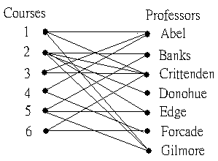
5.2 Matchings in graphs
The graph we get is of a special form , since no edge joins a course to a course , or a professor to a professor . We say a graph with vertex set ν and edge set εis bipartite in case ν can be written as the union of two disjoint sets ν₁ andν₂ such that each edge joins an element of ν₁ with an element of ν₂ . The graph of Figure 5.1 is bipartite since we could take ν₁ to be the set of courses and ν₂ to be the set of professors .

Slide 5
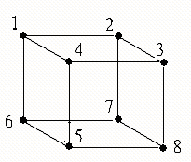
5.2 Matchings in graphs
Example 5.5
The graph shown in Figure 5.2
is bipartite because every edge
goes between an odd-numbered
vertex and an even-numbered
one .
Thus we could take ν₁ = {1 , 3 ,
5 , 7} and ν₂ ={2 , 4 , 6 , 8} .
Figure 5.2

Slide 6
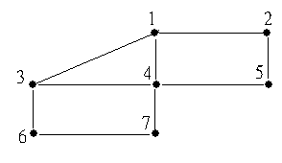
5.2 Matchings in graphs
Example 5.6
The graph shown in Figure 5.3 is
not bipartite , as we can see by
considering the vertices 1 , 3 ,
and 4 . If , for example , 1 is in
ν₁ , then 3 must be inν₂ . But
then 4 can be in neither of these
sets .
Figure 5.3

Slide 7
5.2 Matchings in graphs
A matching of a graph is a set M of edges such that no vertex
of the graph is incident with more than one edge of M .
A maximum matching is a matching such that no other matching
contains more edges .

Slide 8
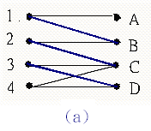
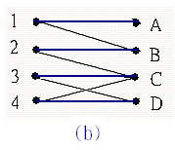
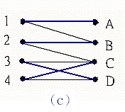
5.2 Matchings in graphs
Example 5.7
The colored edges on Figure 5.4(a) form
a matching of the bipartite graph pictured ,
since no two of them aer incident with the
same vertex . This matching of 3 edges is
not a maximum matching , however , since
Figure 5.4(b) shows another matching with
4 edges .Note that even though the first
matching is not a maximum matching , no
edge could be added to it and still have a
matching . A maximum matching need not
be unique . Figure 5.4(c) shows another
maximum matching of the graph .

Slide 9
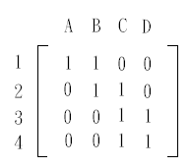
5.2 Matchings in graphs
The matrix of a bipartite graph
A convenient way to represent a bipartite graph
where every edge joins a vertex of ν₁ to a
vertex of ν₂ is by a matrix of 0s and 1s , with
the rows corresponding to the elements of ν₁
and the columns to the elements of ν₂ . We
put a 1 in the matrix whenever the vertices
corresponding to the row and column are
joined by an edge and a 0 otherwise . For
example , the matrix of the graph of Figure 5.4 is

Slide 10
5.2 Matchings in graphs
By a line of a matrix , we mean either a row or a column . Let A
be a matrix . We say that a set of entries of A is independent if no
two of them are in the same line . An independent set of 1s in A
is a maximum independent set of 1s if no independent set of 1s
in A contains more elements .

Slide 11
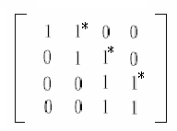
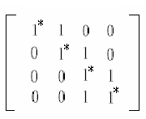
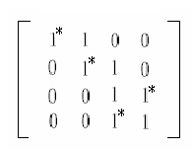
5.2 Matchings in graphs
We will mark the 1s in a particular independent
set with stars . The reader should check that the
stars in the following three matrices mark
independent sets corresponding to the three
matchings shown in Figure 5.4 .
For example , since one of the edges in the
matching shown in Figure 5.4(a) is {1 , B} , a
star is placed on the 1 in row 1 and column B of
the first matrix .

Slide 12
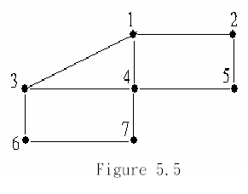
5.2 Matchings in graphs
Coverings
By a covering C of a graph , we mean a set of
vertices such that every edge is incident with at
least one vertex in C . We say C is a minimum
covering if no covering of the graph has fewer
vertices . For example , the set {2 , 3 , 4 , 5 , 6}
may be seen to be a covering of the graph
shown in Figure 5.5 . This is not a minimum
covering , however , since the covering {1 , 3 ,
5 , 7} has fewer elements .

Slide 13
5.2 Matchings in graphs
Theorem 5.2 Let a graph have a matching M and covering C .
Then |M| ≤ |C| . Moreover , if |M| = |C| , then M is a maximum
matching and C is a minimum covering .
Theorem 5.3 If a matrix of 0s and 1s has an independent set of
m 1s and a covering of c lines , then m ≤ c . If m = c , then the
independent set is a maximum independent set and the covering
is a minimum covering .

Slide 14
5.3 A Matching Algorithm
Independent Set Algorithm
Given an independent set of starred 1s in a matrix of 0s and 1s ,
this algorithm either indicates that this independent set is a
maximum independent set , or else it finds a larger independent
set .
Step 1 (start)
Label each column containing no starred 1 .

Slide 15
5.3 A Matching Algorithm
Step 2 (scan and label)
repeat
Step 2.1 (scan columns)
For each column that is labeled but not scanned , look at every unstarred 1 in that column . If such a 1 is in an unlabeled row , then label that row with the name of the column being scanned . Mark the column to indicate that it has been scanned .

Slide 16
5.3 A Matching Algorithm
Step 2.2 (scan row)
For each row that is labeled but not scanned , look for a starred 1 in that row . If there is a starred 1 in the row , then label the column containing the starred 1 with the name of the row being scanned . Mark the row to indicate that it has been scanned .
until either some labeled row contains no starred 1 or all the
labeled rows and all the labeled columns have been scanned .

Slide 17
5.3 A Matching Algorithm
Step 3 (enlarge the independent set if possible )
if some labeled row contains no starred 1
Step 3.1 (backtracking)
find the first labeled row that contains no starred 1 . Circle the 1 in this row and in the column that the row is labeled with . Circle the starred 1 in this column and the row that this column is labeled with . Then circle the unstarred 1 in this new row and in the column that this row is labeled with continue in this manner until a 1 is circled in a column labeled in step 1 .

Slide 18
5.3 A Matching Algorithm
Step 3.2 (larger independent set)
Reverse the stars on all the circled 1s . This gives an independent set of 1s with one more element than the original set .
otherwise
Step 3.3 (no improvement)
The present independent set is a maximum independent set .
end if

Slide 19
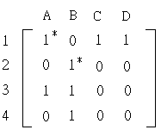
5.3 A Matching Algorithm
Example
For our example we will use the matrix

Slide 20
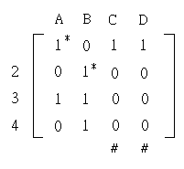
5.3 A Matching Algorithm
First we being by labeling (with the symbol “#”) all columns
containing no starred 1s . In our example , this produces the
following matrix .

Slide 21
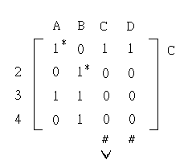
5.3 A Matching Algorithm
Now we scan each labeled column for unstarred 1s . In column C
we find an unstarred 1 in the first row , so we label that row with a
C to indicate that the unstarred 1 was found in column C . ( In
general , row labels are column names , and column labels are row
names , except for the labels“#”. ) Then we put a check mark under
column C to indicate that it has been scanned . The matrix now
appears as follows .

Slide 22
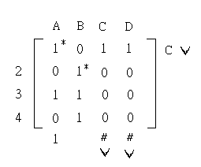
5.3 A Matching Algorithm
When we scan column D , we also find an unstarred 1 in row 1 . Since this row has
already been labeled , we put a check mark under column D to indicate that it also
has now been scanned . Since all labeled columns have been scanned , we now
turn our attention to the rows . Only row 1 has been labeled ; so we scan it , now
looking for starred 1s . There is one in column A ; so we label this column with a 1
(the row scanned) , and put a check mark after row 1 to show that it has been
scanned .

Slide 23
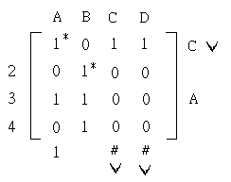
5.3 A Matching Algorithm
Since all labeled rows have been scanned , we go back to
scanning columns . Column A is labeled but not scanned ; so
we scan it for unstarred 1s . There is one in row 3 ; we label
that row with an A , since we found it when scanning column
A .

Slide 24
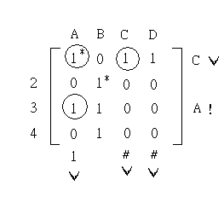
5.3 A Matching Algorithm
We are now at a turning point in the algorithm . When we scan the labeled row 3 ,
we find no starred 1 , and so we mark this row with an exclamation point . This
indicates that we will be able to improve on the independent set of 1s we started
with . The labels on the lines of the matrix tell us exactly how to do this . Row 3
is labeled with an A , so we put a circle around the 1 in column A (and row 3) . This
column is labeled with a 1 , so we put a circle around the starred 1 in row 1 (and
column A) . Row 1 is labeled with a C , so we put a circle aroumd the 1 in column C
(and row 1) . Column C is labeled with the symbol “#” , so we stop drawing circles
at this point .

Slide 25
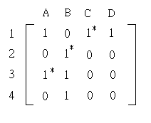
5.3 A Matching Algorithm
At this point we find a larger independent set of 1s by reversing
the stars on the circled 1s , that is , by adding a star to any circled
1 without a star , and removing the star from any circled 1 with a
star . The result is an independent set of 1s with 3 elements
instead of 2 .

Slide 26
5.4 APPLICATION OF THE ALGOITHM
In this section we will prove that our independent set algorithm actually does what it claims to do . At the same time , we will find that the algorithm actually leads to more insight about the relations among independent sets , coverings , and systems of distinct representatives . We start with a sequence of short lemmas concerning the results of applying the algorithm .
Lemma 1 If the algorithm gets to step 3.1 , then it produces an independent set of 1s with more elements than the original one .
Lemma 2 If step 3.3 is reached , then the labeled rows and unlabeled columns form a covering .

Slide 27
5.4 APPLICATION OF THE ALGOITHM
Lemma 3 If step 3.3 is reached , then each labeled row and
unlabeled column contains a starred 1 .
Lemma 4 If step 3.3 is reached , then no starred 1 is in both
a labeled row and unlabeled column .

Slide 28
5.4 APPLICATION OF THE ALGOITHM
Theorem 5.4
The independent set algorithm increases the number of
elements when applied to an independent set that is not a
maximum independent set . When applied to an independent
set that is a maximum independent set , it tells us so .
Theorem 5.5
Köing’s Theorem In a matrix of 0s and 1s , a maximum
independent set of 1s contains the same number of elements
as a minimum covering . Equivalently , in a bipartite graph , a
maximum matching contains the same number of elements as
a minimum covering .

Slide 29
5.5 THE HUNGARIAN METHID
Hungarian Algorithm
Starting with an n × n matrix with integer entries , this algorithm
finds an independent set of n entries with minimum sum .
Step 1 (reduce the matrix)
(a) Subtract from each row the smallest entry in that row .
(b) Subtract from each entry of each column the smallest
entry in that column .
Step 2 (determine a maximum independent set of 0s)
Find in the matrix a maximum independent set , S , of 0s .

Slide 30
5.5 THE HUNGARIAN METHID
Step 3 (enlarge the independent set if |S| < n)
while |S| < n
(a) Find a minimum covering for the 0s of the matrix .
(b) Let k be the smallest matrix entry not in any line of the
covering .
(c) Subtract k from each entry not in a line of the covering .
(d) Add k to each in both a row and column of the
covering .
(e) Replace S with a new maximum independent set of 0s .
endwhile
Step 4 (output)
The set S is an independent set of n entries with minimum
sum .

Slide 31
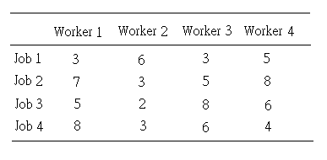
5.5 THE HUNGARIAN METHID
For simplicity , we will start with an example in which there are
the same number of jobs and workers . The time in hours for each
job are given in the following table .

Slide 32
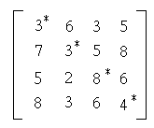
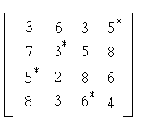
5.5 THE HUNGARIAN METHID
An assignment of a worker to each job amounts to an independent
set of four entries from the corresponding matrix , and we want the
sum of the entries in that set to be as small as possible . For
example , two possible assignments are indicated below.

Slide 33
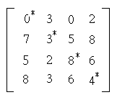
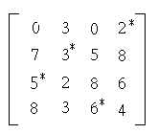
5.5 THE HUNGARIAN METHID
The first of these produces the sum 3 + 3 + 8 + 4 = 18 , and the
second givers 5 + 3 + 5 + 6 = 19 ; so the first independent set is
better than the second for our purposes . Of course , other
assignments might yield even smaller sums . Suppose we subtract 3
from each entry in the first row of our matrix . The two assignments
are shown below for the new matrix .

Slide 34
5.5 THE HUNGARIAN METHID
New the first set has the sum 0 + 3 + 8 + 4 = 15 and the second has
the sum 2 + 3 + 5 + 6 = 16 . The first assignment still has a sum 1
less than the second . The point is that although subtracting the
same number from each entry of the first row changes the problem ,
it dose not change which positions give the answer . Since any
independent set of four entries will have exactly one of them in the
first row , the sum of the entries in any such set will be decreased
by 3 by our operation .

Slide 35
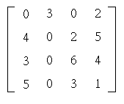
5.5 THE HUNGARIAN METHID
In order to have entries as small as possible without introducing
negative numbers , we will subtract 3 from the entries of the second
row , 2 from those of the third row , and 3 from the entries of the
fourth row .

Slide 36
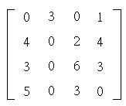
5.5 THE HUNGARIAN METHID
The same argument applies to columns , and so now we will
subtract 1 from each entry of the fourth column .

Slide 37
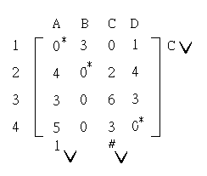
5.5 THE HUNGARIAN METHID
Finding a four-entry independent set in this matrix will solve our
original problem . Furthermore , now at least we might be able to
able to recognize a solution . Suppose we could find an independent
set of four 0s . This will clearly have minimum sum , since the
matrix has no negative entries . Unfortunately , a maximum
independent set of 0s has only three entries , as we can confirm with
the independent set algorithm .

Slide 38
5.5 THE HUNGARIAN METHID
We have reached step 3.3 of that algorithm , and so independent set
of three 0s indicated is a maximum independent set of 0s . Now to
change the matrix so as to have a better chance of finding an
independent set of four 0s . Later we will show why the solution to
the minimum sum problem has not been changed . Since a
maximum independent set of 0s has fewer than four entries , there
is a minimum covering consisting of fewer than four lines . In fact ,
by what we discovered in the last section , such a covering consists
of the labeled rows and unlabeled columns of the above matrix .
These lines are indicated below .

Slide 39
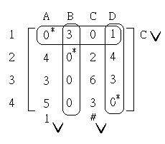
5.5 THE HUNGARIAN METHID
Look at the entries not in any line of this covering . The smallest of
these is 2 . Now we change our matrix as follows :
Subtract 2 from each entry not in a line of the covering .
(2) Add 2 to each entry in both a row and column of the covering .
(3) Leave unchanged the entries in exactly one line of the covering .

Slide 40
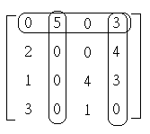
5.5 THE HUNGARIAN METHID
The resulting matrix is shown below .

Slide 41
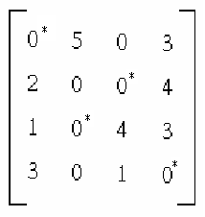
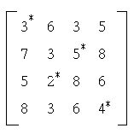
5.5 THE HUNGARIAN METHID
Now we can find an independent set of four 0s , and pick out
the corresponding set in the original matrix , as shown .

