Slide 1
Counting Techniques
離 散 數 學
Contents:
Pascal’s Triangle and the Binomial Theorem
Three Fundamental Principles
Permutations and Combinations
Arrangements and Selections with Repetitions
The Principle of Inclusion-Exclusion

Slide 2
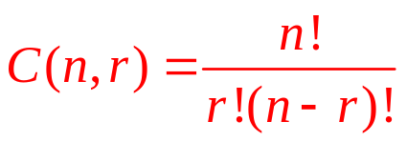



Pascal’s Triangle
For a set S of n elements, how many subsets of S that contains r elements?
Any subset R of S={a₁,a₂,…a_{n}} that contains r elements is either
A subset of S\ a_{n} containing r elements or
the union of {a_{n}} and a subset of S\ a_{n} containing r-1 elements
i.e. either or
Thm 8.1 if r and n are integers such that 1≦r<n , then
C(n,r)=C(n-1,r)+C(n-1,r-1)
Thm 8.2 if r and n are integers such that 1≦r≦n , then
C(n,r)=C(n,n-r)
C(0,0)
Pascal’s Triangle
C(1,1)
C(1,0)
C(2,0)
C(2,1)
C(2,2)
C(3,0)
C(3,1)
C(3,2)
C(3,3)
8.1: Pascal’s Triangle & the Binomial Theorem

Slide 3
Binomial Theorem
Binomial coefficient: C(n,r)
coefficient of the term x^{n-r}y^{r} in the expansion of the binomial (x+y)^{n}
Thm 8.3 The binomial Theorem, for every positive integer n
(x+y)^{n}=C(n,0)x^{n}+C(n,1)x^{n-1}y+…+C(n,n-1)xy^{n-1}+C(n,n)y^{n}
Class exercise
p.406 Q11, 21, 25, 28, 31
Home exercise
p.406 Q32, 33, 34
8.1: Pascal’s Triangle & the Binomial Theorem

Slide 4
Pigeonhole Principle
Thm 8.4 The Pigeonhole Principle
If n pigeonholes are occupied by kn+1 or more pigeons, where k is a positive integer, then at least one pigeonhole is occupied by k+1 or more pigeons
Pf: if each pigeonhole is occupied by at most k pigeons, then n pigeonholes are occupied by at most kn pigeons (i.e. can not be occupied by kn+1 or more pigeons)
Ex1: among n+1 arbitrarily chosen integers, there must exist 2 whose difference is divisible by n
sol:
Ex2: 44 chairs to be positions around 5 tables, some table must have at least 9 chairs around it
sol:
Ex3: in any group of 6 people, at least 3 must be mutual friends or mutual strangers
sol:
n pigeonholes:[0],[1],[2],…,[n-1], n+1 pigeons
5 pigeonholes, 44 pigeons (k=8)
Choose one person A, distribute the other 5 to 2 groups “A’s friends”, “A’s stranger”
Thus at least one group contains 3 or more persons, suppose it’s “A’s friends” group
If 2 of them are friends, we got 3 mutual friends. O.W. we got 3 mutual strangers
8.2: Three Fundamental Principles

Slide 5
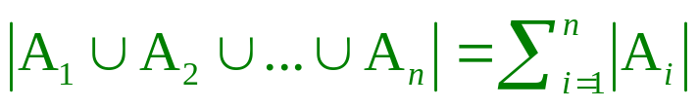
Multiplication & Addition Principle
Thm 8.5 The Multiplication Principle
The number of ways in which a sequence of events can occur is the product of the number of ways in which each individual event can occur
Ex1: how many numbers in [1000,9999] do not have any repeated digits?
sol:
Thm 7.6 The Addition Principle
Given n pairwise disjoint finite sets, A₁,A₂,…,A_{n}, then
Ex1: how many 8-bit strings begin with 1011 or 01?
sol:
Ex2: how many 8-bit strings begin with 1011 or end with 01?
sol:
9×9×8×7=4536
2⁴＋2⁶=80
(a) 1011_ _ _ _ : totally 1×2×2×2×2=16
(b) AAAA_ _01: where AAAA can not be 1011, totally (2⁴-1)×2×2×1=60
thus 16+60=76
8.2: Three Fundamental Principles

Slide 6
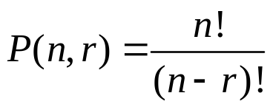
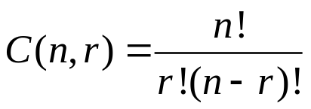
Permutations & Combinations
r-permutation: for natural numbers r and n, r≦n
the arrangement using r of the n distinct objects
The number of different r-premutations of a set of n distinct elements: P(n,r)
Ex1: how many ways are there where 7 people can form a line? a circle?
sol:
r-combination: for natural numbers r and n, r≦n
an unordered selection of r objects chosen from a set of n distinct objects
The number of different r-combinations of a set of n distinct elements: C(n,r)
Ex2: how many 8-bit strings contain exactly three 0s?
sol:
7! for a line; 6! for a circle
i.e. five 1s, three 0s: C(8,3)
8.3: Permutations & Combinations

Slide 7
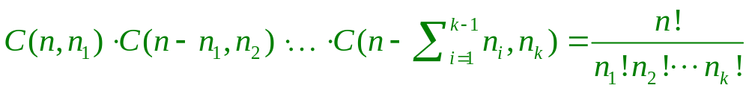
Arrangements/Selection with Repetitions
Thm 8.7 S is a collection containing n objects of k different types, each object belongs exactly to 1 type, there are n_{i} objects of type i
the number of different arrangements of the objects in S is
Ex1: how many ways can the letters of “attention” be rearranged?
sol:
Thm 8.8 if repetition is allowed
the number of ways to put r identical balls into n diff boxes is C(n+r-1,r)
Ex1: Mary wants to buy a dozen of donuts which come in 30 different varieties, how many choices does she have?
sol:
Summary: The number of ways to put r balls into n numbered boxes
Same color All different colors
at most 1 ball in 1 box C(n,r) P(n,r)
any # of balls in a box C(n+r-1,r) n^{r}
9!/(3!2!)
Put 12 balls into 30 boxes, C(30+12-1,12)
8.4: Arrangements & Selections with Repetitions

Slide 8
Principle of Inclusion-Exclusion
Thm 8.9 For any finite sets A₁,A₂,…,A_{r}, let n_{s} be the sum of the sizes of all possible intersections of s sets chosen without repetition from among A₁,A₂,…,A_{r}
i.e.
Then
Pf: let U be the union of all A_{i}s and |U|=m, suppose a is an element of U, and belongs to exactly k of the sets A_{i}s, then a is counted once (i.e. C(k,0)) in m, C(k,1) times in n₁, C(k,2) times in n₂,…, and C(k,k) time in n_{k}. Thus the number of times that a is counted in m-n₁+n₂-n₃+…-(-1)^{r-1}n_{r} is
C(k,0)-C(k,1)+C(k,2)-C(k,3)+…+(-1)^{k}C(k,k)=(1+(-1))^{k}=0 by the binomial thm.
Therefore, we can apply the above procedure for each element of U, and conclude that m-n₁+n₂-n₃+…+(-1)^{r-1}n_{r}=0, which is what we want.
Ex1: how many integers in [1,300] are
(a) divisible by at least one of 3,5,7?
(b) divisible by 3 and by 5, but not by 7?
(c) divisible by 5 but not neither 3 nor 7?
A,B,C: divisible by 3,5,7, |A|=100, |B|=60, |C|=42,
|AB|=20, |BC|=8, |AC|=14, |ABC|=2
|A|+|B|+|C|-|AB|-|BC|-|AC|+|ABC|=162
|AB|-|ABC|=18
|B|-|AB|-|BC|+|ABC|=34
8.6: Principle of Inclusion-Exclusion
Notes:
https://www.youtube.com/watch?v=he9MVAhLttc

Slide 9
Exercise on Chapter 8
All the examples in Section 8.1, 8.2, 8.3, 8.4, 8.5, 8.6
especially 8.2, 8.4, and 8.6
Inclusion-exclusion principle proof
https://www.youtube.com/watch?v=he9MVAhLttc
https://www.youtube.com/watch?v=zZlDUh_zZkE
8.6: Principle of Inclusion-Exclusion

