Slide 1
Recurrence Relations and Generating Functions
離 散 數 學
Contents:
Recurrence Relations
The Method of Iteration
Linear Difference Equations with Constant Coefficients
Counting with Generating Functions
The Algebra of Generating Functions

Slide 2

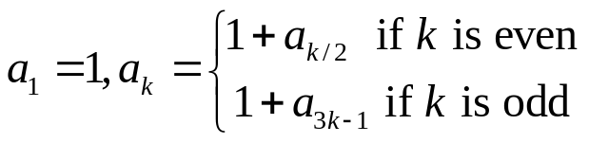
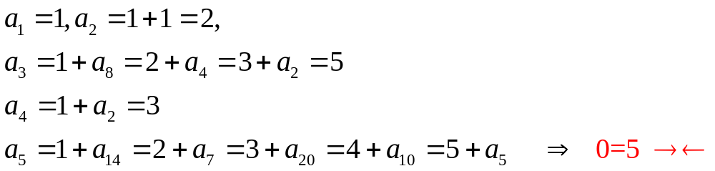
Recurrence Relations
Sequence: a function f: Z→R, usually described by listing its range
(domain is some infinite set of integers, usually , and range is a set of real numbers)
The numbers in the list are called terms of the sequence
Recurrence relation: each term in the sequence beyond the first (which is defined by the initial condition) is defined in terms of the previous terms
Solution to the recurrence relation is an explicit formula for each term
Ex1: arithmetic sequence: a, a+d, a+2d,… that is, a_{i}=a+(i-1)d
geometric sequence: a, ar, ar²,… that is, a_{i}=ar^{i-1}
Fibonacci sequence: f₁=1, f₂=1, f_{k+1}=f_{k}+f_{k-1} for k≧2
!Note!: NOT every recursive definition defines actual sequence
Ex2:
9.1: Recurrence Relations

Slide 3
Examples of Recurrence Relations
Ex1: Towers of Hanoi: 3 spokes A,B,C, n disks of graduated size
m_{n}: the minimum # of moves to transfer n disks from one spoke to another
by
(1) move the smallest n-1 disks as efficiently as possible from spoke A to spoke B
(2) move the largest disk from spoke A to spoke C
(3) move the smallest n-1 disks as efficiently as possible from B to C
Ex2: Dearrangement of integers from 1 to n: permutation of integers from 1 to n where no integer occupies its natural position
Sol1: example 8.44 using principle of inclusion-exclusion
let U denote the set of permutations of 1~n, thus |U|=n! ,
let A_{i} denote the set of members of U having i as i^{th} digit, and UA denote the union of A_{i}s. |UA|=C(n,1)(n-1)!-C(n,2)(n-2)!+…+(-1)^{k-1}1! ,
A dearrangement of 1~n is a member of U not in the union of A_{i}s, thus |U|-|UA|
Sol2: example 9.4 using the recurrence relations
let D_{n} be the # dearrangement of integers from 1 to n
D_{n}=(n-1)(D_{n-2}+D_{n-1}), for n≧3, D₁=0, D₂=1
m_{n}=m_{n-1}+1+m_{n-1} for n≧2, m₁=1
9.1: Recurrence Relations

Slide 4
Dearrangement small example
e.g. 1 2 3 4
n=4, D₄=3+3+3=9 = (4-1)(D₂+D₃)
1st place
has 4-1
=3 choices
2,
or 3,
or 4
2 1 4 3
2 3 4 1
2 4 1 3
➔ D₂=1, since place 3/4 cannot put value 3/4
➔ D₃=2, since place 2/3/4 cannot put 1/3/4
3 4 1 2
3 1 4 2
3 4 1 3
➔ D₂=1, since place 2/4 cannot put 2/4
➔ D₃=2, since place 2/3/4 cannot put 2/1/4
4 3 2 1
4 1 2 3
4 3 1 2
➔ D₂=1, since place 2/3 cannot put 2/3
➔ D₃=2, since place 2/3/4 cannot put 2/3/1
the 1st place has has n-1 choices in {2,3,…,n}
General form D_{n}= (n-1)(D_{n-2}+D_{n-1})

Slide 5

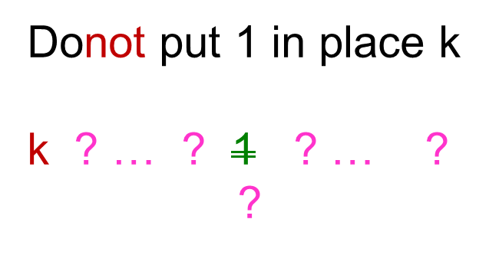
Dearrangement general example
General form D_{n}= (n-1)(D_{n-2}+D_{n-1})
Case 2
Case 1:
Case 2:
Case 1
Put k in the 1st place, such a k has n-1 choices in {2,3,…,n}
put 1 in place k
k ? … ? 1 ? … ?
1 2 …k-1 k k+1 … n
D_{n-2} , place 2/…/k-1/k+1/…/n
cannot put 2/…/k-1/k+1/…/n
Totally n-2 numbers
1 2 …k-1 k k+1 … n
D_{n-1} , place 2/…/k-1/k/k+1/…/n
cannot put 2/…/k-1/1/k+1/…/n
Totally n-1 numbers

Slide 6
Method of Iteration
Ex1: m_{n}=2m_{n-1}+1 for n≧2, m₁=1
Ex2: e_{n}=e_{n-1}+(n-1) for n≧2, e₁=0
Ex3: p_{n}=(2n-1)p_{n-1} for n≧1, p₁=1
Ex4: D_{n}=(n-1)(D_{n-2}+D_{n-1}), for n≧3, D₁=0, D₂=1
Show
D_{n}=nD_{n-1}+(-1)^{n}, for n≧2, D₁=0
m_{n}=2^{n}-1 for n≧2
e_{n}=(n²-n)/2 for n≧2
p_{n}=(2n-1)(2n-3)…(3)1=(2n)!/(2^{n}n!) for n≧1
D_{n}=n![1/(2!)-1/(3!)+…+(-1)^{n}/(n!)] for n≧2
9.2: The Method of Iteration

Slide 7
Example of D_{n}=(n-1)(D_{n-2}+D_{n-1})
Ex4: D_{n}=(n-1)(D_{n-2}+D_{n-1}), for n≧3, D₁=0, D₂=1
Observe: D_{n}=(n-1)D_{n-2} + nD_{n-1} - D_{n-1}
➔ D_{n}- nD_{n-1} = - (D_{n-1} - (n-1)D_{n-2}) , Let S_{n} = D_{n}- nD_{n-1} , then S₂ = D₂- 2D₁ = 1
➔ S_{n} = -S_{n-1}
= (-1)²S_{n-2} = (-1)³S_{n-3} = … = (-1)^{n-2}S_{n-(n-2)} = (-1) ^{n-2} = (-1) ^{n}
➔ D_{n}- nD_{n-1} = (-1) ^{n}, thus D_{n}=nD_{n-1}+(-1)^{n}, for n≧2, D₁=0
Now to show
One can use the mathematical induction,
when n=2 , D₂=2!(1/2!)=1, ok !
Suppose the formula holds for n=k, now we check n=k+1, based on D_{n}=nD_{n-1}+(-1)^{n}
D_{k+1}=(k+1)D_{k}+(-1)^{k+1}
=(k+1)(k![1/(2!)-1/(3!)+…+(-1)^{k}/(k!)])+(-1)^{k+1}
=(k+1)![1/(2!)-1/(3!)+…+(-1)^{k}/(k!)])+ (-1)^{k+1}[(k+1)!/(k+1)!]
=(k+1)![1/(2!)-1/(3!)+…+(-1)^{k}/(k!) + (-1)^{k+1}/(k+1)!] ➔ DONE!!
Thus, by mathematical induction
D_{n}=n![1/(2!)-1/(3!)+…+(-1)^{n}/(n!)] for n≧2
D_{n}=n![1/(2!)-1/(3!)+…+(-1)^{n}/(n!)] for n≧2
9.2: The Method of Iteration

Slide 8
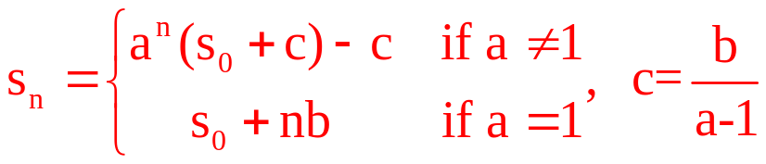
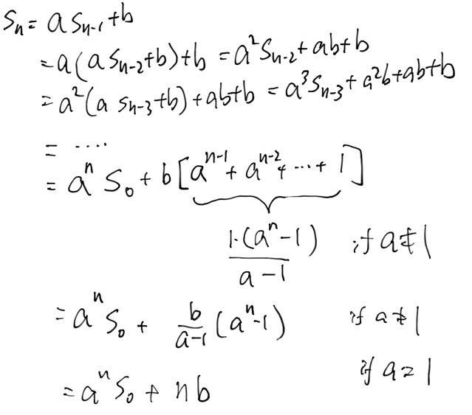
Linear Difference Equations-1st order
Recurrence relation of order k: a function of the form s_{n}=P(s_{n-1},s_{n-2},…,s_{n-k},n)
i.e. s_{n} is a function of its preceding k terms s_{n-1},s_{n-2},…,s_{n-k}, and possibly with n, too.
Linear k^{th}-order recurrence relation with constant coefficients C₁,C₂ ,…, C_{k}
s_{n}=C₁s_{n-1}+C₂s_{n-2}+…+C_{k}s_{n-k}+f(n) where C_{k}≠0 and f(n): a function of n
if f(n)=0, the relation is homogeneous, o.w. it is nonhomogeneous
Given s_{n-1},s_{n-2},…,s_{n-k}, we can uniquely determine s_{n}
Thm 9.1
The general term of the 1st-order linear difference equation s_{n}=as_{n-1}+b with constant coefficients a, b where a≠0, given an initial value s₀ satisfies
Ex1: given s₀=1, solve s_{n}=-s_{n-1}+7 for n≧2
sol:
or
S_{n}= -S_{n-1}+7= S_{n-2}= -S_{n-3}+7= S_{n-4}=…
=S₀=1 for even n; or = -1+7=6 for odd n
S_{n}=(-1)^{n}(-2.5)+3.5 for n≧0
9.3: Linear Difference Equations with Constant Coefficients
Notes:
S_n=a^nS_0+b(a^(n-1)+a^(n-2)+…+1)
If a=1, a^(n-1)+a^(n-2)+…+1=n
If a!=1, S_n=a^n(s_0+b/(a-1))-b/(a-1)

Slide 9
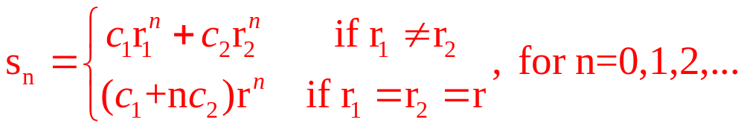
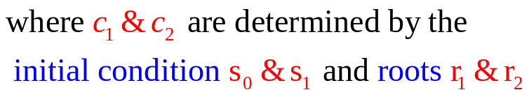
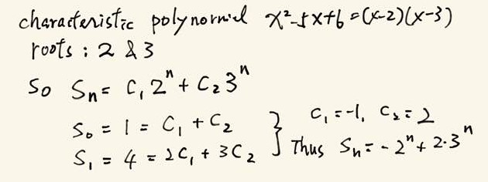


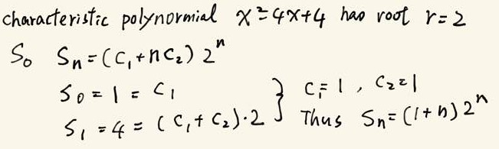
Characteristic Polynomial
Thm 9.2 consider the 2nd-order homogeneous linear recurrence relation s_{n}=as_{n-1}+bs_{n-2} for n≧2 with constant coefficients a & b(≠0), given initial values s₀ & s₁.
we associate the relation with the characteristic polynomial x²-ax-b
(x²-ax-b=0 is also called the auxiliary equation of the recurrence relation)
whose roots, r₁ & r₂, are characteristic roots. The solution of s_{n}=as_{n-1}+bs_{n-2} is
Pf: for each case (r₁=r₂ or not), we first uniquely determine c₁ & c₂, then use math induction assuming the explicit formula holds for n=0,1,2,..,k, then plug-in the recurrence relation for n=k+1, show it will derive the same explicit formula.
Ex1: given s₀=1, s₁=4, solve s_{n}=5s_{n-1}-6s_{n-2} for n≧2
sol:
Ex2: given s₀=1, s₁=4, solve s_{n}=4s_{n-1}-4s_{n-2} for n≧2
sol:
9.3: Linear Difference Equations with Constant Coefficients
Notes:
Why it works?
Known: (a) a_n=c_1a_n-1+c_2a_n-2, a_0, a_1 (b) r_1,r_2 are roots of r^2=c_1r+c_2
Show: if r_1<>r_2, then (c) a_n=alpha_1exp(r_1,n)+alpha2exp(r_2,n) satisfies (a)
Pf: exp(r_1,n) & exp(r_2,n) satisfies (a), but NOT for a_0 & a_1, if we use (c), (a) will also be satisfied, and both alpha_1,alpha_2 can be uniquely determined by a_0 & a_1 (i.e. a_0=alpha_1+alpha_2, a_1=alpha_1r_1+alpha_2r_2)
Now we plug (c) into (a)’s rhs, and if the result equals to (a)’s lhs, we are done!
Plug (c) into (a)’s rhs: c_1[alpha_1exp(r_1,n-1)+alpha_2exp(r_2,n-1)]+c_2[alpha_1exp(r_1,n-2)+alpha_2exp(r_2,n-2)]
=alpha_1[c_1exp(r_1,n-1)+c_2exp(r_1,n-2)]+alpha_2[c_1exp(r_2,n-1)+c_2exp(r_2,n-2)]
=alpha_1exp(r_1,n)+alpha_2exp(r_2,n) ← by (b)
=a_n ← by (c)
Thus rhs=lhs for (a)
===============
If r_1=r_2=r, to show (d) a_n=alpha_1exp(r,n)+alpha_2nexp(r,n) solves (a)
Pf: now (x-r)^2=0, thus c_1=2r, c_2=-r^2, so we can get r=c_1/2, (a)’s rhs=2ra_n-1-r^2a_n-2 ←(a1)
Using a_0,a_1 on (d), we get a_0=alpha_1, and a_1=(alpha_1+alpha_2)r, thus we obtain alpha_1 & alpha_2
Plug (d) into (a)’s rhs, (a1), 2r(alpha_1exp(r,n-1)+alpha_2(n-1)exp(r,n-1))-r^2(alpha_1exp(r,n-2)+alpha_2(n-2)exp(r,n-2) )=alpha_1exp(r,n)+alpha_2nexp(r,n) ← by (d)
=a_n , thus rhs=lhs for (a)

Slide 10
Exercises on the first half of Chap 9
All the examples in Section 9.1, 9.2, 9.3
Section 9.1: Q13, Q25,29,33
Section 9.2: Q9,10, Q25,29
Section 9.3: Q20,25,27,33
Suggested youtube links:
2nd order difference equation:
https://www.youtube.com/watch?v=Ag0YYL41aS0
Dearragement by inclusion-exclusion principle
https://www.youtube.com/watch?v=Wb_kuB7qoaI
9.3: Linear Difference Equations with Constant Coefficients

Slide 11
Generating Function-1
The generating function of a sequence a₀, a₁, a₂,… is the expression f(x)=a₀+a₁x+a₂x²+… , which is also called a formal power series
Addition & multiplication of generating functions:
f(x)=a₀+a₁x+a₂x²+…, g(x)=b₀+b₁x+b₂x²+…
f(x)+g(x)=(a₀+b₀)+(a₁+b₁)x+(a₂+b₂)x² +…+ (a_{n}+b_{n})x^{n} +…
f(x)g(x)=(a₀b₀)+(a₁b₀+a₀b₁)x+…+ (a₀b_{n}+a₁b_{n-1}+a₂b_{n-2}+…+a_{n-1}b₁+a_{n}b₀)x^{n} +…
Ex1: Coefficient of x² in (1+x)³ , C(3,2) means # ways of choosing 2 objects from a set of 3 objects; or, # ways of choosing x¹ instead of x⁰ from (x⁰ + x¹)(x⁰ + x¹)(x⁰ + x¹)
Ex2: How many ways can one choose 2 items from a basket containing an apple, an orange, a pear, a banana, and a plum?
Sol:
coefficient of A^{v}O^{w}P^{x}B^{y}p^{z} from (A⁰+A¹)(O⁰+O¹)(P⁰+P¹)(B⁰+B¹)(p⁰+p¹)
where v,w,x,y,z are binary (0 or 1) variables satisfying v+w+x+y+z=2
i.e. AO,AP,AB,Ap,OP,OB,Op,PB,Pp,Bp
which is the same as the coefficient of x² from (1+x)⁵
9.5: Counting with Generating Functions
Notes:
Pear: 洋梨
Plum: 梅子

Slide 12
Generating Function-2
Ex3: How many ways can one choose 2 items from a basket containing 2 apple, an orange, a pear, and a banana?
Sol:
Ex4: Let d_{r} be the # ways that one can choose r items from a basket containing 2 apple, an orange, a pear, and a banana, what is the generating function of {d_{r}} ?
Sol:
Ex5: Let d_{r} be the # ways that one can choose r items from a basket containing 2 apple, infinite many orange, and 4 pears. Pears must be chosen in pairs. What is the generating function of {d_{r}} ? What is d₅ ?
Sol:
coefficient of A^{v}O^{w}P^{x}B^{y} from (1+A+A²)(1+O)(1+P)(1+B)
where v=0 or 1 or 2, w,x,y are binary (0 or 1) variables satisfying v+w+x+y=2
i.e. A²,AO,AP,AB,OP,OB,PB
which is the same as the coefficient of x² from (1+x+x²)(1+x)³
(1+x+x²)(1+x)³=x⁵+4x⁴+7x³+7x²+4x+1,
where d_{r} is the coefficient of x^{r}, d_{r}=0 for r>5
(1+x+x²)(1+x+x²+…)(1+x²+x⁴)
=1+2x+4x²+5x³+7x⁴+8x⁵+… , d₅=8
9.5: Counting with Generating Functions

Slide 13
Generating Function-3
Ex6: An apple costs $2, and an orange costs $3. Let d_{r} be the # ways of buying r dollars worth of apples and oranges. Find the generating function for the sequence {d_{r}}
Sol:
Ex7: A basket contains infinitely many apples, bananas and oranges. An apple costs $2, an orange costs $3, and a banana costs $4. Let d_{r} be the # ways of putting exactly 3 fruits worth of r dollars into 3 different boxes (i.e. AOB is different from ABO).
(a) Find the generating function for the sequence {d_{r}}
(b) Find the generating function for the # ways of buying r dollars worth of exactly 2 or 3 or 4 fruits
Sol:
Suppose r dollars can buy a apples o oranges, that is, r=2a+3o,
d_{r} is the coefficient of A^{2a}O^{3o} from (1+A²+A⁴+…)(1+O³+O⁶+…)
so the generating function for {d_{r}} is (1+x²+x⁴+…)(1+x³+x⁶+…)
Suppose r dollars can buy a apples o oranges and b bananas, that is, r=2a+3o+4b,
a+o+b=3, d_{r} is the coefficient of A^{2a}O^{3o}B^{4b} from (A²+O³+B⁴)(A²+O³+B⁴)(A²+O³+B⁴)
so the generating function for {d_{r}} is (x²+x³+x⁴)³
Let c_{r} and e_{r} be # ways of buying r dollars worth of 2 fruits and 4 fruits respectively
Then the generating functions for {c_{r}} and {e_{r}} are (x²+x³+x⁴)² and (x²+x³+x⁴)⁴
Thus (x²+x³+x⁴)²+(x²+x³+x⁴)³+(x²+x³+x⁴)⁴

Slide 14
Generating Function-4
Supplement of Ex7:
Note that in Ex7 we put 3 fruits into 3 different boxes. Another method to solve this problem is to enumerate all the possibilities. Since a+o+b=3, Let the set L={(3,0,0),(0,3,0),(0,0,3),(2,1,0),(2,0,1),(1,2,0),(1,0,2),(0,2,1),(0,1,2),(1,1,1)} contain all the possible (a,o,b) vectors.
Let [XYZ] be the arrangement of putting X into the 1st box, Y the 2nd box, and Z the 3rd box. Now we calculate each term of the generating function as follows:
(3,0,0)=> [AAA], thus x²x²x²=x⁶ with coefficient 1
(0,3,0)=> [OOO], thus x³x³x³=x⁹ with coefficient 1
(0,0,3)=> [BBB], thus x⁴x⁴x⁴=x¹² with coefficient 1
(2,1,0)=> [AAO],[AOA],[OAA], thus x²x²x³=x⁷ with coefficient 3
(2,0,1)=> [AAB],[ABA],[BAA], thus x²x²x⁴=x⁸ with coefficient 3
(1,2,0)=> [AOO],[OAO],[OOA], thus x²x³x³=x⁸ with coefficient 3
(1,0,2)=> [ABB],[BAB],[BBA], thus x²x⁴x⁴=x¹⁰ with coefficient 3
(0,2,1)=> [BBO],[BOB],[OBB], thus x³x³x⁴=x¹⁰ with coefficient 3
(0,1,2)=> [OBB],[BOB],[BBO], thus x³x⁴x⁴=x¹¹ with coefficient 3
(1,1,1)=> [AOB],[ABO],[BAO],[BOA],[OAB],[OBA] thus x²x³x⁴=x⁹ with coefficient 6
Thus the generating function for {d_{r}} is
x⁶+3x⁷+6x⁸+7x⁹+6x¹⁰+3x¹¹+x¹²= (x²+x³+x⁴)³ as solved in previous page
9.5: Counting with Generating Functions

Slide 15
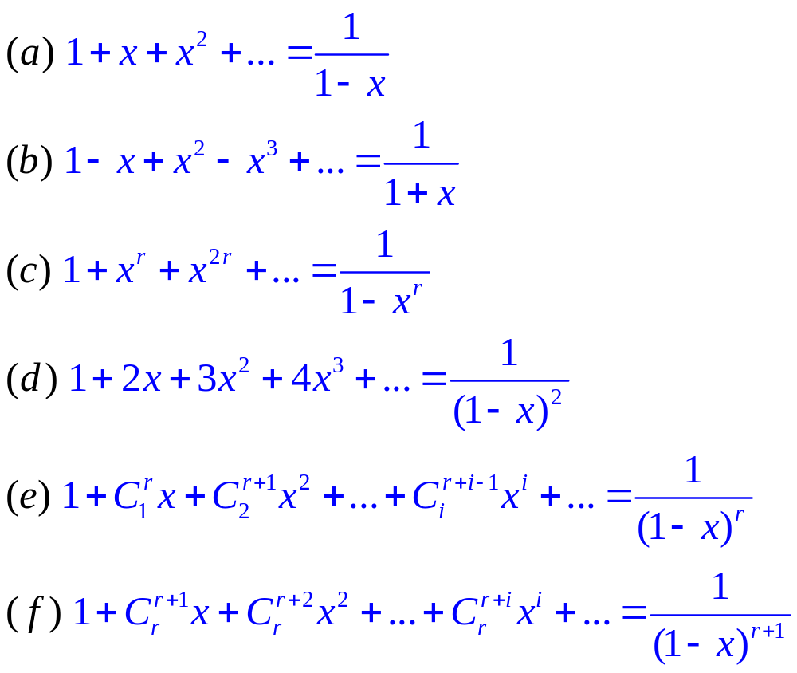
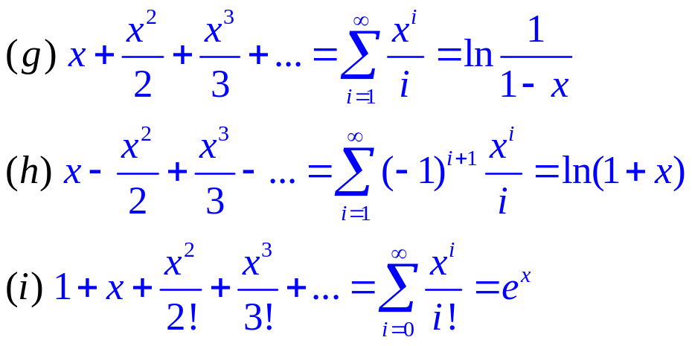
Algebra of Generating Function
Thm 9.3 Suppose f(x)=a₀+a₁x+a₂x²+… where a₀≠0
Then there exists a unique generating function g(x) such that g(x)f(x)=1
Common power series:
9.6: The Algebra of Generating Functions
Notes:
(e),(f), rhs: (1-x)^-r, then apply extended binomial thm to expand the infinite series

Slide 16
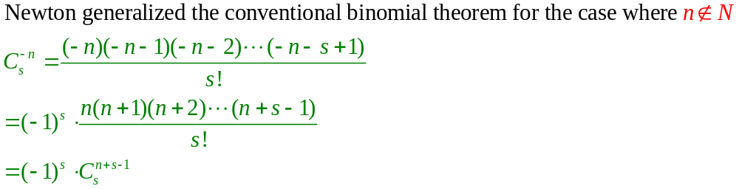
Hints in proving power series
To prove the infinite power series (a)~(i) as given in previous page, we may need to use the “extended binomial theorem” as following:
It can be used to show (e) & (f)
Hints for others:
(d): let F(x) be the power series, try F-xF
(g)~(i): let F(x) be the power series, try F’ (i.e. take its derivative), then do integration
9.6: The Algebra of Generating Functions

Slide 17
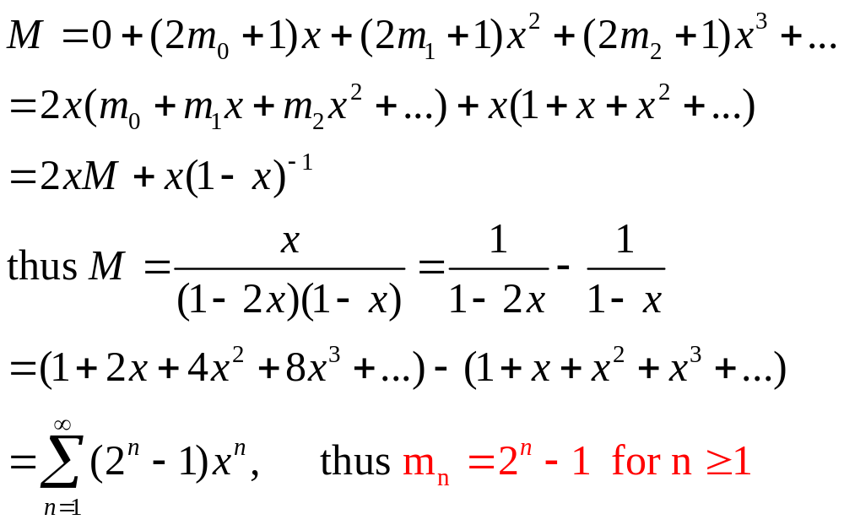
Solving Recurrence Relation by Generating Function
Ex1: m_{n}=2m_{n-1}+1 for n≧2, m₁=1, m₀=0
Sol: Let M be the generating function of {m_{n}}
Exercise: all examples on Section 9.5, 9.6
9.6: The Algebra of Generating Functions

