Slide 1
Getting started
Contents:
insertion sort
analyzing algorithms
designing algorithms

Slide 2



2.1 Insertion Sort
Example: Sorting problem
  Input: A sequence of n numbers
  Output: A permutation of the input sequence such that .
  The number that we wish to sort are known as the keys.

Slide 3
Pseudocode
Insertion sort
  Insertion-sort(A)
  1 for j ←2 to length[A]
  2 do key←A[j]
  3 ∗Insert A[j] into the sorted sequence A[1..j-1]
  4 i ← j - 1
  5 while i>0 and A[i]>key
  6 do A[i+1] ←A[i] (*shift A[i] to the right)
  7 i ← i - 1
  8 A[i +1] ←key

Slide 4
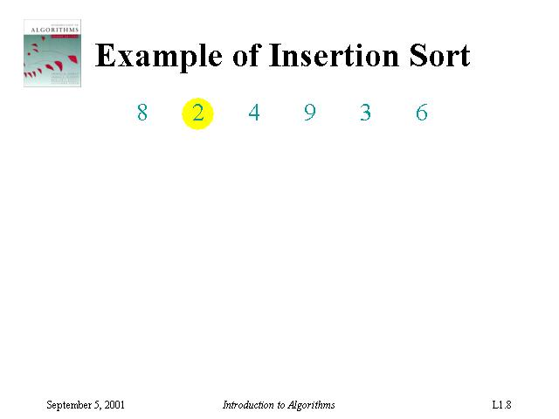
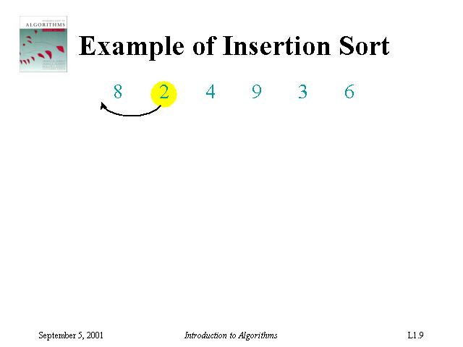
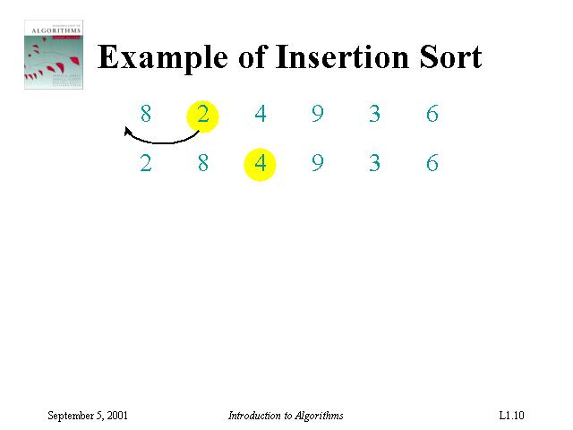
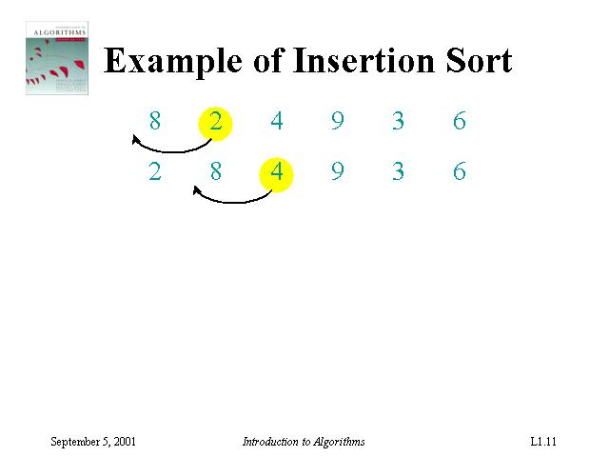
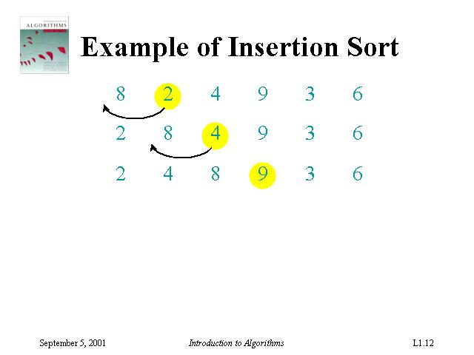
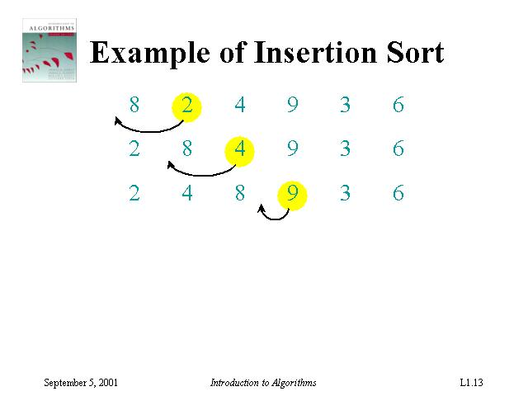
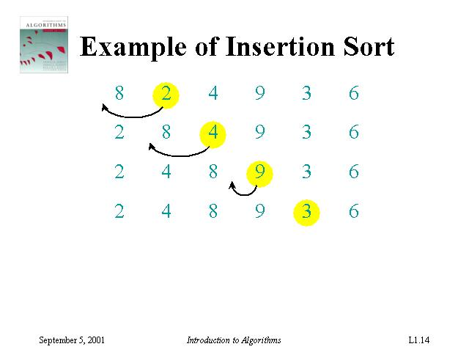
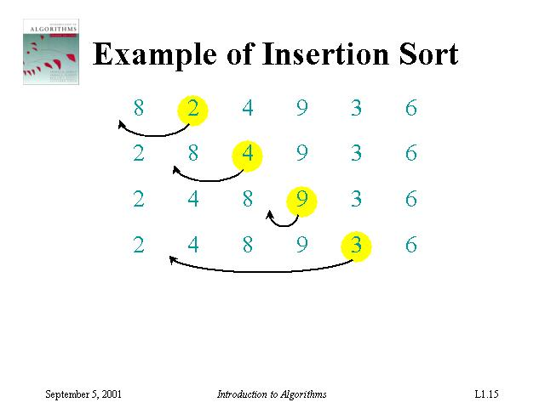
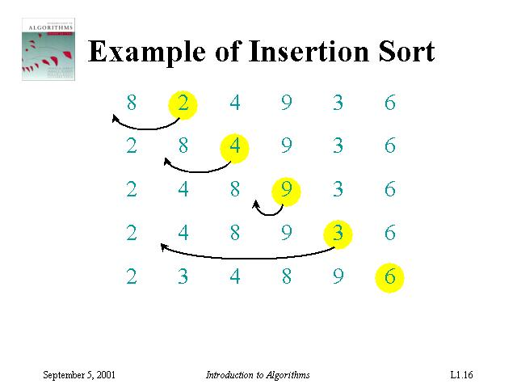
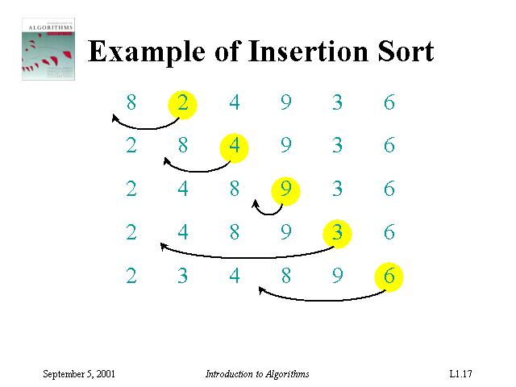
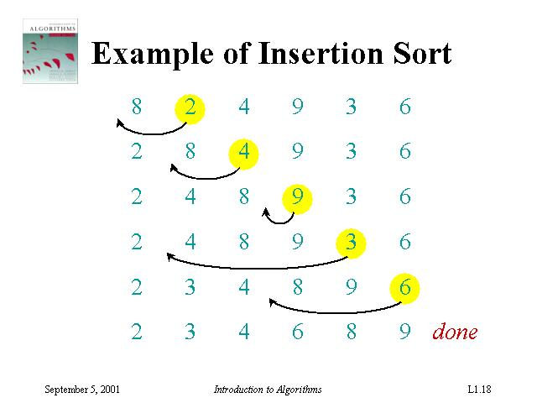

Slide 5
Input numbers (Array A) is Sorted in place :
  The numbers are rearranged within the array A, with at most a constant number of them sorted outside the array at any time.
Loop invariant :
  Conditions and relationships that are satisfied by the variables and data structures at the start (or end) of each iteration of the loop
  E.g. At the start of each iteration of the “outer” for loop of line 1-8, the subarray A[1..j-1] consists of the elements originally in A[1..j-1] but in sorted order.
Correctness of algorithm:
  Using loop invariant
  Similar to the math induction
    Initialization, maintenance, termination

Slide 6
2.2 Analyzing algorithms
Analyzing an algorithm:
predicting the resources that the algorithm requires.
Resources: memory, communication, bandwidth, logic gate, time.
Assumptions: one processor, random-access machine RAM (how real computers are designed)
  Instructions are executed one after another (NO concurrent operations)
  Use common instructions (assume each one takes a constant amount of time): Arithmetic (+,-,*,/,mod,floor,ceiling,shift right/left), data movement (load,store,copy), control (if..else,case)
  Uses integer and floating-point types
  Never mind precisions
  Limit on the word size: inputs of size n, assume integers are represented by clg n bits (lg n means log₂ n)

Slide 7
Analyzing Running Time
How to analyze an algorithm’s running time?
Time taken by an algorithm depends on the input
The input size depends on the problem
  # items, # bits required, more than one input
The running time (complexity) of an algorithm on a particular input is the number of primitive operations or “steps” executed. It is convenient to define the notion of step so that it is as machine-independent as possible

Slide 8
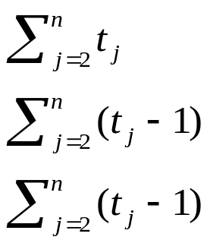
Running Time of Insertion-Sort
INSERTION-SORT(array A)
1 for j=2 to length[A]
2 do key=A[j]
3 // Insert A[j] to the sorted
sequence A[1..j-1].
4 i=j-1
5 while i>0 and A[i]>key
6 do A[i+1]=A[i]
7 i=i-1
8 A[i+1]=key
Cost Best Worst
c₁ n n
c₂ n-1 n-1
0 n-1 n-1
c₄ n-1 n-1
c₅ n-1
c₆ 0
c₇ 0
c₈ n-1 n-1
t_{j}: the number of times the while loop test in line 5 is executed for the value of j.

Slide 9
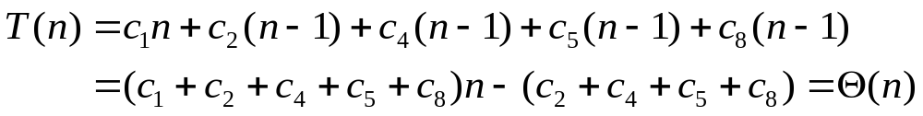
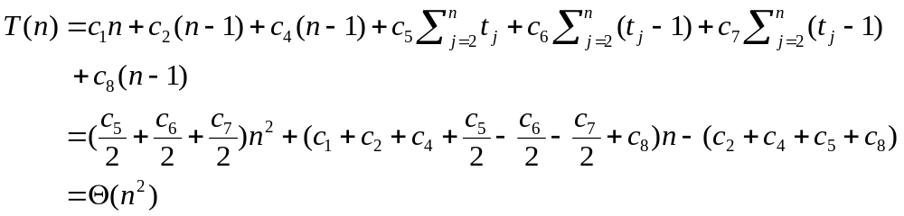
Complexity of Insertion-Sort
Best case: Array A is already sorted in non-decreasing order: t_{j}=1
Worst case: Array A is already sorted in non-increasing order: t_{j}=j
Best-case analysis may be misleading

Slide 10
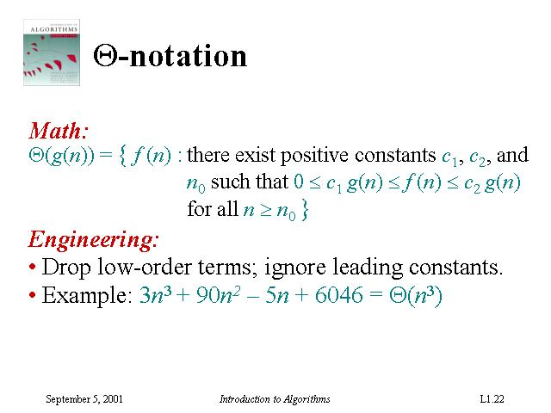

Slide 11
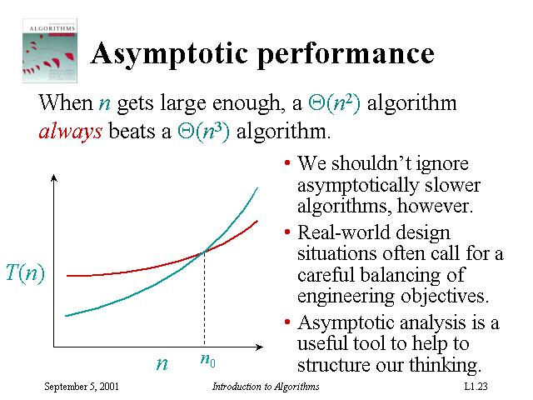

Slide 12
Worst-case and Average-case Analysis
Average-case: require probability analysis
Usually, we concentrate on finding only on the worst-case running time
Reason:
  It is an upper bound on the running time
  The worst case occurs fair often
  The average case is often as bad as the worst case. For example, the insertion sort with t_{j}=j/2. Again, quadratic function although with smaller coefficient.

Slide 13

Order of Growth
In some particular cases, we shall be interested in average-case, or expected running time of an algorithm. (Chap 5)
It is the rate of growth, or order of growth, of the running time that really interests us.
  Only look at the leading terms (drop lower-order terms)
  Ignore the constant coefficient in the leading term
  E.g. insertion sort:
  More on this topic will be taught in Chap 3

Slide 14


2.3 Designing Algorithms
There are many ways to design algorithms:
Incremental approach: insertion sort
Divide-and-conquer: merge sort
  recursive:
    divide
    conquer
    combine (merge) ← key procedure
MERGE-SORT (A[1..n])
  If n=1, done!
  Recursively sort 2 lists: A[ ] and A[ ]
  Merge the 2 sorted lists

Slide 15
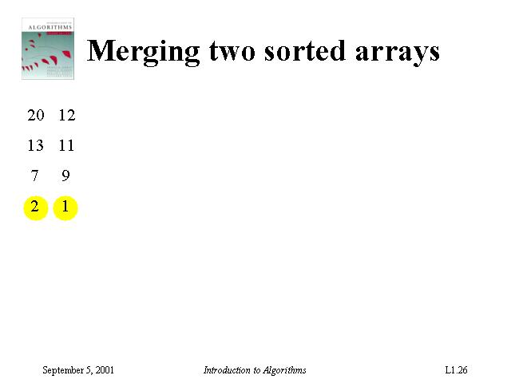
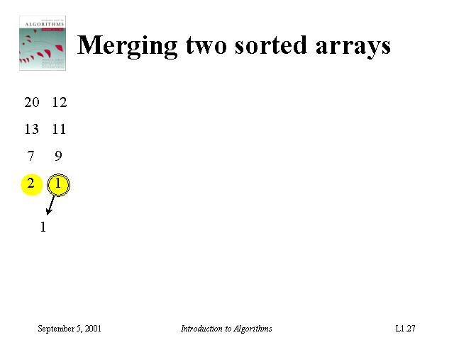
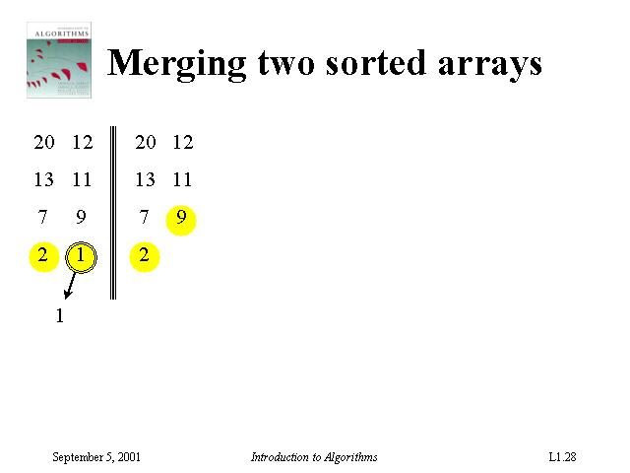
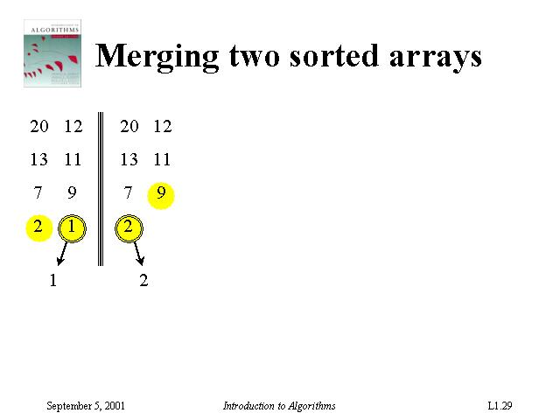
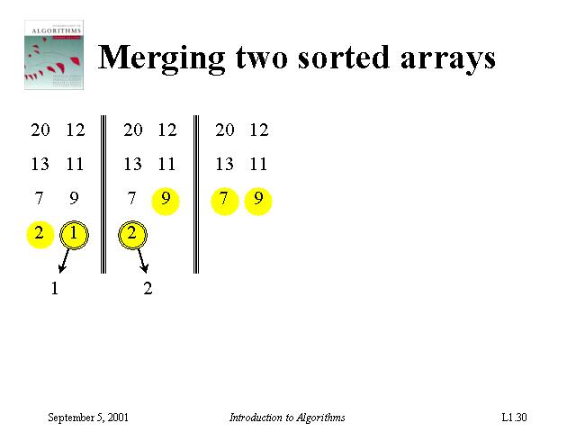

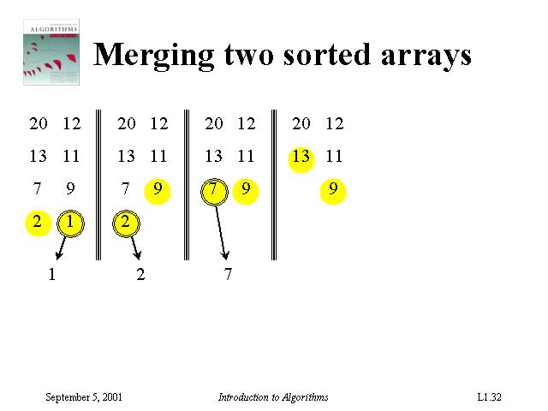
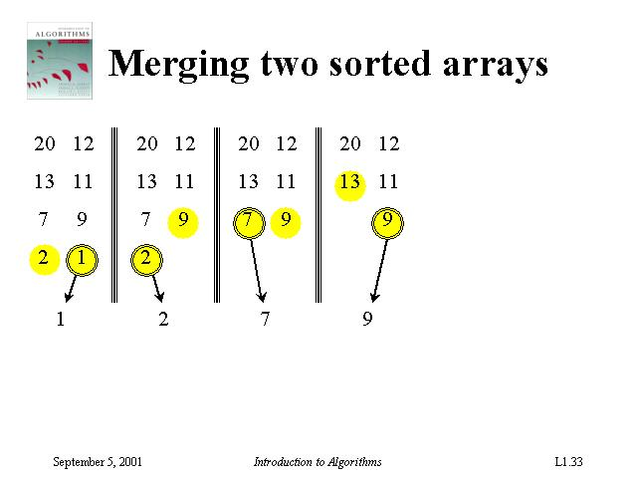
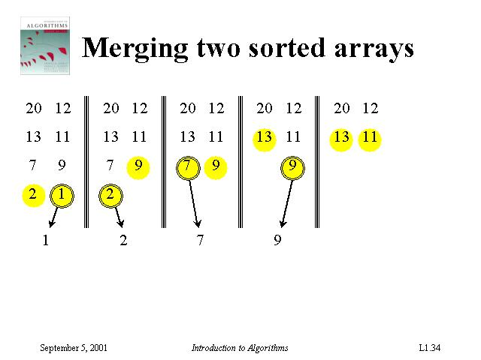
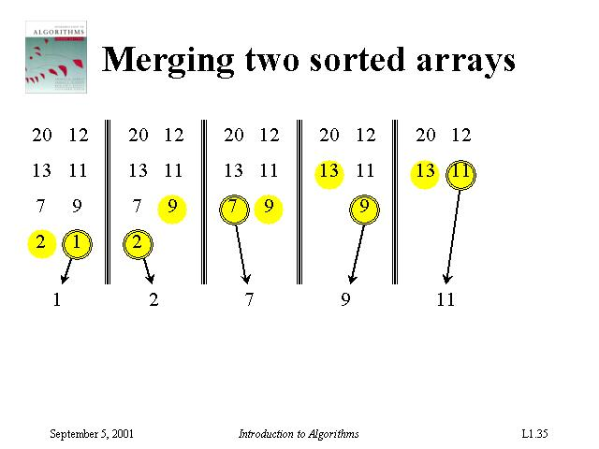
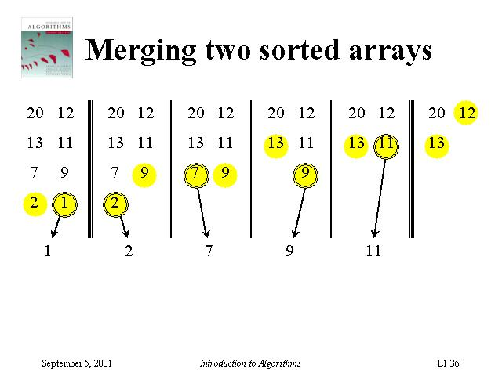
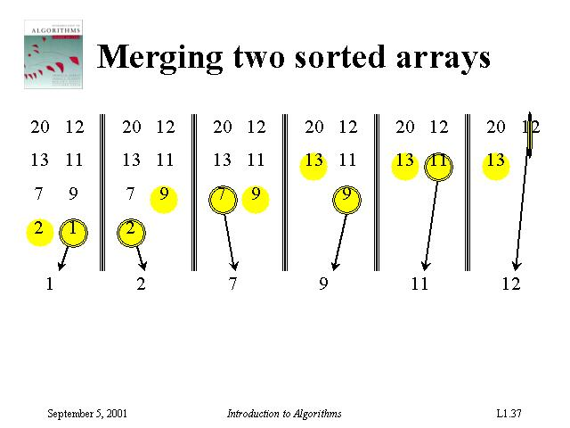
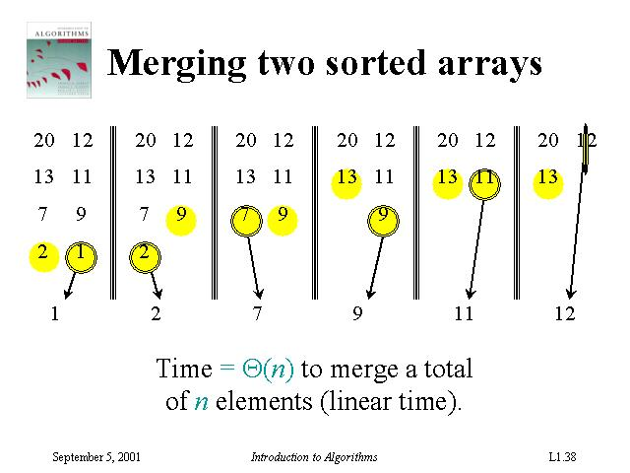

Slide 16
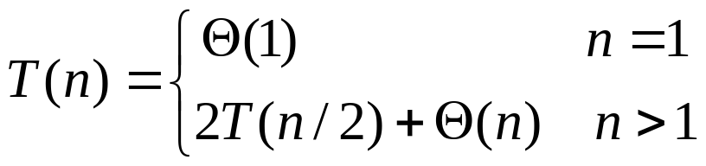

Merge Sort Algorithm
MERGE(A, p, q, r)
1 n₁ = q – p + 1
2 n₂ = r – q
3 // create arrays L[1.. n₁+1] and R[1.. n₂+1]
4 for i=1 to n₁
5 do L[i]=A[p+i – 1]
6 for j=1 to n₂
7 do R[j]=A[q+j]
8 L[n₁+1] = ∞
9 R[n₂+1] = ∞
10 i=1
11 j=1
12 for k=p to r
13 do if L[i] <= R[j]
14 then A[k] = L[i]
15 i=i+1
16 else A[k] = R[j]
17 j=j+1
p <= q <r; A[p..q] and A[q+1..r] are in sorted order;
merges them to a single sorted A[p..r]
MERGE-SORT(A,p,r)
1 if p<r
2 then q=floor((p+r)/2)
3 MERGE-SORT(A, p, q)
4 MERGE-SORT(A, q+1, r)
5 MERGE (A, p, q, r)
MERGE-SORT(A,1,length[A]) gives the order

Slide 17
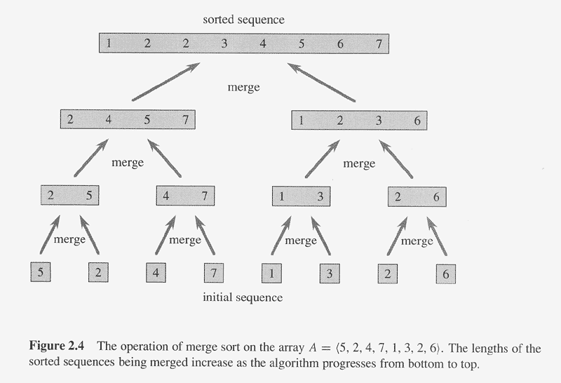

Slide 18
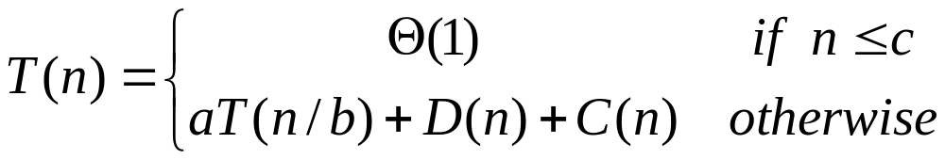
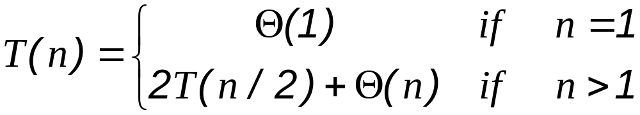
Analyze Divide-and-Conquer Algorithms
Analyzing divide-and-conquer algorithms
a subproblems, each has size 1/b of the original problem, D(n) time to divide, C(n) time to combine
See Chapter 4
Analysis of merge sort

Slide 19
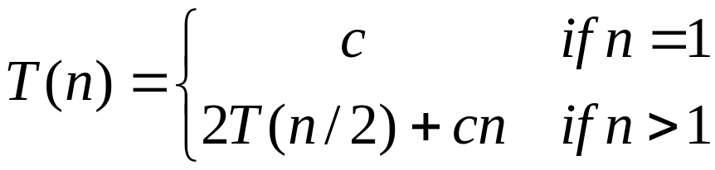

Analysis of Merge Sort
Let constant c represents the time require to solve problems of size 1 as well as the time per array element of the divide and combine steps.

Slide 20
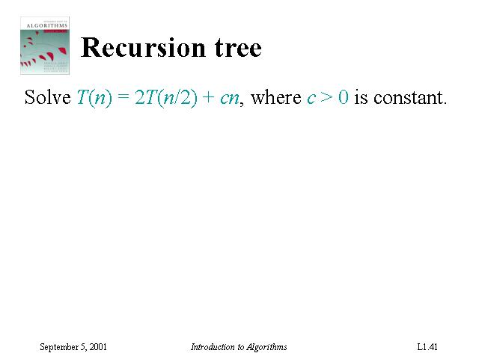
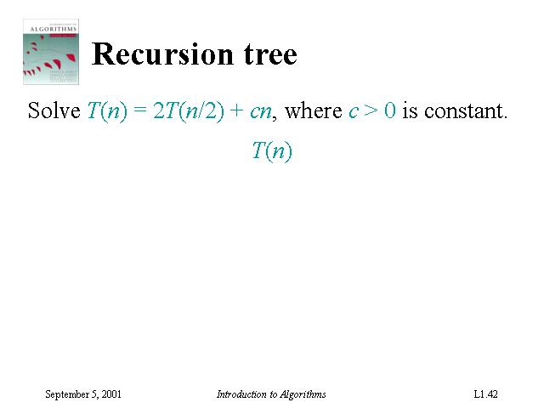
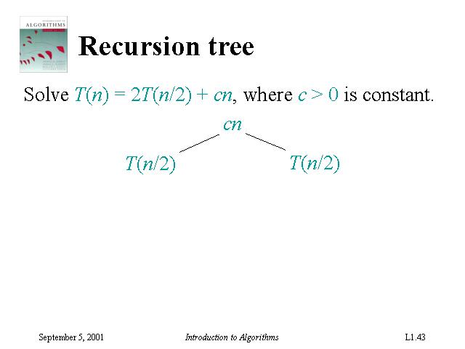
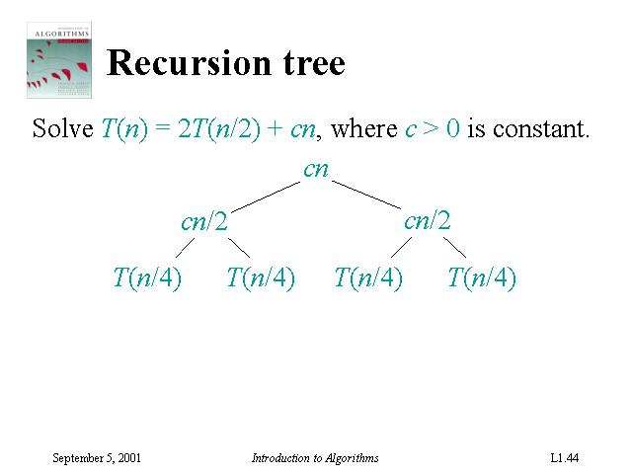
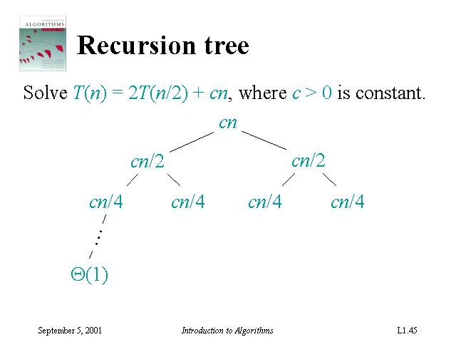
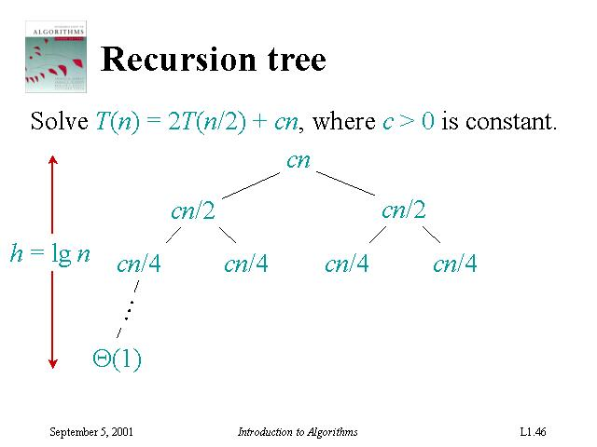
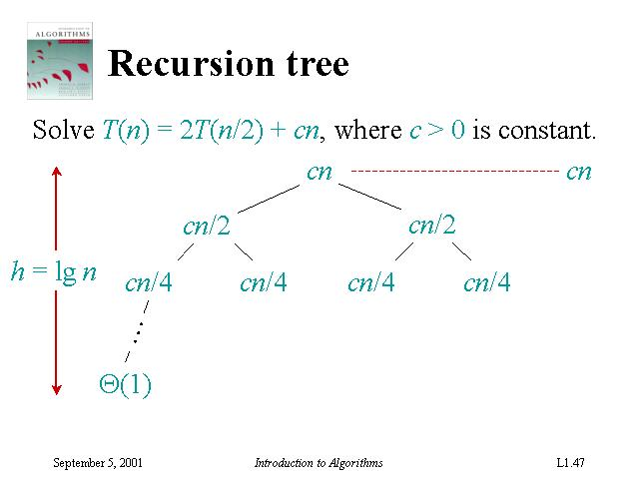
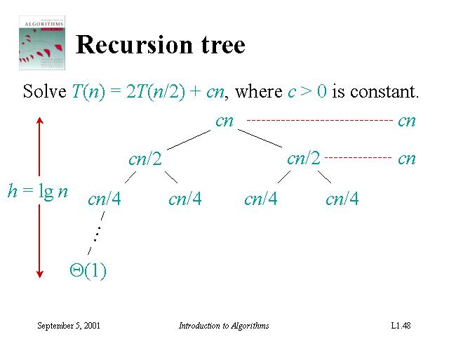

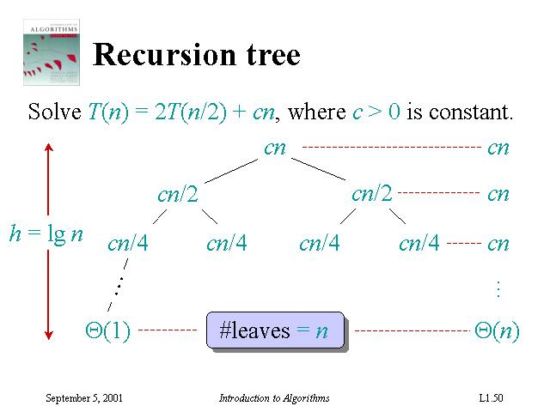
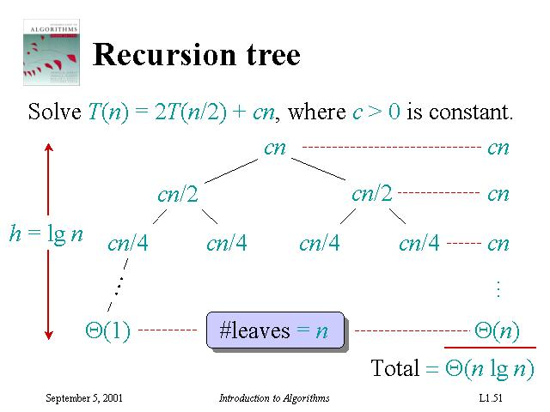

Slide 21
Recursion Tree for Merge Sort
level nodes/ cost/
level level
0 2⁰ = 1 cn
1 2¹ = 2 cn
2 2² = 4 cn
. .
. .
. .
N-1 2^{N-1}=n cn
Since 2^{N-1} = n, lg(2^{N-1}) = lg(n)
levels = N = 1+lg(n)
T(n) = total cost = (levels)*(cost/level)
T(n) = cn [1+lg(n)] = O( n lg(n) )
n nodes at level N-1

Slide 22
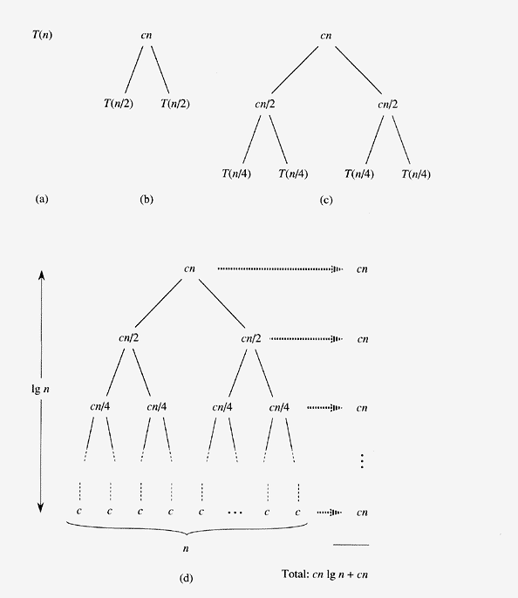

Each level takes cn time
Totally lg n + 1 levels
Thus total time
= cn(lg n + 1)
Ignoring coefficient and only keep dominating terms, we got
Asymptotically better than insertion sort
In practice, merge sort beats insertion sort for n>30 or so

