Slide 1
Growth of Functions
Contents:
asymptotic notation
standard notation and common functions

Slide 2
Asymptotic Notation
Θ(g(n)) = { f(n): there exist positive constants c₁, c₂, and n₀ such that
0 ≤ c₁ g(n) ≤ f(n) ≤ c₂ g(n), ∀ n ≥ n₀ }
Ο(g(n)) = { f(n): there exist positive constants c and n₀ such that
0 ≤ f(n) ≤ c g(n), ∀ n ≥ n₀ }
Ω(g(n)) = { f(n): there exist positive constants c and n₀ such that
0 ≤ c g(n) ≤ f(n), ∀ n ≥ n₀ }

Slide 3
Asymptotic Notation
ο(g(n)) = { f(n): there exist positive constants c and n₀ such that
0 ≤ f(n) < c g(n), ∀ n ≥ n₀ }
ω(g(n)) = { f(n): there exist positive constants c and n₀ such that
0 ≤ c g(n) < f(n), ∀ n ≥ n₀ }

Slide 4
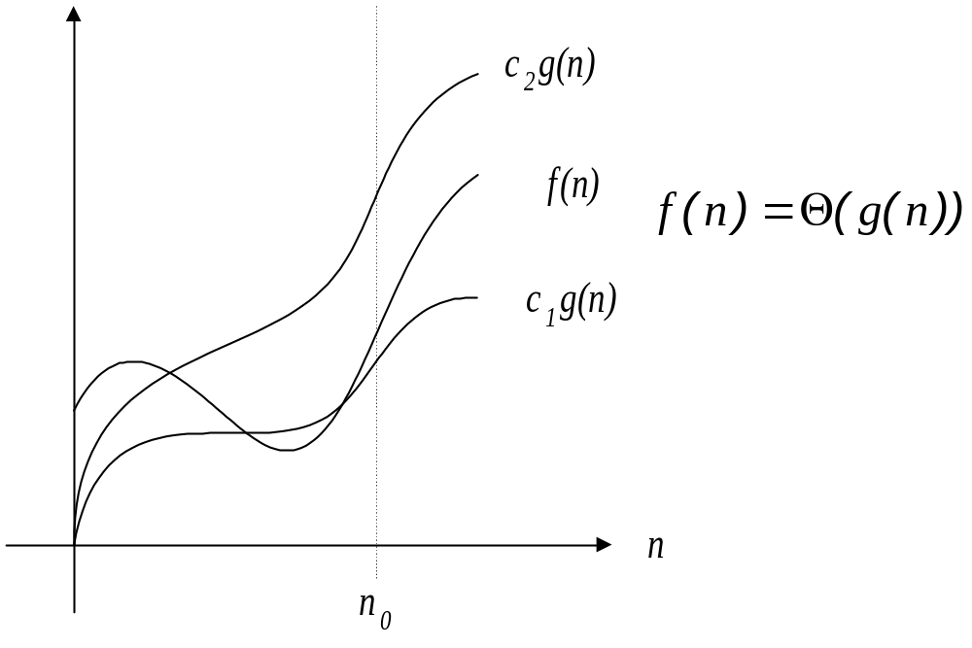

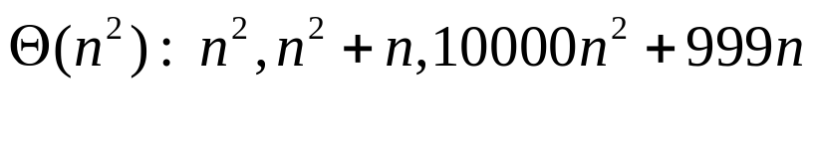
Asymptotic Tight Bound

Slide 5
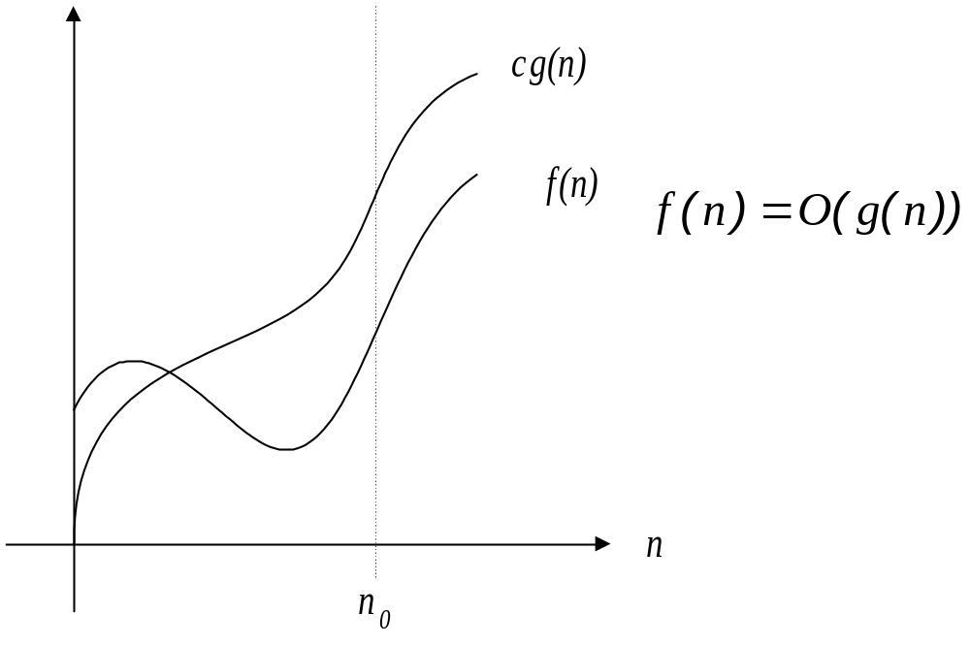

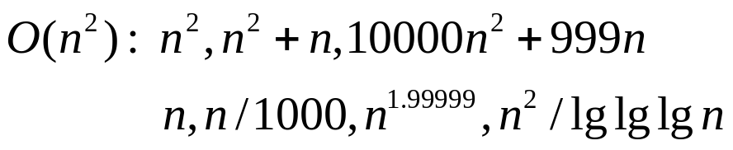
Asymptotic Upper Bound
f(n) is bounded above by g(n),

Slide 6
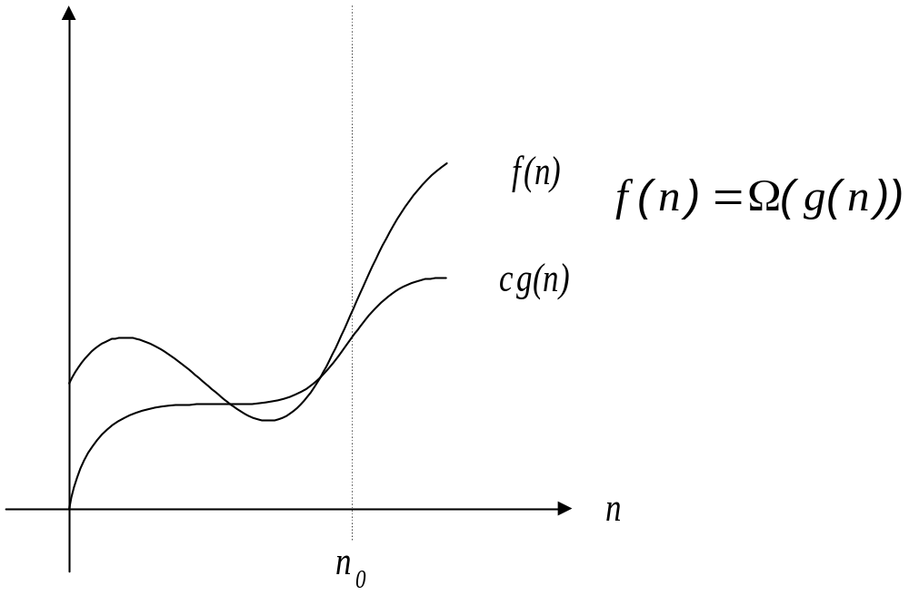

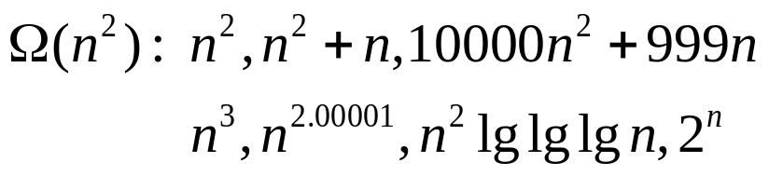
Asymptotic Lower Bound
f(n) is bounded below by g(n),

Slide 7
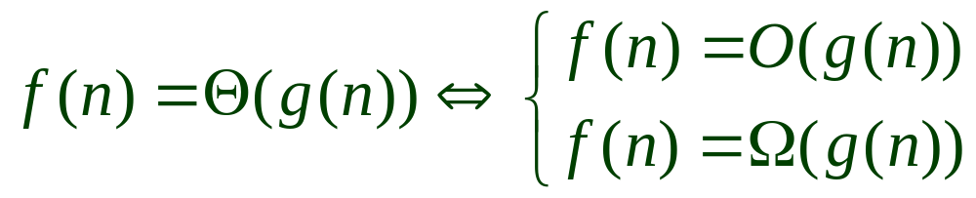
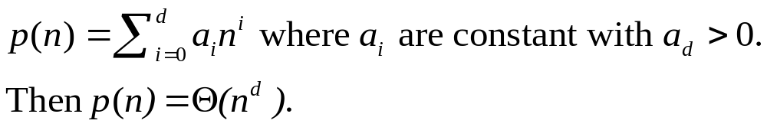
Properties
Thm
In general

Slide 8
Example of Θ
Show that ¼ n³ + 4n² + 24 is Θ(n³).
By definition, we must show that
c₁ n³ ≤ ¼ n³ + 4n² + 24 ≤ c₂ n³ (1)
Divide both sides by n³ to get
c₁ ≤ ¼ + 4/n + 24/n³ ≤ c₂ (2)
Notice that for any n ≥ 0, equation (2) will never go below ¼. So pick c₁ = ¼. Here, we have shown (1) is Ω(n³).
Now see that, for n = 1, rhs of (2) reduces to ¼ + 4 + 24 < 29, which is an upper bound for n ≥ 1. So pick c₂ =29 and n₀ =1. This shows that (1) is Ο(n³).
By thm 3.1, ¼ n³ + 4n² + 24 is Θ(n³).

Slide 9
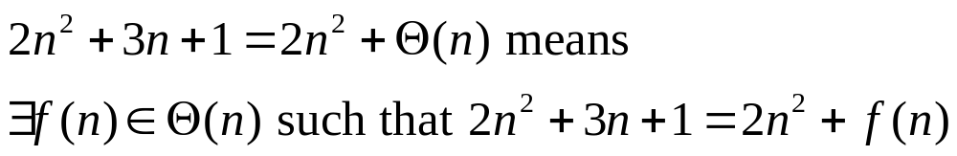
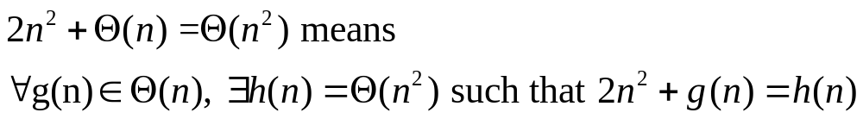
Asymptotic Notation in Equations
When on rhs:
When on lhs: no matter how the anonymous functions are chosen on the lhs, there is a way to choose the anonymous function on the rhs to make the equation valid

Slide 10
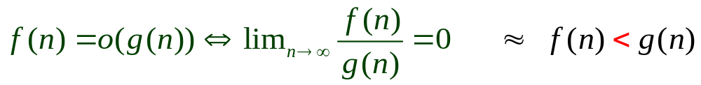
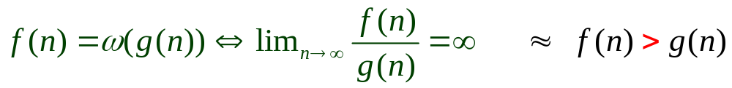
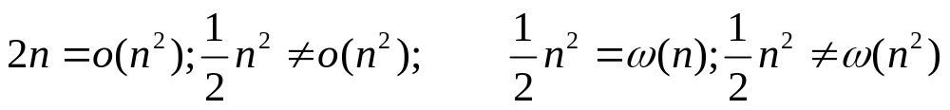
o-notation & w-notation
f(n) is asymptotically smaller than g(n) if f(n)=o(g(n))
f(n) is asymptotically larger than g(n) if f(n)=w(g(n))
Examples:
Property:

Slide 11



Relational Properties
Transitivity
Reflexivity
Symmetry
Transpose Symmetry

Slide 12
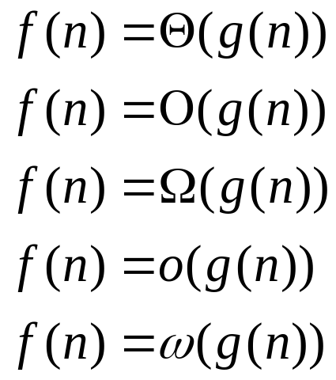
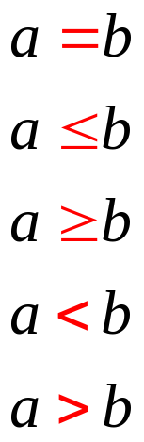
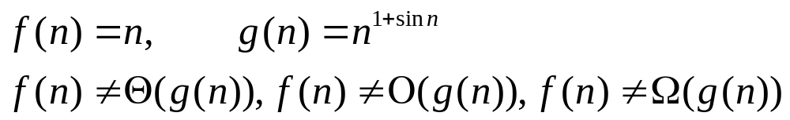
Properties of Asymptotic Notation
Function relationship Number relationship
However, trichotomy does not hold for functions

Slide 13


Standard Notations and Common Functions
Monotonicity: a function f(n) is
  monotonically increasing if m ≤ n implies f(m) ≤ f(n).
  monotonically decreasing if m ≤ n implies f(m) ≥ f(n).
  strictly increasing if m < n implies f(m) < f(n).
  strictly decreasing if m > n implies f(m) > f(n).
Floor & Ceiling:
real number x, r, integers n,a,b; r≥0,a>0,b>0

Slide 14
Modular Arithmetic
For any integer a and any positive integer n, the value
a mod n is the remainder (or residue) of the quotient a/n :
a mod n = a -⎣a/n⎦n
If(a mod n) = (b mod n). We write a ≡ b (mod n) and say that a is equivalent to b, modulo n.
We write a ≢ b (mod n) if a is not equivalent to b modulo n.

Slide 15
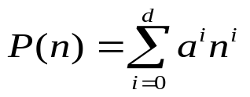
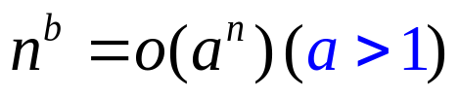
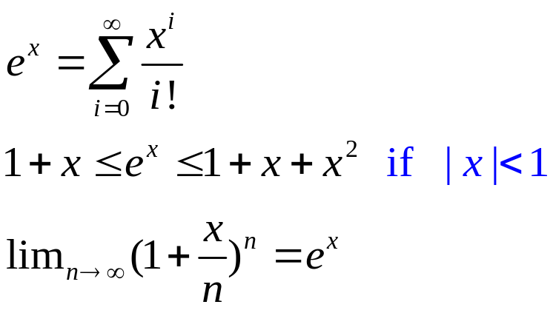
Polynomials v.s. Exponentials
Polynomials:
  A function f(n) is polynomial bounded if .
Exponentials:
  Any positive exponential function with a base strictly greater than 1 grows faster than any polynomial.

Slide 16
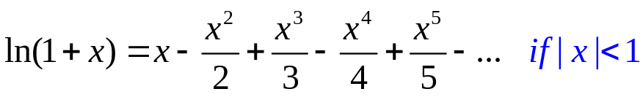
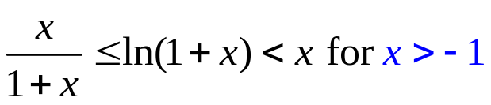
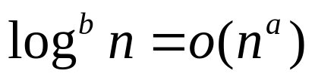
Logarithms
A function f(n) is polylogarithmically bounded if
Any positive polynomial function grows faster than any polylogarithmic function.

Slide 17
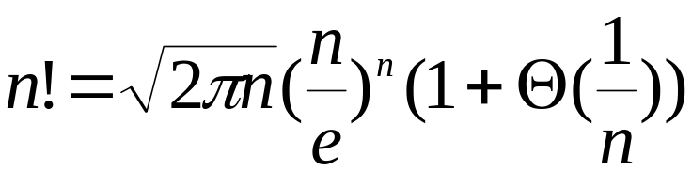



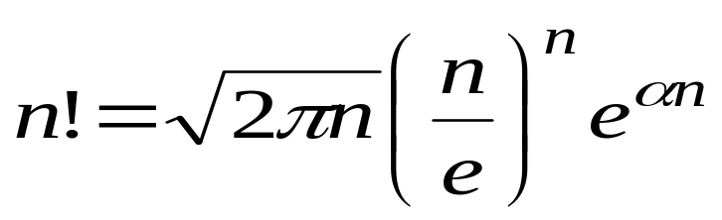
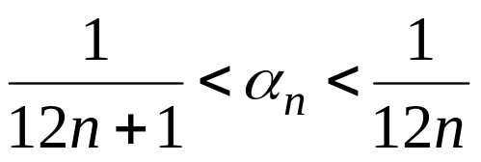
Factorials
Stirling’s approximation
where

Slide 18
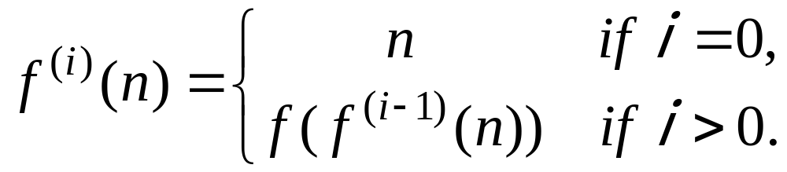

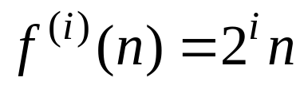
Function Iteration
Formally
For example, if , then

Slide 19
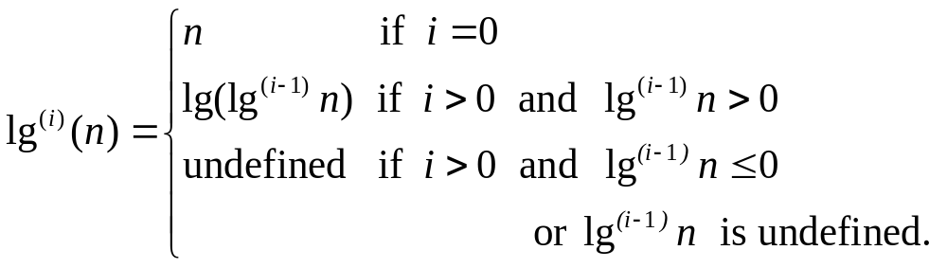
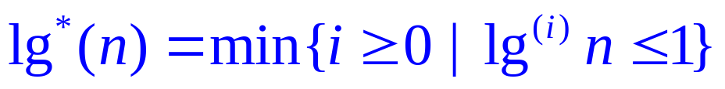
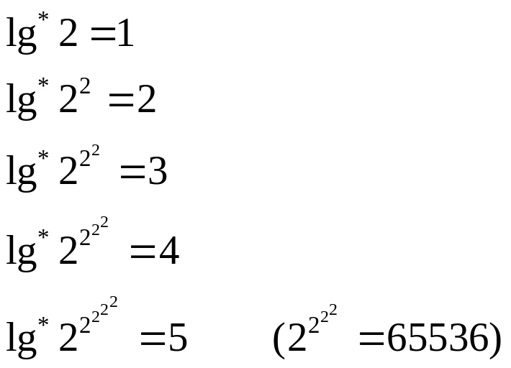

The iterative logarithm function
Since the number of atoms in the observable universe is estimated to be about 10⁸⁰, which is much less than 2⁶⁵⁵³⁶, we rarely encounter a value of n such that .

Slide 20
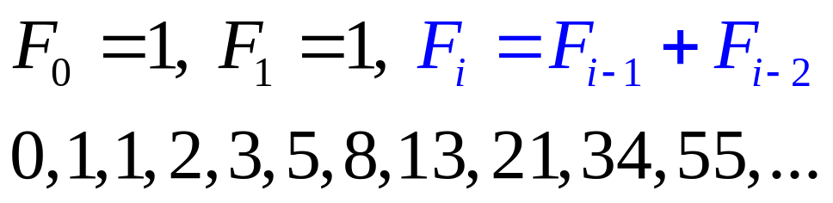
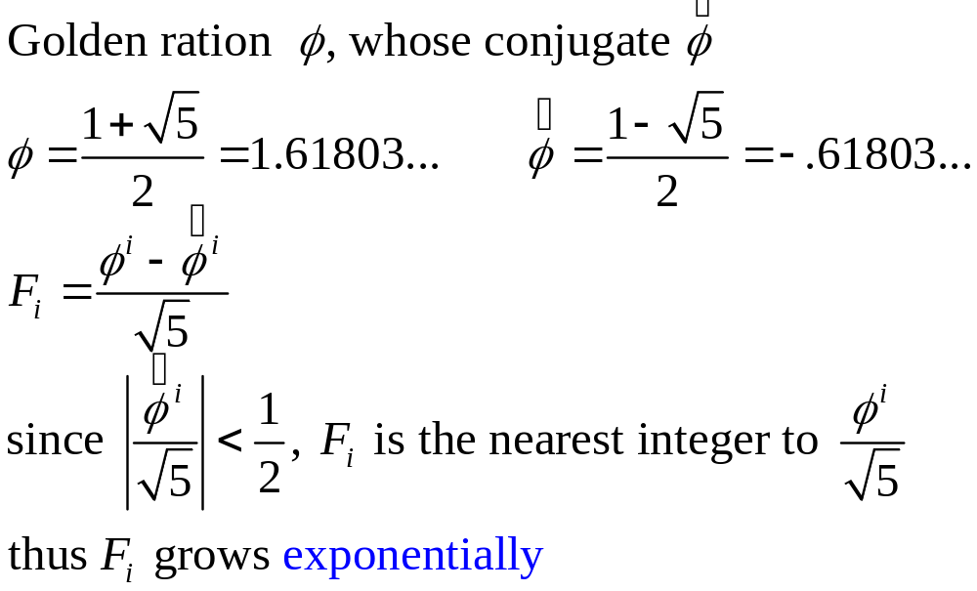
Fibonacci Numbers

