Slide 1
A LEAST-SQUARES DUAL-PRIMAL ALGORITHM FOR THE
MAXIMUM FLOW PROBLEM
I-Lin Wang*
Jeng-Han Chang
Ya-Ting Chen
Ya-Chun Kang
Department of Industrial & Information Management
National Cheng Kung University
Nov. 18, 2006
Notes:
Dual-primal 和primal dual其實是一樣的 只是角色互換
那least squares pd和pd的不同在於pd是以一班線性規劃問題的方式來解 而least square pd是用least square的方法解

Slide 2
Outline
Introduction
  Motivation & Objective
Literature review
  Max flow algorithms
  Least-squares primal-dual algorithms
  (NNLS Phase I; NNLS PD; LSNF)
LSDP for Max-flow problems
  Formulation
  RPP ←→ Electrical network problem
  Algorithm DR
Example
Conclusion

Slide 3
Motivation & Objective
Least-squares primal-dual (LSPD) algorithm
  Nondegenerate pivot (vs. anticycling)
  Efficient implmentation for network flows
  LSPD for shortest path ⬅➔Dijkstra’s algorithm
  (Wang, 2004)
LSPD for max-flow ??
  New max-flow algorithm ??
  Specialized LSPD implementation ??
Solving the max-flow by Kirchhoff’s law!!
Notes:
強調可以用電路方法解

Slide 4
Previous max-flow algorithms
Augmenting path
  Ford & Fulkerson (1956), O(nmU)
  Edmonds & Karp (1972), O(n²m)
  Dinic (1970), O(n²m) ; Sleator & Tarjan, O(nmlogU)
Preflow-push
  Karzanov (1974), O(n³)
  Goldberg & Tarjan (1988), O(nmlog(n²/m))
MA ordering
  Fujishige (2003), O(n(m+n+nlogn)lognU)

Slide 5
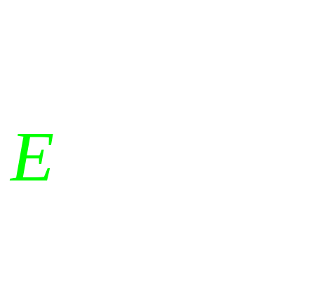
Least-squares primal-dual Literature
NNLS phase I
  Leichner et al. (1993)
NNLS PD
  Barnes et al. (2002)
LSNF
  Gopalakrishnan et al. (2004)
LSNF for shortest path
  Wang (2004)
Notes:
Nnls phase i是解一般lp 然後用非線性規劃問題去解一般lp
Pd的子問題其實是phase i的問題 因此 學者也用ls的方式去解現性規劃問題
Lspd 在解非線性問題時效率不錯
Distra演算法是目前公認在解最短路徑方面是最有效率的

Slide 6
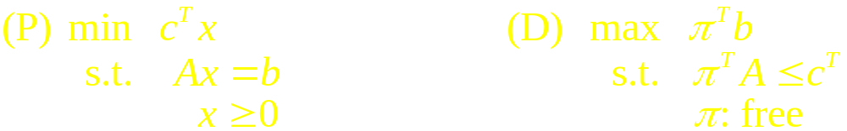
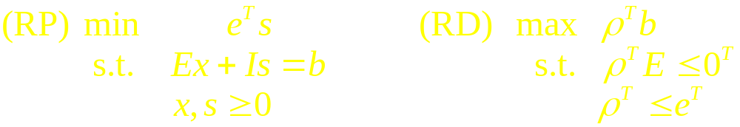


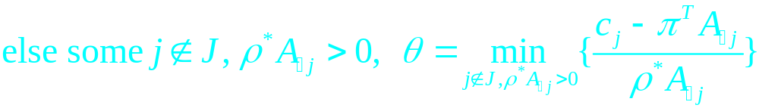
Primal-dual Framework
Given a feasible π
Degenerate pivoting

Slide 7
P-D vs. LS P-D
Primal-Dual
Least-squares
Primal-Dual
LP Phase I
min |b-Ex|
s.t. x ≥ 0
NNLS-Phase I
min ||b-Ex||²
s.t. x ≥ 0
LS
Dual Simplex
Dual improving
direction : ρ*
Dual improving
direction : s*
s_{i}=b_{i}-E_{i}.x , x ≥ 0

Slide 8

Max-flow problem

Slide 9






Least-squares Dual-Primal (LSDP) algorithm for max-flow
MAX FLOW DUAL
MAX FLOW PRIMAL
RPP_{NNLS}
RPP-Cycle_{NNLS}
Algorithm DR for on
Physical Electrical Network
Notes:
只有在最佳解時qr才等於零

Slide 10

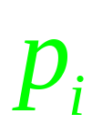


Dual formulation for max-flow

Slide 11


Primal formulation for max-flow

Slide 12
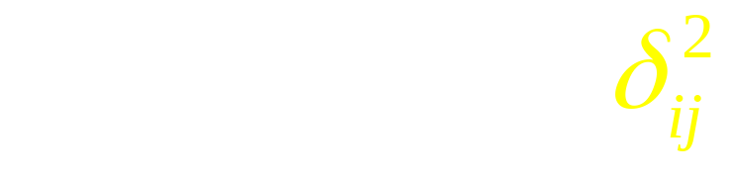

NNLS Restricted Primal formulation (RPP_{NNLS}) for max-flow

Slide 13
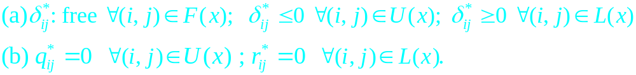
RPP_{NNLS} vs. RPP-Cycle_{NNLS}
Lemma 1.
Notes:
不能再有flow過去 不是改善

Slide 14
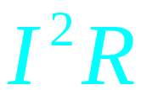
Solving the RPP-Cycle_{NNLS}
Kirchhoff’s Voltage Law (KVL)!!

Slide 15

Minimum-cost flow in convex-cost networks (Hu, 1966)
for each node
Kirchhoff’s Current Law (KCL)!!
for each arc

Slide 16

Algorithm DR
Construct A’(x)=F(x)∪U(x)∪L(x)
→Step1 Let A”(x)=A’(x).
→Step2 If there exists no path from s to t , DONE!!
Otherwise, construct m KCL/KVL equations
to solve for the electron flow .
→Step3 Check for feasibility condition, if optimal, return
Otherwise, continue.

Slide 17
Algorithm DR
→Step4 Calculate the electrical potential for each node.
→Step5 Reconnect some arcs that were in A’(x) but not
currently in A”(x), if necessary.
→Step6 Disconnect the arc in A”(x) that violates the
orientation with the largest electronic flow.
→Step7 GO TO STEP2.

Slide 18
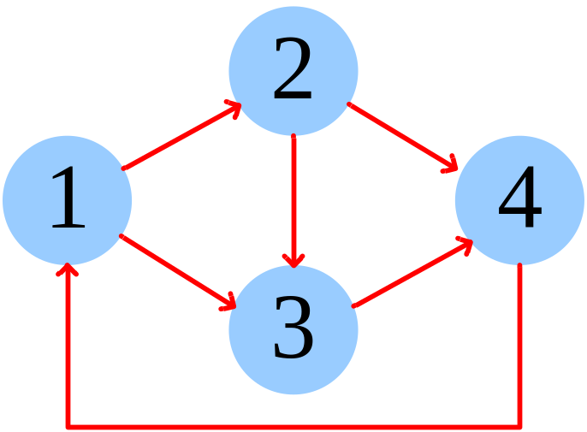
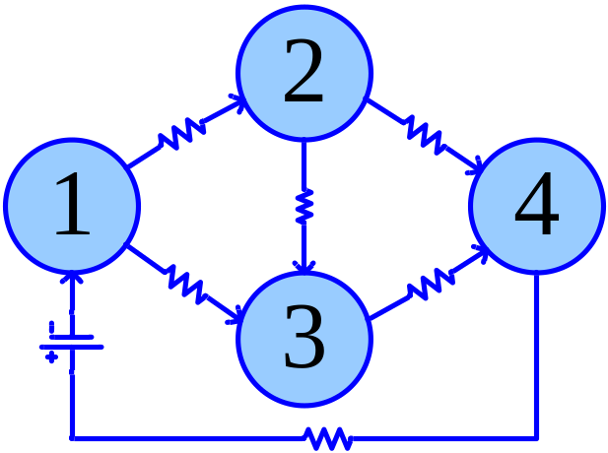
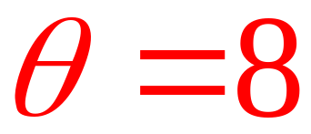
Example (1/3)
A”(X)={(1,2),(1,3),(2,3),(2,4),(3,4),(4,1)}
2
4
3
3
6
x=(0,0,0,0,0,0)
Arc(1,2) upper bound=2

Slide 19
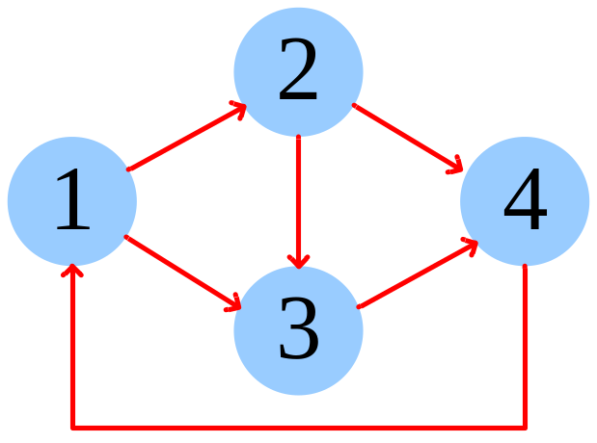
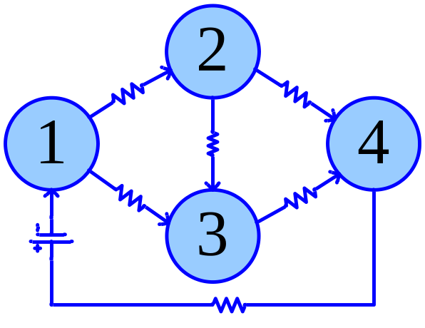
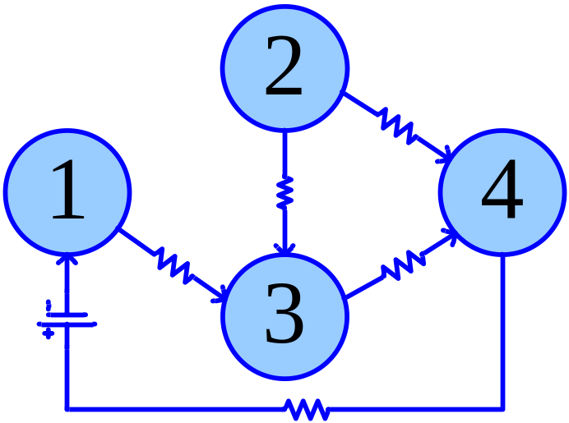
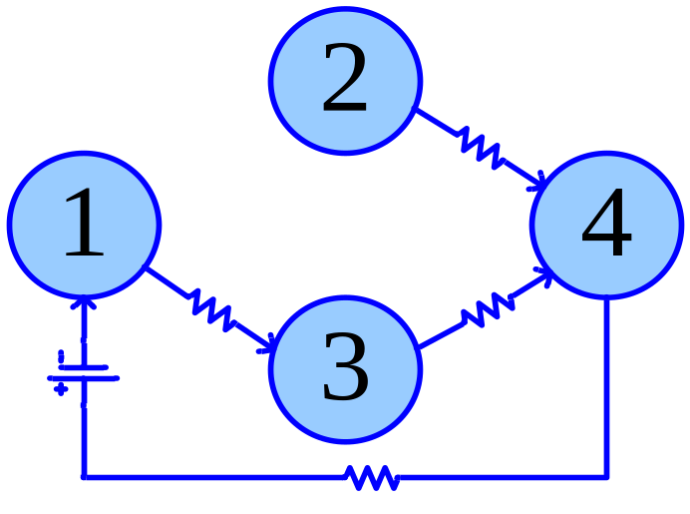
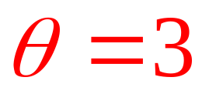
Example (2/3)
(upper bound,x)
A”(X)={(1,2),(1,3),(2,3),(2,4),(3,4),(4,1)}
Saturated!!
(4,2)
(2,2)
(3,0)
(3,2)
(6,2)
(∞,4)
x=(2,2,0,2,2,4)

Slide 20
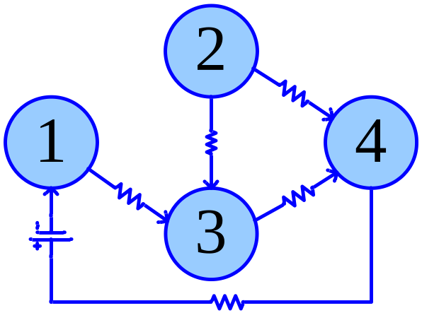
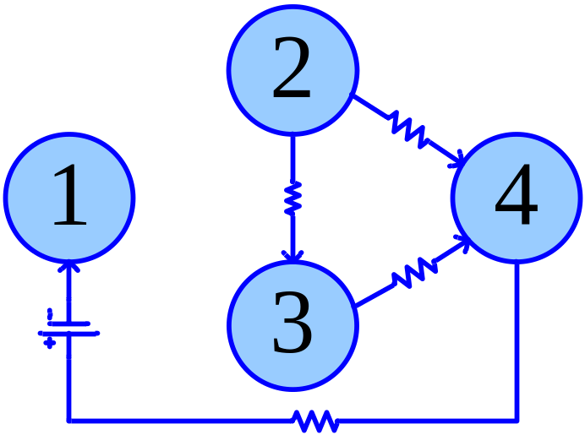
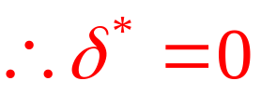
Example (3/3)
Saturated!!
A”(X)={(1,2),(1,3),(2,3),(2,4),(3,4),(4,1)}
(2,2)
(4,2)
(3,0)
(3,3)
(6,3)
(∞,5)
x=(2,3,0,2,3,5)
Saturated!!
No more path connects form 1 to 4
The Max-flow is solved!!

Slide 21
Conclusions & Suggestions
New max-flow algorithm
Link the Kirchhoff’s laws to the max-flow
Theoretical complexity requires
further investigation
Efficient implementation
Notes:
要停頓一下 總結一下 在論文中 我門發現了….竟然可以用電路的方法解
因為這只友在model上做而已 而實際上 我們不知道他到底效率如何 在未來 我門想探討他的complexity 效率

Slide 22
Q & A
More questions?
Contact
I-Lin Wang (王逸琳): ilinwang@mail.ncku.edu.tw
Ya-Ting Chen (陳雅婷)
成功大學工業與資訊管理學系
Thanks for your attention!!!

