Slide 1

Mining changes of patterns from multi-period datasets
I-Lin Wang
Chun-Ta Dai
National Cheng Kung University
Taiwan
Notes:
NCKU IM 戴群達 proposal
I am chun-ta dai, this study is done by my advisor and me. Well Today I would like to give this presentation for defining our problem and give a solution. This subject is about data mining. Mining changes of patterns from multi-period datasets. We would like to process more period datasets to investigate the changes of patterns.

Slide 2
Contribution
mining changes of patterns over time
create value for infrequent patterns
propose a novel algorithm MCP (mining changes of patterns) and tree structure
extend FP-growth to handle multi-period dataset
Notes:
NCKU IM 戴群達 proposal
First of all, let’s look at contribution of this study. First, discover the changes of patterns over time which help data miner to understand the changing environment. We focus on the change of patterns, so even infrequent could have interesting change. For solving our problem, we propose a efficiency algorithm called MCP mining change of patterns algorithm. To the best of our knowledge, no research has been reported to handle our problem. So we also extend FP-growth propose by Han et al to handle out problem.

Slide 3
Introduction
motivation
Pattern discovery research usually focuses on identifying frequent patterns, which only processes single dataset without considering the effect of time.
Change mining that seeks the changes in datasets may give better understanding.
The related studies only deal with the datasets of two periods.
Using minimum support threshold to filter patterns in change mining is not suitable.
Notes:
Data mining is concerned with analyzing large volumes of data. And, pattern discovery is one of the most important area of data mining. But Pattern discovery research usually focus on identifying frequent patterns, which only processes single dataset without considering the effect of time. However, investigating the changes of patterns over time is important in practice. Mining change or difference can give better understanding for data miner. However, the related studies only deal with the datasets of two periods. Like mining frequent patterns, almost mining patterns change studies also use the minimum support to filter patterns. but it is no a good way because of losing information.

Slide 4
Introduction
objective
Develop a technique to find the changes of patterns from multi-period datasets.
Finding the trends of patterns.
Increase the value of infrequent patterns.
Notes:
Our objective: develop a efficient technique to find the changes of patterns from multi-period datasets. And finding the trends of patterns. we also expect to increase the value of infrequent patterns.

Slide 5
Preliminary
Growth rate
If the growth rate of any patterns fits the threshold by user defined we will think the pattern have change.
Notes:
Now, I will describe what patterns will be considered happen change. Growth rate is calculated by ratio of patterns from period T to period T plus one. When the support of pattern in the earlier period is zero, we will use big m to represent the value of growth rate. Like minimum support threshold, user also can define the growth rate threshold. When the growth rate of the pattern is bigger than threshold we think the patterns have change.

Slide 6
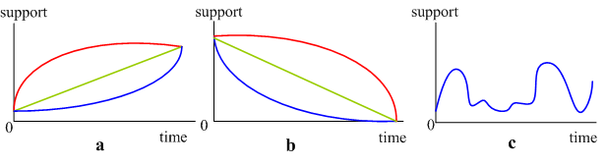
Preliminary
The change types of patterns
Notes:
According to the growth rate threshold by user define, we can find these three types of change. The growth the decline even the irregular change.

Slide 7

Preliminary
The mining procedure
c
Notes:
The mining procedure is from after period to before period, because it can avoid spending time at uninteresting change.

Slide 8
Preliminary
The difference with the mining frequent patterns
support
b
c
a
0
time
Notes:
The figure show the difference between our task and mining frequent patterns. From point a to b, we can find the support is increasing. The trend is growth. However this patterns may be infrequent pattern. but the support of this pattern is increasing over time, the knowledge is interesting. We create the value for infrequent patterns. And, from point b to c is the concept of frequent patterns. The support is high enough.

Slide 9
MCP algorithm
(mining changes of patterns)
Notes:
We propose a algorithm to mine change of patterns from multi-period datasets. And the algorithm is called mining change of patterns algorithm MCP.

Slide 10
MCP algorithm
Constructing a original search tree to store items and their support
Traversing on the original search tree to detect candidate patterns and storing those patterns in a candidate-pattern forest (CP-forest).
Detecting those valid changed patterns satisfying the range of the specified growth rate.
Notes:
MCP contains three major steps. First, constructing a modified FP-tree called original search tree to store items and their support. Second, traversing on the original search tree to find candidate patterns and storing those candidate patterns in a tree structure-candidate-pattern forest ( CP-forest). Finally, detecting those valid changed patterns satisfying the range of the specified growth rate.

Slide 11
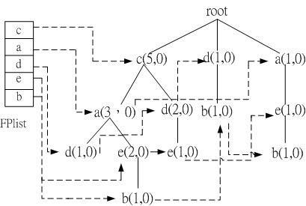
MCP algorithm
Construct the original search tree with period 3 dataset
探勘多期資料下樣式變化之研究
<number>/49
Notes:
I will present MCP algorithm with three period datasets because the process in more periods is the same as three periods. The figure show the original search tree with period three dataset. And you can find , the structure is the same as FP-tree. Both they are prefix tree and every node have a link to the same item.

Slide 12
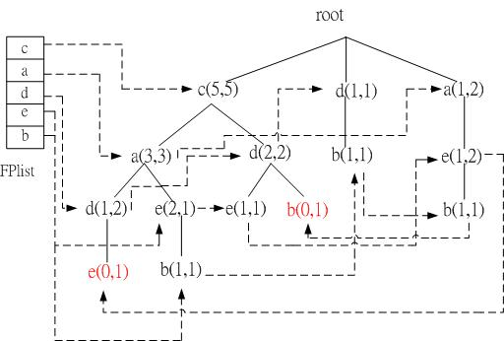
MCP algorithm
Insert period 2 dataset into the original search tree
b(0,1)
e(0,1)
Notes:
We directly insert the period two dataset into the same search tree. in other words, we do not construct a new search tree for period two dataset. When there is no branch to match the transaction in the period two dataset. for example, the node e and node b is generate from period two dataset. Well when we finish constructing the original search tree. It should to find the candidate patterns. we propose a tree-traversal technique to generate candidate patterns from all the branches in the original search tree and construct a pattern tree for each item. mining from bottom node to the root in the search tree will get a unique branch which represent a candidate pattern. in this example, the first bottom node is item b.
All branch associated item b will be selected. They are {b,e,a,c}, {b,d}, {b,e,a} and {b,d,c}.
.

Slide 13
Mining the candidate patterns and constructing the pattern trees
origianal itemset
2
b
b
3
1. {e,a,c}=(1,1)
2. {d}=(1,1)
3. {e,a}=(1,1)
4. {d,c}=(0,1)
c
(1,2)
e
(2,2)
d
(1,2)
1 (e,a)=(1,1)
(1,1)
(1,1)
4
a
(2,2)
(1,1)
c
(0,1)
1 (c)=(0,0)
1 (c)=(0,0)
2 (d)=(0,1)
c
(1,1)
5
1 (d)=(1,1)
5. {c}=(0,0)
4 (c)=(0,1)
derived itemset
Notes:
These four patterns are from the original search tree. we called them original itemset.
Now I will present how to construct a pattern tree for item b and find all candidate pattern associate with item b. first, we construct the pattern tree and rooted at item b. the first itemset will be insert into the tree and generate a branch. Now we insert the second itemset and generate a new branch. Here we should compare to before itemset to see if new pattern generate. In the fourth itemset we find there is a new pattern {b,c}. We need put {b,c} in the list to generate new branch and compare to before itemset. After finish this procedure we have constructed the pattern tree b, and also find all associate patterns with item b.

Slide 14
Mining the candidate patterns and constructing the pattern trees
b
b
{b,e,a}=
{b,c}=
e
(2,2)
d
(1,2)
c
(1,2)
e
(2,2)
a
(2,2)
c
(0,1)
a
(2,2)
{b,e,a,c}=
{b,d}=
{b,d,c}=
c
c
(1,1)
(1,1)
threshold=1.01
Notes:
For example, the pattern-tree b have five candidate patterns, we directly calculate the support can obtain the growth rate. If the growth rate is smaller than threshold, these node will be delete. In this example, there are two patterns that have change.

Slide 15
Mining patterns from multi-period datasets
Update data
Mining the change of patterns
Notes:
Before mining patterns change from multi-period, we first update the other period dataset into patter tree.

Slide 16
Mining patterns from multi-period datasets
Update data
  Period 1 dataset
  Transaction
    1:[e,d,c]
    2:[b,e,c]
    3:[b,e,a,c]
c | a | d | e | b
b
a
(3,1)
(3,0)
(2,2)
(2,0)
e
(2,1)
a
(2,0)
(2,1)
c
(3,0)
(3,1)
a
(2,0)
c
c
(2,1)
(1,1)
(1,1)
(1,0)
(1,0)
(1,2)
c
(1,1)
(1,0)
Notes:
If there are three transaction in the period one dataset. the first is {e, d, c}. We will find the pattern tree e, but there is no patterns tree e and also has no pattern tree d. so, transaction one does not be update to any pattern trees. Transaction two first find the cp-tree b and update the support. It also can not find the cp-tree c. in the transaction three, we can find there are three branch will be update, they are {b,e,a,c}, {b,e,c} and {b,a,c}. In this transaction also can update the cp-tree a. using this technique we can update all cp-tree and to verify the growth rate to find pattern change.

Slide 17
Mining patterns from multi-period datasets
Change pattern | Growth rate (2~3) | Growth rate (1~2)
b,e | 1.1428 | -
b,e,a | 1.1428 | 1.75
b,e,a,c | 1.1428 | -
b,e,c | 1.1428 | -
b,a | 1.1428 | -
b,a,c | 1.1428 | -
a,c | 1.1428 | 1.3125
Notes:
The table show the patterns that are change in three period datasets and here is their growth rate.

Slide 18
Mining patterns from multi-period datasets
support
Pattern: {a, c}
0.6
0.4
0.2
0
1
2
3
period
Notes:
The figure show the curve of support with pattern {a,c}. We can find the trend is growth.

Slide 19
Computational experiments and analysis
Notes:
In this part, I will present the result of computational experiments and analysis.

Slide 20
Computational experiments and analysis
Test efficiency with two algorithms
  MCP algorithm
  MFPG algorithm
Investigate the effect in:
  Period
  Similarity
  Minimum support threshold
  Growth rate threshold

Slide 21
Computational experiments and analysis
MFPG algorithm
  Extended from FP-growth algorithm (Han et al., 2004)
  Stepwise method
  Handle small dataset
Notes:
In order to test the efficiency of MCP, we also implement an algorithm called MFPG, which based on the FP-growth algorithm proposed by Han et al. There are some characteristic of MFPG. First, it is extend from FP-growth. Second, it is a stepwise method. Third, it only can handle small dataset.

Slide 22
Computational experiments and analysis
Synthetic transaction data generator：
  Base on Agrawal and Srikant, (1994)
Multi-period data generator：
  period
  Similarity
    scope: 0.4~0.8 ( Li et al., 2006)
Notes:
Our data generator is base on the Agrawal and Srikant, we extend this generator to generate multi-period dataset. We also add two parameter. The first one is period, the meaning is generate what the number of period datasets second, similarity, according Le they think the dataset of different periods usually exists similarity. We set the scope between zero point four to zero point eight.

Slide 23
Computational experiments and analysis
Parameters and default values
Parameter | meaning | Default value
D | Number of transactions within each period dataset | 10000
I | Number of items | 1000
L | Average size of transaction | 5
P | Number of patterns | 20
T | period | 9
S | similarity | 0.4~0.8
<number>/49
Notes:
This table show the parameters and default values.

Slide 24
small size dataset testing
P=20, L=5 datasets
Notes:
We first test the MCP and MFPG in the small dataset. each dataset has fifty-five patterns and each transaction has the average five items.

Slide 25
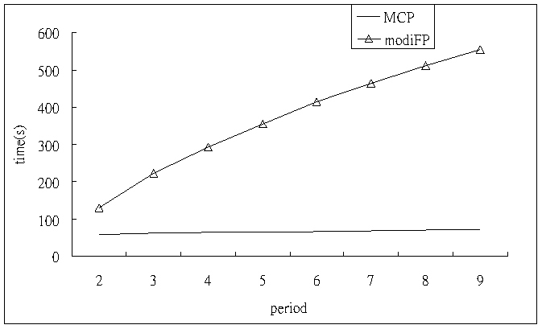
Computational experiments
The effect of periods
MFPG
Notes:
The effect of periods. We can find MCP outperform than MFPG.

Slide 26
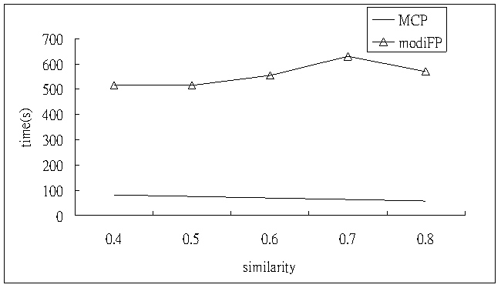
Computational experiments
The effect of similarity
MFPG
Notes:
The effect of similarity. We can find MCP has better efficiency in the high similarity. However, MFPG is not affected by similarity.

Slide 27
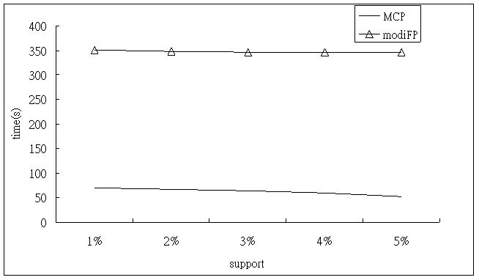
Computational experiments
The effect of minimum support threshold
MFPG
Notes:
The effect of minimum support threshold. minimum support is the key factor to pattern discovery algorithm, so we can find these two algorithm have better efficiency at larger minimum support threshold. especially in MFPG. It reduce about two hundred seconds.

Slide 28
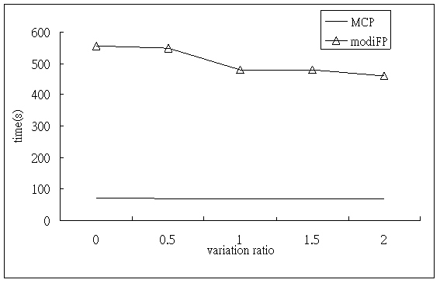
Computational experiments
The effect of growth rate
MFPG
Notes:
We can find the effect of growth rate to MFPG is more than MCP.

Slide 29
Large-scale dataset testing
P=10000, L=10 dataset
Notes:
We also test the capability of MCP in handling large-scale datasets that MFPG can not deal with. Each period dataset has ten thousand patterns and average ten items in each transaction.

Slide 30
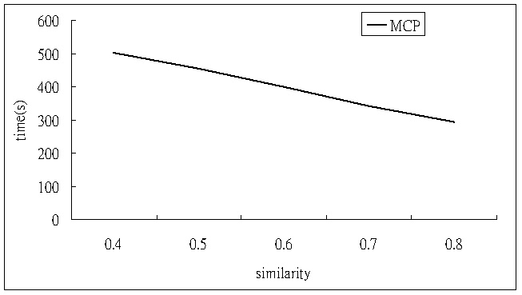
Computational experiments
The effect of similarity
Notes:
This figure show MCP requires less and less running time for datasets of larger similarity.

Slide 31
Conclusion
mining changes of patterns over time
create value for infrequent patterns
propose a novel algorithm MCP (mining changes of patterns) and tree structure
extend FP-growth to handle multi-period dataset
MCP has better efficiency and capability to handle large-scale datasets

Slide 32
Thanks for your attention!

Slide 33
Q & A
探勘多期資料下樣式變化之研究
<number>/49

Slide 34
Introduction
pattern
The traditional finding patterns procedure
support
Threshold : 5%
{b,a,c,d}
t₁:1%
t₂:2%
t₃:4%
t₄:8%
t₅:16%
ignore
no
delete
More than
procedure 1
threshold
yes
Candidate pattern
procedure 2
Matching pattern
探勘多期資料下樣式變化之研究
<number>/49

Slide 35
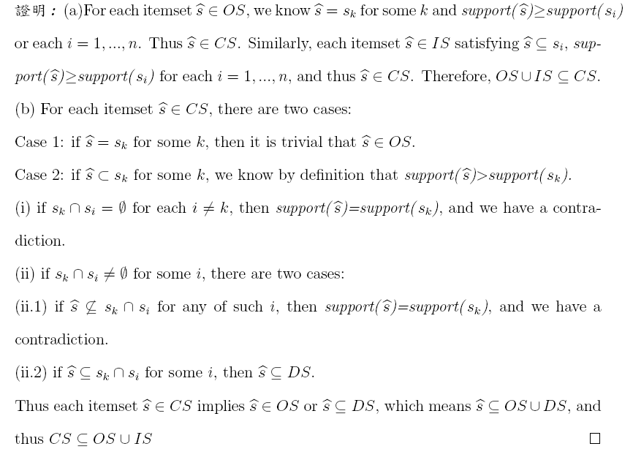
探勘多期資料下樣式變化之研究
<number>/49

Slide 36
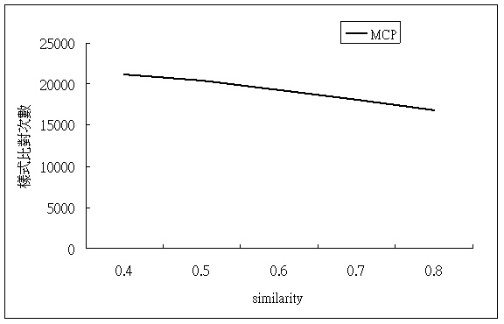
Computational experiments
number of comparisons
探勘多期資料下樣式變化之研究
<number>/49

Slide 37
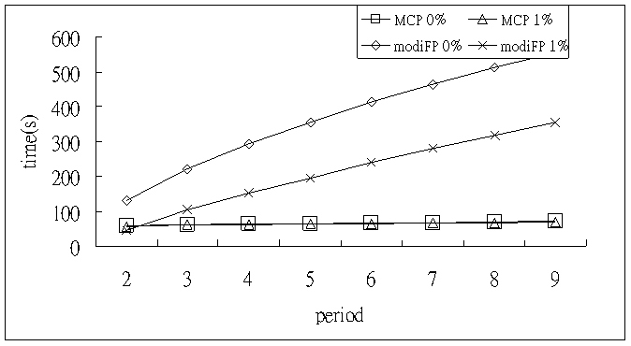
Computational experiments
The effect of minimum support threshold:1%
探勘多期資料下樣式變化之研究
<number>/49

Slide 38
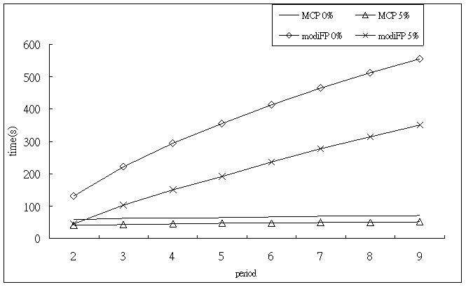
Computational experiments
The effect of minimum support threshold: 5%
探勘多期資料下樣式變化之研究
<number>/49

Slide 39
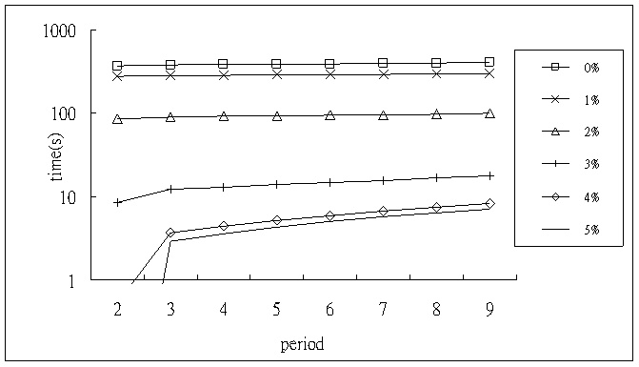
Computational experiments
The effect of minimum support threshold
探勘多期資料下樣式變化之研究
<number>/49

Slide 40
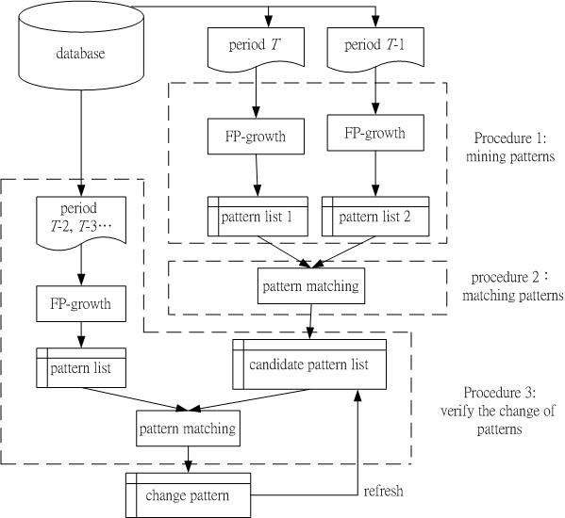
研究成果
Procedure 1:
Mining patterns
The procedure of MFPG
Procedurer2:
patterns matching
Procedure 3:
Repeat the procedure 1 and 2
<number>/49
Notes:
The procedure of MFPG. Procedure one: mining patterns. Using FP-growth to process period T and period T-1 individually, can get pattern list one and patterns list two. And procedure two uses sequential pattern matching to see if any change exists. So we can get the candidate pattern list. We repeat these procedure can handle multi-period dataset.

