Slide 1
Solving maximum flows on distribution networks:
Network compaction and algorithm
I-Lin Wang
Ju-Chun Lin
National Cheng Kung University
Taiwan

Slide 2
Outline
  Introduction
  Compacting distribution networks
  Modified augmenting path algorithm
  Conclusion

Slide 3
Introduction
  Supply chain management
  ”At most how many units of products can I produce?“
  A product is made of various materials.
  Materials may be purchased from different vendors by different channels

Slide 4
Supply chain example
(B,40)
A
(B,40)
(B,40)
(B,∞)
V₁
[2]
[1]
[2]
[0.2]
[0.2]
(B,10)
(B,10)
(A,∞)
(A,∞)
(B,10)
M₂
B
C
(C,∞)
[1]
[0.8]
(A,30)
[0.8]
(A,300)
(A,300)
(C,20)
(C,160)
(C,160)
A: 10g /unit
B: 1g /unit
C: 8g /unit
M₁
V₂
(B,50)
(B,50)
(B,50)
(B,∞)
(A,10)
(A,100)
(A,100)
[2]
[0.2]
(A,∞)
[0.2]
(C,∞)
A
[1]
[0.8]
[0.8]
(C,30)
[0.2]
[0.8]
(C,240)
(C,240)
V₃
(material, capacity)
[material composition quantities]
B
C

Slide 5
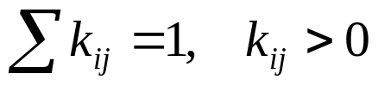
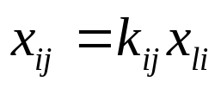
Distribution max flow problem
Fang and Qi (2003)
  Distillation node (D-node)
  One incoming arc
  At least two outgoing arcs
  Distillation factor (k_{ij})
  Flow distillation constraint
●
1
x_{li}
X
[k_{ij}]

D-node
2
[0.4]
[0.6]
x_{ij}
0.6X
0.4X

…
3
4

Slide 6
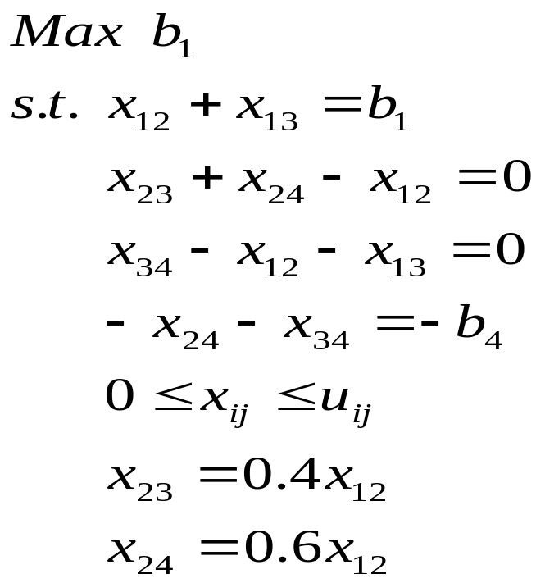
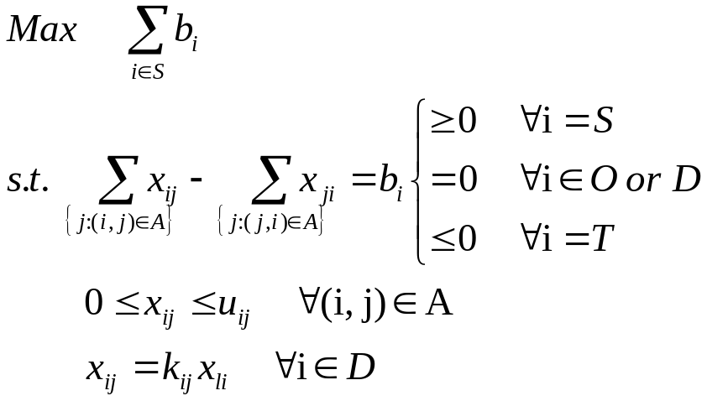
Distribution max flow problem
Fang and Qi (2003)
S=1
T=4
2
[0.6]
10
[0.4]
20
10
4
1
20
15
3
u_{ij}

Slide 7
Compacting networks
  Four rules to compact the original network into an smaller one
  Simplify network problems
  Compacting rules may induce each other.
  A compacted network has some properties

Slide 8
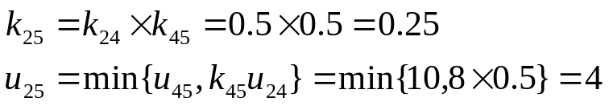
Compacting rules
Compacting D-groups
  Retain the top D-node with incoming arc only
  Add new arcs from top D-node to each O-node
  Reset k_{ij} and u_{ij} for new arcs
  Reduce one node & one arc at least
  Complexity: O(m)
Rule1
1
1
10
10
2
2
[0.5]
[0.5]
[0.5]
[0.25]
2
8
2
2
[0.25]
3
4
3
[0.5]
[0.5]
10
2
4
u_{ij}
5
6
5
6

Slide 9

Compacting rules
Compacting single-transshipment O-nodes
  Remove the single-transshipment O-node
  Merge these two arcs into one single arc
  Reset u_{ij} = min { two arcs’ capacities }
  Reduce one node and one arc
  Complexity: O(n)
Rule2
1
1
u_{ij}
10
10
2
2
[0.2]
[0.8]
[0.2]
[0.8]
2
8
2
8
4
3
4
3
4
4
4
5
5

Slide 10
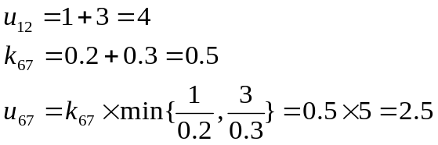
Compacting rules
Compacting parallel arcs
  Merge parallel arcs into one arc
  Reset k_{ij} and u_{ij}
  Reduce at least one arc
  Complexity: O(m)
Rule3
5
5
10
10
6
6
[0.2]
[0.5]
[0.5]
1
1
[0.2]
[0.5]
1
5
2.5
1
5
1
5
u_{ij}
[0.3]
1
[0.3]
5
3
4
3
3
3
2
3
2
3
7
8
7
8

Slide 11
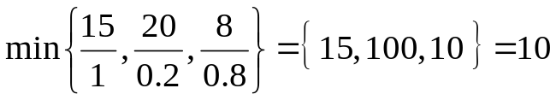
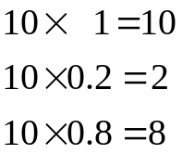
Compacting rules
Compacting mismatched capacities
  Normalize the capacity for each arc adjacent to a D-node
  Bottleneck= min {normalized capacity }
  Reset all capacities
  Complexity: O(m)
Rule4
1
1
u_{ij}
15
10
2
2
[0.2]
[0.8]
[0.2]
[0.8]
20
8
2
8
3
4
3
4

Slide 12
Inducing relation
D-group
1
1
1
1
10
10
10
10
2
2
2
2
[0.5]
[0.5]
[0.5]
[0.25]
[0.5]
[0.5]
[0.5]
[0.25]
2
8
2
2
5
5
5
2
[0.25]
3
3
4
3
[0.25]
[0.5]
[0.5]
[0.5]
[0.5]
2
2.5
10
2
2.5
u_{ij}
10
5
6
5
6
4
5
4
5
Mismatched arcs
Parallel arcs

Slide 13
Inducing relation
Single transshipment O-node
1
1
10
10
2
2
[0.5]
[0.5]
[0.5]
[0.5]
1
1
u_{ij}
5
5
5
5
5
5
5
3
4
4
3
10
5
5
2
3
3
3
[0.5]
[0.5]
[0.5]
[0.5]
5
5
5
5
6
7
6
7
D-group
Mismatched arcs
Parallel arcs

Slide 14
Inducing relation
Parallel arcs
1
1
3
5
8
5
5
u_{ij}
2
3
2
3
7
7
4
4
Single transshipment O-node

Slide 15
Inducing relation
D-groups
Mismatched
arcs
Single
Transshipment
O-nodes
Parallel
arcs

Slide 16
Compacting algorithm
While (G is not in compact form)
Case 1: detect D-group, then apply rule 1
Case 2: detect single transshipment O-node, then apply rule 2
Case 3: detect parallel arcs, then apply rule 3
End while
Case 4: detect mismatch capacities, then apply rule 4
  Complexity: O(m²)

Slide 17
Properties for a compacted network
  Every node is adjacent to at least three arcs
    One incoming arc
    One outgoing arc
  D-node will not be adjacent to any other D-node
1
3
2
4
1
5
2
6
3
4
7

Slide 18
Modified augmenting path algorithm
Ting (2005)
  For distribution max-flow problem
  The approach requires manual detection
  We reorganize procedures in the approach
  We propose an implementation

Slide 19
Procedures
Construct an augmenting subgraph
1
    Directed path from a source to a sink
    Identify a directed path from a visited D-node iteratively
    Until all outgoing-arcs from each visited D-node have been included in an augmenting subgraph
1
2
6
[0.6]
[0.4]
[0.5]
[0.5]
7
3
4
S=1
T=5
5

Slide 20
Procedures
Identify components in an augmenting subgraph
2
    O-nodes with at least three arcs
    Boundary-nodes
    Arc flows in the same component can be expressed by a function of a single variable.
1
1
2b
a
6
2
6
2
[0.5]
[0.5]
[0.6]
[0.5]
[0.5]
[0.6]
[0.4]
[0.4]
0.4a
b
0.6a
b
7
7
4
3
4
3
b
0.6a
S=1
T=5
5
5

Slide 21
Procedures
Solve a system of linear equations
3
    Flow balance constraint
    System of linear equations
    Unify the variables of different components.
    Replace all variables with a single variable
1
0.4a
2b
a
2
6
[0.6]
[0.4]
[0.5]
[0.5]
0.4a
0.2a
b
0.6a
0.2a
b
7
3
4
0.2a
b
0.6a
S=1
T=5
5
0.2 a = b
0.4 a = b + b

Slide 22


Procedures
Determine the flow to be sent
4
    Normalize the capacity for each arc
    Bottleneck = min normalized capacity
    Arc flow
1
0.4a
10
20
a
2
6
[0.6]
[0.4]
[0.5]
[0.5]
0.4a
0.2a
0.6a
10
10
4
0.2a
6
7
u_{ij}
3
4
6
0.2a
12
0.6a
S=1
T=5
5

Slide 23
Procedures
Update the residual network
    Repeat the above procedure 1-5
    Until there is no more augmenting subgraph
5

Slide 24
Conclusion
  Compact distribution networks
    Four compacting rules
    Inducing relationship.
    An O(m²) compacting algorithm
    Properties for a compacted network
  Modified augmenting path algorithm
    Reorganize procedures
    Propose an implementation

Slide 25
for listening
Thank you

