Slide 1

Competitions of Motorcycle Networks in a
Metropolitan Area
Department of Industrial and Information Management
National Cheng Kung University
Tze-Yi Liu & I-Lin Wang
Notes:
Good afternoon every participant, I am going to introduce you to our research, the title is “”

Slide 2

Outline
Introduction
Literature Review
Models
  Monopoly
  Competition
Numerical Illustration and Interpretation
Conclusion

Slide 3
Introduction

Slide 4
Courier Environment (1/2)
Courier Status in Taiwan
  Postal service and private enterprise
  Four-wheel vehicle
Economy Changed
  Saturation of truck courier companies
  Congested traffic, limited parking spaces
Notes:
Before getting into the main topic, let us to know about recently courier environment
In Taiwan, the courier service is provided by postal service and private enterprise, theses small packages are mainly distributed by four-wheel vehicles except mails delivered by motorcycle in the postal service system
However, the inconveniences are largely increasing along with the economic development, company density in a city and the limited traffic.

Slide 5
Courier Environment(2/2)
Motorcycle courier service raised
  Two major network configurations
    Point-to-Point Network (PP)
    Hub-and-Spoke Network (HS)
Notes:
the following I will illustrate explicitly how these networks process the consignments in the market
以上1:57

Slide 6

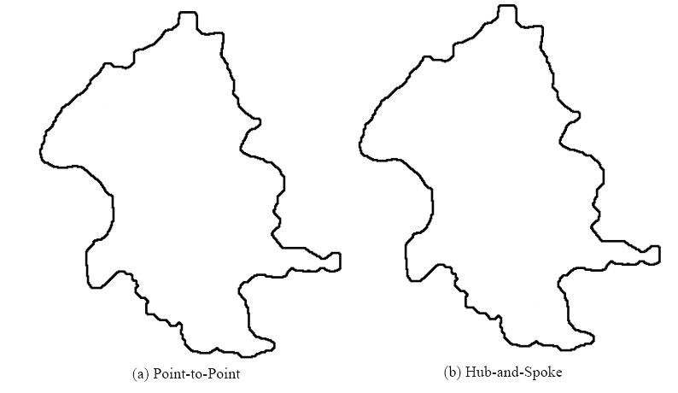

Demand point
Hub
Call Center
Notes:
First, to see the fig (a), PP has a call center and an experienced dispatcher is in charged of assigning received orders to sales riders. Sales riders will arrange the orders and as u see each sales rider encounters a vehicle routing problem.
Therefore PP is a less standardized network but it is teasier to run in the market.
Secondly, to see the HS network, A hub-and-spoke courier network contains a central hub, a service area will be divided into several service zones and each sales rider services in particular zone.
To begin with, every rider will pick up the consignments at their own service zone and return to the hub simultaneously to exchange the consignments after that back to their zone to continue expressing in the next cycle. Thus, the operating procedures are more standardized and effective.
1：40

Slide 7
Research Topics
To model motorcycle courier markets
  Monopoly model
    Efficiency of delivery
  Competition model
    Profit and Market Equilibrium
To choose a beneficial network strategy
Notes:
On the basis of the description above, We try to simulate the motorcycle courier in different market situations.
In monopoly model, we look into the efficiency of delivery of two major type networks respectively.
We consider that companies could decide network type to compete in the same market. In this model we focus on the result of profit and the market equilibrium.
Eventually, we expect that according to our models, decision makers could choose a benefit network strategy.
1：00
以上4:40
4：20

Slide 8
Literature Review

Slide 9
Literature Review (1/2)
Networks
  Advantage of PP (Gillen and Lall, 2004; Franke, 2004)
    Low cost service
  Advantages of HS (Encaoua et al. 1996 ; Oum et al., 1995；Berry, 1990；Borenstein, 1989)
    High productivity and excellent service quality
Competition of Networks
  Cournot Duopoly competition behavior
  (Brander and Zhang, 1990)
Notes:
In regard to Networks Indicate the advantages of PP
Mention that
As for the competition of networks

Slide 10
Literature Review (2/2)
Motorcycle courier
  Wang (2008)
    Without profit consideration
    Using the maximum amount of the consignments delivered per workday as the index
    HS model will deliver more consignments than PP model per workday
Notes:
About Motorcycle courier
Wang proposed a model without profit consideration to certificate
文獻1:25
以上6:00

Slide 11
Models
Monopoly
Competition

Slide 12
Assumptions
Demands arise equally likely
Demand is a linear function of the number of Service zones
Duopoly Market within HS and PP network strategies
The efficiency of HS strategy induces economical scale effect
Consignments are delivered in a FIFO order
Notes:
3. The competition model is in the duopoly market within HS and PP network strategies

Slide 13
Model Environment
Monopoly Model
Competition Model
Simultaneous
Games
Cournot
Total
Consignments
On-time
Consignments
Delayed
Consignments
Profit Function
Delay Ratio
Delay Penalty
Cost Function
Price and Cost
Functions
Notes:
This is the flow char of model construction
Initially, I will introduce the model environment
Firstly, let’s see the monopoly model, we try to calculate the amount of on-time, delayed and total delivered consignments.
Now we are going to get into the competition model, in this model, we transform the mount of delayed and total
Delivered consignments into delay ratio. Then put it into the delay penalty cost function to present the impact of efficiency of networks. And the model is a simultaneous game, it means the players choose the strategies simultaneously. Now let’s see the Competition Model.

Slide 14
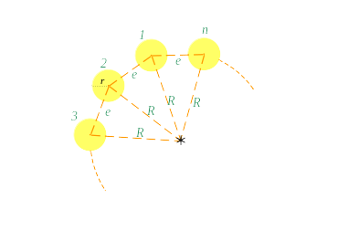
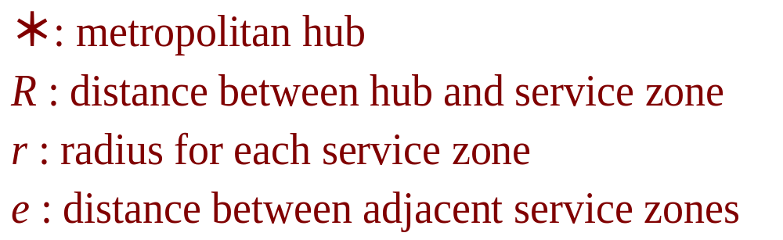
Model Environment (1/2)
(2θ, 0)
(2θ, 0)
(θ, θ)
(θ, θ)
HS network
λ= 2
(Picking up，Delivering)
(2θ, 0)
(θ, θ)
(2θ, 0)
(θ, θ)
Notes:
Suppose the metropolitan area is a large circle and divided into n> 2 service zones, each sales rider services in a particular zone.
In the initial cycle, sales riders pick up the consignments and ……
In the following cycles, riders’ express rule is that the delivering priority is higher than picking up, therefore, the riders will deliver the
Demand of the highest priority cycle under their delivery ability. the remained ability, they will pick up the demand of the highest priority
Cycle. This is the process of HS in the model environment.
5：26

Slide 15
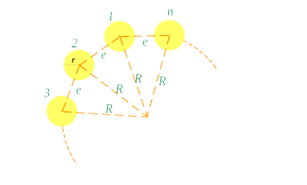
Model Environment(2/2)
PP network
λ= 2
Notes:
The model environment of PP and HS are the same.
Theoretically, a sales rider may visit service zones in a random order. therefore, In order to simplify the complexity of travel pattern . We assume an ideal situation in which each sales rider will travel to his counterclockwise adjacent service zone to serve and each rider serves in a particular zone.
We can recognize the amount of consignments divided by n-1
The reason is that we assume all the demands arisen inside a service zone have to be delivered equally likely to any of the other service zones.
10:00

Slide 16
Monopoly Model
Obtain the data of amount and service time
Observe and Induce the patterns
  The formulas of the amount of total, on-time and delayed delivered consignments
Market coefficients
  The guarantee time T₀, the cycle time T_{C}, length of per workday and the ratio of demand to delivery ability λ
Notes:
According to the express procedures of networks in the model environment, We arrange the data of amount and service time into the table and then
we observed the patterns and inducted out the formulas of the amount of total, on-time and delayed delivered consignments of two
Therefore, given the guarantee time T0, the length of a work day and λ, then we can get the information of these three indices.

Slide 17
Delivery efficiency of HS
The amount of Total delivered consignments
The amount of On-Time delivered consignments before guarantee time T_{o}
The amount of Delayed delivered consignments

Slide 18
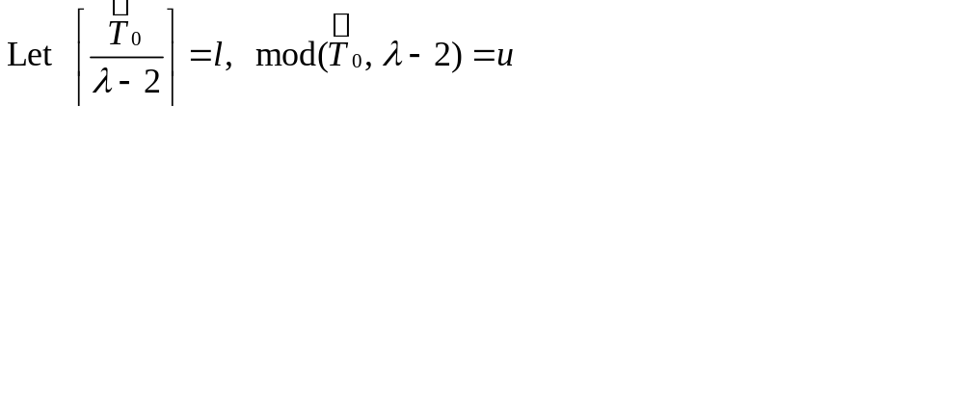
Delivery efficiency of PP
λ≧3
Notes:
However, when lambda is larger than 3, the procedure is becoming too complex to induce, therefore we just can arrange it in the a general formula. Computational calculating tech will help us to get the information of the three factors.
12:00

Slide 19
Profit Function
Price function
Production cost function
Delay penalty cost function
Notes:
Initially, We have to define the profit function composed of price, production cost and delay penalty cost functions.

Slide 20
Price Function
Price Inverse Function (Cournot Duopoly)
：sensitive coefficient of players
  Quote the maximum amount of the delivered consignments (Wang, 2008)
  Normalize to get the sensitive coefficient
Notes:
At first, price function, we followed the concept of cournot duopoly to define the price inverse function and
We add the sensitive coefficient of players in the function, we quote the….. from Wang’s model
This coefficient will imply the market power.

Slide 21
Production Cost Function
HS strategy
  High productive efficiency induces cost discount rate (ε)
  Production Cost Function
PP strategy
  Production Cost Function
Notes:
As for the production cost function, about HS strategy, by assumption and the impact of the function is in here,

Slide 22
Delay Penalty Cost Function
Delay ratio of strategy i
Delay penalty cost function of strategy i
Notes:
As we mentioned previously, we transform the amount of total and delayed consignments into delay ration

Slide 23
Profit Function
Profit Function of exploiting HS strategy
Profit Function of exploiting PP strategy
Notes:
So far, we have already accomplished the definition of profit function, therefore while each player exploited HS then, the profit function will be this, on the other hand if he choosed PP then the profit function is as this
Furthermore, we also consider the impact of the fixed cost.

Slide 24
Simultaneous Games (1/4)
Different Network Strategies (DNS)
  Let player exploits HS strategy while its opponent player chooses PP strategy
  Define both players’ profit functions
    HS strategy
    PP strategy
Notes:
So, now we can begin to solve the simultaneous game
The first game

Slide 25
Simultaneous Games (2/4)
  When , the Equilibrium is
Notes:
The whole solving procedure follows the concept of Cournot duopoly,

Slide 26
Simultaneous Games (3/4)
Same Network Strategy (SNS)
  Both players’ profit functions are symmetric,
  thus their optimal outputs will be symmetric
Notes:
Since both… follows the same solving procedure, and then we can obtained the optimal output as follows.

Slide 27



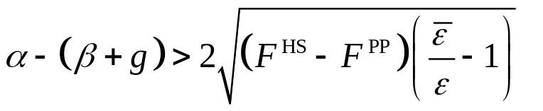
Simultaneous Games (4/4)
Theorem 1
  The competitive scenario of HS vs. PP
  Suppose the price (α), the unit production cost (β) and the unit delay cost (g) parameters of HS and PP are the same, and , then
  if
The Difference
between
Cost and Price
V.S
The Impact of Fixed cost and Process Efficiency
Notes:
Moreover, in the simultaneous game, we proposed theorem 1, while two …… that is the scenario of HS vs. PP
Suppose ………, then … if the parameters followed these inequation. Let’s comprehend this inequation
The left side means the difference between cost and price and the right side means the impact ….
Thus, If the market price is high or the variable cost is low enough
and the HS production advantage is significant enough to supplement the larger fixed cost of investing hub, then HS is a worth strategy choice.
6:30
18:30

Slide 28
Numerical Illustration
and
Interpretation
Notes:
Now, let’s get into the fourth part : …….

Slide 29
Numerical Settings - Monopoly Model
Basic parameters
T | T_{e} | T_{r} | R | V_{e} | D | λ
480 | 80 | 50 | 10 | 40 | 150 | 2
Notes:
All of the basic parameter settings are based on the interview of the GBG company in the Taipei Metropolitan
In order to meet the reality.
Firstly, lets see the numerical testing in the monopoly model.

Slide 30
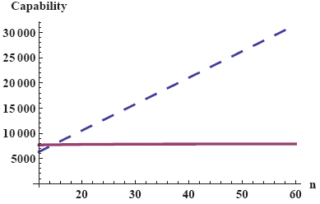
The inference of n - Monopoly Model (1/2)
Impact on the amount of total delivered consignments
HS
PP>HS
PP
Notes:
After finding the reasonable range of n,
We can recognize that the amount of total delivered consignments is increasing along with the larger n
Therefore, we can realize that HS has a good ability to respond the huge demand.
To see the purple line PP, obviously, even though n is increasing the amount of total delivered consignments
Is not raising and when n is small the amount of PP will larger than HS’. the result implies that the capability of pp has a limitation. however, in the small demand market PP could perform well.
competitive ability.

Slide 31
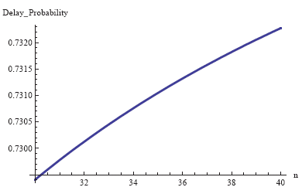
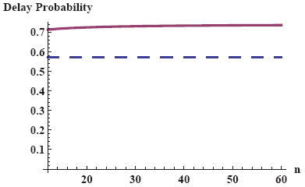
The inference of n - Monopoly Model (2/2)
Impact on delay ratio
PP
PP
HS
Notes:
HS
The delay ratio is stable while the n is increasing,
Based on the HS procedure, We can infer the reason is the standardization.
Now to see pp the delay ratio is slightly increasing along with is larger n,
As this result, we could observe that PP not only can’t handle the large demand, it’s service quality will also decrease while encounter the plenty demand.
If there are more orders on rider’s hand, it’s more difficult to arrange the orders in a effective way.
18:00

Slide 32
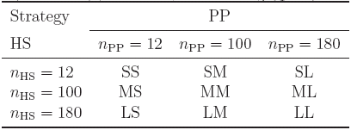
Numerical Settings - Competition Model
9 different market scenarios
  n_{PP} = (12, 100, 180) 、n_{HS} = (12, 100, 180)
S (Small)；M (Medium)；L (Large)
Notes:
According to the testing of monopoly model, we realize that
HS is suitable to choose larger n in order to obtain more market demand, as for PP, this network is better to focus on the small market to keep the good express quality.
Therefore, we test the three types of n to form the 9….. The three types are S M L stands for small …respectively

Slide 33
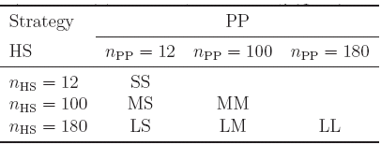
Reasonable Scenarios - Competition Model
Testing rationality of each scenario
  Non-negative requirement in decision variables (q*)
  6 reasonable market scenarios
n_{PP} ＞ n_{HS}
Notes:
Now we are going to test the rationality of each scenario..
The criterion of rationality is Non-negative requirement in decision variables (q),
After eliminating the unreasonable scenarios, there are 6 reasonable market scenarios

Slide 34

Numerical Settings - Competition Model (1/2)
Basic parameters

Slide 35
The inference of ε
- Market Equilibriums
Notes:
Now we are going to discuss the…..

Slide 36
The Same n
SS、MM and LL scenarios
  SS scenario
    (Player1, Player2) ：(HS, HS)
  MM and LL scenarios
    Case1: No production advantage
      (Player1, Player2)：(PP, PP)
    Case2: Weak production advantage
      (Player1, Player2)：(HS, PP)、(PP, HS)
    Case3: Strong production advantage
      (Player1, Player2)：(HS, HS)
Notes:
We divide the six scenarios into two types, the first type is both players choose the same number of service zones, This type involves S,M L
SS After testing the whole range of e ， We fine the only one equilibrium situation is that PP is dominated by HS
As for M L scenarios
According to different impact of HS production advantage, there are three equilibrium situations
Case 1: PP will be the profitable strategy choice based on less fixed cost spent
Case 2: Two strategies will coexist in the market , PP still has the competitive ability in this scenario
Case 3: …. Intuitively, HS will be the dominative strategy in the market.

Slide 37
Different n
The results of MS、LS and LM are similar
  Case 1 Weak production advantage
    (Player1, Player2)：(PP, PP)
  Case 2 Strong production advantage
    (Player1, Player2)：(HS, HS)
Notes:
PP focus on the few service zones and HS choose the lager n to compete in the same market,
There are two equilibrium situations, We find out that PP will survive in the market except the strong production advantage.

Slide 38
Summary of Numerical Result
Monopoly Model
Competition Model
  Equilibriums in different conditions
Express Efficiency | Large number of n | Small number of n
HS | Suitable | Unsuitable
PP | Unsuitable | Suitable
HS
HS or PP
PP
Equilibrium | Strong (ε) | Weak (ε) | No (ε)
SS | HS beats PP | HS beats PP | HS beats PP
MM、LL | HS beats PP | HS 、 PP | PP beats HS
MS、LS、LM | HS beats PP | PP beats HS | PP beats HS
Notes:
When the impact of production advantage is strong, HS will be the only profitable strategy. When the impact is not strong enough, PP has the ability to compete with HS and coexist in this market situation.
And then, if there is no production advantage, PP will be the dominative strategy.
And we also observe that if PP just focus on a few service zones, Even though its pool prodeuction it will survive in the market except the strong advantage of hs. .

Slide 39
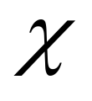
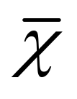
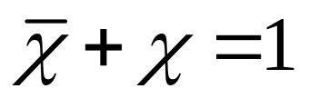
Two Types of Services (1/3)
High Quality (HQ) and Low Quality (LQ)
Adding extra parameters into previous model
  Φ：The ratio of the amount of HQ’s demand to total demand
  ：The ratio of production capability allotted to HQ
  ： The ratio of production capability allotted to LQ
Notes:
Lastly, We propose the two types of services model the difference of these two type is the customer guarantee time

Slide 40
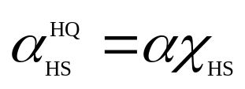
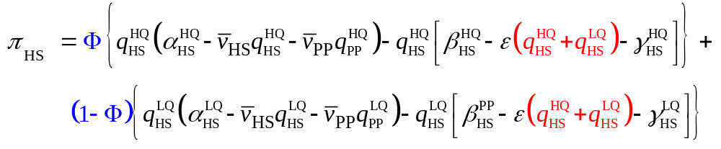
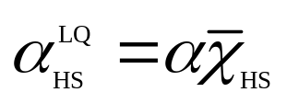
Two Types of Services (2/3)
Profit Functions
  HS Strategy
High Quality
+
Low Quality

Slide 41
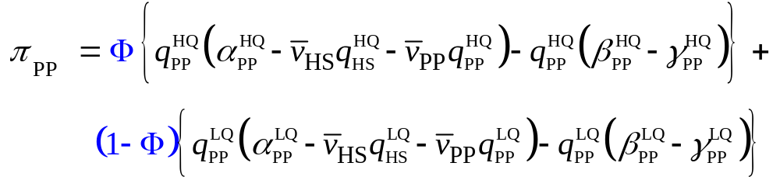
Two Types of Services (3/3)
  PP Strategy
High Quality
+
Low Quality
Notes:
If it is posible to messure the demand proportions of two types of services, Based on this model we can find the optimal decition to allot
capability.

Slide 42
Conclusions
Two types of Market Conditions
  Monopoly Model
    Amount of Total delivered , On-Time delivered and Delay delivered consignments as the performance indices
  Competition Model
    Considering the factors involving Network delivery efficiency、Network market power and Hub Advantage
    Simultaneous Games
Two Types of Services
  Best products (HQ & LQ) compositions

Slide 43
Thanks for Your Listening.
Q & A

