Slide 1
TagSNP Selection Problems based on Linkage Disequilibrium and Lagrangian Relaxation
Chia-Yi Ma
I-Lin Wang
Department of Industrial & Information Management
National Chen Kung University
Notes:
Good afternoon, Ladies and gentlemen. Today I am going to present my research—” TagSNP Selection Problems based on Linkage Disequilibrium and Lagrangian Relaxation”. This is an optimization problem, more specifically, a set covering problem, in the field of bioinformatics. Mathematically speaking, given an m by n matrix, a tagSNP selection problem is to select a set of columns to represent the entire matrix such that the number of columns selected is minimized.
In our research, we take more biological information such as the “Linkage Disequilibrium” into consideration to select those columns of more information; Then, we consider the capacity limit of biochips to select more reliable tagSNPs. Finally we propose heuristics based on Lagrangian Relaxation to solve large scale tagSNP selection problem in shorter time.
My name is Chia-Yi Ma. This research is done by me and my advisor I-Lin Wang.
We are from the Dept of Ind & Inf Mgmt, of this university.

Slide 2
Outline
Introduction
Research Problem
Literature Review
LRH Algorithm
Bi-Objective Programming Model
Consider Biochip
Summary
NCKU _IIM_2008/08/28_Outline
Notes:
This is the outline. I divide into 7 parts of this presentation.

Slide 3
Introduction
Notes:
In introduction, I’ll simply describe the background, motivation and research problem of this study.

Slide 4
Background
SNP (Single Nucleotide Polymorphism)
  Common genetic variation
  Observed at least 1% in all population
Haplotype
  A sequence of closely linked SNP
Locus
1 2 3 4 5 6 7 8
Individual 1
−A T T C G G A G −
Haplotype 1
T C G
Individual 2
−A T T T G G A C −
Haplotype 2
T T C
Individual 3
−A A T C G G A C −
Haplotype 3
A C C
Individual 4
−A T T C G G A C −
Haplotype 4
T C C
SNP₁
SNP₂
SNP₃
NCKU _IIM_2008/08/28_Introduction_Background
Notes:
To help you understand the topics better, I will briefly explain some biological terms.
SNP is the most common genetic variation, at which DNA base are different among individuals, and this variation should be observed at least 1% in all population.
The link of all closely SNP is called Haplotype.
For example, there are 4 individuals’ DNA sequence, you can see locus 2, 4, &8 are different among these individuals. These loci (or, columns) are called SNP, and a series of these SNPs are 4 different Haplotype (or, rows).

Slide 5
Motivation
SNP is the most common type of genetic variation
Applied to identify diseases & other medical research
Make database more cost-effective
Tagging a minimal subset of SNPs called tagSNP
NCKU _IIM_2008/08/28_Introduction_Motivatiion
Notes:
About 90% of Human genetic variation are SNPs, and SNPs are useful since they can be used to identify diseases or other medical use.
However, there are about 400 million discovered SNP data. To store all of them consumes too much resource.
Therefore, we want to select only part of them sufficient to represent the original SNPs for our own use. And these SNPs that we select are called tagSNPs.

Slide 6
Research Problem tagSNPSP
Notes:
And following, I’ll explain my issue – tagSNP selection Problem, called tagSNPSP

Slide 7
tagSNP Selection Problem (tagSNPSP)
Problem illustration
  Select a minimal subset of SNPs called tagSNP, to identify all haplotype patterns
1
2
3
4
5
6
7
8
9
10
4
9
1
6
h₁
0
0
0
0
0
1
0
0
1
0
0
1
0
1
h₂
0
1
0
1
0
0
0
0
0
0
1
0
0
0
h₃
0
0
1
0
0
0
1
1
0
0
0
0
0
0
h₄
0
0
0
1
1
1
1
0
1
1
1
1
0
1
h_{i}
0
0
1
0
0
0
1
1
0
0
0
0
0
0
NCKU _IIM_2008/08/28_Research Problem_tagSNPSP
Notes:
For example, given a 4 by 10 haplotype matrix, where there are 4 haplotypes (or, rows), and each includes 10 SNP (or, columns).
Elements of this matrix are either 0 or 1 (let me skip the biological meaning, and feel free to ask me afterwards if you are interested)
Then, the problem is to use the minimal number of columns to identify all different rows.
In this case, we can select SNP4 & 9 to determine hi is, in fact, h3.
However, if we select SNP1 & 6, then we no longer are sure whether hi is h2 or h3.

Slide 8
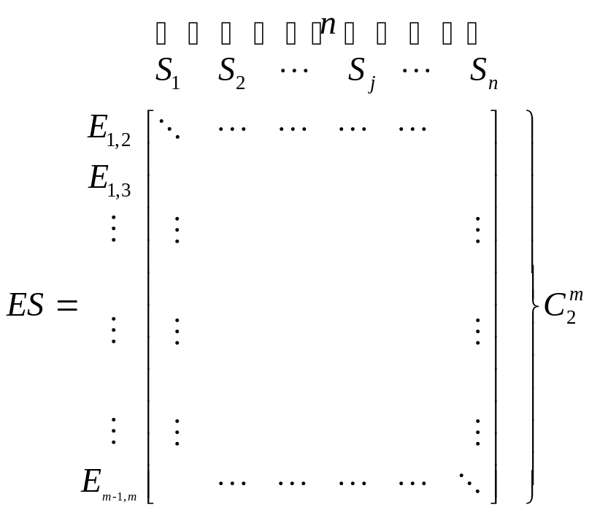
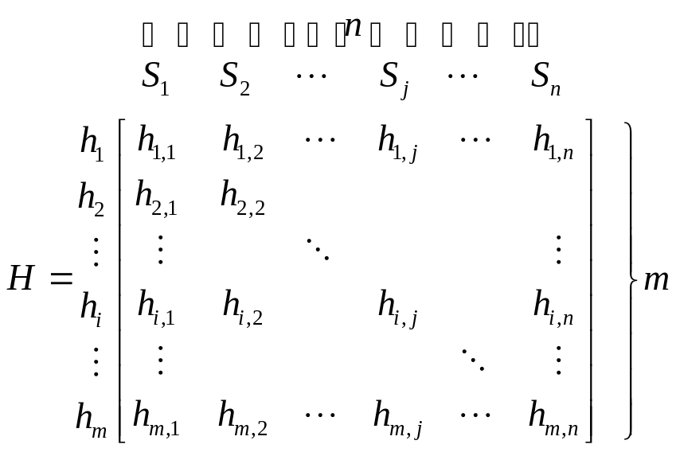
Problem Model
  Change Haplotype data into a binary matrix
  Construct it relationship matrix ES
NCKU _IIM_2008/08/28_Research Problem_tagSNPSP
Notes:
The tagSNPSP can be formulated by integer programming.
To do so, we first construct a relationship matrix ES, whose element represents whether a column can be used to identify two pair of rows or not.

Slide 9
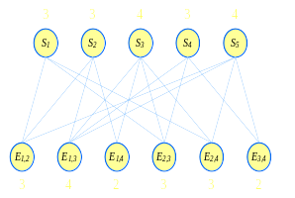
NCKU _IIM_2008/08/28_Research Problem_tagSNPSP
Notes:
For example, S1 can be used to differentiate h1 & h2, so, we put 1 here.
However, S1 can NOT be used to differentiate h1 & h3, so, we put 0 here.
Keep doing the pairwise comparison, finally we can construct the entire ES matrix, which in turn can be used as an adjacency matrix of the bipartite graph here.
From the graph point of view, our problem is to select the smallest number of S nodes such that all the E nodes are selected as well.

Slide 10
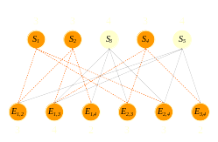
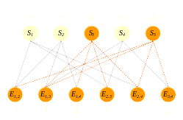
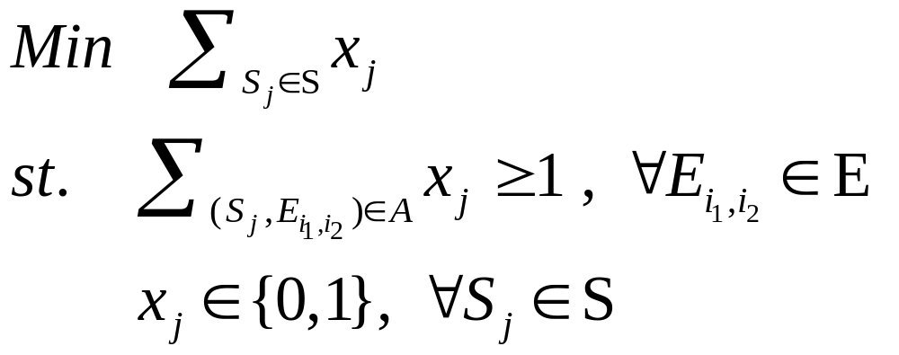
P_{tagSNP} formulation
NCKU _IIM_2008/0/28_Research Problem_tagSNPSP
Notes:
Let’s see more examples. The left one uses 3 S nodes, while the right one uses only 2 nodes. So the left one is not optimal.
The IP formulation is as shown here, where xj equals to 1 if node Sj is selected, and 0 otherwise.
As you can see here, this IP formulation is, in fact, a set covering formulation.
In our research, we investigate several variants of tagSNP selection problems based on this formulation.

Slide 11
Topics of our research
tagSNPSP is a set covering problem
  NP-complete problem
  Solved by LR heuristics
Existence of multiple optimal solutions
  Select an optimal solution of more biological info (i.e. Linkage Disequilibrium, LD)
  A Bi-objective IP formulation
If the capacity of a biochip is sufficiently large
  Select more reliable (or, robust) tagSNPs
  A new IP formulation
Notes:
In short, we focus on the following 3 topics.
First, we try to efficiently solve the tagSNPSP, which is NP-complete, and thus we propose efficient heuristics based on Lagrangian Relaxation.
Second, this problem often contains multiple optimal solutions. To give an optimal solution that has more biological information, we propose a new bi-objective IP formulation that takes the biological information of Linkage Disequilibrium, or LD, into consideration, so that our model can give an optimal solution of better biological sense.
Finally, we consider the case where the selected tagSNPs is to be included in a biochip, while the capacity for the biochip is sufficiently large. In this case, we no longer have to select the SNPs of minimum size. Instead, we focus on selecting those tagSNPs that can be used to differentiate more haplotypes (that is, rows) as many as possible so that the selected SNPs are more robust or reliable.

Slide 12
Literature Review
Notes:
In literature review, I’ll describe the concept of Linkage disequilibrium, and other relative research.

Slide 13
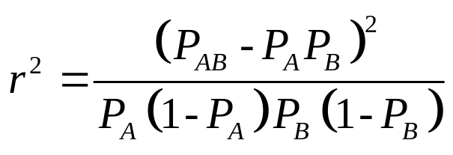
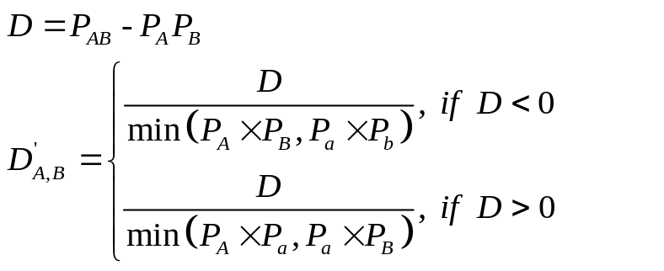
Linkage Disequilibrium (LD)
  The relation of two gene bases
  High recombination → Low LD
  Low recombination → High LD
The method of counting LD value
  Devlin and Risch(1995)
  Correlation coefficient r² (0~1)
  Standard LD parameter D́ (-1~1)
NCKU _IIM_2008/08/28_Literature Review_Apply Biology Knowledge
Notes:
Linkage disequilibrium is the non-random association of alleles at two or more loci. It describes the association of two or more loci with limited recombination between them.
Many methods are proposed to calculate the LD value.
Here we give 2 popular LD formulas as shown on the screen.

Slide 14
Definition of tagSNP
  Identify Haplotype pattern (Avi-Itzhak et al., 2003)
  Conform to diversity threshold (Johnson et al., 2001)
  LD-bin (Carlson et al., 2004)
Relative Problem & Method
  Simple Numerical Algorithm (Avi-Itzhak et al., 2003)
    Completely identify – total enumeration
    Identify an acceptable percentage
  Two Greedy Algorithms (Huang et al., 2005)
    Consider missing data : Greedy2 better than Greedy1
NCKU _IIM_2008/08/28_Literature Review_Apply Biology Knowledge
Notes:
There are many definitions of tagSNP, we use this one that can identify all the Haplotype patterns.
Since the tagSNP selection problem is NP-hard, most of the methods in literature are based on total enumeration
or greedy heuristics.

Slide 15
LRH Algorithm
Notes:
Now I will introduce our heuristics based on Lagrangian Relaxation to solve large scale tagSNPSPs more efficiently.

Slide 16
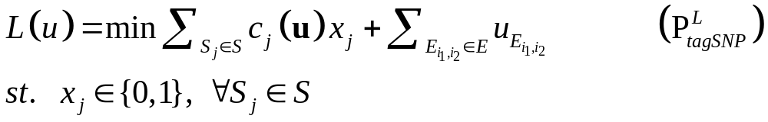
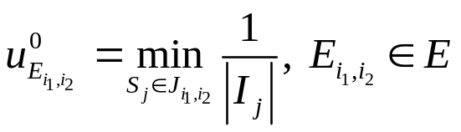
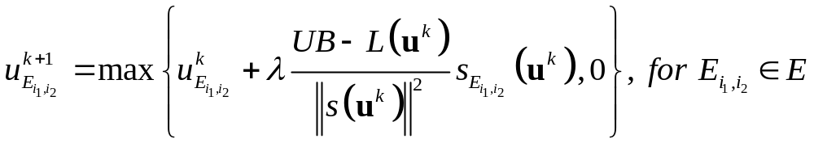
Lagrangian Relaxation
Use Lagrangian Relaxation on P_{tagSNP}
Subgradient Method
  Lagrangian Multiplier Initial Value
(Caprara et al.,1999)
  Lagrangian Multiplier Function
NCKU _IIM_2008/08/28_LRH Algorithm_Lagrangian Relaxation
Notes:
Because this problem is also a set covering problem. Scholars show it’s efficiently to use lagrangian relaxation on solving set covering problem. So we based on the theory of Lagrangian Relaxation to develop our algorithm.
This is the model with lagrangian relaxation. We use subgradient method for the optimization of L(u).

Slide 17
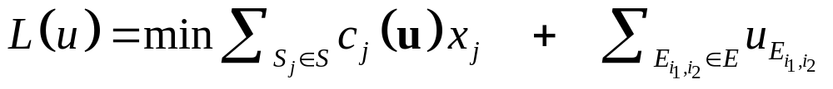
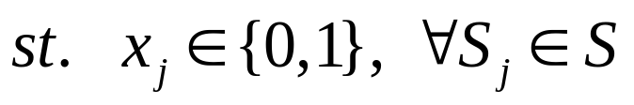
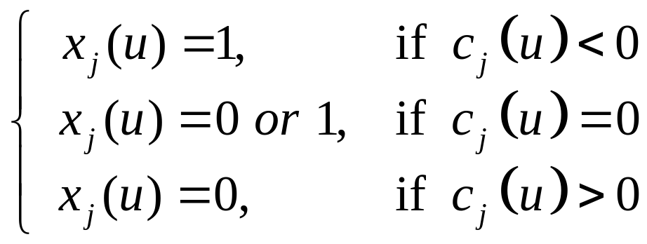
  Finding P^{L}_{tagSNP}’s corresponding solution
NCKU _IIM_2008/08/28_LRH Algorithm_Lagrangian Relaxation
Notes:
This lagrangian model has a feature, this feature make the problem easy to obtain it corresponding solution. Here are three rule of finding it solution.

Slide 18
Input SNP Data
Setup Initial variance：
1. UB = N 2. Setup λ value
3. Calculate u⁰
Solve P^{L}_{tagSNP}：
1. Find out Solution
2. Update s(u)
Delete this outcome
N
Check s(u)
Y
Record this outcame & related value
1. Update u^{k}
2. Judge if update UB
Fix Column
Reach iteration times?
N
Y
Find approximate solution or optimal
NCKU _IIM_2008/08/28_LRH Algorithm_Lagrangian Relaxation_Solve Procedures
Notes:
This is the procedure chart of the original lagrangian heuristic. We modify two parts of the procedures. First is to change the rule of finding corresponding solution. Second is to fix column before check iteration.

Slide 19
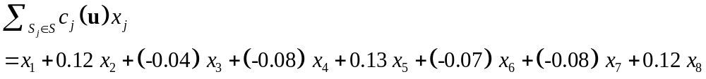
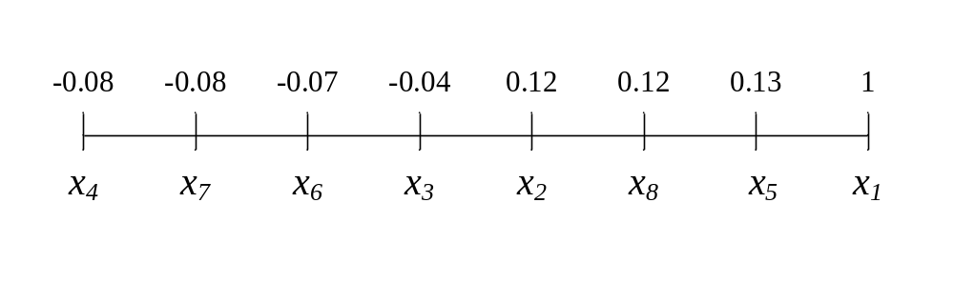
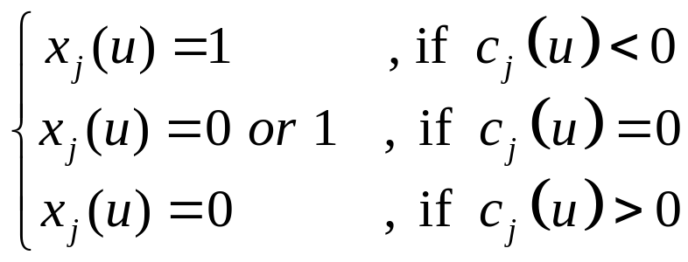
Revise Lagrangian Relaxation
LRH algorithm (Lagrangian Relaxation Heuristic)
  Revise the rule of corresponding solution
UB=3
NCKU _IIM_2008/08/28_LRH Algorithm_Revise Lagrangian Relaxation
Notes:
On the first modify. Here I explain it with this example. By original rules, we’ll select x3, x4, x6, & x7 as the corresponding solution.
But if now we know the UB is 3, that is mean there is already a solution selecting 3 SNPs,
it is unnecessary to choose more than 3 as new solution. So we sort the coefficient and just choose the 3 best ones as our corresponding solution.

Slide 20
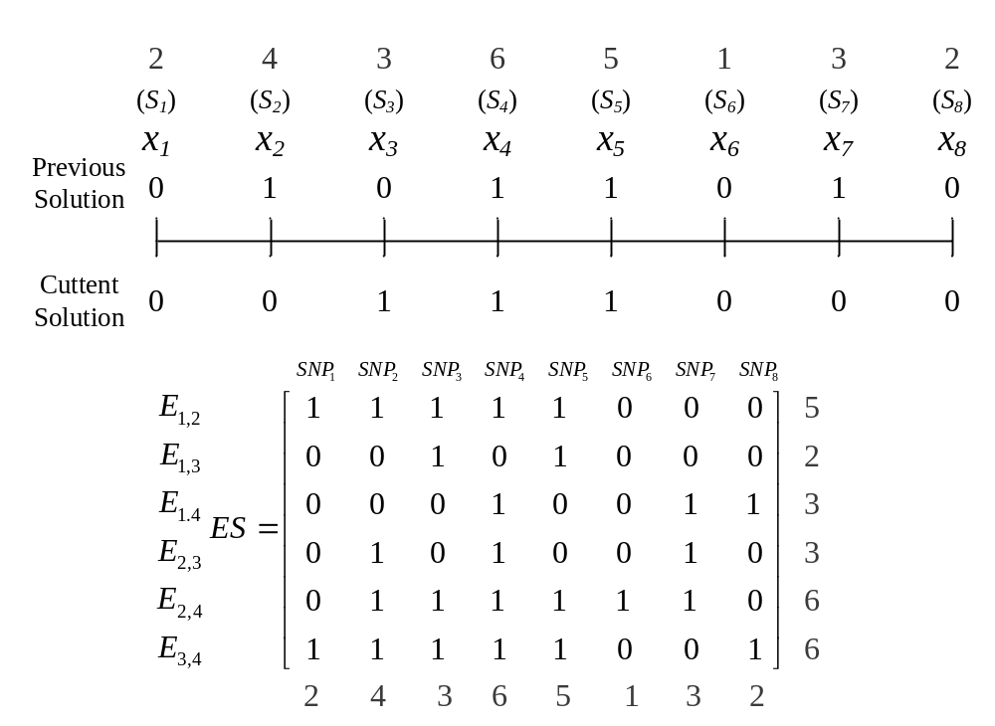
  Fix column to reduce problem scale
NCKU _IIM_2008/08/28_LRH Algorithm_Revise Lagrangian Relaxation
Notes:
Another modify is to fix column to reduce the scale of problem. We compare the solution between previous & current. In this example, SNP4 & SNP5 are both selected.
The rule of fix column is base on greedy theory.
First, to seek the smallest value of E degree, in this case, the smallest E degree is 2. Then, If the elements of the intersection of the column & the row is one, we delete the column

Slide 21

NCKU _IIM_2008/08/28_LRH Algorithm_Revise Lagrangian Relaxation
Notes:
But if there are more than one occurs such situation, we delete one with the maximal SNP degree. Just like In this case, we delete column SNP4

Slide 22
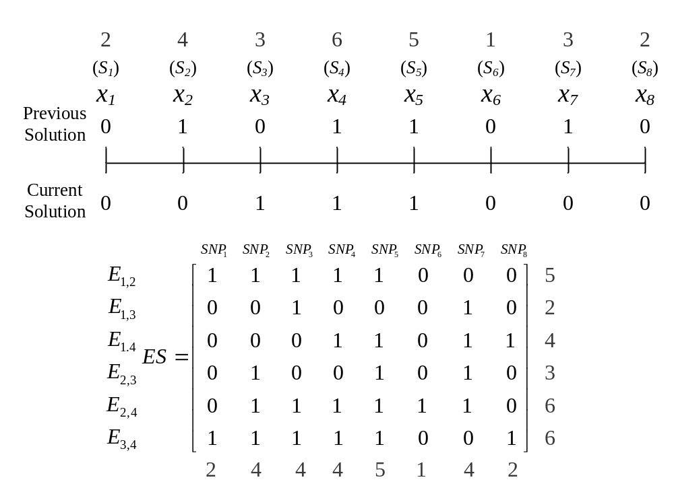
NCKU _IIM_2008/08/28_LRH Algorithm_Revise Lagrangian Relaxation
Notes:
But if the part of intersection are all zero, we just see the SNP degree, delete the maximal one. In this case, we delete column SNP5

Slide 23
Implement Result
Implement Data
  Simulator (variation rate 5% & 20%)
  Hudson’s program (2002)
  Scale
n m | 50 | 100 | 150
15 | P_{15×50} | P_{15×100} | P_{15×150}
30 | P_{30×50} | P_{30×100} | P_{30×150}
45 | P_{45×50} | P_{45×100} | P_{45×150}
NCKU _IIM_2008/08/28_LRH Algorithm_Implement Result
Notes:
We implement 3 kinds of data category. The first 2 categories is our simulate program with different variation rate. And the last one is Hudson’s program. The entire categories include 9 scale of problem. Each scale has 10 cases.

Slide 24
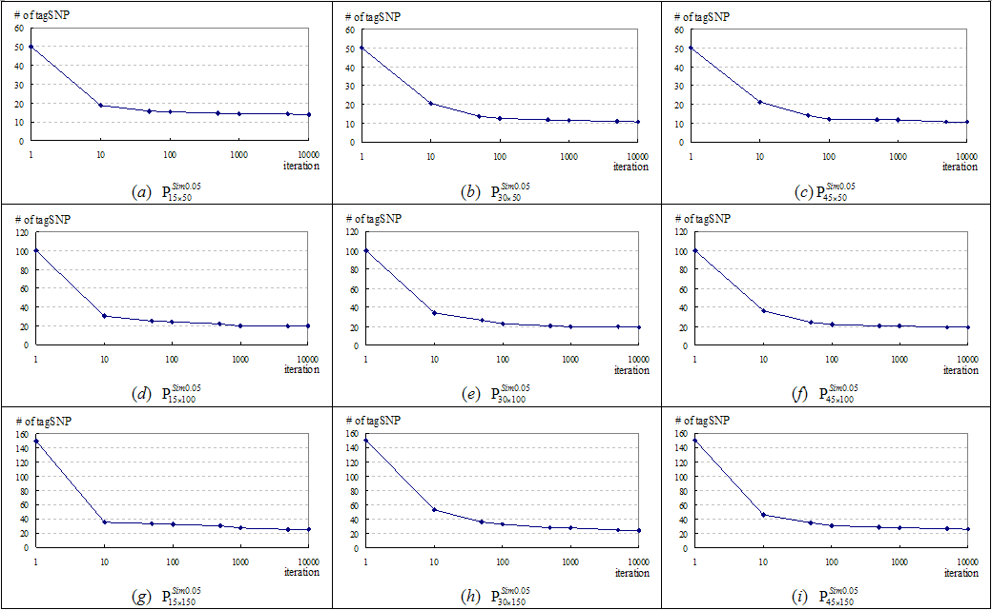
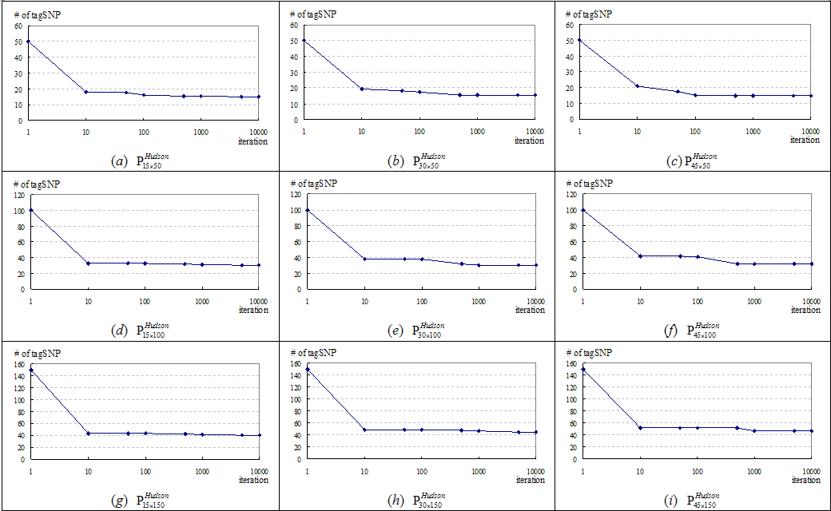

LRH algorithm’s converge condition
Notes:
This is the converge condition. The Figure is the Simulation data with variation rate 5%
And this is Simulation data with variation rate 20%.
This is Hudson’s data.
We can see no matter what data categories, the converge in the beginning is vary fast, it can quickly obtain a nice solution.
And during testing CPLEX, We find using CPLEX on solving small problem, it’s can quickly find the optimal solution.
To combine the advantage of LRH and CPLEX, we also suggest a two-stage solution method, named MIX method.

Slide 25
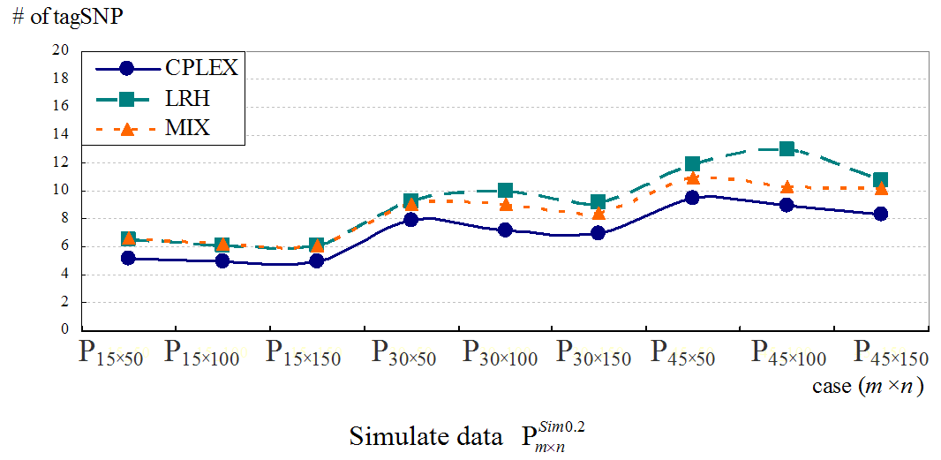
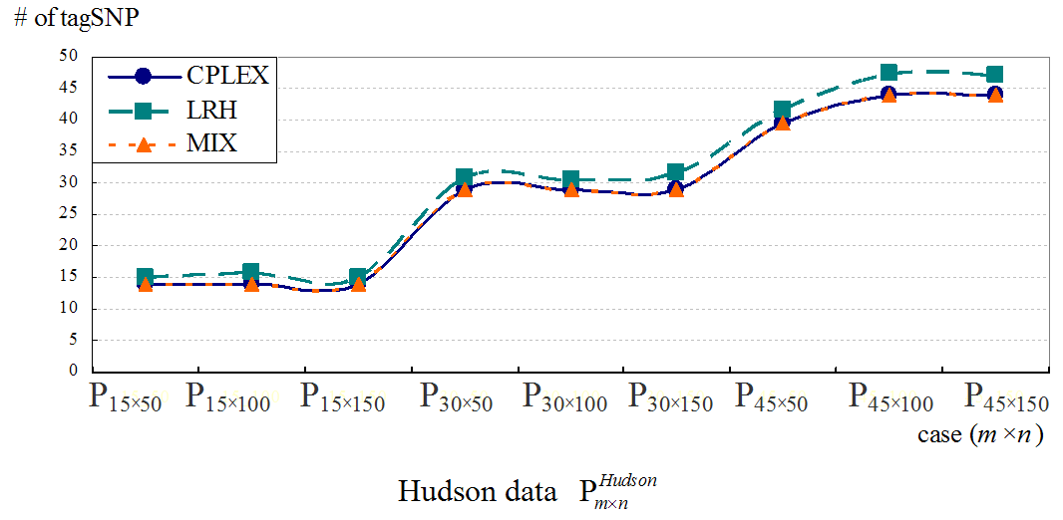
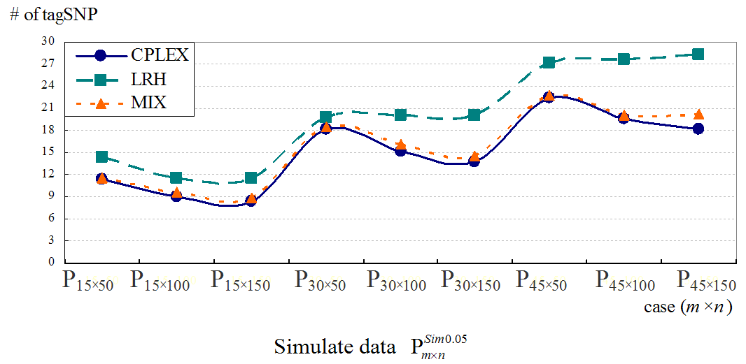
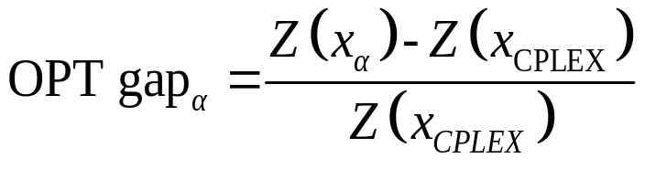
 | P_{15×50} | P_{15×100} | P_{15×150} | P_{30×50} | P_{30×100} | P_{45×50} | P_{30×150} | P_{45×100} | P_{45×150}
CPLEX | 14.0 | 14.0 | 14.0 | 29.0 | 29.0 | 29.0 | 39.6 | 44.0 | 44.0
LRH (OPT gap) | 15.1 | 15.7 | 14.9 | 30.8 | 30.5 | 31.5 | 41.5 | 47.5 | 47.2
 | 7.86% | 12.14% | 6.43% | 6.21% | 5.17% | 8.62% | 4.80% | 7.95% | 7.27%
MIX (OPT gap) | 14.0 | 14.0 | 14.0 | 29.0 | 29.0 | 29.0 | 39.6 | 44.0 | 44.0
 | 0.00% | 0.00% | 0.00% | 0.00% | 0.00% | 0.00% | 0.00% | 0.00% | 0.00%
 | P_{15×50} | P_{15×100} | P_{15×150} | P_{30×50} | P_{30×100} | P_{45×50} | P_{30×150} | P_{45×100} | P_{45×150}
CPLEX | 11.4 | 9.0 | 8.4 | 18.1 | 15.1 | 13.7 | 22.5 | 19.6 | 18.1
LRH (OPT gap) | 14.3 | 11.5 | 11.6 | 19.8 | 20.0 | 20.1 | 27.2 | 27.7 | 28.3
 | 25.44% | 27.78% | 38.10% | 9.39% | 32.45% | 46.72% | 20.89% | 41.33% | 56.35%
MIX (OPT gap) | 11.5 | 9.7 | 8.9 | 18.4 | 16.1 | 14.6 | 22.7 | 20.1 | 20.2
 | 0.88% | 7.78% | 5.95% | 1.66% | 6.62% | 6.57% | 0.89% | 2.55% | 11.60%
 | P_{15×50} | P_{15×100} | P_{15×150} | P_{30×50} | P_{30×100} | P_{45×50} | P_{30×150} | P_{45×100} | P_{45×150}
CPLEX | 5.2 | 5.0 | 5.0 | 7.9 | 7.2 | 7.0 | 9.5 | 8.9 | 8.3
LRH (OPT gap) | 6.5 | 6.1 | 6.1 | 9.3 | 10.0 | 9.2 | 11.9 | 12.9 | 10.7
 | 25.00% | 22.00% | 22.00% | 17.72% | 38.89% | 31.43% | 25.26% | 44.94% | 28.92%
MIX (OPT gap) | 6.6 | 6.2 | 6.1 | 9.1 | 9.1 | 8.4 | 11.0 | 10.3 | 10.2
 | 26.92% | 24.00% | 22.00% | 15.19% | 26.39% | 20.00% | 15.79% | 15.73% | 22.89%
NCKU _IIM_2008/08/28_LRH Algorithm_Implement Result
Notes:
The implement result shown on the scream. This is the simulation with variation rate 5%. And below the figure is it associate table. The optimality gap is defined as this formula. In these figure and table we can see MIX method can improve the solution quality.
This one is simulate with variation rate 20%.
And this is the result of Hudson data. In Hudson data, the solutions of MIX method are exactly optimal solution.

Slide 26
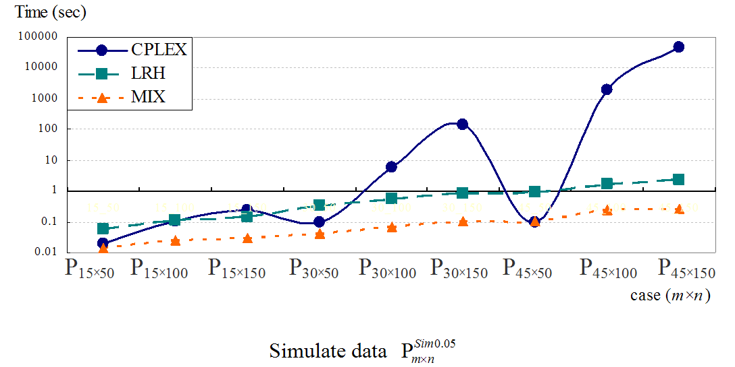
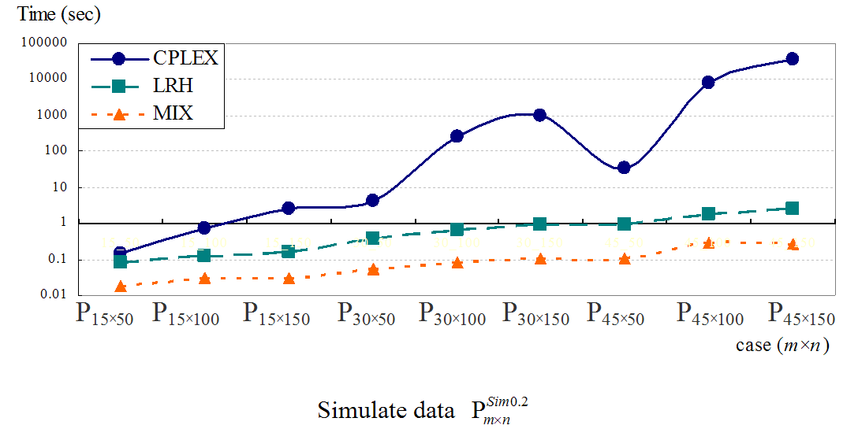
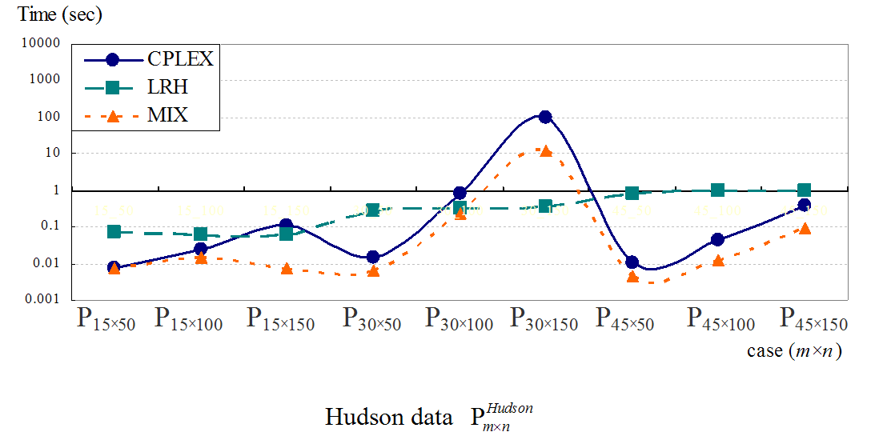
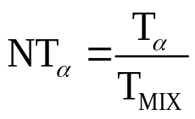
 | P_{15×50} | P_{15×100} | P_{15×150} | P_{30×50} | P_{30×100} | P_{45×50} | P_{30×150} | P_{45×100} | P_{45×150}
CPLEX (NT) | 0.01 | 0.03 | 0.11 | 0.01 | 0.82 | 99.91 | 0.01 | 0.04 | 0.39
 | 1.01 | 1.66 | 14.59 | 2.31 | 3.47 | 8.27 | 2.33 | 3.41 | 4.08
LRH (NT) | 0.07 | 0.06 | 0.06 | 0.29 | 0.32 | 0.36 | 0.84 | 0.94 | 1.02
 | 9.61 | 3.89 | 7.95 | 47.07 | 1.38 | 0.03 | 186.73 | 76.69 | 10.72
MIX | 0.01 | 0.02 | 0.01 | 0.01 | 0.24 | 12.07 | 0.00 | 0.01 | 0.09
 | P_{15×50} | P_{15×100} | P_{15×150} | P_{30×50} | P_{30×100} | P_{45×50} | P_{30×150} | P_{45×100} | P_{45×150}
CPLEX (NT) | 0.15 | 0.75 | 2.47 | 4.22 | 254.48 | 1027.64 | 35.43 | 8330.64 | 36438
 | 8.31 | 25.84 | 84.70 | 80.60 | 3084.60 | 9419.24 | 329.87 | 30150 | 136422
LRH (NT) | 0.08 | 0.12 | 0.16 | 0.37 | 0.66 | 0.90 | 0.95 | 1.76 | 2.46
 | 4.54 | 4.16 | 5.45 | 6.99 | 8.03 | 8.25 | 8.86 | 6.38 | 9.22
MIX | 0.02 | 0.03 | 0.03 | 0.05 | 0.08 | 0.11 | 0.11 | 0.28 | 0.27
 | P_{15×50} | P_{15×100} | P_{15×150} | P_{30×50} | P_{30×100} | P_{45×50} | P_{30×150} | P_{45×100} | P_{45×150}
CPLEX (NT) | 0.02 | 0.11 | 0.25 | 0.10 | 5.89 | 138.45 | 0.10 | 1908.91 | 47613
 | 1.49 | 4.41 | 8.30 | 2.24 | 87.98 | 1292.69 | 0.94 | 7611.28 | 176280
LRH (NT) | 0.06 | 0.11 | 0.14 | 0.34 | 0.57 | 0.87 | 0.90 | 1.70 | 2.44
 | 4.21 | 4.51 | 4.70 | 7.86 | 8.59 | 8.09 | 8.52 | 6.78 | 9.02
MIX | 0.01 | 0.02 | 0.03 | 0.04 | 0.07 | 0.11 | 0.11 | 0.25 | 0.27
NCKU _IIM_2008/08/28_LRH Algorithm_Implement Result
Notes:
This slice is shown the performing time of three methods. To easy contrast the different. It also display the normalized time in table. The normalized formula is this.
The result shown MIX method has the best efficiency.

Slide 27
Bi-Objective Programming tagSNPSP with two criteria
－ Minimize number of tagSNP
－ Maximize the LD value
Notes:
Next, I will show how to give a bi-objective integer programming formulation to
Guarantee the size of the selected tagSNPs is minimized while whose LD value is maximized at the same time.

Slide 28
Motivation & Objective
P_{tagSNP} exists multiple optimal solutions
Scholars focused on efficiency of solution method
Discuss the differences between all solutions
Recommend the concept of Linkage Disequilibrium
Bi-Objective → Minimal tagSNP number
Maximal LD value
NCKU _IIM_2008/08/28_tagSNPSP with two criteria_Motivation & Objective
Notes:
Although the original tagSNPSP often contains multiple optimal solutions,
Most literatures focused on developing efficient solution methods instead of investigating the differences among the optimal solutions.
Here we propose to include the idea of LD into consideration when solving the tagSNPSP.
In particular, we give an integer programming formulation that minimize the size of selected tagSNP while maximize the LD value at the same time.

Slide 29
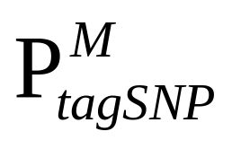
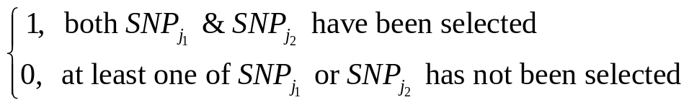
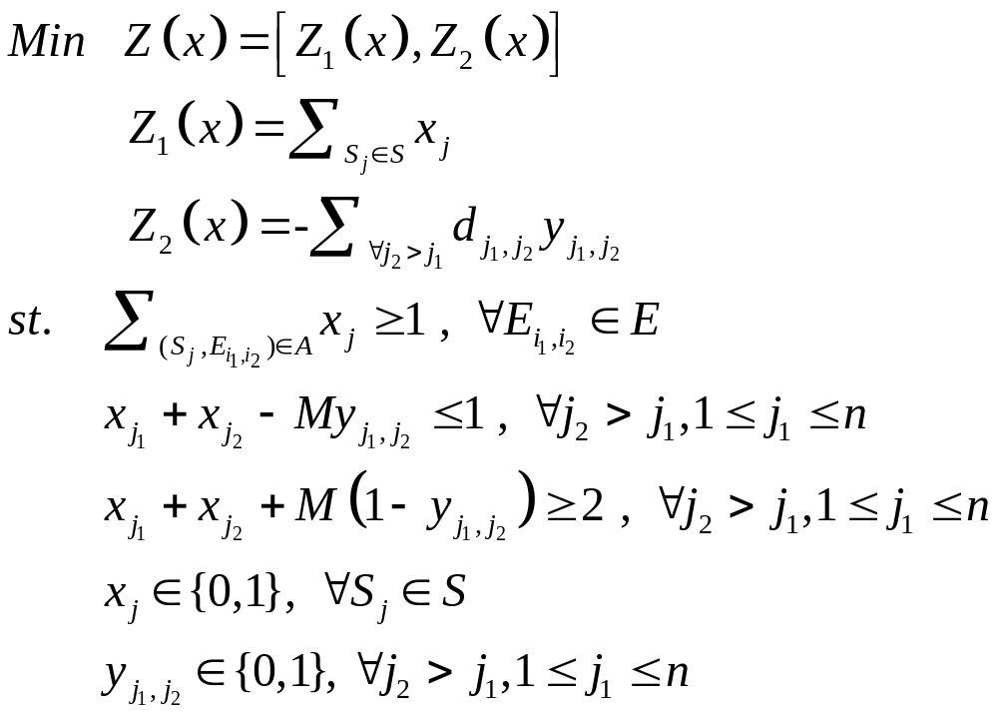
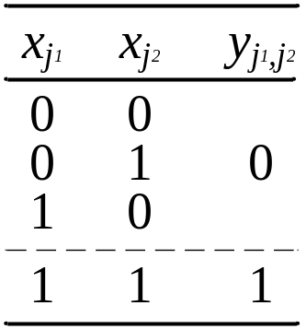
Bi-Objective Programming Model
formulation
NCKU _IIM_2008/08/28_tagSNPSP with two criteria_Bi-Objective Programming Model
Notes:
Here is our proposed model.
the first objective remains the same, while the 2nd objective maximize the LD value
Here we use the binary variable yj1j2 to represent whether both Sj1 & Sj2 have been selected or not.
Using some Integer programming modeling techniques, we can achieve two objectives at the same time
And its optimal solution not only is optimal to the original tagSNPSP, but also provides more biological information.

Slide 30

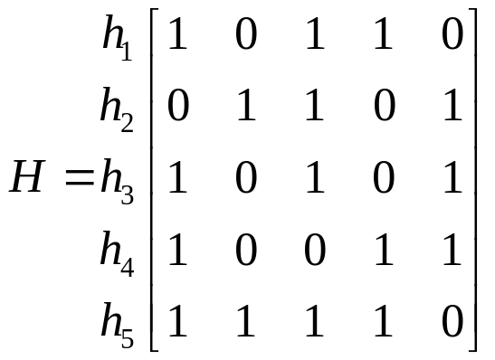
weight |  | slope | efficient solution |  |  |  |  | noninferior solution
w₁ | w₂ | w₁/w₂ | x₁ | x₂ | x₃ | x₄ | x₅ | Z₁ | Z₂
1 | 0 | - | 0 | 1 | 1 | 1 | 0 | 3 | 1.451
5 | 1 | -5 | 0 | 1 | 1 | 1 | 0 | 3 | 1.451
1 | 1 | -1 | 0 | 1 | 1 | 1 | 0 | 3 | 1.451
1 | 5 | -0.2 | 0 | 1 | 1 | 1 | 0 | 3 | 1.451
0 | 1 | 0 | 0 | 1 | 1 | 1 | 0 | 3 | 1.451
S₁
S₂
S₃
S₄
S₅
E_{1,2}
E_{1,3}
E_{1,4}
E_{1,5}
E_{2,3}
E_{2,4}
E_{2,5}
E_{3,4}
E_{3,5}
E_{4,5}
d_{1,2}
d_{1,2}
d_{1,2}
d_{1,2}
d_{1,2}
d_{1,2}
d_{1,2}
d_{1,2}
d_{1,2}
d_{1,2}
NCKU _IIM_2008/08/28_tagSNPSP with two criteria_Bi-Objective Programming Model_Example
Notes:
Here we may use any techniques for solving the multi-objective optimization problem to solve this problem.
For example, one may try different weights for different objectives to enumerate all the efficient optimal solutions.

Slide 31
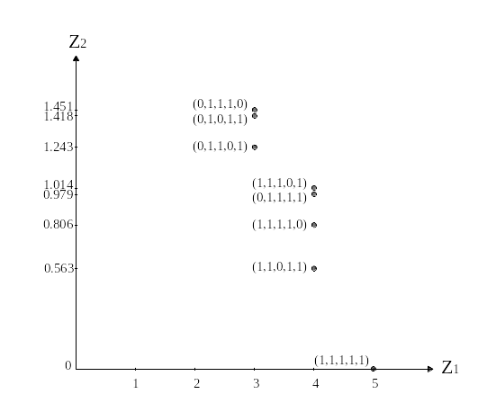

Minimize number of tagSNP
NCKU _IIM_2008/08/28_tagSNPSP with two criteria_Bi-Objective Programming Model_Example
Notes:
As shown in this Figure, if we only consider the original tagSNPSP objective, then we can have 3 optimal solutions.
After considering the 2nd objective, we will know that selecting S2,S3, and S4 is the set of tagSNPs that can provide more biological insights.

Slide 32
Integer Programming consider capacity
Notes:
Next, consider the capacity of biochip, We propose a IP formulation.

Slide 33
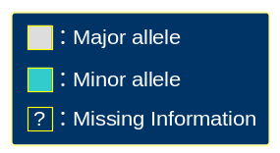
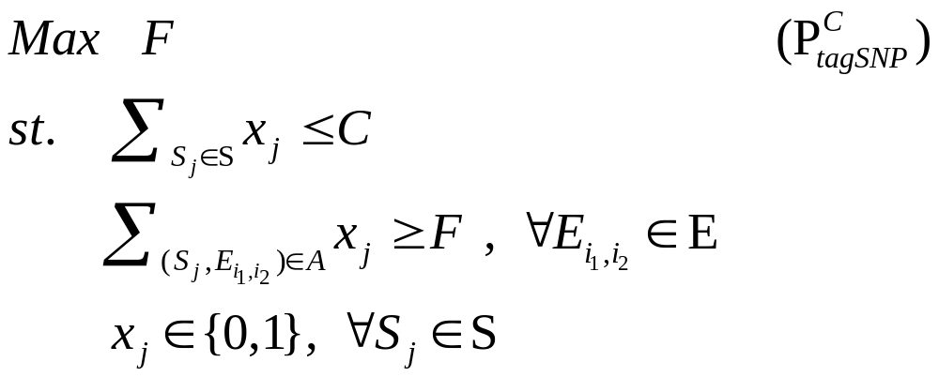
Consider Biochip Capacity
Experiment Failure → Missing information
Each E_{i1,i2} identify more than F
Biochip Capacity C
1
2
3
4
5
6
7
8
9
10
h₁
0
0
0
0
0
1
0
0
1
0
h₂
0
1
0
1
0
0
0
0
0
0
h₃
0
0
1
0
0
0
1
1
0
0
h₄
0
0
0
1
1
1
1
0
1
1
h₁
0
1
h_{i}
0
0
1
0
0
?
1
1
0
?
h₃
0
0
NCKU _IIM_2008/08/28_Consider Biochip Capacity
Notes:
Before selecting tagSNP, we can obtain the capacity for the Biochip. So it’s not necessary to select the minimal one, just select one that within the limit of the capacity.
How to judge to select other redundant tagSNP?
Since the experiment can occur failure to cause missing some SNP information. As you see on this slice, suppose there are 4 haplotypes, and each includes 10 SNPs.
We select SNP 4 & 6 as tagSNP. If now we want to identified hi. We find in this case, because of missing some information, we can not determine whether hi is h1 or h3. To avoid this condition, we can increase the minimum number of each E node at least be selected. Not just one time like original model. For example, if we increases the number from 1 to 2, then due to missing information, the unselected node E can be selected now through another S node. By increasing the lower bound of the number that each node E be selected, we can find more reliable tagSNP.
Therefore we propose a model on the conditions of the limit capacity to select a tagSNP which can identify haplotype more reliability.
The variable F represent the minimum number that each node to be selected & C represent the capacity for the biochip.

Slide 34
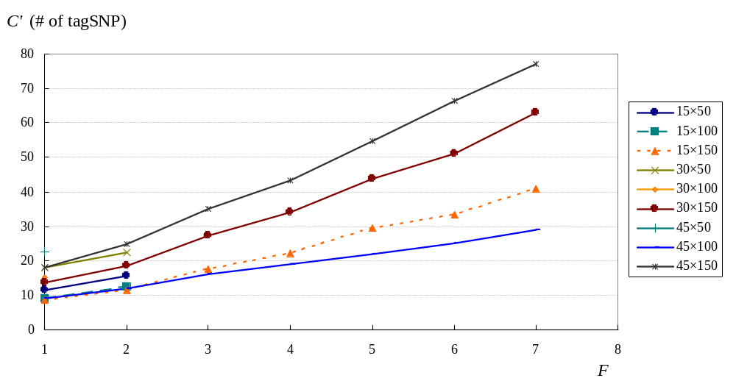
F – C’ chart
NCKU _IIM_2008/08/28_Consider Biochip Capacity_F-C chart
Notes:
This figure is the relation between F & C’, here we define C’ is the lower bound of C. In this figure you can see the number of tagSNP increase as F increases, the biochip manufacturer can consider of their cost & technology, decide how reliability they can select in their condition.

Slide 35
Summary
Propose a LRH algorithm to solve large scale tagSNP selection problem
Combine the advantage of LRH & CPLEX to give a two-stage solution method
Propose a bi-objective programming model
  minimize the number of tagSNP
  maximize its associated LD value
Consider biochip capacity to propose a model to maximal the reliability of tagSNP
NCKU _IIM_2008/08/28_Summary
Notes:
In the large scale of tagSNP Selection problem, we propose a LRH algorithm base on the theory of lagrangian relaxation. By incorporate the concept of Greedy theory which selects some good SNP column, gradually reduces the problem size, and thus improves the algorithm‘s efficacy and solution quality. We also combine the advantage of LRH & CPLEX to give a two-stage solution method, and find this MIX method can reduce the cost of time and also obtain a better solution.
Besides, we propose a bi-objective programming model with consider minimize the number of tagSNP & maximize its LD value between tagSNP and the other SNPs.
Finally, we propose a model on the conditions of considering the capacity for the biochip, and the objective is to find the most reliability of tagSNP used on identify haplotype pattern.

Slide 36
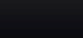
Thanks for your listening
Q&A?
NCKU _IIM_2008/08/28
Notes:
That all of my presentation. Thanks for your listening

