Slide 1
Solving the network flow problem by a least-squares primal-dual (LSPD) method
研究生：張正翰
口試委員：陳文智 博士
許瑞麟 博士
李宇欣 博士
王逸琳 博士
Notes:
以least-squares primal dual 的概念發展出一套用以有效求解網路問題的圖形化演算法

Slide 2
Outline
Introduction
  Motivation
  Objective
Literature review
  Primal-dual algorithm
  NNLS
  NNLS primal-dual algorithm
  LSNF
LSNF for MCF problems
  Initial solution
  Capacitated MCF
LSDP for Max-flow problems
  The original primal-dual algorithm for max-flow problems
  Electrical network problem
  LSDP for MCF problems
Conclusion
Notes:
前言部分包括動機與目的
文獻回顧主要介紹瞭解本研究所需具備的基本背景知識
第三、四部分是本論文重點 包含修改前人所提出的演算法以應用於更廣泛的問題 與 將類似概念用以求解最大流量問題
最後是結論部分

Slide 3





Network flow problems
Notes:
網路問題在生活中最直接的應用就是 物流網路 ....

Slide 4
Motivation
The directions provided by NNLS (Nonnegative Least-Squares) has been proved as the steepest ascent/descent direction of the primal-dual algorithm
The least-squares property of network flow problem is advantageous
Wang (2004) proved the application of LSPD to shortest path problem with nonnegative cost is equivalent to the Dijkstra’s algorithm
Gopalakrishnan (2004) proposed the LSNF algorithm can solve MCF problems effectively
Notes:
促使本研究發展的動機主要為以下數點

Slide 5
Objective
Propose a new graphical algorithm based on the concept of the NNLS primal-dual algorithm to solve network flow problems.
Notes:
希望能提出一個有效求解各類網路問題的圖形化演算法

Slide 6
Literature review
Primal-dual algorithm (Ford and Fulkerson, 1962)
NNLS (Dantzig et al., 1993)
NNLS primal-dual algorithm for general LPs (Barnes et al., 2002)
A least-squares network flow algorithm (Gopalakrishnan et al.,)
Notes:
文獻回顧包括～～

Slide 7
Primal-dual algorithm
Dual feasible
Solution p
Minimize the
Objective value
Improving
Direction v
Primal
P
Dual
D
Restricted
Primal
RP
Dual of
restricted primal
DRP
Adjustment to p
Notes:
Primal-dual 是一種類似dual simplex的演算法....以dual problem為主 根據互補對偶性質檢測其是否到達最佳解
若否, 則往下一個解前進 而與simplex最大的不同在於 simplex 是沿著邊線前進 而primal-dual 則是藉由一個improving direction,
所以 傳統的primal-dual流程 主要可以下面的方式表達

Slide 8
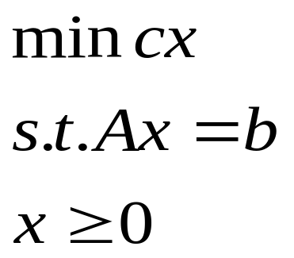
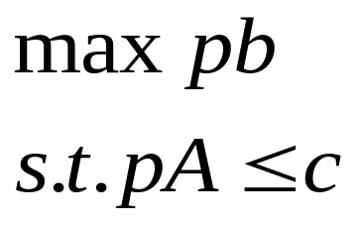
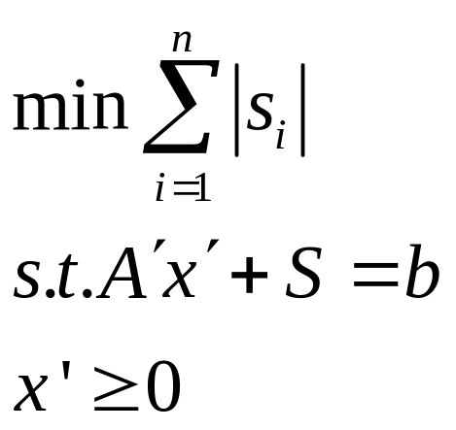
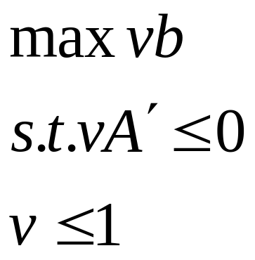
How to get an improving direction
Primal problem
Dual problem
Original primal-dual: form the dual problem of the RP
RP problem
DRP problem
Degenerate pivoting
The optimal solution of DRP , v, is an improving direction
Notes:
RP 是一個phase I problem
重點是DRP也是一個LP問題 所以通常會以simplex求解 往往會造成degenerate pivoting的結果
事實上primal-dual 是一個很有彈性的演算法 其improving direction並非唯一 只要符合兩個條件皆可運行
接著我們介紹什麼叫做NNLS 為什麼可以與primal-dual 做結合

Slide 9
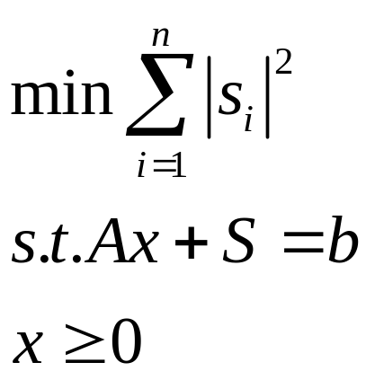
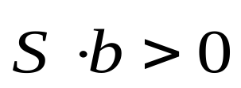
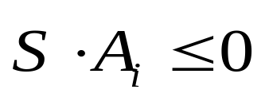


NNLS (Nonnegative Least-Squares)
Z*=min ||b - Ax||², x≥0 , find a feasible x such that Z*=0
A₁
A₂
Ax
A₁
A₂
S
b
b
b
Ax
A₃
is an improving direction
Notes:
以幾何觀點來解釋的話～～....列式可改為右上角的型態～～
可知nnls達到optimal時 其slack variable可作為primal-dual 的improving direction

Slide 10
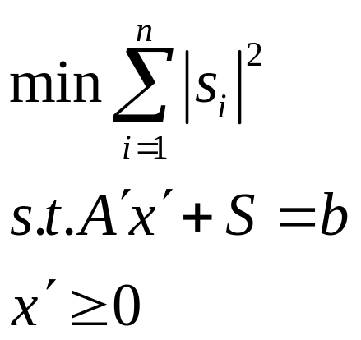
How to get an improving direction
Primal problem
Dual problem
NNLS primal-dual: replace the RP problem by an NNLS problem
NNLS
The improving direction is “S”
Notes:
所以整個流程可以表達為～～

Slide 11
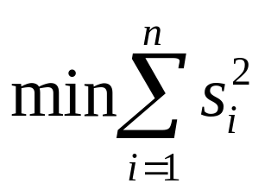
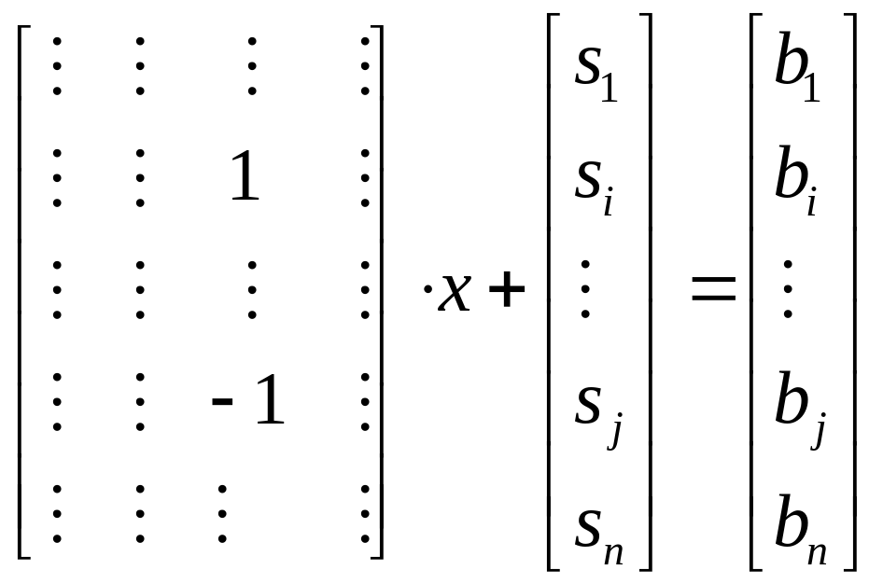
The least-squares property
Notes:
皆下來跟大家介紹 我們在動機的第二點所提到的 網路結構的最小平方和特性
主要是因為網路問題的若以node-arc的方式呈現 則其限制式矩陣中 每個column會有成對的1與-1
將其相加可得～

Slide 12
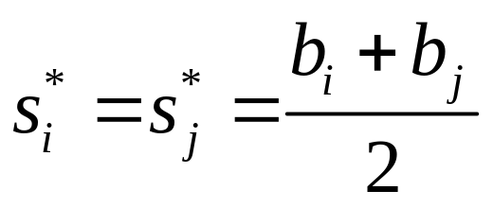
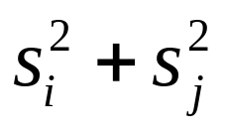
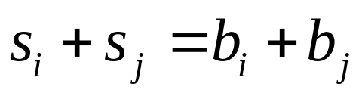
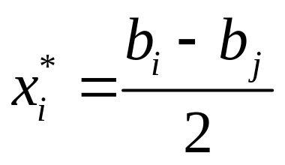
The least-squares property
min
Notes:
根據一次為分 可知 最佳解是當其平分的時候～～
根據這樣的概念 G學者發展出了LSNF演算法
以下是其演算法的運作過程

Slide 13



Example
0.333
0
-0.333
-0.5
0
PV=nRT
5
0
1
2
0
-0.5
-2
-3
2
2
optimal
0
-1
-2
-2.5
-4
-5
-0.333
-1
-0.5
0
2
0
1
1.5
2
3
0.333
4
3
0
0.5
1
1
5
0
4
0.5
1
2
3
0
-1
0.333
0.5
0
-0.333
0
Notes:
利用 理想氣體方程式 pv=nrt的概念來解釋 c (resistance) 與p (pressure)之間的關係

Slide 14
Methodology
Negative cost
  Initial dual feasible solution
Capacity constraints
  Method 1
  Method 2
Notes:
雖然G學者已提出LSNF的演算法,但其實尚有不足之處 , 包括cost 為負值 與arc有流量限制的問題
其中負的cost將會影響我們取得初始可行解

Slide 15
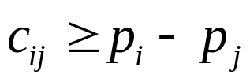
Negative cost
How does it affect our problem
  Initial dual feasible solution
Traditional method
  Artificial constraint technique
Notes:
Artificial constraint technique 會破壞網路的特殊結構

Slide 16

The method for finding a dual feasible solution
We can not vary the constraints matrix of our problem
Tracking the affection of those arcs with negative cost to assign the dual feasible solution.
  Make sure for each arc, the condition
  is satisfied.
Notes:
我們不想破壞網路問題的特殊結構,所以我們利用label correcting追蹤的概念 一個一個去check每個限制式是否有被滿足

Slide 17




Label-correcting like algorithm
algorithm label-correcting like algorithm
====================================
begin
=0 for every node;
S={nodes pointed by arcs with negative costs}
for j ∈S
while S≠ do
begin
remove an element i from S;
for each arc(i,j) ∈ A(i) do
if
begin
if j∉S then add node j to S;
end;
end;
end;
3
0
0
1
4
2
-1
4
-3
0
1
4
1
2
3
5
-2
0
0
2
i
j
3
S=
2
4
5

Slide 18
Capacity constraints
The methods of handling these capacity constraints
  Method 1
  Method 2
Notes:
接下來是對於有流量上線的arc的處理方法 主要有兩類

Slide 19
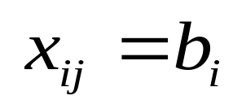
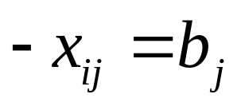
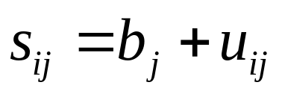
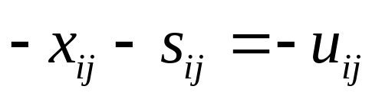
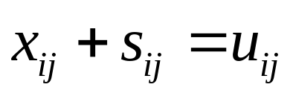
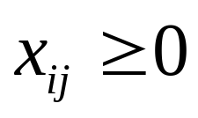
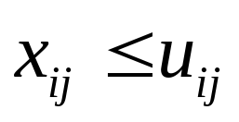


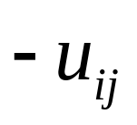
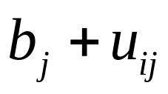
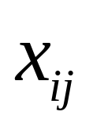
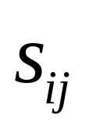
Method 1
i
j
i
k
j
Notes:
利用變數變換 可將有上限之弧轉為無上線

Slide 20
Method 1
The drawback
  The number of variables will increase from n to 2n, and the constraints will increase from m to m+n
  We transform all of these capacitated arcs before solving the problem
Notes:
但此方法的缺點為~~

Slide 21

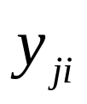
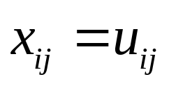


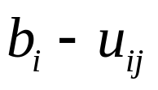

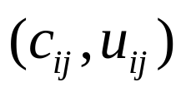
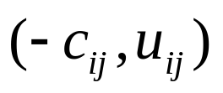
Method 2
We check these capacity constraints when we calculate the minimum ratio at every pivoting
We replace by when
i
j
i
j
Notes:
另一種方法為arc reversal transformation

Slide 22
Example
-3
0
0
3
3
1
0
2
2
0
4
Upper
Bound=1
2
-4
0
3
0
-0.5
-1
0
-0.5
-2
0
-1
3
2
1.5
1
0
-1.66
-1
-1.5
-2
-4.66
0
2
3
4
5.33
4.33
3.5
4
0.25
3
1
2
0
optimal
-0.5
-1
0.25
0
0
0
1
2
3.33
0
-0.5
-1
0.33
0.25
1
0
0
0.25
-0.5
0
0

Slide 23
The LSDP algorithm for max-flow problems
Notes:
接下來是本研究的第二個主體

Slide 24
The dual-primal algorithm for max-flow problems
The max-flow problem
The reachability problem
Primal
P
Dual
D
Restricted
Primal
RP
Dual of
restricted primal
DRP
Adjustment to p
Notes:
傳統的primal-dual 是將主問題視為dual problem

Slide 25

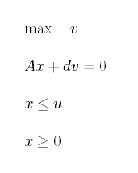

The max-flow formulation
i
j
2
5
4
1
3
4
2
6
3
Notes:
D代表arc 41

Slide 26
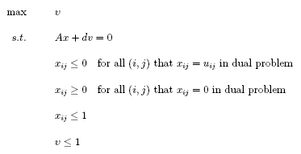
The DRP formulation
Notes:
此為max-flow的DRP問題,事實上就是再找尋一條連接s到t的path,找到之後便沿著此path推送流量. 即所謂的augmenting path algorithm
現在我們延續前面的概念,想要利用NNLS 問題來取得每個iteration的improving direction

Slide 27
-K
K
i
j
Notes:
但是在我們寫出對應的NNLS問題之前 我們先將max-flow的formulation做些小轉換
我們將等號換乘小於等於 因為網路的特殊結構(成對的1與-1) 所以小於的狀況是不會成立的
也就是我們這個放寬的動作並不會影響到我們的問題
雖然不會影響到我們原本的問題 但必須經過此改變才能列出對偶的”NN”LS問題

Slide 28
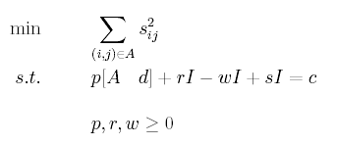
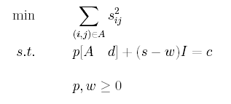
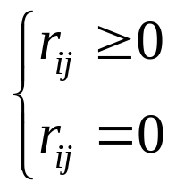
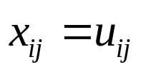
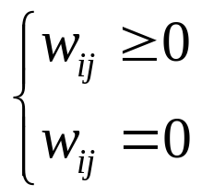
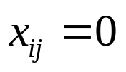
The NNLS formulation
For all (I,j) that
For all (I,j) that
Otherwise
Otherwise
Notes:
解釋各變數
若採用arc-reversal transformation則可將r去掉 簡化式子
而我們在測試多個case發現一個有趣的現象
就是 每次的improving direction都會服從柯希荷夫定律
也就是 我們可將NNLS在取得improving direction的過程 比擬成電路上所產生的電流

Slide 29
The Kirchhoff’s law
Current Law:
For every node the summation of all entering and leaving current equals to zero.
(same as the flow balance constraint)
Voltage Law:
For every cycle, the summation of voltage change along the cycle equals to zero.
Notes:
在此我先稍微跟大家介紹一下什麼事柯希荷夫定律

Slide 30
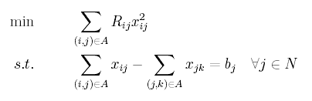
Hu’s model
Minimum-cost flow in convex-cost networks (1966)
Notes:
事實上Hu 在1966年就提出,電路網路實際上可轉換成為一個二次目標式的數學規劃問題
在本model中 constraint扮演current law 而目標式代表的是最小化熱功率
我們知道熱功率=ir^2……..

Slide 31
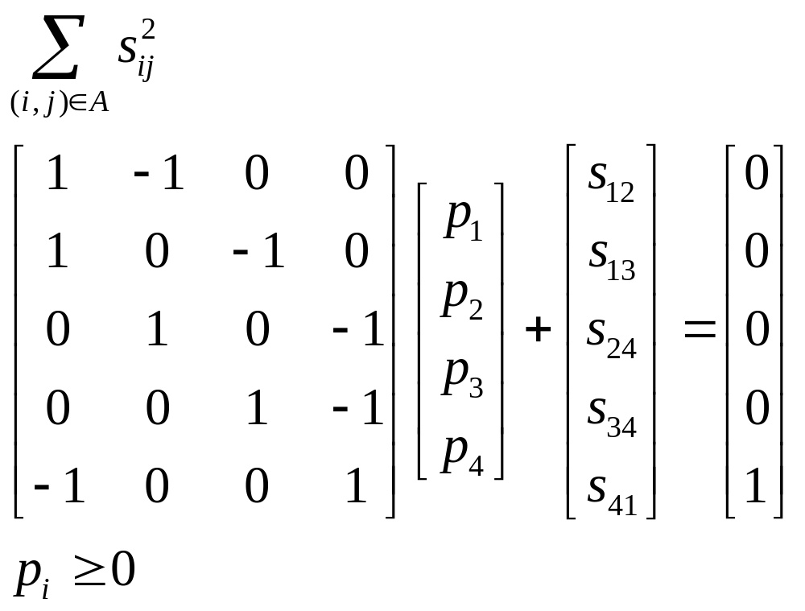

2
2
1
1
4
4
3
1’
3
Notes:
而我們NNLS的列式也有類似之處 constraint與voltage law等價
未簡單起見 我們先假設不考慮w 只看s的話….解釋~~
但大家可能會想說 那如果包含s41的不就是不等於0嗎
如果我們將原網路轉換為……就可以理解 她還是服從voltage law

Slide 32
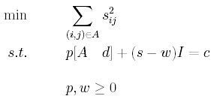

The comparison with diode
disconnected
0
-0.2
0.2
diode
0.5
0.4
0.5
0.6

Slide 33

How to identify those disconnected arcs
Sequentially delete the arc with largest amount of illegal flow
It was concluded by testing several cases
n | m
30~40 | 150~200 | 0~100
Notes:
砍最負的～！！！！

Slide 34
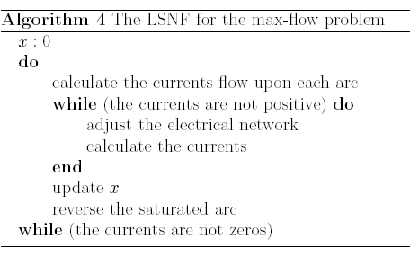
Pseudo-code
Notes:
按照這個概念 我們現在來看看整個流成的pseudo-code

Slide 35

Example
OPTIMAL
2
2
2
2
2
4
1
1
4
1
4
4
1
3
4
3
1’
1’
6
1’
3
3
3
Broke circuit
3
S=(0.25, 0.25, 0, 0.25, 0.25, 0.5)
S=(0, 0.333, 0, 0, 0.333, 0.333)
X=(0,0,0,0,0,0)
X=(2,3,0,2,3,5)
X=(2,2,0,2,2,4)

Slide 36

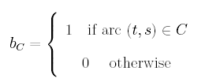
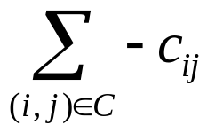
Application on MCF problems
2
1
1
1
3
2
2
4
1
2
1
1
3
2
2
4

Slide 37

Example:Step1
i
j
(3,1)
6.46
2
4
(2,3)
2
4
(2,3)
6.46
6.89
3
1
(3,2)
(2,2)
6
-3
1
0
0.43
6
(1,1)
(1,3)
(5,1)
6.74
3
5
3
5
6.31
6.74
(40, )
13.2

Slide 38
Example:Step2
i
j
(3,1)
7.2
2
4
(2,3)
2
4
(2,3)
9.9
6
3
1
(3,2)
(2,2)
6
-3
1
2.7
1.2
6
(1,1)
(1,3)
(5,1)
0
3.9
3
5
3
5
2.7
(40, )
9.9

Slide 39
Example:Step3
i
j
(3,1)
0
2
4
(2,3)
2
4
(2,3)
6.3
2.4
3
1
(3,2)
(2,2)
6
-3
1
6.3
2.4
6
(1,1)
(1,3)
(5,1)
0
3.9
3
5
3
5
6.3
(40, )
6.3

Slide 40
Example:Step4
i
j
(3,1)
0
2
4
(2,3)
2
4
(2,3)
5
5
3
1
(3,2)
(2,2)
6
-3
1
6
5
5
(1,1)
(1,3)
(5,1)
0
3
5
3
5
0
5
(40, )
5

Slide 41
Example:Step5
i
j
(3,1)
2
4
(2,3)
2
4
(2,3)
0.3
3
1
(3,2)
(2,2)
6
-3
1
0.3
6
(1,1)
(1,3)
(5,1)
0.3
3
5
3
5
(40, )

Slide 42
Example:Step6
i
j
OPTIMAL
(3,1)
2
4
(2,3)
2
4
(2,3)
3
1
(3,2)
(2,2)
6
-3
1
6
(1,1)
(1,3)
(5,1)
3
5
3
5
Broke circuit
(40, )

Slide 43
Future Work
Construct a more rigorous proof on our proposed max-flow algorithm
Develop the specialized method to identify the disconnected arcs of the corresponding electrical network
Apply the LSPD algorithm on the multi-commodity network flow problems
Notes:
最後是我們的預期目標
我們在將max-flow部份做最後的修訂之後
將會探討以類似max-flow解法的概念 套用在MCF上會有什麼情況
目前我們已經有初步的結果

Slide 44
Thanks for your listening

