Slide 1

Reliability for Multi-state Capacitated Manufacturing Networks with Distillation Processes
指導教授：
王逸琳 教授
李宇欣 教授
林義貴 教授
洪一薰 教授
黃耀廷 教授
學生：
陳正楠

Slide 2

Outline
Introduction
Literature review
Compacting process
Computing network reliability
Min-cost with reliability constraints
Summary

Slide 3
Introduction
About network reliability
  Definition: the probability of satisfying system’s requirements
  Applications: power system, transportation, manufacturing
About D-node
  Distribution (distillation) node
Notes:
MP: 連結st的路徑，的弧集合，且其子集合非st路徑（沒有cycle）。
MC: 中斷st的割集，的弧集合，且其子集合非st割集。

Slide 4
Outline
Introduction
Literature review
Compacting process
Computing network reliability
Min-cost with reliability constraints
Summary

Slide 5
Literature Review
- Network reliability
Reliability index
  Lower Bound Point (LBP) and Upper Bound Point (UBP)
Problem types:
  Binary state: Moskowitz (1958), Mine (1959)
  Multistate capacity: Yeh (1998), Lin et al. (1995)
  Node failure: Yeh(2001), Lin (2002b)
  Cost budget: Lin (2004), Lin (2002a)
  Multicommodity: Lin (2003), Yeh (2006b)
Notes:
滿足系統需求d單位或以上的機率
滿足系統需求最多是d單位的機率

Slide 6
Literature Review
- Network reliability
Solution methods
  Minimal path and flow constraints: Yeh (2001), Lin (2001)
  State enumeration: Yeh (2006)
  State Space Partitioning method (SSP): Alexopoulos (1997)

Slide 7
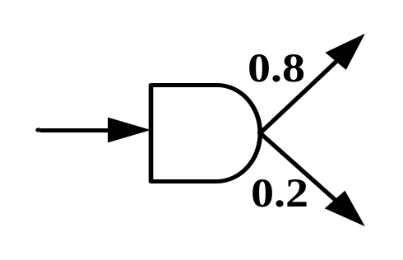
Literature Review
- D-node
Pure processing network (PPN) vs. Distribution network
  Koene (1982): refine and blend
  Fang & Qi (2003): distill and combine
  Optimization technique for PPN and Distribution network
    Sheu et al.(2006), Lin (2005)
Reliability + D-node = ?

Slide 8
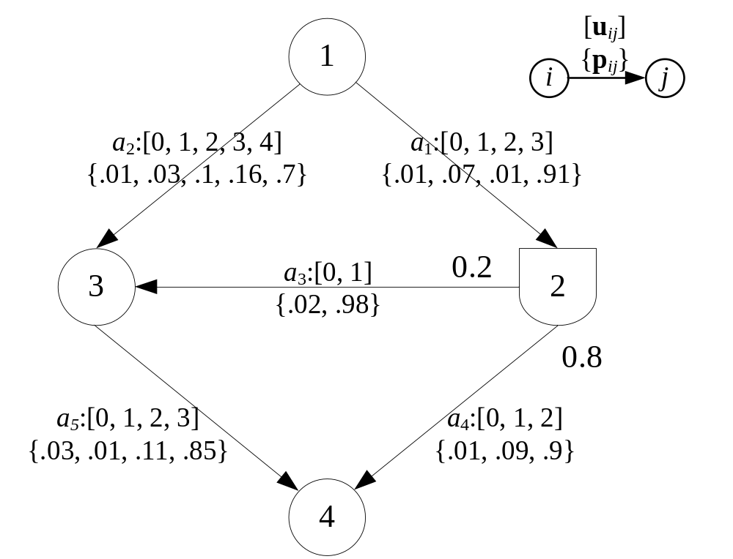
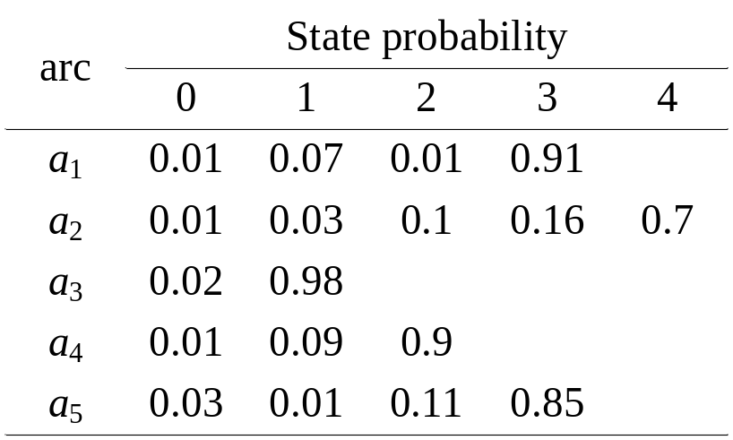
A new type of a reliability problem

Slide 9
Outline
Introduction
Literature review
Compacting process
Computing network reliability
Min-cost with reliability constraints
Summary

Slide 10
Compacting Process
To simplify the network structure
Five compacting cases:
  D-groups
  Single transshipment O-nodes
  Self-loop arcs
  Parallel arcs
  Mismatched capacities

Slide 11
Compacting Process
Single transshipment
Self loop arc
Parallel arc
Single transshipment
D-groups
Parallel arc

Slide 12
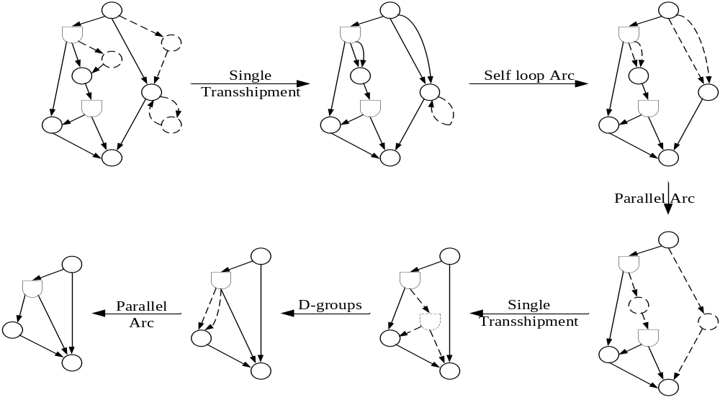

Slide 13
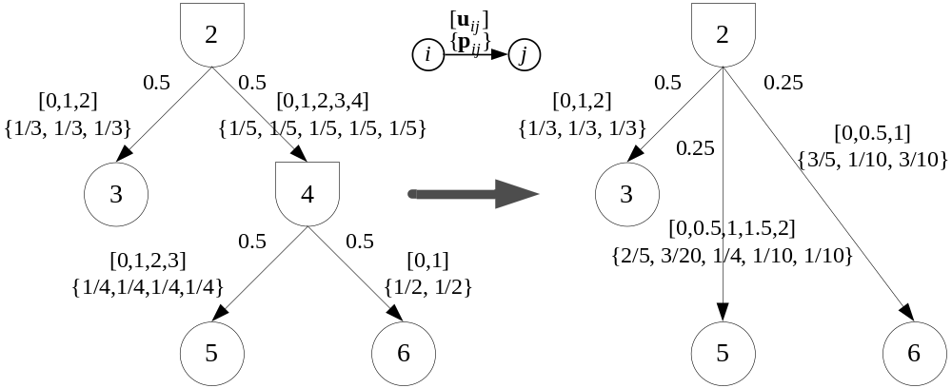
Compacting Process
Case 1: D-groups
D-groups

Slide 14
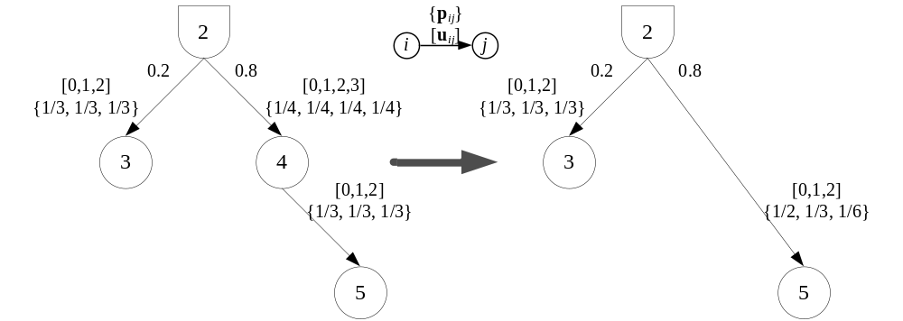
Compacting Process
Case 2: Single transshipment O-nodes

Slide 15
Compacting Process
Case 2: Single transshipment O-nodes
state | Prob. | state | Prob. | state | Prob.
0,0 | 1/4×1/3 | 1,1 | 1/4×1/3 | 2,2 | 1/4×1/3
0,1 | 1/4×1/3 | 1,2 | 1/4×1/3 | 3,2 | 1/4×1/3
0,2 | 1/4×1/3 | 2,1 | 1/4×1/3
1,0 | 1/4×1/3 | 3,1 | 1/4×1/3
2,0 | 1/4×1/3
3,0 | 1/4×1/3
0 | 1/2 | 1 | 1/3 | 2 | 1/6

Slide 16
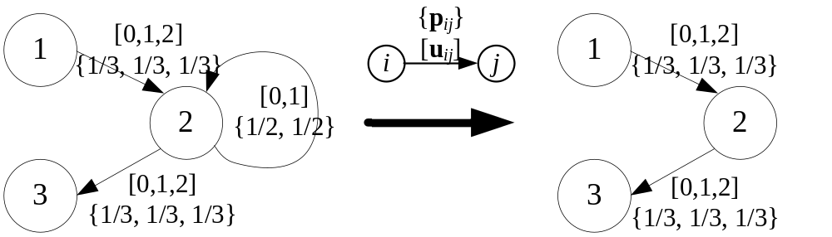
Compacting Process
Case 3: Self-loop arcs

Slide 17
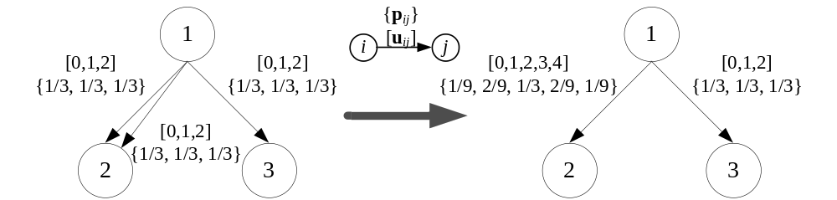
Compacting Process
Case 4: Parallel arcs (connecting O-nodes)

Slide 18
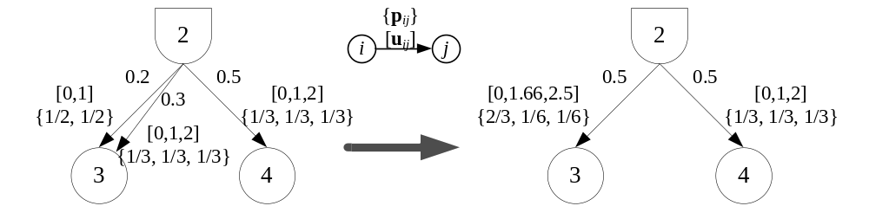
Compacting Process
Case 4: Parallel arcs (connecting a D-node)

Slide 19
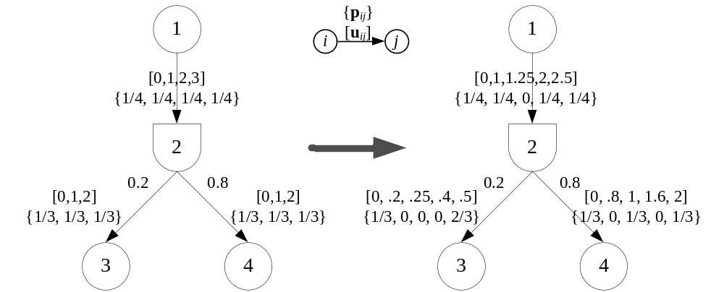
Compacting Process
Case 5: Mismatched capacities

Slide 20
Outline
Introduction
Literature review
Compacting process
Computing network reliability
Min-cost with reliability constraints
Summary
Modified state enumeration method (MSE)
Modified state space partition method (MSSP)

Slide 21
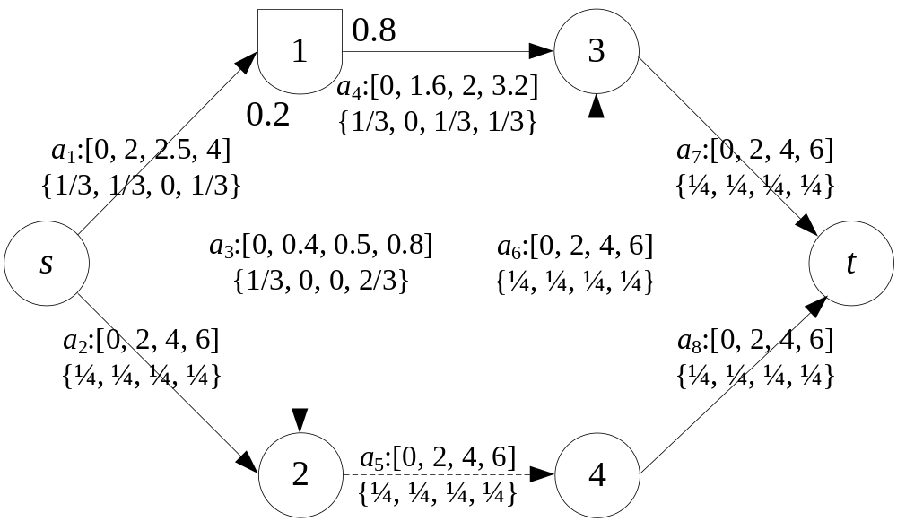
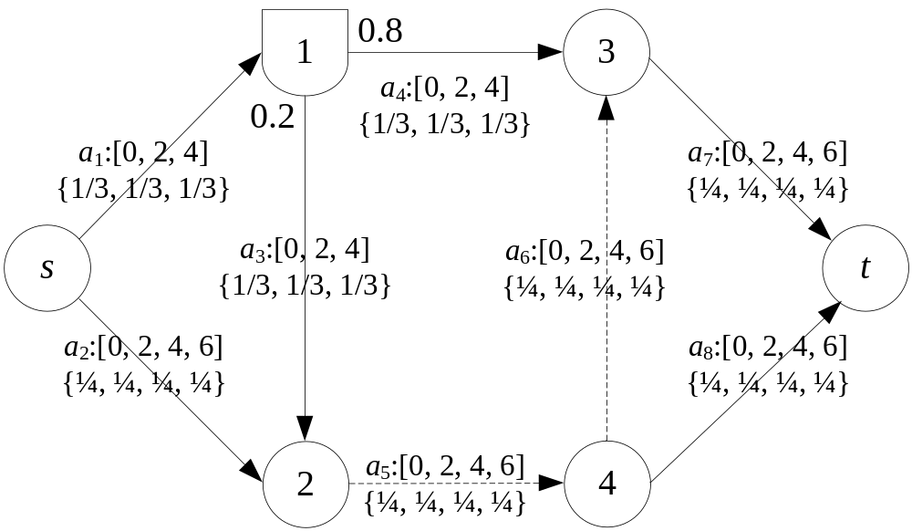
Computing Network Reliability
- Problem definition

Slide 22
Computing Network Reliability
MSE method
  Enumerate all capacity state combination
  Check feasibility
  Find LBP to calculate reliability
MSSP method
  Partition state space into feasible and infeasible interval
  Squeeze the reliability

Slide 23
Computing Network Reliability
MSE - General procedure
Step 1. Enumerate all CCC (Candidate Capacity Combination vector)
Step 2. Eliminate infeasible CCC by checking the capacity constraints
Step 3. Check the feasibility of remaining CCC
Step 4. Compare all pairs to identify QCC Qualified Capacity Combination vector, that is LBP)
Step 5. Compute the system’s reliability

Slide 24
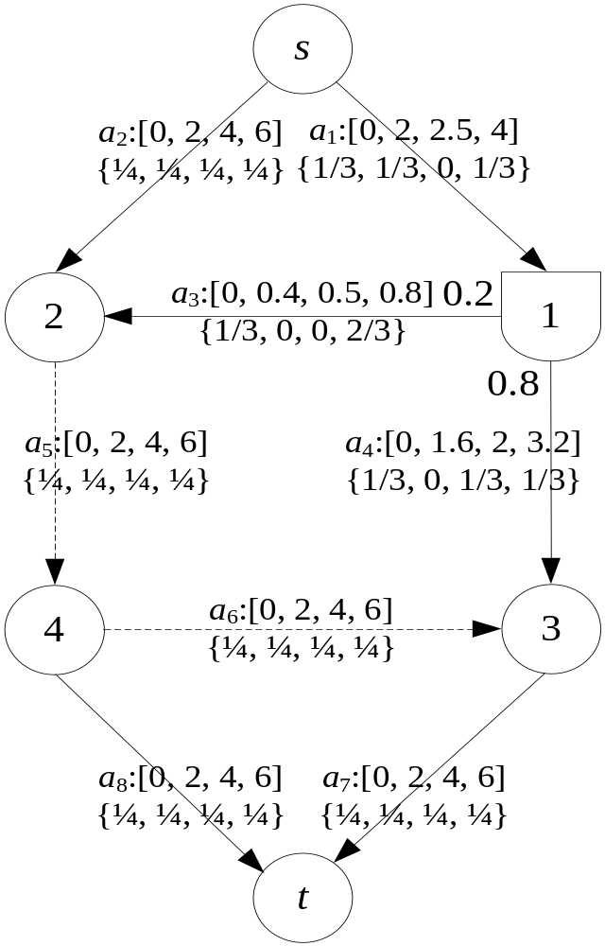


Computing Network Reliability
MSE - Numerical example (step 1)
Enumerate all capacity state combinations
4 states
4 states
a₁
a₂
a₃
a₄
a₅
a₆
a₇
a₈
4 states
0
0
0
0
0
0
0
0
0
0
0
0
0
0
0
2
4 states
4 states
65536 CCC
0
0
0
0
0
0
0
4
0
0
0
0
0
0
0
6
4⁸
4 states
0
0
0
0
0
0
2
0
0
0
0
0
0
0
2
2
4 states
4 states
4
6
0.8
3.2
6
6
6
6

Slide 25

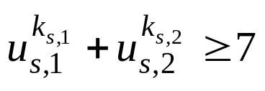
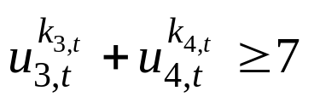
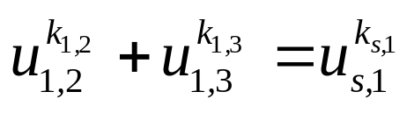
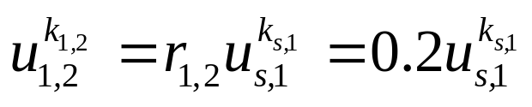
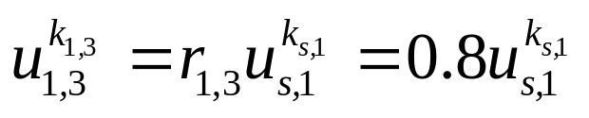
Computing Network Reliability
MSE – Numerical example (step 2)
Check feasibility by using following constraints:
385 CCC

Slide 26
Computing Network Reliability
MSE – Numerical example (step 3)
Check feasibility by solving max-flow problem, 120 CCC remains
a₁
a₂
a₃
a₄
a₅
a₆
a₇
a₈
1
2
6
0.4
1.6
6
0
2
6
2
2
6
0.4
1.6
6
0
4
6
3
2
6
0.4
1.6
6
0
6
6
4
2
6
0.4
1.6
6
2
2
6
5
2
6
0.4
1.6
6
2
4
4
119
4
6
0.8
3.2
6
6
6
4
120
4
6
0.8
3.2
6
6
6
6

Slide 27
Computing Network Reliability
MSE – Numerical example (step 4)
i
j
qualification
I
1
2
CCC₂ > CCC₁
{ 2}
1
3
CCC₃ > CCC₁
{ 2, 3}
1
117
CCC₁₁₇ > CCC₁
{ 2, 3, 4, 6, 8, 9, 11, 14, 15, 17, 20, 21, 22, 23, 24, 26,
28, 29, 31, 34, 35, 37, 40, 98, 100, 102, 103, 105, 108, 109, 111, 114, 115, 117}
1
120
CCC₁₂₀ > CCC₁
{ 2, 3, 4, 6, 8, 9, 11, 14, 15, 17, 20, 21, 22, 23, 24, 26, 28, 29, 31, 34, 35, 37, 40, 98, 100, 102, 103, 105, 108, 109, 111, 114, 115, 117, 120}
5
7
CCC₇ > CCC₅
{ 2, 3, 4, 6, 8, 9, 11, 14, 15, 17, 20, 21, 22, 23, 24, 26, 28, 29, 31, 34, 35, 37, 40, 98, 100, 102, 103, 105, 108, 109, 111, 114, 115, 117, 120, 7}
5
10
CCC₁₀ > CCC₅
{ 2, 3, 4, 6, 8, 9, 11, 14, 15, 17, 20, 21, 22, 23, 24, 26, 28, 29, 31, 34, 35, 37, 40, 98, 100, 102, 103, 105, 108, 109, 111, 114, 115, 117, 120, 7, 10}

Slide 28
Computing Network Reliability
MSE – Numerical example (step 5)
Obtained five qualified capacity combination vector (QCC) after comparison
  QCC₁ = [2, 6, 0.4, 1.6, 6, 0, 2, 6]
  QCC₂ = [2, 6, 0.4, 1.6, 6, 2, 4, 4]
  QCC₃ = [2, 6, 0.4, 1.6, 6, 4, 6, 2]
  QCC₄ = [4, 4, 0.8, 3.2, 4, 0, 4, 4]
  QCC₅ = [4, 4, 0.8, 3.2, 4, 2, 6, 2]

Slide 29
Computing Network Reliability
MSE – Numerical example (step 5)
Reliability of multistate network
  E_{i} = {X | X ≥ QCC_{i}}
  Pr(E₁∪E₂∪E₃∪E₄∪E₅) = 0.010127315

Slide 30
Computing Network Reliability
MSSP – General Procedure
Partition entire state space (Ω) into feasible, infeasible and undetermined interval with v⁰ and v*
Step 1. Set P_{U} = 1, P_{L} = 0 and Γ = Ω
Step 2. Partition the interval set of Γ into feasible interval F, infeasible interval I_{j} and undetermined interval U_{j} by v⁰ and v*
Step 3. Set P_{L} = P_{L} + Pr{F}, P_{U} = P_{U} - Pr{Ij}
Step 4. End with Γ is empty or P_{L} = P_{U} = P

Slide 31
Computing Network Reliability
MSSP – Improve efficiency
Decrease the number of times to solve max-flow problem by distillation constraint
  v⁰ = v* = v for all D-node’s adjacency arcs
  Obey distillation constraint
    v_{j} = r_{j}v_{i} ,where arc i is entering arc of D-node, arc j is outgoing arc of D-node

Slide 32
Computing Network Reliability
MSSP – Numerical example (1/3)
Step 1.
  Set P_{U}=1, P_{L}=0 and Γ= Ω = [α, β] = [(0, 0, 0, 0, 0, 0, 0, 0), (4, 6, 0.8, 3.2, 6, 6, 6, 6)]
Step 2.
  Lower each arc’s capacity level to obtain feasible state v⁰=[2, 6, 0.4, 1.6, 6, 0, 2, 6]
  Fix all arcs’ capacity levels at α and lower each arc’s capacity level to obtain v*=[2, 4, 0.4, 1.6, 4, 0, 2, 2]

Slide 33
Computing Network Reliability
MSSP – Numerical example (2/3)
  F = [v⁰, β] = [(2, 6, 0.4, 1.6, 6, 0, 2, 6), (4, 6, 0.8, 3.2, 6, 6, 6, 6)],
  I₁ = [(0, 0, 0, 0, 0, 0, 0, 0), (0, 6, 0.8, 3,2, 6, 6, 6, 6)]
  I₈ = [(2, 4, 0.4, 1.6, 4, 0, 2, 0), (4, 6, 0.8, 3.2, 6, 6, 6, 0)]
  U₂ = [(2, 4, 0.4, 1.6, 4, 0, 2, 2), (4, 4, 0.8, 3.2, 6, 6, 6, 6)]
  U₅ = [(2, 6, 0.4, 1.6, 4, 0, 2, 2), (4, 6, 0.8, 3.2, 4, 6, 6, 6)]
  U₈ = [(2, 6, 0.4, 1.6, 6, 0, 2, 2), (4, 6, 0.8, 3.2, 6, 6, 6, 4)]

Slide 34
Computing Network Reliability
MSSP – Numerical example (3/3)
Step 3.
  P_{L} = P_{L} + Pr{F}
  = 0 + 0.67×0.25×0.67×0.67×0.25×1×0.75×0.25
  = 0.0034722
  P_{U} = P_{U} － Pr{I₁} － ··· － Pr{I₈}
  = 1 － 0.333 － ··· － 0.0138
  = 0.04166
  Γ = {U₂, U₅, U₈}, use undetermined interval U₂ and go to step 2

Slide 35
Computing Network Reliability
MSSP – Numerical example (4/4)
Step 4.
  Γ is empty and P_{L} = P_{U} = 0.010127315

Slide 36
Computing Network Reliability
MSSP – some properties
QCC can be obtained by comparing all v⁰ to find LBP in each undetermined interval
Since we obtained QCC, we can use IE method to find reliability directly rather than squeezing
link

Slide 37
Outline
Introduction
Literature Review
Compacting process
Computing Network reliability
Min-cost with reliability constraints
Summary

Slide 38
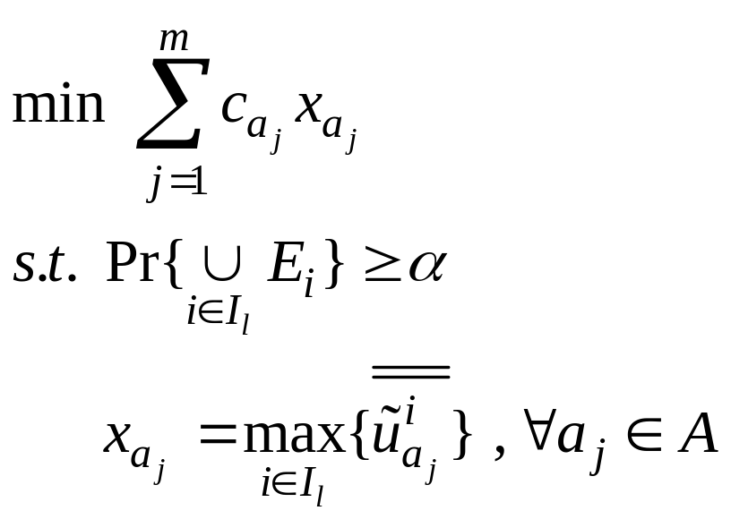
Min-cost with reliability constraints
- Problem definition
A managerial information
Satisfy reliability threshold (α) and then find the minimum cost

Slide 39
Min-cost with reliability constraints
- General procedure
Step 1. Use the information of the whole system’s reliability: Pr(E₁), Pr(E₂), …, Pr(∩_{i} E_{i})
Step 2. Enumerate all QCC_{i}’s combination (Set I_{l})
Step 3. Find the feasible set
Step 4. Find the minimum cost from all feasible sets

Slide 40
Min-cost with reliability constraints
- Numerical example (1/2)
5 QCC, α = 0.009
Step 1. Pr(E₁), Pr(E₂), Pr(E₃),…,
Pr(E₁∩E₂ ∩ E₃ ∩ E₄ ∩E₅),
Step 2. I₁ = {QCC₁, QCC₂, QCC₃, QCC₄}
I₂ = {QCC₁, QCC₂, QCC₃, QCC₅}
I₃ = {QCC₁, QCC₂, QCC₄, QCC₅}
I₃₀ = {QCC₅}

Slide 41
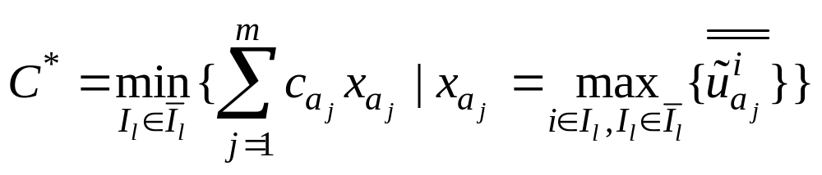
Min-cost with reliability constraints
- Numerical example (2/2)
  Rel_{I_1}(G), Rel_{I_3}(G), Rel_{I_4}(G) > 0.009,
  Rel_{I_2}(G), Rel_{I_5}(G), …, Rel_{I_30}(G) < 0.009
Step 3. Feasible set = {I₁, I₃, I₄}
Step 4. C* = {38, 36, 38} = 36,
I* = I₃ = {QCC₁, QCC₂, QCC₄, QCC₅}

Slide 42
Outline
Introduction
Literature Review
Compacting process
Computing Network reliability
Min-cost with reliability constraints
Summary

Slide 43
Summary
Compacting capacitated networks with D-nodes
Calculate network reliability for multistate distribution network with two methods:
  MSE
  MSSP
More managerial information: min-cost with reliability constraint

Slide 44
Future research
Use heuristic method to approximate reliability
Network reliability with budget constraint by SSP
Solve stochastic shortest path problem by SSP
Reliability for multicommodity

Slide 45
Thanks for your listening!!

Slide 46
Original SSP
4 +2+2+4+4+2=18
0 +3+3+4+4+4=18
Improved SSP
3+3+3 +2+2+4+4+2=23
3+3+3 +3+3+4+4+4=27
 | a₁ | a₂ | a₃ | a₄ | a₅ | a₆ | a₇ | a₈
β | 4 | 6 | 0.8 | 3.2 | 6 | 6 | 6 | 6
v⁰ | 2 | 6 | 0.4 | 1.6 | 6 | 0 | 2 | 6
 | a₁ | a₂ | a₃ | a₄ | a₅ | a₆ | a₇ | a₈
β | 4 | 6 | 4 | 4 | 6 | 6 | 6 | 6
v⁰ | 2 | 6 | 2 | 2 | 6 | 0 | 2 | 6
 | a₁ | a₂ | a₃ | a₄ | a₅ | a₆ | a₇ | a₈
β | 4 | 6 | 0.8 | 3.2 | 6 | 6 | 6 | 6
v* | 2 | 4 | 0.4 | 1.6 | 4 | 0 | 2 | 2
 | a₁ | a₂ | a₃ | a₄ | a₅ | a₆ | a₇ | a₈
β | 4 | 6 | 4 | 4 | 6 | 6 | 6 | 6
v* | 2 | 4 | 2 | 2 | 4 | 0 | 2 | 2
back

