Slide 1
Uncapacitated Minimum Cost Problem in a Distribution Network
系級 工管碩二
報告人 楊羽惠
指導教授 陳文智
老師
許瑞麟
老師
李宇欣
老師
2005.5.29
王逸琳
老師

Slide 2
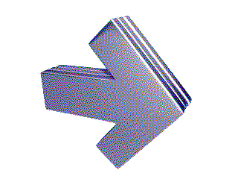
Outline
Introduction
  Motivation
  Objectives
Literature Review
  Traditional minimum cost flow problem
  Traditional shortest path problem
  Some algorithms for solving shortest path problem
Introduce the distribution network flow problems
  The new uncapacitated minimum distribution cost problem
  Three new shortest path problems
  Develop algorithms for solving three problems

Slide 3
Introduction (1)
Motivation
Fang and Qi (2003) presented a manufacturing network flow (MNF)
model which included a new kind of nodes, called D-nodes.
And, they solve the minimum cost problem by using a modified network
simplex algorithm.
When the flow value on each arc has no upper bound, the uncapacitated
minimum cost problem can be regarded as a shortest path problem.
In this thesis, we will probe into the uncapacitated minimum cost problem in a distribution network.

Slide 4
Introduction (2)
Objectives
Define three shortest path problems
Discuss the formulations
Find methods to solve the three problems

Slide 5


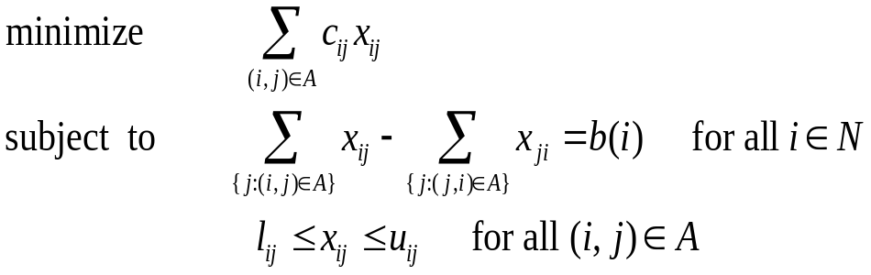
Traditional minimum cost flow problem
We wish to determine a minimum shipment
cost of a commodity through a network in order
to satisfy demands at the termination nodes
from the source node.
s
18
(0,5,1)
(0,10,2)
0
1
2
0
(0,7,1)
(0,8,1)
(0,9,1)
(0,5,1)
3
4
5
-5
-6
-7

Slide 6
Traditional shortest path problem (1)
When the flow value on each arc has no upper bound, the uncapacitated minimum cost problem can be regarded as a shortest path problem.
We wish to find a path of minimum cost
(or length) sending a unit flow from
a source node to other specific
termination nodes.
s
18
(0,∞,1)
(0,∞,2)
0
1
2
0
(0,∞,1)
(0,∞,1)
(0,∞,1)
(0,∞,1)
3
4
5
-5
-6
-7

Slide 7
Traditional shortest path problem (2)
Single-source shortest path problem
  One source node to one termination node (called one-to-one)
  One source node to some termination nodes (called one-to-some)
All-pairs shortest path problem
  Every node to every other node
Various generalizations of the shortest path problem
  The maximum reliability path problem
  Shortest path with an additional constraint

Slide 8
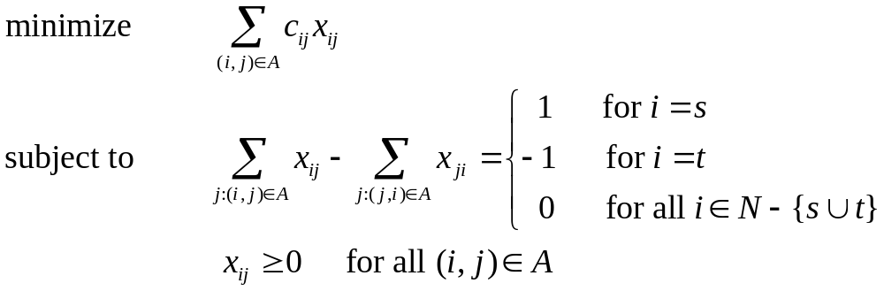
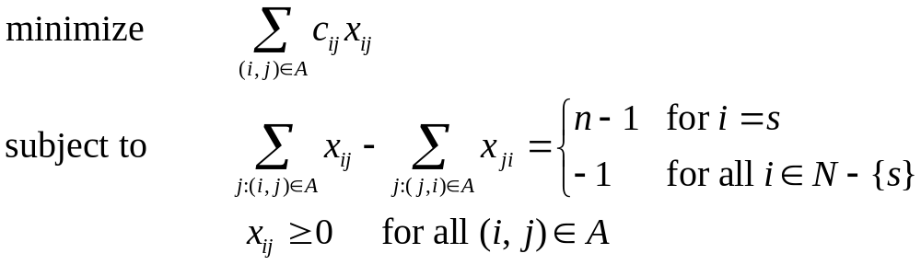
Traditional shortest path problem (3)
1-1 case
1-some case

Slide 9
Algorithms for solving shortest path problem (1)
For single-source shortest path problems
The algorithms are classes into two groups:
(1) Label-setting algorithms
(2) Label-correcting algorithms
Label setting algorithms are applicable:
(1) in the network with nonnegative arc costs (lengths).
(2) in the network with arbitrary arc costs (lengths) without directed cycle.
Such as: (1) Dijkstra’s Algorithm (Dijkstra, 1959)
(2) Dial’s implementation (Dial, 1969)
(3) radix heap implementation (Ahuja, Mehlhorn, Orlin & Tarjan, 1990)
(4) binary-heap implementation (Johnson, 1972)
(5) Fibonacci heap implementation (Fredman & Tarjan, 1987)
Label correcting algorithms apply to all problems, including those with
negative arc costs (lengths).
Such as: (1) first label-correcting algorithm (Ford, 1956)
(2) FIFO implementation (Bellman, 1958)

Slide 10
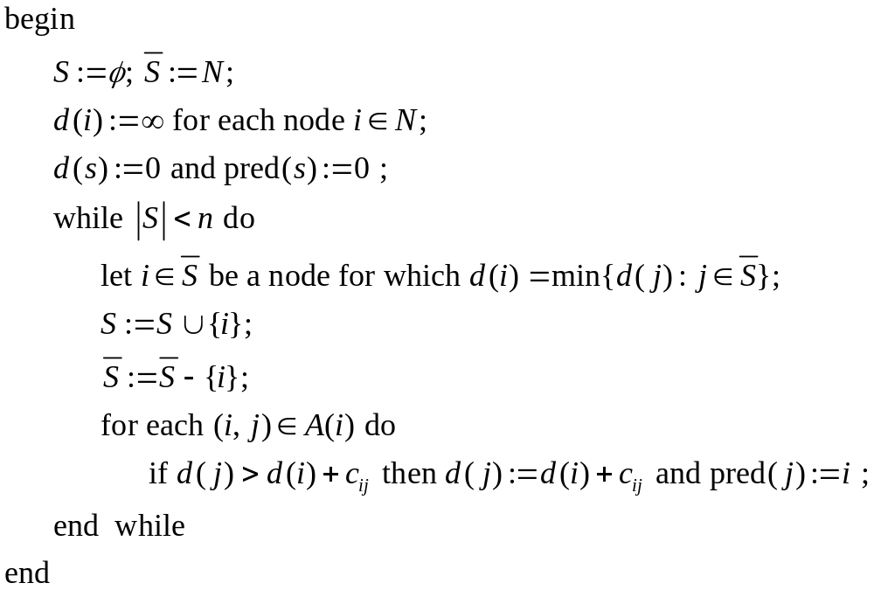
Dijkstra’s Algorithm

Slide 11
General MNF model
We introduce the general MNF problem which presented by Fang and Qi (2003).
s
18
(0,5,1)
(0,10,2)
D
0.2
0.1
0
1
2
0
0.3
0.4
(0,7,1)
(0,8,1)
(0,9,1)
(0,5,1)
0.2 + 0.3 + 0.4 + 0.1 = 1
3
4
5
-5
-6
-7

Slide 12












Notations (1)
Let be a general network, and denote and
be the node and arc set.
We say and are tail and head node for an arc .
Denote be the flow value on a specific arc with a given
upper bound satisfying capacity constraint.
i.e.,
We also denote be the unit cost on an specific arc .

Slide 13

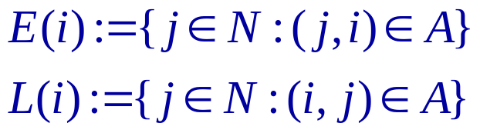


Notations (2)
For a node , we define the set of all “entering” nodes to node and the set of all “leaving” nodes from node as:
…
…

Slide 14
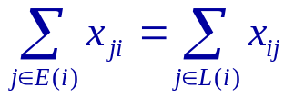

Notations (3)
O-nodes : the ordinary nodes for transition which satisfy
…
…
An O-node

Slide 15
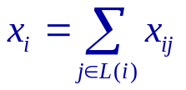


Notations (4)
S-nodes : the source nodes for raw-materials which satisfy
…
An S-node

Slide 16
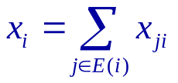

Notations (5)
T-nodes : the termination nodes for final products which
satisfy
…
An T-node

Slide 17






Notations (6)
D-nodes : the distillation nodes which satisfy
and
…
An D-node

Slide 18

Uncapacitated minimum distribution cost problem
If we set , the uncapacitated minimum
distribution cost problem (UMDCP) can be regarded
as a shortest path problem.
s
18
(0,∞,1)
(0,∞,2)
0
1
2
0
(0,∞,1)
(0,∞,1)
(0,∞,1)
(0,∞,1)
3
4
5
-5
-6
-7

Slide 19
Three shortest path problems
We define the UMDCP as three shortest path problems:
  UMDCP₁
  UMDCP₂
  UMDCP₃
These problems can be applied in many regions,
such as manufacturing networks, chemical-processing networks,
and reverse-logistics networks, etc.

Slide 20
Compacting
Compacting single-transshipment O-nodes
Compacting D-groups
Compacting parallel arcs

Slide 21
Compacting process (1)
Compacting single-transshipment O-nodes
  Remove the transshipment O-node .
  Merge two arcs into one arc .
  Reset the cost of this arc by summing
  up the two original arcs’ costs.
  Reduce one O-node and one arc.
  Complexity: O(n)
arc cost
1
1
5
5
2
2
7
3
7
3
3
5
3
4
4
2
2
5
5

Slide 22
Compacting process (2)
Compacting D-groups: Case 1
  For UMDCP1
    Retain the top D-node 2, arc (1,2) and arc (2,3).
    Calculate the outgoing number from node 4
    and 6, and reset the incoming costs.
    Calculate the outgoing number
    of top D-node 2,
    and create some now arcs.
    Reset costs on new arcs by summing up
    the original arcs’ costs along each path.
    Reduce one D-node and one arc at least.
    Complexity: O(m)
1
1
5
5
2
2
7
1
7
3
3
3
4
3
8
2
4
2
5
5
6
5
2
5
7
8
7
8

Slide 23
Compacting process (3)
Compacting D-groups: Case 2
  For UMDCP2 and UMDCP3
    Retain the top D-node 2, arc (1,2) and arc (2,3).
    Calculate the outgoing number of
    top D-node 2,
    and create some now arcs.
    Reset costs on new arcs by summing up
    the original arcs’ costs along each path.
    Reset ratios on new arcs by multiplying
    the original arcs’ ratios along each path.
    Reduce one D-node and one arc at least.
    Complexity: O(m)
1
1
5
5
2
2
0.2
0.8
0.2
0.32
0.336
7
3
7
0.144
3
4
3
5
0.4
0.6
12
2
4
9
5
6
5
0.3
0.7
2
5
7
8
7
8

Slide 24
Compacting process (4)
Compacting parallel arcs (1)
  Merge parallel arcs into one arc.
  Reset the cost on this arc by summing up the original arcs’ costs.
  Reduce one arc at least.
  Complexity: O(m)
1
1
5
5
1
1
2
2
3
5
5
3
5
2
2
3
5
5
3
5
2
3
2
3
2
2
3
4
3
4

Slide 25


Compacting process (5)
Compacting parallel arcs (2)
  Merge parallel arcs into one arc.
  Reset the ratio on this arc by summing up
  the original arcs’ ratios.
  Reset the cost on this arc which the
  total cost divides the ratio.
  Reduce one arc at least.
  Complexity: O(m)
1
1
5
5
2
2
0.2
0.4
0.2
0.4
0.6
0.4
0.4
3
5
3
5
2
2
3
4
3
4

Slide 26
Description of problems (1)
UMDCP₁
  We wish to find a path of minimum
  distribution cost from the source node
  to other termination nodes without
  considering the flow value
  on each arc.
s
arc cost
1
2
1
2
1
1
1
1
3
4
5
1
2
1
2
6
7
8

Slide 27
Description of problems (2)
UMDCP₂
  We wish to find a path of minimum
  distribution cost from the source node
  to other termination nodes with
  considering the flow value on
  each arc.
flow value
1.25
s
arc cost
1
2
1.25
1
2
0.2
0.8
0.4
0.6
1
1
0.25
1
1
1
3
4
5
1
2
1
1
2
6
7
8
3.5
unit cost from s to 7

Slide 28
Description of problems (3)
UMDCP₃
  We wish to find a path of minimum
  distribution cost from the source node
  to other termination nodes with
  considering the flow value on each
  arc and all flows must go to the
  termination nodes.
flow value
1.25
s
arc cost
1
2
1.25
1
2
0.2
0.8
0.4
0.6
1
1
0.25
1
1
1
3
4
5
1
2
1
1
2
6
7
8
3.2
unit cost from s to 7

Slide 29



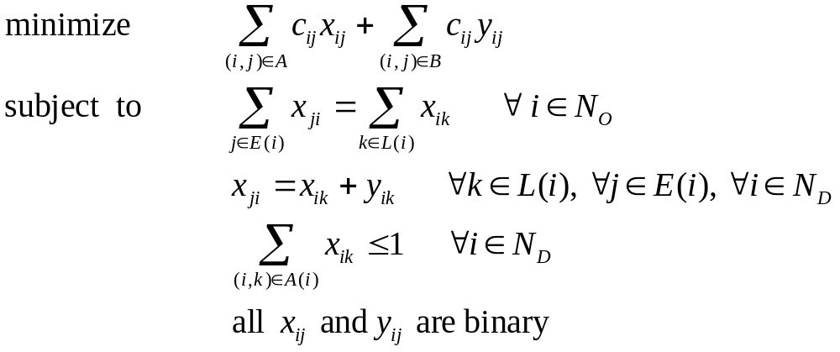
UMDCP₁ (1)
Let be the dummy
arcs that parallel all
outgoing arcs from
each D-node.
1-1 case
D
The formulation of 1-1 UMDCP₁:

Slide 30
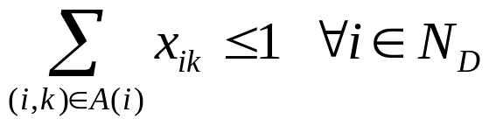
UMDCP₁ (2)
1-1 case
Let y₁₂ and y₁₃ be the dummy arcs which parallel x₁₂ and x₁₃ .
arc cost
s
1
x_{s1}
According to the constraint,
We have x_{s1}=x₁₂+y₁₂ and x_{s1}=x₁₃+y₁₃
1
1
1
x_{s1} x₁₂ y₁₂ are binary
x_{s1} x₁₃ y₁₃ are binary
x₁₂
x₁₃
y₁₂
y₁₃
0 0 0
1 1 0
1 0 1
0 0 0
1 1 0
1 0 1
2
3
x₁₂ + x₁₃ ≤ 1

Slide 31
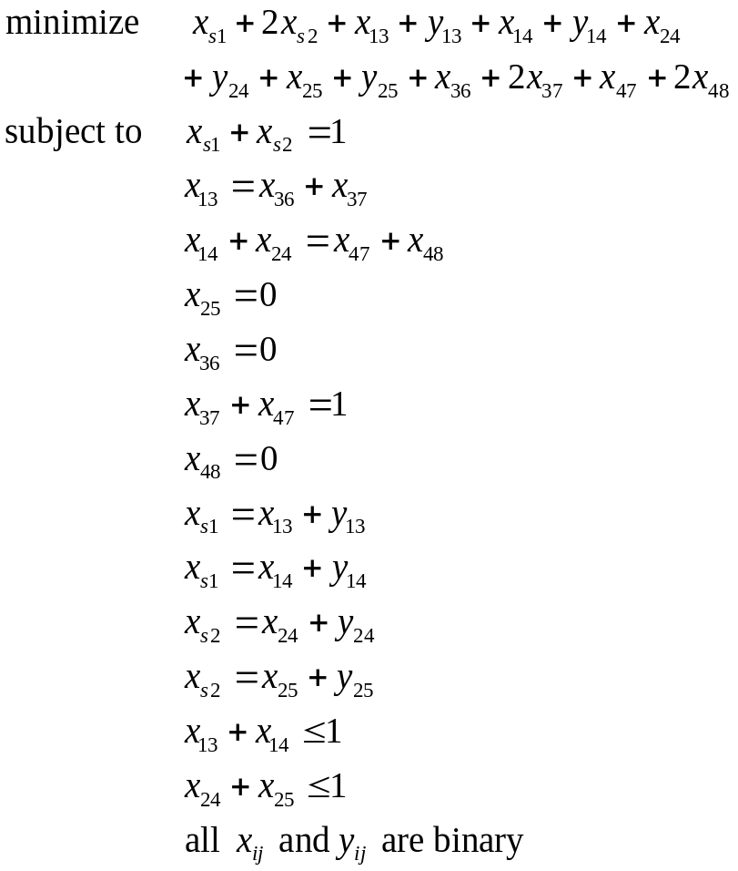
UMDCP₁ (3)
1-1 case
For example:
arc cost
s
1
2
1
2
1
1
1
1
3
4
5
1
2
1
2
6
7
8
The shortest path from s to 7

Slide 32
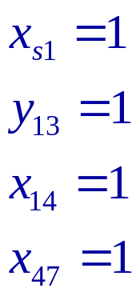
UMDCP₁ (4)
1-1 case
arc cost
The solution is
s
1
2
1
2
1
1
1
1
3
4
5
and the objective value is 4 .
1
2
1
2
The shortest path is (s,1)(1,3)(1,4)(4,7)
And minimum cost is 4 .
6
7
8

Slide 33


UMDCP₁ Algorithm
1-1 case
s
(0,0)
Because that the total cost
from node 2 is 4 which is
greater than 3.
0
1
2
(3,s)
1
2
(4,s)
1
1
Because that the total cost
from node 4 is 4 which is
less than 5.
1
1
(3,1)
3
(3,1)
4
(4,2)
5
(4,2)
1
2
The shortest path from s to
node 7 is (s,1)(1,3)(1,4)(4,7),
and the total cost is 4.
1
2
(4,3)
6
(5,3)
7
(4,4)
8
(5,3)

Slide 34
Correctness of UMDCP₁ Algorithm
We prove our UMDCP₁ Algorithm according to the correctness
of original Dijkstra’s Algorithm.
Because our UMDCP₁ Algorithm selects the node with the
smallest distance label in temporarily labeled set in each step,
by this way, it has the smallest distance label at the termination node.
That is, we find a shortest path from the source node to the
termination node.

Slide 35
Reduced Method of UMDCP₁ (1)
1-1 case
We transform all D-nodes in the distribution network
to be O-nodes, and solve it by using Dijkstra’s algorithm.
s
arc cost
s
arc cost
1
2
3
4
1
2
1
2
1
1
1
1
transform
0
0
0
0
3
4
5
3
4
5
1
2
1
2
1
2
1
2
6
7
8
6
7
8

Slide 36
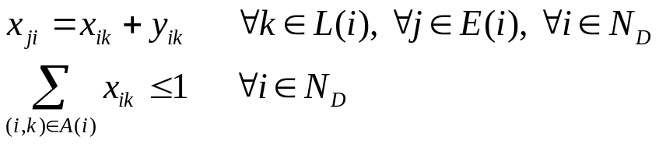
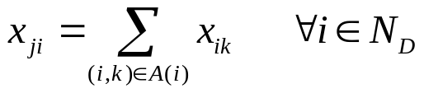

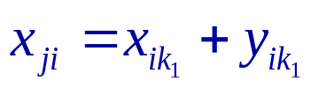

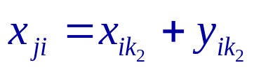
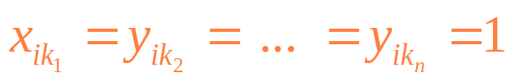
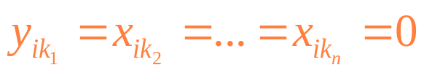

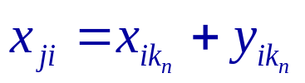


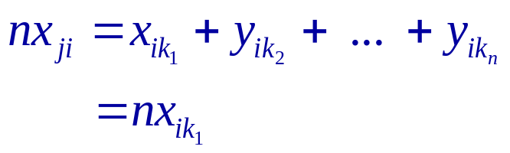
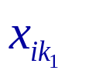
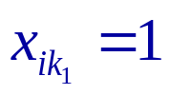
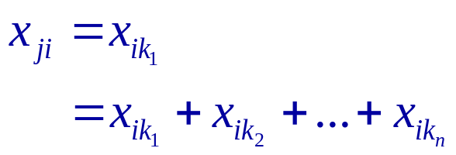
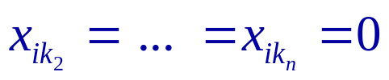
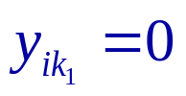
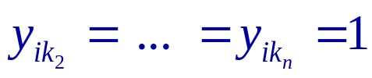
Reduced Method of UMDCP₁ (2)
1-1 case
transform
We have
We have
…
…
…
…
…
If is selected

Slide 37




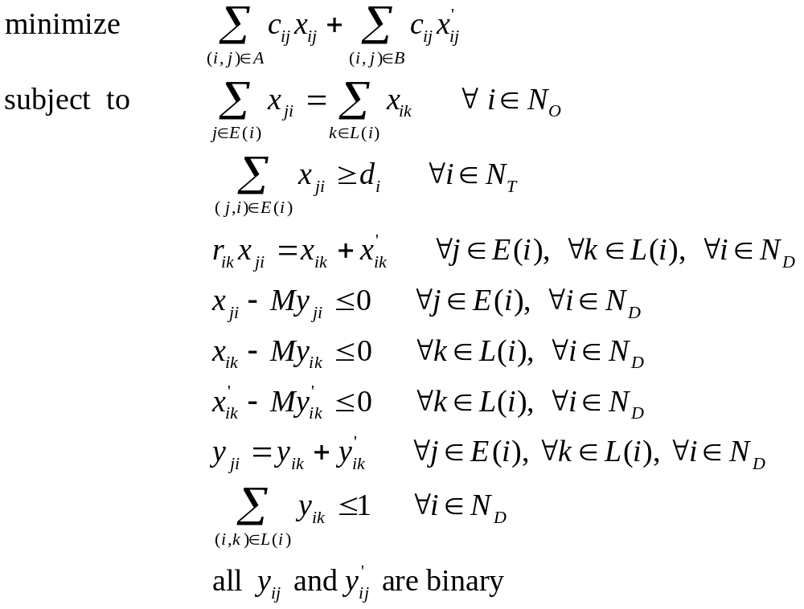

UMDCP₂ (1)
Let be the dummy
arcs that parallel all
outgoing arcs from
each D-node.
Let be the binary
values represents that
arc has flow or
not.
1-1 case
D
D
The formulation of 1-1 UMDCP₂:

Slide 38
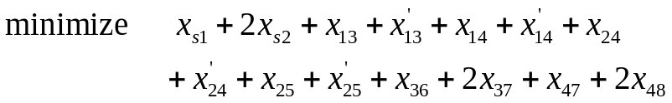
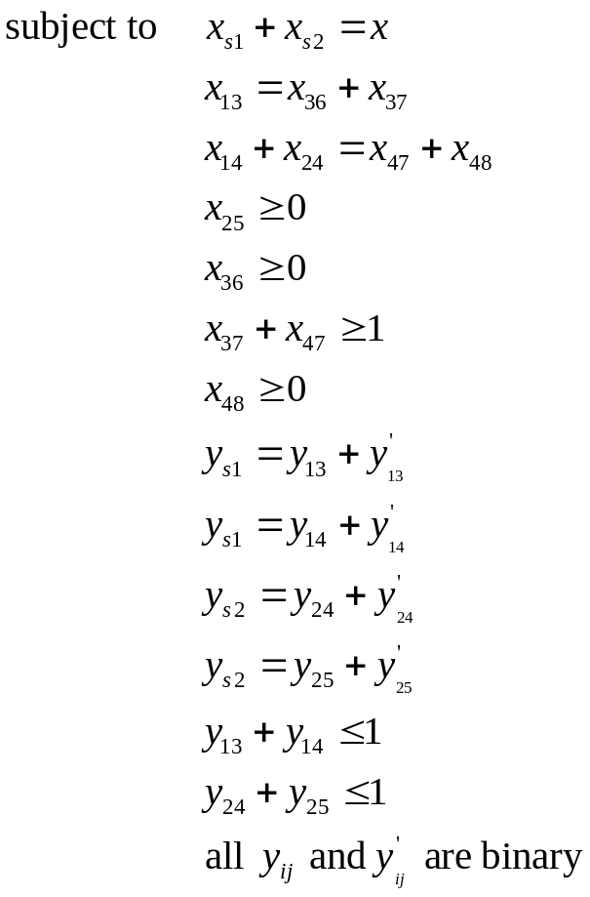
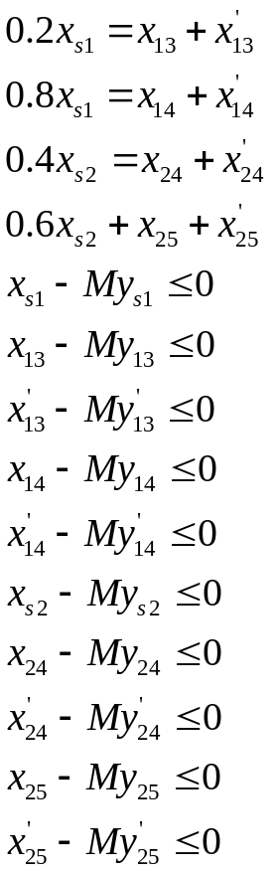
UMDCP₂ (2)
1-1 case
For example:
arc cost
s
1
2
1
2
0.2
0.8
0.4
0.6
1
1
1
1
3
4
5
1
2
1
2
6
7
8
The shortest path from s to 7

Slide 39
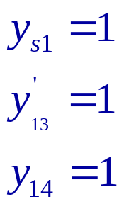
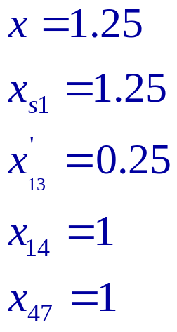
UMDCP₂ (3)
1-1 case
1.25
The solution is
arc cost
s
1
1.25
2
1
2
0.2
0.8
0.4
0.6
1
1
0.25
1
1
1
3
4
5
1
and the objective value 3.5 .
1
2
1
2
6
7
8
The shortest path is (s,1)(1,3)(1,4)(4,7)
And the minimum unit cost is 3.5 .
unit cost = 3.5

Slide 40






























UMDCP₂ Algorithm
1-1 case
s
Because that the unit cost
from node 2 is 7.5 which is
greater than 2.5 .
0
1
2
1
2
0.2
0.8
0.4
0.6
1
1
1
1
Because that the unit cost
from node 4 is 3.5 which is
less than 12 .
3
4
5
1
2
1
2
The shortest path from s to
node 7 is (s,1)(1,3)(1,4)(4,7),
and the unit cost is 3.5 .
6
7
8

Slide 41
Correctness of UMDCP₂ Algorithm
We prove our UMDCP₂ Algorithm according to the correctness
of original Dijkstra’s Algorithm.
Because our UMDCP₂ Algorithm selects the node with the
smallest average distance label in temporarily labeled set in
each step, by this way, it has the smallest average distance label at the termination node.
That is, we find a shortest path from the source node to the
termination node.

Slide 42
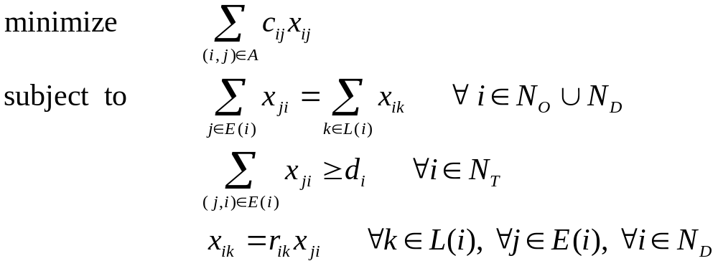
UMDCP₃ (1)
1-1 case
The formulation of 1-1 UMDCP₃:

Slide 43
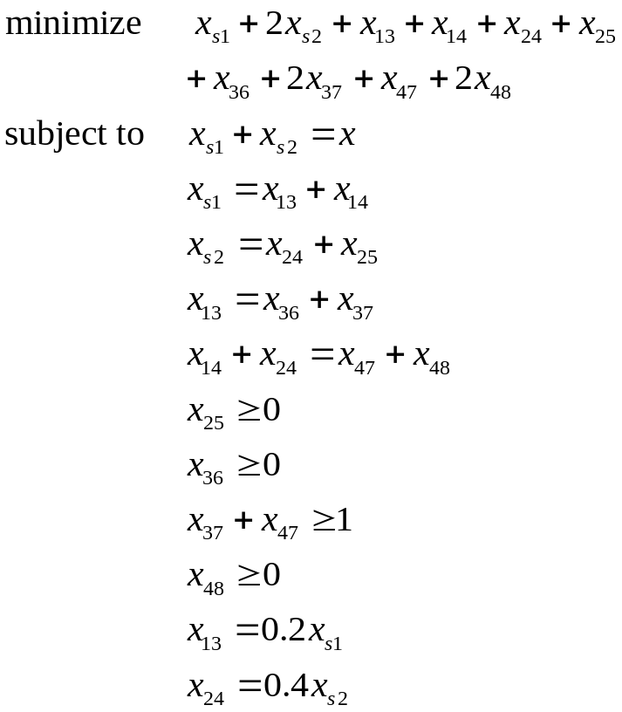
UMDCP₃ (2)
1-1 case
For example:
arc cost
s
1
2
1
2
0.2
0.8
0.4
0.6
1
1
1
1
3
4
5
1
2
1
2
6
7
8
The shortest path from s to 7

Slide 44
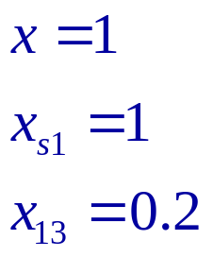
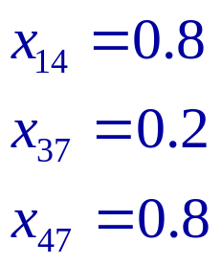
UMDCP₃ (3)
1-1 case
1
arc cost
s
The solution is
1
2
1
1
2
0.2
0.8
0.4
0.6
1
1
0.2
0.8
1
1
and the objective value 3.2 .
3
4
5
1
2
0.8
0.2
1
2
The shortest path is (s,1)(1,3)(3,7)(1,4)(4,7)
And the minimum unit cost is 3.2 .
6
7
8
unit cost = 3.2

Slide 45
UMDCP₃ Algorithm (1)
1-1 case
Step1：Modifying DFS
Step2：Delete paths
arc cost
s
s
s
s
1
1
1
1
2
1
1
1
0.2
0.8
0.2
0.8
0.2
0.8
1
1
1
1
1
1
1
2
3
4
3
4
3
4
0.2
0.8
0.4
0.6
1
1
2
2
1
1
1
1
1
1
6
7
6
8
7
3
4
5
1
s
s
s
2
1
2
2
1
2
1
2
2
0.2
0.8
0.4
0.6
0.4
0.6
6
7
8
1
1
1
1
1
1
3
4
4
5
4
5
2
2
1
2
The shortest path from s to 7
7
8
7
8

Slide 46

















UMDCP₃ Algorithm (2)
1-1 case
Step3：Distribute flow
s
s
s
s
1
1
1
2
1
1
1
2
0.2
0.8
0.2
0.8
0.2
0.8
0.4
0.6
1
1
1
1
1
1
1
1
3
4
3
4
3
4
4
5
1
1
2
1
2
2
1
6
7
7
7
8
7
Step4：Calculate unit cost
Step5：Choose the best solution

Slide 47
UMDCP₃ Algorithm (3)
1-1 case
1
arc cost
s
The solution is
1
2
1
1
2
0.2
0.8
0.4
0.6
1
1
0.2
0.8
1
1
and the objective value 3.2 .
3
4
5
1
2
0.8
0.2
1
2
The shortest path is (s,1)(1,3)(3,7)(1,4)(4,7)
And the minimum unit cost is 3.2 .
6
7
8
The shortest path from s to 7

Slide 48
Correctness of UNDCP₃ Algorithm
Our UMDCP₃ algorithm finds out all possible subgraphs,
calculate each total cost, total flow, and unit cost.
Then we choose the path with minimum total unit cost
as the shortest path.
Hence, we find a shortest path from the source node to the
termination node.

Slide 49
We define three uncapacitated minimum cost problems
For one-to-one cases:
    Discuss formulations
    Propose algorithms
For one-to-some cases:
    Discuss formulations
    Discover the countereaxmples

Slide 50
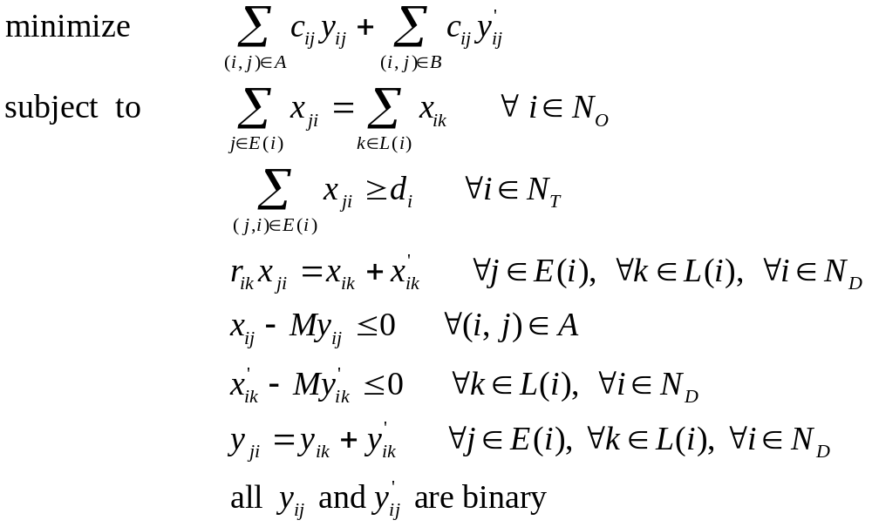
UMDCP₁ (1)
Let be the dummy
arcs that parallel all
outgoing arcs from
each D-node.
1-some case
D
The formulation of 1-some UMDCP₁:

Slide 51
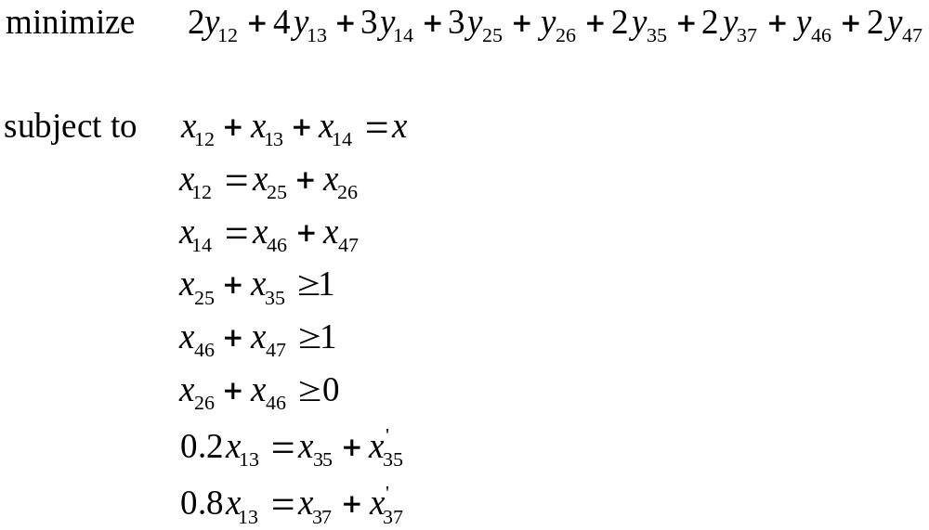

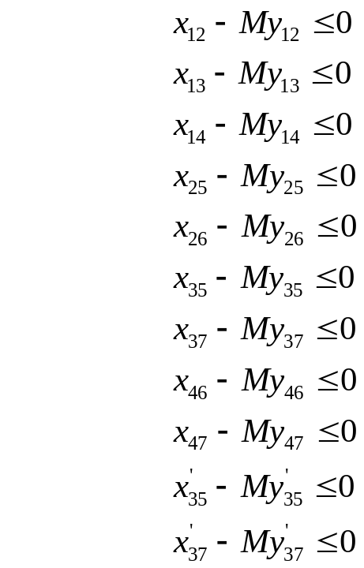
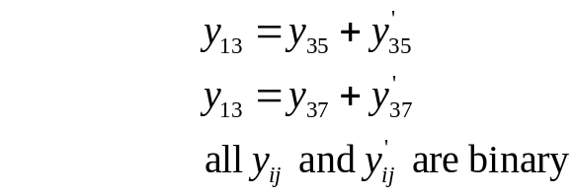
UMDCP₁ (2)
1-some case
For example:
arc cost
1
2
4
3
2
3
4
0.2
0.8
3
1
1
2
2
2
5
6
7
The shortest path from s to 5 and 7

Slide 52
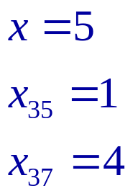
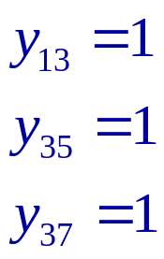
UMDCP₁ (3)
1-some case
The solution is
arc cost
1
2
4
3
2
3
4
0.2
0.8
and the objective value 6 .
3
1
1
2
2
2
5
6
7
The shortest path is (1,3)(3,5)(3,7)
And the minimum cost is 6 .

Slide 53
Reduced Method of UMDCP₁ (1)
1-some case
arc cost
1
1
2
4
3
2
6
3
2
3
4
transform
2
3
4
0.2
0.8
0.2
0.8
3
1
1
2
3
0
0
2
2
2
2
2
5
6
7
5
6
7

Slide 54
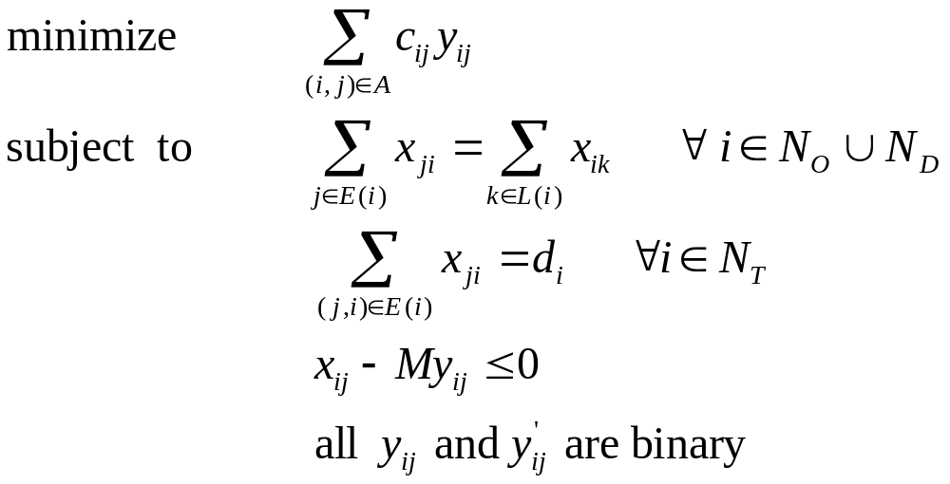
Reduced Method of UMDCP₁ (2)
1-some case
The formulation of 1-some reduced UMDCP₁:
1
arc cost
2
6
3
2
3
4
0.2
0.8
3
0
0
2
2
2
5
6
7

Slide 55
Method for solving 1-some UMDCP₁
1
1
2
4
3
2
4
3
arc cost
1
2
3
4
2
3
4
2
3
0.2
0.8
0.2
0.8
4
3
1
2
3
1
2
2
2
1
2
2
1
2
3
4
0.2
0.8
5
6
7
5
6
7
3
1
1
2
2
2
5
6
7
1
2
4
3
2
3
4
The shortest path from s to 5 and 7
0.2
0.8
3
1
1
2
2
2
5
6
7

Slide 56
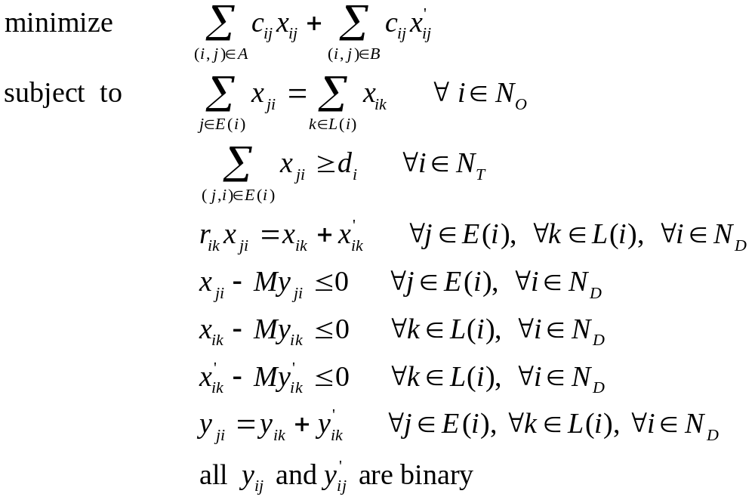
UMDCP₂ (1)
1-some case
The formulation of 1-some UMDCP₂:

Slide 57
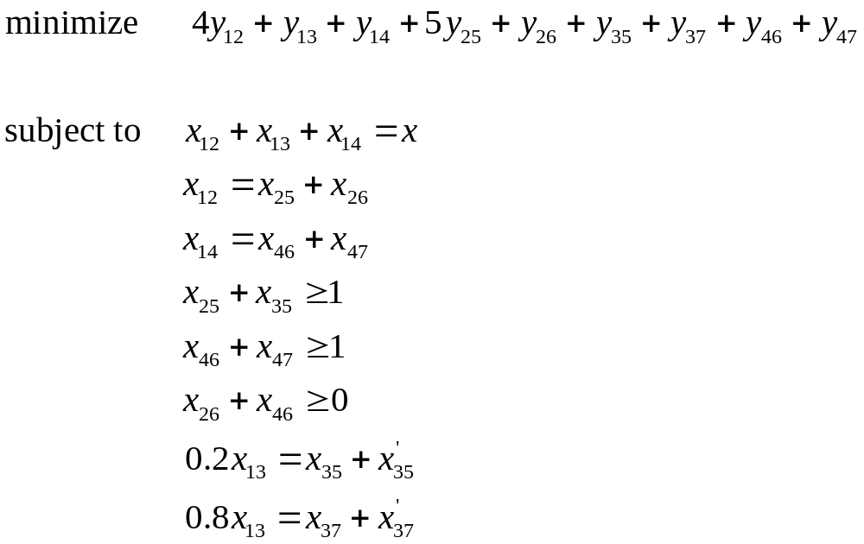
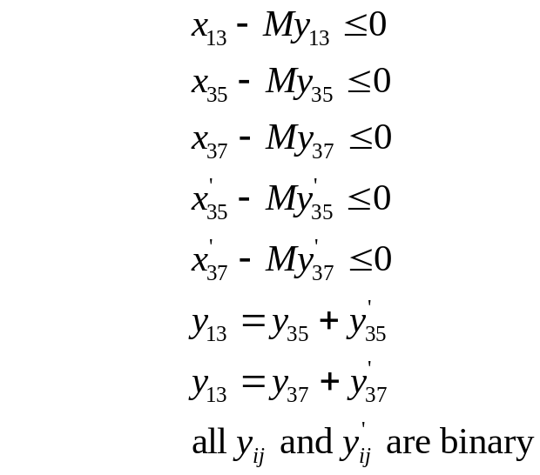
UMDCP₂ (2)
1-some case
For example:
arc cost
1
4
1
1
2
3
4
0.2
0.8
5
1
1
1
1
1
5
6
7
The shortest path from s to 5 and 7

Slide 58
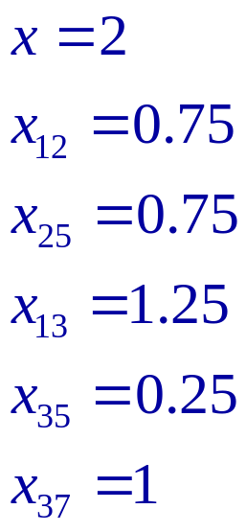
UMDCP₂ (3)
1-some case
The solution is
arc cost
1
4
1
1
2
3
4
0.2
0.8
5
1
1
1
1
1
5
6
7
and the objective value 9.25 .
The shortest path is (1,2)(2,5)(1,3)(3,5)(3,7)
And the minimum cost is 9.25 .

Slide 59
Method for solving 1-some UMDCP₂
1
1
4
1
1
4
1
1
arc cost
1
2
3
4
2
3
4
4
1
0.2
0.8
0.2
0.8
1
5
1
1
5
1
1
1
1
1
1
1
1
2
3
4
0.2
0.8
5
6
7
5
6
7
5
1
1
1
1
1
5
6
7
1
2
4
3
2
3
4
The shortest path from s to 5 and 7
0.2
0.8
3
1
1
2
2
2
5
6
7

Slide 60
UMDCP₃ (1)
1-some case
The formulation of 1-some UMDCP₃:

Slide 61
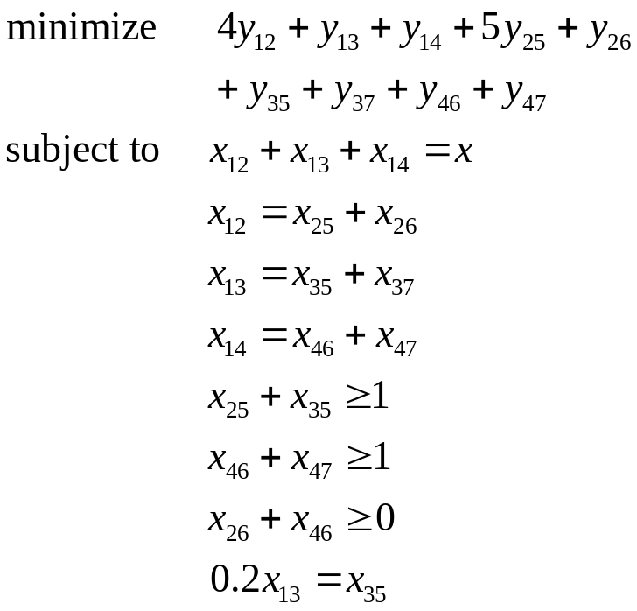
UMDCP₃ (2)
1-some case
For example:
arc cost
1
4
1
1
2
3
4
0.2
0.8
5
1
1
1
1
1
5
6
7
The shortest path from s to 5 and 7

Slide 62
UMDCP₃ (3)
1-some case
The solution is
arc cost
1
4
1
1
2
3
4
0.2
0.8
5
1
1
1
1
1
5
6
7
and the objective value 9.25 .
The shortest path is (1,2)(2,5)(1,3)(3,5)(3,7)
And the minimum cost is 9.25 .

Slide 63
Method for solving 1-some UMDCP₃
1
1
4
1
1
4
1
1
arc cost
1
2
3
4
2
3
4
4
1
0.2
0.8
0.2
0.8
1
5
1
1
5
1
1
1
1
1
1
1
1
2
3
4
0.2
0.8
5
6
7
5
6
7
5
1
1
1
1
1
5
6
7
1
2
4
3
2
3
4
The shortest path from s to 5 and 7
0.2
0.8
3
1
1
2
2
2
5
6
7

Slide 64

Conclusion
Define three uncapacitated minimum cost problems
Compacting rules
Discuss formulations
Propose algorithms
Reduced method for UMDCP₁
Discover the counterexamples

Slide 65
Future research
To find efficient algorithms for solving the one-to-some cases of
UMDCP would be an interesting research direction.
To develop efficient algorithms that can solve the manufacturing
networks containing both D-nodes and C-nodes may be more
challenging worth investigation.

Slide 66
Thanks for your attention !!

