Slide 1

On solving population haplotype inference problems
學 生: 楊惠娥
口試指導老師: 陳文智 博士
李宇欣 博士
許瑞麟 博士
指導老師: 王逸琳 博士

Slide 2
Outline
Introduction
Literature review
Methodologies
Conclusions
Future works

Slide 3
Introduction
Background and Motivation
  Human Genome Project
  Integer programming
  Dynamic programming
DNA, variations and mutations
SNP, haplotypes and genotypes
Population haplotype inference problem
Objectives

Slide 4
DNA
Bases
  A, T, G, C
Double helixes
Watson-Crick base pairing
  A and T, G and C are always in pairs, respectively

Slide 5
Variation and Mutation
Chemical, radiation, ultraviolet rays, and other unknown factors lead to variations or mutations of DNA
Proteins may not be produced or produced correctly
Point mutation, insertion, deletion

Slide 6
SNP and Haplotype (1/2)
SNP
  Single Nucleotide Polymorphism
  Point mutation
  Positions that DNA bases are different among individuals
  Observed at least 1% in all populations
Haplotype
  A sequence of closely linked SNPs in one copy of chromosome

Slide 7
SNP and Haplotype (2/2)
Chromosome 1
Chromosome 1a
Chromosome 1b
Individual1
−A A G C C T A T C−
Haplotype1
A C C
Individual2
−A A G C T T A T C−
Haplotype2
A T C
Individual3
−A T G C T T A T C−
Haplotype3
T T C
Individual4
−A A G C T T A T T−
Haplotype4
A T T
SNP₁
SNP₂
SNP₃

Slide 8
Genotype
Genotype
  The description of one conflated pair of haplotypes
  Human beings are diploid organism
  Due to the cost and time consideration, genotypes rather than haplotypes are collected

Slide 9
Haplotype and Genotype
SNP₁
SNP₂
SNP₃
Chromosome 1
Chromosome 1a
Chromosome 1b
A/A
A
A
Genotype 1
Haplotype 1
AGC
Haplotype 2
AGT
G/G
G
G
Genotype 2
C/T
C
T
Genotype 3

Slide 10
Applications of Haplotype
Customize the treatments
Minimize side effects
Disease diagnosis
  For example, sickle cell anemia
    A DNA base, A, is replaced by T

Slide 11



Population Haplotype Inference (PHI) Problem (1/3)
Given genotypes and each has SNP sites ( matrix, genotype matrix) for individuals
  Every element in the genotype matrix is 0, 1, or 2
    0 : homozygous wild type
    1 : homozygous mutant type
    2 : heterozygous

Slide 12
Population Haplotype Inference (PHI) Problem (2/3)
Chromosome 1
Genotype 1
A/A
0 (homozygous wild type)
G/G
Genotype 2
1 (homozygous mutant type)
C/T
Genotype 3
2 (heterozygous)

Slide 13
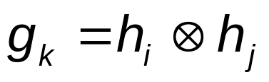
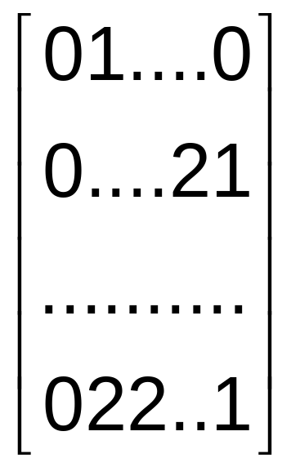




Population Haplotype Inference (PHI) Problem (3/3)
Resolved
01…0
and 01…0
Combinatorial Problem
genotypes
0…01
and 0…11
000..1
and 011..1
001..1
and 010..1
??
OR
SNPs
There are 2^{n – 1} possible pairs to resolve a genotype if it has n
elements with value 2
Given a genotype matrix G, find one haplotype
matrix H, such that every row i in G is resolved by the (2i-1)th
and (2i)th rows in H

Slide 14
Objectives
A new greedy heuristic algorithm
New technique to solve large scale population haplotype inference problems
Improve a heuristic algorithm called PTG to get a better solution

Slide 15
Methodologies to PHI Problem
Statistical methods
  EM algorithm
  Bayesian method
Combinatorial methods
  Perfect phylogeny – Gusfield (2002)
  Clark’s inference rule
  Pure parsimony
    Integer linear programming
    Branch and bound
    Integer quadratic programming
    Dynamic programming
    Graph theory

Slide 16
Statistical Methods
EM-algorithm
  Excoffier and Slatkin (1995)
  Estimation
  Maximization
Bayesian method
  Stephens and Donnelly (2003)
  Prior distribution
  The likelihood

Slide 17
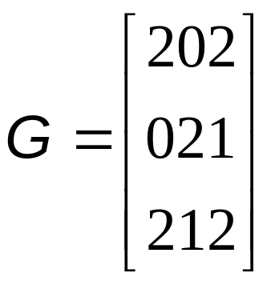
Clark’s Inference Rule
Clark (1990)
Resolved set
Step 3
Step 2
001
001
100
Step 1
001
011
011
100
011
111
111
Find one genotype where there is no or one element
with value 2, and add it to the resolved set R
Find one haplotype in the resolved set which can
be applied to resolve one of the unresolved
genotypes, if such a haplotype does not exist,
then stop; otherwise, continue
Add the haplotypes obtained in step 2 into
resolved set R, go to step 2

Slide 18

Pure Parsimony Criterion (1/4)
Find the smallest number of distinct haplotypes to resolve all genotypes
  The existent haplotypes are far less than the number of all possible combinations
  Example
  NP-hard problem
    Proven by Lancia (2004)
6
5
5
4
p₁ = (000,101) or p₂ = (001,100)
p₃ = (001,011)
p₄ = (010,111) or p₅ = (011,110)

Slide 19
Pure Parsimony Criterion (2/4)
Techniques
  Integer linear programming (Optimal!)
    Gusfield (2003)
      For every genotype, enumerate all possible inferred haplotype pairs
      For every genotype, apply constraints to ensure exactly one pair among all the possible pairs to be selected
      Exponential-sized integer linear programming formulation
    Brown and Harrower (2004)
      Polynomial-sized integer linear programming formulation
    Actually, Gusfield’s formulation runs faster than Brown and Harrowers’ despite its exponential-sized formulation

Slide 20
Pure Parsimony Criterion (3/4)
Techniques
  Branch and bound
    Wang and Xu (2003) (Not optimal!)
  Integer quadratic programming
    Huang et al. (2005)
      For every genotype, enumerate all possible inferred haplotype pairs
      Formulate an integer quadratic problem
    Solving it by Semidefinite Programming Relaxation (Not optimal!)
  Dynamic programming
    Li et al. (2005)
    Column by column (Not optimal!)

Slide 21
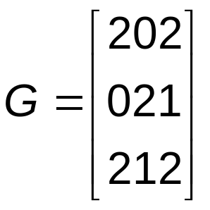
Pure Parsimony Criterion (4/4)
Dynamic programming
  Li et al. (2005)
  Column oriented
List
1
3
1
0
V₂₁
1
V_{2,1}
1,2
V₂₁
1
V_{2,1}
1,2
V_{3,1}
2
V_{2,1}
1,2
V_{3,1}
1,2
Input
V_{1,1}
1, 2, 3
V_{1,1}
1, 2
V_{1,1}
1
0
1
V_{2,2}
2
V_{3,2}
2
V_{2,2}
2,3
V_{3,2}
2,3
1
V_{0,1}
1, 2, 3
0
0
V_{2,3}
1
V_{3,3}
1
V_{2,3}
1
V_{2,3}
1
V_{1,2}
1
1
V_{1,2}
1,3
0
V_{2,4}
3
V_{3,4}
3
1
f(3) = true
f(1) = true
f(2) = false
f(3) = false
f(1) = false
f(2) = true

Slide 22
New Greedy Heuristic Algorithm (GHI)
The exact optimal solution
  Consumes a lot of computational time
  The error rate (the proportion of genotypes whose original haplotype pairs are inferred incorrectly) is high
Haplotype that can resolve more genotypes should be more likely to appear in the solution

Slide 23
New Greedy Heuristic Algorithm (GHI)
Procedures
Time complexity analysis
Experiments and results

Slide 24
Procedures of GHI (1/2)
For each genotype, enumerate all possible resolving haplotype pairs
For each genotype, calculate the total number of elements with value 2 in a given genotype matrix divided by the number of elements with value 2 in that genotype and use this number as its weight
For each haplotype, add the weights of its resolved genotypes and use this number as its weight

Slide 25
Procedures of GHI (2/2)
For each candidate haplotype pair, multiply the weights of its two haplotypes and use this product of weights as the weight associated with this candidate haplotype pair
For each genotype, select the candidate haplotype pair with the largest weight to be its inferred haplotype pair

Slide 26




Example of GHI
Total number of elements with value 2 : 5
gw₁ = 5 / 2 = 2.5
Haplotype
Weight
000
2.5
g₁ = 202
p₁ = ( 000, 101 )
001
7.5
gw₂ = 5 / 1 = 5
p₂ = ( 001, 100 )
010
2.5
011
7.5
g₂ = 021
p₃ = ( 001, 011 )
100
2.5
101
2.5
g₃ = 212
p₄ = ( 010, 111 )
110
2.5
p₅ = ( 011, 110 )
gw₃ = 5 / 2 = 2.5
111
2.5

Slide 27
Time Complexity Analysis (1/3)
Suppose there are total p inferred haplotype pairs
Time complexity analysis
  Enumerate all inferred haplotype pairs
    O(p)
  Calculate weight for individual haplotype
    It depends on what data structure is used
  Calculate weight for each candidate haplotype pair
    O(p)
  Select the one candidate pair with maximum weight for each genotype
    O(p)

Slide 28
Time Complexity Analysis (2/3)
Calculate weight for individual haplotype
  Array, saves search time but requires more storage space
n: the number of columns in a given genotype matrix
p: the number of total inferred haplotype pairs
g₁ = 202
p₁ = ( 000, 101 )
haplotype weight list
p₂ = ( 001, 100 )
0
1
2
3
4
5
…
2^{n} -1
g₂ = 021
p₃ = ( 001, 011 )
…
g₃ = 212
p₄ = ( 010, 111 )
O(p)
p₅ = ( 011, 110 )

Slide 29
Time Complexity Analysis (3/3)
Calculate weight for individual haplotype
  Link list, saves storage space but requires more search time
q: the number of total distinct haplotypes
g₁ = 202
p₁ = ( 000, 101 )
haplotype weight list
p₂ = ( 001, 100 )
1
2
3
q
g₂ = 021
p₃ = ( 001, 011 )
…
g₃ = 212
p₄ = ( 010, 111 )
O(pq)
p₅ = ( 011, 110 )

Slide 30
Experiments Design (1/3)
Biological data
  β₂AR gene
Simulation data
  Haplotypes
    The program provided by Hudson (2002)
    Recombination rate (0, 4.0, 16.0)
  Genotypes
    Randomly pair two haplotypes as a genotype
  Problem sets, 15 data sets for each setting
# | Matrix Size | # | Matrix Size | # | Matrix Size
1 | 10 x 10 | 4 | 10 x 20 | 7 | 10 x 30
2 | 20 x 10 | 5 | 20 x 20 | 8 | 20 x 30
3 | 30 x 10 | 6 | 30 x 20 | 9 | 30 x 30

Slide 31
Experiments Design (2/3)
Evaluated algorithms
  Our greedy heuristic, denoted as “GHI”
    Implemented in C++ and compiled by g++ compiler
  The dynamic programming algorithm directly imported from Li et al. (2005), denoted as “PTG”
    Implemented using Borland Delphi 5.0 in Pascal
  The semidefinite programming relaxation algorithm by Huang et al. (2005), denoted as “SDPHapInfer”
    Implemented using Matlab
  The integer linear programming model by Gusfield (2003), denoted as “OPT”
    Implemented in C++, compiled by Visual C++, and linked with CPLEX 9.0 callable library
  The Clark inference rule algorithm directly imported from Clark (1990), denoted as “CLARK”
    Implemented using Fortran

Slide 32



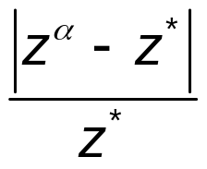
Experiments Design (3/3)
Comparison criteria
  Optimality gap
  Error rate
    The proportion of genotypes whose original haplotype pairs are inferred incorrectly
  Computational time
: the minimum number of the inferred haplotypes by algorithm
: the number of distinct inferred haplotypes appeared in the solution

Slide 33
Experiment on β₂AR Gene
Real data
  18 genotypes, 12 SNPs (18 x 12)
  10 haplotypes
Inferred data
Evaluated algorithm | # of haplotypes | Error Rate
OPT | 10 | 56%
GHI | 10 | 0%
CLARK | 10 | 0%
SDPHapInfer | 12 | 11%
PTG | 10, 11, or 12 | 0%, 17%, or 17%

Slide 34
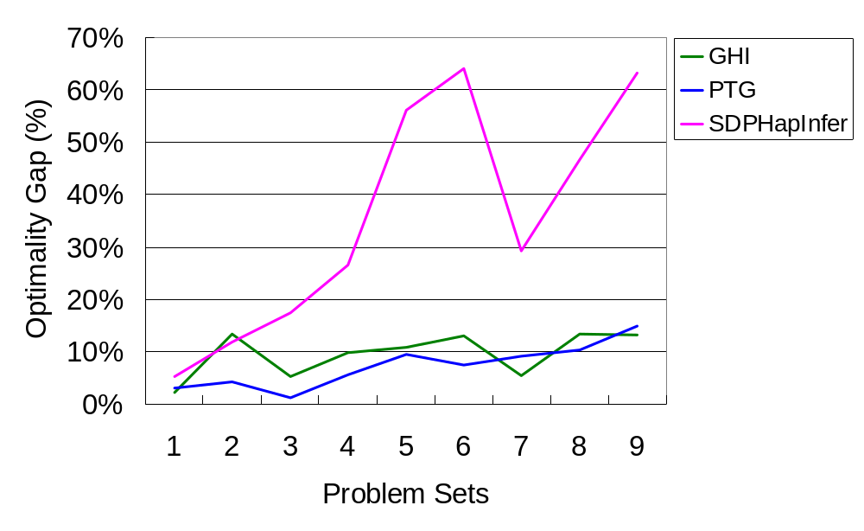
Optimality Gap Comparison – no recombination
Problem Sets
#
Matrix Size
1
10 x 10
2
20 x 10
3
30 x 10
4
10 x 20
5
20 x 20
6
30 x 20
7
10 x 30
8
20 x 30
9
30 x 30

Slide 35
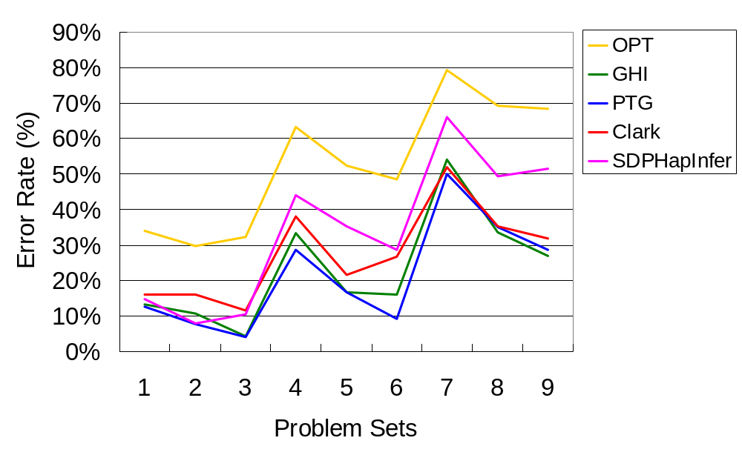
Error Rate Comparison – no recombination
Problem Sets
#
Matrix Size
1
10 x 10
2
20 x 10
3
30 x 10
4
10 x 20
5
20 x 20
6
30 x 20
7
10 x 30
8
20 x 30
9
30 x 30

Slide 36
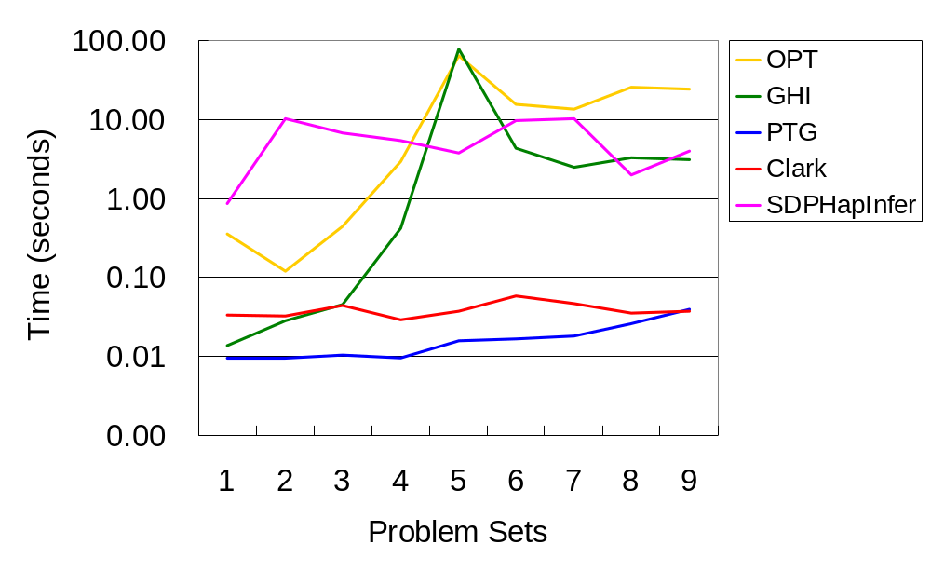
Time Comparison – no recombination
Problem Sets
#
Matrix Size
1
10 x 10
2
20 x 10
3
30 x 10
4
10 x 20
5
20 x 20
6
30 x 20
7
10 x 30
8
20 x 30
9
30 x 30

Slide 37
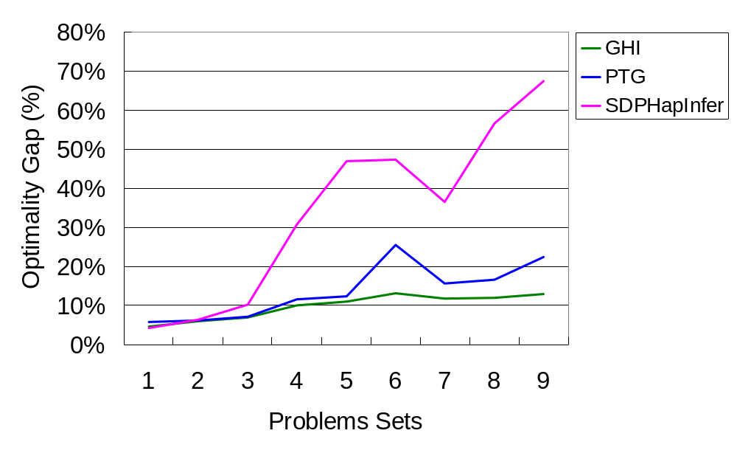
Optimality Gap Comparison – recombination rate = 4.0
Problem Sets
#
Matrix Size
1
10 x 10
2
20 x 10
3
30 x 10
4
10 x 20
5
20 x 20
6
30 x 20
7
10 x 30
8
20 x 30
9
30 x 30

Slide 38
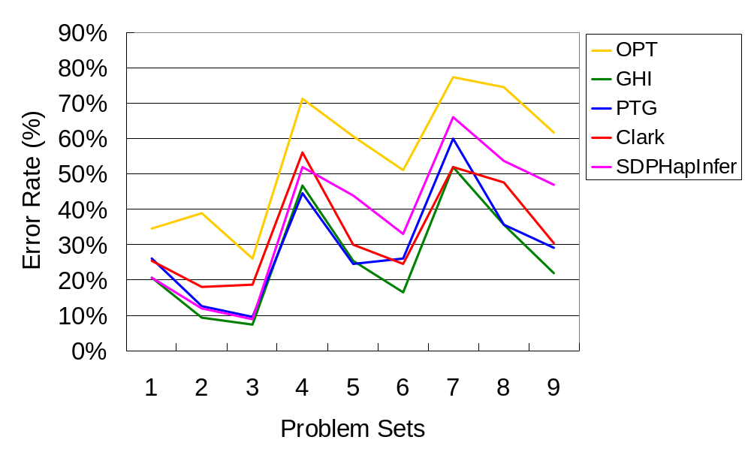
Error Rate Comparison – recombination rate = 4.0
Problem Sets
Problem Sets
#
Matrix Size
#
Matrix Size
1
10 x 10
1
10 x 10
2
20 x 10
2
20 x 10
3
30 x 10
3
30 x 10
4
10 x 20
4
10 x 20
5
20 x 20
5
20 x 20
6
30 x 20
6
30 x 20
7
10 x 30
7
10 x 30
8
20 x 30
8
20 x 30
9
30 x 30
9
30 x 30

Slide 39
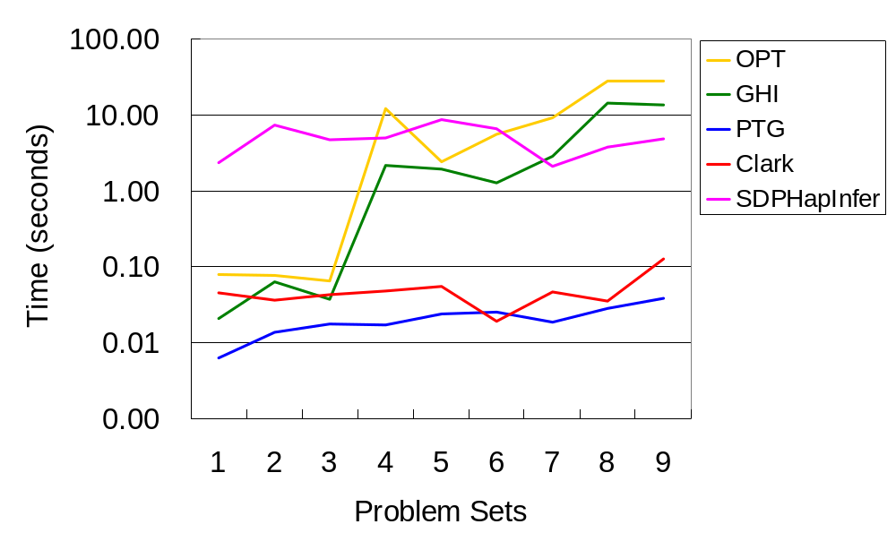
Time Comparison – recombination rate = 4.0
Problem Sets
Problem Sets
#
Matrix Size
#
Matrix Size
1
10 x 10
1
10 x 10
2
20 x 10
2
20 x 10
3
30 x 10
3
30 x 10
4
10 x 20
4
10 x 20
5
20 x 20
5
20 x 20
6
30 x 20
6
30 x 20
7
10 x 30
7
10 x 30
8
20 x 30
8
20 x 30
9
30 x 30
9
30 x 30

Slide 40
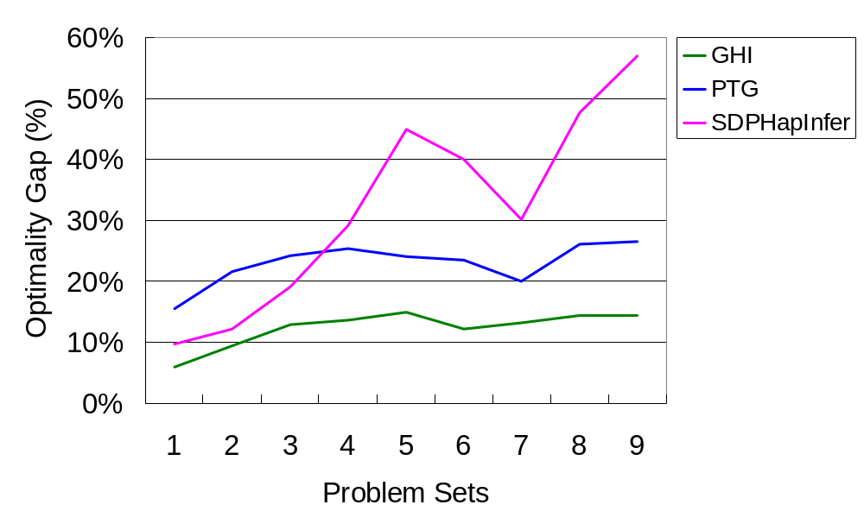
Optimality Gap Comparison – recombination rate = 16.0
Problem Sets
#
Matrix Size
1
10 x 10
Problem Sets
2
Problem Sets
20 x 10
#
Matrix Size
#
Matrix Size
3
30 x 10
1
10 x 10
1
10 x 10
4
10 x 20
2
20 x 10
2
20 x 10
5
20 x 20
3
30 x 10
3
30 x 10
6
30 x 20
4
10 x 20
4
10 x 20
7
10 x 30
5
20 x 20
5
20 x 20
8
20 x 30
6
30 x 20
6
30 x 20
9
30 x 30
7
10 x 30
7
10 x 30
8
20 x 30
8
20 x 30
9
30 x 30
9
30 x 30

Slide 41
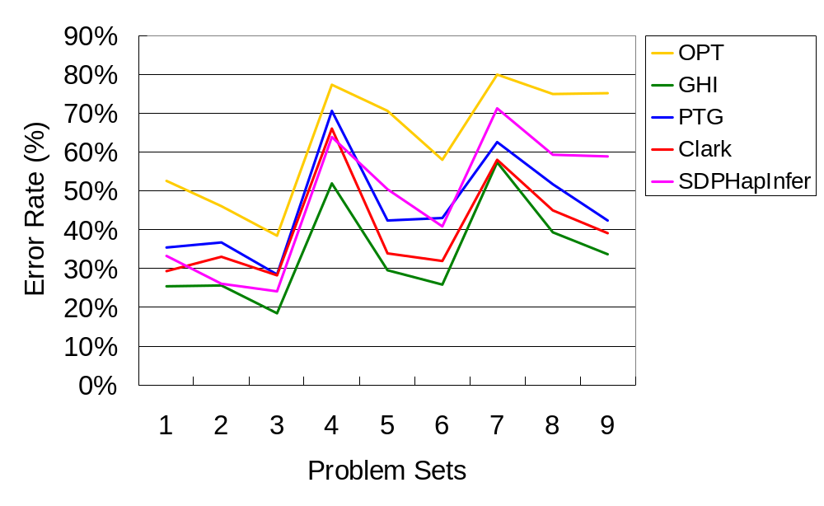
Error Rate Comparison – recombination rate = 16.0
Problem Sets
Problem Sets
#
Matrix Size
#
Matrix Size
1
10 x 10
1
10 x 10
2
20 x 10
2
20 x 10
3
30 x 10
3
30 x 10
4
10 x 20
4
10 x 20
5
20 x 20
5
20 x 20
6
30 x 20
6
30 x 20
7
10 x 30
7
10 x 30
8
20 x 30
8
20 x 30
9
30 x 30
9
30 x 30

Slide 42
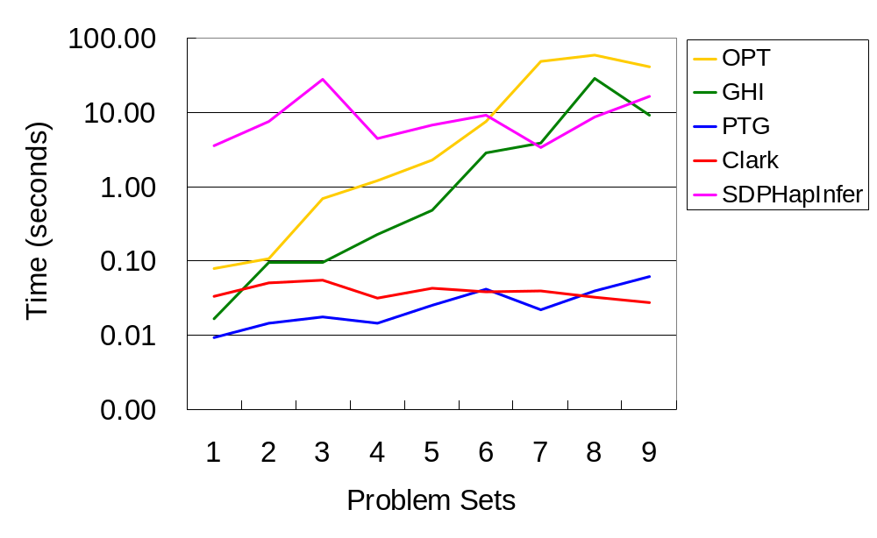
Time Comparison – recombination rate = 16.0
Problem Sets
Problem Sets
#
Matrix Size
#
Matrix Size
1
10 x 10
1
10 x 10
2
20 x 10
2
20 x 10
3
30 x 10
3
30 x 10
4
10 x 20
4
10 x 20
5
20 x 20
5
20 x 20
6
30 x 20
6
30 x 20
7
10 x 30
7
10 x 30
8
20 x 30
8
20 x 30
9
30 x 30
9
30 x 30

Slide 43
Summary of Experiments
Exact optimal solution methodology
  Large error rate due to the multiple optimal solutions
For cases of no recombination
  The PTG algorithm by Li et al. (2005) almost performs the best
For cases with recombination
  Our heuristic algorithm (GHI) outperforms all the other algorithms in optimality gap and error rate

Slide 44
The Rule of Thumb
Give larger weights to candidate haplotype pairs that contain “popular” individual haplotypes capable of resolving more genotypes
We use multiplication of the weights to avoid selecting a candidate haplotype pair which contains both a very popular haplotype and a very unpopular individual haplotype

Slide 45
Solving The Large Scale PHI Problem
The formulations proposed by Gusfield and Huang et al. have to enumerate all possible haplotypes first
  In the worst case, we can only deal with a matrix containing up to 32 columns by popular programming languages nowadays

Slide 46
Solving The Large Scale PHI Problem
Example
Optimality analysis

Slide 47
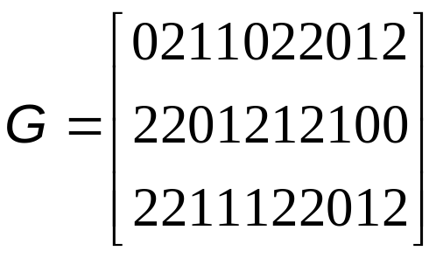
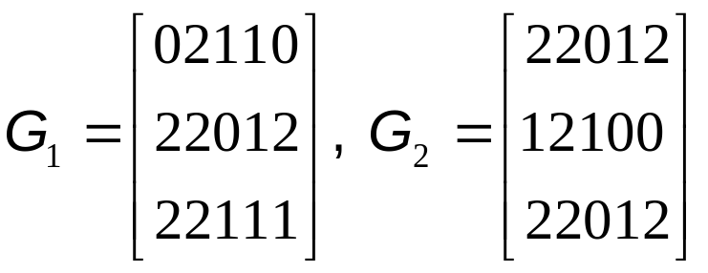
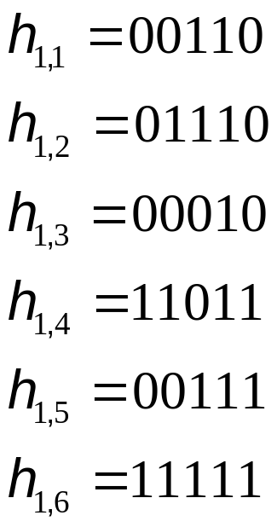
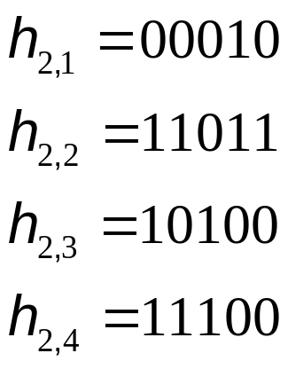
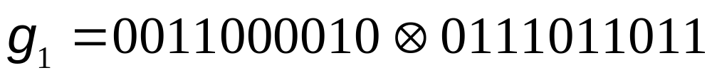
Example
1
1
3
1
1
3
2
2
2
2
3
3

Slide 48
Optimality analysis (1/2)
Two reasons which influence the solution quality towards the pure parsimony criterion
  Some submatrix may have multiple optimal solutions
  The local optima may not be the global optima

Slide 49
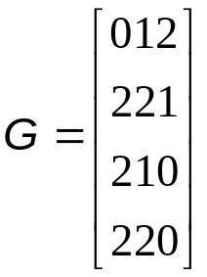
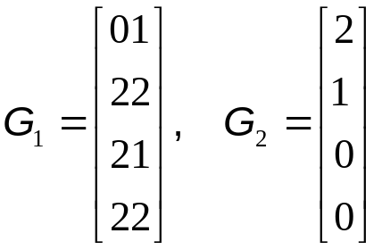
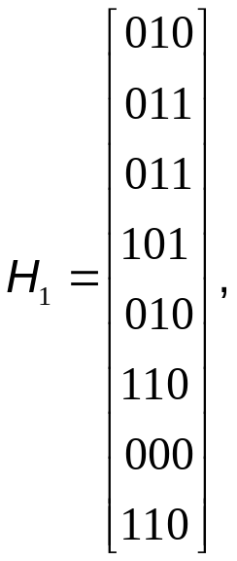
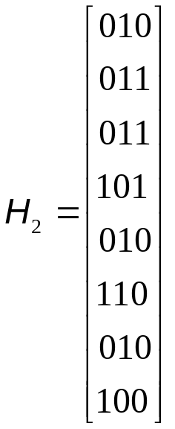
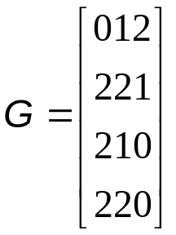
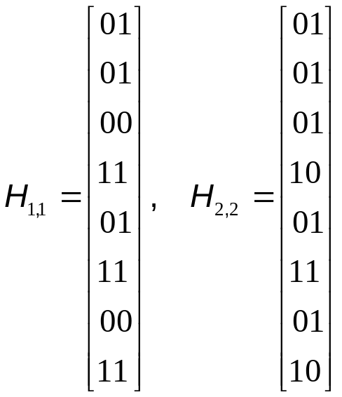
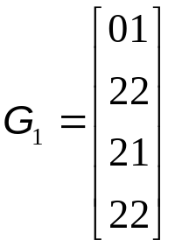
Optimality analysis (2/2)
Global optimal solutions for G
There are two global optimal solution for G₁
Multiple optimal solutions
Global optima which is not contained in the local optima
00
01
10
11
01
10
11
00
01
11
01
10
11

Slide 50
Improved PTG
Procedures
  Make pairwise comparisons among all m rows in a given genotype matrix G
  Whenever we meet the site with value 2 during each tree-growing process, expanding all possible combinations and building the corresponding trees
  For each possible expanding tree, we use the pairwise comparison matrix obtained by procedure 1 to decide whether to cease its growth or not
  Repeat the second and third procedures until all columns are resolved
Example

Slide 51
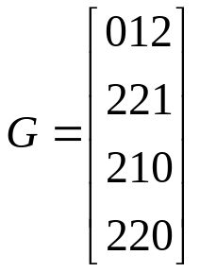
Example of Improved PTG
2
3
4
1
genotype i and genotype j have common haplotypes
2
genotype i and genotype j do not have common haplotypes
3
0
V_{3,1}
1, 3
1
V_{2,1}
1, 3, 2
V_{2,1}
1, 3
V_{1,1}
1, 2, 3, 4
1
V_{3,2}
1, 2
1
0
0
V_{1,1}
1, 2, 3, 4
V_{2,2}
4
V_{3,3}
4
0
0
V_{2,2}
2, 4
V_{0,1}
1, 2, 3, 4
0
V_{0,1}
1, 2, 3, 4
V_{2,3}
3, 4
1
V_{3,4}
3, 4
V_{1,2}
2, 3, 4
V_{2,3}
3, 2, 4
1
V_{1,2}
2, 3, 4
0
1
1
V_{2,4}
2
V_{3,5}
2
0
1
1
V_{2,1}
1, 3, 4
1
V_{1,1}
1, 2, 3, 4
V_{1,1}
1, 2, 3, 4
V_{2,1}
1, 3, 2, 4
0
V_{3,1}
1, 3, 4
0
0
V_{2,2}
2
1
V_{3,2}
1, 2
0
V_{0,1}
1, 2, 3, 4
1
V_{0,1}
1, 2, 3, 4
V_{2,2}
3
V_{2,3}
3, 2
V_{1,2}
2, 3, 4
0
V_{3,3}
3
1
1
1
V_{1,2}
2, 3, 4
V_{2,3}
2, 4
0
V_{3,4}
4
0
V_{2,4}
4
0
1
V_{3,5}
2

Slide 52
Conclusions
PHI problem
  Inferring haplotypes from genotypes for a group of person
A heuristic algorithm
  Performance (optimality gap and error rate) is best among all algorithms we tested for the cases with recombination
Procedure to solve the large scale PHI problem
Improved PTG algorithm
  We can get all of the multiple solutions to the PHI problem based on pure parsimony

Slide 53
Future Works
Improve our greedy heuristic algorithm
  Adjust our weight assignment mechanism to reduce optimality gap or error rate
Optimality gap analysis of our procedure to solve the large scale PHI problem

Slide 54
Thanks for your attention!!!
Q&A?

Slide 55
Recombination
Portions of the paternal and maternal chromosomes are exchanged
  The higher the recombination rate is, the more different number of haplotypes in offspring exist
a
A
a
a
A
A
a
a
A
A
a
a
A
A
b
B
b
b
B
B
b
b
B
B
b
B
b
B
Chromosome 1

