Slide 1
Dijkstra’s Algorithm for the Shortest Path Problem
CONTENTS:
Dijkstra’s Algorithm
Dial’s Implementation
READING ASSIGNMENTS:
Chap 4
Notes:
Get ahold of a network, and use the same network to illustrate the shortest path problem for communication newtorks, the max flow problem, the minimum cost flow problem, and the multicommodity flow problem. This will be a very efficient way of introducing the four problems. (Perhaps under 10 minutes of class time.)

Slide 2
Wide Range of Shortest Path Problems
Sources and Destinations
  We will consider single source problems here
Properties of the costs.
  We will consider non-negative cost coefficients here
Network topology.
  We will consider all directed graphs

Slide 3
Assumptions for the Problem Today
Integral, non-negative data
There is a directed path from source node s to all other nodes.
Objective: find the shortest path from node s to each other node.
Applications.
  Vehicle routing
  Communication systems

Slide 4
Overview of today’s lecture
One nice application (see the book for more)
Dijkstra’s algorithm
  animation
  proof of correctness (invariants)
  time bound
Dial’s algorithm (a way of implementing Dijkstra’s algorithm)
  animation
  time bound

Slide 5
Approximating Piecewise Linear Functions
INPUT: A piecewise linear function
  n points a₁ = (x₁,y₁), a₂ = (x₂,y₂),..., a_{n} = (x_{n},y_{n}).
  x₁ ≤ x₂ ≤ ... ≤ x_{n}.
Objective: approximate f with fewer points
  c* is the “cost” per point included
  c_{ij} = cost of approximating the function through points a_{i}, a_{i+1}, . . ., a_{j} by a single line a_{i}--a_{j} joining point a_{i} to point a_{j}.
  Find the minimum cost path from node 1 to node n.
  Each path from 1 to n corresponds to
  an approximation of the data points a₁ to a_{n}.

Slide 6
c_{i,j} is the cost of deleting points a_{i+1}, …, a_{j-1}
a₉
a₅
a
a₄
a
5
9
a₈
f (x)
a
1
a₁₀
a₂
4
a
a
8
a
a₂
f(x)
10
a
a₆
6
f (x)
a
2
a₃
a
a
3
a₇
1
7
a₃
a₁
a₁
x
e.g., c_{1,3} =
-c* + dist of a₂ to the line
2
4
6
8
1
10
c_{7,10}
c_{1,3}
3
5
7
9
c_{3,5}
c_{5,7}

Slide 7
A Key Step in Shortest Path Algorithms
In this lecture, and in subsequent lectures, we let d( ) denote a vector of temporary distance labels.
d(i) is the length of some path from the origin node 1 to node i.
Procedure Update(i)
  for each (i,j) ∈ A(i) do
  if d(j) > d(i) + c_{ij} then d(j) : = d(i) + c_{ij} and pred(j) : = i;
used in Dijkstra’s algorithm and in the label correcting algorithm

Slide 8
Update(7)
d(7) = 6 at some point in the algorithm, because of the path 1-8-2-7
9
11
8
2
1
3
2
1
1
8
2
7
5
9
7
3
0
1
4
6
3
8
no change
Suppose 7 is incident to nodes 9, 5, 3, with temporary distance labels as shown.
We now perform Update(7).

Slide 9
On Updates
Note: distance labels cannot increase in an update step. They can decrease.
9
11
8
2
1
3
2
1
1
8
2
7
5
9
7
3
0
1
4
6
3
8
no change
We do not need to perform Update(7) again, unless d(7) decreases.
In general, if we perform Update(j), we do not do so again unless d(j) has decreased.

Slide 10
Dijkstra’s Algorithm
Let d*(j) denote the shortest path distance from node 1 to node j.
Dijkstra’s algorithm will determine d*(j) for each j, in order of increasing distance from the origin node 1.
S denotes the set of permanently labeled nodes.
  That is, d(j) = d*(j) for j ∈ S.
T denotes the set of temporarily labeled nodes.
  That is, d(j) ≥ d*(j) for j ∈ T.

Slide 11
Dijkstra’s Algorithm
begin
  S : = {1} ; T = N – {1};
  d(1) : = 0 and pred(1) : = 0; d(j) = ∞ for j = 2 to n;
  update(1);
  while S ≠ N do
  begin (node selection, also called FINDMIN)
    let i ∈T be a node for which
    d(i) = min {d(j) : j ∈ T};
    S : = S ∪ {i}; T: = T – {i};
    Update(i)
  end
end
Dijkstra’s Algorithm

Slide 12
Why Does Dijkstra’s Algorithm Work?
A standard method for proving correctness.
Determine things that are true at each iteration. These are called invariants.
Prove invariants using induction
Prove that the algorithm is finite
Choose invariants so that the algorithm’s correctness follows directly from the invariants and the fact that the algorithm terminates.

Slide 13
Why Does Dijkstra’s Algorithm Work?
Invariants for Dijkstra’s Algorithm
1. If j ∈ S, then d(j) is the shortest distance from node 1 to node j.
2. If i ∈ S, and j ∈ T, then d(i) ≤ d(j).
3. If j ∈ T, then d(j) is the length of the shortest path from node 1 to node j in S ∪ {j}.
S: permanently labeled nodes, T=N\S
After Update(i) :
Note: S increases by one node at a time. So, at the end the algorithm we obtain 1-ALL shortest distance.

Slide 14
Verifying invariants when S = { 1 }
2
∞
2
4
4
2
2
0
1
1
2
3
∞
1
6
4
2
Consider S = { 1 }
and after update(1)
3
3
5
4
∞
1. If j ∈ S, then d(j) is the shortest distance from node 1 to node j.
2. If i ∈ S, and j ∈ T, then d(i) ≤ d(j).
3. If j ∈ T, then d(j) is the length of the shortest path from node 1 to node j in S ∪ {j}.

Slide 15
Verifying invariants Inductively
Assume that the invariants are true before the update.
2
6
2
4
4
0
2
2
6
1
1
2
3
6
∞
Node 5 was just selected. It is now transferred from T to S.
4
2
3
3
5
3
4
2. If i ∈ S, and j ∈ T, then d(i) ≤ d(j).
If this was true before node 5 was transferred, it remains true afterwards.

Slide 16
Verifying invariants Inductively
To show: 1. If j ∈ S, then d(j) is the shortest distance from node 1 to node j.
2
6
2
4
4
0
2
2
6
1
1
2
3
6
∞
4
2
By inductive hypothesis: Before the transfer of node j* (node 5) to S, if k ∈ T, then d(k) is the length of the shortest path from node 1 to node k in S ∪ {k}.
3
3
5
3
4
The result is clearly true for nodes in S prior to transferring node j*. We need to prove it for j* = 5. Any path from node 1 to node j* has a first node k in T prior to the transfer, and the path from 1 to k has length at least d(k) ≥ d(j*). So, the shortest path to j* has length at least d(j*).

Slide 17
Verifying invariants Inductively
To show: 3. If j ∈ T, then d(j) is the length of the shortest path from node 1 to node j in S ∪ {j}.
2
6
2
4
4
0
2
2
6
1
1
2
3
6
∞
4
2
By inductive hypothesis: 1-3 are all true prior to the transfer of node j* to S and prior to update(j*).
3
3
5
3
4
Consider node k ∈ T (e.g., node 4). By hypothesis, d(4) is the shortest path length from 1 to 4 in G restricted to {1, 2, 3, 4}. Let d’(4) be the value after update(5). We want to show that d’(4) is the length of the shortest path P from 1 to 4 in G as restricted to {1, 2, 3, 4, 5}.
If P does not contain node 5, then d’(4) = d(4) and the result is true.
If P does contain node 5, then 5 immediately precedes node 4 and the result is true.

Slide 18
A comment on invariants
It is the standard way to prove that algorithms work.
Finding the best invariants for the proof is often challenging.
A reasonable method. Determine what is true at each iteration (by carefully examining several useful examples) and then use all of the invariants.
Then shorten the proof later.

Slide 19
Complexity Analysis of Dijkstra’s Algorithm
Update Time: update(j) occurs once for each j, upon transferring j from T to S. The time to perform all updates is O(m) since the arc (i,j) is only involved in update(i).
FindMin Time: To find the minimum (in a straightforward approach) involves scanning d(j) for each j ∈ T.
  Initially T has n elements.
  So the number of scans is n + n-1 + n-2 + … + 1 = O(n²).
O(n²) time in total. This is the best possible only if the network is dense, that is, m is about n².
We can do better if the network is sparse.

Slide 20

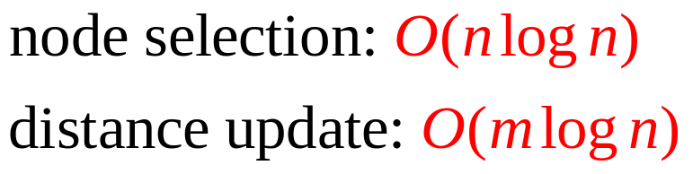
Binary Heap implementation
begin
  create-heap(H) ;
  d(j) = ∞ for j ∈ N ; d(s) : = 0 and pred(s) : = 0 ;
  insert(s,H) ;
  while H ≠ do
  begin
    find-min(i,H) ;
    delete-min(i,H) ;
    for each (i,j) ∈ A(i) do
  begin
    temp=d(i) + c_{ij} ;
    if d(j) > temp then
    if d(j) = ∞ then insert(j,H) ;
    else decrease-key(temp, i, H) ;
    d(j) = d(i) + c_{ij} , pred(j):=i,
  end
  end
end
Complexity:

Slide 21
Example on Binary Heap’s Implementation
₂
₉
₄
₁
₄
₁
₂
₆
₅
₆
₈
₈
₃
₃
₅

Slide 22
A Simple Bucket-based Scheme
Let C = max(c_{ij} : (i,j) ∈ A); then nC is an upper bound on the minimum length path from 1 to n.
Assume:c_{ij} is integer
RECALL: When we select nodes for Dijkstra's Algorithm we select them in increasing order of distance from node 1.
SIMPLE STORAGE RULE. Create buckets from 0 to nC.
Let BUCKET(k) = {i ∈ T: d(i) = k}.
This technique is known as Dial’s Algorithm.

Slide 23
Dial’s Algorithm
Whenever d(j) is updated, update the buckets so that the simple bucket scheme remains true.
The FindMin operation looks for the minimum non-empty bucket.
To find the minimum non-empty bucket, start where you last left off, and iteratively scan buckets with higher numbers.
Dial’s Algorithm

Slide 24
Running time for Dial’s Algorithm
Let C be the largest arc length (cost).
Number of buckets needed. O(nC)
Time to create buckets. O(nC)
Time to update d( ) and buckets. O(m)
Time to find min. O(nC)
Total running time. O(m+ nC).
This can be improved in practice.

Slide 25
Additional comments on Dial’s Algorithm
Create buckets when needed. Stop creating buckets when each node has been stored in a bucket.
Let d* = max d*(j). Then the maximum bucket ever used is at most d* + C.
d*
d*+1
d*+2
d*+3
d*+C
d*+C+1
k
∅
Proof by contradiction:
Suppose there exists j ∈ Bucket( d* + C + 1) after update(i). Then d(j)= d* + C + 1 ,
but d(j) = d(i) + c_{ij} ≤ d* + C →←

Slide 26
Wraparound Buckets
Property: if d(i) is the distance label that the algorithm designates are permanent at the beginning of an iteration, then at the end of that iteration, d(j) ≤ d(i) + C for each finitely labeled node j
C-1
C
0
Store a temporarily labeled node j in bucket d(j) mod(C+1)
Bucket k stores nodes with temporary distance labeles k+d(C+1) ,d=0,1,2,..
d+1 is the iteration number
At any time, bucket k only holds nodes with the same distance label
When we scan bucket k, all nodes in bucket k+1,k+2,…,C,0,1,2,…,k-1 have larger distance labels.
1
2
k+1
3
k

Slide 27
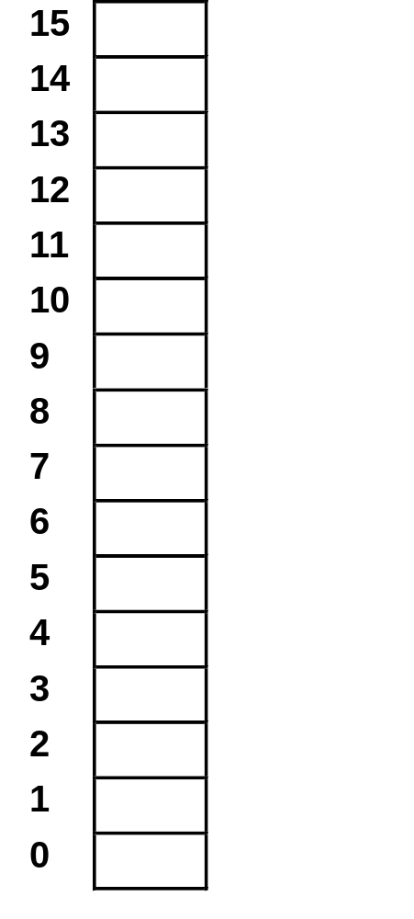
Example on Dial’s Implementation
₂
₉
₄
9
₁
₄
8
0
₁
₂
₆
₅
₆
7
1
₈
₈
6
2
₃
₃
₅
5
3
4

Slide 28
Summary
Shortest path problem, with
  Single origin
  Non-negative arc lengths
Dijkstra’s algorithm (label setting)
  Simple implementation
  Binary heap implementation
  Dial’s simple bucket procedure
Next lecture: a more complex bucket procedure
(radix heap) that reduces the time to O(m + n log C).

