Slide 1
Shortest Path Problems
Single Source Shortest Path (SSSP)
  Nonnegative Arc Cost (LS)
  General Arc Cost (LC)
All Pairs Shortest Paths (APSP)
  Combinatorial Type Algorithms (repeated SSSP)
  Algebraic Type Algorithms (FW)
  LP Type Algorithms (Network simplex)
Multiple Pairs Shortest Paths (MPSP)
0
 | 0
 |  | 0
 |  |  | 0
 |  |  |  | 0
0
 | 0
 |  | 0
 |  |  | 0
 |  |  |  | 0
0
 | 0
 |  | 0
 |  |  | 0
 |  |  |  | 0
0
 | 0
 |  | 0
 |  |  | 0
 |  |  |  | 0
0
 | 0
 |  | 0
 |  |  | 0
 |  |  |  | 0
Graphs: 3.3

Slide 2
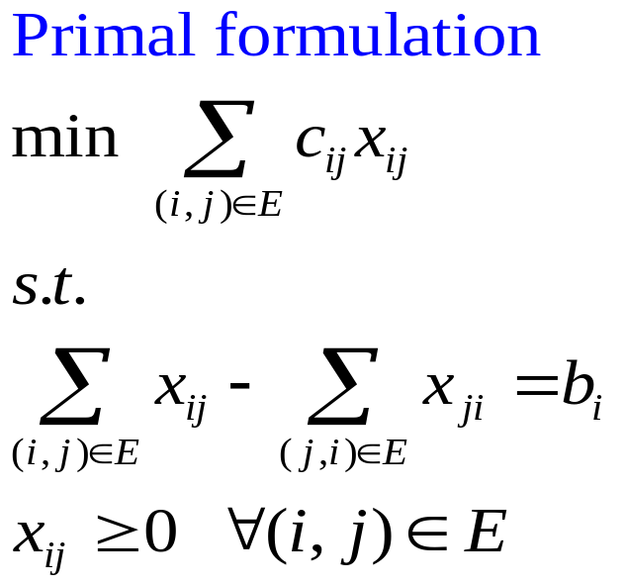
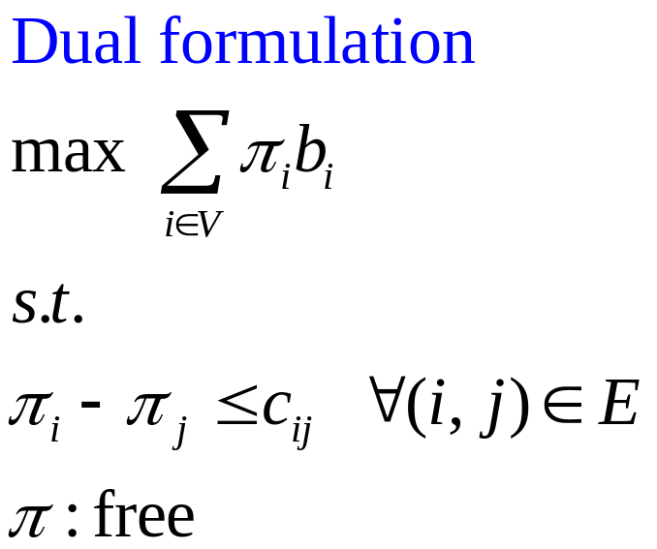
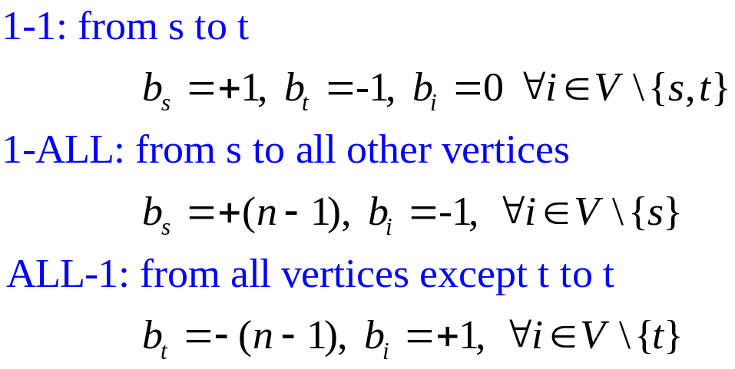
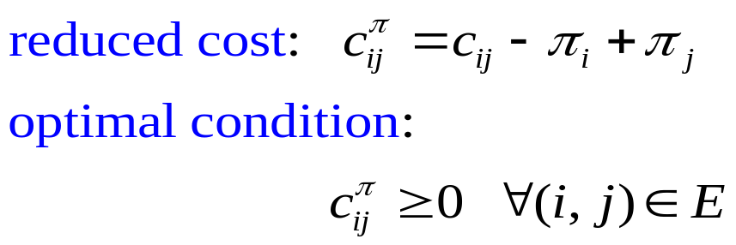
LP form for SSSP Problems
Graphs: 3.3

Slide 3

Dijkstra’s Algorithm
Only valid for graphs with nonnegative edge length
1-ALL: from s to all other vertices
begin
initialization: S= ∅; S^{c}=V;
d[i]=∞, pred[i]=NULL for each i in V
d[s]=0, pred[s]=NULL;
while |S|<n do
choose i from S^{c} such that d[i]=min{d[j]: j in S^{c}};
S=S∪{i}; S^{c}= S^{c}\{i};
for each (i,j) in E[i] do
if d[j]>d[i]+c_{ij} then
d[j]=d[i]+c_{ij}; pred[j]=i;
end for
end while
end
Vertex Selection
select a vertex i to scan
then vertex i becomes
permanently labeled
Outgoing edge list
Scan edge (i,j)
Distance Updating
(triple comparison)
Graphs: 3.3

Slide 4
Example of Dijkstra’s Algorithm
3 [s]
∞ [-]
2 [B]
4 [B]
Choose B
S={s,B}
S^{c}={A,C,D,E}
Scan (B,A),(B,C),(B,D)
2
A
2
C
A
C
3
Choose s
S={s}
S^{c}={A,B,C,D,E}
Scan (s,A), (s,B)
3
0 [-]
3
∞ [-]
0 [-]
3
∞ [-]
s
1
3
1
E
s
1
3
1
E
1
1
1
1
5
B
5
B
D
D
1 [s]
∞ [-]
1 [s]
6 [B]
2 [B]
4 [B]
2 [B]
4 [B]
Choose C
S={s,B,A,C}
S^{c}={D,E}
Scan (C,D),(C,E)
2
C
Choose A
S={s,B,A}
S^{c}={C,D,E}
Scan (A,C)
A
2
C
A
3
3
0 [-]
3
∞ [-]
0 [-]
3
7 [C]
s
1
3
1
E
s
1
3
1
E
1
1
1
1
5
B
5
B
D
D
1 [s]
6 [B]
1 [s]
5 [C]
2 [B]
4 [B]
2 [B]
4 [B]
Choose D
S={s,B,A,C,D,E}
S^{c}=∅
DONE!!
2
C
Choose D
S={s,B,A,C,D}
S^{c}={E}
Scan (D,E)
A
2
C
A
3
3
0 [-]
3
6 [D]
0 [-]
3
6 [D]
s
1
3
1
E
s
1
3
1
E
1
1
1
1
5
5
B
D
B
D
1 [s]
5 [C]
1 [s]
5 [C]
Graphs: 3.3

Slide 5
Binary Min-Heap
Priority queue: any data structure that supports the operations of search min, insert, and delete min (or max)
Heap: a min heap is a complete binary tree with the property that the value at each node is ≦ the values at its children
Suppose there are n elements in the heap:
Search min: O(1) (i.e. the toppest node)
Insert an element: O(log n)
put the new element to the last node, then compare with its ancestors, swap parents/children when necessary
Delete min: O(log n)
delete the toppest node, put the last node to be the toppest, then compare with its descendants, swap parents/children when necessary
Graphs: 3.3

Slide 6
More about Binary Heap
Why is the depth of a binary tree “log n” for a tree of n nodes?
Since we keep “balanced” binary tree, suppose there are n nodes in the binary tree,
Graphical illustration of inserting & deleting an element in min-heap
5
5
5
5
5
2
11
120
11
120
11
20
11
20
11
2
11
5
40
100
40
100
20
40
100
120
40
100
120
2
40
100
120
20
40
100
120
20
Original min-heap
Insert a new element 20
Insert a new element 2
20
5
5
5
3
11
5
11
5
11
20
11
20
3
20
5
20
40
100
120
20
40
100
120
40
100
120
40
3
120
40
11
120
40
11
120
Delete an element 2
Change element 100 to be 3
Graphs: 3.3

Slide 7
Complexity of Dijkstra’s Algorithm
Scan vertex i:
scan all the outgoing edges (i,j) connecting vertex i (i.e. edges in E[i])
after i is scanned, we say i is permanently labeled
Once a vertex is permanently labeled, its distance label is set and won’t be changed.
Scan edge (i,j): check whether d[j]>d[i]+c_{ij} or not
if yes then update distance label of vertex j
d[j]= d[i]+c_{ij}; pred[j]=i;
Two major operations:
Vertex Selection: each vertex is selected to be scanned exactly once
however, effort to choose the vertex with minimal distance label:
by linear search: |V|+|V-1|+|V-2|+…+1= O(|V|²)
by binary heap: O(|V|log|V|)
Distance Updating: each outgoing edge is scanned exactly once
i.e. total # of edge scanning operations= |E|
using binary heap: after each updating, need to resort the data structure,
each sorting takes O(log|V|), so totally takes O(|E|log|V|)
Complexity: O(|V|²+|E|) , or O((|V|+|E|)log|V|)
There are many other variants of Dijkstra’s algorithm. Most of them use different techniques to do the vertex selection.
Graphs: 3.3

Slide 8
Other Implementations of Dijkstra’s algorithm
Variants of Dijkstra’s algorithm:
Dial’s bucket implementation (for integral edge length)
nC+1 unit-length buckets to store temporarily labeled vertices (C=max{c_{ij}})
bucket k stores vertices with distance label k (using doubly linked list)
idea: 1. choose the 1st nonempty bucket;
2. scan all vertices in the bucket one by one;
3. redistribute vertices into new buckets if their distance labels are decreased;
e.g. In iteration 5, d[E]=9 (i.e. put vertex E in the bucket 9), if d[E] becomes 7
in iteration 7, we have to move vertex E from bucket 9 to bucket 7
4. remove any scanned vertices;
5. then choose the next nonempty bucket, repeat steps 1~4 until
all buckets are checked
Complexity: O(m+nC)
Radix Heap implementation
more complicated data structure (not covered in this course)
Bucket
Distance label
….
0
1
2
3
4
5
6
7
….
Graphs: 3.3

Slide 9
Binary Heap & Dial’s implementation-1
3 [s]
∞ [-]
Binary min-heap: parent.key ≦ child.key
key: distance label
A
2
C
Choose s
S={s}
S^{c}={A,B,C,D,E}
Scan (s,A), (s,B)
3
3
∞ [-]
0 [-]
0
3
3
1
s
1
3
1
E
1
1
--
--
--
--
1
--
3
--
B
5
D
Bucket
Distance label
s | B |  | A
1 [s]
∞ [-]
4 [B]
0 | 1 | 2 | 3 | 4 | 5 | 6 | 7
2 [B]
2
Choose B
S={s,B}
S^{c}={A,C,D,E}
Scan (B,A),(B,C),(B,D)
A
C
3
3
2
2
0 [-]
3
∞ [-]
s
1
3
1
E
--
--
--
--
4
6
1
1
B
5
Bucket
Distance label
 |  | A |  | C |  | D
D
1 [s]
6 [B]
0 | 1 | 2 | 3 | 4 | 5 | 6 | 7
2 [B]
4 [B]
Choose A
S={s,B,A}
S^{c}={C,D,E}
Scan (A,C)
A
2
C
6
4
3
3
∞ [-]
0 [-]
4
--
6
--
s
1
3
1
E
1
1
Bucket
Distance label
 |  |  |  | C |  | D
5
B
D
0 | 1 | 2 | 3 | 4 | 5 | 6 | 7
1 [s]
6 [B]
Graphs: 3.3

Slide 10
Binary Heap & Dial’s implementation-2
2 [B]
4 [B]
Binary min-heap: parent.key ≦ child.key
2
C
Choose C
S={s,B,A,C}
S^{c}={D,E}
Scan (C,D),(C,E)
A
3
0 [-]
3
7 [C]
6
5
3
E
5
s
1
1
1
1
--
--
--
--
7
--
B
5
D
Bucket
Distance label
 |  |  |  |  | D |  | E
1 [s]
5 [C]
2 [B]
4 [B]
0 | 1 | 2 | 3 | 4 | 5 | 6 | 7
2
C
Choose D
S={s,B,A,C,D}
S^{c}={E}
Scan (D,E)
A
3
7
6
0 [-]
3
6 [D]
s
1
3
1
E
--
--
--
--
1
1
Bucket
Distance label
 |  |  |  |  |  | E
5
B
D
1 [s]
5 [C]
0 | 1 | 2 | 3 | 4 | 5 | 6 | 7
2 [B]
4 [B]
Choose D
S={s,B,A,C,D,E}
S^{c}=∅
DONE!!
A
2
C
--
Trace Paths
s-B-A
s-B
s-B-C
s-B-C-D
s-B-C-D-E
3
3
6 [D]
0 [-]
--
--
s
1
3
1
E
1
Bucket
Distance label
5
1
B
D
0 | 1 | 2 | 3 | 4 | 5 | 6 | 7
1 [s]
5 [C]
Graphs: 3.3

Slide 11
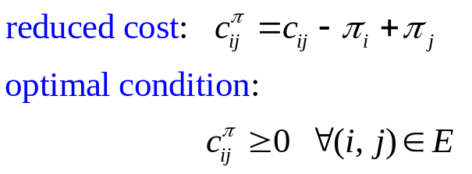
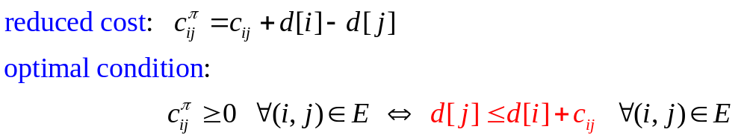
Triple Comparisons
Distance Updating:
when we scan node i, we check each outgoing edges (i,j) as follows:
if d[j]>d[i]+c_{ij} then
d[j]=d[i]+c_{ij}; pred[j]=i;
such an operation is called a “triple comparison”
Remember in the dual form of SSSP
By defining d[i]=-π_{i}, the above become
Thus, triple comparison is an operation to achieve the LP optimal condition.
All Shortest Path algorithms perform sequences of triple comparisons.
d[i]
i
c_{ij}
d[j]
s
j
Graphs: 3.3

Slide 12
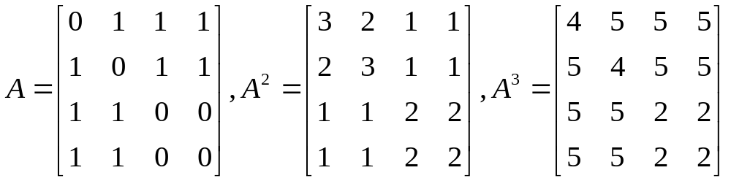
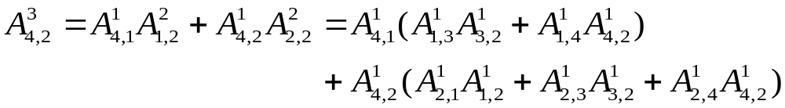
Number of Paths
How many paths of p edges between 2 specific vertices?
Thm 3.7 Given a graph G with vertices V, edges E
the # paths of p edges from vertex i to vertex j is the (i,j)^{th} entry of A^{p},
where A is the adjacency matrix
Ex:
Paths of 3 edges from 3 to 4: 3-1-2-4, 3-2-1-4
Paths of 3 edges from 4 to 2: 4-1-3-2, 4-1-4-2, 4-2-1-2, 4-2-3-2, 4-2-4-2
1
2
3
4
Graphs: 3.3

Slide 13
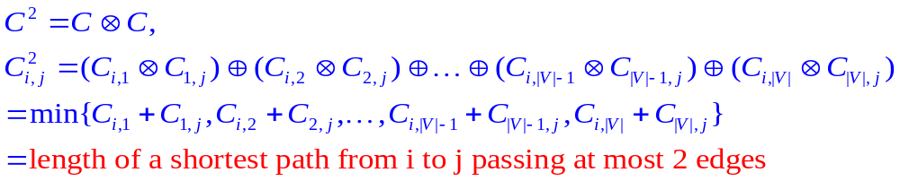
Path Algebra
Path algebra: an ordered semiring
with 2 binary operations defined as
Measure matrix: C, where C_{ij} represents the length of edge (i,j)
C_{ii} =0 for all i; C_{ij}=∞ , if there exists no edge (i,j)
 | Generalized addition | Generalized multiplication | Unit element | Null element
Original sense | a ⊕ b | a ⊗ b | e | 0
Path algebra | min{a,b} | a+b | 0 | ∞
|V| addition
|V|-1 comparison
Graphs: 3.3

Slide 14
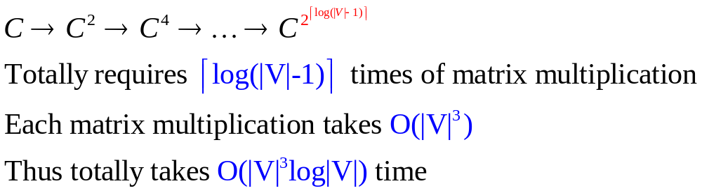
Compute APSP by C^{|V|-1}
Every simple path between 2 vertices at most contains |V|-1 edges
Thus
By computing matrix C^{|V|-1}, we can obtain ALL-ALL shortest paths
How to efficiently compute C^{|V|-1}?
There are many fast-matrix-multiplication techniques that can be used to improve this complexity, but such algorithms are complicated.
O(|V|²*|V|) since there are
|V|² entries, each takes O(|V|)
Graphs: 3.3

Slide 15
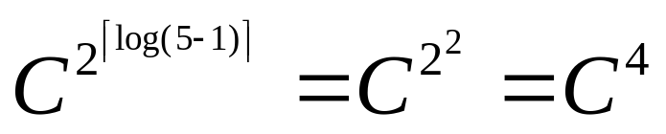
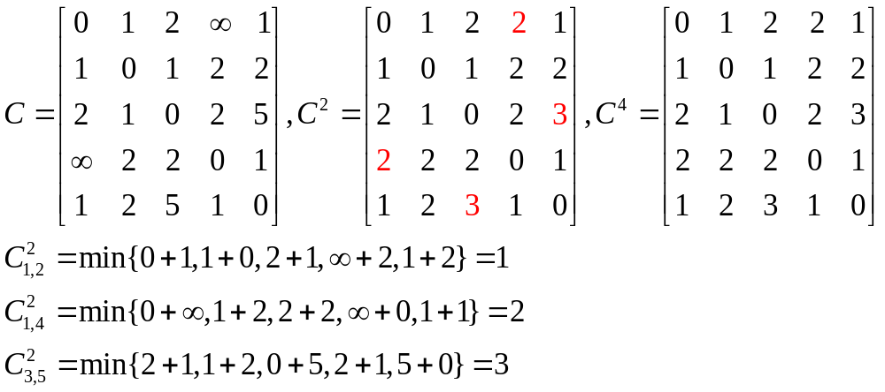
Example of Matrix Multiplication
2
3
2
1
1
5
4
2
1
1
1
2
2
5
Graphs: 3.3

Slide 16
Floyd-Warshall Algorithm
Let D be a n×n distance matrix, whose entry D_{ij} is initially set to be C
final D_{ij} denotes the length of the shortest path from i to j
PRED be a n×n predecessor matrix, whose entry PRED_{ij} is initially set to be j
final PRED_{ij} denotes the predecessor of j on the path from i to j
Triple comparison : d_{ij}=min{d_{ij}, d_{ik}+d_{kj}}
Claim:
if we perform triple comparisons for successive k=1,2,…,|V|
then the final d_{ij} equals the length of the shortest path from i to j
Floyd-Warshall Algorithm is based on the above claim
begin
initialization: D:=C; PRED_{ij}:=i for each (i,j);
for k=1 to |V| do
for i=1 to |V| do
for j=1 to |V| do
if d_{ij}>d_{ik}+c_{kj} then
d_{ij}=dik +c_{kj}; PRED_{ij}=PREDkj ;
end
Graphs: 3.3

Slide 17
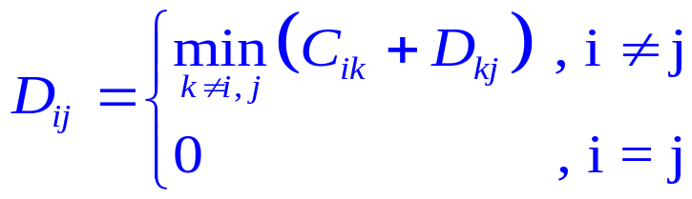
Properties of Floyd-Warshall Algorithm
Let D_{ij}^{k} denote the entry D_{ij} after the k^{th} iteration of Floyd-Warshall algorithm
D_{ij}^{k} is the length of shortest path from i to j with intermediate vertices in {1,2,…,k-1,k}
Totally O(|V|³) operations, most efficient for complete graph
Detect negative cycle: if D_{ii}^{k}<0, there exists a negative cycle from i to i with k edges
Dynamic Programming:
Bellman’s Equation:
D = C ⊗D ⊕ I_{n}
Floyd-Warshall algorithm ⬄ Gauss Jordan method
D_{ij}
i
k
j
Graphs: 3.3

Slide 18
Example of APSP problems
2
3
2
D_{k}: distance matrix after the k^{th} iteration
PRED_{k}: predecessor matrix after the k^{th} iteration
After the |V|-1th iteration, the last column & row are already optimal
1
1
5
4
2
1
1
1
2
2
5
D¹
D²
D³
D⁴
D⁵
0
1
2
∞
1
0
1
2
3
1
0
1
2
3
1
0
1
2
3
1
0
1
2
2
1
1
0
1
2
2
1
0
1
2
2
1
0
1
2
2
1
0
1
2
2
1
0
1
2
2
2
1
0
2
3
2
1
0
2
3
2
1
0
2
3
2
1
0
2
3
2
1
0
2
3
∞
2
2
0
1
3
2
2
0
1
3
2
2
0
1
3
2
2
0
1
2
2
2
0
1
1
2
3
1
0
1
2
3
1
0
1
2
3
1
0
1
2
3
1
0
1
2
3
1
0
PRED¹
PRED²
PRED³
PRED⁴
PRED⁵
1
1
1
1
1
1
1
1
2
1
1
1
1
2
1
1
1
1
2
1
1
1
1
5
1
2
2
2
2
2
2
2
2
2
2
2
2
2
2
2
2
2
2
2
2
2
2
2
2
2
3
3
3
3
1
3
3
3
3
1
3
3
3
3
1
3
3
3
3
1
3
3
3
3
1
4
4
4
4
4
2
4
4
4
4
2
4
4
4
4
2
4
4
4
4
5
4
4
4
4
5
5
1
5
5
5
5
1
5
5
5
5
1
5
5
5
5
1
5
5
5
5
1
5
5
Graphs: 3.3

Slide 19
Trace Shortest Paths by PRED matrix
2
3
2
PRED⁵
1
1
5
4
1
1
1
5
1
2
1
1
2
2
2
2
2
1
3
3
3
3
1
2
2
5
5
4
4
4
4
5
5
1
5
5
Trace_path(PRED,i,j)
begin
k=j;
output k;
while PRED_{ik} ≠ i do
k=PRED_{ik};
output k
end while
output k
end
trace path 1→4: i=1,j=4
k=j=4
output 4
Since PRED₁₄=5 ≠ 1
k= PRED₁₄=5
output 5
Since PRED₁₅=1 = 1
output 1
Thus we obtain 4←5←1 as the shortest path
Graphs: 3.3

