Slide 1
Heapsort
Contents:
Heaps
Maintaining the heap property
Building a heap
Heapsort algorithm
Priority queues

Slide 2
Heap Data Structure
Heap A is a nearly complete binary tree.
  Height of node = # of edges on a longest simple path from the node down to a leaf.
  Height of heap = height of root = (lg n).
A heap can be stored as an array A.
  Root of tree is A[1].
  Parent of A[i ] = A[floor(i/2)].
  Left child of A[i ] = A[2i ].
  Right child of A[i ] = A[2i + 1].
  Computing is fast with binary representation implementation.

Slide 3
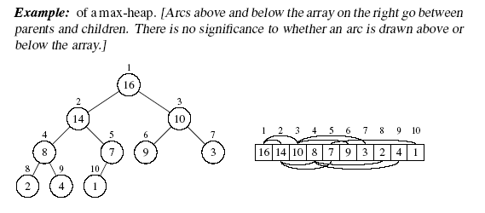
Heap Property
max-heap property: for all nodes i , excluding the root, A[PARENT(i )] ≥ A[i ].
min-heap property: for all nodes i , excluding the root, A[PARENT(i )] ≤ A[i ].

Slide 4
Maintaining the heap property
MAX-HEAPIFY is used to maintain the max-heap property.
Before MAX-HEAPIFY, A[i ] may be smaller than its children.
Assume left and right subtrees of i are max-heaps.
After MAX-HEAPIFY, subtree rooted at i is a max-heap.
MAX-HEAPIFY(A, i, n)
  l ← LEFT(i )=2i
  r ← RIGHT(i )=2i+1
  if l ≤ n and A[l] > A[i ]
  then largest ← l
  else largest ←i
  if r ≤ n and A[r] > A[largest]
  then largest ←r
  if largest ≠ i
  then exchange A[i ] ↔ A[largest]
  MAX-HEAPIFY(A, largest, n)
Compare A[i ], A[LEFT(i )], and A[RIGHT(i )].
If necessary, swap A[i ] with the larger of the two children to preserve heap property.
Continue this process of comparing and swapping down the heap, until subtree rooted at i is a max-heap. If we hit a leaf, then the subtree rooted at the leaf is trivially a max-heap.

Slide 5
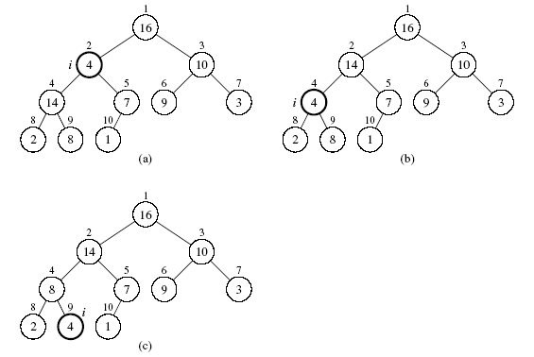
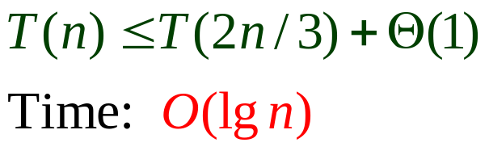
Example of MAX-HEAPIFY
Suppose the heap has height h, extreme case is
when the last row of the tree is exactly half-full
left-subtree has 1+2+2²+…+2^{h-1}=2^{h}-1 nodes
right-subtree has 1+2+2²+…+2^{h-2}=2^{h-1}-1 nodes
Node 2 violates the max-heap property
Compare node 2 with its children, then swap it with the larger of its 2 children
Continue down the tree, swapping until the value is properly placed at the root of a subtree that is a max-heap. In this case, the max-heap is a leaf.

Slide 6
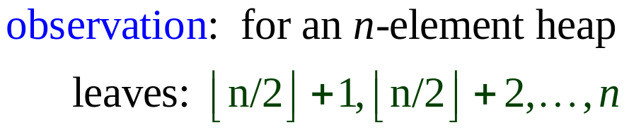

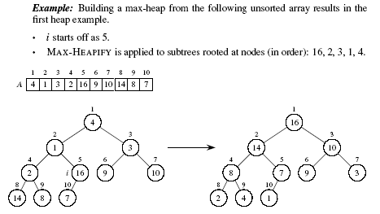
Building a Heap
BUILD-MAX-HEAP(A, n)
  for i ← downto 1
  do MAX-HEAPIFY(A, i, n)

Slide 7
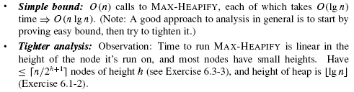
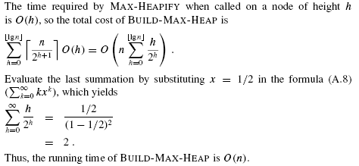
Complexity of BUILD-MAX-HEAP

Slide 8
Heapsort Algorithm
Builds a max-heap from the array.
Starting with the root (the maximum element), the algorithm places the maximum element into the correct place in the array by swapping it with the element in the last position in the array.
“Discard” this last node (knowing that it is in its correct place) by decreasing the heap size, and calling MAX-HEAPIFY on the new (possibly incorrectly-placed) root.
Repeat this “discarding” process until only one node (the smallest element) remains, and therefore is in the correct place in the array.

Slide 9
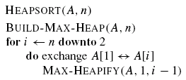
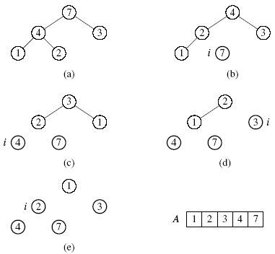
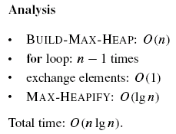
Heapsort

Slide 10
Heap Implementation of Priority Queue
A heap gives a good compromise between fast insertion but slow extraction and vice versa. Both operations take O(lg n) time.
Priority queue
Maintains a dynamic set S of elements.
Each set element has a key —an associated value.
Max-priority queue supports dynamic-set operations:
  INSERT(S, x): inserts element x into set S.
  MAXIMUM(S): returns element of S with largest key.
  EXTRACT-MAX(S): removes and returns element of S with largest key.
  INCREASE-KEY(S, x, k): increases value of element x’s key to k. Assume k ≥ x’s current key value.
Example max-priority queue application:
schedule jobs on shared computer, extracting higher-priority job
Example min-priority queue application:
event-driven simulator, extracting earlier event

Slide 11
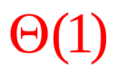

Max Heap Operations- Find & Extract
Finding the maximum element (i.e. the root)
Time:
Extracting max element
Time:
HEAP-MAXIMUM(A)
return A[1]
Given the array A:
• Make sure heap is not empty.
• Make a copy of the maximum element (the root).
• Make the last node in the tree the new root.
• Re-heapify the heap, with one fewer node.
• Return the copy of the maximum element.
HEAP-EXTRACT-MAX(A, n)
if n < 1
then error “heap underflow”
max ← A[1]
A[1] ← A[n]
MAX-HEAPIFY(A, 1, n − 1)
return max

Slide 12
Max Heap Operations – Increasing key
Increasing key value
Time:
Given set S, element x, and new key value k:
• Make sure k ≥ x’s current key.
• Update x’s key value to k.
• Traverse the tree upward comparing x to its parent and swapping keys if necessary, until x’s key is smaller than its parent’s key.
HEAP-INCREASE-KEY(A, i, key)
  if key < A[i ]
  then error “new key < current key”
  A[i ] ← key
  while i > 1 and A[PARENT(i )] < A[i ]
  do exchange A[i ] ↔ A[PARENT(i )]
  i ← PARENT(i )

Slide 13
Max Heap Operations – Insertion
Inserting into the heap
Time:
Given a key k to insert into the heap:
• Insert a new node in the very last position in the tree with key −∞.
• Increase the −∞ key to k using the HEAP-INCREASE-KEY procedure defined above.
MAX-HEAP-INSERT(A, key, n)
  A[n + 1]←−∞
  HEAP-INCREASE-KEY(A, n + 1, key)

