Slide 1

Perl: Unit Testing 101
Part II
It’s All About Mocking

Slide 2
Basic Mocking
A rose by any other name
Keeps everything isolated
Without isolation unit tests are not unit tests

Slide 3
Mock all the things!
(Almost) Everything can be mocked:
Methods / functions
Objects
Modules
Built in functions can be difficult due to their global scope.
In most cases this does not matter.
Mocked Sub:
*Foo::Bar::sub = \&{...};
Mocked Object:
my $foo = Test::MockObject->new;
$foo->mock(‘sub’, sub {...});
$foo->unmock;
(See also Mock::Object::Extends)
Mocked Module:
my $foo = new Test::MockModule(‘Foo::Bar');
$foo->mock(‘sub’, sub {...});
$foo->unmock(‘sub’[,...]);

Slide 4

DBD::Mock
Keeps you sane when testing database calls
Accessed like any regular database connection
If your objects or functions accept a DB handle then this drops right in
Can be populated with specific result sets for testing
Easy to review all queries and bound parameters
# Create a result set
$dbh_mock->{mock_add_resultset} =
\( [‘col1’,’col2’], [‘row1val1’,’row1val2’],
[‘row2val1’,’row2val2’]);
# Retrieve query history as array ref
my $history = $dbh_mock->{mock_all_history};

Slide 5

Test::Fatal
Makes testing die() routines simple
Exports a single routine: exception({...})
exception() does not provide TAP asserts so use it with is/isn’t
Provides on-request dies_ok and lives_ok wrappers but they are not recommended
See Test::Warn
# Given Foo::Bar::sub(undef) will die():
my $ex = exception { Foo::Bar::sub(undef) };
is($ex, ‘<die message>’, ‘Can’t be undef!);

Slide 6

Test::MockCmd
Makes it so
Makes it simple to mock system(), exec() , and backticks ``
It will affect all your tests, not just the class which loads it
With proper planning it can be a powerful tool
use Test::Mock::Cmd \&newCode;
sub newCode {
# command now does whatever you want!
...
return ‘This was mocked’;
}

Slide 7
Appendix: Devel::Cover
How much did you actually test?

Slide 8
You may think you’ve covered it all...
Devel::Cover reports on what code was run
Verticles include: Statement, branch, condition, subroutine, POD* and time coverage.
Statements != line of code!
*POD coverage is actually provided by Pod::Coverage.
# 1 subroutine
# 2 branches
# 3 conditions
# 3 statements
# Oops forgot the POD
sub foo {
If ($a && $b){
return 1;
} else {
return 0;
}
}

Slide 9
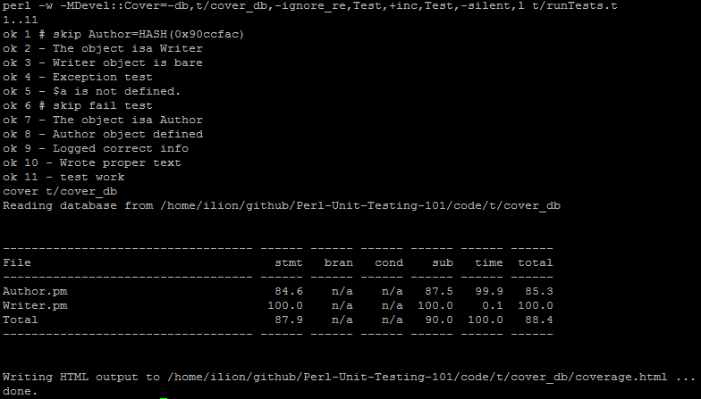
Running ‘cover /path/to/db’ gives an ascii report and creates detailed HTML

Slide 10
These slides and sample code available at:
https://github.com/ilionblaze/Perl-Unit-Testing-101
Michael Holt
©2012

