Slide 1
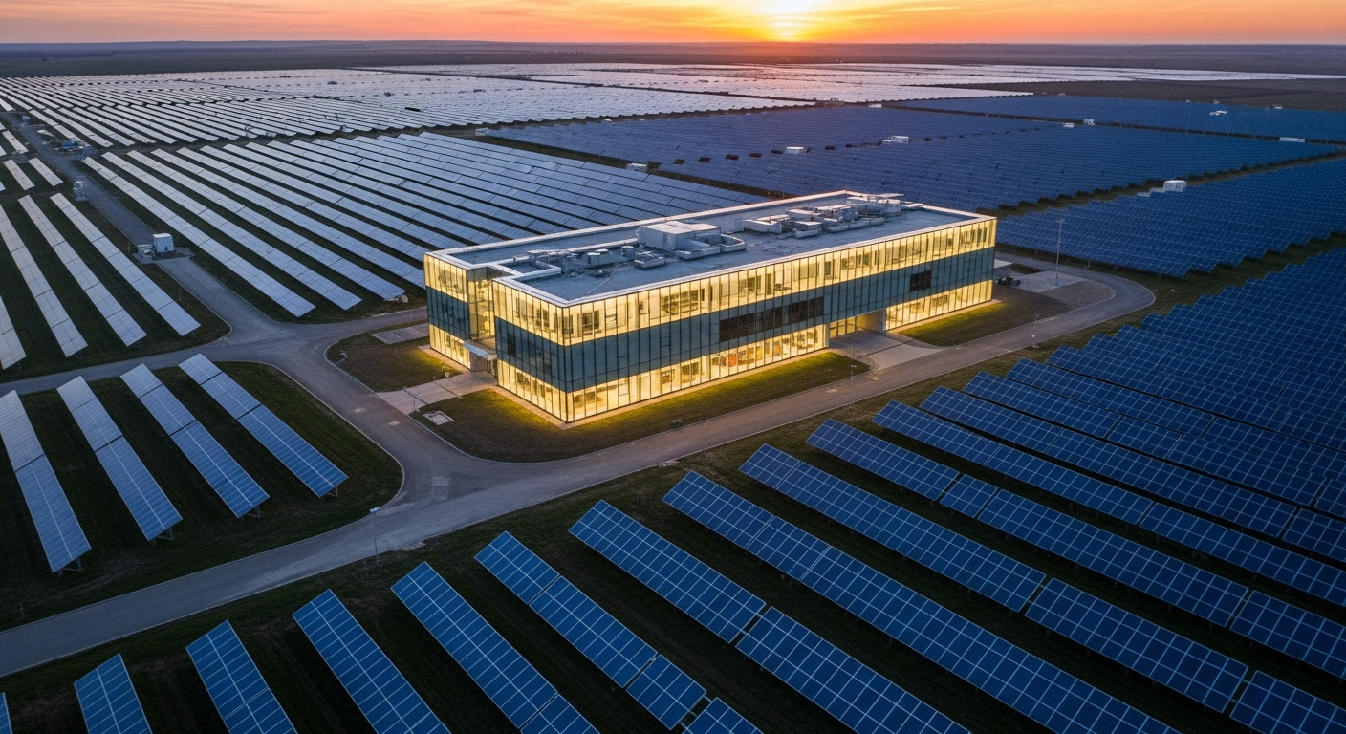
iliOS
The Sun's Operating System
AI-Powered Real Estate Investment Management
Product Overview | 2026

Slide 2
THE CHALLENGE
Real Estate Investment Management Is Broken
01
Manual Document Review
02
Fragmented Data Sources
Teams spend weeks manually reading leases, PPAs, and financial models with no standardized extraction or verification process.
Critical investment data lives across spreadsheets, email chains, and disconnected systems with no single source of truth.
03
Slow Due Diligence
04
No Operational Visibility
Cross-document analysis requires senior analysts to manually compare terms across dozens of files per project.
Asset performance, telemetry, and financial health are tracked in silos with no unified monitoring dashboard.

Slide 3
PLATFORM OVERVIEW
One Platform for the Entire Investment Lifecycle
AI Data Room
Acquisitions
Project Hub
Automated document parsing, field extraction, and verification workflows
13-stage deal pipeline from origination through closing
Unified asset management, due diligence, and operational tracking
Finance
Telemetry
Reporting
Capital governance, budgeting, and vendor management
Real-time production monitoring and device health analytics
PowerBI integration for portfolio-wide business intelligence

Slide 4

AI-POWERED DATA ROOM
Documents That Read Themselves
iliOS uses advanced AI to automatically parse, extract, and verify critical data from every document in your investment portfolio.
Automated PDF/document parsing with AI field extraction
Programmatic page navigation linked to extracted evidence
Sequential verification workflow with audit trail
Bulk acceptance with parse run safety validation
Support for 16+ document types across the portfolio

Slide 5
AI DOCUMENT INTELLIGENCE
How AI Transforms Your Document Workflow
1
2
3
4
Upload
AI Parse
Verify
Accept
Drop any PDF, lease, PPA, or financial model into the Data Room
OpenAI-powered extraction identifies key terms, dates, and values
Each extracted field links to its source page for evidence review
Bulk acceptance promotes verified data to current assumptions
Fully in-app parsing powered by OpenAI -- no external services, no data leaves your platform.

Slide 6
SMART DUE DILIGENCE
Cross-Document Analysis at Scale
Terms & Values Roll-Up
Document Versioning
AI aggregates and compares key terms across all project documents, surfacing discrepancies automatically.
Track candidate, active, and retired versions with full promotion history and diff computation.
Co-Terminus Checks
Acceptance Safety
Automatically verifies that contract end dates align across related agreements like leases and PPAs.
Validates parse run status before allowing bulk acceptance, preventing stale data from entering assumptions.
DD Health Indicator
Audit Trail
Project-level health score based on document completeness, verification status, and cross-document consistency.
Every extraction, verification, and promotion action is logged with user, timestamp, and evidence links.

Slide 7
EXTRACTION REGISTRY & PROMPT STUDIO
Configure AI Without Writing Code
The Extraction Registry lets your team define new document types and extraction fields through a visual interface -- no engineering required. The Prompt Studio provides full control over AI prompt templates for each document category.
16+
100+
99.2%
Dynamic document type configuration via database-driven schemas
Document Types
Extraction Fields
Parse Accuracy
Custom field definitions with validation rules per document type
Prompt template editor for fine-tuning AI extraction accuracy
Re-extraction workflows for iterative quality improvement
Quality guardrails: configurable text length, file size, and LLM limits

Slide 8
TELEMETRY & PERFORMANCE
Real-Time Solar Production Intelligence
Production Monitoring
Irradiance Analysis
Track actual vs. expected energy production across all sites with daily, weekly, and monthly views.
Compare actual vs. expected irradiance with hourly granularity to identify underperformance.
Device Health
Cumulative Energy
Monitor inverters, weather stations, and modules with MTBF/MTTR availability metrics.
Portfolio-wide and site-level cumulative energy tracking against capacity-based expectations.
DAS Integration
Company Dashboard
Connect to Data Acquisition Systems for automated telemetry ingestion and device mapping.
Aggregate production data across all sites with fleet-level performance overview.

Slide 9
ACQUISITIONS
13-Stage Deal Pipeline
Track every deal from initial screening through closing with full entity management, readiness scoring, and executive summaries.
Screening
Initial Review
LOI
Due Diligence
Underwriting
IC Review
Negotiation
Legal Review
Financing
Closing Prep
Signing
Post-Close
Completed
Entity Directory
Deal Readiness
Executive Summary
Link legal entities, EPCs, offtakers, and tax equity partners to every deal
Automated scoring based on entity assignments, DD completeness, and docs
One-click overview of deal terms, timeline, and key stakeholders

Slide 10
FINANCE & REPORTING
Capital Governance with Full Visibility
Integration Hub
Health Monitoring
Connect multiple external finance providers with encrypted credentials and pluggable architecture. Sync accounts and transactions with upsert semantics for idempotent reruns.
Real-time sync status indicators (Healthy, Attention Needed, In Progress) with automated stale-sync detection and actionable error summaries.
Budgeting & Vendors
PowerBI Reporting
Company-level budget tracking with vendor management, account mapping to projects, and 30-day transaction summaries at a glance.
Embedded PowerBI dashboards for portfolio-wide business intelligence, with row-level security matching platform access controls.

Slide 11
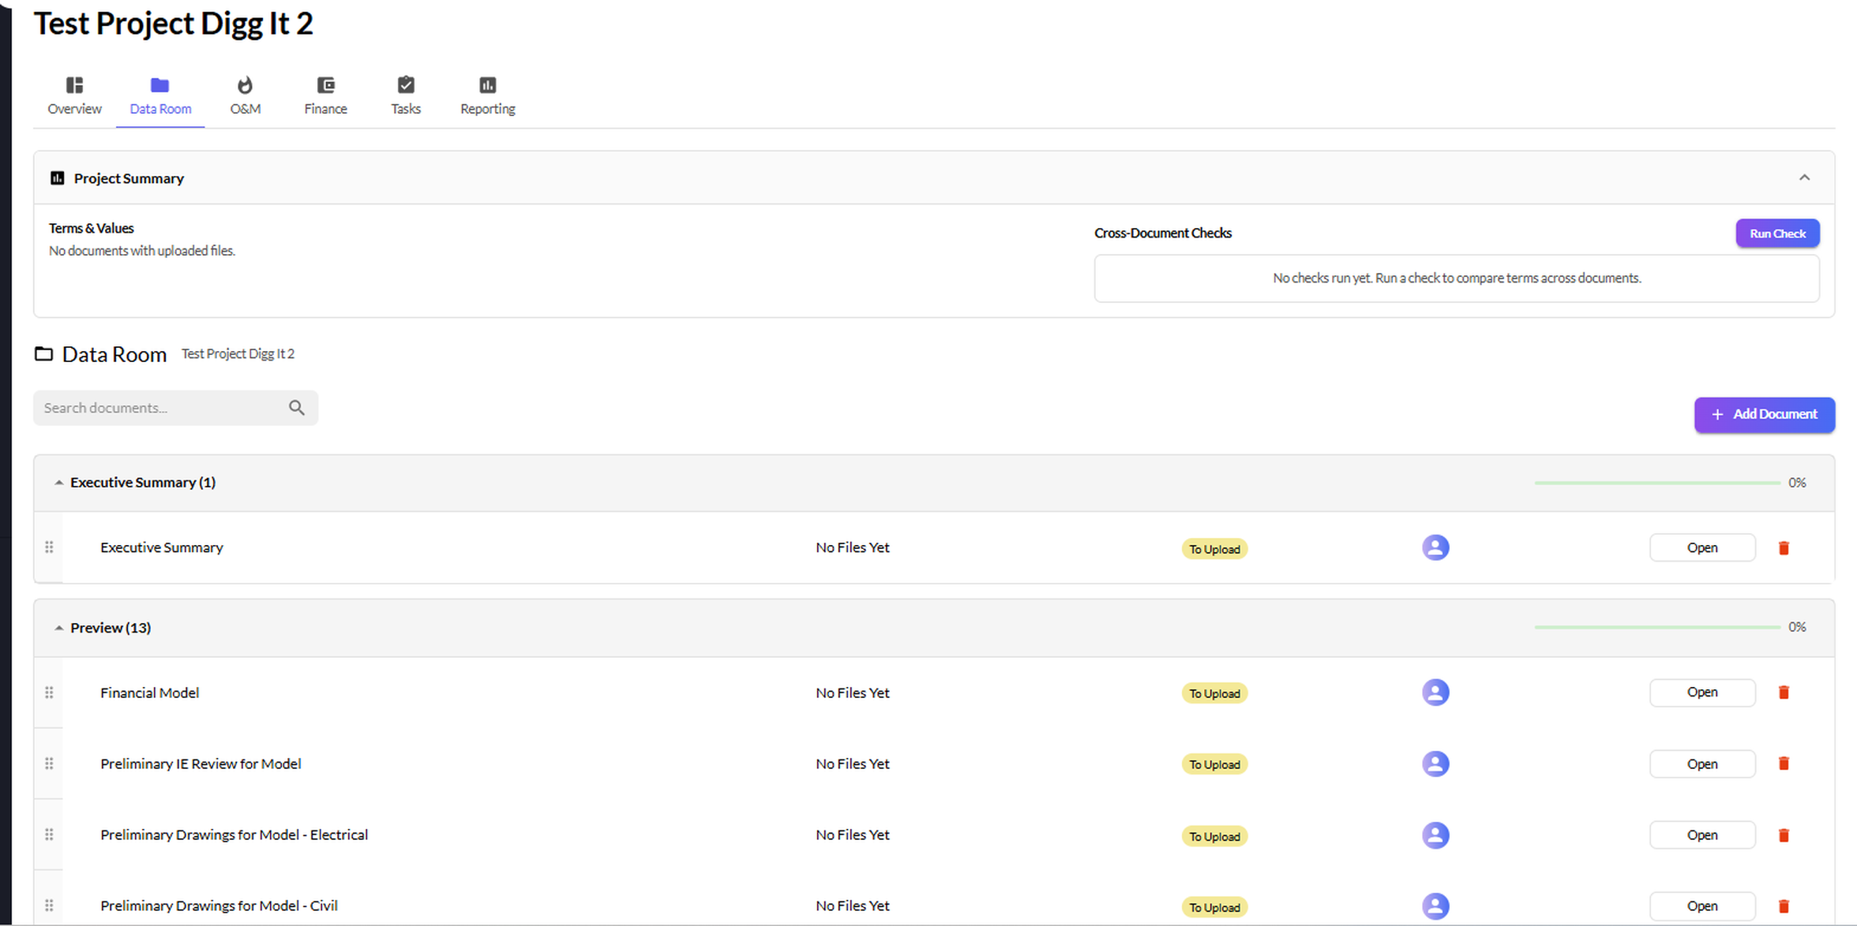
PRODUCT SCREENSHOT
The Data Room in Action

Slide 12
SECURITY & ACCESS CONTROL
Enterprise-Grade Data Protection
1
Multi-Company Access
2
Module-Level Permissions
Granular authorization with a Canonical Effective-Access Resolver supporting read-only, contributor, and company admin roles across portfolios.
Fine-grained permission enforcement at the module level -- control who can view, edit, or manage each area of the platform.
3
Role Profiles
4
Encrypted Credentials
Detailed stakeholder definitions with Portfolio Hub Boundary Model for precise data visibility and operational access.
All third-party integration credentials are encrypted at rest with environment-level isolation between tenants.

Slide 13

iliOS
The Sun's Operating System
AI-powered real estate investment management for the modern portfolio.
Schedule a Demo | info@ilios.energy

