Slide 1
Evolution of Software
In terms of Structure & Design
Multi-Layerism
Modularity
Front-End / Midde-End / Back-End
Programs should grow like Plants

Slide 2
How to analyze design
Dependency Graph
  Static & Acyclic (DAG)
  Module dependency graph
  Class hierarchy graph
Call Graph
Dynamic and with possible cycles
AKA: Sequence Diagram

Slide 3
$ modulegraph -p /starcal scal2/ui_gtk/starcal2.py -g > graph.dot
(then clean .dot file by hand)
$ dot -Tpng graph.dot -o mgraph.png
(modulegraph does not support dynamic __import__)
$ pycallgraph graphviz scal2/ui_gtk/starcal2.py
(The result is HUGE)

Slide 4
StarCalendar
How do I code
How do I publish my codes
How do I release a new version

Slide 5
My Tools
Gedit (Pluma)
Gnome/Mate Terminal
git, gitg, colordiff
pydoc
Nautilus / Caja
Chrome & Firefox

Slide 6
My Branches
master
next
next-major *
py3
one for each challenging feature
gh-pages

Slide 7
How to setup a simple homepage
with
Github pages (gh-pages)

Slide 8
Some Innovations of StarCalendar
Parallel Calendar Types
Encapsulated GUI codes and extreme modularity
Event Occurrence Index
Events structure and format
Real Continuous Time Line

Slide 9
Events structure and format
Designed better than iCalendar
  Registered in 1998 by Microsoft as RFC 2445
  Used by Google cal, Evolution, Korganizer, Apple calendar and almost every other calendar program
  Designed very disorderly, not very much object-orinented
  Hard to implement in both back-end and front-end (GUI)
  Wikipedia says: "Recurring and repeating meetings still have a bit of mystery and ambiguity associated with them. Resulting in no true interoperability between the current calendaring and scheduling vendors."
  Not compatible with some non-Gregorian calendars like Islamic and Hebrew calendars (as Wikipedia says). And applications implementing it do not support Jalali calendar either
  For more information http://en.wikipedia.org/wiki/ICalendar

Slide 10
Events structure and format
Object Types
  Rules (~22 types, with dependencies)
  Notifiers (~4 types)
  Events (~15 types, with some inheritance)
  Event Groups (~9 types)
  Accounts
Use JSON file format, why?
  Faster than XML, designed to be read/write by machine, not by human
  Still plain-text (ASCII or UTF-8), editable by human
  C-style explicit blocks, not weird blocks like iCalendar
  Can be saved in Pretty format (with indentation), or Compact format
No database

Slide 11
Event Occurrence Index
Super-Fast overlap queries
  I have 10,000 events in the last 10 years
  Max 10 events per day
  Give me all the events in this one day range, right now! (avg < 0.01 s)
  Logarithmic (Sublinear) time: O(query_time) ~ ln(evens_count)
Small index size (in-memory)
Fast index generating
Algorithm
  EventSearchTree
    A complex of
      Red-Black BinarySearchTree
      Binary Heap
      Dictionary (HashTable)
    400 LOC
  TimeLineTree
    Customized (non-binary) Search Tree
    200 LOC

Slide 12
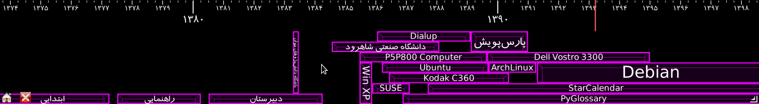
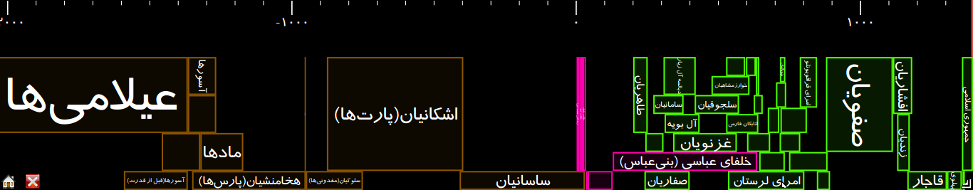
Real Continuous Time Line
Dynamic scaling (from seconds to millions of years)
Dynamic and fast event drawing using Graph Theory algorithms
  Construct an Interval Graph
  Color the graph with (practically) minimum colors in a fast way (trade-off)
  Extract intervals with the least color and draw them, again and again...

Slide 13
For Ubuntu users
Install python-appindicator
to use StarCalendar in Unity
install-ubuntu script is added
in master branch (2.3.4 not out yet)

Slide 14
We need package mantainers
for
Ubuntu
Debian
openSUSE
Fedora
ArchLinux
…
even Windows
Please Help if you feel like it

Slide 15
Please report bugs via
https://github.com/ilius/starcal/issues
or send it to
saeed.gnu@gmail.com
Your help is most appreciated
Thank you :-)

