Slide 1
Internationalization & Localization
بین المللی سازی و بومی سازی

Slide 2
internationalization ⟶ i18n
18
localization ⟶ l10n
10
محلی، بومی
محل، بوم
بومی کردن
بومی‌سازی
Local
Locale
Localize
Localization

Slide 3
Definition
Localization: Adapting software for location-dependent requirements
Internationalization: Making the software localizable for any region / country / locale, without changing the code

Slide 4
Scopes
Text / Language
Time
Other
Econimical
Cultural
Political

Slide 5
Text / Language
Scopes ⟶
Translation
Number Localization (Persian / Arabic / Urdu, Indian, Thai)
Other (Capitalization, Plural forms, Text sorting)
Language
Encoding
Text Rendering (BiDi, CTL, ...)
Keyboard Layouts and Shortcuts
Optical Character Recognition (OCR)
Text to Speech ( T T S )
Voice Recognition

Slide 6
POSIX (Unix-style) Locale Names
fa_IR.utf8
en_US.utf8
en_GB.utf8
$ less /etc/locale.alias
$ less /etc/default/locale
$ man locale

Slide 7
Scopes ⟶ Text / Language
Visual
Vector
Pixel Table
Render
سلام
Physical (RAM, HD, ...)
Logical
OCR
Byte Array
Decode
Symbol Array
Encode
D8 B3 D9 84 D8 A7 D9 85
م ا ل س
TTS
VR
Text Processing
Voice

Slide 8
Encoding
Scopes ⟶ Text / Language ⟶
Other Names
character encoding
character set = charset
character map
codeset
code page (windows)
Notes:
UTC = Unicode Transformation Format
USC = Universal Character Set
BMP = Basic Multilingual Plane
ISO/IEC 8859-N
N = 1, 2, ... 16
1-4: Latin (European languages)
6: Arabic/English (No Persian گ‌چ‌پ‌ژ)
ASCII
aka ANSI code pages - wrong naming
1250: Latin (European languages)
1256: Arabic/English (with Persian)
ASCII-compaible
Windows-N
Encoding
Unit size = 8 bits
Used for writing files
Mac Roman
non-ASCII
UTF-8
All the languages together (in one file)
Mac Farsi
UTF-16 (USC-2)
UTF-32 (USC-4)
Big-Endian (default)
Little-Endian
ASCII-incompaible
Unicode
Java String
Python 2 unicode
Python 3 str
UTF-16 / USC-2 is used for text processing
USC-2 is a subset of UTF-16 (called BMP)

Slide 9
Scopes ⟶ Text/Language ⟶ Encoding
UTF-8
Windows Arabic
Windows-1250
(Latin)
UTF-16
ISO-8859-6
(Arabic)
ISO-8859-1
(Latin)
Mac Farsi

Slide 10

Problems arising from the use of code pages in Windows
Microsoft strongly recommends using Unicode in modern applications, but many applications or data files still depend on the legacy code pages. This can cause many problems, especially since the Windows default is still not Unicode:
Programs need to know what code page to use in order to display the contents of files correctly. If a program uses the wrong code page it may show text as mojibake. Like: ï»¿Ø§Ù„Ø¥Ø¹Ù„Ø§Ù† Ø§Ù„Ø¹Ø§Ù„Ù…Ù‰ Ù„Ø­Ù‚ÙˆÙ‚ Ø§Ù„Ø¥Ù†Ø³Ø§Ù†
The code page in use may differ between machines, so files created on one machine may be unreadable on another.
Data is often improperly tagged with the code page, or not tagged at all, making determination of the correct code page to read the data difficult.
These Microsoft code pages differ to various degrees from some of the standards and other vendors' implementations. This isn't a Microsoft issue per se, as it happens to all vendors, but the lack of consistency makes interoperability with other systems unreliable in some cases.
The use of code pages limits the set of characters that may be used.
Characters expressed in an unsupported code page may be converted to question marks (?) or other replacement characters, or to a simpler version (such as removing accents from a letter). In either case, the original character may be lost.
From en.wikipedia.org/wiki/Windows_code_page
Note: Microsoft is using a seperate code page called OEM for DOS and Windows console

Slide 11
Windows-1256 Character Table

Slide 12
Scopes ⟶ Text/Language ⟶ Encoding
About Mac Farsi
Similar to ISO 8859-6 in Arabic codes, but also includes Persian گ‌چ‌پ‌ژ
Contains all the ASCII characters
Not ASCII-compatible, why?
>>> import string
>>> for c in string.printable:
... if unicode(c).encode('mac farsi') != c:
... print c,
...
! " # $ & ' ( ) * + - . / : < = > [ \ ] ^ _ { | }
>>> ord(u'.'.encode('mac farsi')) - ord('.')
128

Slide 13
Mac Farsi Character Table
Font: XB Zar (IRMUG)

Slide 14
Scopes
Text / Language
Time
Other

Slide 15
Time
Scopes ⟶
Gregorian
Persian (Jalali)
Arabic (Hijri)
Indian
Hebrew (Jewish)
Ethiopian
Calendaring Systems
Time Zone
Asia/Tehran
UTC + 3:30
Daylight Saving
Date Format
First Day of Week
Work Days / Holiday(s)
Week Numbering
Week

Slide 16
Scopes ⟶ Time
Locale
Time Zone
Calendar Type
gregorian, jalali, ...
Julian Day Number
Dailight Saving
UTC Offset
Date
Year
Month
Day
Epoch Time
Time in Day
Hour
Minute
Second
Local Time

Slide 17
Scopes ⟶ Time ⟶ Calendaring Systems
Gregorian
Jalali
Arabic
Julian Day
Number
Indian
Ethiopian
Hebrew

Slide 18
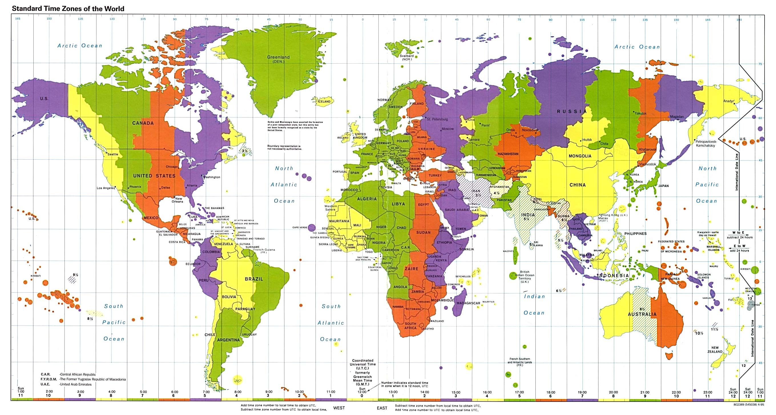
Time Zone
Scopes ⟶ Time ⟶
Asia/Tehran
UTC + 3:30
GMT + 3:30

Slide 19
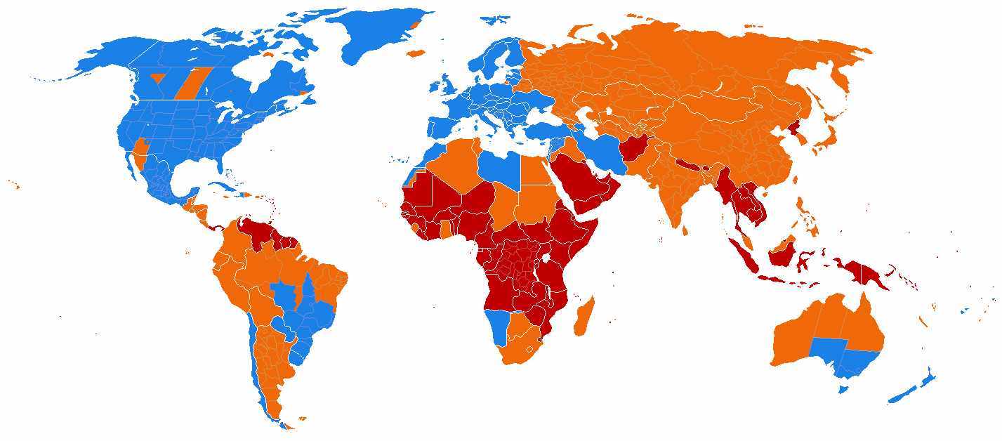
Daylight Saving
Scopes ⟶ Time ⟶
DST is used
DST is no longer used
DST has never been used

Slide 20
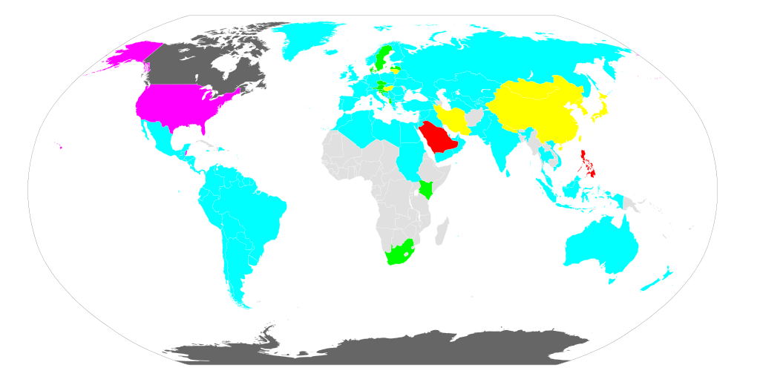
Date Format
Scopes ⟶ Time ⟶
YMD | 2013/12/30 | Iran, East Asia (CJK)
MDY | 12/30/2013 | USA, Belize
DMY | 30/12/2013 | Most of Asia & Europe , North Africa, South America, ...
YMD, DMY
DMY, MDY
YMD, DMY, MDY

Slide 21
Scopes ⟶ Time ⟶
Week
At least six methods for week numberings are in use
http://www.pjh2.de/datetime/weeknumber/wnd.php?l=en

Slide 22
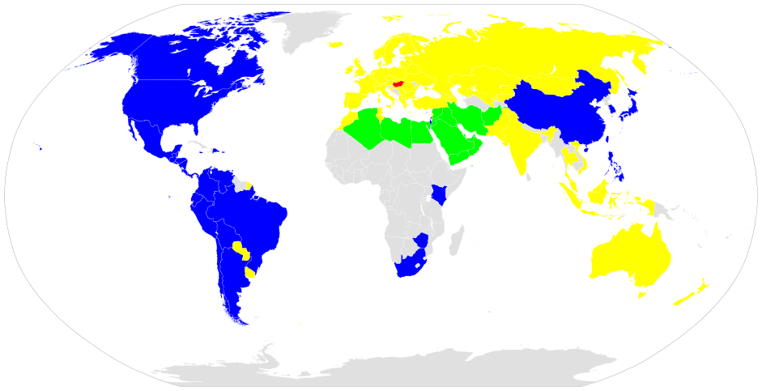
Scopes ⟶ Time ⟶ Week ⟶
First Day of Week
شنبه
یکشنبه
دوشنبه
چهارشنبه
Saturday
Sunday
Monday
Wednesday

Slide 23
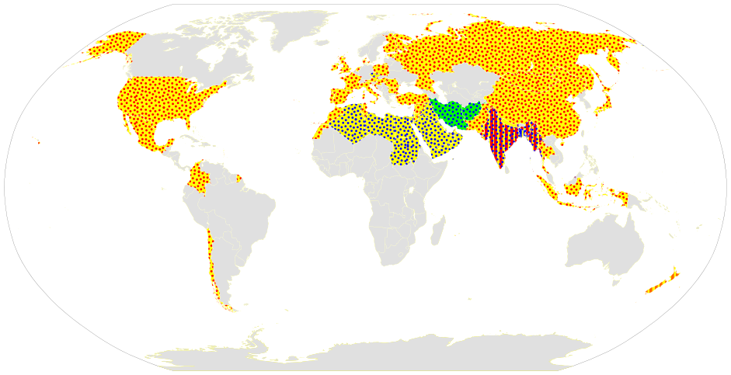
Scopes ⟶ Time ⟶ Week ⟶
Holidays
پنج‌شنبه
جمعه
شنبه
یکشنبه
Thursday
Friday
Saturday
Sunday

Slide 24
Scopes
Text / Language
Time
Other

Slide 25
Scopes ⟶
Other
Currency, Tax and Economical differences
Native Laws (Copyright, DRM, ...)
Phone Numbers, Area Codes, Zip Codes, ...
Native Themes and Styles

Slide 26
Now Let's Do the Code
Python
Examples

Slide 27
Python Examples ⟶
Translation
myapp_fa.po
msgid “Hello World”
msgstr “سلام دنیا”
myapp_locale.py
import gettext
def tr(s):
## See next slide
return s
myapp_fa.mo
myapp.py
from myapp_locale import tr as _
print _('Hello World')

Slide 28
Python Examples ⟶ Translation
Terminal
$ msgfmt "myapp_fa.po" -o “myapp_fa.mo”
myapp_locale.py
import gettext
lang = 'fa'
try:
fd = open('myapp_%s.mo'%lang, 'rb')
except IOError:
tr = str ## Fallback translator
else:
transObj = gettext.GNUTranslations(fd)
def tr(s):
return transObj.gettext(toStr(s)).decode('utf-8')

Slide 29
Python Examples ⟶
Encoding
$ python2.7
>>> st = 'سلام'
>>> st
'\xd8\xb3\xd9\x84\xd8\xa7\xd9\x85'
>>> st[0]
'\xd8'
>>> print st[0]
>>> uni = st.decode('utf-8')
>>> uni
u'\u0633\u0644\u0627\u0645'
>>> print uni[0]
س
>>> len(st), len(uni)
(8, 4)
>>> for c in uni: print c
...
س
ل
ا
م

Slide 30
Python Examples ⟶ Encoding
>>> uni = u'سلام'
>>> uni
u'\u0633\u0644\u0627\u0645'
>>> uni.encode('utf-8')
'\xd8\xb3\xd9\x84\xd8\xa7\xd9\x85'
>>> uni.encode('windows-1256')## or 'cp1256'
'\xd3\xe1\xc7\xe3
>>> uni.encode('iso 8859-6')## or 'arabic'
'\xd3\xe4\xc7\xe5'
>>> uni.encode('mac farsi')## different from iso 8859-6
'\xd3\xe4\xc7\xe5'
>>> uni.encode('mac arabic')## the same as mac farsi
'\xd3\xe4\xc7\xe5'
>>> u'گچپژ'.encode('iso 8859-6', 'ignore')## or 'arabic'
''
>>> u'گچپژ'.encode('mac farsi', 'ignore')
'\xf8\xf5\xf3\xfe'
>>> u'گچپژ'.encode('windows-1256', 'ignore')
'\x90\x8d\x81\x8e'

Slide 31
>>> uni.encode('windows-1250')
Traceback (most recent call last):
File "<stdin>", line 1, in <module>
File "/usr/lib/python2.7/encodings/cp1250.py", line 12, in encode
return codecs.charmap_encode(input,errors,encoding_table)
UnicodeEncodeError: 'charmap' codec can't encode characters in position 0-3: character maps to <undefined>
>>> unicode('سلام')
Traceback (most recent call last):
File "<stdin>", line 1, in <module>
UnicodeDecodeError: 'ascii' codec can't decode byte 0xd8 in position 0: ordinal not in range(128)
>>> unicode('hello')
u'hello'
>>> str(u'سلام')
Traceback (most recent call last):
File "<stdin>", line 1, in <module>
UnicodeEncodeError: 'ascii' codec can't encode characters in position 0-3: ordinal not in range(128)
>>> str(u'hello')
'hello'

Slide 32
ord, chr, unichr
>>> ord('a')
97
>>> ord(u'a')
97
>>> hex(ord('a'))
'0x61'
>>> ord(u'س')
1587
>>> chr(97)
'a'
>>> unichr(97)
u'a'
>>> unichr(1587)
u'\u0633'
>>> print unichr(1587)
س
>>> ord('a')-ord('A')
32
>>> chr(ord('b')-32)
'B'

Slide 33
#!/usr/bin/python
# -*- coding: utf-8 -*-
# recode a file from arabic windows(windows-1256) to utf8
import sys, os
from os.path import splitext
def winArabicToUtf8(st):
uni = st.decode('windows-1256')
for ar, fa in [
(u'ي', u'ی'),
(u'ك', u'ک'),
(u'ۀ', u'هٔ'),
]:
uni = uni.replace(ar, fa)
return uni.encode('utf8')
if __name__=='__main__':
fname, ext = splitext(sys.argv[1])
newName = fname + '.utf8' + ext
st = open(sys.argv[1], 'rb').read()
st = winArabicToUtf8(st)
open(newName, 'w').write(st)

Slide 34
encoding2csv.py
Create a CSV file containing the character table of a given encoding
import sys
import csv
def getHex(n, fill=True):
s = hex(n)[2:].upper()
if fill and len(s) % 2 == 1:
s = '0' + s
return s
ext = '.csv'
encoding = sys.argv[1]
try:
opath = sys.argv[2]
if not opath.endswith(ext):
opath += ext
except IndexError:
opath = encoding + ext
writer = csv.writer(open(opath, 'wb'))

Slide 35
writer.writerow(
[''] + [getHex(i, False) for i in range(16)]
)
for i in range(2, 16):
row = [
getHex(16*i)
]
for j in range(16):
ordNum = 16*i + j
ordHex = getHex(ordNum)
try:
cstr = chr(ordNum).decode(encoding).encode('utf8')
except UnicodeDecodeError:
print 'Unknown character %s'%ordHex
cstr = ''
row.append(cstr)
writer.writerow(row)
del writer

Slide 36
Any Questions?
(C) 2013 by Saeed Rasooli <saeed.gnu@gmail.com>
http://saeedgnu.blog.ir
You are free to use this document under the both CC-BY-SA and GFDL licenses
Only some slides (marked in the right-down corner) are exclusively under CC-BY-SA 3.0
Python codes are under the Public Domain

