Slide 1
Git
Design and advanced usage

Slide 2
Objects
blob
File contents (with no name/path or metadata)
Name and mode are set in parent tree.
object
tree
Directory contents (with no name/path for itself)
Recursive (can contain other tree)
Name is set in parent tree.
commit
Unit of work. Conains tree id, author, committer, timestamps
tag
Static ref to a commit (not auto-updated)
note
https://git-scm.com/book/en/v2/Git-Internals-Git-Objects

Slide 3
Object Database
Git includes a key-value data storage for objects
Key: hash of contents (SHA1) git hash-object -w test.txt
Value: contents (immutable)
Stored in .git/objects/ find .git/objects -type f
git cat-file -p ObjectID
git cat-file -p Reference:FilePath
git cat-file -p Reference:FilePath
git cat-file -p Reference:DirPath
git cat-file -p HEAD

Slide 4
References
tag
Static ref to a commit (not auto-updated)
True objects
ref
branch
(aka head) Dynamic ref to a commit (auto-updated)
Not true objects
remote refs
Fetched remote branches: refs/remotes/RemoteName/Branch
Not true objects
symbolic refs
HEAD
refs/remotes/RemoteName/HEAD
References are not objects

Slide 5
Tags
Q: What are tags? Objects or references?
A: Yes!
There are tag refs and tag objects.
Lightweight tags
points
tag ref
commit
(or any object)
Annotated tags
points
points
tag ref
tag object
commit
(or any object)

Slide 6
Tags
From man git tag
If one of -a, -s, or -u <key-id> is passed, the command creates a tag object, and requires a tag message. Unless -m <msg> or -F <file> is given, an editor is started for the user to type in the tag message.
If -m <msg> or -F <file> is given and -a, -s, and -u <key-id> are absent, -a is implied.
Otherwise, a tag reference that points directly at the given object (i.e., a lightweight tag) is created.

Slide 7
Tags
Example of an annotated tag:
$ cat .git/refs/tags/3.2.3
9cb963df94e0701b31f40af7f7258d538ec42cb7
$ git cat-file -p 9cb963df94e0701b31f40af7f7258d538ec42cb7
object 7101592899ca6674f76489a9ccfe115f5c8a93df
type commit
tag 3.2.3
tagger Saeed Rasooli <saeed.gnu@gmail.com> 1721447216 +0330
version 3.2.3
$ git cat-file -p 3.2.3
(same output as above command)

Slide 8
Object / ref Graph
Many objects / refs point to other objects / refs
But in a non-cyclic manner (no cycles)
In Math terms: Directed Acyclic Graph (DAG)
For example: a tree can not point to itself or its parent
Orphan objects:
Not reachable by any ref (branch, tag, remote ref, symbolic ref)
tree
blob
main
branch
commit
tree
tree
blob
commit
blob
commit
tree
merge
blob
blob
tree
commit
commit
blob
blob

Slide 9
Commit objects
What’s inside a commit object:
tree (root directory)
parent(s)
author (email)
committer (email)
author timestamp
committer timestamp
signature
message
notes
No patch / diff is stored for commits
Unlike svn, cvs, hg, etc
(pack files store diff for large objects for optimization)

Slide 10
Commit objects
An eample of a commit object
starcal $ git cat-file -p next
tree 3352ac72e9d67b37e404ab2c037b7f82a171d512
parent 3005f0a4eac70fdbd2776efb059c4064774232f9
author Saeed Rasooli <saeed.gnu@gmail.com> 1728525015 +0330
committer Saeed Rasooli <saeed.gnu@gmail.com> 1728525015 +0330
gpgsig -----BEGIN PGP SIGNATURE-----
...
-----END PGP SIGNATURE-----
add a comment

Slide 11
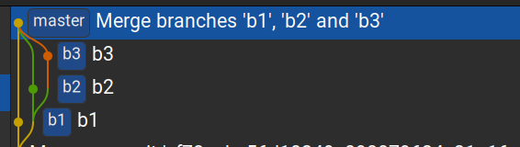
Commit parents
Non-merge commits have one parent (except for initial commit)
Merge commits typically have two parents
Merge commits with 3 or more parents are called octo-merge or Octopus Merge.
Simply write: git merge branch1 branch2 ...

Slide 12
Author and committer
Author is the person who supposedly made the change (sent a patch for example).
Committer is the person who committed the change.
Often they are the same.
git log only shows author time by default.
When rebase or amend a commit, only committer time changes.
Can fake timestamps with env vars:
GIT_AUTHOR_DATE
GIT_COMMITTER_DATE

Slide 13
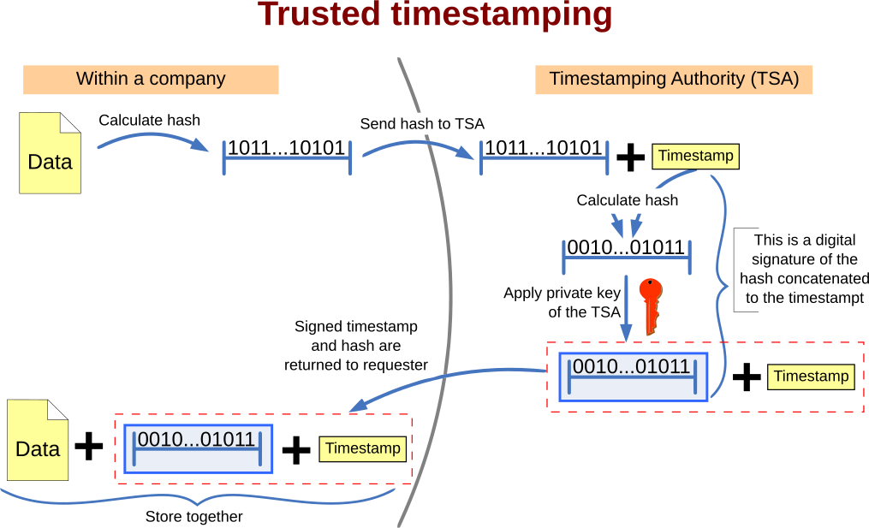
Commit timestamps
Proving timestamps is beyond git itself. Needs Timestamping Authority (TSA)
https://en.wikipedia.org/wiki/Trusted_timestamping

Slide 14
Stages of data
Modified files
git add
git update-index
git read-tree
Staging area / index
git commit
git write-tree
git commit-tree
Committed changes
git push
Published changes

Slide 15
Recover or Cleanup
To access unreachable objects: git fsck --unreachable
See: man git fsck
To remove all unreachable commits, trees and blobs
git reflog expire --expire-unreachable=now --all
git gc --prune=now
Lesson: do WIP commits, and git commit --amend frequently!

Slide 16
Fetch and pull
git fetch connects to a remote, downloads all changes and updates its refs (representations of remote branches) stored in .git/refs/remotes/NAME/
git pull is equivalent to git fetch and then git merge
git pull -r is equivalent to git fetch and then git rebase

Slide 17
Merge: fast-forward
When you run git pull or git merge, and the latest upstream commit is a linear descendant of the latest local commit, no merge commit is needed.
So the branch ref will be changed to point to the new commit.
Then it’s called fast-forward.
main
origin/main
after merge
c1
c2
c3
c4
Latest local
commit
Latest upstream
commit

Slide 18
Merge commit
When fast-forward is not possible, a merge commit needs to be created.
Git uses 3-way merge algorithm to combine and create a merge commit
Merge commits generally have two parents, but can have more as mentioned above

Slide 19
Merge commit
$ git cat-file -p e3f229047af4ccd23d66814fa2194e3313fd6c1f
tree 46b2bc03ab556f209a74d5c9073c98a37cc56a6d
parent efe837835946b6f8eb5c9e2e9c7a9b751ce05e8a
parent d15e17eab787103b30fe51d88b02f25cdd5cbece
author Saeed Rasooli <saeedgnu@riseup.net> 1643816137 +0330
committer GitHub <noreply@github.com> 1643816137 +0330
gpgsig -----BEGIN PGP SIGNATURE-----
wsBcBAABCAAQBQJh+qTJCRBK7hj4Ov3rIwAAMMsIADakXiYX3Y3byrSVHQP5ZDMh
bzp5/Jq5EdfdZVH7nr33jtawY8vyes4VR62CV+H1+Asf0XVoqYAoc1dATvvHRTZu
iASDLwNIsWKuvOJrZbaaI8o/4yrvPazJLhQAmczpEMEJls2BubY07aerwKvTkKly
nXdBeNBKGDfAG5CTNTNmmJiG8ccHtQR3PkGeRE+QewMWmdvLZeJDKFy7SDlXpJiw
Sy+3qu/L8sJL+cXxl61/YDuWJd/pqZGQyaFRCbLUrWzzd0Mzv9pKbbRd+ceMq2xi
rEPzluE+XhxYXutmS1gDo7WooD1NsPUWpKqTR1w3Lzt+Qf2wIMu5hIsE44M7jdc=
=haBm
-----END PGP SIGNATURE-----
Merge pull request #361 from BoboTiG/fix-deprecation-warnings-escape-sequence
Fix DeprecationWarning: invalid escape sequence

Slide 20
Merge algorithm
But what’s 3-way merge algorithm?
Let’s say we want to merge commit A (branch main) with commit B (branch develop)
First: git finds the Last Common Ancestor (merge-base), let’s call it C
Files different
between C and A
Files different
between C and B
main
C
A
C..A
files
C..B
files
merge-base
develop
B
Conflicts
Note: commits are pointing to their parents

Slide 21
Merge algorithm
Conflicts are files that are different between C and A, and also between C and B.
Non-conflict files are easily added to the new tree.
Git can auto-resolve some conflicts (if it can apply a patch successfully)
Other conflicts need to be resolved manually by user.
Only 3 commits are involved in this, hence the name: 3-way merge.
See: https://git-scm.com/docs/merge-strategies

Slide 22
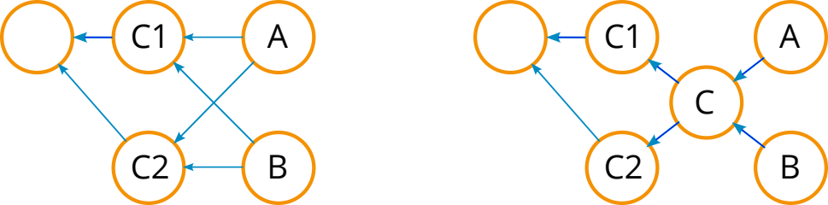
Merge algorithm
In rare cases with two last common ancestors (merge bases), here: C1 and C2
a virtual merge-base is created (here: C) and is used for 3-way merge.
This is the default for git, and is called ort (Ostensibly Recursive’s Twin)
Note: commits are pointing to their parents

Slide 23
Commit signing
Commits can be signed with a private key (RSA, EC etc)
Using: git commit --sign
(You need to add your public key to Github or other hosting)
To automatically sign all commits, change ~/.gitconfig, for example:
[user]
name = Saeed Rasooli
email = saeed.gnu@gmail.com
signingkey = FD046A7C28FA209E
[gpg]
program = gpg
[commit]
gpgsign = true

Slide 24
Rebase
git rebase: re-creates commits on top of a new base, then moves the head
Untimately, moving changes to a new base (generally branch)
You can rebase based on a commit id as well.
Like: git rebase 327b2f5
git checkout feature
git rebase main
main
main
feature (new)
A
B
C
feature
A2
B2
C2
Note: show an example of interactive rebase: git rebase -i

Slide 25
Bisect
git bisect helps you find the commit causing a certian bug, using a binary search.
(or a commit that accidentically fixed a certain bug)
First you mark a good commit and a bad commit (two ends of our search range)
Then at each step, bisect checks out to the commit in the middle and asks you to mark it as good or bad, then halves the search range.
Until good and bad meet each other! (one is parent of other)
1
3
4
2
g
g
g
b
b
b
meet

Slide 26
Git notes
Write notes for existing commits (amend creates a new commit)
Displayed on git log and git show
git notes list
git notes add <commit_hash>
git notes show <commit_hash>
git notes edit <commit_hash>
git notes remove <commit_hash>

Slide 27
Git blame
To figure out who made a certain change in a certain file. and when.
Shows the author and time of last modification for each line of file.
Simple usage:
git blame FILE_PATH
There are colorful wrappers and VS Code/Coduim extension for it.

Slide 28
Git ignore
To prevent git from adding or tracking certain files
Can list patterns of file name/path in any of these files:
~/.gitignore
.gitignore in the repository
.gitignore in a sub-directory of the repository
.git/info/exclude to avoid publishing the list

Slide 29
Git hooks
Hooks are scripts/programs you can place in a .git/hooks/ directory to trigger actions at certain points in git’s execution.
Can be used for:
Checking/linting, formatting/normalizing code before commit
Running tests before/after commit or before push
Building things (executable, docker image etc) after commit
Checking commit message conventions
And more, see .git/hooks/ directory and man githooks

Slide 30
Git config
Show my ~/.gitconfig file

Slide 31
Git subtree
git subtree lets you nest one repository inside another as a sub-directory. It is one of several ways Git projects can manage project dependencies.
Unlike submodule, subtree does not require users of your repository to learn anything new. They can ignore the fact that you are using git subtree to manage dependencies.
All new changes to sub-directory are only stored in parent repo by default.

Slide 32
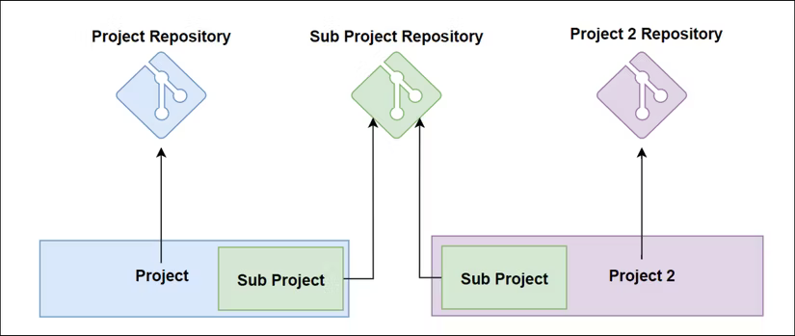
Git subtree
Source: https://www.howtogeek.com/devops/how-to-use-git-subtree-to-manage-multiple-project-repositories/

Slide 33
Git subtree
git remote add subtreeName git@github.com:user/projectName
git subtree add --prefix=dirName subtreeName subtreeBranch
git subtree pull --prefix=dirName subtreeName subtreeBranch [--squash]
git subtree merge --prefix=dirName subtreeName subtreeBranch [--squash]
See: man git subtree
Specially: --squash

Slide 34
Git subtree
git subtree push --prefix=dirName subtreeName subtreeBranch
Until subtree push, all new commits on dirName are only stored in parent repo and pushed to parent repo on git push.
subtree push creates new commit objects for the subtree and pushes them to the subtree remote URL.
https://www.atlassian.com/git/tutorials/git-subtree
https://medium.com/@v/git-subtrees-a-tutorial-6ff568381844

Slide 35
Git submodule
To vendor / include extrenal dependencies in a repo without adding their code or full history to the repo. Only maintains commit hash of the child/sub-repo.
The command line interface is often confusing and troubling.
Best to automate every step / scenario with Makefile or scripts.
git submodule add URL [subDir]
git add .gitmodules subDir ; git commit
After clone (non-recursive): git submodule update --init
Use the status of the submodule’s remote-tracking branch:
git submodule update --remote

Slide 36
Questions
Check out my Github:
https://github.com/ilius
Any questions?

