Slide 1
Elastic Stack
also known as ELK
Overview and Usage

Slide 2
About me
Saeed Rasooli
github.com/ilius
Go and Python. Mostly Back-end and desktop
Open Source projects: StarCalendar, PyGlossary, AyanDict and several command line tools in Go
saeed.gnu@gmail.com, saeedgnu@riseup.net

Slide 3

About me
Currently work at ParsPooyesh
Most of this slide was made at work, as a result of a R&D task.
https://github.com/ParspooyeshFanavar

Slide 4

What is Elastic Stack?
It’s a “Search Platform” according to its website:
  https://www.elastic.co/elastic-stack/
It’s comprised of
  Elasticsearch: Distributed RESTful Search Engine
  Logstash: transport and process your logs, events or other data
  Kibana: Your window into the Elastic Stack
  Beats: Lightweight shippers (in Go) for Elasticsearch & Logstash

Slide 5
Why use Elastic Stack?
Because log files are:
Not centralized or container-friendly
  Mount external storage for each instance of app.
  Each instance writes it’s own log files.
  Must observe free space for each instance (or share it)
Not easy to filter and/or aggregate by level / component.
Not easy / fast to search (no index).
Need command line access to view / monitor logs.

Slide 6
Centralized Logging: The Elastic Stack provides a centralized repository for storing logs from various sources, making it easier to collect, manage, and analyze log data.
Real-time Analysis: Logs are ingested and indexed in real time, allowing for immediate analysis and monitoring of system activity.
Advanced Search and Analytics: Elasticsearch's powerful search capabilities enable users to quickly find specific log entries and perform complex data analysis.
Visualization and Dashboards: Kibana provides a user-friendly interface for visualizing log data in dashboards, charts, and graphs, making it easier to identify trends and patterns.
Scale and Reliability: The Elastic Stack is designed to handle large volumes of log data and can be scaled horizontally to meet growing demands.

Slide 7
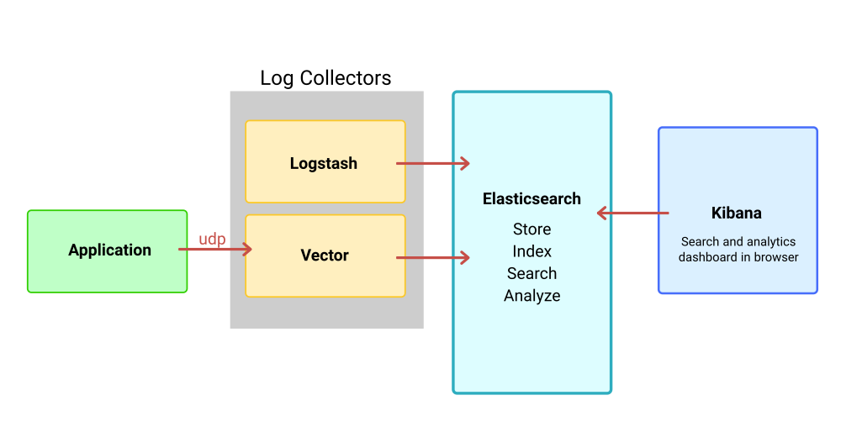
How we use it

Slide 8
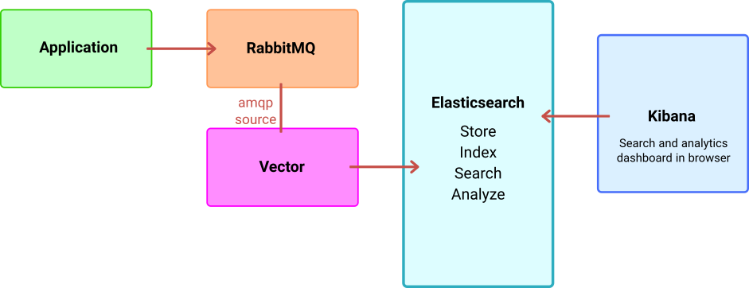
A safer way to use it

Slide 9
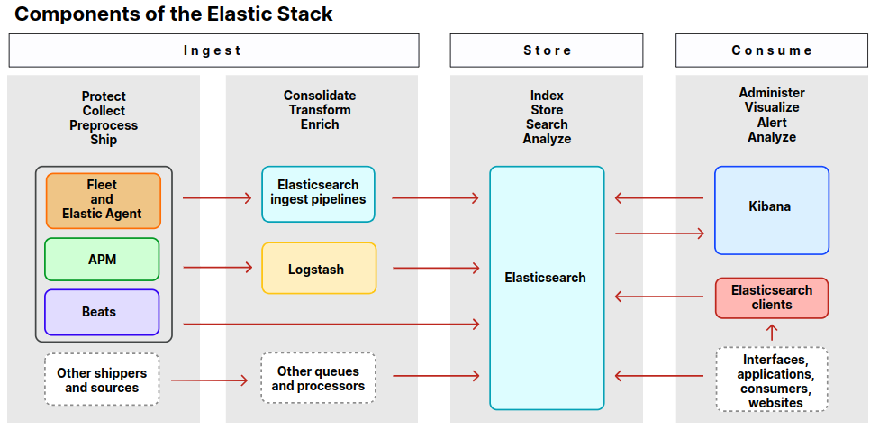
APM: Application Performance Monitoring

Slide 10
Beats
A collection of lightweight shippers (data pipelines)
Written in Go
Licensed under the Apache License version 2.0
https://github.com/elastic/beats
libbeat: Go library containing the common packages for all the Beats. It is Apache licensed and actively maintained by the Elastic team.

Slide 11
Beat | Description
Audit beat | Collects your Linux audit framework data and monitors the integrity of your files
File beat | Tails and ships log files
Function beat | Reads and ships events from serverless infrastructure
Heart beat | Pings remote services for availability
Metric beat | Fetches sets of metrics from the operating system and services
Packet beat | Monitors the network and applications by sniffing packets
Winlog beat | Fetches and ships Windows Event logs
Osquery beat | Runs Osquery and manages interraction with it

Slide 12
What is Elasticsearch NOT?
It is designed as a “Search Engine”, not a “Database”
It’s not meant to be used as a primary store.
Want to use it as a NoSQL Database? Read this post first:
  https://www.elastic.co/blog/found-elasticsearch-as-nosql
  “Elasticsearch is commonly used in addition to another database. A database system with stronger focus on constraints, correctness and robustness, and on being readily and transactionally updatable”

Slide 13
Log collectors
 | Language | GH Stars | Last commit
logstash | Java, Ruby | 13.6k | 2023
vector | Rust | 14.2k | 2023
fluentd | Ruby | 12.1k | 2023
fluent-bit | C, C++ | 4.8k | 2023
gogstash | Go | 104 | 2023
logcool | Go | 164 | 2017
protologbeat | Go | 28 | fork: 2022
logpeck | Go | 23 | 2020

Slide 14
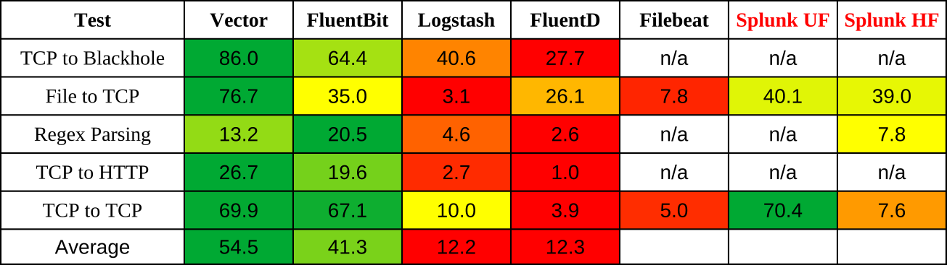
Log collectors: performace
Source: Vector’s Github: https://github.com/vectordotdev/vector/
Splunk: US company, server is closed-source: https://en.wikipedia.org/wiki/Splunk

Slide 15
Log collectors: my choice
I chose Vector. Why?
Startup time: much lower than Logstash
Better performance (better than/comparable with Fluent Bit: C++)
Documentation: very clean, organized, complete
Errors on mis-config: nicer and more readable
Runtime-safety of Rust (even better than Go or Java)
Easier to build/compile than C/C++
So many stars on Github (even more than Logstash)

Slide 16
Data streams
A data stream lets you store append-only time series data across multiple indices while giving you a single named resource for requests.
Data streams are well-suited for logs, events, metrics, and other continuously generated data.
(from elastic.co)

Slide 17
Data streams: indices
Data stream automatically creates (backing) indices with this naming pattern:
.ds-{data_stream}-{date}-{generation}
For example:
.ds-logs-myapp-auditlog-2023.09.03-000001
.ds-logs-myapp-auditlog-2023.09.04-000002
.ds-logs-myapp-auditlog-2023.09.04-000003

Slide 18
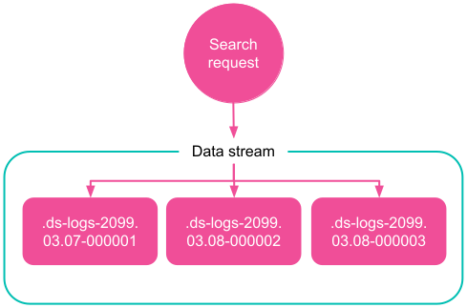

Slide 19
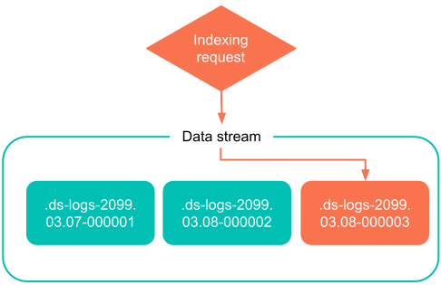

Slide 20
Data streams: examples
Some Examples:
Log Type | Data Stream Name
Requests | logs-myapp-request
Audit Log | logs-myapp-auditlog
Email | logs-myapp-email
SMS | logs-myapp-sms
Internal logs | logs-myapp-log

Slide 21
Index template
A data stream requires a matching “index template”.
For data streams, the index template configures the stream’s backing indices as they are created.
An index template is a way to tell Elasticsearch how to configure an index when it is created.

Slide 22
License! (more at the end)
Elasticsearch is dual-licensed since 2021:
Elastic License: Proprietary, Source-available
Server Side Public License (SSPL): Proprietary, Source-available
  Introduced by MongoDB Inc. in 2018
  Strong Copyleft, more copyleft than GNU Aferro GPL (AGPL)
  Rejected by Open Source Initiative (called “fauxpen”)
  Rejected by Debian, Fedora, RHEL
  No comments from Free Software Foundation!
Now Elasticsearch is just like MongoDB!

Slide 23
Kibana → Discover
Uses Kibana Query Language (KQL)
KQL only filters data, and has no role in aggregating, transforming, or sorting data.
Examples:
@timestamp < now-2w
response_status >= 500
logger_name: "django.server" and level_no > 30

Slide 24
Kibana → Discover
More KQL Examples:
http.request.method: (GET or POST or DELETE)
remote_ip: 172.30.0.0/16 and object_type: "Branch"
user:{ first: "John" and last: "Doe" }
user.names:{ first: "John" and last: "Doe" }

Slide 25
Vector configuration
Components:
Sources (inputs)
Transforms (filters / modifiers)
Sinks (outputs)
Global options
https://vector.dev/docs/reference/configuration/

Slide 26
Vector config example
Format: TOML (Tom's Obvious, Minimal Language)
File: /etc/vector/vector.toml
Mount it as volume in docker-compose.yml
[sources.udp_input]
type = "socket"
address = "0.0.0.0:5958"
mode = "udp"
decoding.codec = "bytes"`

Slide 27
[transforms.json_parser]
type = "remap"
inputs = ["udp_input"]
drop_on_error = false
source = '''
parsed, err = parse_json(.message)
if err == null {
. |= object!(parsed)
} else {
log("Failed to parse json from udp_input", level: "error")
}
'''

Slide 28
[sinks.elastic_output]
type = "elasticsearch"
inputs = ["json_parser"]
healthcheck = false
api_version = "v7"
endpoints = ["http://elasticsearch:9200"]
auth.user = "${VECTOR_ELASTIC_USERNAME}"
auth.password = "${VECTOR_ELASTIC_PASSWORD}"
auth.strategy = "basic"
mode = "data_stream"
data_stream.dataset = "{{ tags[0] }}"
data_stream.namespace = "{{ type }}"

Slide 29
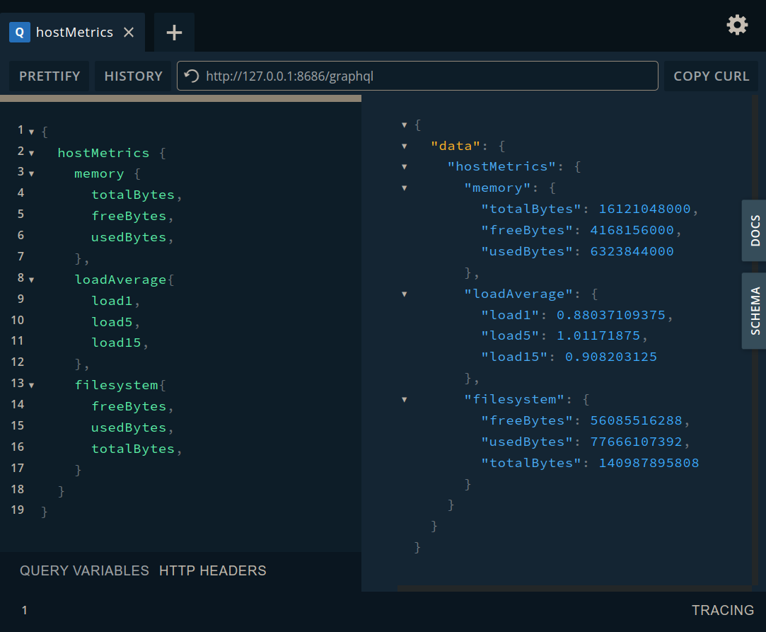
Vector API
GET /health
POST /graphql
GET /playground

Slide 30
Run It Yourself (RIY?)
Github repository with (almost) ready-to use configurations and scripts (needs some initial setup)
https://github.com/ParspooyeshFanavar/docker-elk
Install docker and docker-compose
Copy ‘.env.default’ file to ‘.env’
Edit ‘.env’ (change passwords etc)
  Don’t put funny characters in passwords (bug in Bash script)
    Best to use long alphanumerics (alphabet + numbers)
Run: make init
Run: make build and make up

Slide 31
License: why?
Microsoft and Google were paying Elastic for their managed service
Amazon launched it’s own managed service without paying Elastic, even using Elastic’s trademarks with no authorization. Basically taking advantage of it being Open Source. So Elastic changed it’s license!
This does not effect other users / companies in practice (specially in Iran)
SSPL is "Extreme Copyleft": those who offer the software to third-parties as a service must release the entirety of their source code, including all software, APIs, tools and other software that would be required for a user to run an instance of the service themselves.

Slide 32
License: Amazon!
Amazon forked Elasticsearch (called Opensearch) under Apache license, and is trying to attract Open Source contributors (like free employeees), by acting like defenders of Open Source, and fish from the muddy water they helped create.
Elasticsearch is not in the same boat as MongoDB who had the same story with Amazon! (and Amazon forked it under name of DocumentDB).
Amazon keeps using both forks the same way! Even getting contributors from Open Source community!

Slide 33
License: Lessons
Lessons that we can learn:
CLAs (Contributor License Agreement) allow the company to re-license your code without your consent to suit their needs.
It’s always hard to pick a side between the bad and the worse.
Big Tech normally steals (ideas, codes etc) from smaller companies as well as Open Source community!
Cloud service providers challenge the fundumental concepts of Open Source and Free Software.

