Slide 1
WebMail App
Fortech - Java Course – Demo Application - 2018

Slide 2
Content
Overview - App
Technologies used
Use case diagram
Sequence diagrams
Demo application

Slide 3
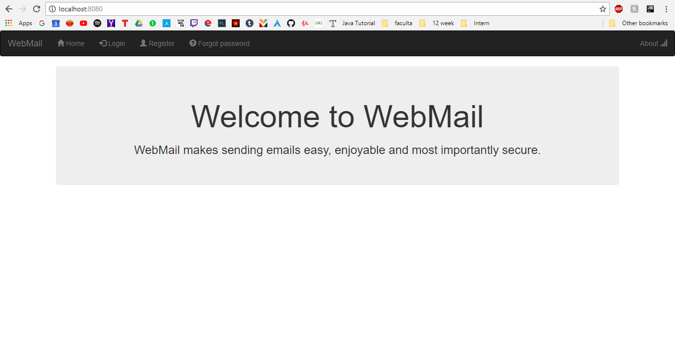
Overview

Slide 4
Technologies Used
Spring boot
Jpa, Hibernate with MySql database
Jsp files using bootstrap, css
Maven for dependencies solver
Project Lombok
Javax mail

Slide 5
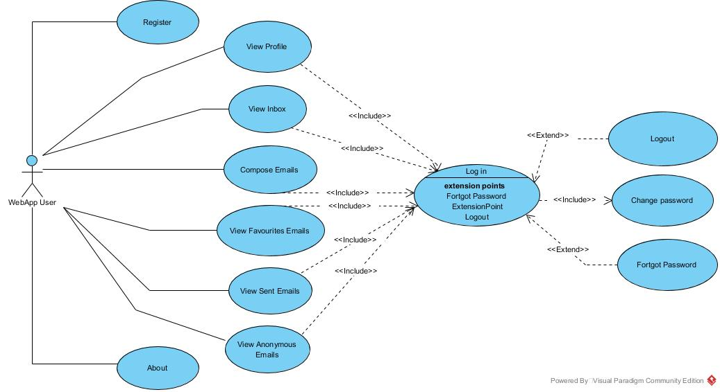

Slide 6
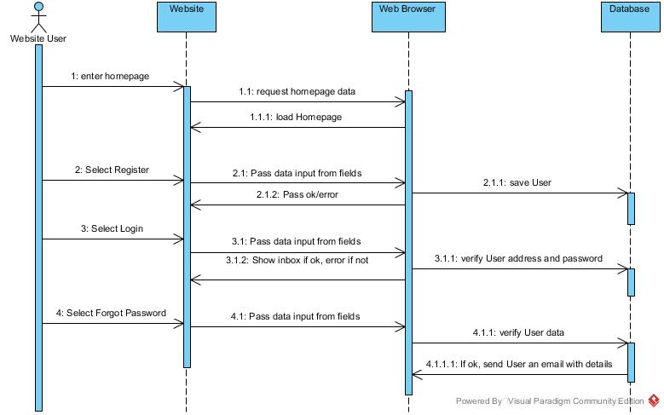
Main Page Squence diagram

Slide 7
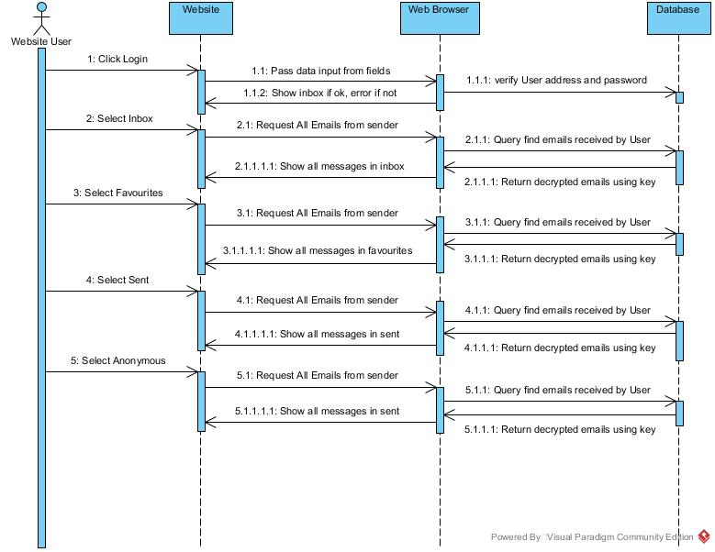
Mail Sequence Diagram

Slide 8
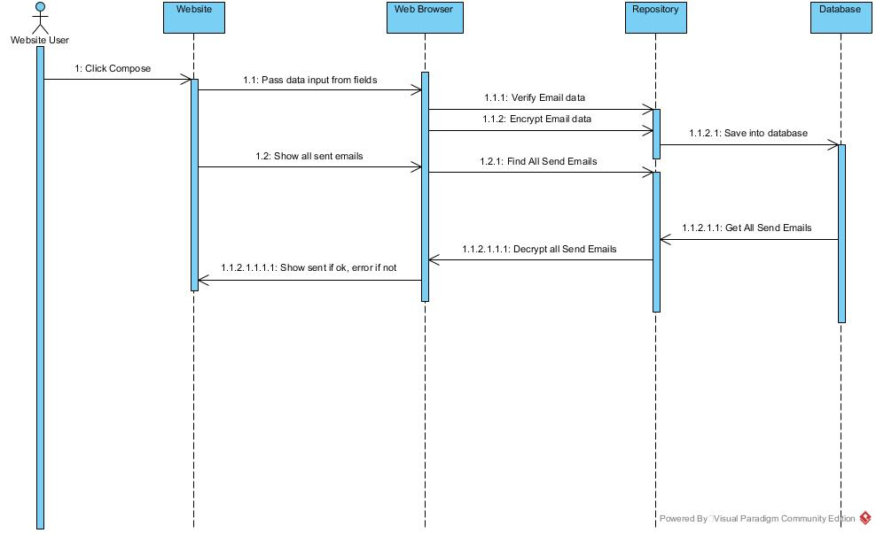
Compose Sequence Diagram

