Slide 1

PROJECT1-2020
UBER IN GREATER METROPOLITAN AREA (UBER FOUNDED: MARCH, 2009)
GROUP# 4
TEAM MEMBERS :
ALIM MEMON
HASTI PATEL
ASLAM MOMIN
RICK SHEVLIN

Slide 2
OBJECTIVES
Uber Service availability across the NYC metropolitan area
Ridership during special events, holidays and work weekdays
Uber Service pickups during inclement weather (high-low temperature/wind/snow/precipitation)
Uber ridership study across latitude and longitude around NYC
Uber ridership statistics during Spring and Summer (Seasons)
Uber demand supply gap influencing wait time for riders

Slide 3
OBJECTIVES TO BE EXPLORED :
Rider usage during inclement weather
Ridership statistics during holidays/special events (sporting, political events, concerts, rides based paring primarily, …. )
Ridership around Hotspots Time Square, Central Park, Wall Street
Ridership statistics during Spring and Summer seasons
Wait times influencing Uber demand supply dap study

Slide 4
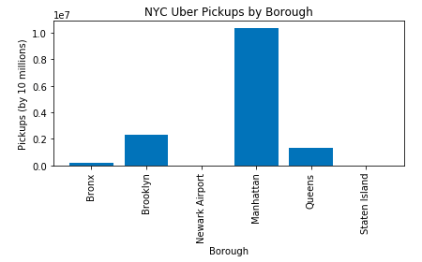
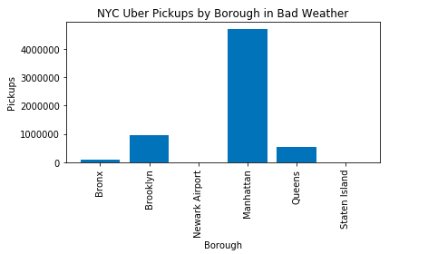
WEATHER
Bad Weather Borough VS Pickups
Weather Borough VS Pickups

Slide 5
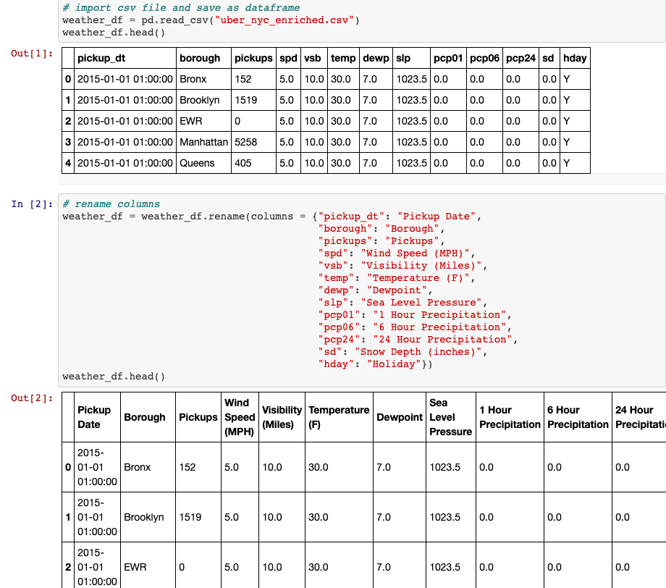
WEATHER (CONT..)
Weather data

Slide 6
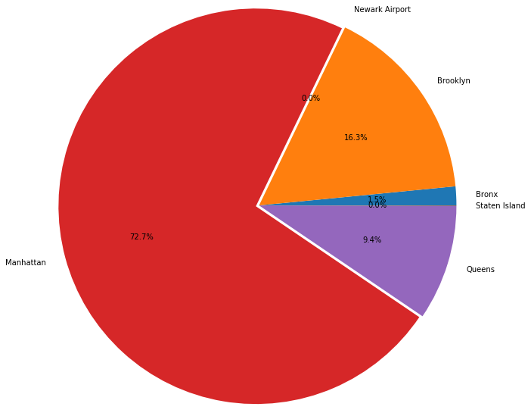
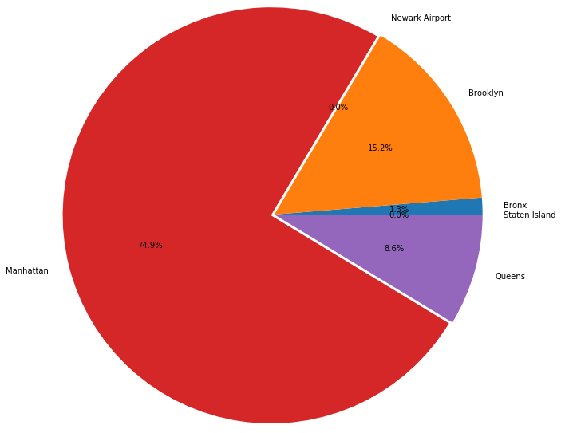
WEATHER (CONT..)
Whole Weather Data
Bad Weather Ratio

Slide 7


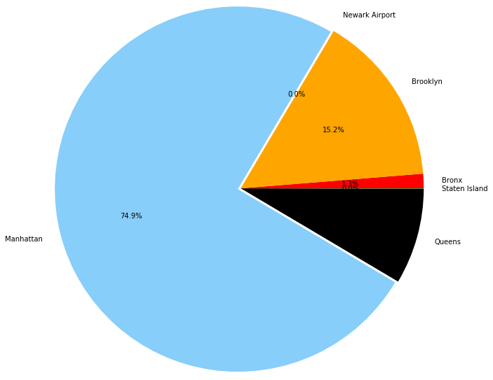
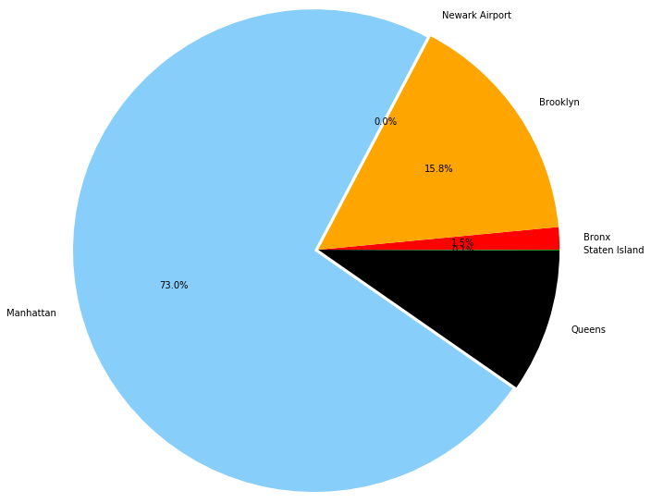

WEATHER(CONT..)
High Temp. Dataset
High Wind Dataset
Low Temp. Dataset

Slide 8


WEATHER (CONT..)
Precipitation
Snow

Slide 9
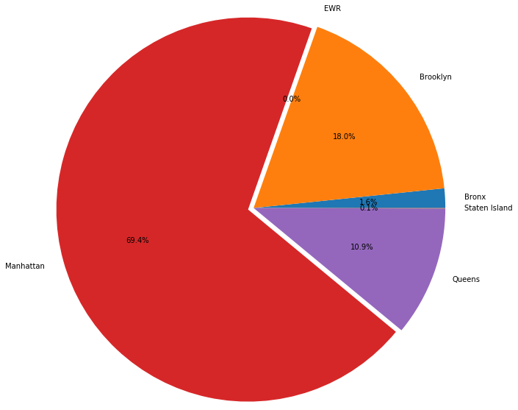
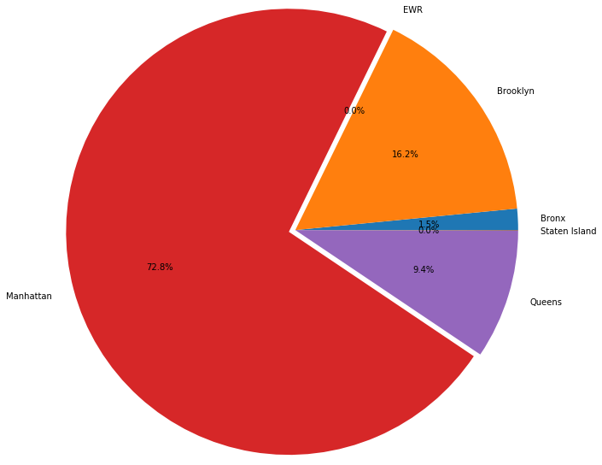
EVENTS
Uber Usage for Holiday
Uber Usage for Non-Holiday

Slide 10
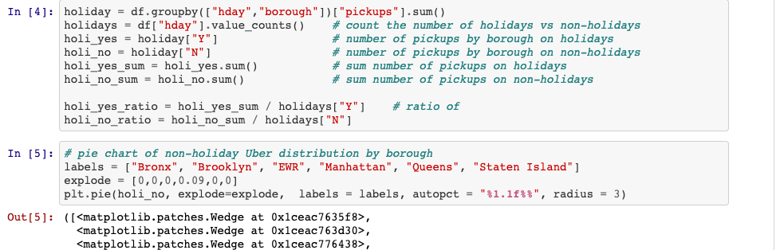
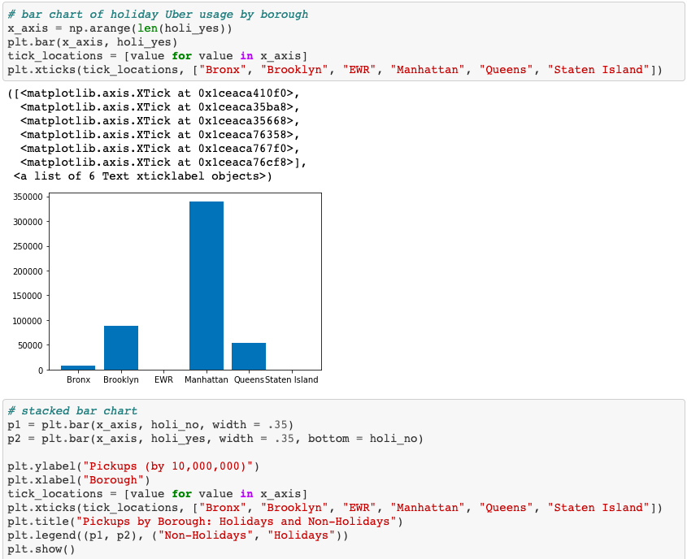
EVENTS (CONT…)

Slide 11
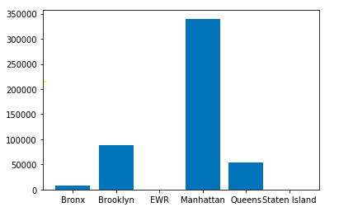
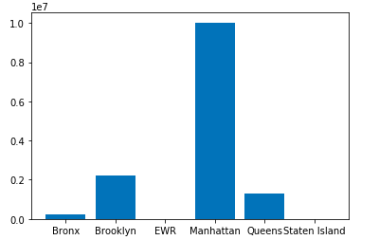
EVENTS (CONT…)
Bar Graph for Non-Holiday
Bar Graph for Holiday

Slide 12
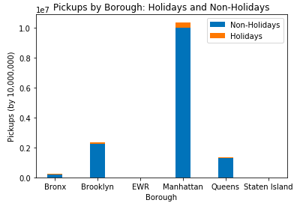
EVENTS (CONT…)
Stacked Graph Holiday VS Non-Holiday

Slide 13
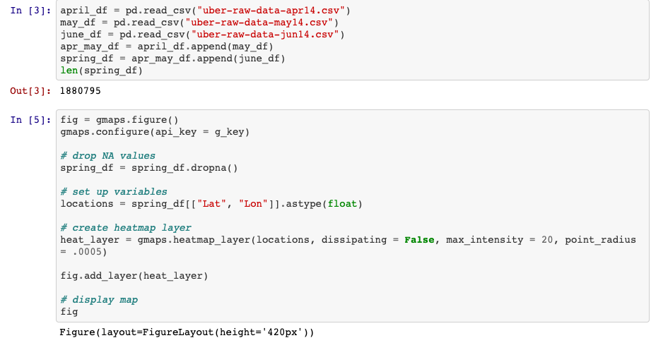
HOTSPOTS
Spring data set

Slide 14

HOTSPOTS(CONT..)
Heat Map of Spring

Slide 15
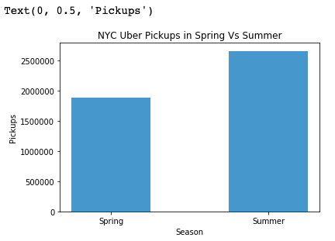
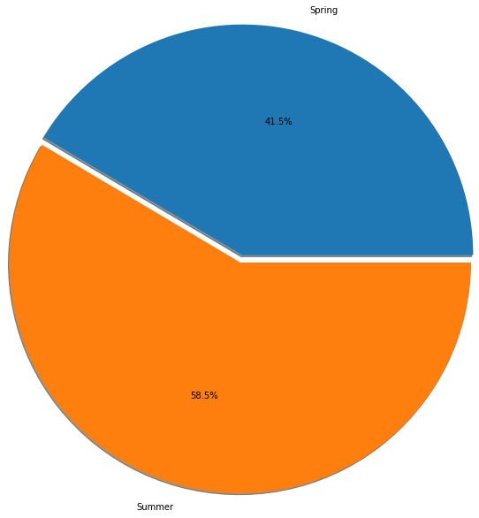
SEASONS
Bar Chart and Pie Chart
Spring VS Summer Uber Usage

Slide 16
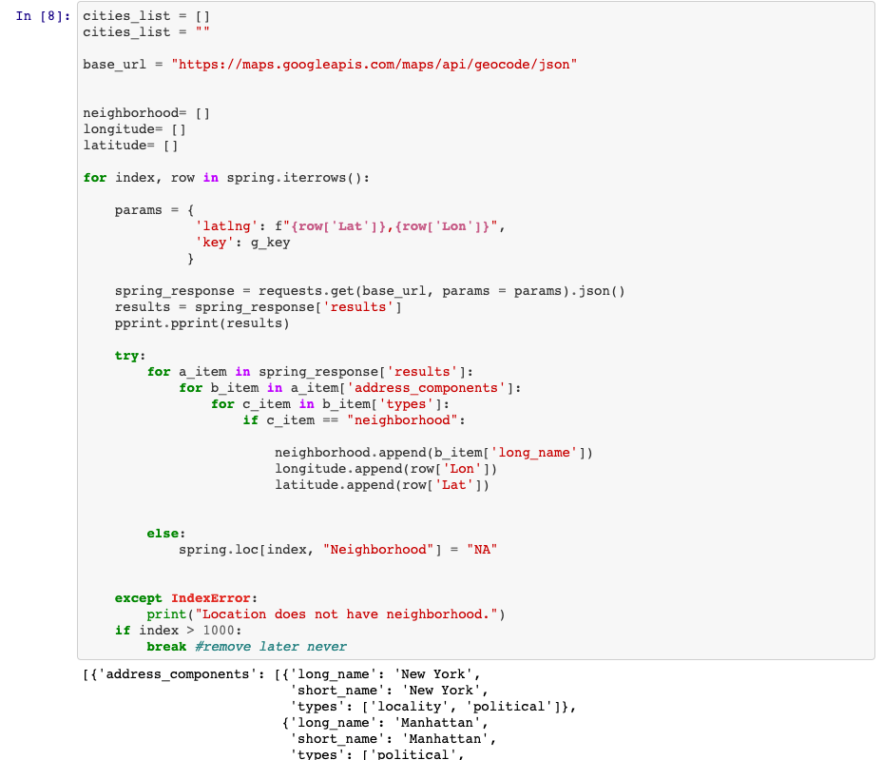
SEASONS(CONTI…)
List of neighborhood, Longitude, Latitude

Slide 17
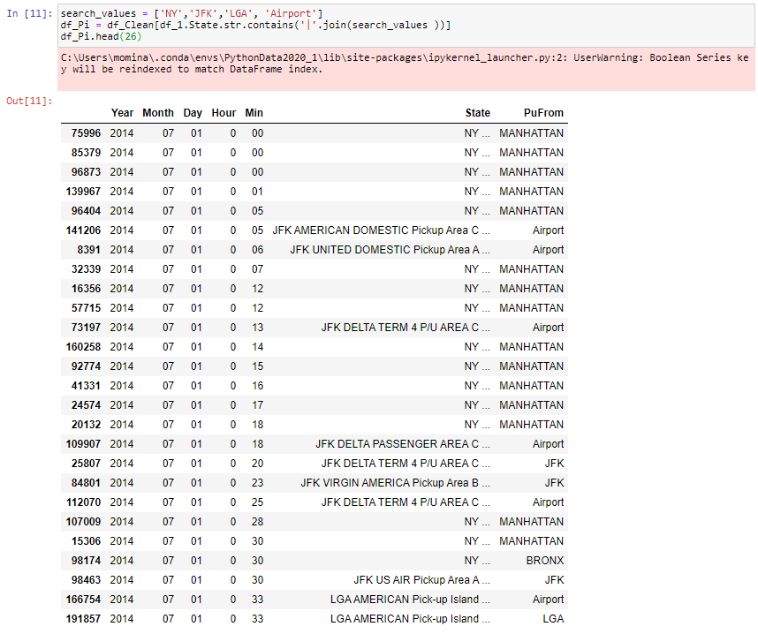
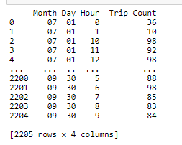
WAIT TIMES
Wait time/ Demand-supply gap
Trip counts : most during Month-End

Slide 18
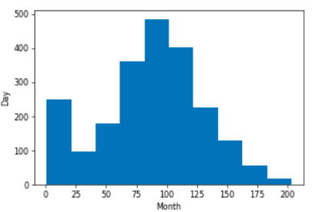
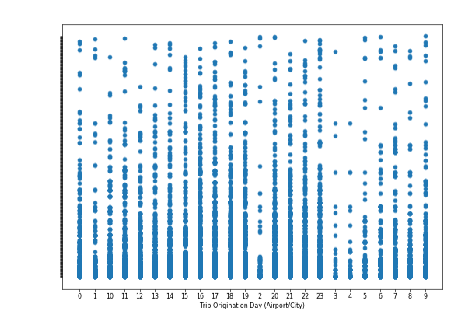
WAIT TIMES(CONTI…)
Wait times month VS day
Ridership high at airports during mid-way period

Slide 19
RESOURCES
Dataset used for the period : (2014-2016)
○Kaggle (CSV Files)
https://www.kaggle.com/
○Weather_api
https://openweathermap.org/api
○Google (gmaps) / Base maps uber
https://developers.google.com/maps/documentation/embed/get-api-key
○Data World (CSV Files)
https://data.world/

Slide 20
CONCLUSION:
Uber service utilized most in an around NYC compare to specific Borough
Implement weather certainly influences higher ridership
Special events and holidays are a good business overall for Uber Service
Tourist uses Uber Service for shorts distance around key Hotspots(Time Square)
Wait times around the airports are higher during afternoon period and beginning of the month

