Slide 1
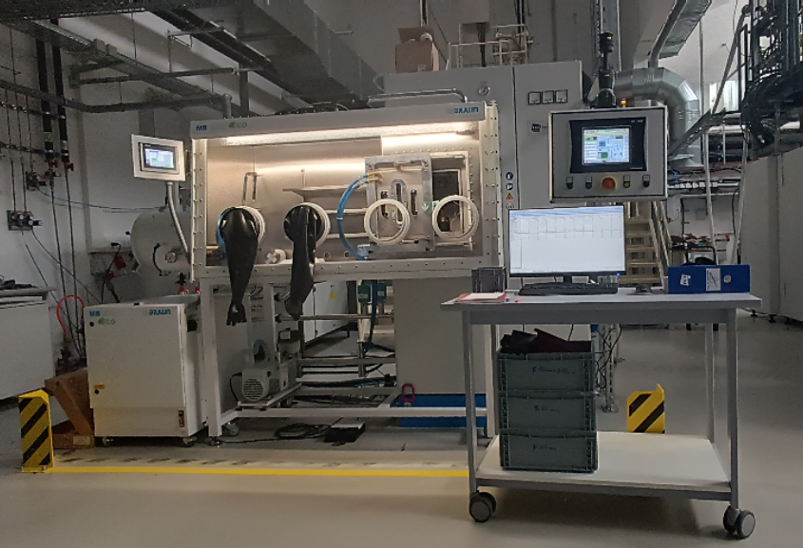
HP D10 unit (FCT Systeme, Rauenstein, Germany)
System equipped with glovebox.
Powder preparation under protective atmosphere possible
Max temp 2200°C (controlled by pyrometer)
Alternative temperature control by TC up to 1000°C
Min pressure 3 kN
Max pressure 100 kN
up to 800°C hardened steel die (2.4973 (NiCr19CoMo)), can be used only with TC
up to 2200°C graphite die (SGL Carbon, SIGRAFINE R7710) can be used with TC and pyrometer
Standard foil - graphite foil (SGL Carbon, SIGRAFEX, thickness of 0.2, 0.35 or 0.5 mm)

