Slide 1
CS105 Lab 1 Introduction
Taghreed Alanazi

Slide 2
TA information
Name: Taghreed Alanazi
Email:
talan002@ucr.edu
taghreed.alanazi@email.ucr.edu
OH:
OH reservation through this link: https://calendly.com/talan002/cs-105-oh
Tuesdays 11:00 to 1:00 pm (WCH room 110)
Thursdays 2:00 to 4:00 pm (WCH room 110)
Fridays (only over zoom) 3:30-4:30 pm.
If you have any question, please reach me out through my email or Slack (Direct message).

Slide 3
Lab work and grading procedure
Lab attendance is required, 8 to 9 lab assignments.
Student are highly encouraged to team up to finish the lab work (no more than 2 students in the group) or individually.
Each group submits one assignment. Both students will receive the same credit (unless requested otherwise).
For gaining scores of your lab work:
Directly demo the work to us.
Submitting files for grading on both (Canvas and Gradescope).
NOTE: you still need to submit you file online before the due day.
Each lab must be demoed. If a student (or a group) fails to submit or demo the assignment, he/she receives a "0".
Late submission → 20% off.

Slide 4
Demo
Each group can demo during the lab time or OHs with me, or reserve a time slot with one of the graders any day before the deadline for each lab which is on Wednesdays.
Graders are responsible to evaluate the assignments.
Reserve a time slot with one of them using Calendy (on Canvas).
During demo, both group members need to show up and contribute to answer questions and explanations.
Scores are totally dependent on your demo. You can get feedback immediately.

Slide 5
IMPORTANT NOTES!
Before each lab session, I will upload materials that will assist you in completing the lab assignment. Additionally, I will provide recorded slides (except lab1), which I recommend you review before attending the class.
If you have any questions about the content, please make a note of them and bring them up during our lab time.
At the beginning of each class, we will discuss the lab example and assignment. After which, I will address any questions you may have. Once all questions are answered, we can start with the demos.
If you don’t demo, we can’t grade your work! You should explain how you solved the problem, and if you understand what you are doing.
I must emphasize:
DO NOT COPY the work or code of your peers.
Academic integrity is of the utmost importance in this course. Cheating will not be tolerated.
If you ever find yourself in doubt or need assistance, please just ask .. we are here to help!

Slide 6
How to demo and the programming language used
You can use Anaconda (check Anaconda Installation Guide pdf).
We will use → Python programming language.
Widely Used: Python is a popular language for data analysis, machine learning, AI, web development, and more.
Simple and Readable: Python is known for its clear and human-readable syntax.
No need for semicolons to end statements.
Lines end by themselves, making code more readable.
Dynamic Typing: No need to declare variable types upfront.
Indentation Matters: Unlike many languages, Python uses indentation to denote code blocks.
Ensure consistent whitespace for logical blocks of code.

Slide 7
Basic Python concepts
Data Types:
Integers: Whole numbers (e.g., 5, -3, 0)
Floats: Decimal numbers (e.g., 3.14, -0.001, 5.0)
Strings: Text (e.g., 'Hello', "Python")
Booleans: True or False values (True, False)
Variables:
Store and reference data by a name.
Example:
age = 25
name = "Alice"
Basic Operations:
Arithmetic: +, -, *, /
Concatenation for strings: 'Hello' + ' World!'
Comparison: ==, !=, <, >, <=, >=
Print Function:
Display values to the screen.
Example:
print("Hello, World!")

Slide 8
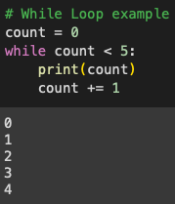
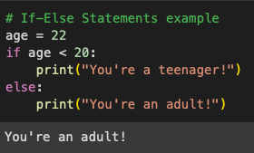
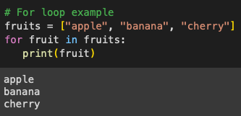
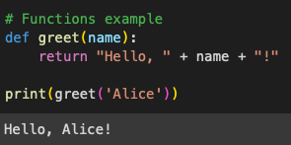
Lists: Collection of items (can be of mixed types).
Example: fruits = ["apple", "banana", "cherry"]
Tuples: Similar to lists but immutable (can't be changed after they're created).
Example: coordinates = (4, 5)
Dictionaries: Key-value pairs.
Example: person = {"name": "Alice", "age": 25}
Control Structures:
If-Else Statements: Conditional execution based on a test.
Loops:
For Loop: Iterate over sequences (like lists or ranges).
While Loop: Execute as long as a condition remains true.
Functions: Blocks of reusable code.
Examples:

Slide 9
In data analysis, we do:
Data Cleaning:
Handling missing data.
Data transformation and normalization.
Exploratory Data Analysis (EDA):
Understanding the data's main characteristics, often using statistical graphics, plots, and information tables.
Data Preprocessing:
Feature engineering.
One-hot encoding, normalization, etc.
… and more!
We want to introduce some libraries and tools that are frequently used in Data analysis field.

Slide 10
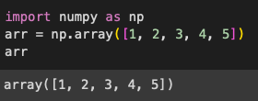
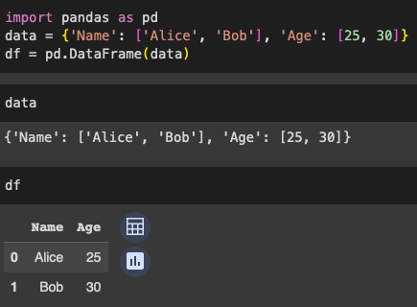
Libraries and tools (with examples)
Numpy:
Fundamental package for scientific computing in Python.
Provides support for large multi-dimensional arrays and matrices.
Pandas:
Essential for data manipulation and analysis.
Provides data structures like DataFrame for handling and analyzing structured data.

Slide 11
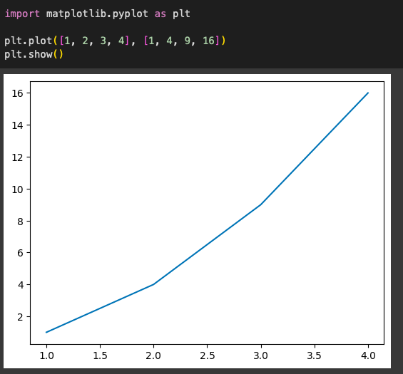
Libraries and tools (with examples)
Matplotlib & Seaborn:
Libraries for data visualization.
Plot graphs, histograms, scatter plots, etc.
Scipy:
Used for high-level computations.
Provides modules for optimization, integration, interpolation, eigenvalue problems, and more.

Slide 12
Useful Python resources
You can learn more with these tutorials:
https://docs.python.org/3/tutorial/
Also, you can try Code Academy: https://www.codecademy.com/learn/learn-python-3

Slide 13
Go through ‘lab1_examples_W24.ipynb’.

Slide 14
Hints for Lab1_Assignment: (no demo need for this lab!)
Question 0:
Give your best guess and explain your thought process behind your answer.
Question 1:
use set_index(col_name)
Question 2:
Instead of using a for loop to change all the values of a column, we can use special functions offered by pandas that can modify entire columns at a time. For example, if we wanted to cast a column of floats (eg. df.col1) as integers, we might use the following line of code: df.col1 = df.col1.astype(int), also, we can visualize a series of numbers using value_counts() and plot().
Question 3:
Here we do the same thing as Q2, but we are extracting the last digit. An easy way to index the last digit is by using -1 (e.g. ‘hello’[-1] returns letter ‘o’).
Question 4:
Here we again are doing something similar to Q2. (But how to get rid from ‘$’?)

