Slide 1
Tarkvara projekt
GAME
VISUAL NOVEL ADVENTURE
ILJA KUZNETSOV, MIHKEL ERIK RIID
Notes:
16

Slide 2
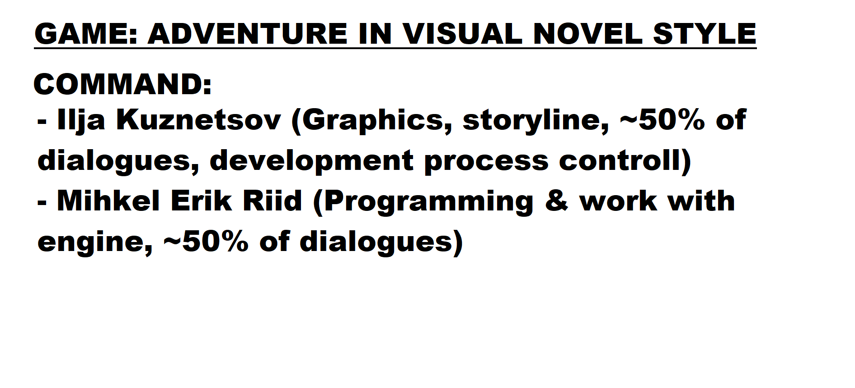
MAIN INFO ABOUT THE PROJECT
Notes:
16

Slide 3
MAIN INFO ABOUT THE PROJECT
Main idea - make an interesting and good-looking visual novel.
A visual novel is a game where storytelling is presented
through text and scene illustrations.
In other words, it is an interactive book, where the ending
depends on the players actions.
Notes:
16

Slide 4
TOOLS WE ARE
PLANNING TO USE
1. Neural networks for picture processing.
2. Neural networks for music creation.
3. Engine for game — Godot
4. GDScript as programming language.
5. Some programs for manual picture processing.
Notes:
16

Slide 5
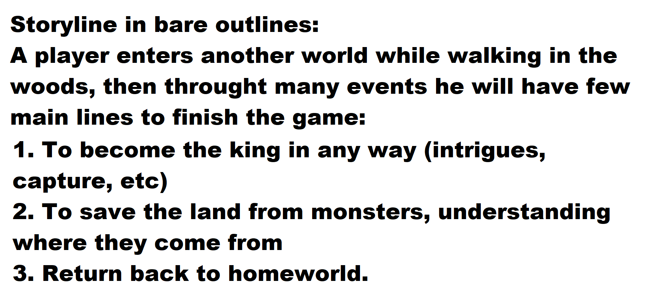
Storyline
Notes:
16

Slide 6
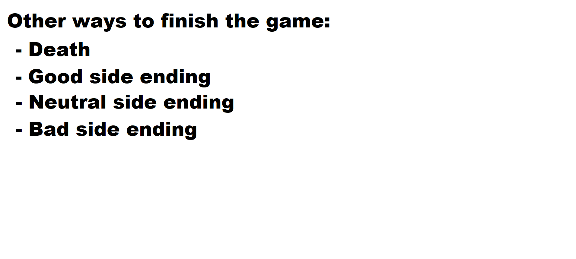
Storyline
Notes:
16

Slide 7
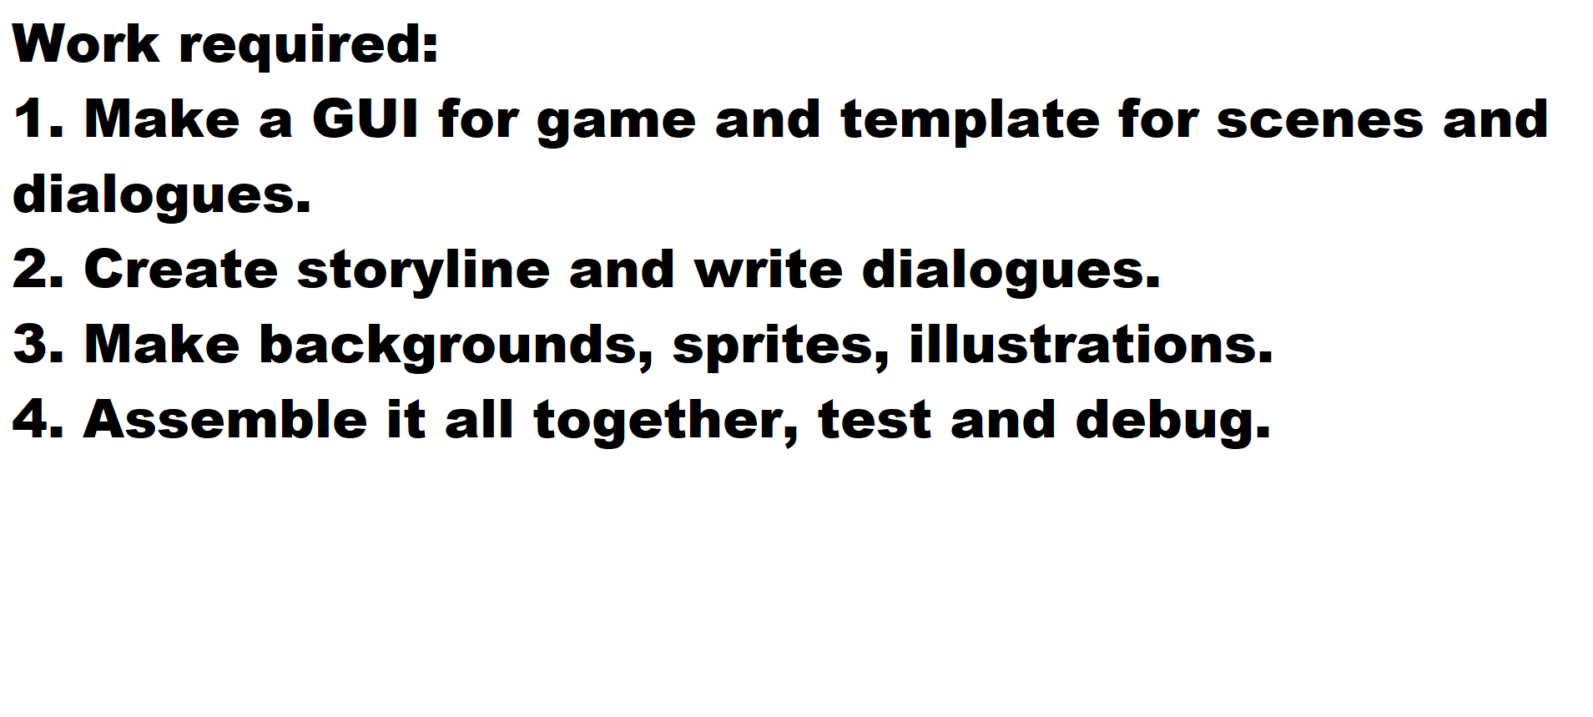
Todo list
Notes:
16

Slide 8
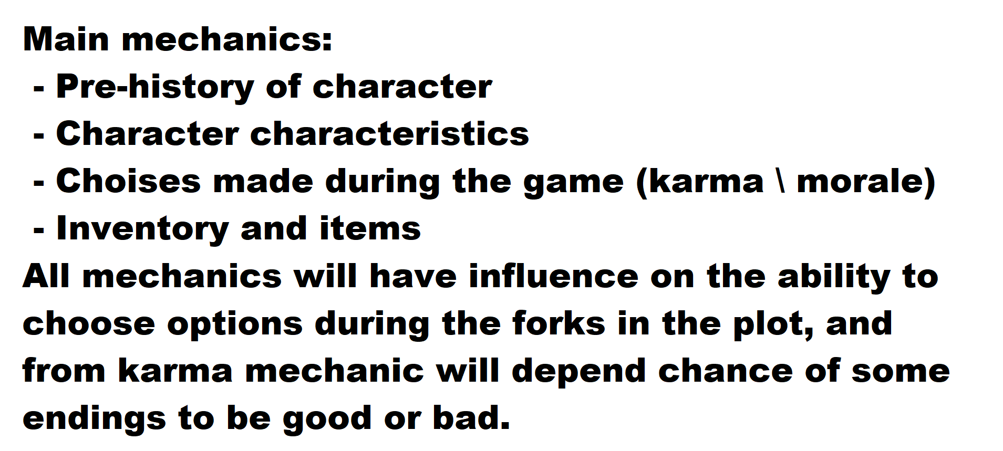
Game mechanics
Notes:
16

Slide 9
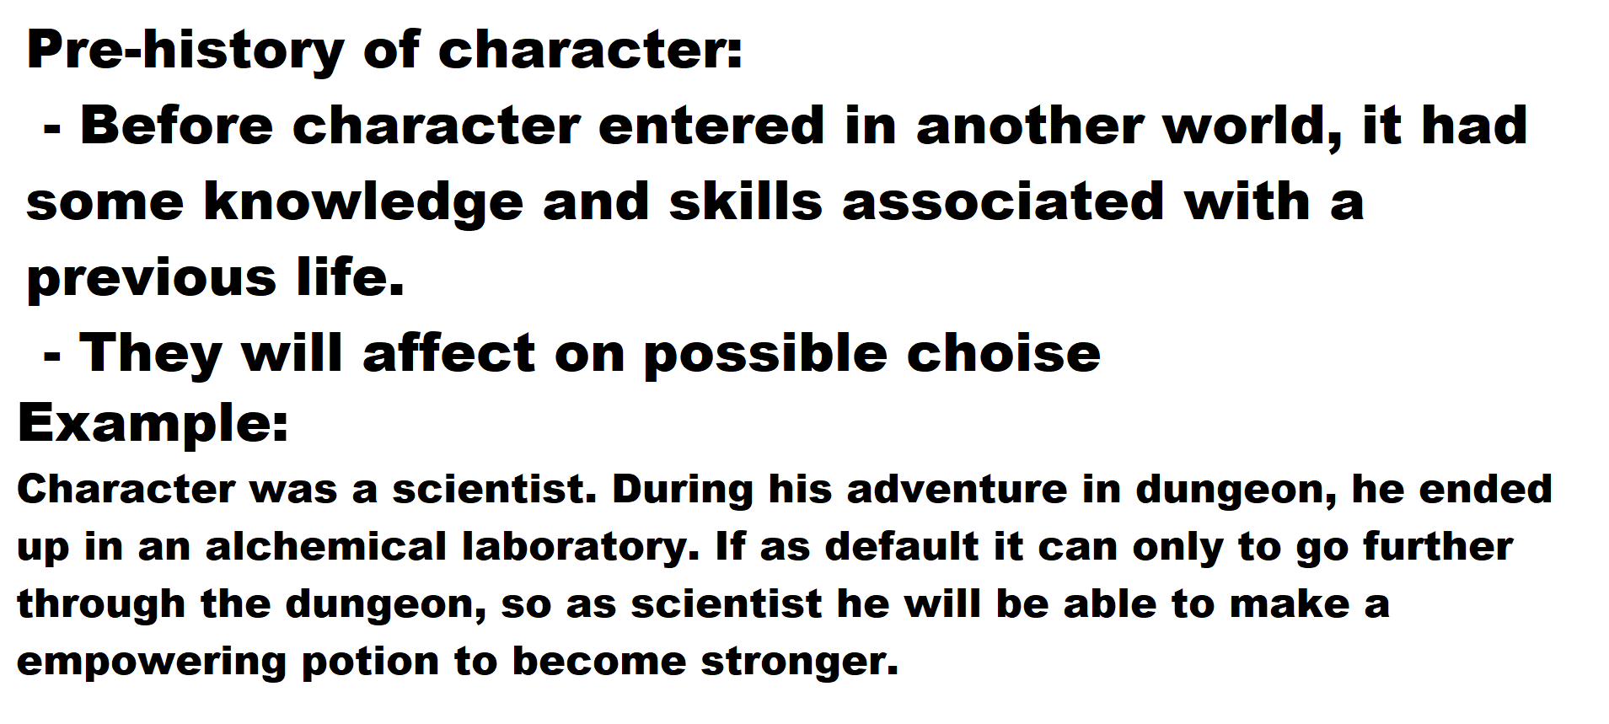
Game mechanics
Notes:
16

Slide 10
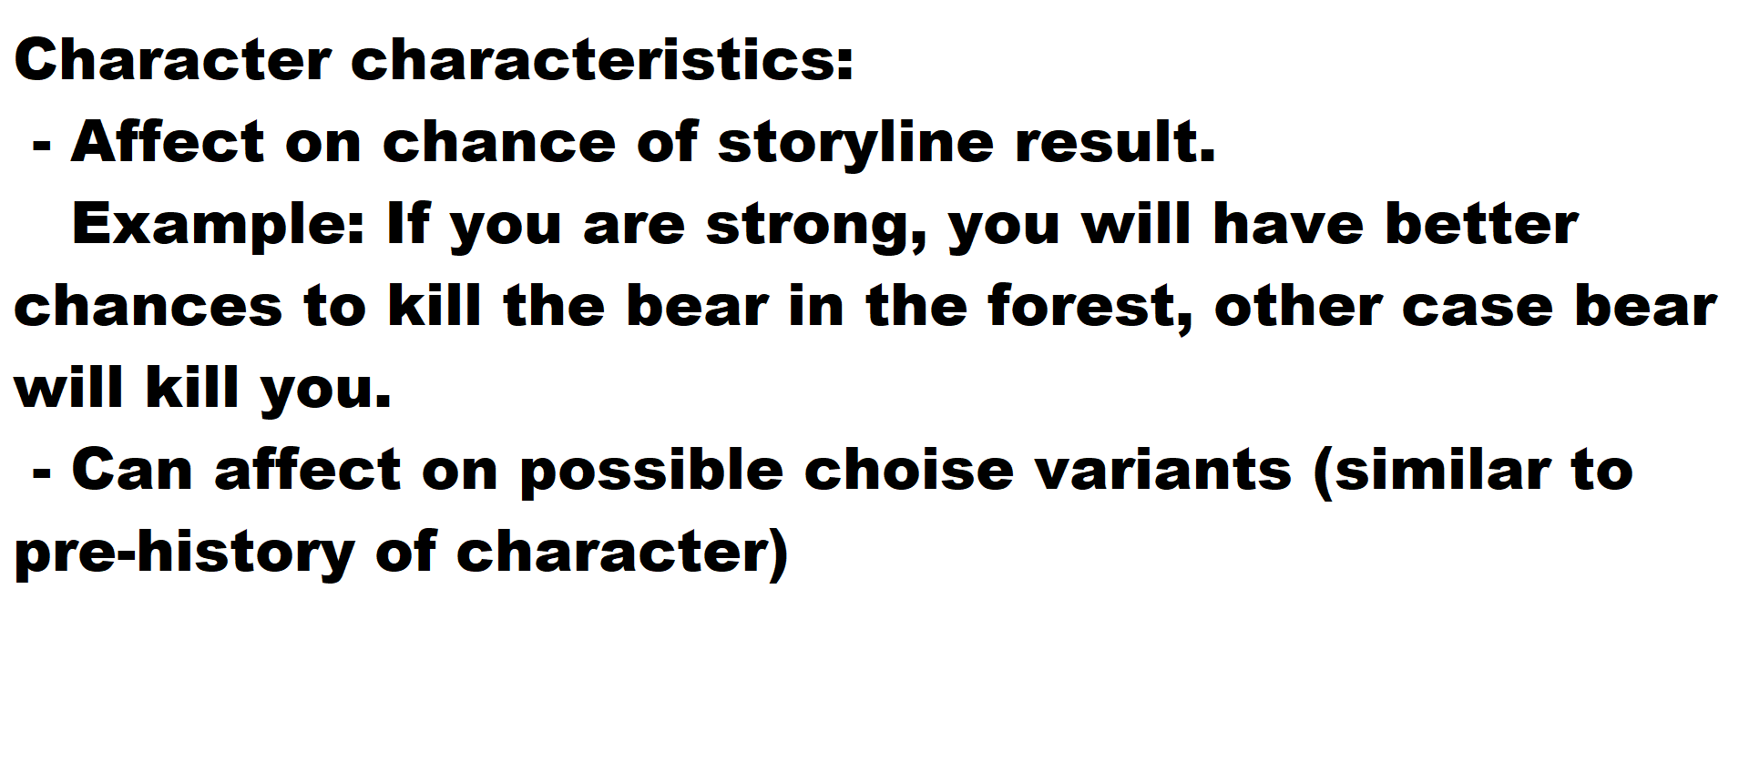
Game mechanics
Notes:
16

Slide 11
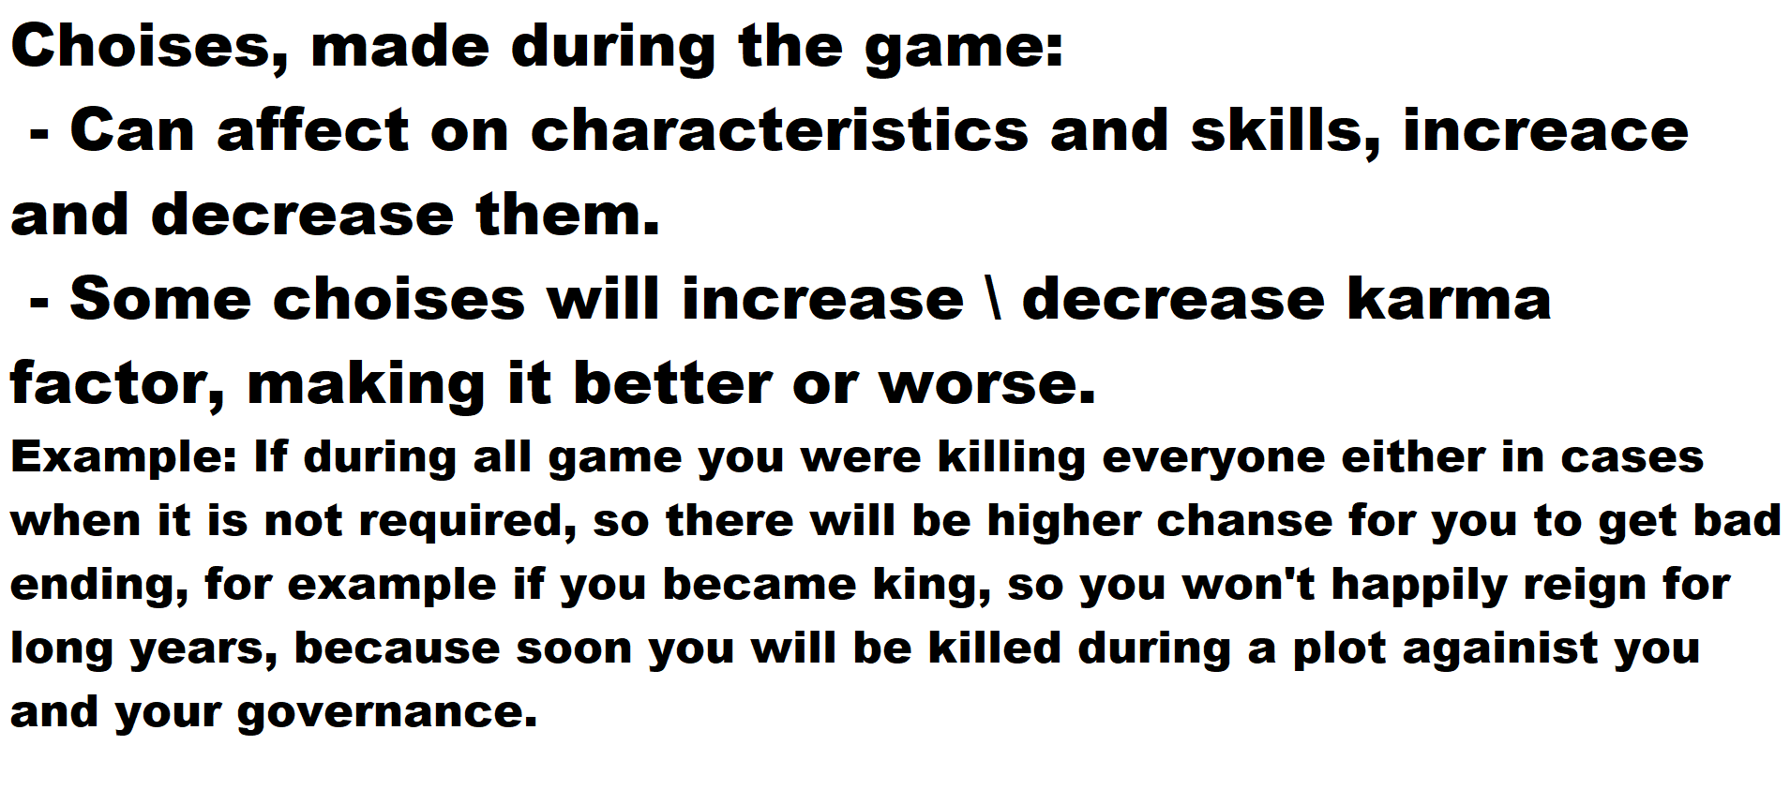
Game mechanics
Notes:
16

Slide 12
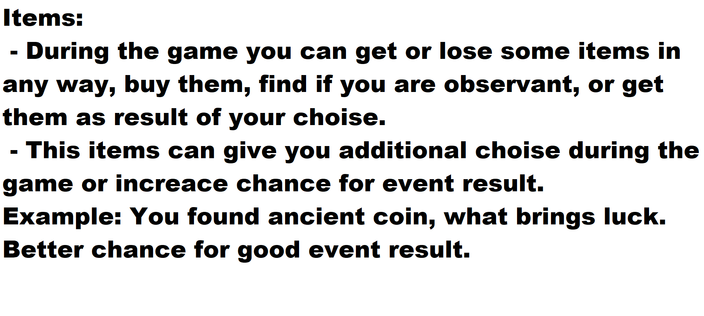
Game mechanics
Notes:
16

Slide 13
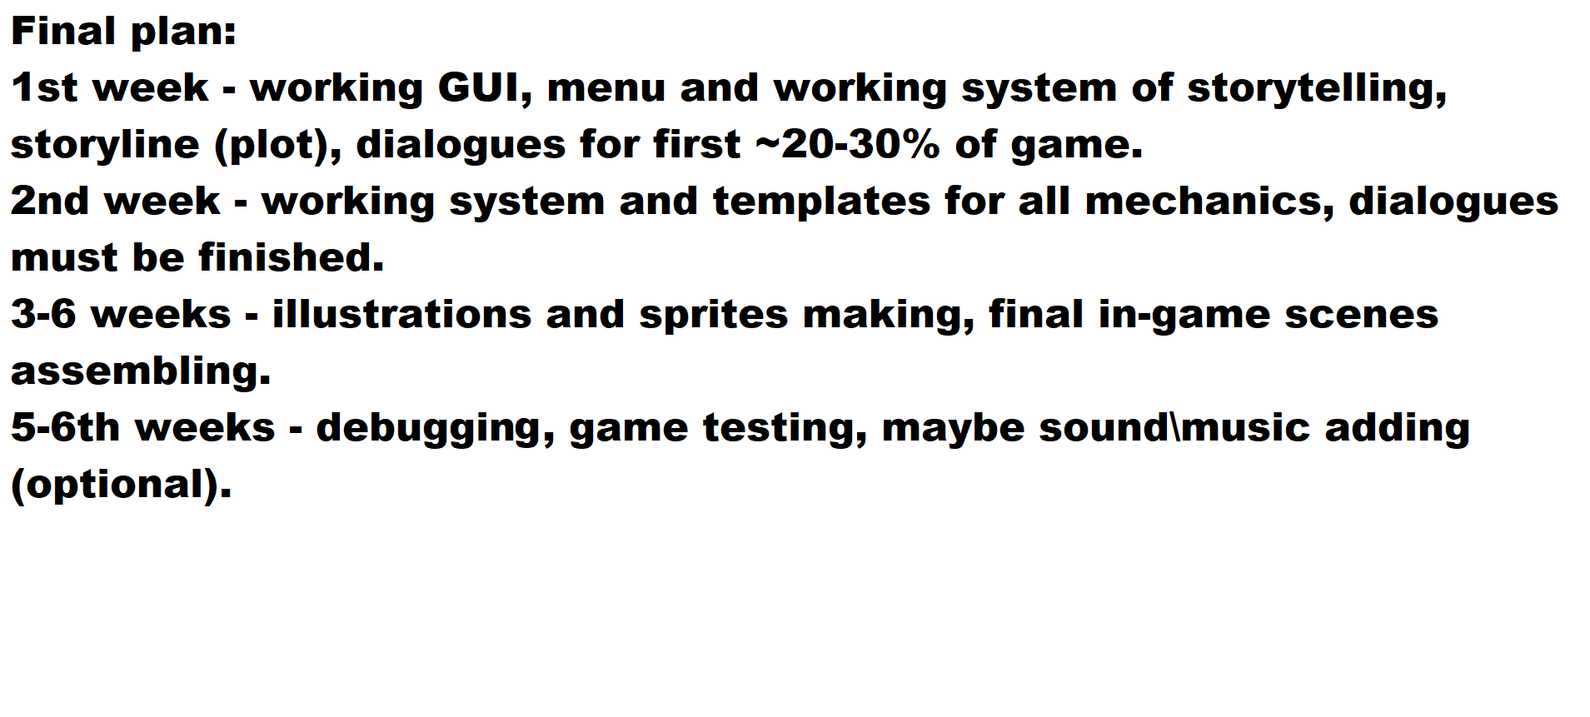
Final plan
Notes:
16

Slide 14
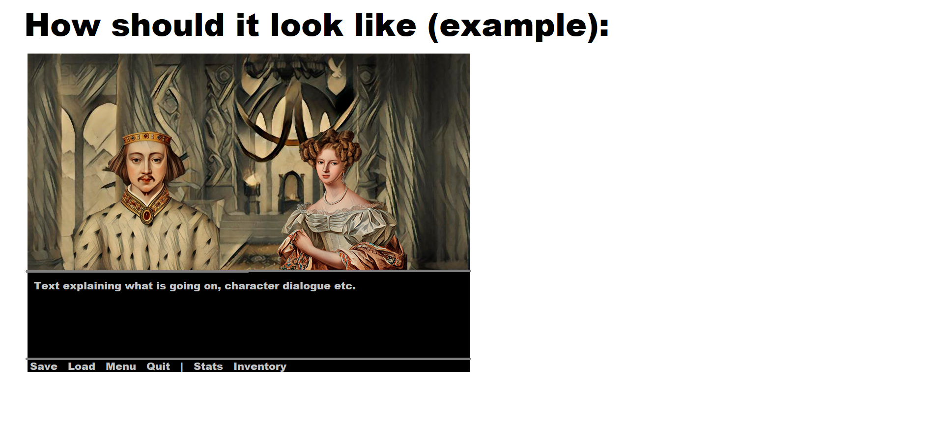
How it should look like (rude)
Notes:
16

Slide 15
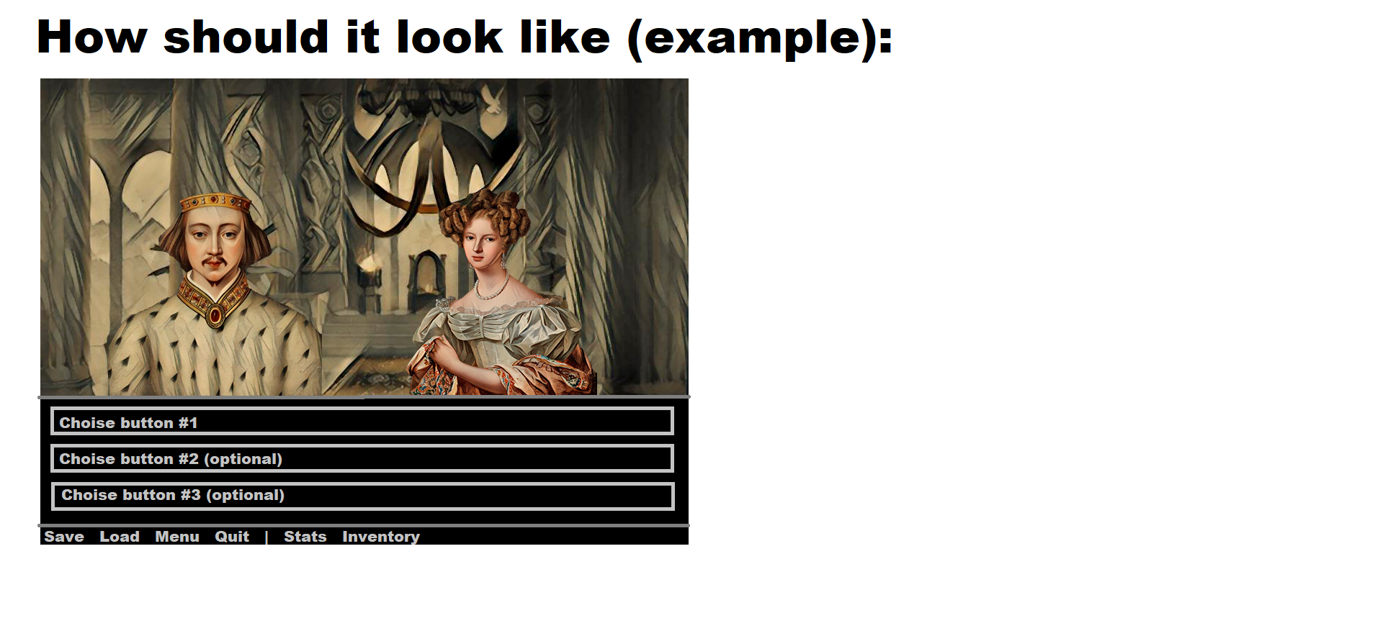
How it should look like (rude)
Notes:
16

Slide 16
Expected Result
Learn Godot
Make an amazing game
Get an experience of command work and game-making
Notes:
16

