Slide 1
Are all BSDs created equally? A survey of BSD kernel vulnerabilities.
Ilja van Sprundel <ivansprundel@ioactive.com>

Slide 2
Who Am I
Ilja van Sprundel
ivansprundel@ioactive.com
Director of Penetration Testing at IOActive
Pen test
Code review
Break stuff for fun and profit ☺

Slide 3
Outline/Agenda
Intro
Data!
vulnerabilities over the years
Test by audit
Common attack surface
Somewhat less common attack surface
Some results / conclusions

Slide 4
What is this talk about?
BSD kernel vulnerabilities
Comparison
Between different BSD flavors
Audience
Low level security enthusiasts
UNIX/BSD geeks
I suspect Linux folks might enjoy this too ☺
Curious people that like to poke around in OS internals
Knowledge
Some basic knowledge of UNIX / BSD internals

Slide 5
Standing on the shoulders of giants
Previous interesting BSD kernel security research by:
Silvio
the noir
Esa Etelavuori
Patroklos (argp) Argyroudis
Christer Oberg
Joel Erikkson
Clement Lecigne

Slide 6
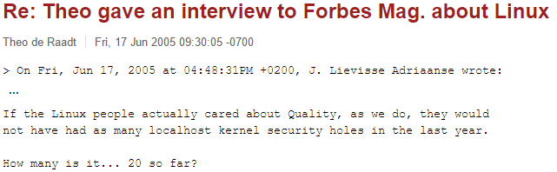
intro

Slide 7
Really? Got Data?
Somehow that statement has always been stuck in my head
Is it true?
Can we look at some data ?

Slide 8
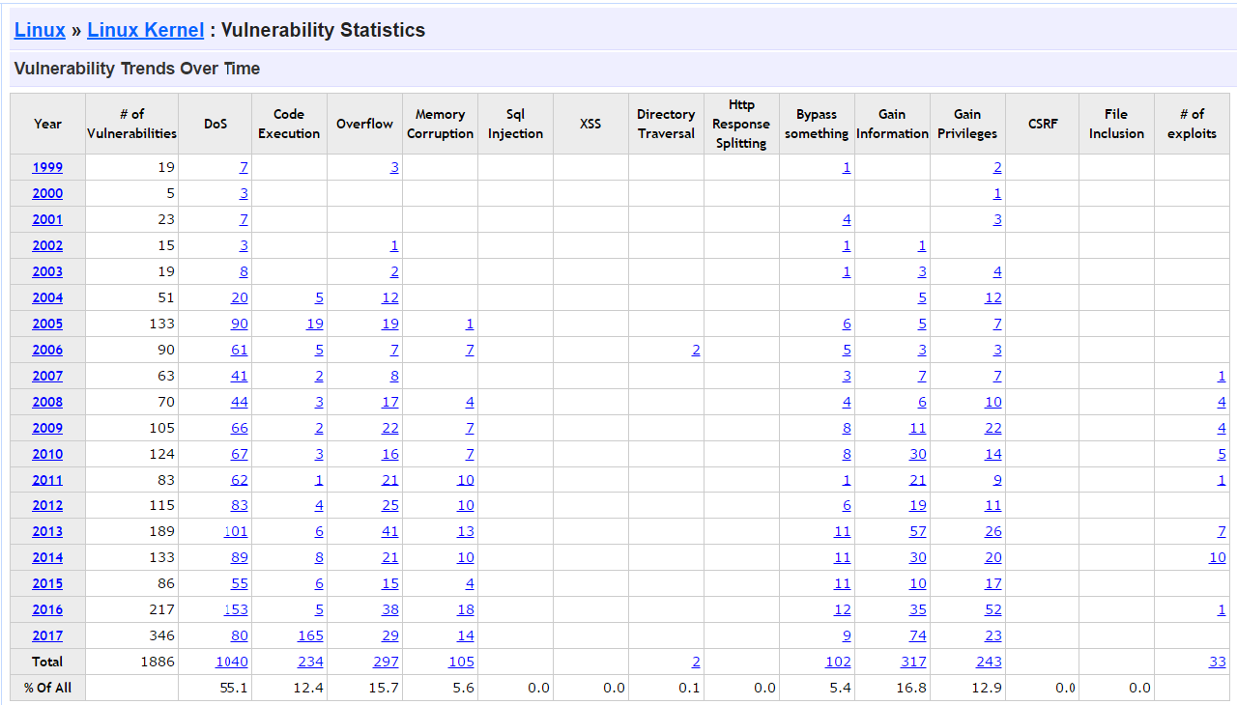
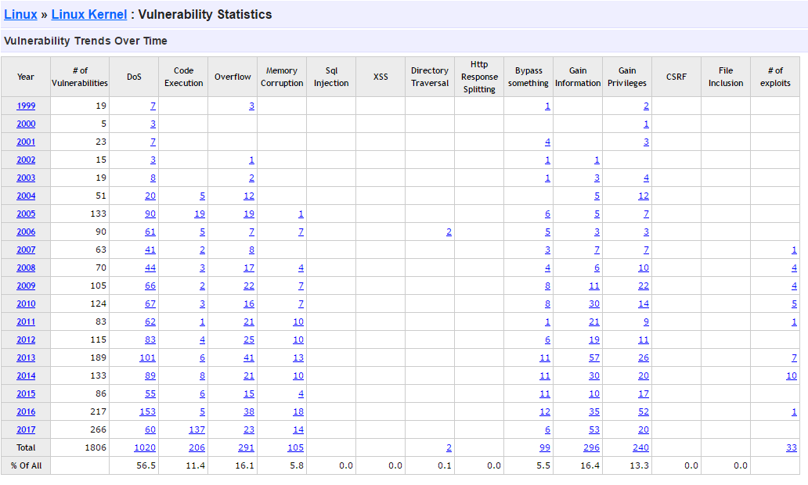
Source: https://www.cvedetails.com/product/47/Linux-Linux-Kernel.html

Slide 9
Data!
Goes from july 2017 back to 1999 for Linux kernel vulnerabilities
Cvedetails.com doesn’t seem to provide data for OBSD/NBSD/FBSD
Manually grab it from
https://www.freebsd.org/security/advisories.html
http://netbsd.org/support/security/advisory.html
https://www.openbsd.org/errata*.html

Slide 10
BSD kernel vulnerabilities over the years
 | FreeBSD | NetBSD | OpenBSD
1999 | 3 | 8 | 10
2000 | 8 | 4 | 15
2001 | 6 | 7 | 13
2002 | 11 | 6 | 11
2003 | 7 | 3 | 8
2004 | 8 | 5 | 13
2005 | 11 | 8 | 4
2006 | 9 | 15 | 6
2007 | 1 | 4 | 9
2008 | 8 | 6 | 7
2009 | 5 | 1 | 4
2010 | 3 | 6 | 8
2011 | 1 | 2 | 3
2012 | 2 | 1 | 0
2013 | 8 | 8 | 6
2014 | 7 | 6 | 10
2015 | 7 | 2 | 6
2016 | 12 | 1 | 17
2017 | 1 | 3 | 13
Total | 118 | 96 | 163
Looking at these numbers, that was an astute observation by Theo.
20 was a very low estimate
But are these numbers on equal footing?
Many eyeballs?
Yea, yea, I know …. But is there some truth to it in this case?
Notes:
OpenBSD: harder to get numbers. Used curl/perl/excel.

Slide 11
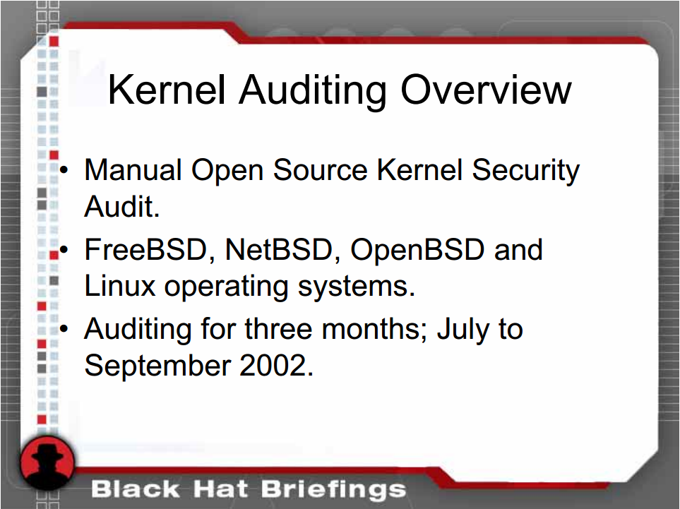
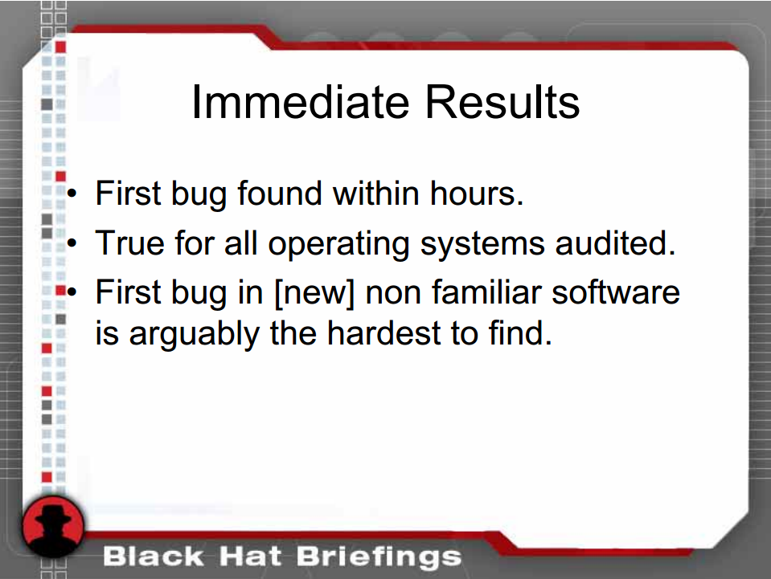
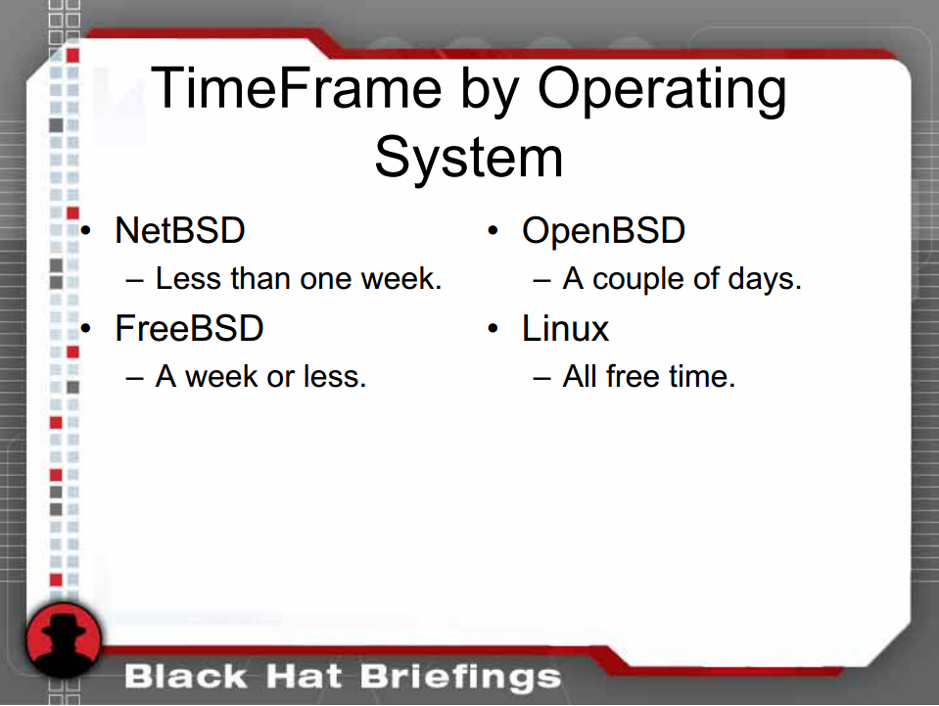
Test by audit!
Silvio Cesare did some interesting work in ~2002 that gives some answers
https://www.blackhat.com/presentations/bh-usa-03/bh-us-03-cesare.pdf
His results seem to indicate there isn’t really that much of a quality difference. However:
that was well over a decade ago.
Have things changed?
Time spend on the BSDs was only a couple of days compared to Linux
If more time would’ve been spend, would more bugs have been found?
bugs are mostly int overflows and info leaks
Other kinds of issues that can ‘easily’ be found ?

Slide 12
Test by Audit redux.
Spend April-May-June-july auditing BSD source code.
Asked myself, “where would the bugs be?”
Attack surface
Very common
Syscalls
TCP/IP stack
Somewhat less common (in ascending order, more or less)
Drivers (ioctl interface)
compat code
Trap handlers
Filesystems
Other networking (BT, wifi, IrDA)

Slide 13
Syscalls

Slide 14
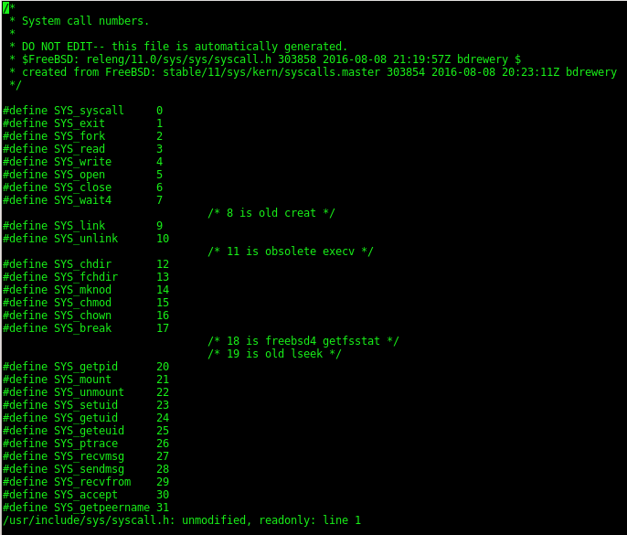
Attack surface entrypoint
The obvious attack surface
Syscalls are how userland gets anything done from kernel
Hundreds of them
FreeBSD: ~550
OpenBSD: ~330
NetBSD: ~480
Assumption: given that they’re obvious, and well tested, less likely to contain security bugs

Slide 15
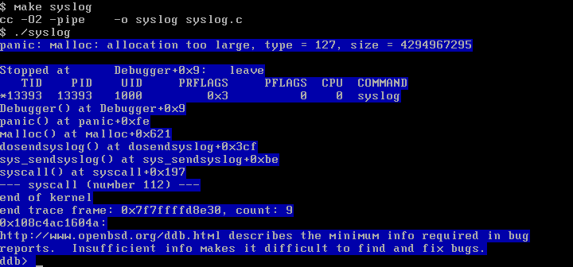
int
sys_sendsyslog(struct proc *p, void *v, register_t *retval)
{
struct sys_sendsyslog_args /* {
syscallarg(const void *) buf;
syscallarg(size_t) nbyte;
syscallarg(int) flags;
} */ *uap = v;
int error;
static int dropped_count, orig_error;
...
error = dosendsyslog(p, SCARG(uap, buf), SCARG(uap, nbyte),
SCARG(uap, flags), UIO_USERSPACE);
...
return (error);
}
int
dosendsyslog(struct proc *p, const char *buf, size_t nbyte, int flags,
enum uio_seg sflg)
{
...
struct iovec aiov;
struct uio auio;
size_t i, len;
...
aiov.iov_base = (char *)buf;
aiov.iov_len = nbyte; ← user controlled size_t. never capped anywhere
...
auio.uio_resid = aiov.iov_len;
...
len = auio.uio_resid; ← user controlled size_t
if (fp) {
...
} else if (constty || cn_devvp) {
...
} else {
...
kbuf = malloc(len, M_TEMP, M_WAITOK);
...
}
...
}

Slide 16
Sample bug
sendsyslog system call
OpenBSD 6.1
Been there since OpenBSD 6.0
Unbound length passed to malloc() from userland
Will trigger a kernel panic

Slide 17
int
sys_kldstat(struct thread *td, struct kldstat_args *uap)
{
struct kld_file_stat stat;
int error, version;
/*
* Check the version of the user's structure.
*/
if ((error = copyin(&uap->stat->version, &version, sizeof(version)))
!= 0)
return (error);
if (version != sizeof(struct kld_file_stat_1) &&
version != sizeof(struct kld_file_stat))
return (EINVAL);
error = kern_kldstat(td, uap->fileid, &stat); ← doesn’t full init stat struct
if (error != 0)
return (error);
return (copyout(&stat, uap->stat, version)); ← uninit stat struct copied to user
}

Slide 18
Sample bug 2
kldstat system call
FreeBSD 11.0
Been there for almost 10 years (Modified Mon Oct 22 04:12:57 2007 UTC (9 years, 9 months ago))
Doesn’t fully initialize a structure. Sends it back to userland
infoleak
Previous assumption is not true: bugs in syscalls do occur with some frequency
Especially newly added syscalls

Slide 19
TCP/IP stack

Slide 20
Attack surface entrypoint
TCP/IP stack
Ipv4/6
Udp/tcp/icmp
Ipsec
…
Obvious and well known attack surface
Has been around forever
Assumption: well tested and less likely to find bugs there

Slide 21
static void pppoe_dispatch_disc_pkt(struct mbuf *m, int off)
{
...
int noff, err, errortag;
u_int16_t *max_payload;
u_int16_t tag, len;
...
while (off + sizeof(*pt) <= m->m_pkthdr.len) {
n = m_pulldown(m, off, sizeof(*pt), &noff);
...
pt = (struct pppoetag *)(mtod(n, caddr_t) + noff);
tag = ntohs(pt->tag);
len = ntohs(pt->len);
...
switch (tag) {
...
case PPPOE_TAG_SNAME_ERR:
err_msg = "SERVICE NAME ERROR";
errortag = 1;
break;
…
}
if (err_msg) {
log(LOG_INFO, "%s: %s: ", devname, err_msg);
if (errortag && len) {
n = m_pulldown(m, off, len,
&noff); ← if m_pulldown() fails, it will mfreem(m)
if (n) {
u_int8_t *et = mtod(n, caddr_t) + noff;
while (len--)
addlog("%c", *et++);
} <-- should have else case that sets m to NULL
}
addlog("\n");
goto done; ← will end up mfreem(m) again
}
off += len;
}
...
done:
m_freem(m); ← possible double free!
}

Slide 22
Sample bug
pppoe_dispatch_disc_pkt()
Double free when parsing packet
Affects OpenBSD 6.1
Been there since 2004
Fixed in NetBSD a couple of months ago
Previous assumption is not [entirely] true: bugs in TCP/IP stack do occur with some frequency
newer code
mbuf handling is complicated and error prone

Slide 23
Drivers

Slide 24
Attack surface entrypoint
Lots and lots of drivers
For all sorts of things
UNIX: everything is a file
Most expose entrypoints in /dev
File operations
Open
Ioctl
Read
Write
Close
…
Ioctl is where most of the attack surface is!

Slide 25
int
cryptof_ioctl(struct file *fp, u_long cmd, void *data)
{
...
switch (cmd) {
...
mutex_enter(&crypto_mtx);
fcr->mtime = fcr->atime;
mutex_exit(&crypto_mtx);
mkop = (struct crypt_mkop *)data;
knop = kmem_alloc((mkop->count * sizeof(struct crypt_n_kop)),
KM_SLEEP);
error = copyin(mkop->reqs, knop,
(mkop->count * sizeof(struct crypt_n_kop)));
if (!error) {
error = cryptodev_mkey(fcr, knop, mkop->count);
if (!error)
error = copyout(knop, mkop->reqs,
(mkop->count * sizeof(struct crypt_n_kop)));
}
kmem_free(knop, (mkop->count * sizeof(struct crypt_n_kop)));
break;
...
}
Integer overflow
Memory corruption due to int overflow

Slide 26
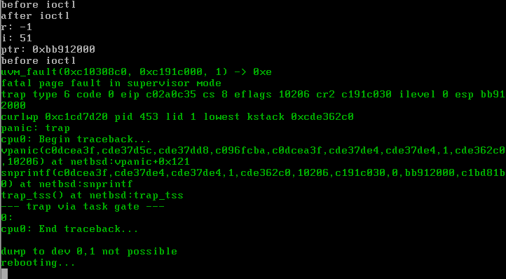
Sample bug
Crypto device CIOCNFKEYM ioctl
NetBSD 7.1
Been there since NetBSD 4.0.1? Thu Apr 10 22:48:42 2008
Classic integer overflow → memory corruption

Slide 27
static int
ksyms_open(struct cdev *dev, int flags, int fmt __unused, struct thread *td)
{
...
struct ksyms_softc *sc;
...
sc = (struct ksyms_softc *) malloc(sizeof (*sc), M_KSYMS,
M_NOWAIT|M_ZERO);
...
sc->sc_proc = td->td_proc;
sc->sc_pmap = &td->td_proc->p_vmspace->vm_pmap; ← will be used in d_mmap callback.
...
error = devfs_set_cdevpriv(sc, ksyms_cdevpriv_dtr);
…
}
static int
ksyms_mmap(struct cdev *dev, vm_ooffset_t offset, vm_paddr_t *paddr,
int prot __unused, vm_memattr_t *memattr __unused)
{
struct ksyms_softc *sc;
int error;
error = devfs_get_cdevpriv((void **)&sc);
if (error)
return (error);
/*
* XXX mmap() will actually map the symbol table into the process
* address space again.
*/
if (offset > round_page(sc->sc_usize) ||
(*paddr = pmap_extract(sc->sc_pmap, ← can be expired pointer!
(vm_offset_t)sc->sc_uaddr + offset)) == 0)
return (-1);
return (0);
}

Slide 28
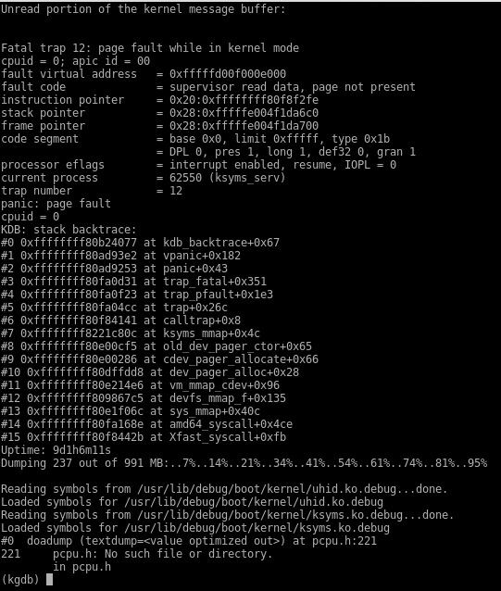
Sample bug 2
Ksyms device
FreeBSD 11
Been there since FreeBSD 8.0 Tue May 26 21:39:09 2009
Expired pointer
open() callback saves pointer to pmap to private fd/device storage
mmap() callback uses saved pointer in private fd/device storage
So how is this a problem ?
What if we hand fd off to another process (e.g. send over socket or fork/execve)
And then we exit
If other process now does mmap, it will be using an expired pmap!

Slide 29
Compat code

Slide 30
Attack surface entrypoint
The BSDs have binary compatibility [compat] support for some binaries:
Older versions of the OS
32bit versions of a program (on a 64bit version of the OS)
Other operating system (e.g. Linux)
Has to emulate a bunch of stuff (e.g. syscalls)
“The people who rely on the compat layers don't care enough to maintain it. The people who work on the mainline system don't care about the compat layers because they don't use them. The cultures aren't aligned in the same direction. Compat layers rot very quickly.” – Theo De Raadt

Slide 31
static int
ti_bind(file_t *fp, int fd, struct svr4_strioctl *ioc, struct lwp *l)
{
...
struct svr4_strmcmd bnd;
...
if (ioc->len > sizeof(bnd))
return EINVAL;
if ((error = copyin(NETBSD32PTR(ioc->buf), &bnd, ioc->len)) != 0)
return error;
...
switch (st->s_family) {
case AF_INET:
...
netaddr_to_sockaddr_in(&sain, &bnd);
...
}
...
}
#define SVR4_C_ADDROF(sc) (const void *) (((const char *) (sc)) + (sc)->offs)
...
static void netaddr_to_sockaddr_in
(struct sockaddr_in *sain, const struct svr4_strmcmd *sc)
{
const struct svr4_netaddr_in *na;
na = SVR4_C_ADDROF(sc); ← could point to anywhere in memory
memset(sain, 0, sizeof(*sain));
sain->sin_len = sizeof(*sain);
sain->sin_family = na->family; ← crash or info leak
sain->sin_port = na->port; ← crash or info leak
sain->sin_addr.s_addr = na->addr; ← crash or info leak
…
}
/*
* Pretend that we have streams...
* Yes, this is gross.
...
*/

Slide 32
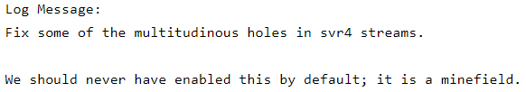
Sample bug
SVR 4 streams compat code
NetBSD 7.1
Been there since NetBSD 1.2 Thu Apr 11 12:49:13 1996
Uses offset that comes from userland
Without any validation
Can read arbitrary(-ish) kernel memory
Panic
Info leak
CVS commit message on the bugfix:

Slide 33
Trap handlers

Slide 34
Attack surface entrypoint
Trap handlers handle some kind of exception or fault
Div by zero
Syscall
Breakpoint
Invalid memory access
…
Some can be triggered by userland, and the kernel has to handle them correctly
due to their nature, they are ugly and highly architecture specific

Slide 35
Fuzz it!
int rfd;
void execute_code(unsigned char *p) {
int (*fn)();
fn = p;
fn();
return;
}
void fuzz() {
unsigned char *code = mmap(NULL, lenbuf, PROT_EXEC | PROT_READ | PROT_WRITE, MAP_PRIVATE | MAP_ANONYMOUS, -1, 0);
while(1) {
read(rfd, code, lenbuf);
int pid = fork();
if (pid == -1) {
exit(0);
} else if (pid == 0) {
execute_code(code);
} else {
int status;
pid_t r;
r = waitpid(pid, &status, 0);
if (r == -1) {
kill(pid, 9);
sleep(1);
waitpid(pid, &status, WNOHANG);
}
}
}
}
int main(void) {
rfd = open("/dev/urandom", O_RDONLY);
fuzz();
}
what would happen if you simply executed a bunch of random bytes as instructions?
Surely a bunch of traps will get generated, and the kernel would have to handle them

Slide 36
demo!

Slide 37
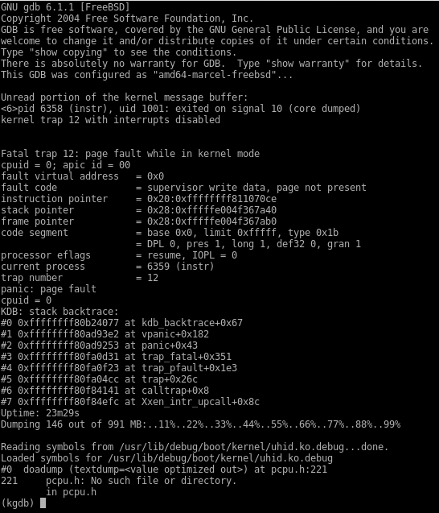
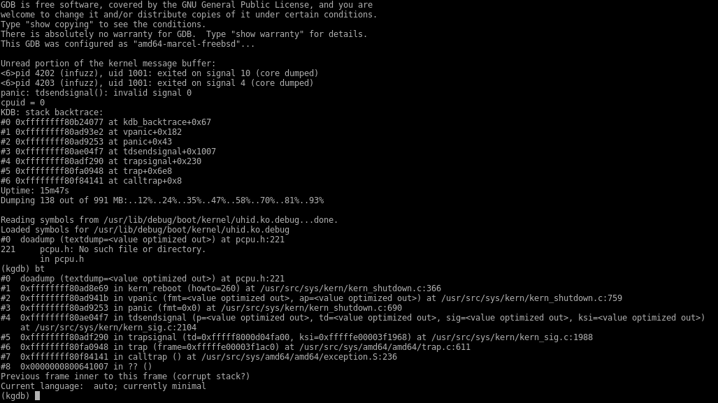

Hit trap bugs
Xen NULL deref
tdsendsignal() invalid signal 0

Slide 38
File systems

Slide 39
Attack surface entrypoint
Filesystem attack surface seems easy enough.
Malicious fs image that gets mounted
Also do file operations on them once mounted
Is certainly attack surface
However, there is more!
In recent years all 3 BSDs support fuse
VFS layer now has to deal with malicious data that comes from userland
Before it always came from a trusted file system driver

Slide 40
Attack surface entrypoint [fuse]
FBSD/OBSD/NBSD all have different fuse implementations (no shared code whatsoever)
NBSD: most complete (allows for the most file operations)
FBSD: most controlled arguments passed back and forth (getattr, readdir) less opportunity for consumers to make mistakes, but more parsing/processing in fusefs itself, more potential for bugs in fuse code itself
OBSD: minimal functional implementation (compared to the previous two)
none implement ioctl
all do:
read
write
readdir
getattr
setattr
...

Slide 41
int
vfs_getcwd_scandir(struct vnode **lvpp, struct vnode **uvpp, char **bpp,
char *bufp, struct proc *p)
{
int eofflag, tries, dirbuflen, len, reclen, error = 0;
...
struct vattr va;
...
error = VOP_GETATTR(lvp, &va, p->p_ucred, p); ← data can come from fusefs
...
dirbuflen = DIRBLKSIZ;
if (dirbuflen < va.va_blocksize)
dirbuflen = va.va_blocksize; ← fusefs can make this really big
dirbuf = malloc(dirbuflen, M_TEMP, M_WAITOK); ← malloc() will panic on very large values
...
error = VOP_READDIR(uvp, &uio, p->p_ucred, &eofflag); ← fusefs can provide arbitrary content
...
cpos = dirbuf;
...
for (len = (dirbuflen - uio.uio_resid); len > 0;
len -= reclen) {
dp = (struct dirent *)cpos;
reclen = dp->d_reclen;
/* Check for malformed directory */
if (reclen < DIRENT_RECSIZE(1)) {
error = EINVAL;
goto out;
}
if (dp->d_fileno == fileno) {
char *bp = *bpp;
bp -= dp->d_namlen; ← fusefs can lie about d_namlen
if (bp <= bufp) {
error = ERANGE;
goto out;
}
memmove(bp, dp->d_name, dp->d_namlen); ← out of bound read.

Slide 42
Sample bug
Unbound malloc and out of bound read (could panic or info leak)
OpenBSD 6.1
Been there since OpenBSD 4.0 Fri Apr 28 08:34:31 2006
getcwd syscall when taking data from fuse / userland

Slide 43
static daddr_t
ext2_nodealloccg(struct inode *ip, int cg, daddr_t ipref, int mode)
{
...
error = bread(ip->i_devvp, fsbtodb(fs,
fs->e2fs_gd[cg].ext2bgd_i_bitmap),
(int)fs->e2fs_bsize, NOCRED, &bp); ← read from filesystem
...
ibp = (char *)bp->b_data;
...
len = howmany(fs->e2fs->e2fs_ipg - ipref, NBBY);
loc = memcchr(&ibp[start], 0xff, len);
if (loc == NULL) {
len = start + 1;
start = 0;
loc = memcchr(&ibp[start], 0xff, len); ← logic driven by fs data
if (loc == NULL) {
printf("cg = %d, ipref = %lld, fs = %s\n",
cg, (long long)ipref, fs->e2fs_fsmnt);
panic("ext2fs_nodealloccg: map corrupted"); ← panic driven by fs data
/* NOTREACHED */
}
}
...
}

Slide 44
Sample bug 2
panic() driven by filesystem data
FreeBSD 11
Been there since FreeBSD 8.1 Thu Jan 14 14:30:54 2010
Ext2 file system code

Slide 45
Networking (bt, wifi, irda)

Slide 46
Wifi Attack surface entrypoint
Stack itself
802.11 network data
Parsing
Info leaks
Wifi drivers
Data send by device to host

Slide 47
802.11 stack
One 802.11 stack for all wifi drivers
Much easier to maintain
Need to fix in only 1 place if bugs are found
ieee80211_input() is main parsing input
Called from all wifi drivers

Slide 48
ieee80211_eapol_key_input(struct ieee80211com *ic, struct mbuf *m,
struct ieee80211_node *ni)
{
struct ifnet *ifp = &ic->ic_if;
struct ether_header *eh;
struct ieee80211_eapol_key *key;
...
eh = mtod(m, struct ether_header *);
...
if (m->m_len < sizeof(*key) &&
(m = m_pullup(m, sizeof(*key))) == NULL) { ← guarantees that there are sizeof(struct ieee80211_eapol_key) continuous bytes in the mbuf
..
}
...
key = mtod(m, struct ieee80211_eapol_key *);
...
if (m->m_pkthdr.len < 4 + BE_READ_2(key->len)) ← assume key->len is larger than key->payload
goto done;
/* check key data length */
totlen = sizeof(*key) + BE_READ_2(key->paylen); ← assume key->len is larger than key->payload
if (m->m_pkthdr.len < totlen || totlen > MCLBYTES)
goto done;
...
/* make sure the key data field is contiguous */
if (m->m_len < totlen && (m = m_pullup(m, totlen)) == NULL) { ← not enough data pulled up if key->len is larger than key->payload!
…
}
key = mtod(m, struct ieee80211_eapol_key *);
...
ieee80211_recv_4way_msg3(ic, key, ni); ← can crash in here if not enough data is pulled up.
...
}

Slide 49
802.11 Stack sample bug
mbuf mishandling, leading to crash
Doesn’t guarantee it pulls up enough mbuf data
OpenBSD 6.1
Bug has been there for almost 9 years
Parsing EAPOL frames

Slide 50
802.11 Drivers
Wifi drivers are either PCI or USB
Do you trust the radio?
What if it does get compromised?
Assume PCI cards cause total compromise (they can do DMA)
Well, actually, with IOMMU that’s no longer the case …
USB is packet based protocol
Host USB parsers should be able to parse safely
Currently BSD wifi drivers do not do this!
Leads to trivial heap smashes

Slide 51
void
run_rx_frame(struct run_softc *sc, uint8_t *buf, int dmalen)
{
...
struct rt2860_rxwi *rxwi;
...
uint16_t len;
...
rxwi = (struct rt2860_rxwi *)buf;
...
len = letoh16(rxwi->len) & 0xfff; ← can be at most 4095
...
/* could use m_devget but net80211 wants contig mgmt frames */
MGETHDR(m, M_DONTWAIT, MT_DATA);
if (__predict_false(m == NULL)) {
ifp->if_ierrors++;
return;
}
if (len > MHLEN) { <-- if len is 4095, come here
MCLGET(m, M_DONTWAIT); ← allocates a cluster, which is 2048 bytes long
if (__predict_false(!(m->m_flags & M_EXT))) {
ifp->if_ierrors++;
m_freem(m);
return;
}
}
...
/* finalize mbuf */
memcpy(mtod(m, caddr_t), wh, len); ← memory corruption!
m->m_pkthdr.len = m->m_len = len;
...
}
/*
* A frame has been uploaded: pass the resulting mbuf chain up to
* the higher level protocols.
*/
void
atu_rxeof(struct usbd_xfer *xfer, void *priv, usbd_status status)
{
...
h = (struct atu_rx_hdr *)c->atu_buf;
len = UGETW(h->length) - 4; /* XXX magic number */ ← integer underflow
m = c->atu_mbuf;
memcpy(mtod(m, char *), c->atu_buf + ATU_RX_HDRLEN, len); ← need to validate len before copy. can cause memory corruption
...
usbd_setup_xfer(c->atu_xfer, sc->atu_ep[ATU_ENDPT_RX], c, c->atu_buf,
ATU_RX_BUFSZ, USBD_SHORT_XFER_OK | USBD_NO_COPY, USBD_NO_TIMEOUT,
atu_rxeof);
usbd_transfer(c->atu_xfer);
}
void
otus_sub_rxeof(struct otus_softc *sc, uint8_t *buf, int len) ← len comes from usb. can be ~8k
{
...
uint8_t *plcp;
...
plcp = buf;
...
mlen = len - AR_PLCP_HDR_LEN - sizeof (*tail);
...
mlen -= IEEE80211_CRC_LEN; /* strip 802.11 FCS */
wh = (struct ieee80211_frame *)(plcp + AR_PLCP_HDR_LEN);
...
MGETHDR(m, M_DONTWAIT, MT_DATA);
if (__predict_false(m == NULL)) {
ifp->if_ierrors++;
return;
}
if (align + mlen > MHLEN) {
MCLGET(m, M_DONTWAIT); ← allocates a cluster, which is 2048 bytes long
if (__predict_false(!(m->m_flags & M_EXT))) {
ifp->if_ierrors++;
m_freem(m);
return;
}
}
/* Finalize mbuf. */
m->m_data += align;
memcpy(mtod(m, caddr_t), wh, mlen); ← mlen can be ~8k. can cause memory corruption.
...
}
void
rsu_event_survey(struct rsu_softc *sc, uint8_t *buf, int len)
{
...
struct ndis_wlan_bssid_ex *bss;
struct mbuf *m;
int pktlen;
...
bss = (struct ndis_wlan_bssid_ex *)buf;
...
if (__predict_false(len < sizeof(*bss) + letoh32(bss->ieslen))) ← could int overflow
return;
...
/* Build a fake beacon frame to let net80211 do all the parsing. */
pktlen = sizeof(*wh) + letoh32(bss->ieslen); ← could int overflow
if (__predict_false(pktlen > MCLBYTES)) ← signedness issue
return;
MGETHDR(m, M_DONTWAIT, MT_DATA);
if (__predict_false(m == NULL))
return;
if (pktlen > MHLEN) {
MCLGET(m, M_DONTWAIT);
if (!(m->m_flags & M_EXT)) {
m_free(m);
return;
}
}
wh = mtod(m, struct ieee80211_frame *);
...
memcpy(&wh[1], (uint8_t *)&bss[1], letoh32(bss->ieslen)); ← memory corruption
...
}

Slide 52
802.11 drivers sample bug
Wide open attack surface
Atmel AT76C50x IEEE 802.11b wireless network device [atu(4)]
Atheros USB IEEE 802.11a/b/g/n wireless network device [otus(4)]
Realtek RTL8188SU/RTL8192SU USB IEEE 802.11b/g/n wireless network device [rsu(4)]
Ralink Technology/MediaTek USB IEEE 802.11a/b/g/n wireless network device [run(4)]
Atheros USB IEEE 802.11a/b/g wireless network device [uath(4)]
Across all BSDs
They didn’t think about the attack surface on this one

Slide 53
miscellaneous
NULL derefs
malloc(len, type, M_NOWAIT/M_CANFAIL)
Not checking return value
Relatively frequent bug
M_WAITOK (== can never fail) is a very common case
Developers treating M_NOWAIT/M_CANFAIL code as if it was M_WAITOK
DRM/DRI
DRM/DRI code base is part of linux kernel source tree.
BSD folks fork it
Code quality is about as big a shit sandwich as it is in linux DRM/DRI code base
“ All this linux code that we are importing ... is not going to be reviewed by any of the other OpenBSD kernel developers ... because they refuse to read any code that is not conformant to the BSD KNF standard” – Matthieu Herrb
Notes:
https://lwn.net/Articles/616097/
https://youtu.be/KopgD4nTtnA?t=7m14s

Slide 54
Results
results:
About ~115 kernel bugs so far
FBSD: ~30
OBSD: ~25
NBSD: ~60
types of bugs seen:
Straight heap/stack smash
race conditions
expired pointers
Double frees
recursion issues
integer issues
Underflows, overflows, signedness
Refcount issues
Overflows
Reference dropped too soon → use after free
info leaks
out of bound read
NULL deref
Logic bugs
typo
Division by zero
kernel panics driven by userland
Memory leaks

Slide 55

Conclusions
Bugs were found in all 3 of the examined BSDs
Among all of the attack surfaces mentioned above
Code quality Winner / loser
OBSD clear winner (they have massively reduced their attack surface over the years):
Attack surface reduction
no loadable modules
relatively few devices
Virtually no compat code (they removed Linux a couple of years ago)
removed entire Bluetooth stack
Significantly less syscalls (e.g. 200+ syscalls less than FBSD)
Cut support for some older architectures
Code Quality
int overflows / signedness bugs, as good as gone in most places
Few info leaks
NBSD clear loser
Tons of legacy and compat code (who the hell still needs the ISO protocols ??? Really?)
seems to be less consistent with security code quality
Too many signedness bugs.
This is NOT a dis.
if you think building/maintaining/improving and OS is easy, go ahead, try it. See how far you get.
FBSD is somewhere in between

Slide 56
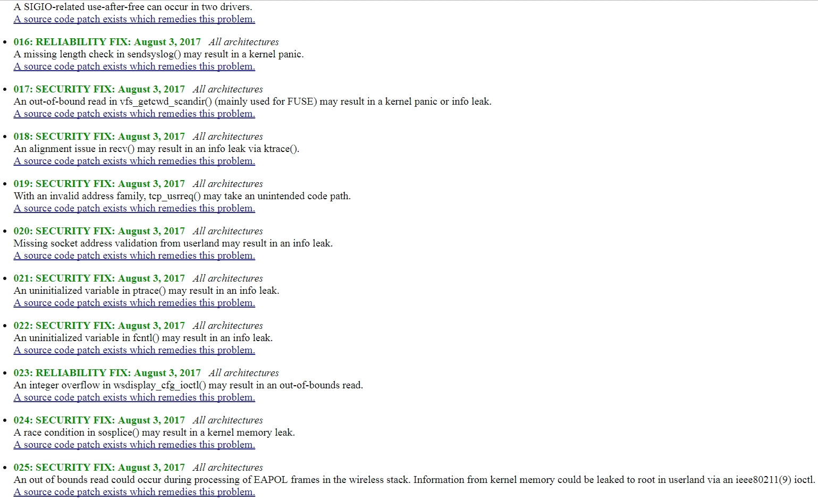
Conclusions
Security team responses
OpenBSD
About a week or so to get response (Theo said it took so long because he was on vacation)
Bugfixes rolled out in the next couple of days
Advisories released in early august.

Slide 57
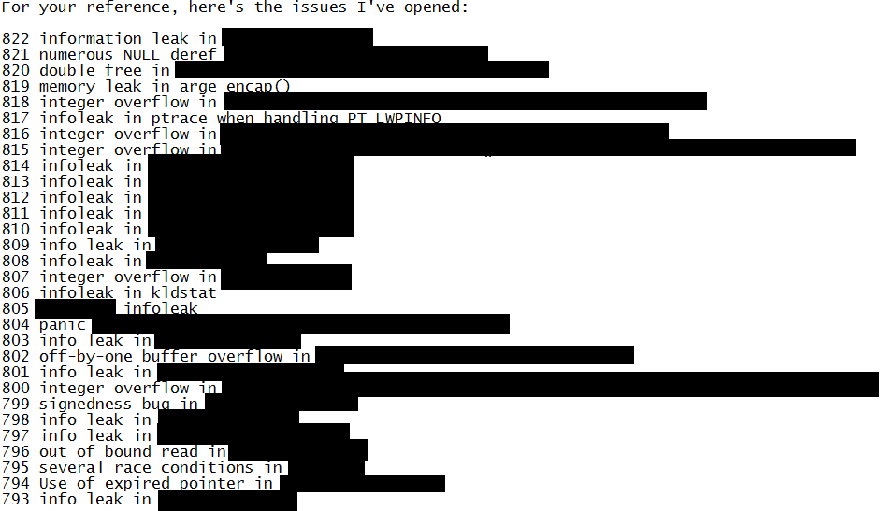
Conclusions
Security team responses
FreeBSD
Response in about a week or so
The filed bugs internally on july 14th 2017
A handful of fixes in cvs
2 advisories released (kldstat and ptrace info leaks)
Status of the rest is unknown at the moment

Slide 58
Conclusions
Security team responses
NetBSD
They fixed virtually all bugs submitted. Pretty much overnight !!!
That is ridiculously impressive.
Check out cvs commits for july 28 and july 29th 2017.
They also turned off the SVR4 subsystem for i386 by default
That was late july 2017
Bugs fixed in cvs
Not patches for current
No advisories yet
Unless you run your own builds from recently checked out code, your NetBSD machine is still vulnerable.
“We have also disabled COMPAT_SVR4 by default on i386, something that should have been done a long time ago.” – Response from NetBSD developers

Slide 59
More conclusions
Bugs are still easy to find in those kernels. Even OpenBSD.
Varying level of quality depending on age and who wrote it
Most consistent quality was observed with OpenBSD
The maintainers of various BSDs should talk more among each other
Several bugs in one were fixed in the other
OpenBSD expired proc pointer in midiioctl() fixed in NetBSD
NetBSD signedness bug in ac97_query_devinfo() fixed in OpenBSD

Slide 60
More conclusions
Code base size
OpenBSD: 2863505 loc
NetBSD: 7330629 loc
FreeBSD: 8997603 loc
Obviously this plays a part
Can’t have a bug in code you don’t have
Accidental vs. planned
Haven’t gotten to implementing something yet or …
Choice made on purpose to delete code
Attack surface reduction

Slide 61
More conclusions
Many eyeballs …
Gut feeling, I suspect this is a factor.
Based on my result, code quality alone can’t account for the discrepancy between the bug numbers (BSD vs. Linux).
Say what you will about the people reviewing the Linux kernel code, there are simply orders of magnitude more of them. And it shows in the numbers.

Slide 62

Questions ?

