Slide 1
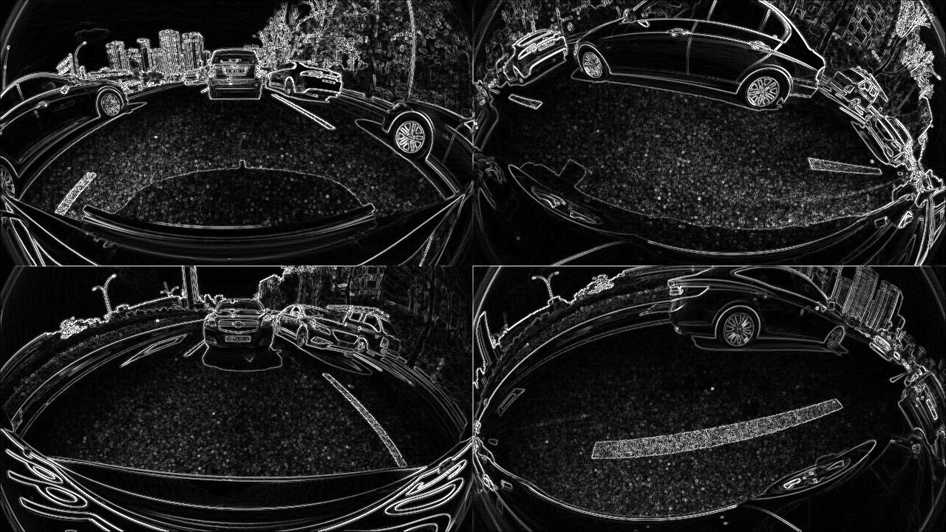
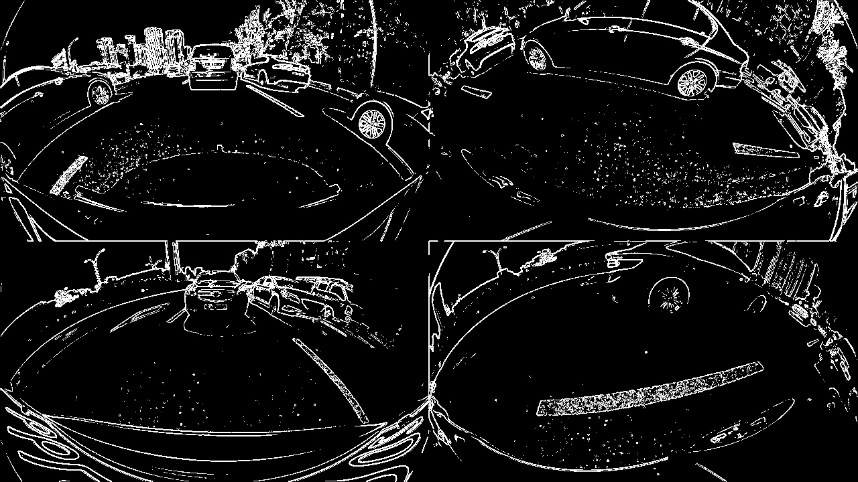
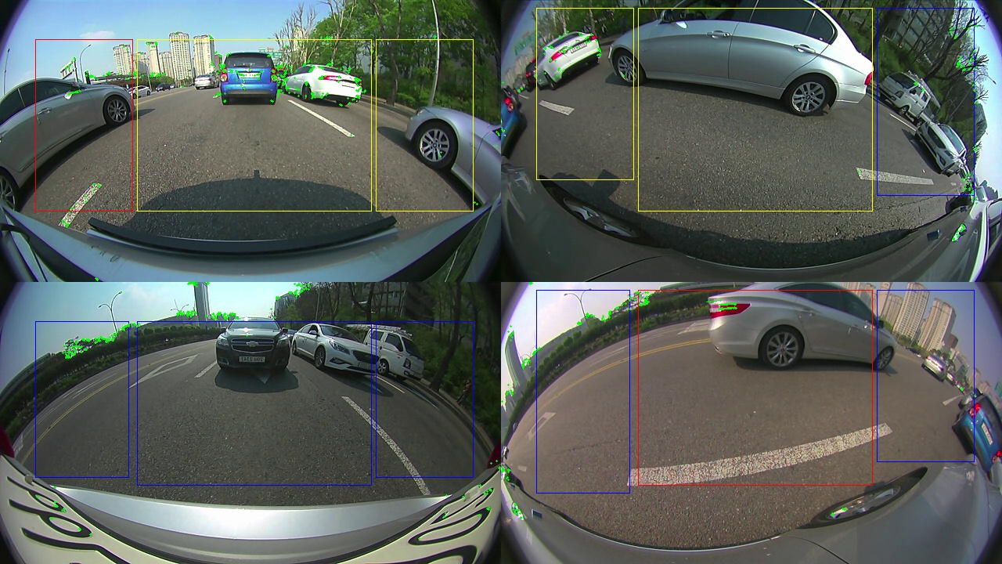
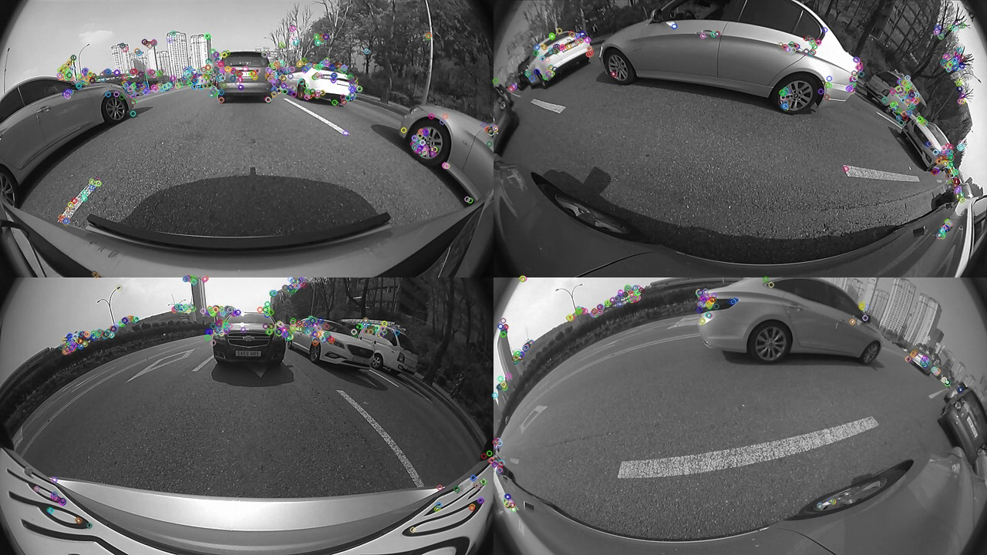
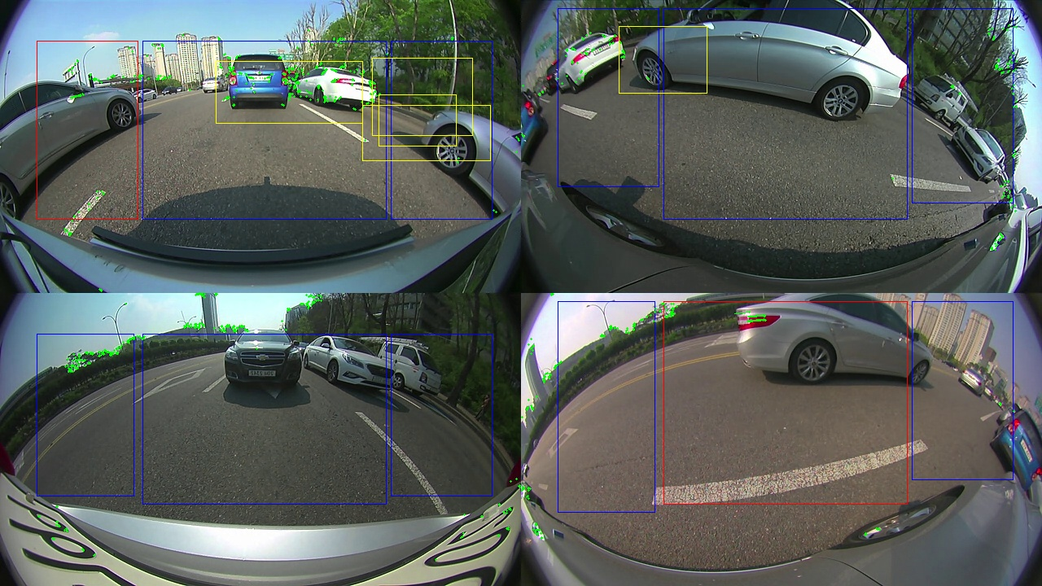
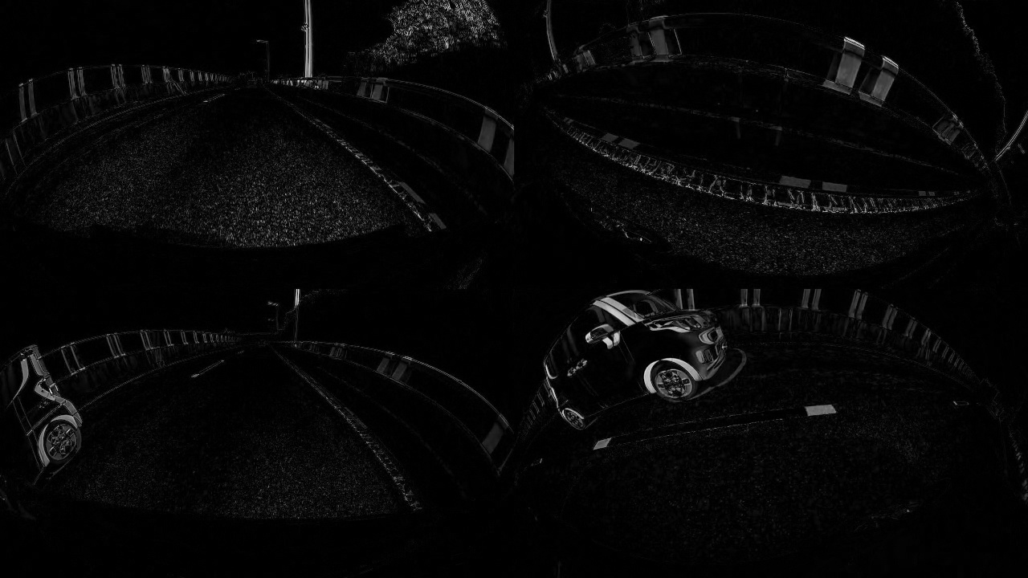
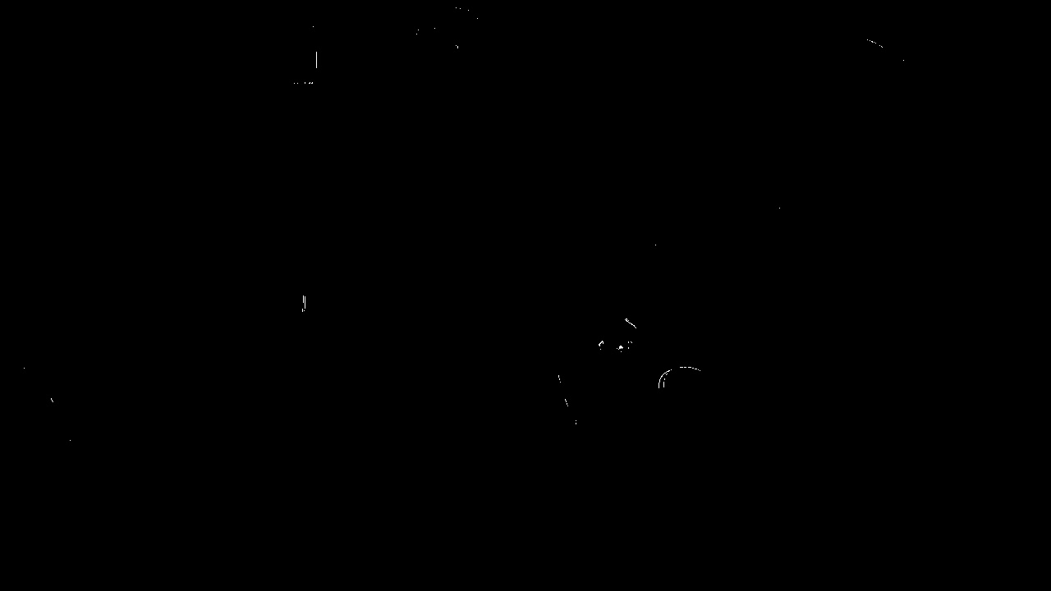
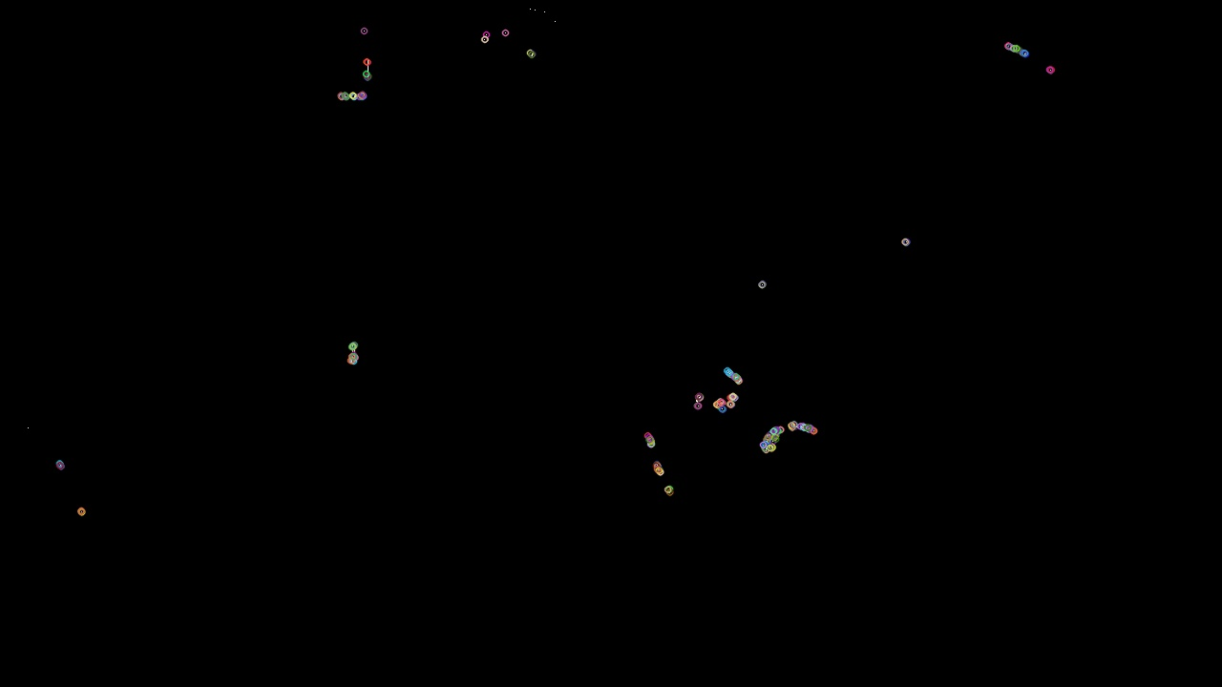
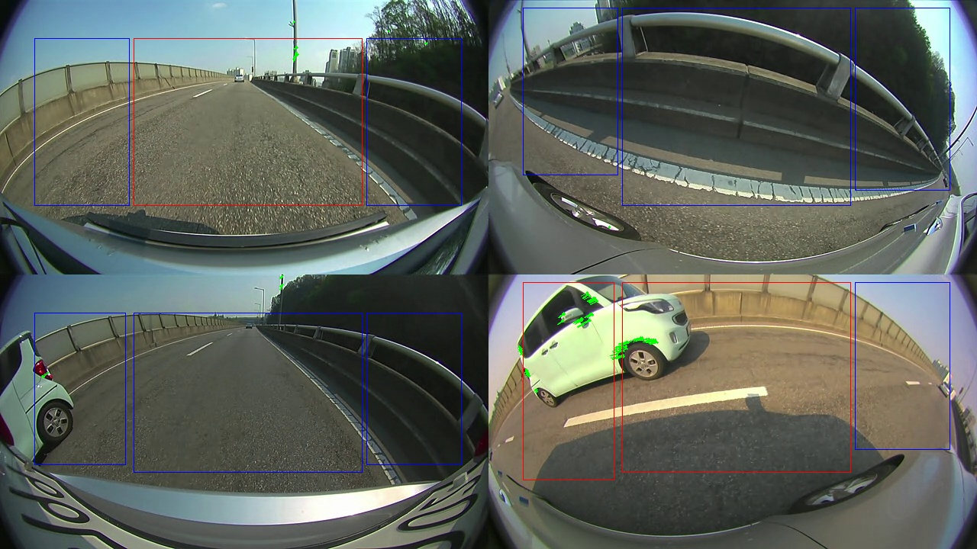
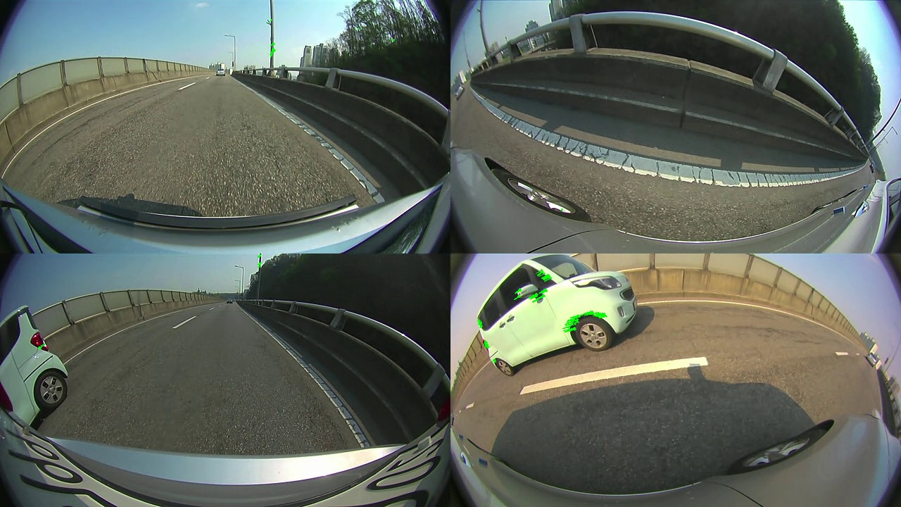
Compute gradient along x and y and add it to obtain a gradient image
Convert this to a binary image.
Look at the region of interest and if any windows are present then we say there is a static object in this window.
Compute ORB interest points
Remove the windows that have motion in them
Compare these windows with the images of roads using HOG descriptors and discard the ones that match them.
Discard erroneous points
Merge points belonging to the same window using connected components and extract windows around them
Diff of these two frames
Obtain binary image by thresholding
Element wise multiplication
Compute ORB feature points
Frame at time t
Video
Frame at time t-1
Threshold the flow value in a region to determine if there is a moving object
Calculate optical flow on these interest points
Discard erroneous points

