Slide 1
Crusader Kings III: Royal Court Steam Reviews Analysis
Mike Kazantsev
March 2022

Slide 2
Summary
Problem
Proposed actions
There is a noticeable difference between critics ratings and players reviews on Steam for the Royal Court DLC.
Test reducing the price with the different distribution channels/sales and observe the changes in reviewers' opinions through the appropriate platform.
Do a separate dev diaries/news articles discussing the DLC fixes to observe the player's opinions on the DLC issues.
Increase the DLC content exposure for the less experienced players by providing additional pointer

Slide 3
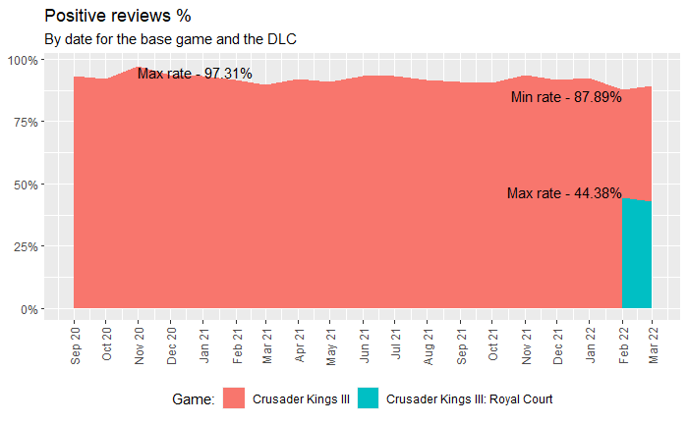
Players are very unhappy by the DLC release
The difference in review rates between the base game and the DLC is more than 40% after the DLC release

Slide 4
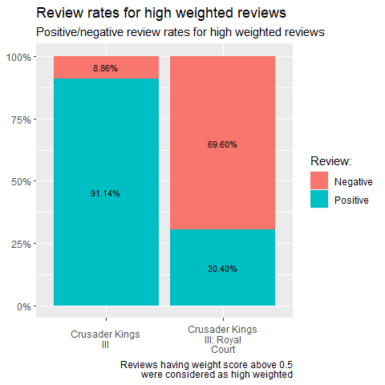
Impactful reviews
Negative reviews are appreciated more than positive
High weighted DLC review rates are at 69.6% comparing to the general 55.65%

Slide 5
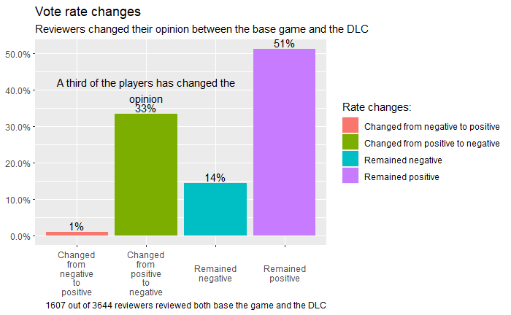
Changing vote: Yes or No?

Slide 6
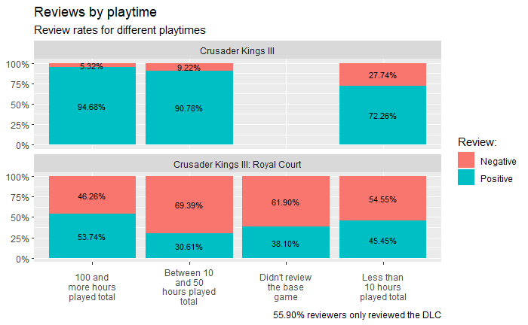
The longer you get the better it gets. But not enough better.
41.1% Players that have a lot of playtime also have less negative reviews (46.26 % compared to 55.65%)

Slide 7
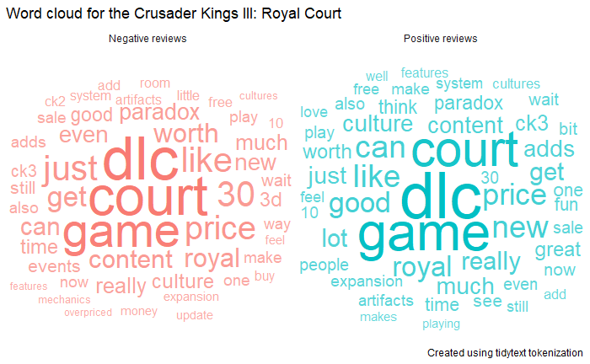
What are we talking about?

Slide 8
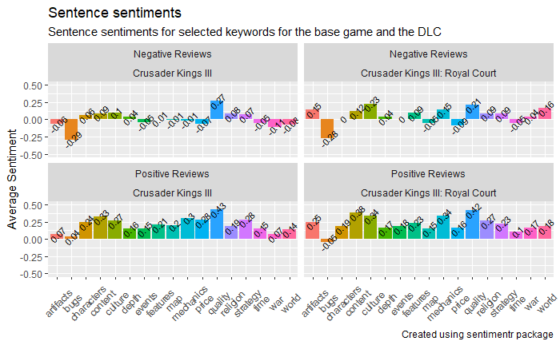
What are we talking about pt.2
The noticeable aspects players seem to be dissatisfied with are the DLC bugs, price, map and time
Bugs sentiment is negative both for positive and negative reviews

Slide 9
Main points of the players' dissatisfaction
The DLC price is considered to be too big by the reviewers.
The severity of bugs experienced by players.
The amount of content delivered by the DLC seems to be questionable to some players.

Slide 10
Further exploration
The Steam review text data doesn't have a fixed format so exploring additional sources or specifically crafted questionnaires might get additional insights.
Using NLP models specifically designed to work with the internet slang and free form texts might provide additional insights as well.
Observing review rate changes at the later dates might show how the DLC patches and DLC price changes/sales change the players' game perception.

Slide 11
Thank you

