Slide 1

OfflIne MessagIng API

Slide 2
Contents
Cover Page – 1
Technologies Used – 3
Help Page – 4
User Register – 5
User Login – 6
Accesing Past User Messages – 7
User Messages: GetAllMessages – 8, Test – 9
User Messages: GetAllMessagesSentByAUser – 10, Test – 11
User Messages: GetAllMessagesSentToAUser – 12, Test – 13
Sending Messages – 14
Sending Messages: Block – 15, Test – 16
Sending Messages: SendMessage – 17, Test – 18
Logging Critical Info – 19
Unit Testing With Xunit – 20
Unit Testing: GetAllMessagesSentByAUser – 21

Slide 3
Technologıes USED
- ASP NET .NET FRAMEWORK MVC WITH IDENTITY, ENTITITY, HELPPAGE, MSSQL, XUNIT
- POSTMAN
- VISUAL STUDIO 2019

Slide 4
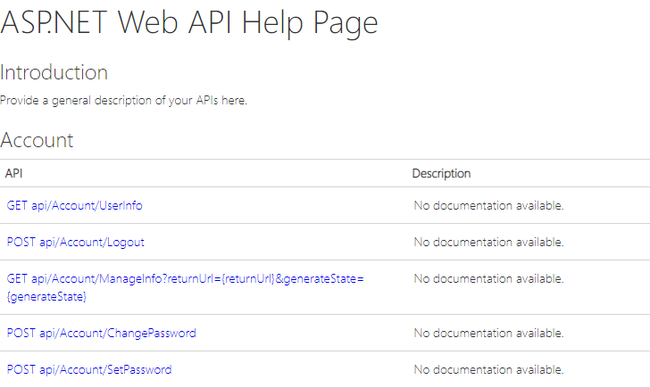
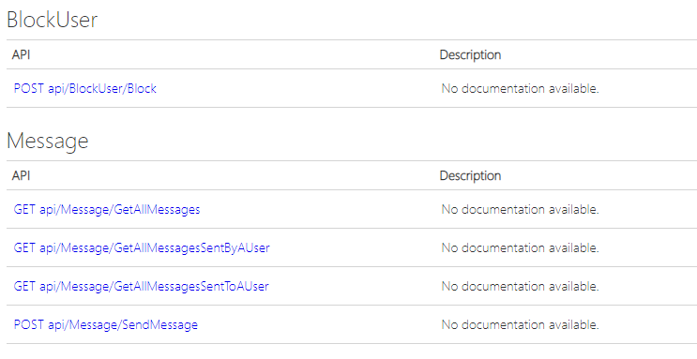
Help Page
Microsoft.AspNet.WebApi.HelpPage
A new entry in help page is automaticaly generated when a new API endpoint is added.
It is up to the programmer to fill in the API detaIls in the help page though.

Slide 5
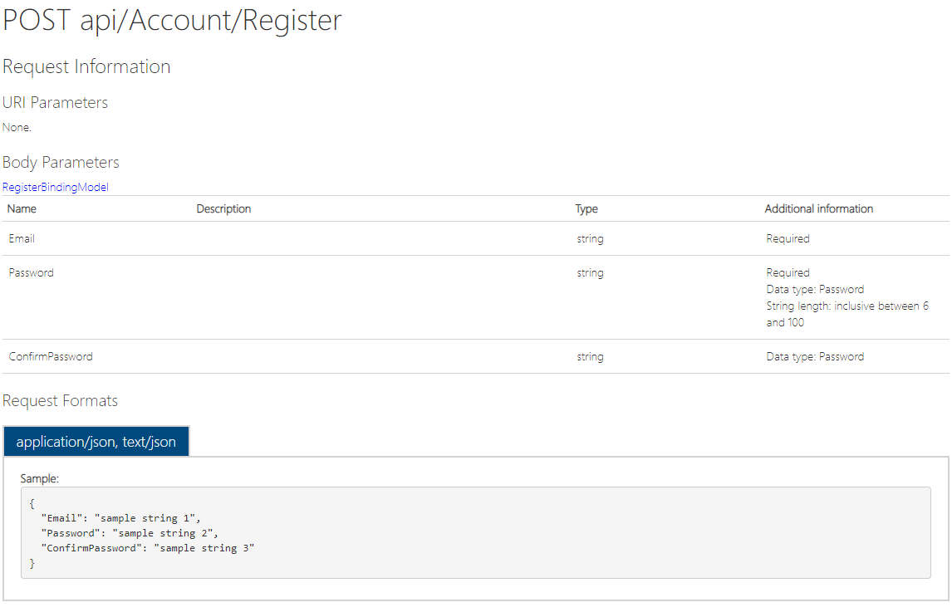
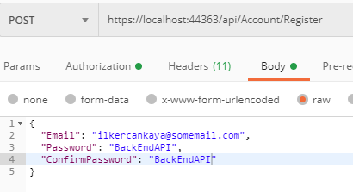

User RegIster
- Built in Identity Framework is Used.
- POST api/Account/Register
- Test Below: PostMan Request with Database After Request

Slide 6
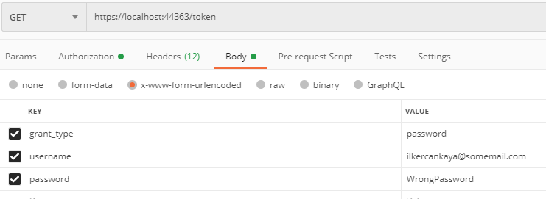
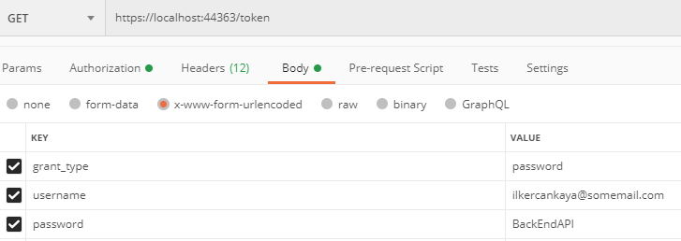


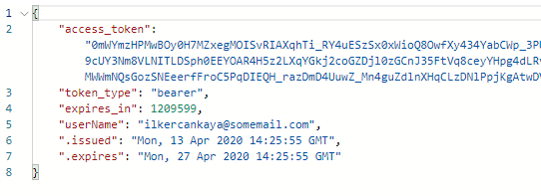
USER LOGIN
- Built in Identity Framework is Used.
- POST /token
- Test Below: Postman Request
Test With Invalid Credentials

Slide 7
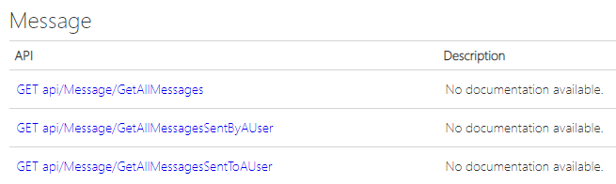
Accesıng past user messages
- Three Endpoints are made in which each all three have different functionality of processing and responding the data.
- All of these endpoints require tokens to work.

Slide 8
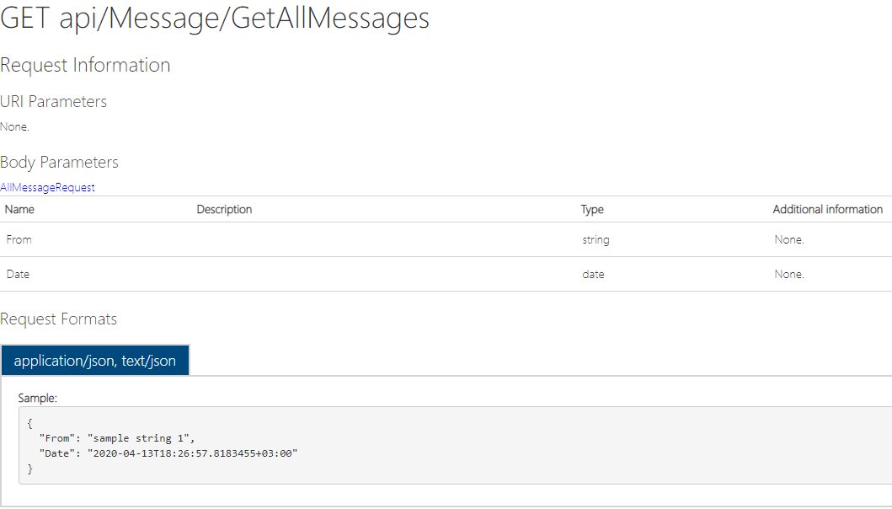
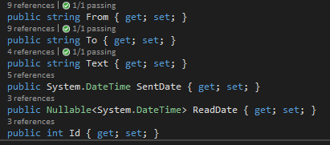
User messages - getallmessages
- Gets all the messages Sent or Received by a user starting from «Today» until the given «Date» (both «Today» and «Date» are inclusive).
- If no «Date» is given, API sets the «Date» as the minimum date thus returns all the messages.
- Returns a JSON list of the «message» which have the structure below:
See the next slıde for tests

Slide 9




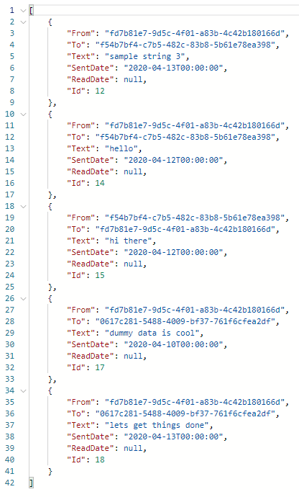
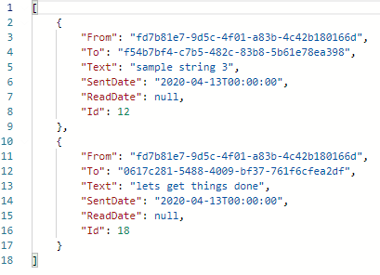
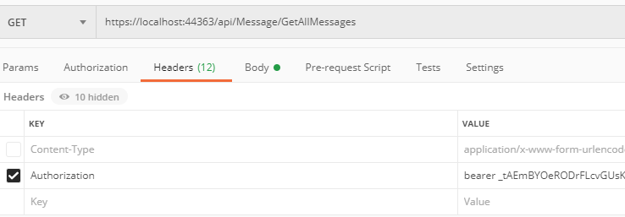
Getallmessages - tests
Test1 – No date
Test2 – wıth date (INCLUSIVE)
A token must be acquıred from PATH /token
and be used as an auth header for apı poınts to work

Slide 10
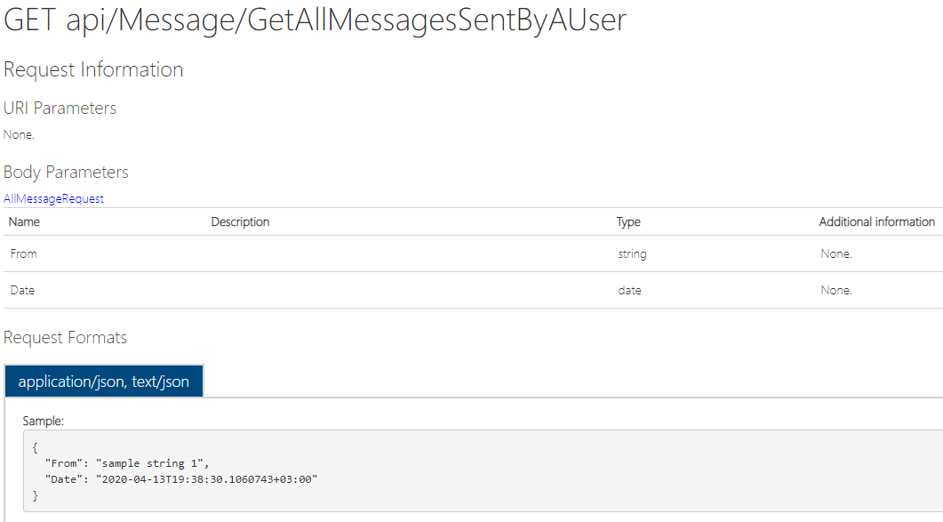
User messages - GetAllMessagesSentByAUser
- Gets all the messages Sent by a user while categorizing it wrt received «userId» and sorts each category by «SentDate» also limits the message dates starting from «Today» until to the given «Date» (both «Today» and «Date» are inclusive).
- If no «Date» is give, API sets the «Date» as the minimum date thus returns all the messages.
- Returns a JSON «message» list categorized by «SentUser» and each category is sorted wrt Date. «message» structure:
See the next slıde for tests

Slide 11


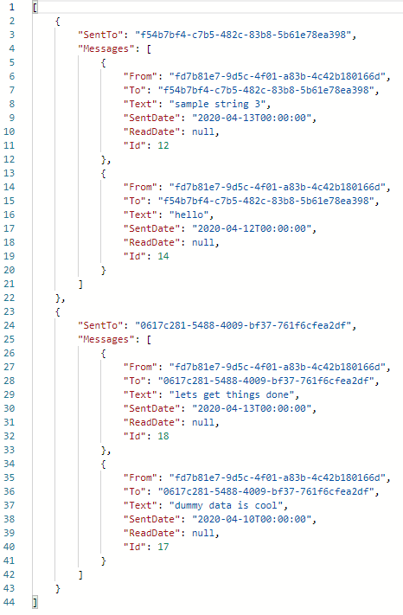
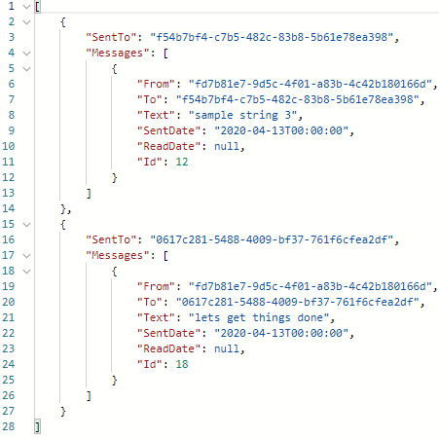
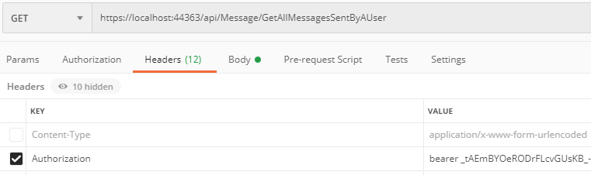
GetAllMessagesSentByAUser - tests
Test1 – No date
Test2 – wıth date (INCLUSIVE)
A token must be acquıred from PATH /token
and be used as an auth header for apı poınts to work

Slide 12
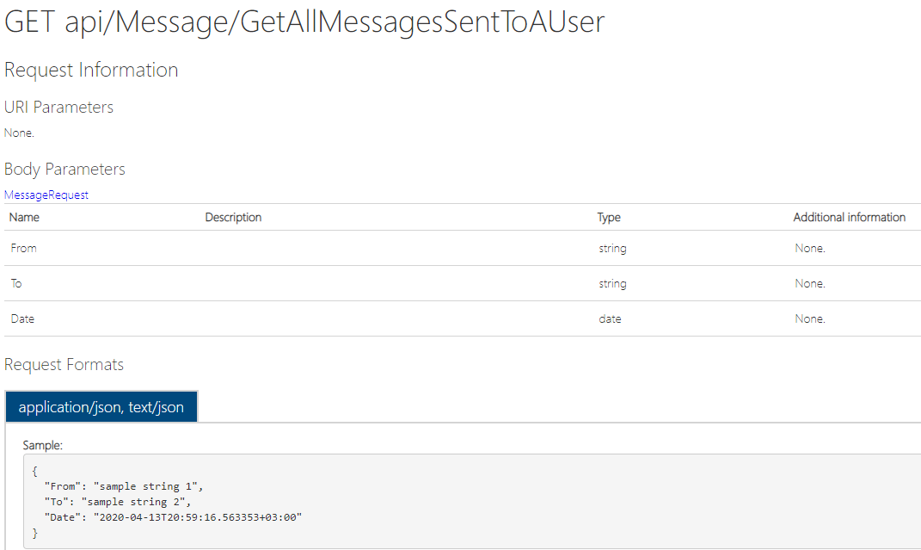
User messages - GetAllMessagesSentToAUser
- Gets all the messages sent to a specific user from a user starting from «Today» until the given «Date» (both «Today» and «Date» are inclusive).
- If no «Date» is given, API sets the «Date» as the minimum date thus returns all the messages.
- Returns a JSON list of the «message» which have the structure below:
See the next slıde for tests

Slide 13


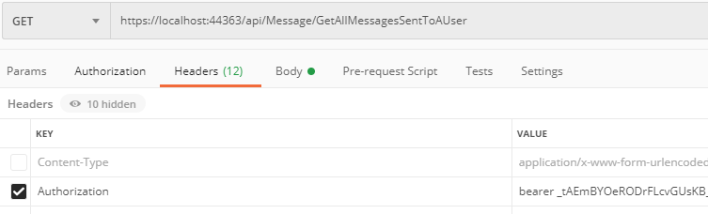
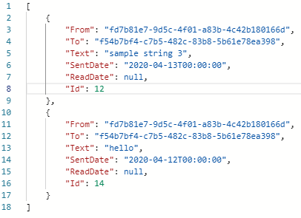
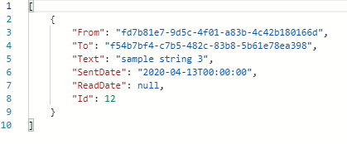
GetAllMessagesSentTOAUser - tests
Test1 – No date
Test2 – wıth date (INCLUSIVE)
A token must be acquıred from PATH /token
and be used as an auth header for apı poınts to work

Slide 14
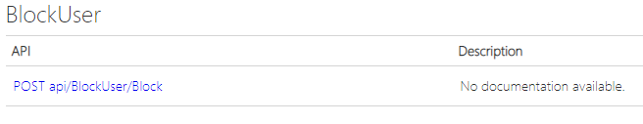

Sendıng messages
- One endpoint is set for users messages that is sent from one user to another.
- Another endpoint is set to allow one user to block another user.
- If user A blocks user B then any message sent from B to A will not be registered to the system.
- All of these endpoints require tokens to work.

Slide 15
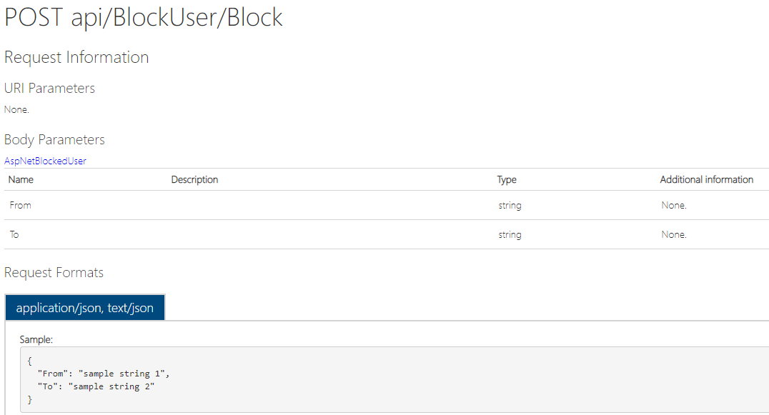
Sendıng messages - Block
- Allows user «From» to block «To».
- Any calls containing users «From», «To» that are not registered to the database will not be processed.
- Entries are kept in a seperate table hence no need for a boolean as a parameter.
See the next slıde for tests

Slide 16


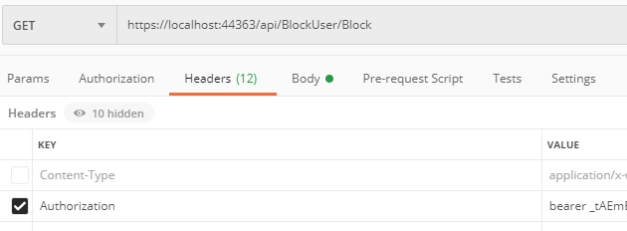
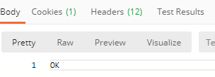
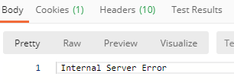

Block - TESTS
Test1 – Valıd Users
Test2 – INValıd Users
A token must be acquıred from PATH /token
and be used as an auth header for apı poınts to work

Slide 17
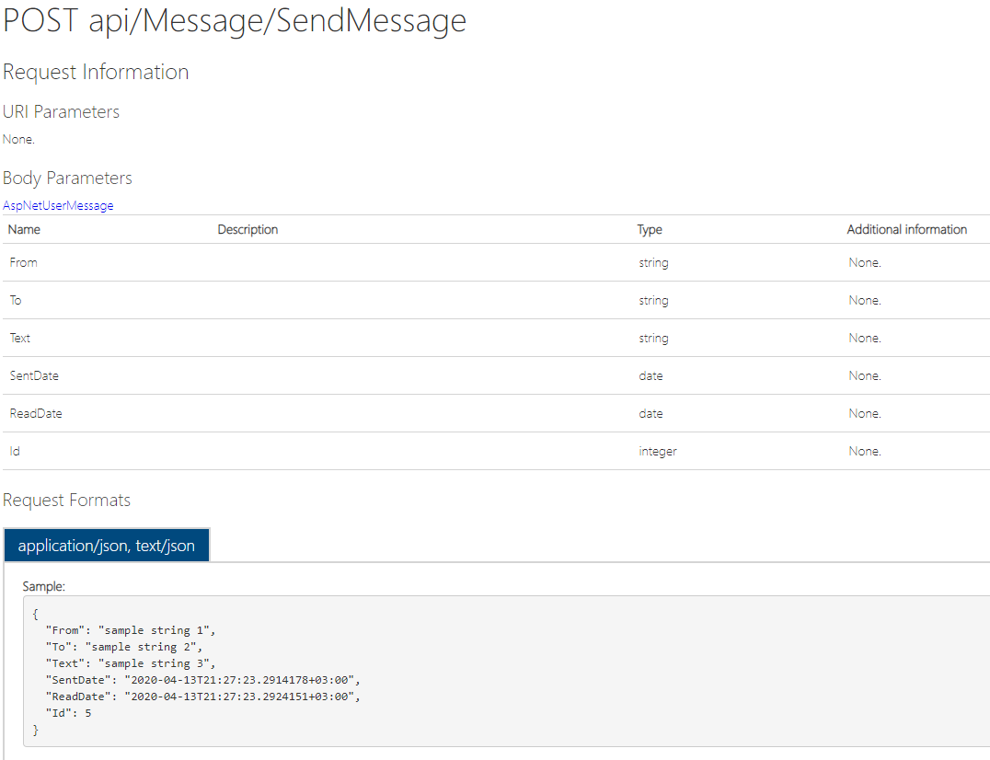
Sendıng messages - SENDMESSAGE
- Stores the sent message from user A to B if user B has not blocked A.
- «SentDate» is expected to be given from the client side but if it is null backend will set it to current time.
- Has its own table to store the messages.
- ID is generated incrementally with IDENTITY keyword in SQL
- Messages are structured as below:
See the next slıde for tests

Slide 18


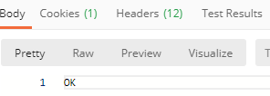
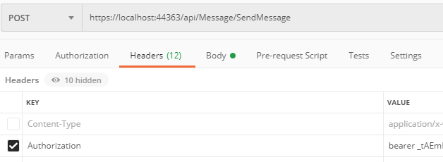


SENDMESSAGE - Tests
Test1 – NonBLocked Users No sent Date
Test2 – NonBLocked Users wıth sent Date
A token must be acquıred from PATH /token
and be used as an auth header for apı poınts to work
Test3 –BLocked Users
Blocked database ıs below for these tests
Messages database ıs below after these tests

Slide 19
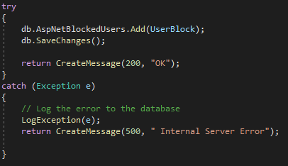
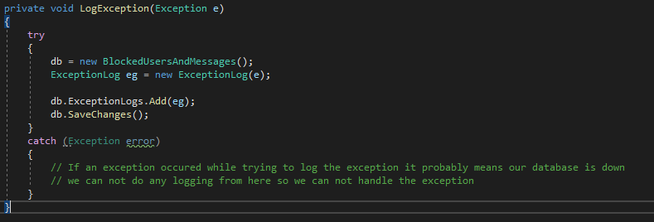
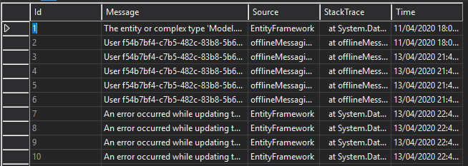
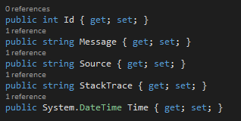
Loggıng crıtıcal errors
- Every critical error in the system is logged and user is not informed about the details but rather given the 500 «Internal Server Error» as the message.
- Critical errors are caught by try, catch blocks and they are logged to a «ExceptionLog» table.
- For example, for every «messaging» and «block» API, if an «userID» which does not exist in the registered users table is given, an exception is automatically raised due to foreign key constraints in the table designs. These exceptions are logged.
-Logs have the structure below:

Slide 20
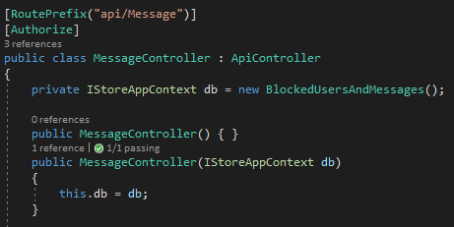
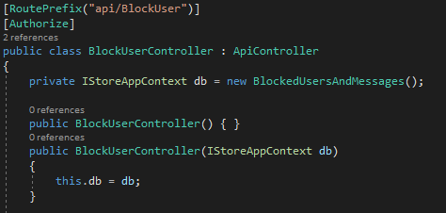
Unıt testıng wıth xunıt
- In order to unit test our project, we needed to add dependency injection.
- This was achieved through Microsoft’s official tutorial here
- Our project has a testable structure now.
- TestContext was created by using the same tutorial.
- Test coverage is (calculating it as feature vise) 1/8 = 12.5%
See the next slıde for Unıt test

Slide 21
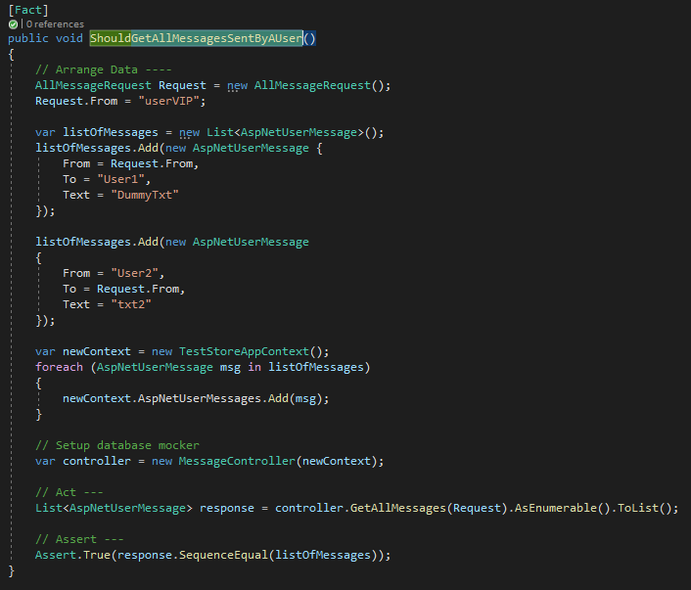
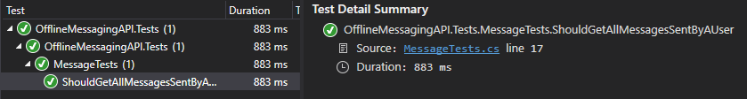
Unıt testıng - GetAllMessagesSentByAUser
- A simple Unit Test.
- 3 stages: Arrange, Act, Assert.
- Sets TestContext through dependency injection.
- Calls the controllers corresponding method which is used in the API route.
- Succesfully passes the test.
- Done with XUNIT library.

