Slide 1
What is ACIT Library ?
It’s a C programming language based 32 bit library that holds the data’s and control functions of thermal cycle for an Inverter Type Air Conditioner with Heating and Cooling.
At the thermal cycle library receives related temperature’s, peripheral positions, user commands; calculates and gives output to drivers like expansion valve position, compressor frequency, fan rpm, etc.
Library is developed in ANSI C in order to keep compatibility between C language and C++ which is high level language derived from C. Purpose is to be able to run library on an embedded platform with C and on a Windows based platform which is developed with C++ language.
The approach is ‘Write Once Compile Anywhere’.
What is ACIT Simulator?
ACIT Simulator is an interactive environment that is developed by ACIT Library in C++ language with Microsoft .Net platform which has a graphical user interface. User can simulate , observe, modify or log data’s of thermal cycle visually on a PC.
What is ACIT Emulator?
By the same user interface user is able to connect to a physical Air Conditioner and run ACIT, the inputs will be real physical values and the outputs of the thermal cycle will be directly processed by the Air Conditioner. In this case intervention of some Values are limited.
Conclusion:
Air Conditioner is a product that needs to be tested in a test chamber in terms of thermal cycle. Test chamber operating costs are too much expensive and time consuming. This library and simulator gives an opportunity to make initial test or debugging just on a computer without need of any Air Conditioner . After then connecting to an Air Conditioner user can observe, debug, modify and log any value.
Developing thermal cycle algorithms directly with C and running on the Air Conditioner as classical methods is prone to any error, hard to debug and time consuming.

Slide 2
Air Conditioner Connection

Slide 3
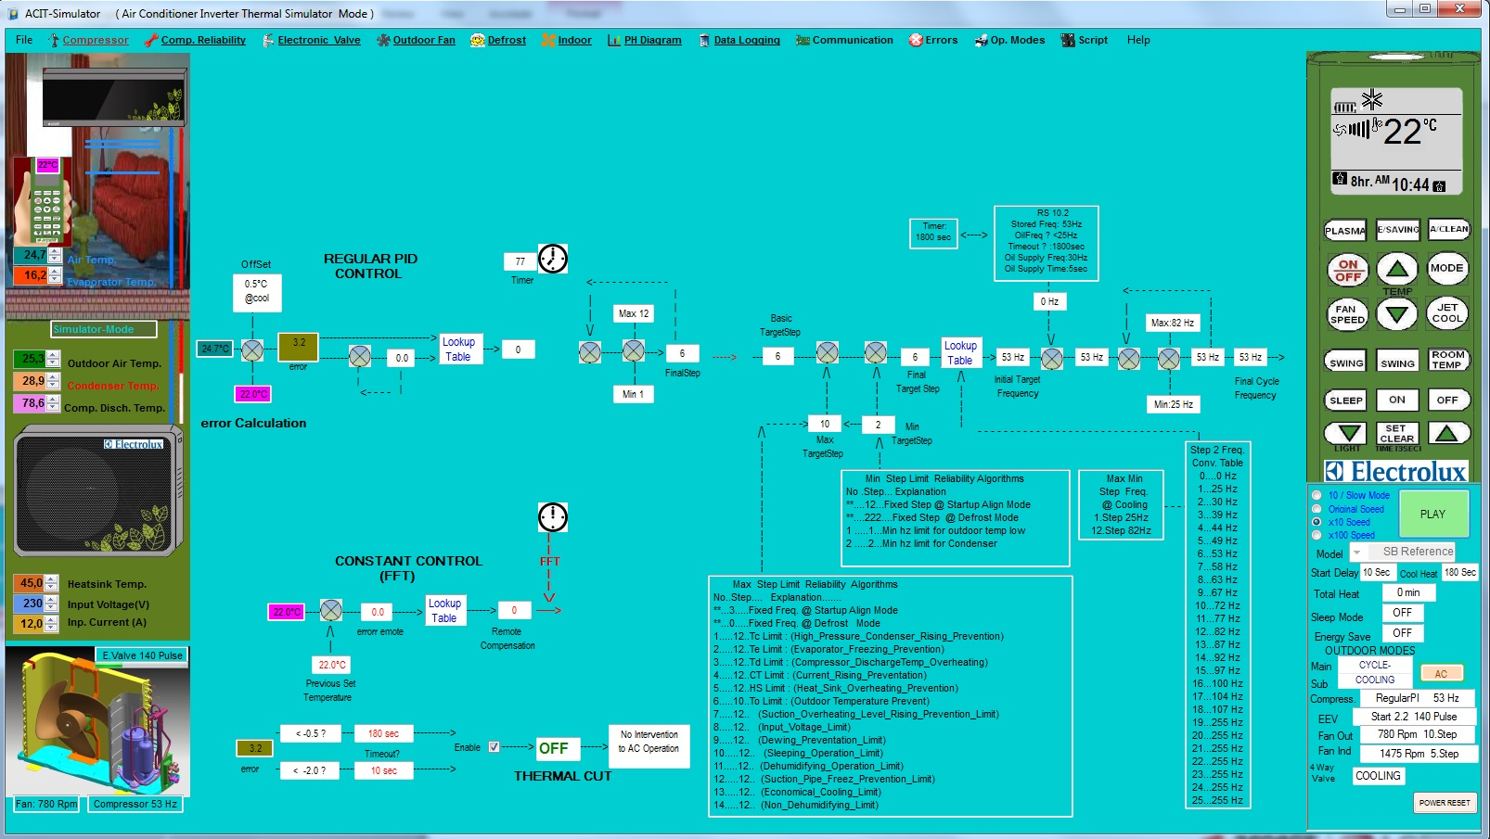
ACIT Library & Simulator Functions
Determine_Basic_TargetStep();
Determine_Initial_Frequency();
Determine_Offset_Error ();
Find_PI_CompensationStep();
GetMinMax_Step();
Sort_Reliable_Array( );
Determine_Oil_Supply ();
Determine_FinalCycle_Frequency ();
Sense_Remote_Change();

Slide 4
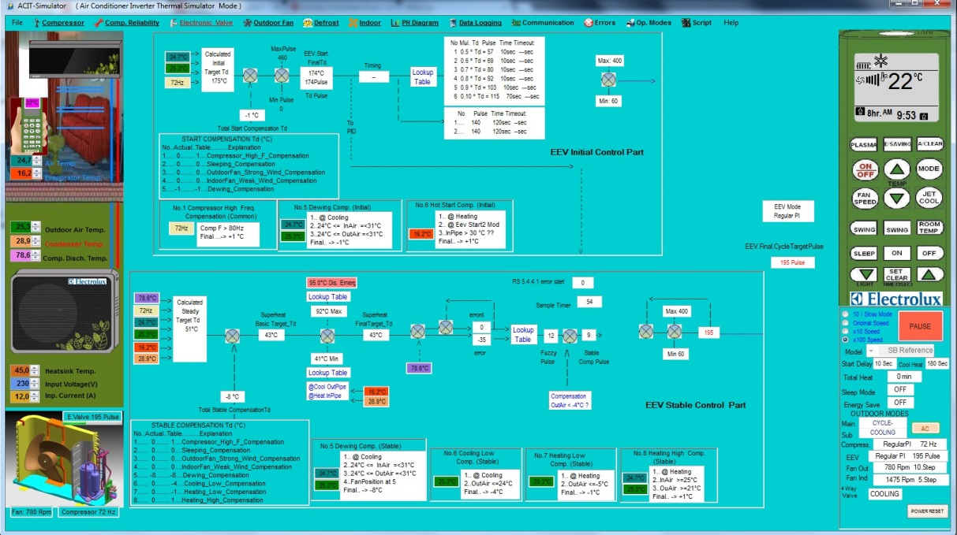
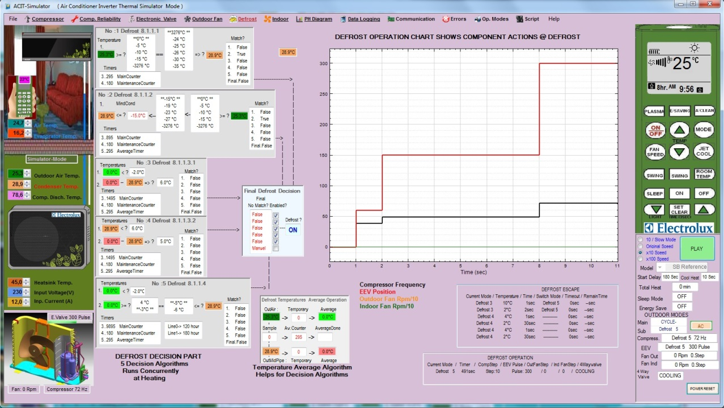
Screenshots Of ACIT Simulator Menus

Slide 5
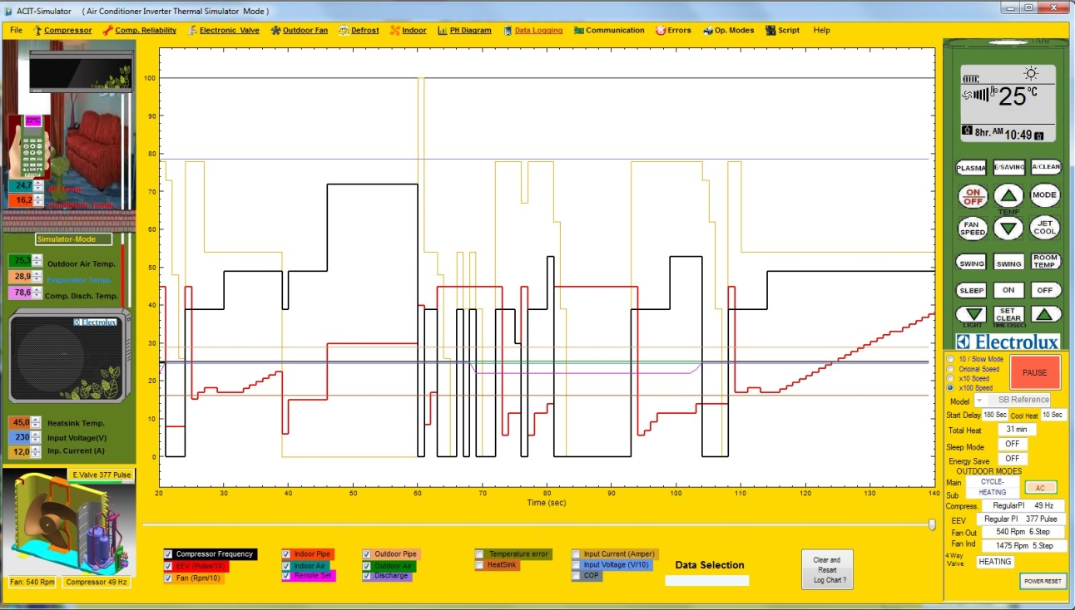
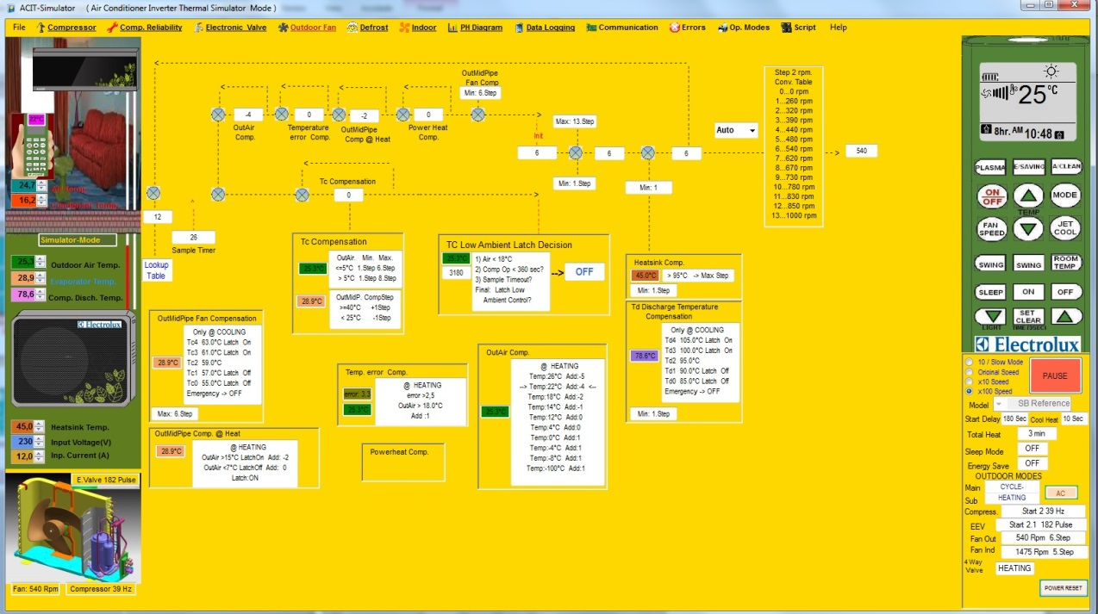
Screenshots Of ACIT Simulator Menus

Slide 6
Code Snippet of ACIT Library
struct Reliability_Ram{ // Here we defined a template structure for Reliability functions
unsigned char PrevZone;
unsigned char Zone;
unsigned char Counter;
unsigned char Timeout;
unsigned char Hysteresiz[2]; // T0 Hyst T1 Hytsteresiz Datas that will be used
signed char Zone_Limits[5]; // { T4 T3 T1 T2 T0}; Threshold Datas that will be used to find zones; limits
}Reliability_Ram;
struct Reliability_Ram Tc_Hold; // Here we defined the structure for Condenser Hot Preventing related function will work on it!
struct Reliability_Ram HS; // Here we defined the structure for Heat Sink Hot Preventing related function will work on it!
struct Reliability_Ram Te_Hold; / / Here we defined the structure for Evaporator Freeze Preventing related function will work on it!
struct Reliability_Ram Td_Hold; // Here we defined the structure for Discharge Hot Preventing related function will work on it!
struct Reliability_Ram Dew_Hold; // Here we defined the structure for Dewing Preventing related function will work on it!
void Determine_Limits(struct Reliability_Ram *p1,signed char *p2,unsigned char *p3,unsigned char Conf_Line,unsigned char Lojic){
switch(AirCon.SubMode){
case CoolingM: // PULL T4 AND T2 FROM TABLES AND WRITE TO ITS STRUCTURE
p1->Zone_Limits[4] = p2[p3[0+Conf_Line*CONF_WIDTH]*MAX_MODEL+AirCon.Model]; /// X4 FOR COOLING Te4
p1->Zone_Limits[2] = p2[p3[1+Conf_Line*CONF_WIDTH]*MAX_MODEL+AirCon.Model]; /// x2 FOR COOLING Te2
break;;
case HeatingM:
p1->Zone_Limits[4] = p2[p3[2+Conf_Line*CONF_WIDTH]*MAX_MODEL+AirCon.Model]; // X4 FOR COOLING Te4
p1->Zone_Limits[2] = p2[p3[3+Conf_Line*CONF_WIDTH]*MAX_MODEL+AirCon.Model]; // x2 FOR COOLING Te2
break;;
}
switch(Lojic){
case RISING: // CONDITION T4 AND T2 WITH THE TEMPERATURE COEFFICIENTS
p1->Zone_Limits[2] *= RISETABLE_CORRECTION;
p1->Zone_Limits[4] *= RISETABLE_CORRECTION;
break;;
case FALLING:
p1->Zone_Limits[2] *= FALLTABLE_CORRECTION;
p1->Zone_Limits[4] *= FALLTABLE_CORRECTION;
break;;
} // CALCULATE T0 TI T3 AND WRITE TO ITS STRUCTURE VARIABLE
p1->Zone_Limits[0] = (unsigned char)(p1->Zone_Limits[2] - ((float) p1->Zone_Limits[4] - p1->Zone_Limits[2])); //T0 = T2 - (T4-T2)
p1->Zone_Limits[1] = (unsigned char)(p1->Zone_Limits[2] - ((float)1/2)*(p1->Zone_Limits[4] - p1->Zone_Limits[2])); / / T1 = T2 - (T4-T2)*1/2
p1->Zone_Limits[3] = (unsigned char)(p1->Zone_Limits[2] + ((float)1/2)*(p1->Zone_Limits[4] - p1->Zone_Limits[2])); / / T3 = T2 + (T4-T2)*1/2
}
//*************************************************************************************************************************************************************************************************************//

Slide 7
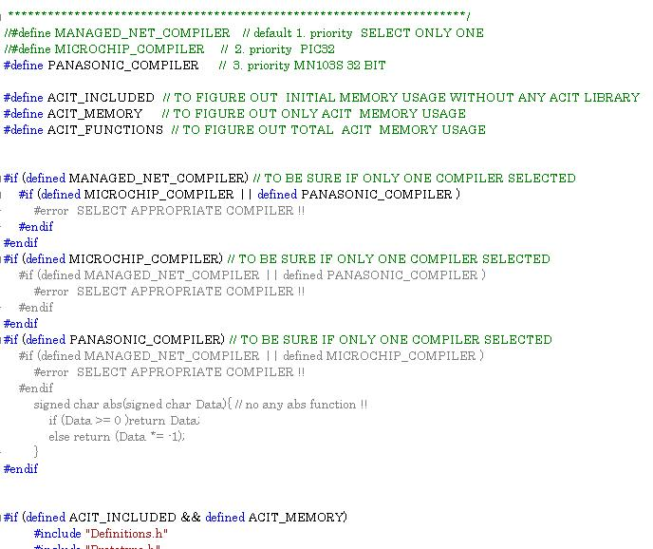
Code Size and Compiling for Microcontrollers and PC:
The ACIT Library has option to compile 3 target environment
1) .net CLI Framework (For using integrated Simulator )
2) Microchip 32bit Compiler ( Target processor PIC32MX795F512L)
3) Panasonic Debug Factory (Target processor MN103S)

Slide 8
Control loops
Thermal Cycles can be considered as non real time library, required speed is relatively too slow. The outputs are updated on 1 second intervals.
There are two closed loops running on the thermal cycle. First loop takes input from indoor and set temperature
And gives an output of Compressor Frequency. This loop purpose is to minimize error of indoor and set temperature according to heating or cooling commands. The loop updates output in every 90 seconds.
The second loop takes input from all temperatures and calculates Target Discharge Temperature which is consistent with target Superheat or Subcool depending on cooling or heating command. This loop’s purpose is to minimize the error between actual and Target Discharge Temperature by giving an output to the electronic valve that has max 450 position. This loop updates on every 60 seconds. This loop can be considered as pressure control loop.
Reliability Functions
There are several reliability algorithms that runs meantime within the loops. All have different priority depending on the importance. For example oiling of compressor has the most highest priory. Reliability functions has high priority over control loops and intervenes the loops immediately.
The emergency functions that is directly related with the hardware must be kept on the drivers like
Motor protection functions.
Thanks
ilker.yagci@electrolux.se

