Slide 1
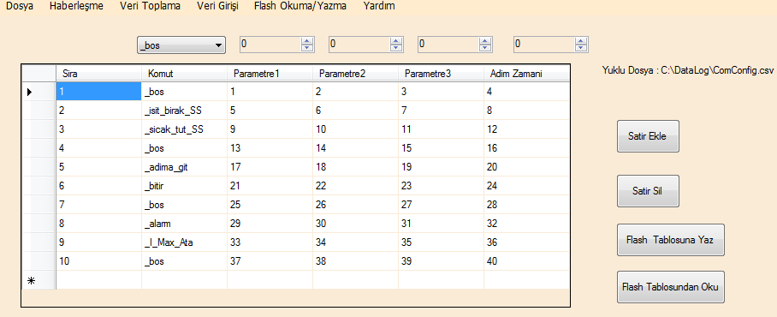
Okyanus.Variables.Var_Parameter1[i] / İ Okyanus.VariablesCommandRawIndex kadar artmalı
Okyanus.Variables.Var_Parameter2[i]
Okyanus.Variables. Var_Command[i]
Okyanus.Variables.Var_Parameter3[i]
Okyanus.Variables.Var_Parameter4[i]
Okyanus.VariablesCommandRawIndex++
Okyanus.VariablesCommandRawIndex--
dr0
dr1
dr4
dr5
dr2
dr3
Okyanus.VariablesCommandRawIndex
index pointer 0 – 10 arası

